Slide 1
Pipeline Final Project
Hadi Serhan (323968669)
Pipeline 07/25

Slide 2
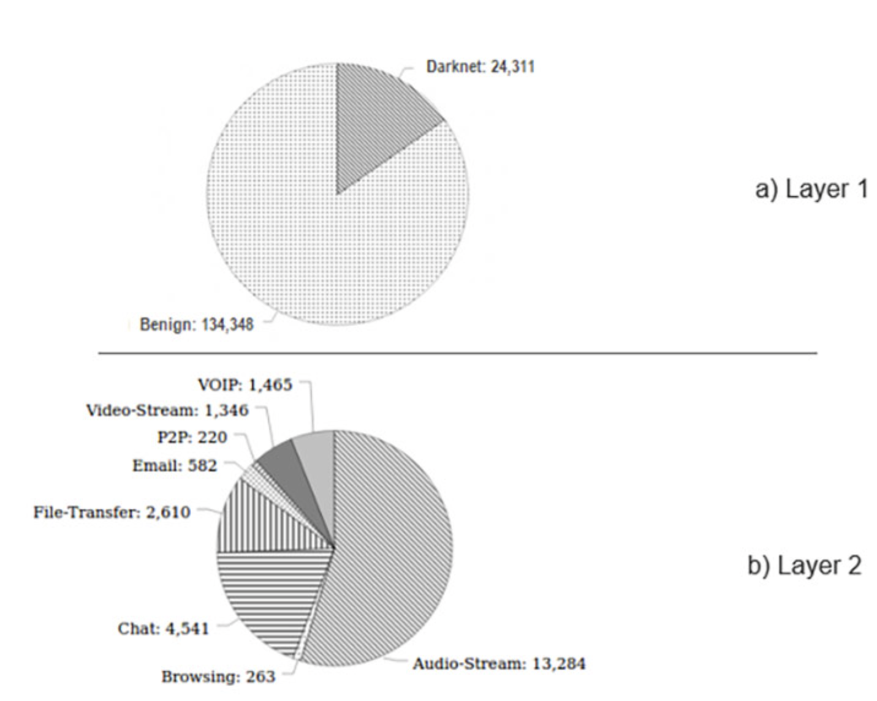
Dataset Overview
Presents real-world encrypted traffic flow from the darknet in 2020.

Slide 3
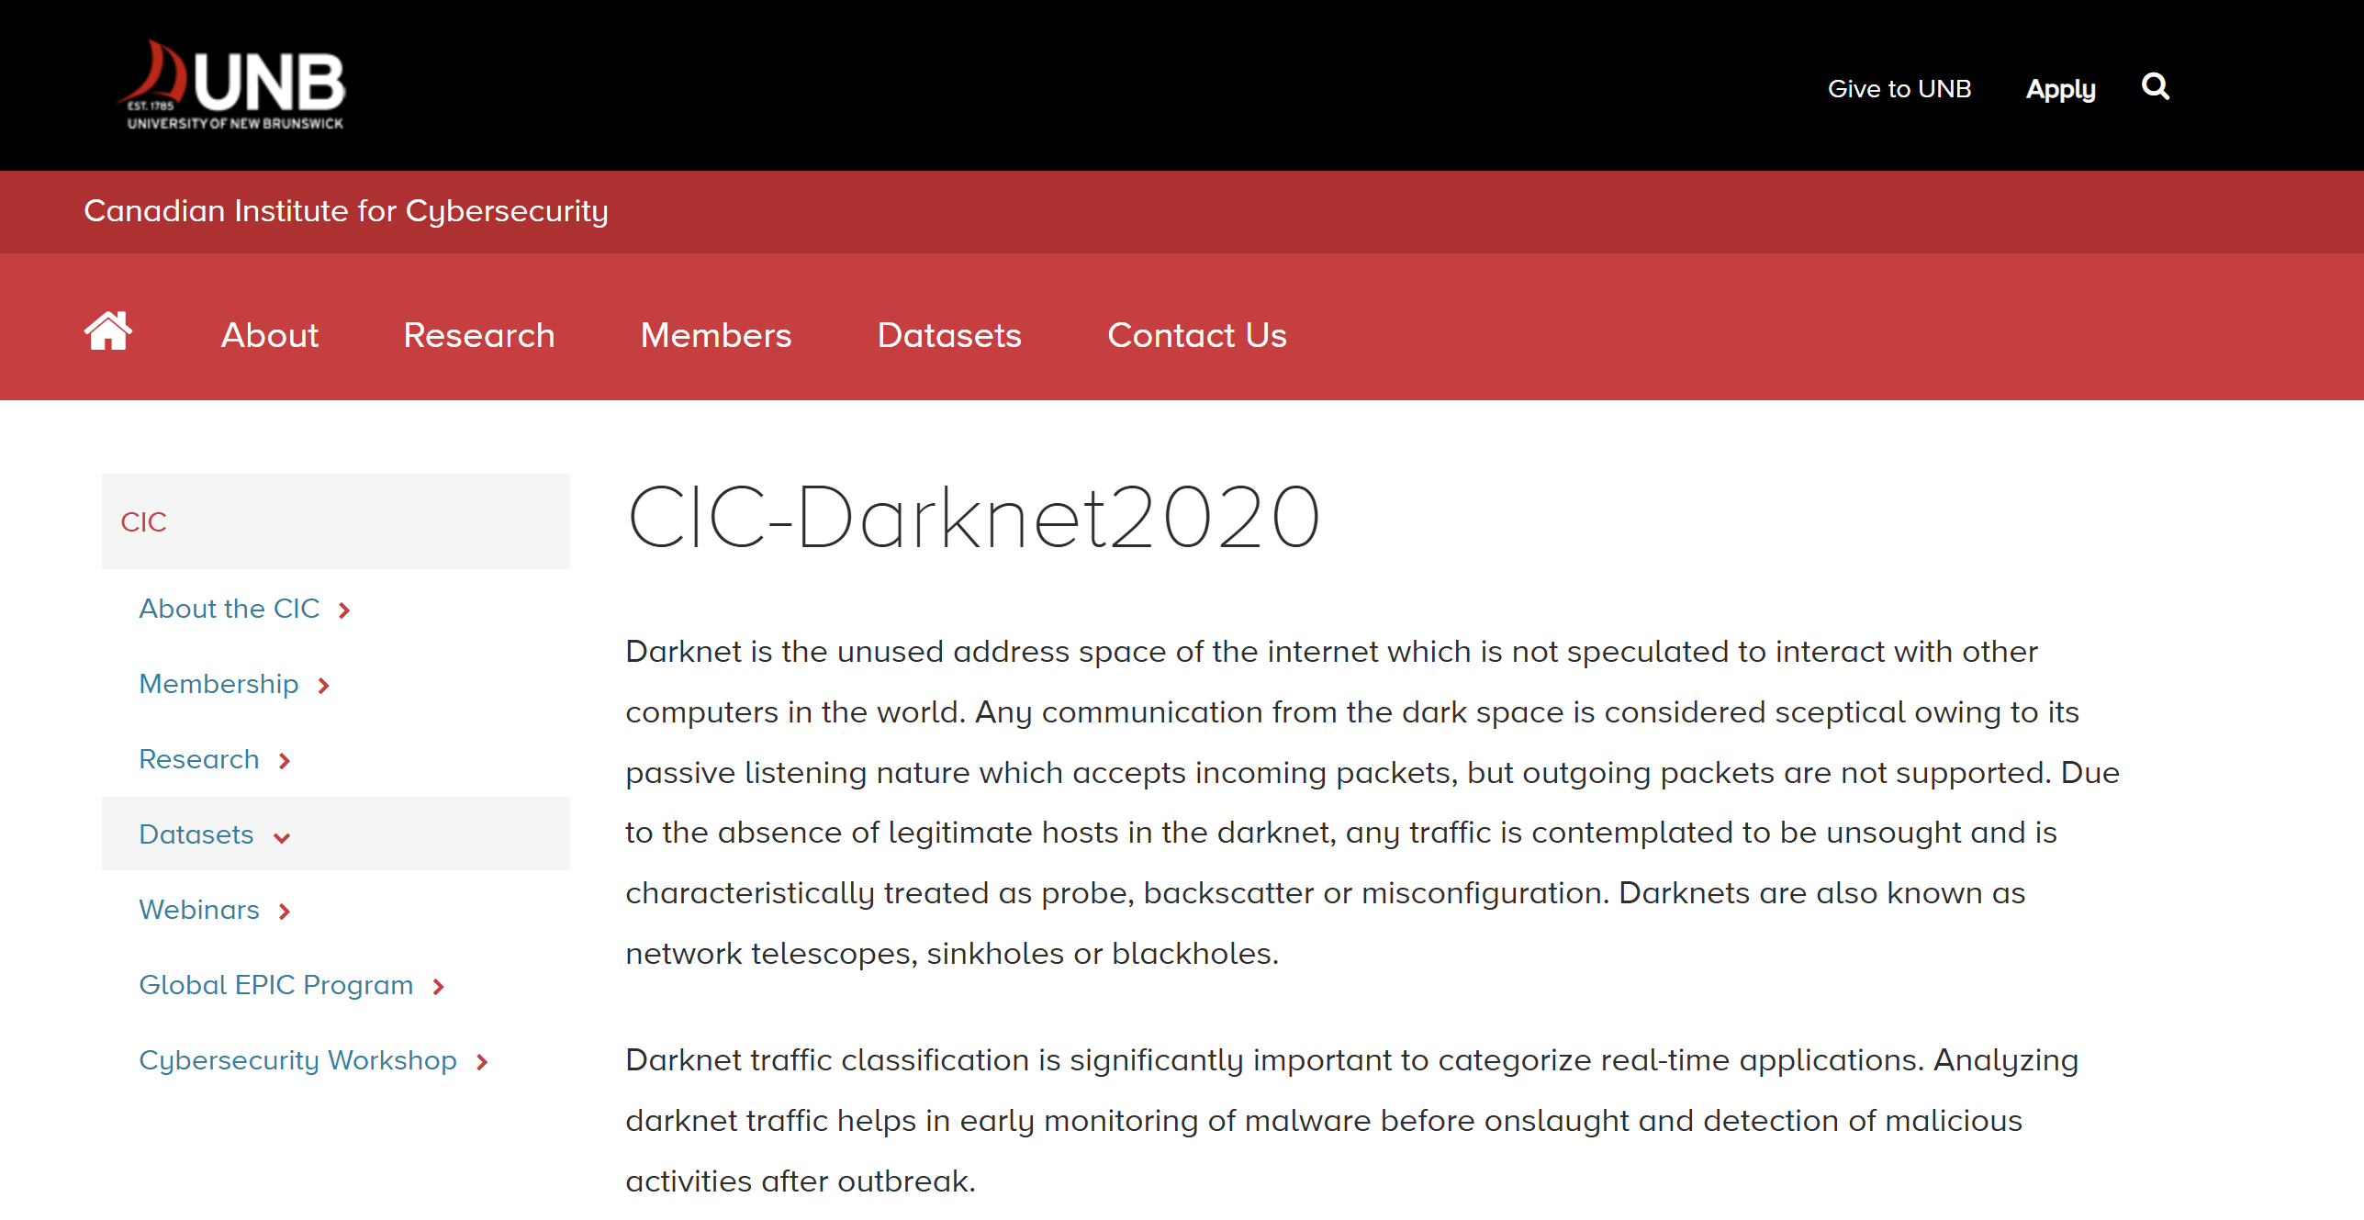
Dataset Overview
Presents real-world encrypted traffic flow from the darknet in 2020.
University of New Brunswick –
Data collected for research reasons
Data has 85 variables and 140,000 rows.
Each represents a connection.

Slide 4
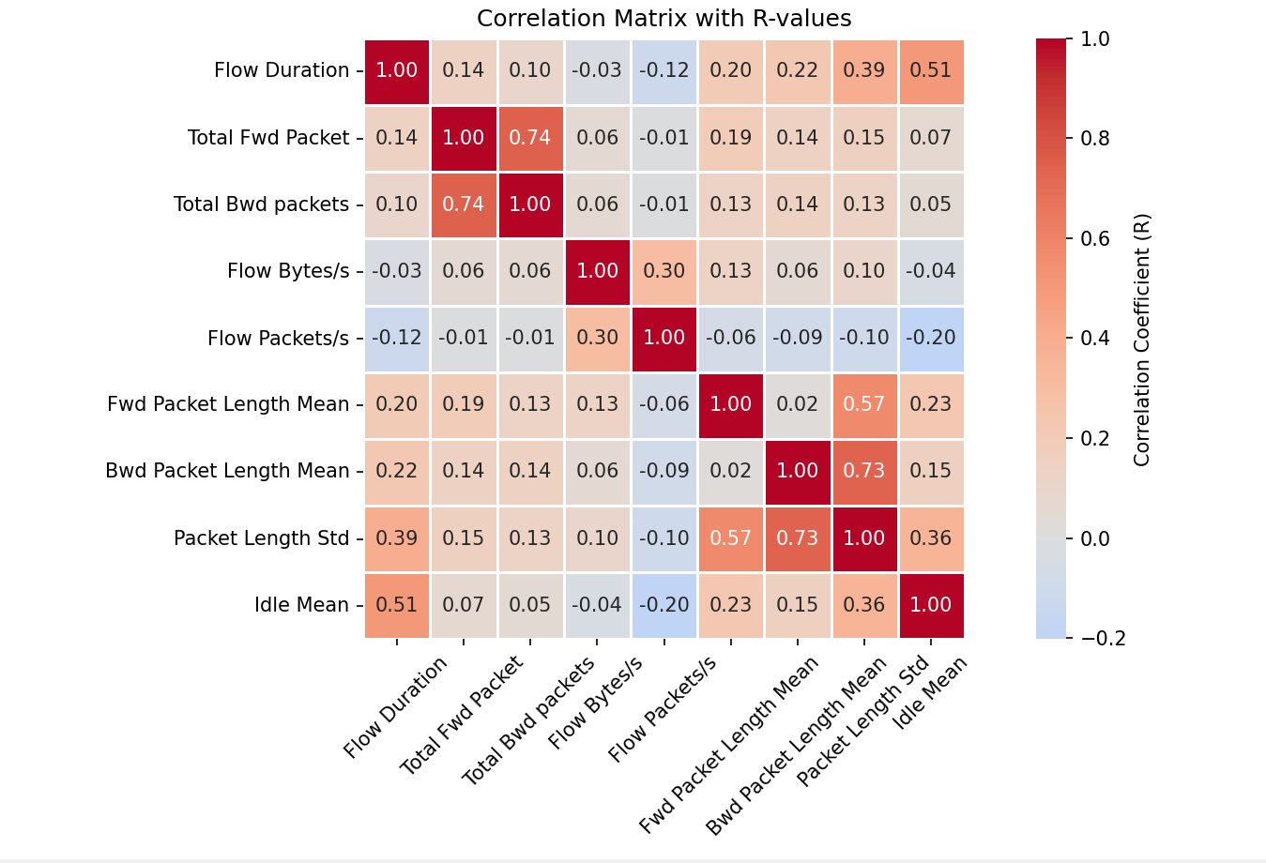
Metadata
After viewing the correlations between variables:

Slide 5
Metadata
After viewing the correlations between variables, I focused on the following 10 variables:

Slide 6
Metadata Chosen variables
Label
Timestamp
Type of Flow (Tor, non-Tor, VPN, non-VPN), nominal variable.
Mode – non-Tor (65.96%)
The time a flow started.

Slide 7
Metadata Chosen variables
Flow Duration
Total Fwd Packet
Total Bwd Packet
Time in microseconds the flow lasted, ratio variable.
(M = 20819965.83, std = 38086045.21).
Number of packets sent from the source to the destination, ratio variable
(M = 152.85, std = 2378.73).
Number of packets sent from destination to source, ratio variable.
(M = 154.69, std = 3419.30).

Slide 8
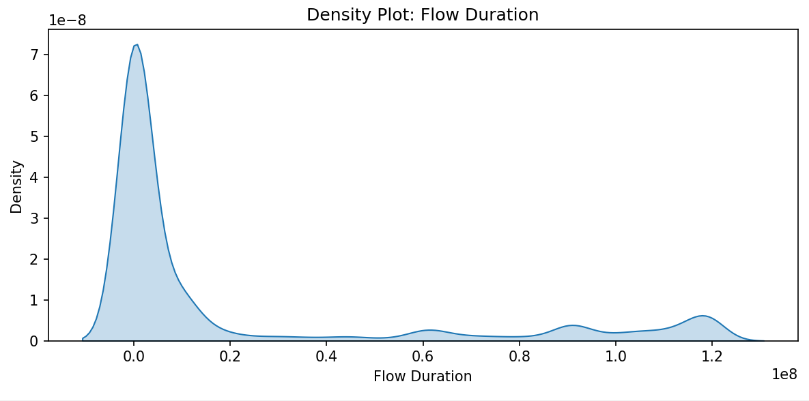
Metadata Chosen variables
Flow Duration
Time in microseconds the flow lasted, ratio variable. (M = 20819965.83, std = 38086045.21).
Majority of flows end quickly.
Long durations could indicate large file transfers, video streaming or idle connections.
Threshold = 29575914.75. #outliers = 29721 (21.01%).
Because of the high number, I think these values are not outliers, rather, they can make a classified group
outlier threshold - .29

Slide 9
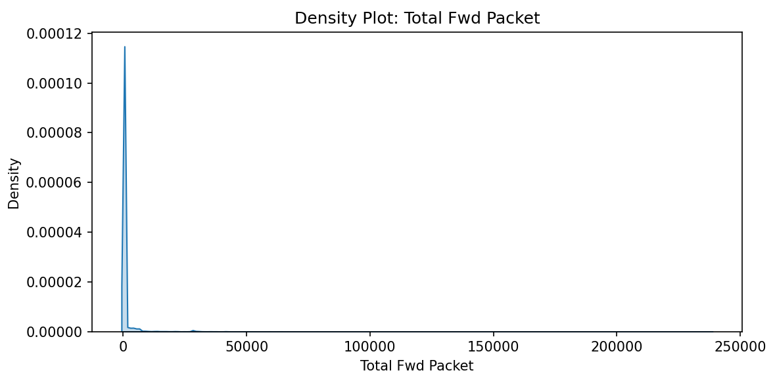
Metadata Chosen variables
Total Fwd Packet
Number of packets sent from the source to the destination, ratio variable (M = 152.85, std = 2378.73).
Peak is very close to zero with a long tail.
Large number of fwd packets can indicate a large number of file transfers.
Threshold = 8.5, #outliers = 23349 (16.50%).
outlier threshold

Slide 10
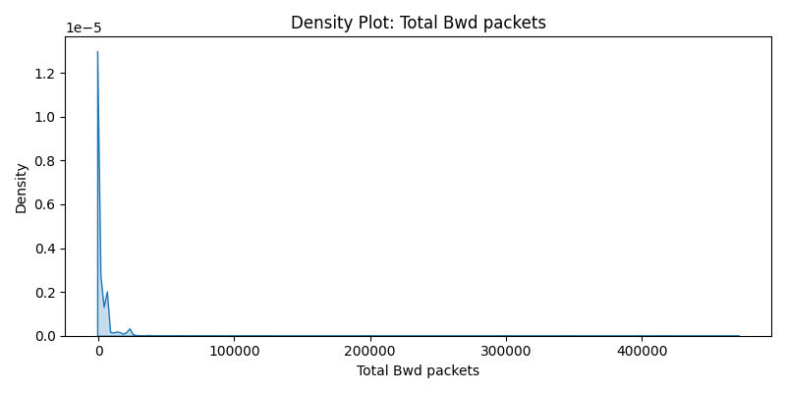
Metadata Chosen variables
Total Bwd Packet
Number of packets sent from destination to source, ratio variable. (M = 154.69, std = 3419.30).
Very little return traffic, a few have massive amounts.
Outliers = extremely large number of packets sent from the opposite direction.
Threshold = 7.5, #outliers = 22105 (15.62%).
outlier threshold

Slide 11
Metadata Chosen variables
Flow Bytes/s
Flow Packets/s
Idle Mean
Mean number of byte rate of the flow, ratio variable
(M = 85114.48, std = 1253100.98).
Mean number of packets per second in the flow, ratio variable
(M = 10900.18, std = 51407.09).
Mean time where no packets were sent in either direction during a flow, ratio variable
(M = 703041450982981.50, std = 705872024269573.90).

Slide 12
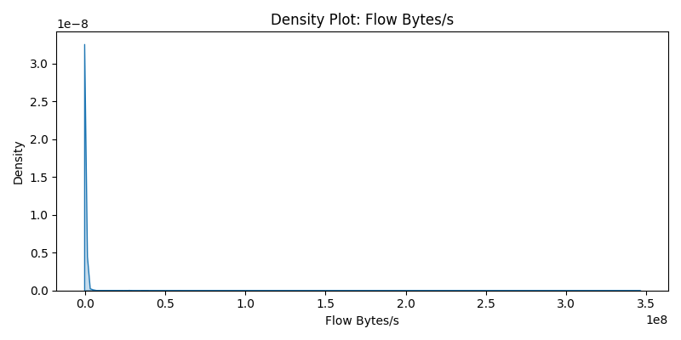
Metadata Chosen variables
Flow Bytes/s
Mean number of byte rate of the flow, ratio variable (M = 85114.48, std = 1253100.98).
Most flows transfer data very slowly.
Outliers = very fast transfers, such as in the case of bursts in attacks (as in the case of DDoS).
Threshold = 2476.99, #outliers = 25023 (17.69%).
This percentage may represent DDoS types of attacks; therefore, these cases are very meaningful
outlier threshold

Slide 13
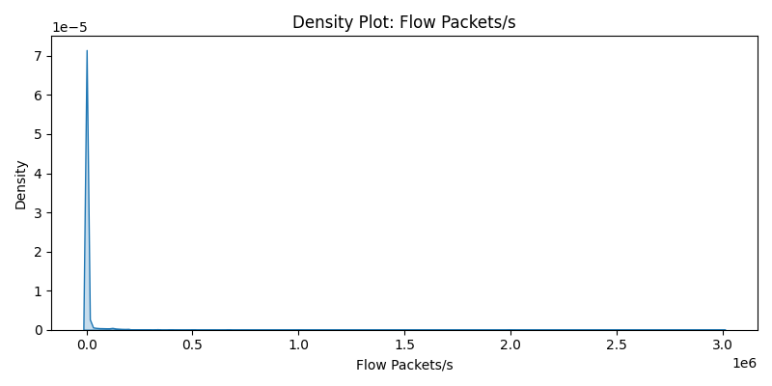
Metadata Chosen variables
Flow Packets/s
Mean number of packets per second in the flow, ratio variable (M = 10900.18, std = 51407.09).
Most flows transmit packets at a slow rate.
Outliers = rapid packet bursts, such as in the case of flooding attacks or botnet communication.
Threshold = 987.96, #outliers = 33723 (23.84%).
Because of the high percentage, these cases may hold a meaning
outlier threshold

Slide 14
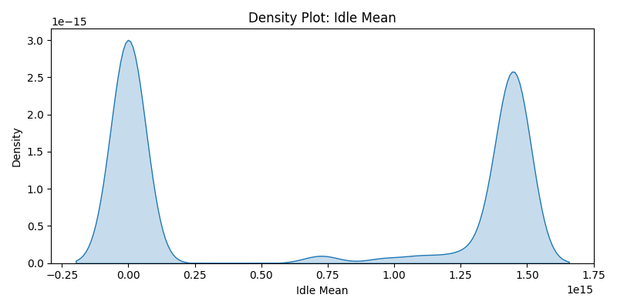
Metadata Chosen variables
Idle Mean
Mean time where no packets were sent in either direction during a flow, ratio variable (M = 703041450982981.50, std = 705872024269573.90).
2 peaks: almost no idle, or long idle durations.
No outliers.

Slide 15
Metadata Chosen variables
Fwd Packet Length Mean
Bwd Packet Length Mean
Packet Length Std
Average size of forward packet, ratio variable
(M = 69.62, std = 219.99).
Average size of packets in the backward direction, ratio variable
(M = 107.32, std = 240.54).
standard deviation of packet sizes in a flow, ratio variable
(M = 108.51, std = 207.67).

Slide 16
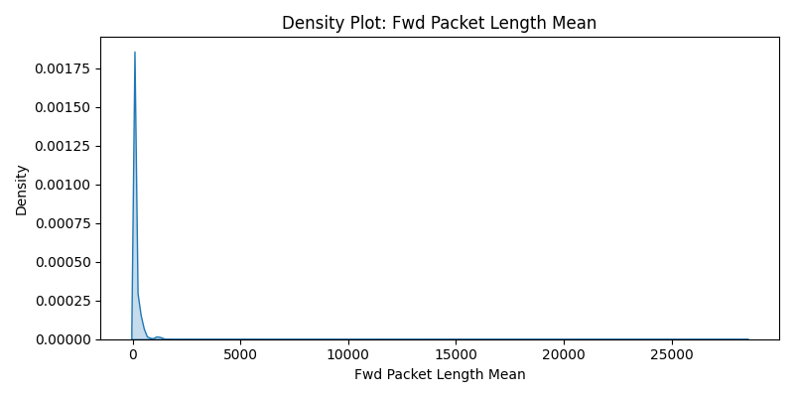
Metadata Chosen variables
Fwd Packet Length Mean
Average size of forward packet, ratio variable (M = 69.62, std = 219.99).
Sharp peak, concentrated near 0-500 bytes, suggesting typical communication.
Outliers = very high mean of fwd packet length, such as in the case of video streaming.
Threshold = 112.5. #outliers = 18382 (12.99%).
outlier threshold

Slide 17
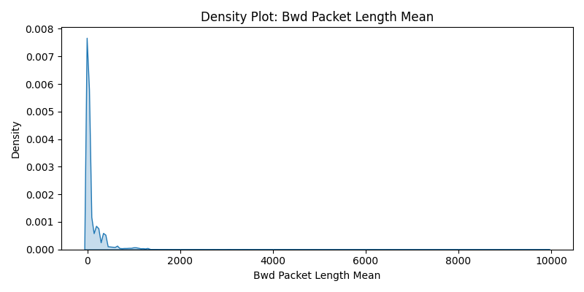
Metadata Chosen variables
Bwd Packet Length Mean
Average size of packets in the backward direction, ratio variable (M = 107.32, std = 240.54).
short response packets.
Threshold = 242.5. #outliers = 19261 (13.61%)
outlier threshold

Slide 18
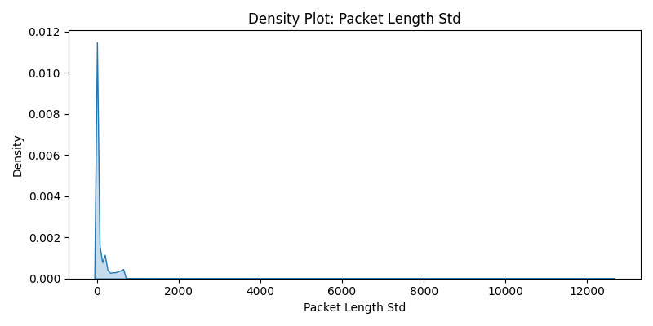
Metadata Chosen variables
Packet Length Std
standard deviation of packet sizes in a flow, ratio variable (M = 108.51, std = 207.67).
Peak is near 0-500 bytes, flows of similar size.
Outliers = high variability in the length of packets –inconsistent behaviour or multiple services.
Threshold = 296.69, #outliers = 18883 (13.35%).
outlier threshold

Slide 19
Metadata Missing Data & Special Cases
Missing Data
Special Cases
Duplicates
0.0003% had zero flow duration. Therefore other variables had NaN (such as flow bytes/s).
Low number = the following analysis ran without them.
Label variable had a value of a number with 1 occurrence; therefore, I ignored it in the following analysis.
I found 24457 duplicate rows in the dataset and removed them for the following analyses.

Slide 20
Metadata Correlations between variables
Total fwd packet with total bwd packet (r = .74)
Bwd packet length mean with packet length std (r = .73)
Fwd packet length mean with packet length std (r = .57)
Idle mean with flow duration (r = .51)
Packet length std with flow duration (r = .39)
Fwd packet length mean with flow duration (r = .20)
Flow packets/s with idle mean (r = -.20)

Slide 21
Metadata Correlations between variables
Total fwd packet with total bwd packet (r = .74): large forward flows are usually matched by large backward responses like requests and replies

Slide 22
Metadata Correlations between variables
Bwd packet length mean with packet length std (r = .73): Packet variability is closely tied to backward packet size.
Typical in asymmetric protocols like HTTP or streaming

Slide 23
Metadata Correlations between variables
Fwd packet length mean with packet length std (r = .57): The opposite from Bwd Packet.
Usually, messages sent from client to server are smaller than messages sent from server to client

Slide 24
Metadata Correlations between variables
Idle mean with flow duration (r = .51): The longer a flow lasts, the more likely it contains gaps between packets.
Notes:
for example if you’re chatting with someone and you send a text, you’re basically in idle mode in the app/website until they send you a message and you have to reply.

Slide 25
Metadata Correlations between variables
Packet length std with flow duration (r = .39): As Flow Duration increases, there tends to be more variability in packet sizes.
Notes:
An example for this is if you’re chatting with someone on Whatsapp for example, and usually if you’re chatting with someone for a long time you might send voice messages/pictures/videos, thus introducing more variability to packet size.

Slide 26
Metadata Correlations between variables
Fwd packet length mean with flow duration (r = .20): similar reasons as the previous one.

Slide 27
Metadata Correlations between variables
Flow packets/s with idle mean (r = -.20): This means that the more packets/sec are sent, the less idle time there is

Slide 28
Shared Abnormalities
All variables (exc. Idle mean) had identified outliers. As expected:
Flow
duration
Total fwd packet
Total fwd packet
Total bwd packet
Flow duration
Packet length std
56.70%
91.37%
59.32%
Expected because of their high correlation
*same for total bwd packet – 53.26%
packets sent from the client to the server will also generate packets from server to client
Expected because of their high correlation

Slide 29
Principal Component Analysis
PC3 | PC2 | PC1 | Variable
-.12 | -.22 | .38 | Flow duration
-.25 | .58 | .30 | Total fwd packet
-.26 | .60 | .27 | Total bwd packet
.62 | .23 | .06 | Flow bytes/s
.55 | .27 | -.13 | Flow packets/s
.19 | -.01 | .35 | Fwd packet length mean
.20 | -.10 | .38 | Bwd packet length mean
.26 | -.17 | .52 | Packet length std
-.16 | -.29 | .35 | Idle mean
PCA with 3 components.
PC1 (ev = 2.63) explains 29.26% variance.
PC2 (ev = 1.63) explains 18.06% variance.
PC3 (ev = 1.33) explains 14.82% variance.
Total of 62.14% explained variance

Slide 30
Principal Component Analysis
PC3 | PC2 | PC1 | Variable
-.12 | -.22 | .38 | Flow duration
-.25 | .58 | .30 | Total fwd packet
-.26 | .60 | .27 | Total bwd packet
.62 | .23 | .06 | Flow bytes/s
.55 | .27 | -.13 | Flow packets/s
.19 | -.01 | .35 | Fwd packet length mean
.20 | -.10 | .38 | Bwd packet length mean
.26 | -.17 | .52 | Packet length std
-.16 | -.29 | .35 | Idle mean
PC1 (ev = 2.63) explains 29.26% variance.
Represents the General size or timing of flows.

Slide 31
Principal Component Analysis
PC3 | PC2 | PC1 | Variable
-.12 | -.22 | .38 | Flow duration
-.25 | .58 | .30 | Total fwd packet
-.26 | .60 | .27 | Total bwd packet
.62 | .23 | .06 | Flow bytes/s
.55 | .27 | -.13 | Flow packets/s
.19 | -.01 | .35 | Fwd packet length mean
.20 | -.10 | .38 | Bwd packet length mean
.26 | -.17 | .52 | Packet length std
-.16 | -.29 | .35 | Idle mean
PC2 (ev = 1.63) explains 18.06% variance.
Reflects communication volume, in terms of forward and backward packet counts.

Slide 32
Principal Component Analysis
PC3 | PC2 | PC1 | Variable
-.12 | -.22 | .38 | Flow duration
-.25 | .58 | .30 | Total fwd packet
-.26 | .60 | .27 | Total bwd packet
.62 | .23 | .06 | Flow bytes/s
.55 | .27 | -.13 | Flow packets/s
.19 | -.01 | .35 | Fwd packet length mean
.20 | -.10 | .38 | Bwd packet length mean
.26 | -.17 | .52 | Packet length std
-.16 | -.29 | .35 | Idle mean
PC3 (ev = 1.33) explains 14.82% variance.
Represents data transfer rate – how fast the flow sends bytes or packets.

Slide 33
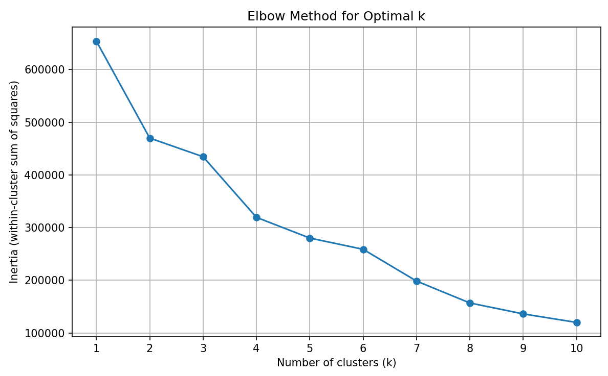
Clustering K-Means Elbow method
Elbow method was applied to find the optimal K.
Drastic drop from k=1 to k=4, then it slows down, hence, the elbow.
I originally tried for 4 clusters, but because the fourth one included 12 observations, I decided to go for 3 clusters.
Notes:
K-means is an unsupervised learning algorithm that partitions data into K distinct clusters.
It works by assigning K centroids and assign each point to the nearest centroid using Euclidian distance, then updating the centroids as the mean of points in each cluster, and we keep repeating this until there’s no more change.

Slide 34
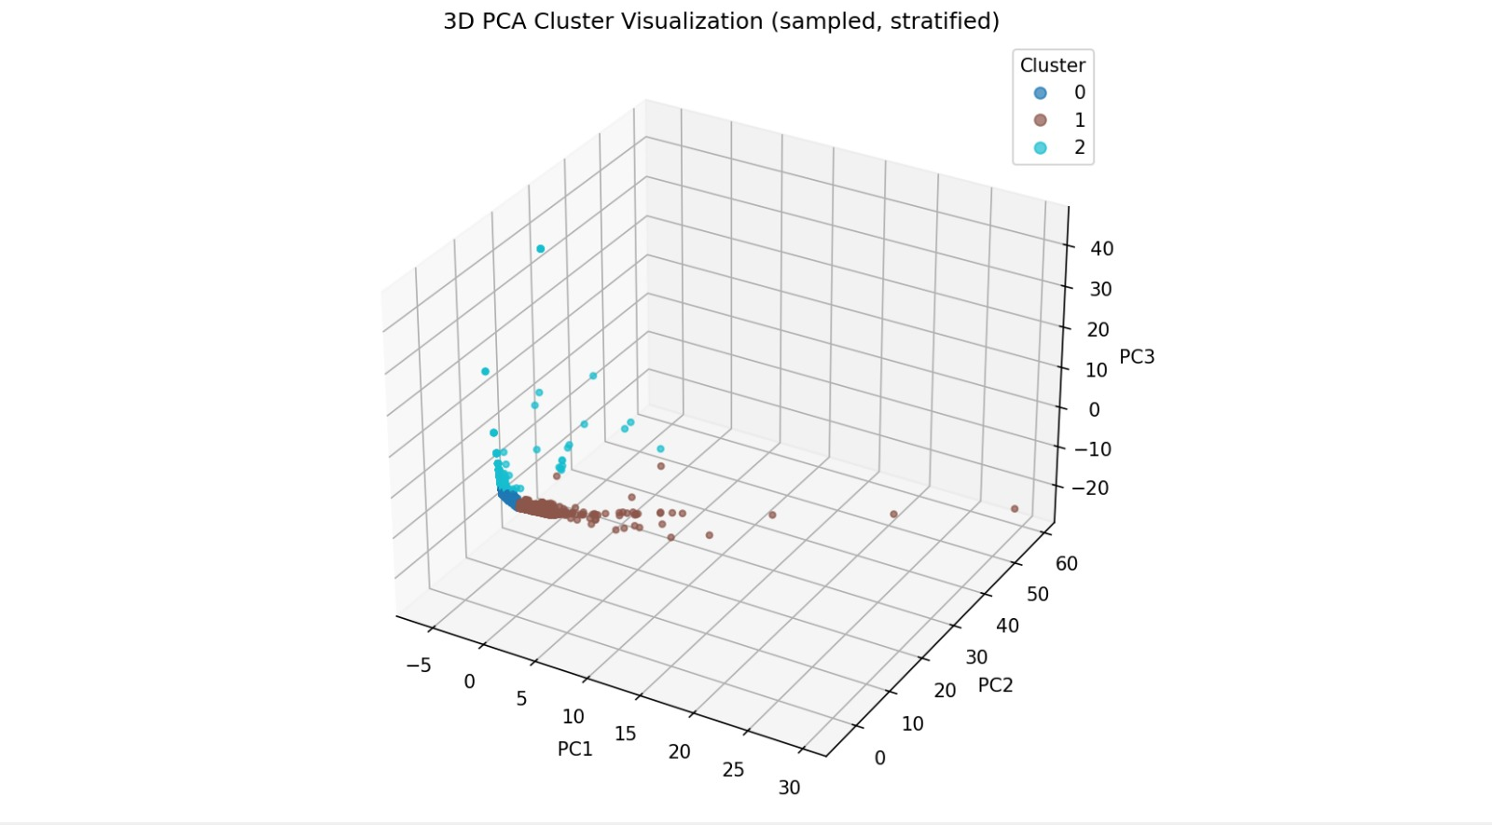
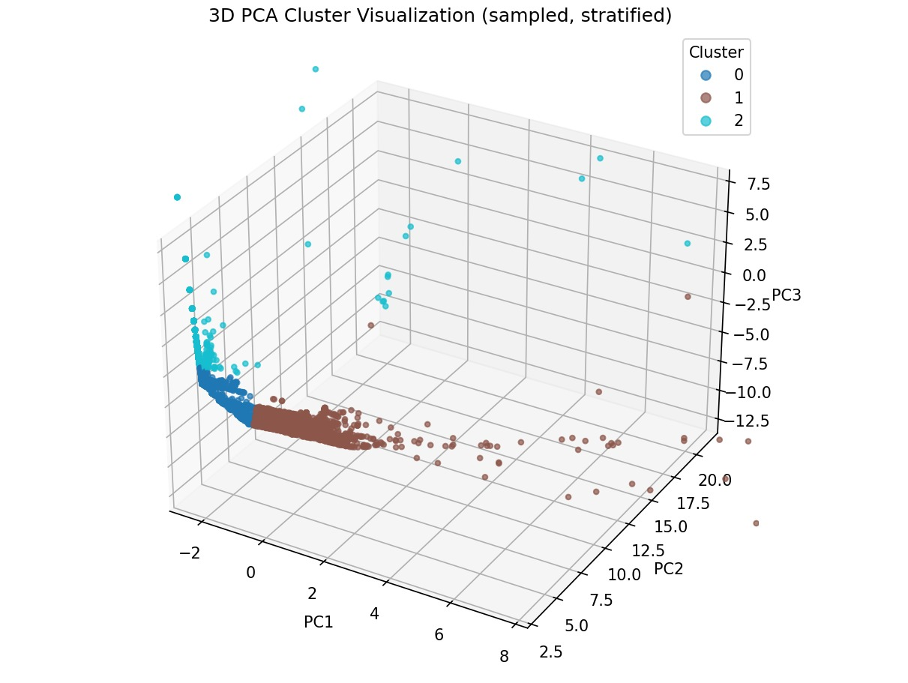
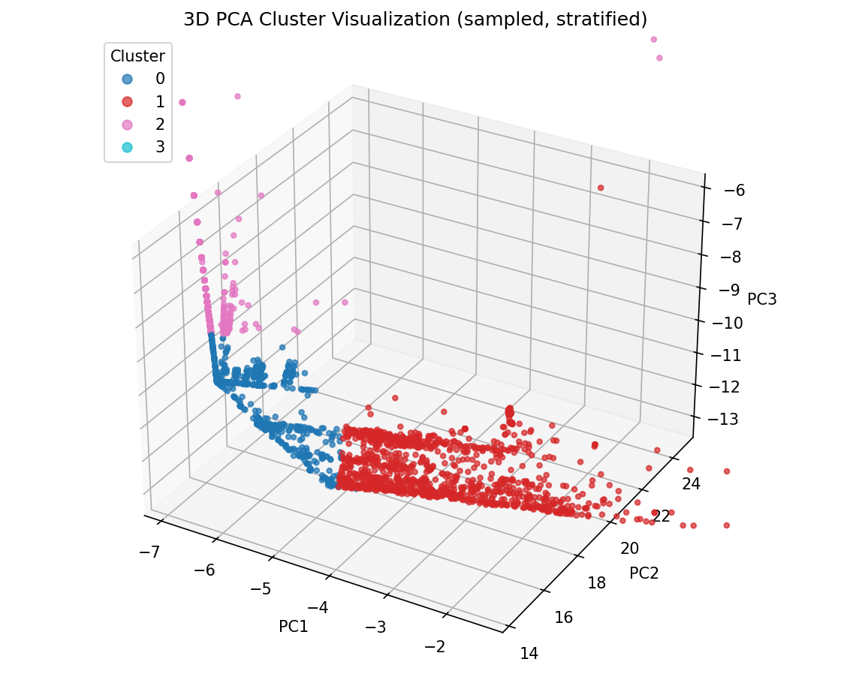
Clustering K-Means Results on 3PC
Zooming in
*For visual reasons, presented 5k sampled points.
Notes:
K-means is an unsupervised learning algorithm that partitions data into K distinct clusters.
It works by assigning K centroids and assign each point to the nearest centroid using Euclidian distance, then updating the centroids as the mean of points in each cluster, and we keep repeating this until there’s no more change.

Slide 35
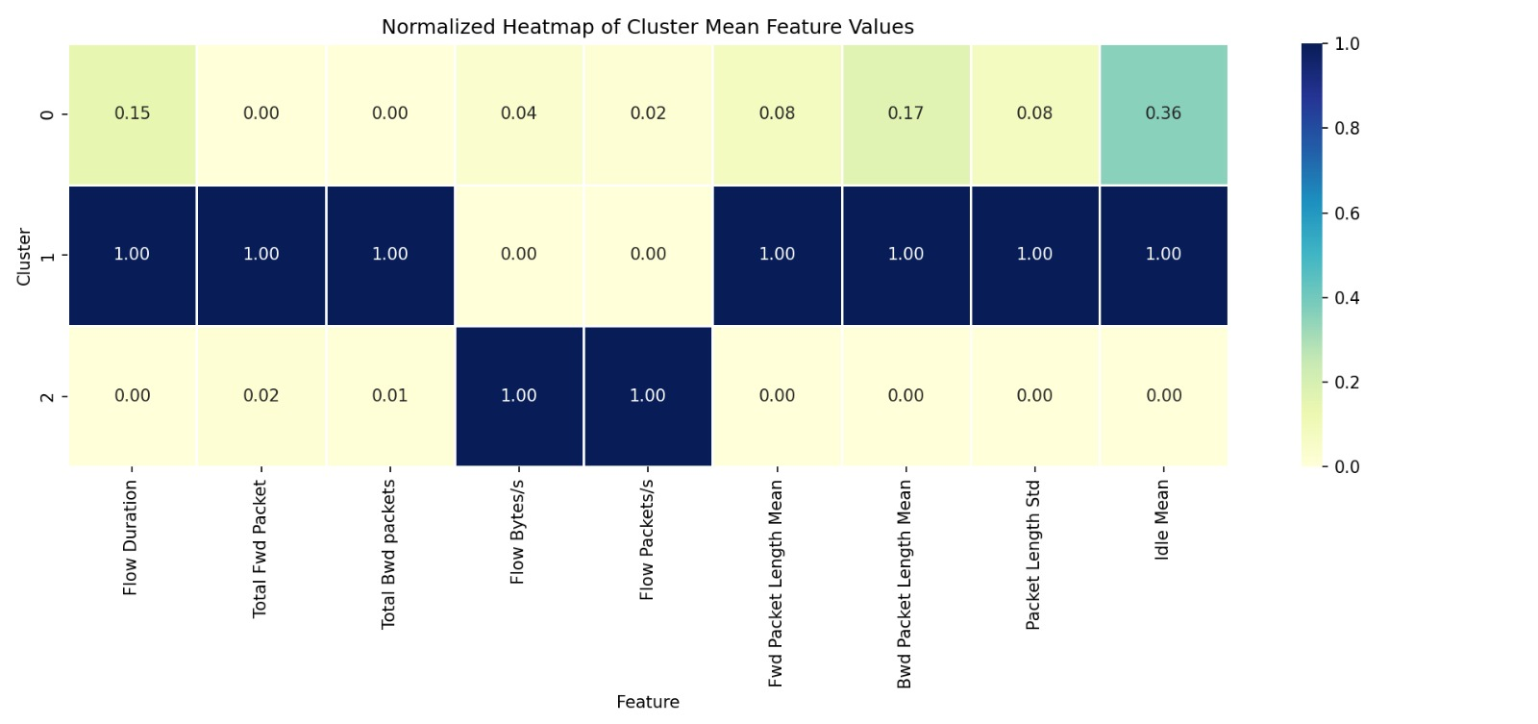
Clustering K-Means Results on 3PC
Cluster 0:
Moderate in Flow duration and Idle mean
Very low in most packet count/length metrics
This looks like low-traffic or idle sessions – short flows and few packets.
Notes:
K-means is an unsupervised learning algorithm that partitions data into K distinct clusters.
It works by assigning K centroids and assign each point to the nearest centroid using Euclidian distance, then updating the centroids as the mean of points in each cluster, and we keep repeating this until there’s no more change.

Slide 36
Clustering K-Means Results on 3PC
Cluster 1:
Highest in Flow packets/s and flow bytes/s.
Represents long-lived sessions, like downloads or video streams
Notes:
K-means is an unsupervised learning algorithm that partitions data into K distinct clusters.
It works by assigning K centroids and assign each point to the nearest centroid using Euclidian distance, then updating the centroids as the mean of points in each cluster, and we keep repeating this until there’s no more change.

Slide 37
Clustering K-Means Results on 3PC
Cluster 2:
Highest in Flow packets/s and flow bytes/s.
Low across the map otherwise – everything is nearly 0
Represents burst attacks, bots, or high speed automated traffic.
Notes:
K-means is an unsupervised learning algorithm that partitions data into K distinct clusters.
It works by assigning K centroids and assign each point to the nearest centroid using Euclidian distance, then updating the centroids as the mean of points in each cluster, and we keep repeating this until there’s no more change.

Slide 38
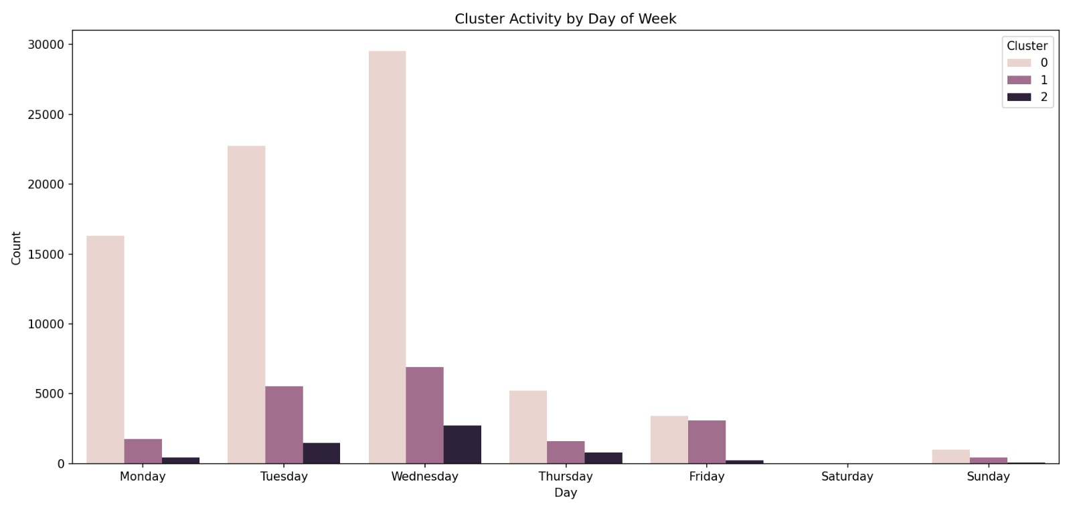
Segmentation Analysis Temporal
Regarding the day of the week, we can clearly see that the clusters have different frequencies for each day.
After trying to compare during the week and weekend, I noticed the plots are meaningless, and therefore did not include them in the presentation.

Slide 39
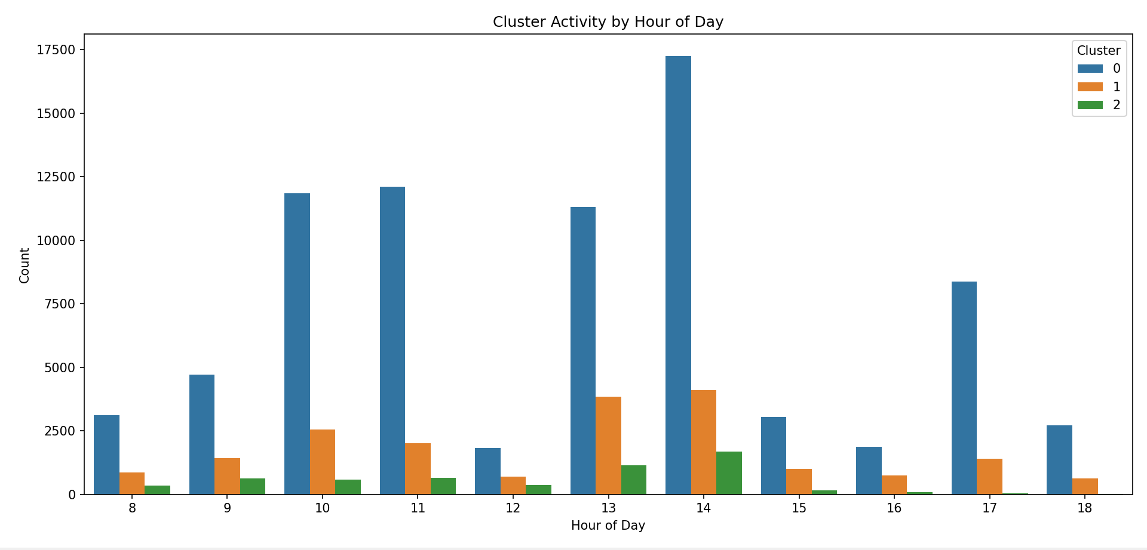
Segmentation Analysis Temporal
I combined the hours of the day into parts of day as follows: Morning from 6a.m to 12 p.m., afternoon from 12 p.m. to 6 p.m., and evening from 6 p.m. to 12 a.m. (no data in night time).
I found similar patterns for every feature when I compared between clusters and part of day using the Kolmogorov–Smirnov test (with Bonferroni correction for the high number of comparisons).

Slide 40
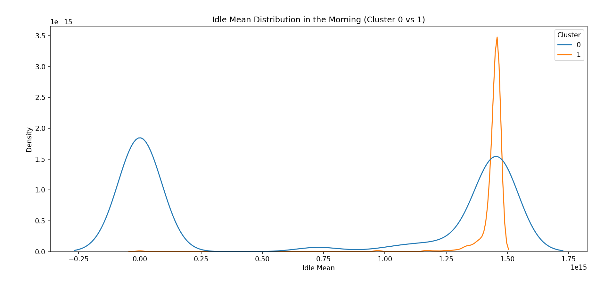
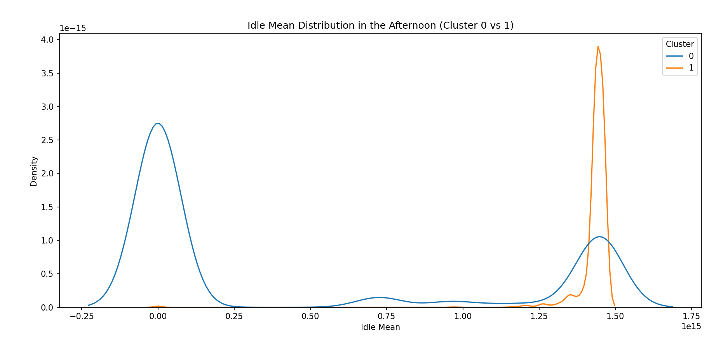
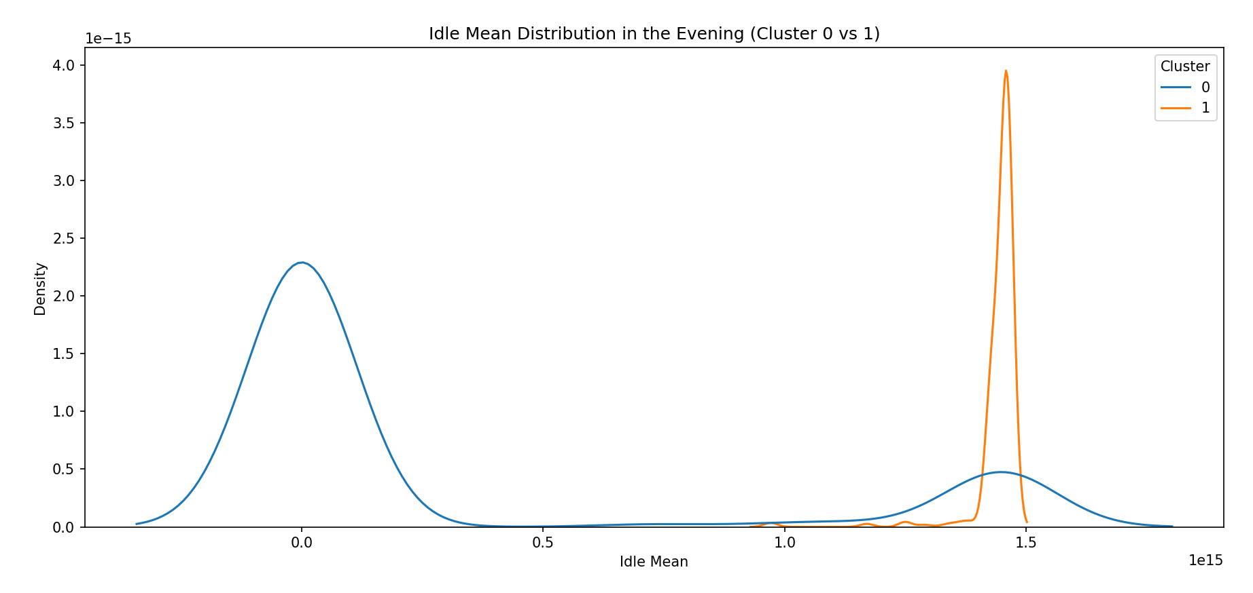
Segmentation Analysis Temporal – Idle Mean
Example feature – idle mean (comparing cluster 0 and 1):
As expected:
Cluster 0 has two peaks of low and high idle mean sessions.
We see that, regardless of time of day, cluster 1 always has a peak, and the data is very much grouped at high idle mean time

Slide 41
Segmentation Analysis Temporal – Idle Mean
Example feature – idle mean (comparing cluster 0 and 1):
Interestingly, for cluster 0, we see that in the morning, there are two peaks, where the peak of high idle mean sessions starts to get flattened by time.
I would expect that at night time,, a short idle times session only, but if I had the data, it would be interesting to see which hour approximately this peak starts to show up again.

Slide 42
Segmentation Analysis Temporal – K-S test results
Time | Feature | Cluster 1 | Cluster 2 | KS Statistic (D) | Raw p-value | Adjusted p-value
Afternoon | Idle Mean | 0 | 1 | 0.724 | 0 | 0
Afternoon | Idle Mean | 0 | 2 | 0.348 | 0 | 0
Afternoon | Idle Mean | 1 | 2 | 0.997 | 0 | 0
Evening | Idle Mean | 0 | 1 | 0.820 | 7.9e-322 | 6.403e-320
Evening | Idle Mean | 0 | 2 | 0.213 | 0.198 | 1
Evening | Idle Mean | 1 | 2 | 1 | 6.85E-44 | 5.55E-42
Morning | Idle Mean | 1 | 0 | 0.557 | 0 | 0
Morning | Idle Mean | 1 | 2 | 0.992 | 0 | 0
Morning | Idle Mean | 0 | 2 | 0.511 | 0 | 0
Highlighted – are the ones we saw in the previous slide.

Slide 43
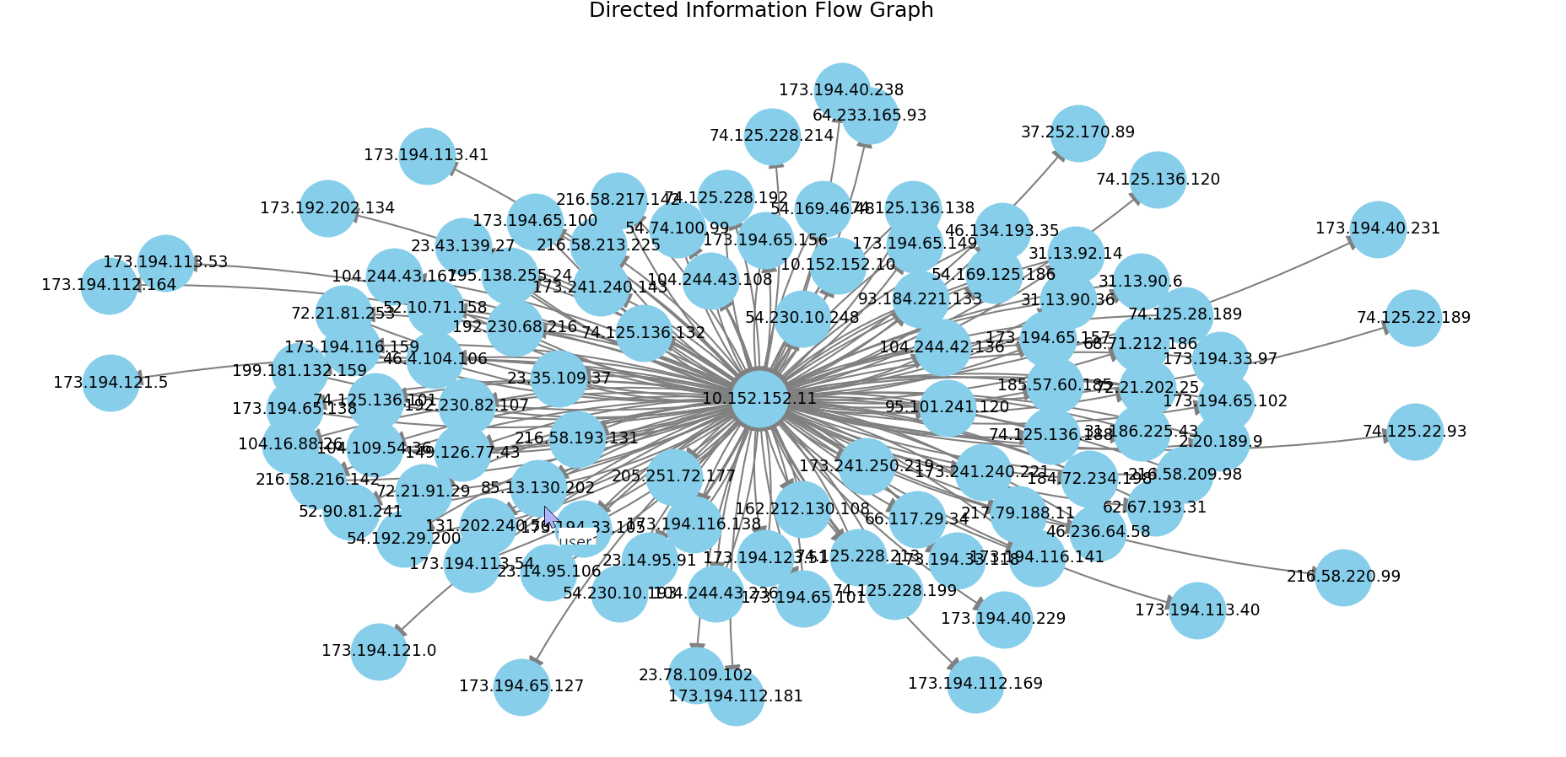
Network Graph
A directed network graph to show connections from source to destination – in the following plot, there are only 100 nodes (sampled) to make the graph readable and meaningful.
We see that 10.152.152.11 is a central source node or a hub which many flows are outgoing from, meaning it initiates or responds to most traffic.

Slide 44
Summary Modeling & Analysis
I tried to understand the data from different perspectives that would give a fuller picture of the variables’ connections using unsupervised clustering methods:
PCA was used to first lower the dimensions of the data, where I succeeded in lowering their number to 3.
K-Means helped me further discover patterns of behaviour, where I managed to find very distinct clusters (as we can see from the heatmap and the 3d graphs).
I further used KS tests to justify that the clusters show different patterns of behaviour, as demonstrated above, we see how clusters act differently in their idle mean time.
Finally, we can see from the plots of the networks that there is a “hub” node that sends requests and replies to many other nodes.

Slide 45
Summary Future Directions
Whether malicious activity manifests immediately, or if there is a gradual learning phase?
From a cybersecurity perspective, it would have been interesting to investigate the early stages of the network connections. As our current database captures established flows, while an open question is whether malicious activity manifests immediately, or if there is a gradual learning phase where an attacker or malware observes and adapts to the target system before attacking.

Slide 46
Summary Improving the System
Explainability layer = Adding an interpretability framework that explains why a particular flow was clustered in a certain group, aiding in trust and understanding by analysts.
Using different clustering algorithms = Different clustering algorithms have different strengths and weaknesses, so using different methods can give better diversity and thus better and more accurate results.

Slide 47
Thank you
Name: Hadi Serhan (323968669)
Email: hadixserhan@gmail.com

