Slide 1
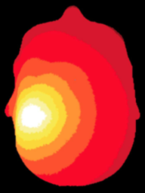
NeuroDOT
Tutorial:
Data Quality, Pre-processing, and Reconstruction

Slide 2
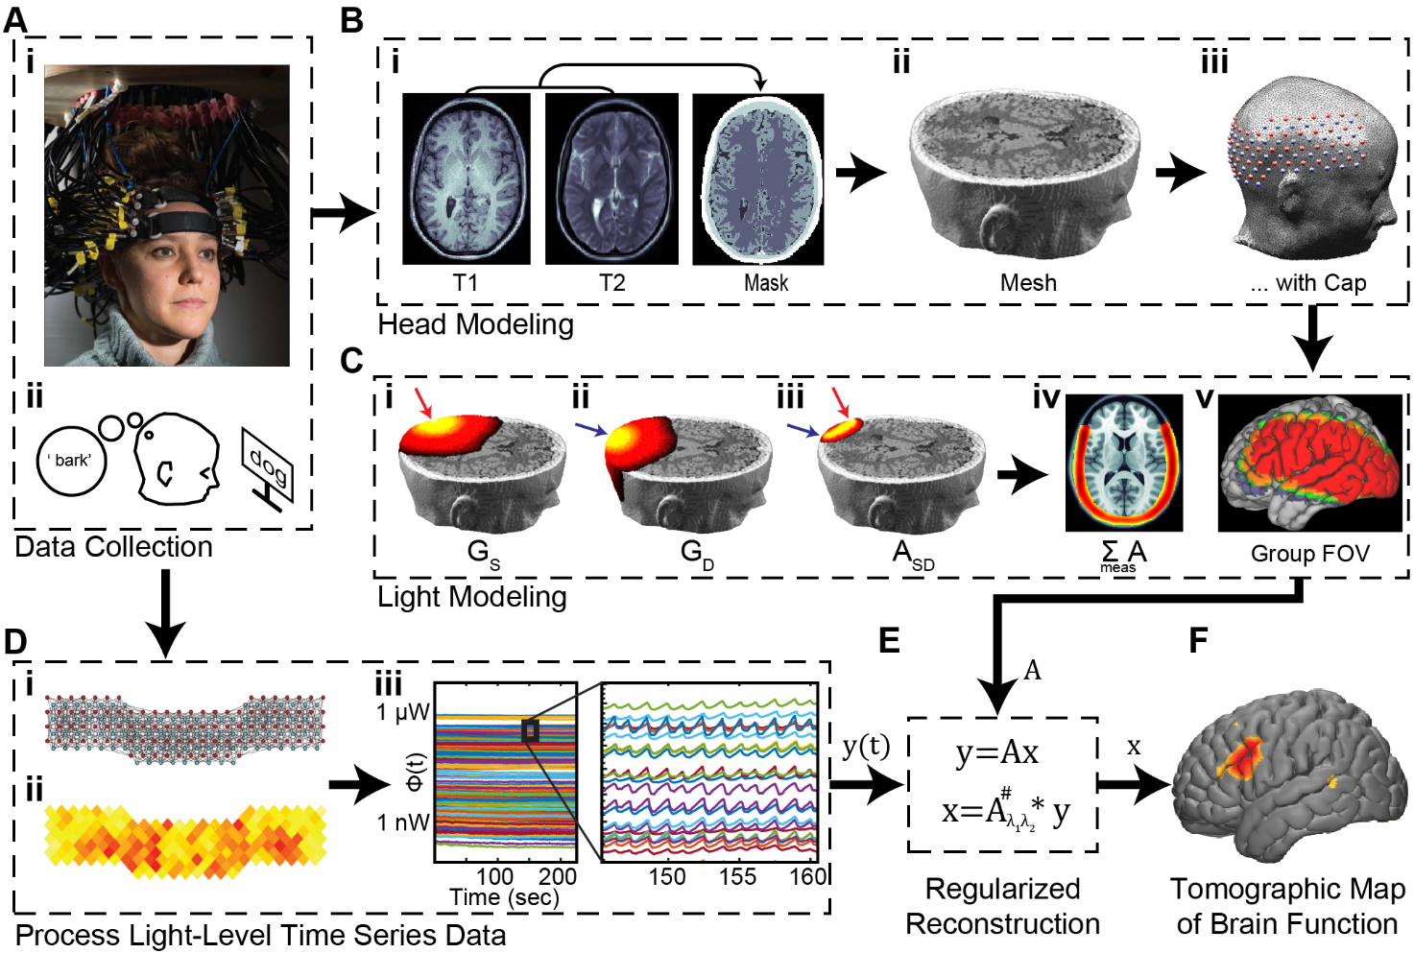
Diffuse Optical Tomography
In diffuse optical tomography (DOT), arrays of optical sources and detectors are used to perform functional neuroimaging experiments on task-based or resting state modes of human brain function.
Analyses are broken into several pipelines:
B: modeling of the tissue shape, optical property distribution, and source/detector locations
C: modeling of the light emission, diffusion, and detection through the head
D: preprocessing of the raw source-detector measurements
E: reconstruction and spectroscopy of the preprocessed data and light model into a functional neuroimaging volume
F: post-processing analysis of these results.

Slide 3
Pre-processing and Image Reconstruction
This tutorial will follow the NeuroDOT_Full_Processing_Script.m Matlab file which can be found in the Documentation/Scripts folder.
The tutorial will:
Generate raw data quality assessment figures
Process and visualize source-detector measurements
Perform image reconstruction using a light model sensitivity matrix A
Visualize the reconstructed data
We will use data from a rotating-wedge retinotopy experiment
Start by loading this data set:
load('NeuroDOT_Data_Sample_CCW1.mat'); % data, info, flags

Slide 4
Pre-processing and Image Reconstruction
To fully processes the Sample Datasets contained within the toolbox, you will need to generate the Sensitivity matrices for the 24x28 and 96x92 (source x detector) arrays.
If these Sensitivity matrices have not yet been generated, you can make them using the files and scripts included in the toolbox.
To do so, please see the NeuroDOT_Tutorial_Generating_a_Light_Model.pptx and its associated script for the 24x28 array and the …Pad_Adult_96x92_Example.pptx and its associated script for the 96x92 array.
After generating, be sure to add the name of the relevant Sensitivity matrix file to the %% Load Measurement data section of the NeuroDOT_Full_Processing_Script_Tutorial.m script.

Slide 5
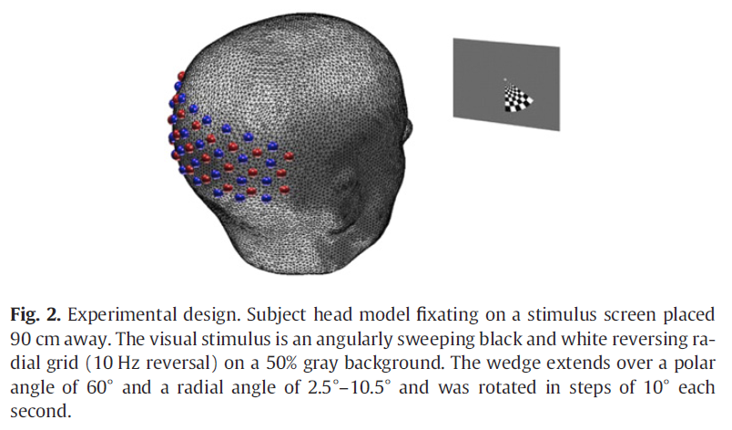
NeuroDOT_Data_Sample_CCW1.mat
The CCW1 data set is one of those acquired for the Eggebrecht et al., Neuroimage, 2012 paper.
Briefly, the participant gazed upon a fixation cross while a reversing checkerboard progressed in the counter-clockwise (CCW) direction.
In the figures below, synchronization points labelled with a red line denote resting epochs; those with a green line denote the start of the CCW block wherein the flickering wedge is located at 6:00.
Please see the paper for more information.
Matlab code segments that can be copied and pasted into matlab to be run are in Courier 12pt. BOLD font.

Slide 6
Flow Chart for Pre-processing and Image Reconstruction
DOT Acquisition
Log-mean
Detect noisy channels
Band-pass filter
Superficial signal regression
Low-pass filter
Resample
Light
Model
Reconstruction
Spectroscopy
Spatial normalization

Slide 7
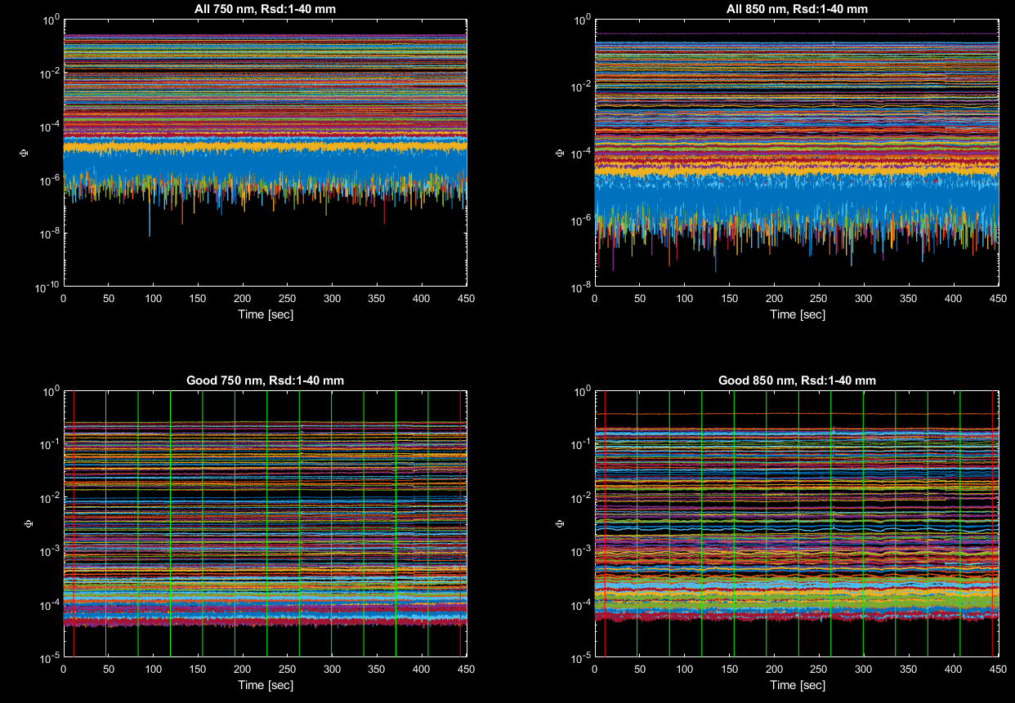
Raw Data Quality Assessment: Time Traces
DOT Acquisition
Plot_RawData_Time_Traces_Overview(data,info);
The left panels show data at 750 nm and the right panels show data at 850 nm.
The top panels show all measurements and the bottom panels measurements with standard deviation below a set threshold
The y-axis on all is log scale to highlight the range of light levels for the set of source-detector distances.
Vertical lines on the bottom row of plots signify time points where something happened in the stimulus paradigm.

Slide 8
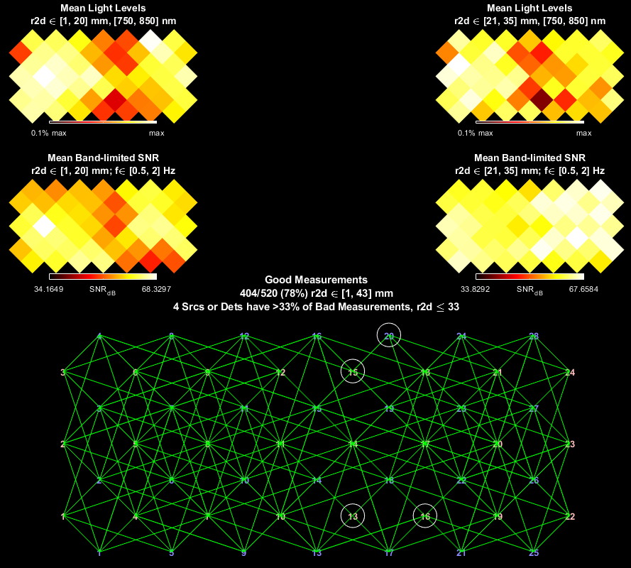
Raw Data Quality Assessment: Cap-relevant views
DOT Acquisition
Plot_RawData_Cap_DQC(data,info);
Top row shows average light levels for short-distance (left) and medium-distance (right) measurements. Good coupling across the entire cap results in mostly white and yellow in these figures.
Middle row show signal-to-noise ratio (SNR) for cardiac pulse band of frequencies.
Bottom edge plot shows measurements that satisfy the criteria. Optodes that have multiple ‘bad’ measurements are identified with large circles.

Slide 9
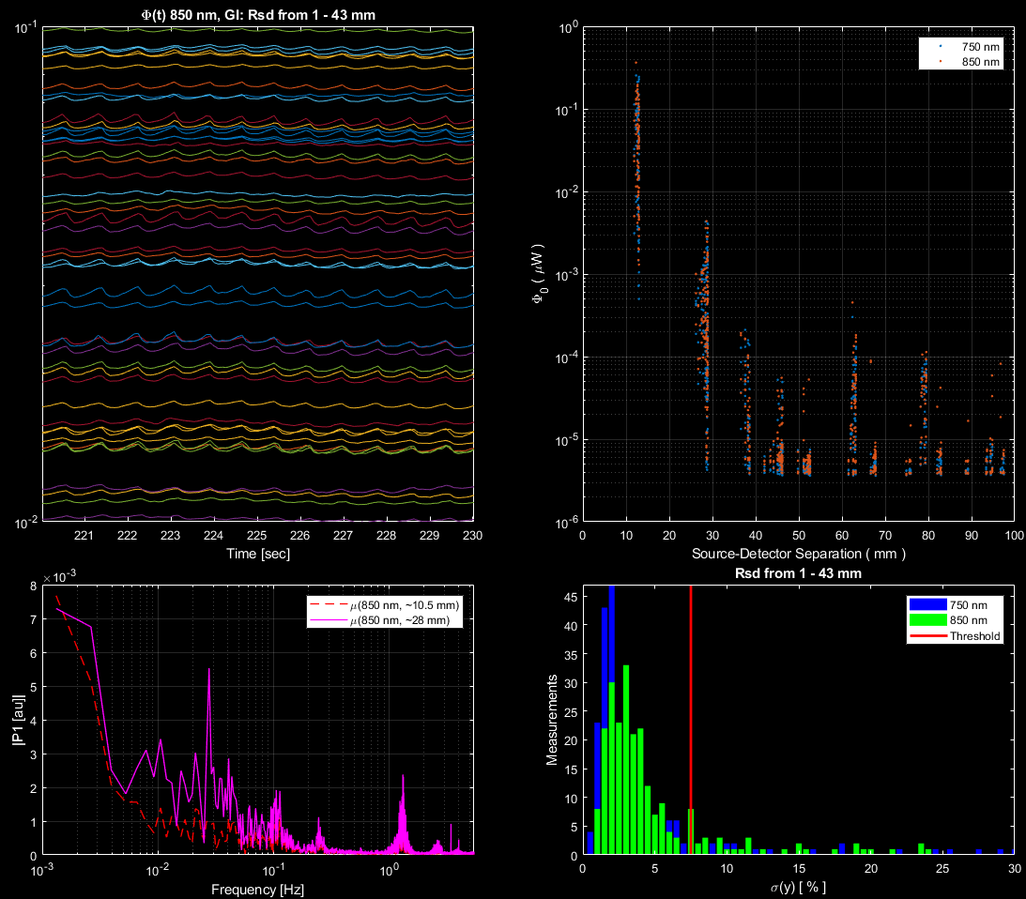
Raw Data Quality Assessment: The signal and the noise
DOT Acquisition
Plot_RawData_Metrics_I_DQC(data,info)
(Upper left) A zoomed-in view of several signals shows the presence of cardiac pulse at approximately 1 Hz.
(Lower left) Spectral measures averaged over several time traces show strong peaks at ~1Hz (cardiac pulse) and approximately 1/26 Hz (the stimulus frequency).
(Upper right) Light level (log) vs. source-detector distance shows expected falloff, with cross-talk at distances > 45 mm.
(Lower right) Histogram of signal % standard deviation shows several measurements below ‘good measurement’ threshold of 7.5%.

Slide 10
Pre-processing
DOT Acquisition
Pre-processing generally follows the pipeline on the right, as shown below:
lmdata = logmean(data); % Logmean Light Levels
info = FindGoodMeas(lmdata, info, 0.075); % Detect Noisy Channels
lmdata = detrend_tts(lmdata); % Detrend Data
lmdata = highpass(lmdata, .02, info.system.framerate); % High Pass Filter
lmdata = lowpass(lmdata, 1, info.system.framerate); % Low Pass Filter 1
hem = gethem(lmdata, info); % Superficial Signal Regression
[lmdata, ~] = regcorr(lmdata, info, hem);
lmdata = lowpass(lmdata, 0.5, info.system.framerate); % Low Pass Filter 2
[lmdata, info] = resample_tts(lmdata, info, 1, 1e-5); % 1 Hz Resampling
Subsequent plots and images show differential measurements, computed as the logarithm of the ratio of each signal and its temporal average
For a more in-depth exploration of pre-processing parameter settings, please see the Tutorial on Pre-processing.
Log-mean
Detect noisy channels
Band-pass filter
Superficial signal regression
Low-pass filter
Resample

Slide 11
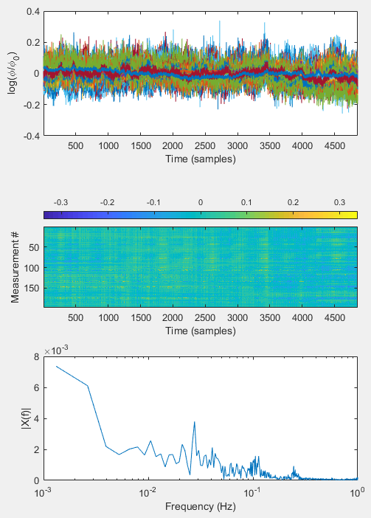
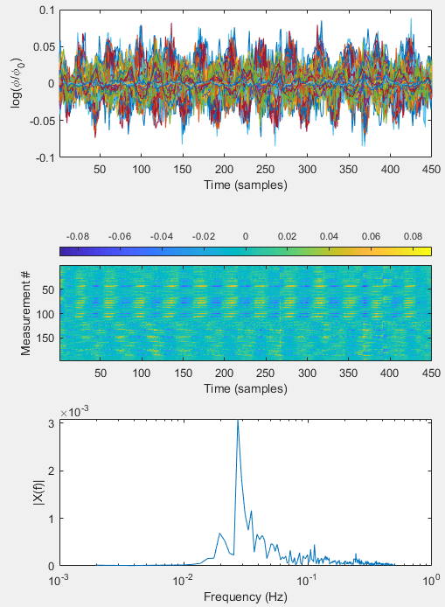
View effects of Pre-processing
%% View pre-processed data
keep = info.pairs.WL==2 & …
info.pairs.r2d < 40 & info.MEAS.GI;
figure('Position',[100 100 550 780])
subplot(3,1,1);
plot(lmdata(keep,:)');
set(gca,'XLimSpec','tight'), …
xlabel('Time (samples)'), …
ylabel('log(\phi/\phi_0)')
m=max(max(abs(lmdata(keep,:))));
subplot(3,1,2);
imagesc(lmdata(keep,:),[-1,1].*m);
colorbar('Location','northoutside');
xlabel('Time (samples)');
ylabel('Measurement #')
[ftmag,ftdomain] = fft_tts(…
squeeze(mean(lmdata(keep,:),1))…
,info.system.framerate); subplot(3,1,3);
semilogx(ftdomain,ftmag);
xlabel('Frequency (Hz)');
ylabel('|X(f)|');
xlim([1e-3 1])
Before
After

Slide 12
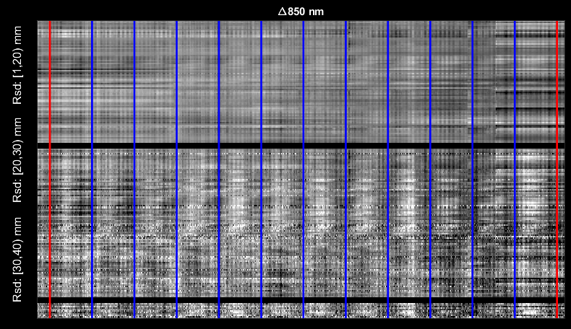
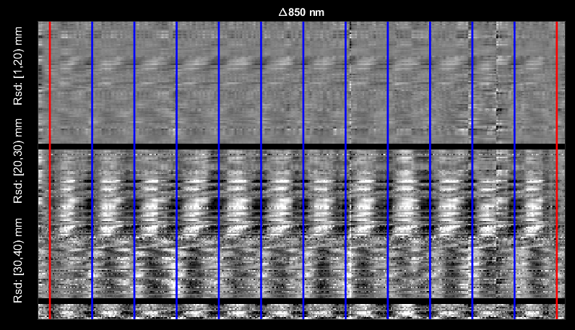
View effects of Pre-processing Gray plots
nlrGrayPlots_180818(lmdata,info); % Gray Plot with synch points
Before
After

Slide 13
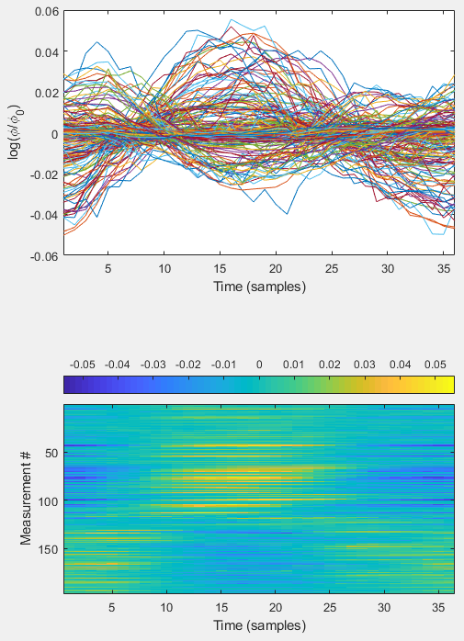
View effects of Pre-processing Block averaging
%% Block Averaging the measurement data and view
badata = BlockAverage(lmdata, info.paradigm.synchpts(info.paradigm.Pulse_2), dt);
badata=bsxfun(@minus,badata,mean(badata,2));
figure('Position',[100 100 550 780])
subplot(2,1,1);
plot(badata(keep,:)');
set(gca,'XLimSpec','tight'),…
xlabel('Time (samples)'), …
ylabel('log(\phi/\phi_0)')
m=max(max(abs(badata(keep,:))));
subplot(2,1,2);
imagesc(badata(keep,:),[-1,1].*m);
colorbar('Location','northoutside');
xlabel('Time (samples)');
ylabel('Measurement #')

Slide 14
Reconstruction & Spectroscopy
DOT Acquisition
Absorption image volumes are reconstructed from the measurements based on a regularized inversion of the A matrix (for details, see, e.g., Eggebrecht et al., Neuroimage, 2012)
%% Reconstruct absorption, each wavelength
if ~exist('A', 'var')
load('A_AdultV24x28.mat') % Contains A-matrix, info.
end
for j = 1:2 % each wavelength
keep = (info.pairs.WL == j) & (info.pairs.r2d <= 40) & info.MEAS.GI;
% Invert A-Matrix
iA = Tikhonov_invert_Amat(A(keep, :), 0.01, 0.1);
% Smooth Inverted A-Matrix
iA_smoothed = smooth_Amat(iA, dim, 5);
% Reconstruct Image Volume
cortex_mu_a(:, :, j) = reconstruct_img(preprocessed(keep, :), iA_smoothed);
end
Image volumes store estimated absorption values as voxels by time by wavelength.
Hemoglobin images are computed from the wavelength-dependent absorption images
%% Spectroscopy, convert to Hb
load('E.mat')
cortex_Hb = spectroscopy_img(cortex_mu_a, E);
cortex_HbO = cortex_Hb(:, :, 1);
cortex_HbR = cortex_Hb(:, :, 2);
cortex_HbT = cortex_HbO + cortex_HbR;
Log-mean
Detect noisy channels
Band-pass filter
Superficial signal regression
Low-pass filter
Resample
Light
Model
Reconstruction
Spectroscopy

Slide 15
Spatial normalization
DOT Acquisition
The cortex_HbO data is in an array that is voxels by time where the voxels are within a subspace described by info.tissue.dim which itself is a subspace of the original anatomical volume used to generate the light model.
To properly contextualize the reconstructed data, it is helpful to view on an appropriate anatomical background.
The following will load in the anatomical data used for the light model and spatially register it to the reconstructed optical data.
[MNI,infoB]=LoadVolumetricData('Segmented_MNI152nl_on_MNI111',[],'4dfp');
MNI_dim = affine3d_img(MNI,infoB,A.info.tissue.dim,eye(4),'nearest');
We are using nearest-neighbor interpolation here because we are transforming a mask, so we do not want the values to change.
To move DOT data to the atlas, simply:
HbO_T1 = affine3d_img(cortex_HbO, A.info.tissue.dim, infoB, eye(4));
Log-mean
Detect noisy channels
Band-pass filter
Superficial signal regression
Low-pass filter
Resample
Light
Model
Reconstruction
Spectroscopy
Spatial normalization

Slide 16
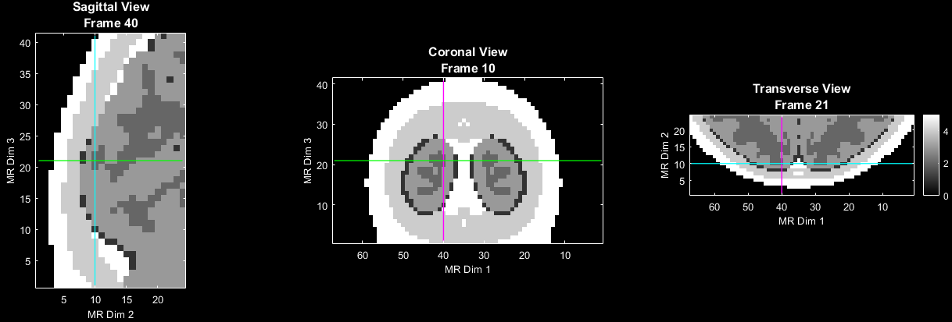
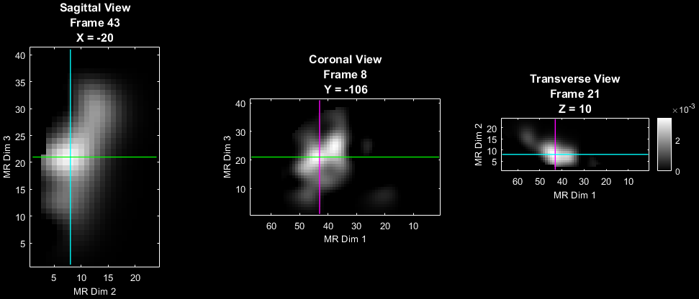
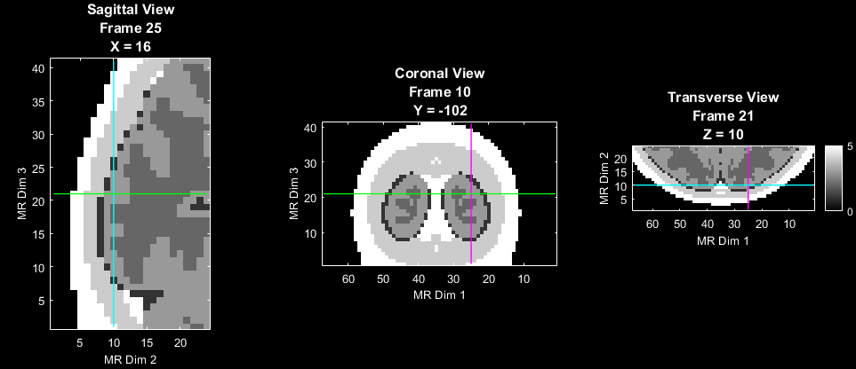
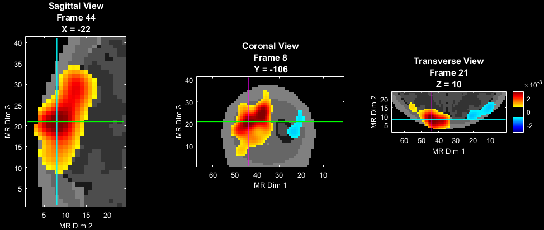
Visualization of Reconstructed Volumetric Images
To get a sense of how to visualize the volumetric data try first with the anatomical volume. Note that PlotSlices defaults to an interactive mode. Click in any view plane to browse the reconstructed volume.
PlotSlices(MNI_dim)
PlotSlices(MNI_dim,A.info.tissue.dim)
Now, block average the HbO data, put it in the full voxel space, and visualize.
badata_HbO = BlockAverage(cortex_HbO,… info.paradigm.synchpts(info.paradigm.Pulse_2), dt);
badata_HbO=bsxfun(@minus,badata_HbO,badata_HbO(:,1));
badata_HbOvol = Good_Vox2vol(badata_HbO,A.info.tissue.dim);
tp_Eg=squeeze(badata_HbOvol(:,:,:,tp));
PlotSlices(tp_Eg,A.info.tissue.dim); % data by itself
PlotSlices(MNI_dim,A.info.tissue.dim,[],tp_Eg); % data with anatomical underlay

Slide 17
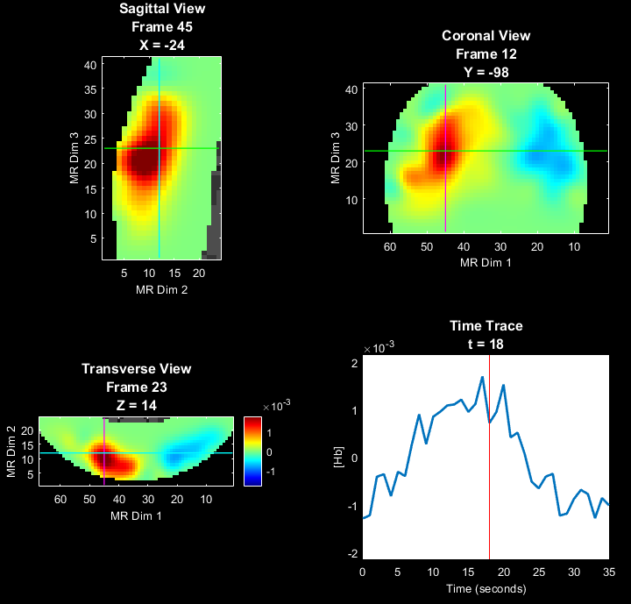
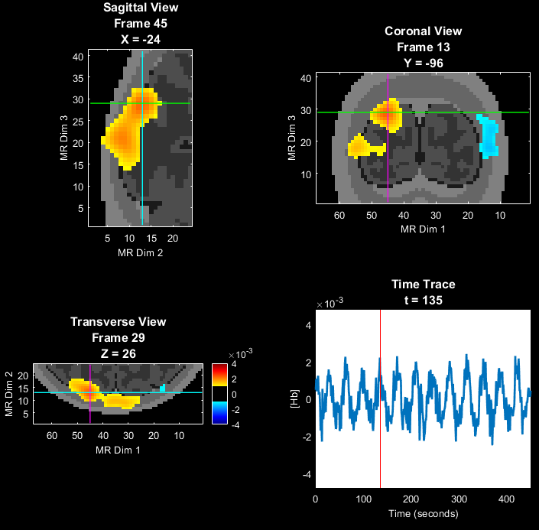
Visualization with Voxel Time Trace
Adding the time trace at the selected location further aids interpretation
% Explore the data a bit more interactively
Params.Scale=0.8*max(abs(badata_HbOvol(:)));
Params.Th.P=0;
Params.Th.N=-Params.Th.P;
PlotSlicesTimeTrace(MNI_dim,A.info.tissue.dim,Params,badata_HbOvol,info)
In this data set, regions within the visual cortex show varying time to peak response, corresponding to the varied position of the rotating checkerboard wedge.
These data are block-averaged, which reduces variance in the reconstructed signals. Visualizing the un-averaged data (next) can help in interpretation.
% Explore the not-block-averaged data a bit more interactively
HbOvol = Good_Vox2vol(cortex_HbO,A.info.tissue.dim);
Params.Scale=2e-3;
Params.Th.P=1e-3;
Params.Th.N=-Params.Th.P;
PlotSlicesTimeTrace(MNI_dim,A.info.tissue.dim,Params,HbOvol,info)

Slide 18
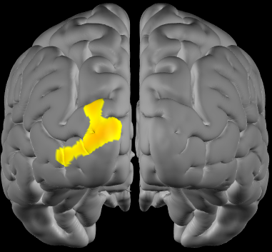
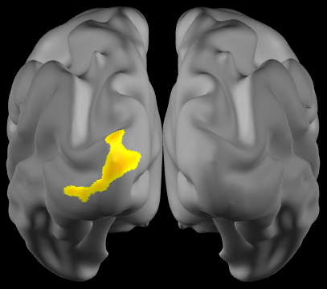
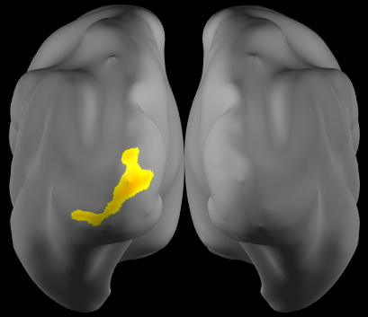
Visualization of reconstructed data on a surface model of the cortex
%% Select Surface visualizations
if ~exist('MNIl', 'var'),load(['MNI164k_big.mat']);end
HbO_atlas = affine3d_img(badata_HbOvol,A.info.tissue.dim,infoB,eye(4));
tp_Eg_atlas=squeeze(HbO_atlas(:,:,:,tp));
pS=Params;
pS.view='post';
pS.ctx='std'; % Standard pial cortical view
PlotInterpSurfMesh(tp_Eg_atlas, MNIl,MNIr, infoB, pS);
pS.ctx='inf'; % Inflated pial cortical view
PlotInterpSurfMesh(tp_Eg_atlas, MNIl,MNIr, infoB, pS);
pS.ctx='vinf';% Very Inflated pial cortical view
PlotInterpSurfMesh(tp_Eg_atlas, MNIl,MNIr, infoB, pS);

Slide 19
That’s It (For Now)
Congratulations! You have finished the NeuroDOT Tutorial for the full processing of CCW data acquired with the 24x28 visual pad.
See other Sample Results Appendices for example visualizations of these same processing steps on the other Sample Data included in the toolbox.
Also, see the PreProcessing and Reconstruction tutorials to gain a deeper understanding of the effects of altering the processing parameters.
For further questions or more information, please consult the NeuroDOT User Manual and the various Appendices.
NeuroDOT Team:
Adam Eggebrecht (aeggebre@wustl.edu)
Jason Trobaugh (jasont@wustl.edu)

