Slide 1

Redis
Presented by: Hadi Abou Daya Presented to: Dr Rima Kilany

Slide 2
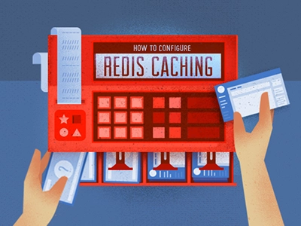
What is Redis?
Redis (or) Remote Dictionary Server is an open-source, in-memory data structure store, used as a distributed, in-memory key-value database, cache, and message broker, with optional durability. Redis supports different kinds of abstract data structures, such as strings, lists, maps, sets, sorted sets, HyperLogLogs, bitmaps, streams, and spatial indexes.

Slide 3
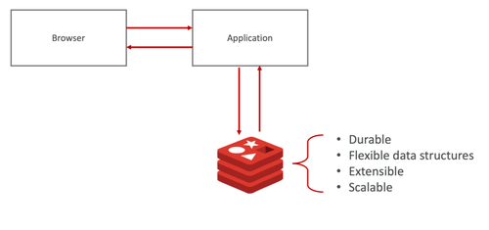
What is Redis?
Redis began as a caching database, but it’s evolved to a primary database. Many applications built today use Redis as a primary database. You can eliminate complexity and latency by using Redis Enterprise as both a caching system and a primary database.

Slide 4
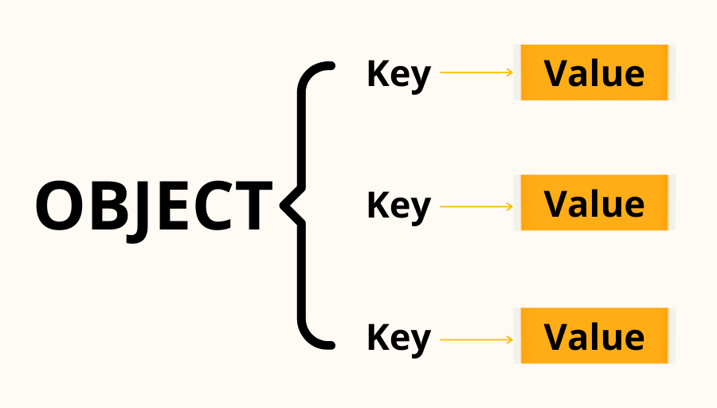
key-value pair

Slide 5
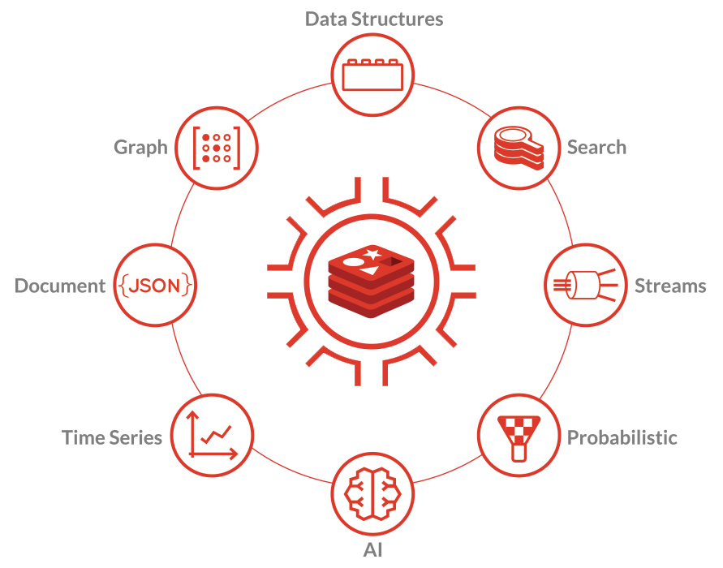

Slide 6
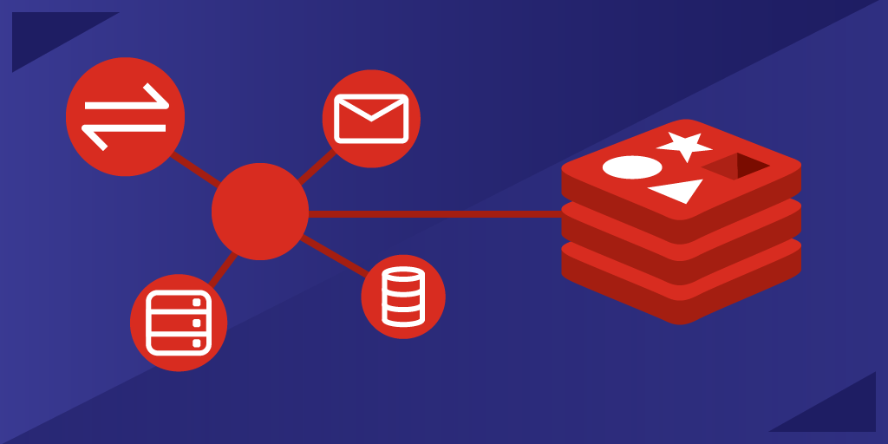

Slide 7
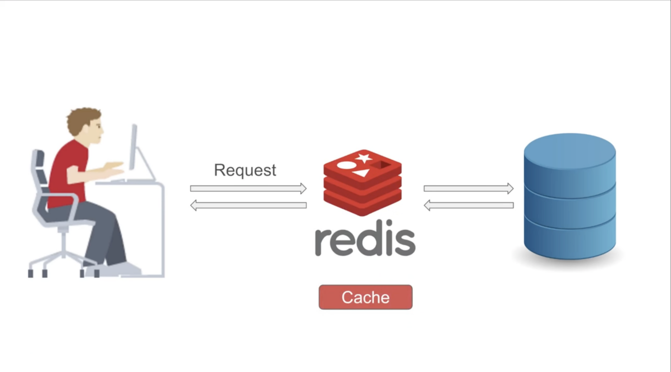
Redis Caching
Redis is ideal for creating a high-performance in-memory cache to reduce data access latency and boost throughput. They can answer in milliseconds, which is really quick, and it also allows you to scale for bigger loads without having to spend a lot of money on the backend.

Slide 8
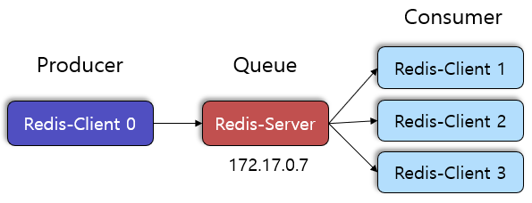
Redis Messaging and Queue
With pattern matching and a range of data formats, Redis also offers Pub/Sub (Publish and Subscribe). Redis can now support high-performance messaging, chat rooms and server-to-server communication.

Slide 9
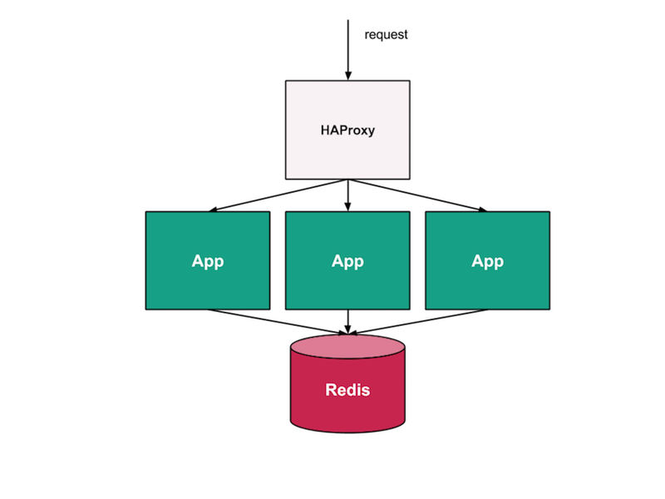
Redis Session Store
Redis is the best solution for internet-scale applications as it supports in-memory. It delivers the sub-millisecond latency, scale, and resiliency needed to manage session data such as session status, credentials ...

Slide 10

Redis Real-Time Analytics
Redis is ideal for real-time analytics such as social media analytics, ad targeting, customization, Artificial Intelligence-based applications, Cyber Security, and more since it manages data with sub-millisecond latency.

Slide 11
About this template
Ways Redis Is Used
In front of a DB
Redis stores data that you need to access a lot, or data that takes a long time to compute. And since the memory is already loaded, it takes milliseconds to access the data instead of hundreds of milliseconds.
Redis will be sitting in front of other databases such as MongoDB.
As a standalone DB
With Redis Enterprise, you can use Redis as both an in-memory cache and a primary database in a single system, thus eliminating the complexity and latency of two separate systems. Not only that, you can use it as a multi-model primary database, enabling you to build modern applications, as well as low-latency microservice-based architectures, all on top of Redis.

Slide 12
Installing Redis to you local machine:
Installing redis on mac and linux only takes a single simple command: Linux: sudo apt-get install redis
Mac: brew install redis
For windows users, you need the windows subsystem for Linux to install Redis because it cannot be done on windows directly.

Slide 13
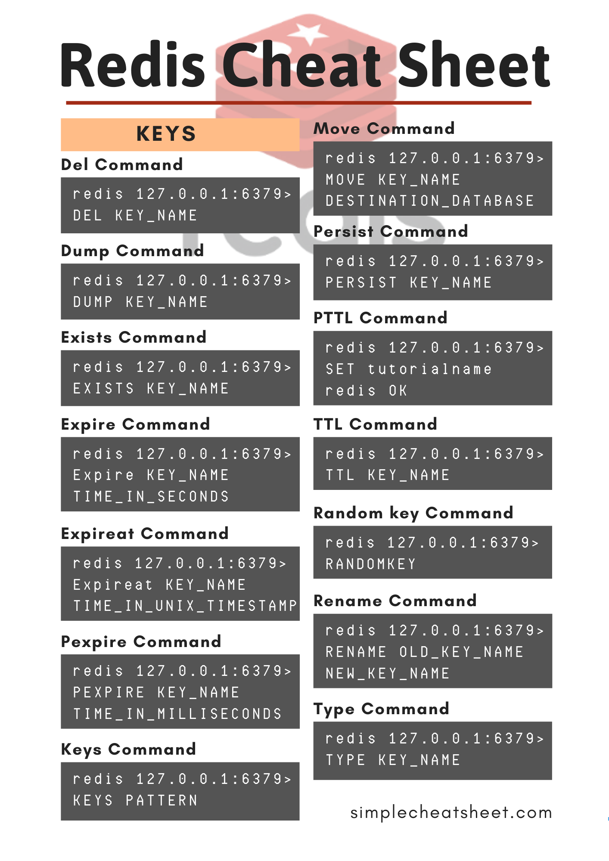
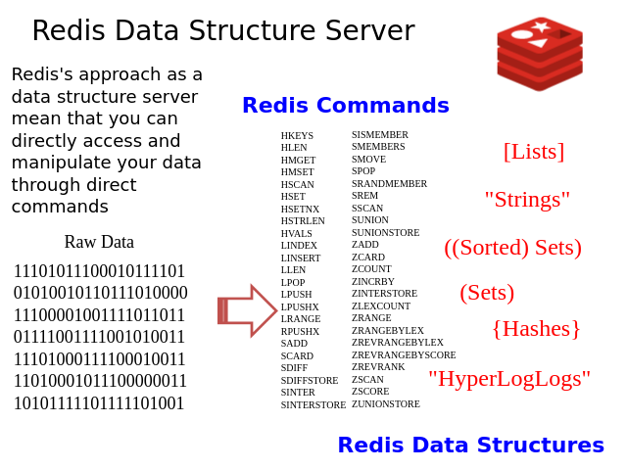
Redis commands

Slide 14
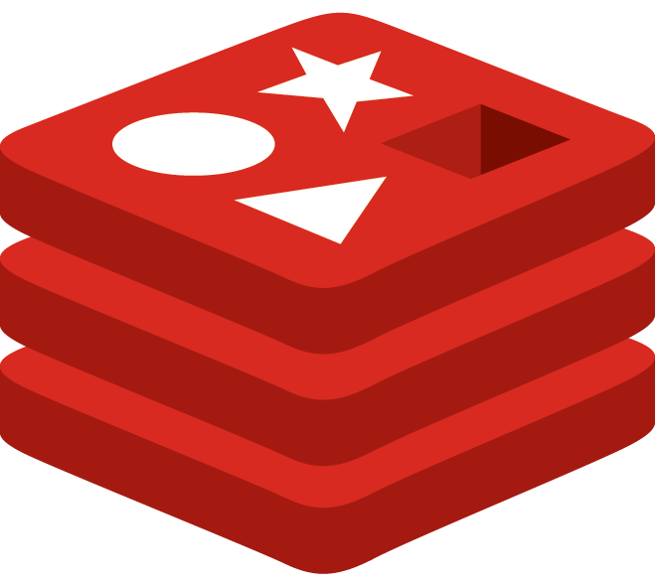
Redis Project
Build a web app based on a RedisJSON DB

Slide 15
Thanks!
ANY QUESTIONS?
You can find me at:
www.linkedin.com/in/hadiad
hadi.aboudaya@hotmail.com

