Slide 1

QR Code Based Entrance Gate System
PRESENTER: ZAEMAH BINTI AHMAD
SUPERVISOR: DR. MUSA BIN MOHD MOKJI
PROGRAMME: 4SKEL

Slide 2
INTRODUCTION
QR code are widely used
Can store large number of data
Target user : Entrance of residential area

Slide 3
INTRODUCTION
*Survey done by observing residential area around Skudai and Pulai
Notes:
-it can be said that at any of the residential in Malaysia especially at town is like this (not only skudai and pulai)

Slide 4
PROBLEM STATEMENT
“How to change the security system at a residence by changing it from manual security to automatic system that make it more practical and secured”

Slide 5
OBJECTIVES
To automate entrance gate system
To apply QR code as an easy and secured access for owner of the residence and guest
To develop a secured system for entrance gate system
Notes:
Jawab balik objective:
2. QR code as tools-QR code more effective and easy to generate
3. The system is more secure which residence can generate QR code to the person they want to invite so no simply person can enter the residence

Slide 6
SCOPES OF WORK
By invitation pass
Special pass
Solve for relatives and friends type of guest only
Relatives and friends
Business
Authority (Police, Fire Fighter)
Services (Postman, district council)
Notes:
Type of guest can be classified into:
-relatives & friends
-business (delivery of something that you buy, gas man, plumber)
-authority
-services
Therefore, the scope of this project is just solve for relatives and friends only.
Counter balik jawapan:
-special pass because they may come when special cases (authority) and for services they come for a fixed time

Slide 7
SCOPES OF WORK
Limited for web base only but can be access in any type of gadget that can browse through internet
Provide a file of recorded data consists of (name, NRIC, plate number, phone number, address and date)

Slide 8
LITERATURE REVIEW/RELATED WORK
No. | Title | Description | Reference
1. | Modern Applications of QR-Code for security | -QR code conveys information by the arrangement of its dark & light elements called “modules” in columns & rows -Can hold large amount of data in a smaller space | http://ieeexplore.ieee.org/stamp/stamp.jsp?tp=&arnumber=7569235&tag=1
2. | Students Attendance System Using QR Code | -Proposed a student attendance system which reduced the burden of maintaining manual records and saved time -The system requires a simple login process by the class instructor through its Server Module to generate an encrypted QR Code with specific information | Fadi Masalha, Nael Hirzallah, “Students Attendance System Using QR Code”, Volume 5, Issue 3, International Journal of Advanced Computer Science and Applications, 2014, pp. 75-79.

Slide 9
3. | Secure Authentication for Online Banking Using QR Code | -Designed a QRP, a secure authentication system that uses a two factor authentication by combining a password and a camera equipped mobile phone | Sonawane Shamal, Khandave Monika, Nemade Neha,”Secure Authentication for Online Banking Using QR Code”, Volume 4, Issue 3, International Journal of Emerging Technology and Advanced Engineering,march 2014,pp. 778- 781.
4. | Data Management and Prediction about Health Status to Support Health Care System Using QR Code | -Proposed an integrated system, developed for use by the healthcare personnel within hospitals, adapted to Smartphone's, tablets and handheld devices | Madhuri Chaudhari, Jyoti Dighe, Supriya Gadhave, Snehal Khairnar, Prof. Sonal Gore,”Data Management and Prediction about Health Status to Support Health Care System Using QR Code”, Volume 5, Issue 11, International Journal of Advanced Research in Computer Science and Software Engineering, November 2015,pp. 412-415

Slide 10



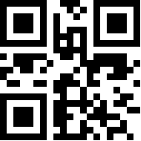
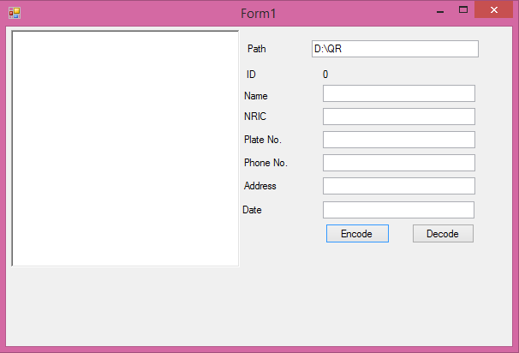
METHODOLOGY
Residence
Guest
System

Slide 11



METHODOLOGY
Guest
- Receive QR code
Resident
- Generate QR code by fill in invitation form provided
Notes:
Tak siap lagi ni dia suruh tambah ganti yang atas tu hahaha

Slide 12
methodology
Add in apa yang guna untuk generate qr code how to code, library semua

Slide 13
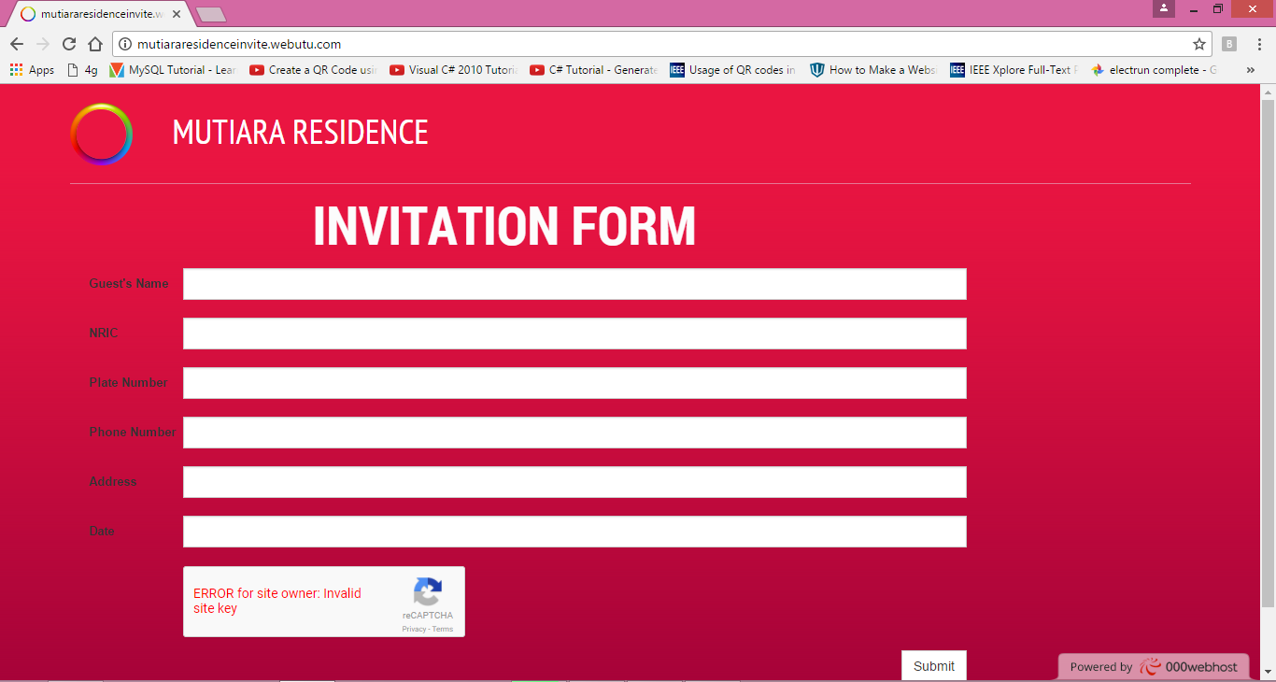
RESULTS & DISCUSSION
Website page: http://mutiararesidenceinvite.webutu.com/

Slide 14
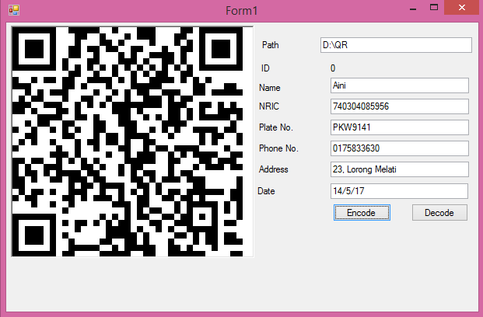
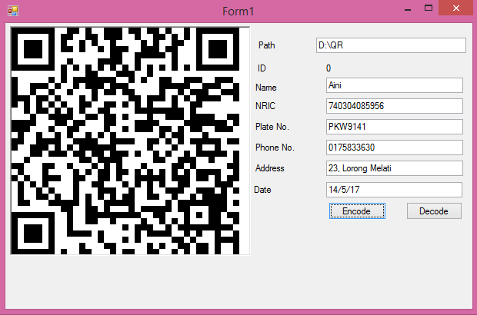
RESULTS & DISCUSSION
Encoded QR code

Slide 15
CONCLUSION
QR code can be automatic that can be practical and secured method to access a residential area for visitors
Future works:
provide an apps to easily enter the data
provide proper server for better implementation
add in plate recognition and visitor’s face recognition

Slide 16
Q&A SESSION
-THANK YOU-

