Slide 1

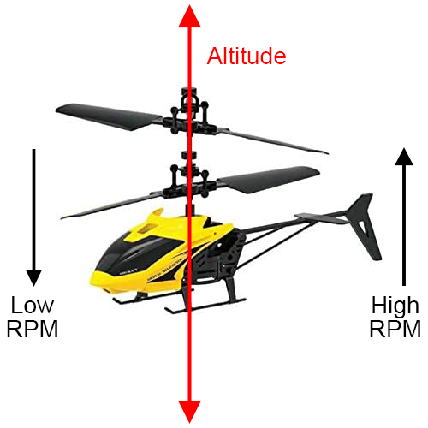
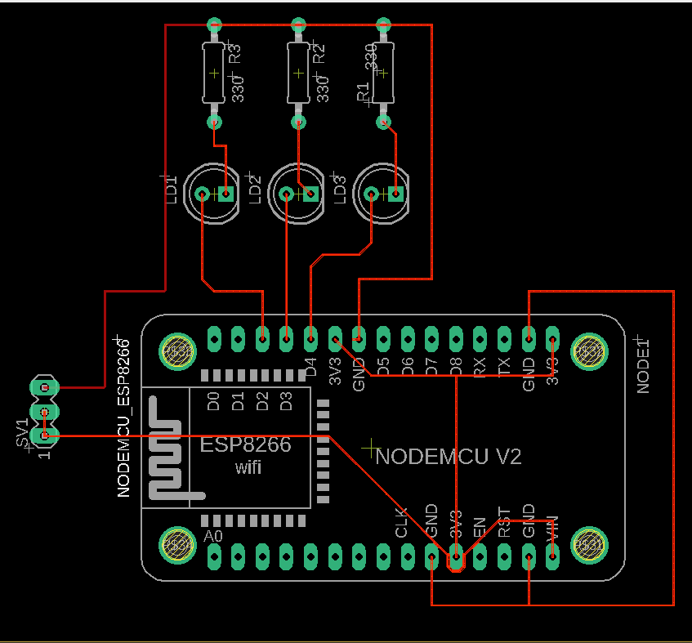
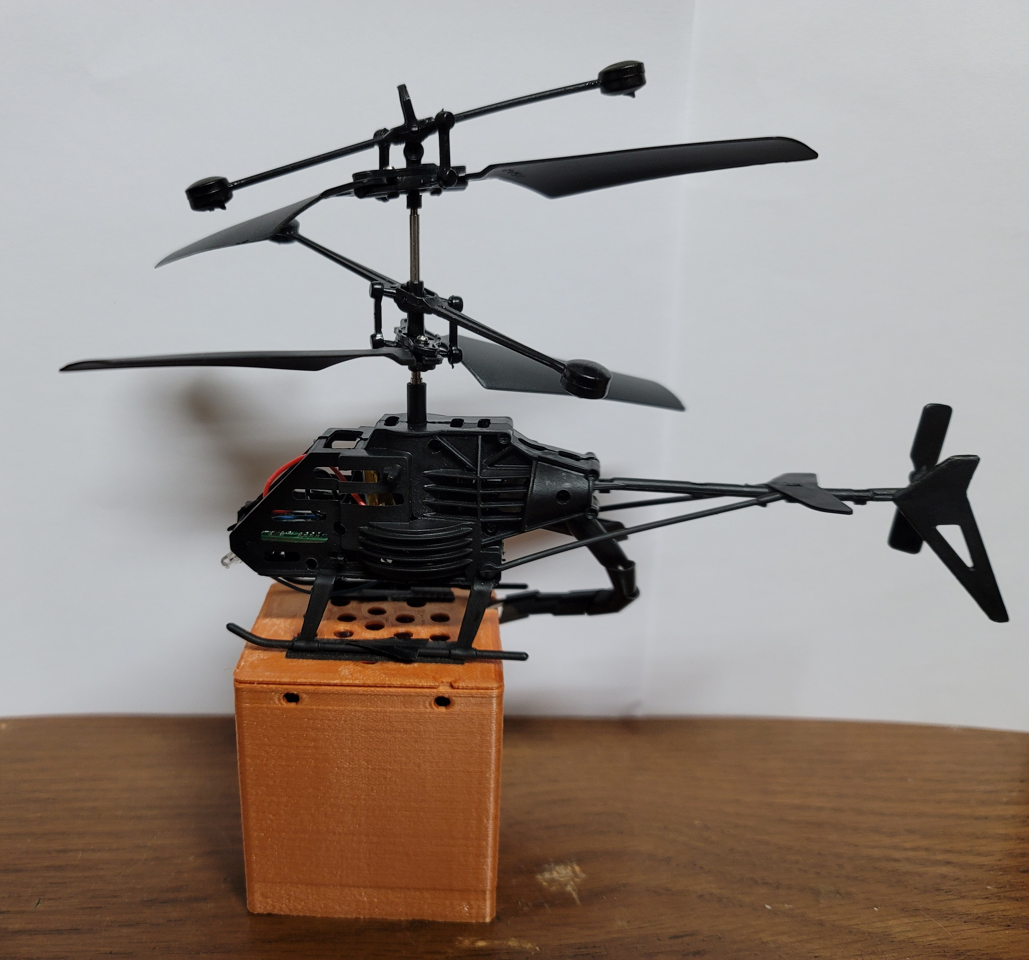
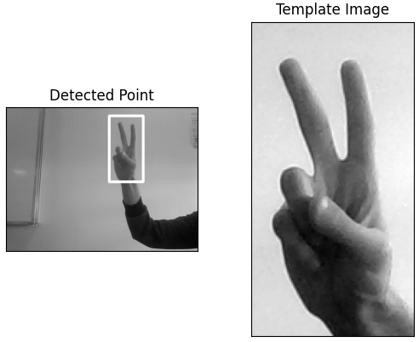
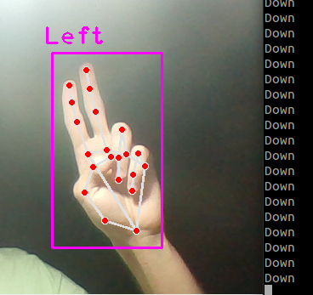
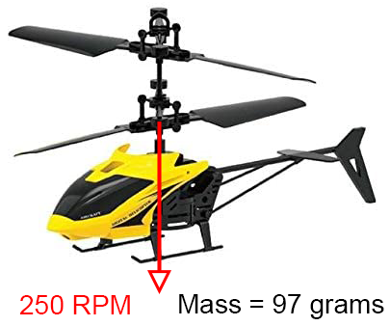
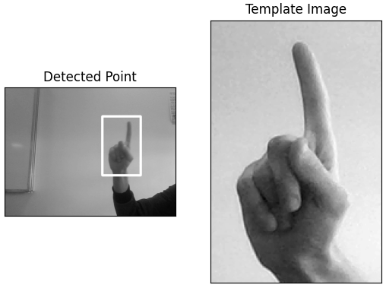
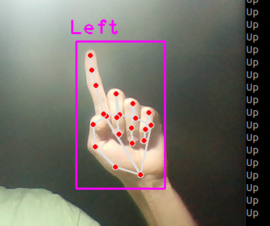
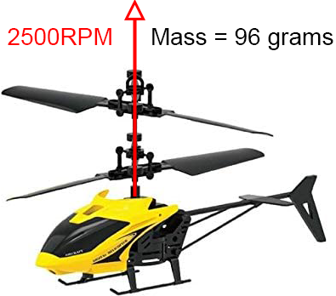
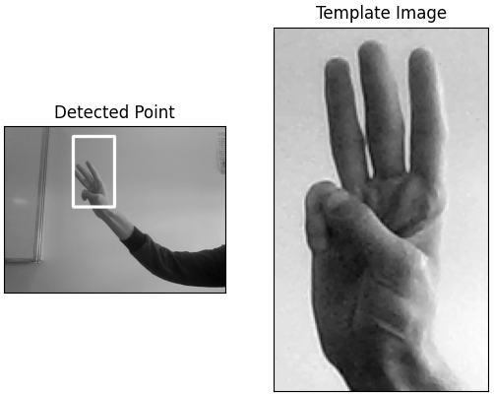
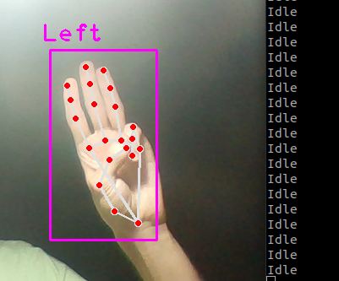
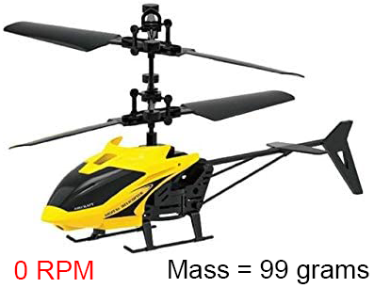


Sensors
Engineering and
Technology
Mechatronics Engineering
ELCT 903
9th
Semester
Material Sciences
Hand Control Altitude for RC Drone based on Hand Gestures
Made by: Ahmed Fathy 46-7647, Ahmed Shaban 46-18402, David Eskounddos 46-7725, Hadi Elnemr 46-6804, Mohammed Ashraf 46-13903
OBJECTIVE
Aerial drones are increasing in popularity and are used in numerous applications such as aerial photography, mapping, agriculture, and more. Drones are mostly controlled by a remote controller, which sends control signals to the drone. However, this is not ideal, and a more direct line of communication is required. This leads us to our objective, which is to wirelessly control a drone's altitude using a set of defined hand gestures.
METHODOLOGY
To implement the objective, a webcam was used alongside image processing techniques to identify different hand gestures and control the motor RPM accordingly. After identifying the gesture, a PWM signal is sent to the drone’s motor wirelessly from the controller to the drone using an ESP8266 board. This allows the generation of an infinite number of gestures that control the drone in various ways.
ANALYTICAL WORK
Figure 1: Objective for the drone’s altitude control
EXPERIMENTAL WORK
The image processing code was developed using CVZone, a computer vision package in Python. The webcam of a Lenovo Thinkpad E570 of 1080p resolution with a bandwidth of 200 Mbit/sec was used to capture the gestures at 30 frames per second and feed them to our code, which can then identify the hand gesture and send the appropriate signal to the drone motor’s driver. To assemble the electronic components, a PCB is designed, as shown in Figure 2, to host the ESP8266 module and output the required signals when prompted.
The transfer function maps our output signal from the motor driver to the input image as follows:
$$TF= \frac{Output signal}{Input image}= \frac{UDP WiFi message transmit}{Input image}×\frac{Output signal}{UDP WiFi message receive}$$
Subsequently, cross correlation was carried out to measure the similarity between the images using the following function:
$$R\left(x,y\right)= \frac{\sum_{x^{′},y^{′}}{\left(T\left(x^{′},y^{′}\right)\right).I(x+x^{′},y+y^{′})}}{\sqrt{\sum_{x^{′},y^{′}}{{T\left(x^{′},y^{′}\right)}^{2}}.\sum_{x^{′},y^{′}}{{I(x+x^{′},y+y^{′})}^{2}}} }$$
where I stands for image, T stands for template, and R stands for result. Here, x and y denote the position of the top-left point on the image. The mean cross correlation value for our samples reached 0.9838 with a standard deviation of 0.0095, proving that our gestures can be easily detected in a repeatable manner.
Figure 2: PCB Design
Figure 3: Finalized hardware
RESULTS and CONCLUSIONS
Three hand gestures were developed to control the altitude of our drone: the first gesture runs the drone at maximum RPM (100% duty cycle) to lift it, the second reduces the motor RPM (10% duty cycle) so that it can slowly descend, and the last one turns the motor off completely.
This prototype achieves our objective to an extent; however, there are some things that can be improved. Using better drone hardware with more degrees of freedom as well as an IMU to transmit the drone's position and orientation, we can extend our gesture set to control roll, pitch, and yaw, as well as the position in 3D space.
Figure 4: Developed hand gestures, their respective signal outputs and the drone’s response
Supervised by:
Assoc. Prof. Dr. Eng. Amir Roushdy,
Eng. Nouran Adel, Eng. Loaie Amgad, Eng. Aya ElNahas, Eng. Esraa Mahmoud.
www.ARAtronics.com

