Slide 1


Musicly Application Overview
Ali Al-Hadi Tarraf - 24766736
Sami Kudsi - 24077792
Simon Nansae Hagemann – 77396532
Arash Rahmani – 26819056
Rafael de Athayde Moraes - 59752266

Slide 2
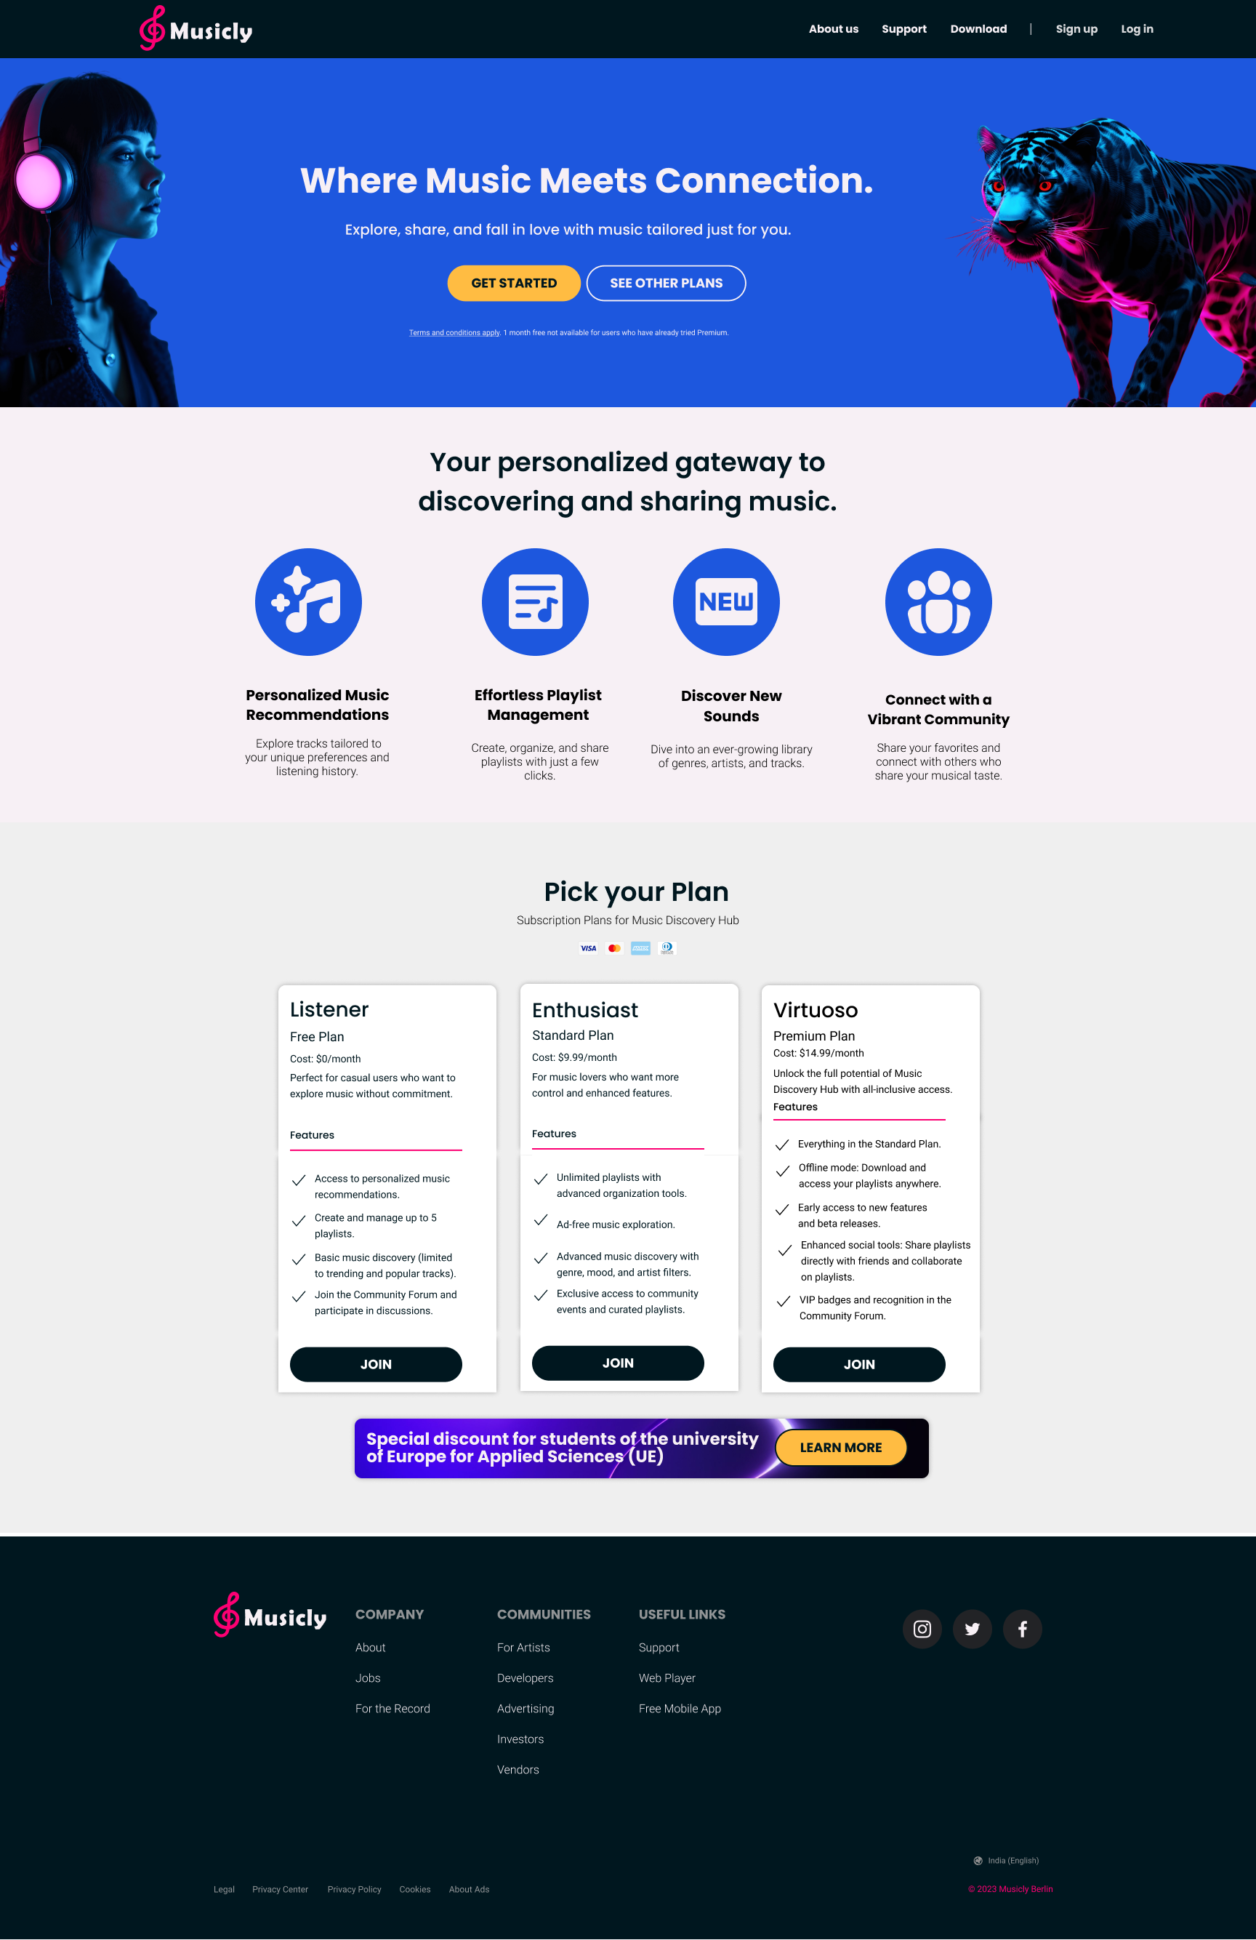




Introduction to Musicly What is Musicly?
2
Musicly is an innovative platform designed for music lovers to discover and enjoy music in a personalized way.
It provides a seamless experience combining intelligent recommendations, playlist management, and a vibrant social community.
Whether you're a casual listener or a music enthusiast, Musicly has something for everyone.

Slide 3
Key Features
3
Discover New Tracks
Effortless Playlist Management
Connect with a Vibrant Community
Personalized Music Recommendations
Flexible Subscription Plans

Slide 4
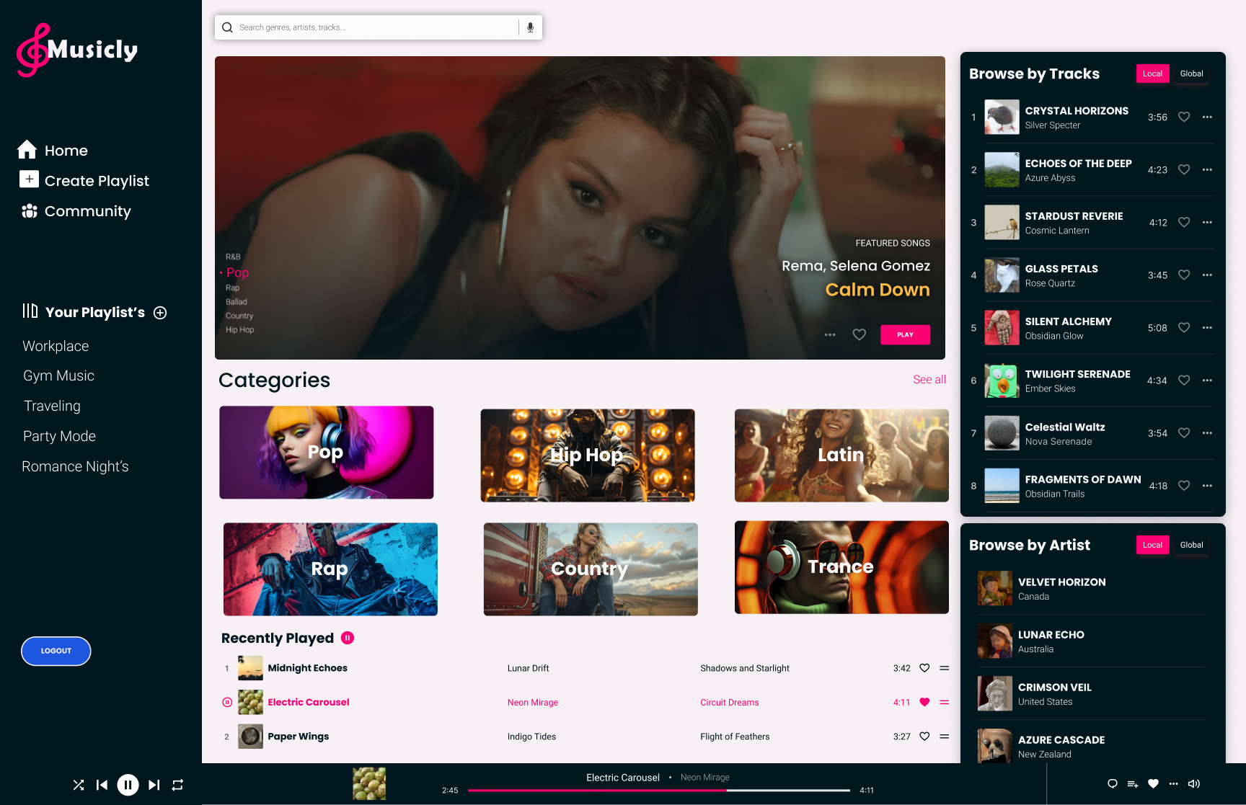
Why This Design?
4
User-Centric Approach
Modern Aesthetic
Seamless Navigation
Emotionally Engaging Visuals
"Our design philosophy ensures the user feels connected to music, both functionally and emotionally."

Slide 5
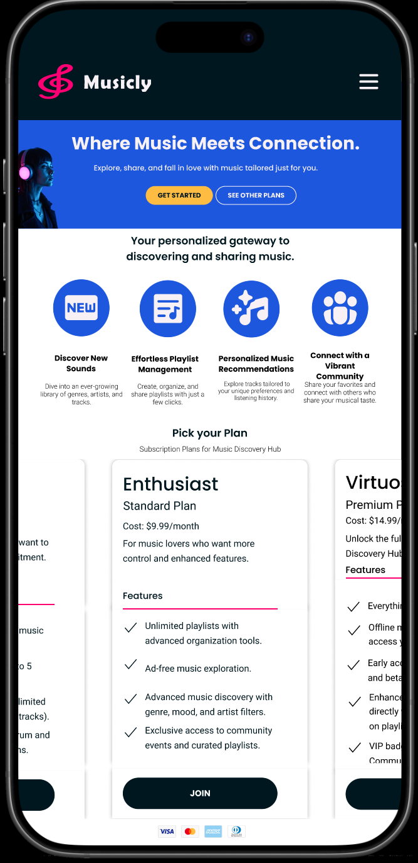
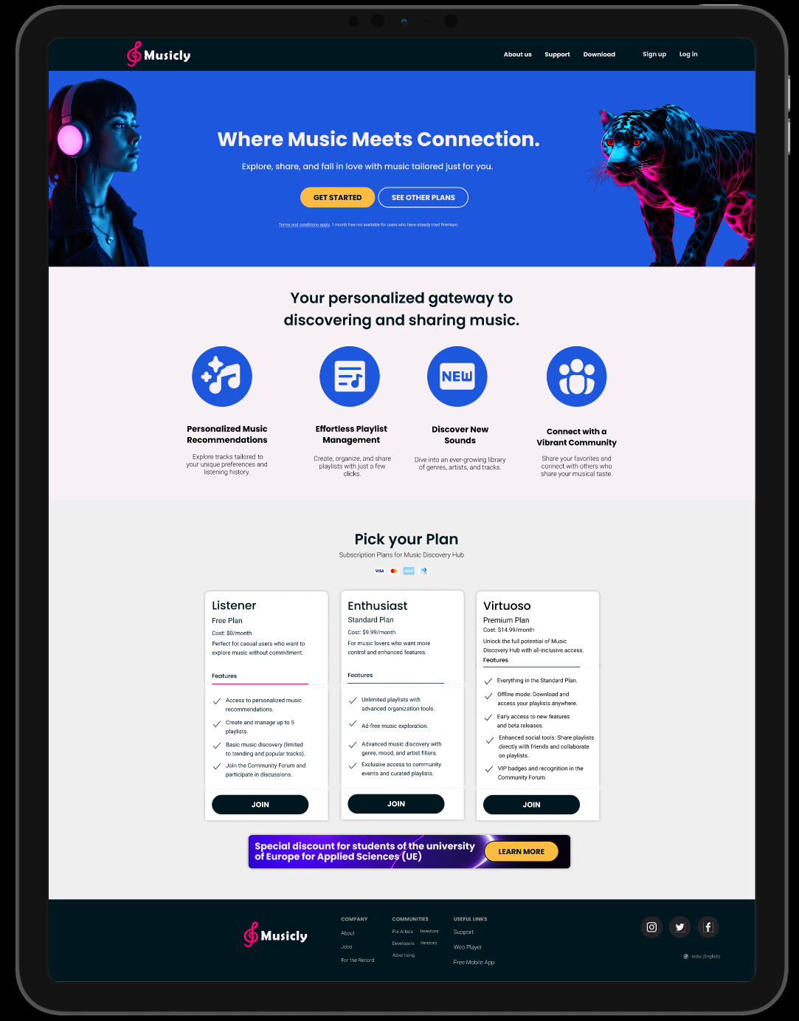
Design Decisions Specific Design Decisions
5
Homepage:
Engaging hero section that highlights the platform’s primary benefits: Discover, Share, Connect.

Slide 6
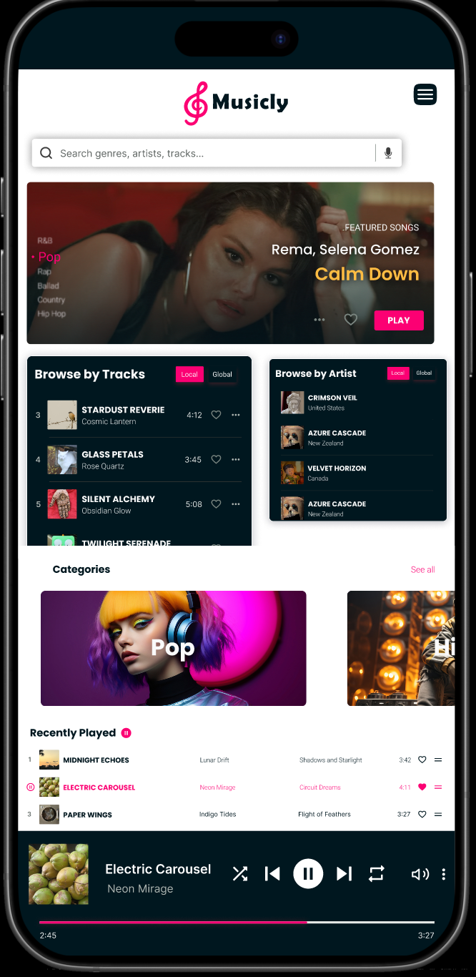
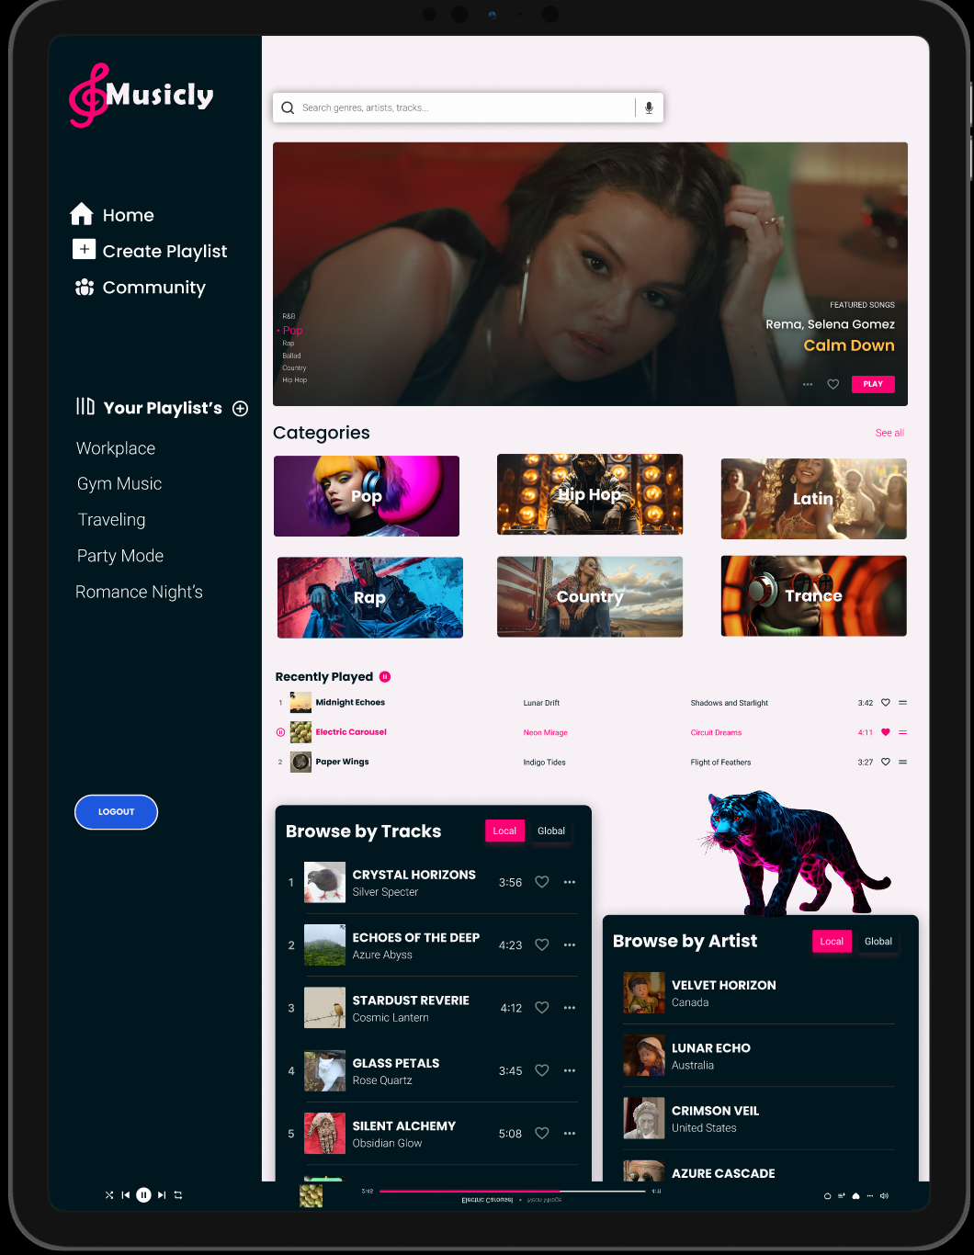
Design Decisions Specific Design Decisions
6
Client Dashboard:
Organized layout with categories and personalized recommendations.
Recently played tracks and categories placed prominently for quick access.

Slide 7
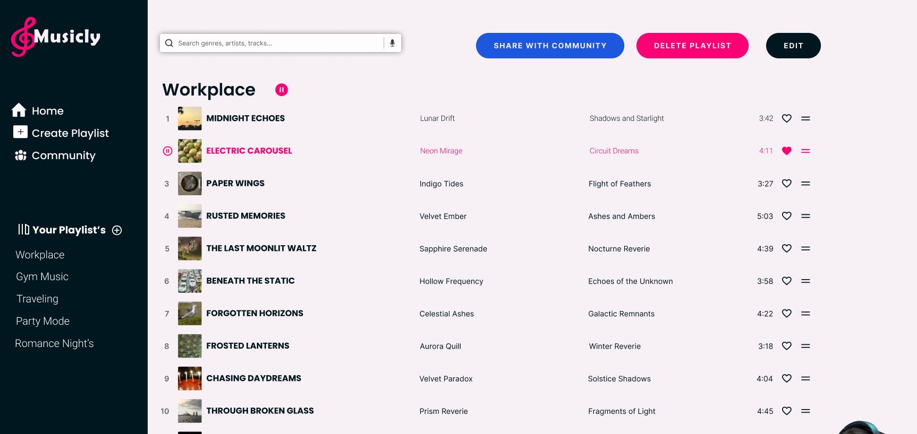
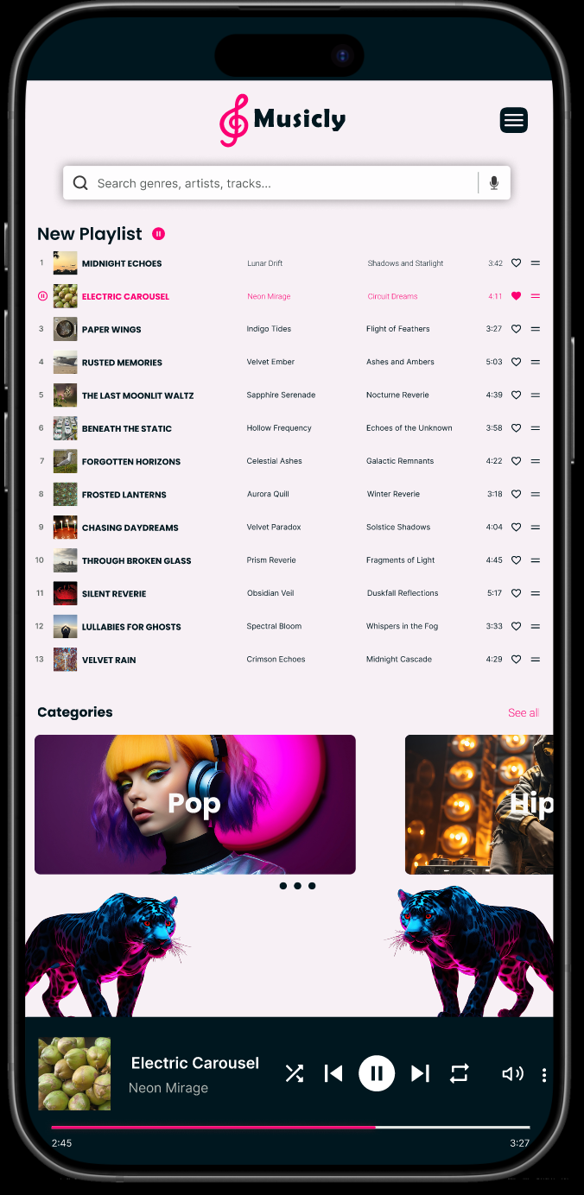
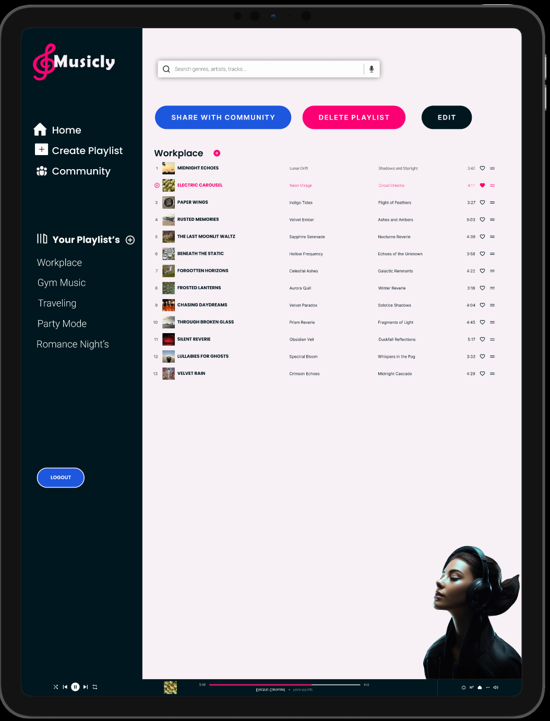
Design Decisions Specific Design Decisions
7
Playlist Page:
Simple playlist editing tools with options to share with the community.
User-friendly buttons for sharing, deleting, or editing playlists.

Slide 8
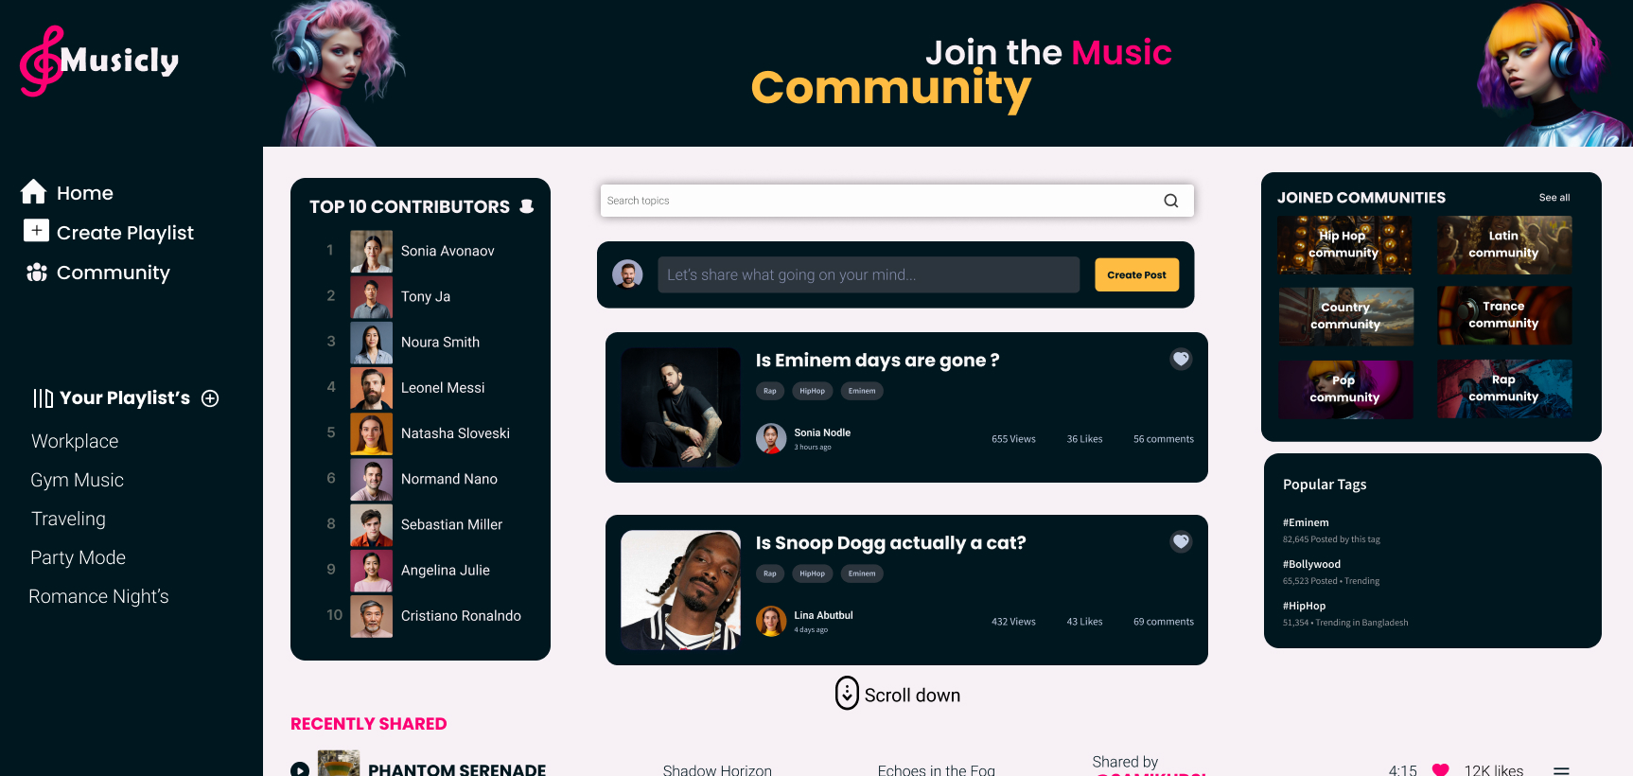
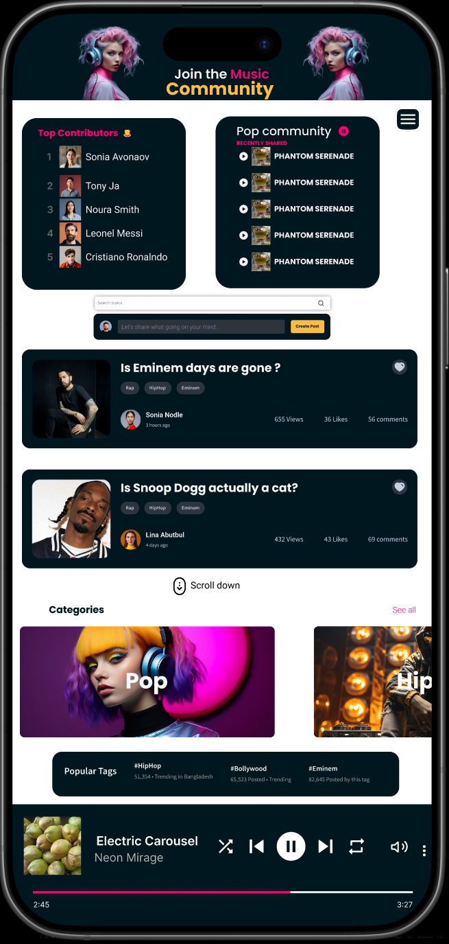
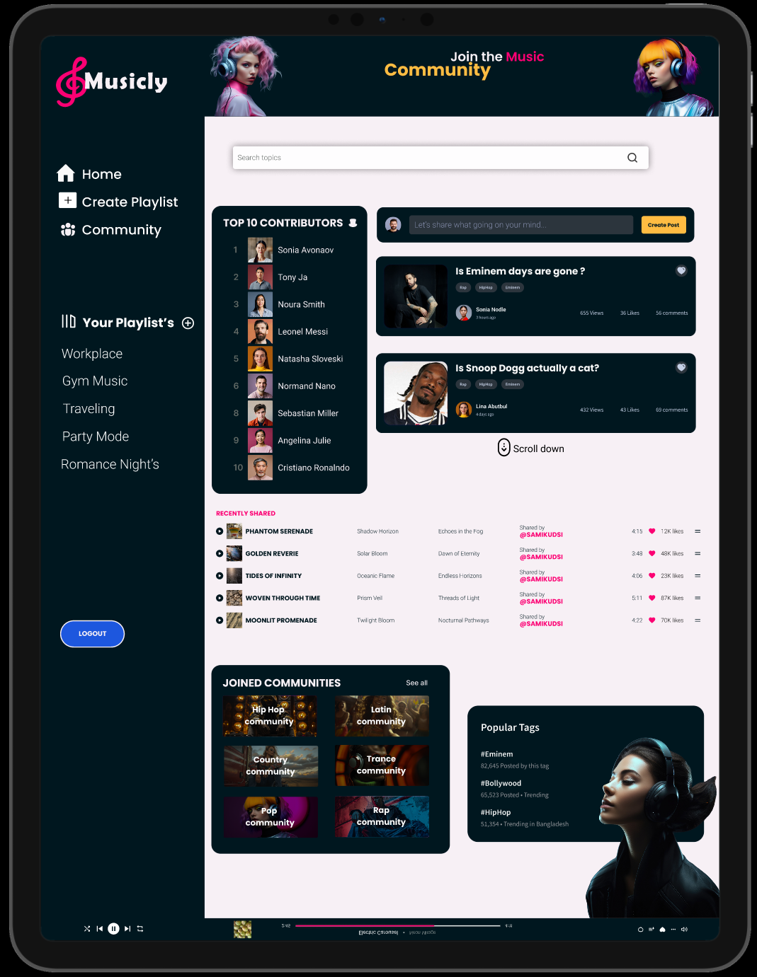
Design Decisions Specific Design Decisions
8
Community Page:
A space for users to interact, post, and join communities based on genres.
Displays trending topics and popular contributors to encourage engagement.

Slide 9
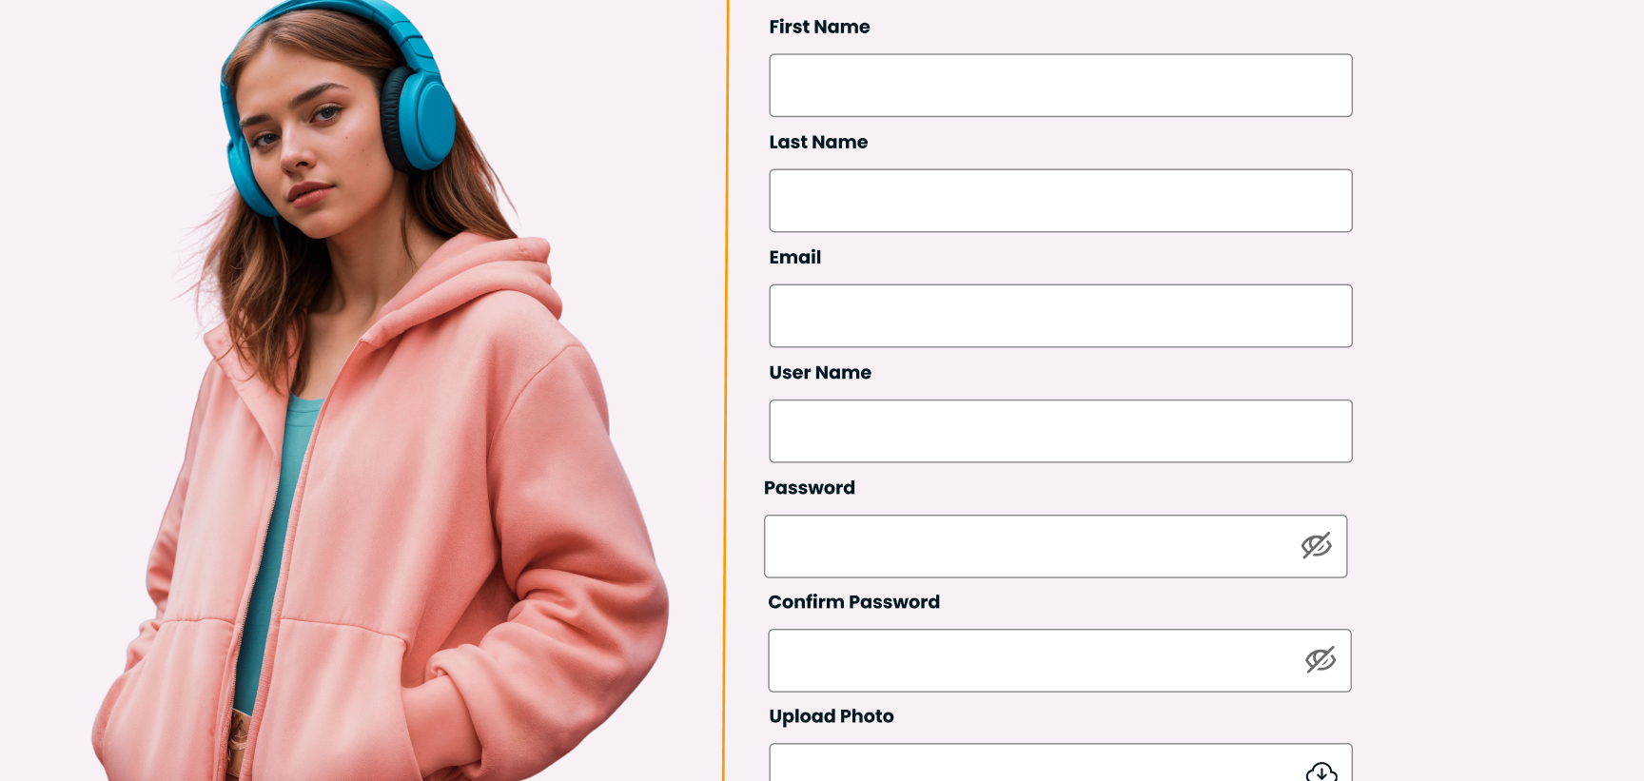
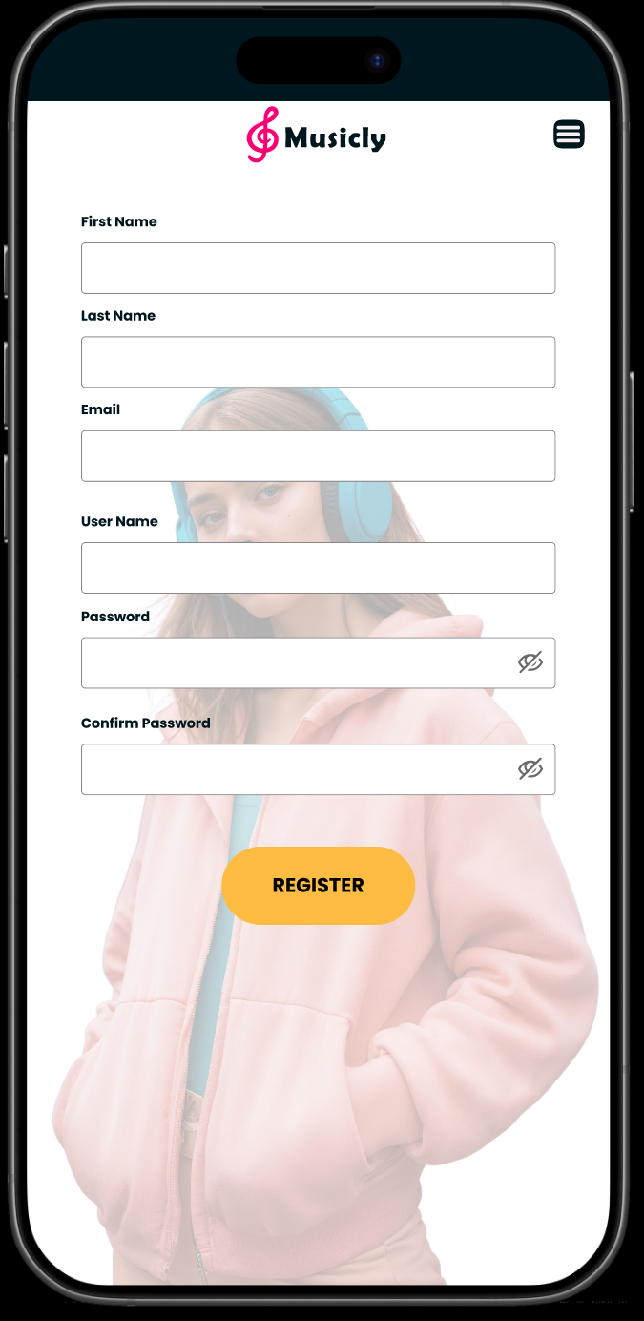
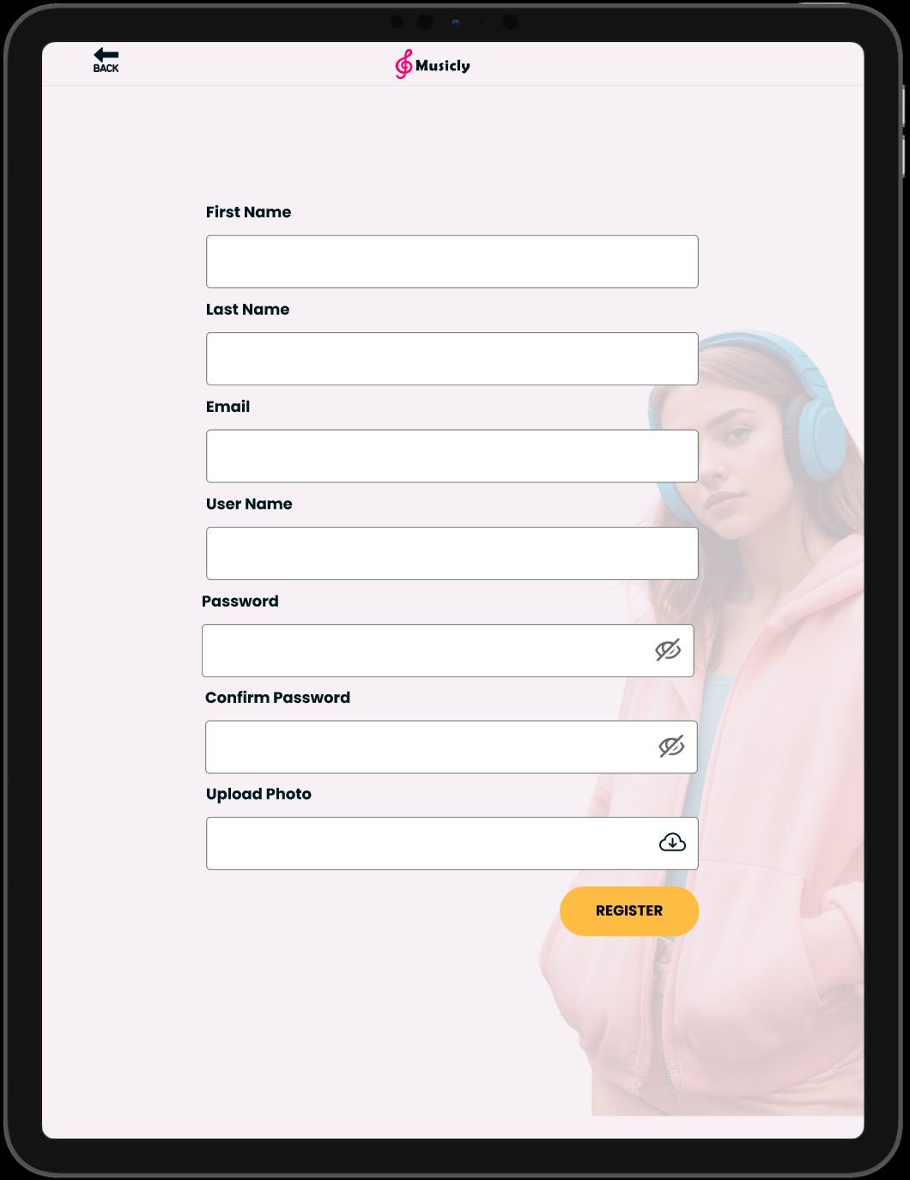
Design Decisions Specific Design Decisions
9
Login/Register Page:
Easy onboarding with multiple sign-in options (Google, Apple, Facebook).
Minimalistic design to ensure a smooth user registration process.
"Every page is designed to simplify user interaction while creating a rich, immersive experience."

Slide 10

10
Conclusion
Musicly is more than a music app—it’s an ecosystem for exploration, discovery, and connection.
Our user-focused design ensures accessibility, simplicity, and enjoyment. With tailored subscription plans and a vibrant community, Musicly aims to redefine how users experience music.

