Slide 1


Integrating big data and blockchain technologies for securing data collected in vanet
Hadi Jibbawi
2020-2021

Slide 2
Why swarm robotics?
Swarm Robotics
Live data streaming
Dynamic Topology
VANET
High Mobility
Dynamic Topology
Mobility
Live data streaming

Slide 3
Why blockchain with swarm robotics?
Authentication of Nodes
Secure Data Channel
Global Agreement
Network Consistency

Slide 4
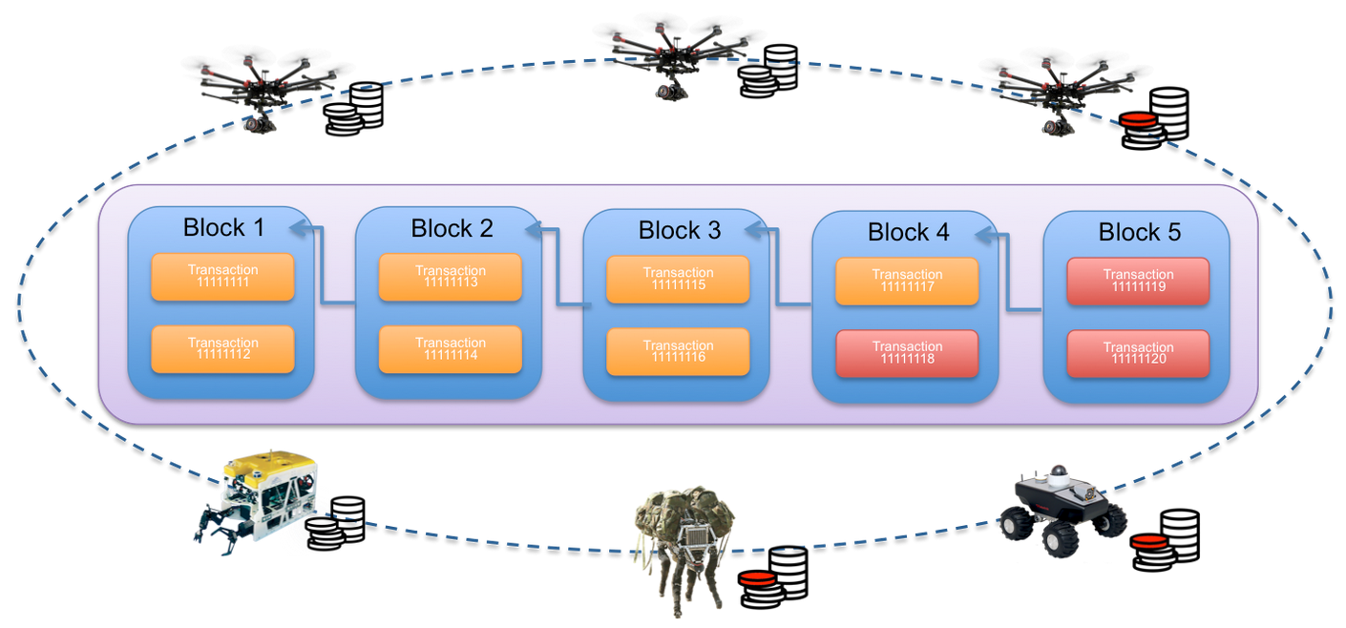
Swarm Robotics with blockchain Components
Network Node
Network Node
Network Node
Network Node

Slide 5
Swarm Robotics with blockchain Architecture
Consensus: Round-Robin Algorithm ( Voting)
Blockchain nodes: Robots
Network: Decentralized with synchronized distributed ledger
Security: Blockchain with Asymmetric Cryptography

Slide 6
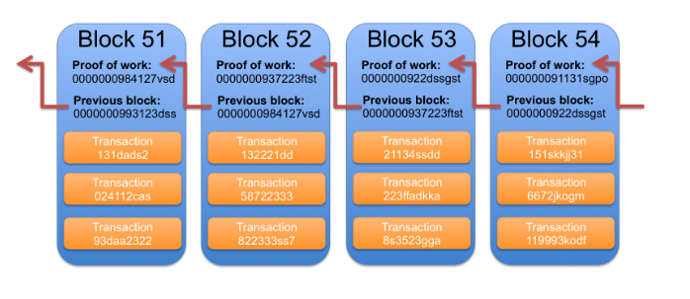
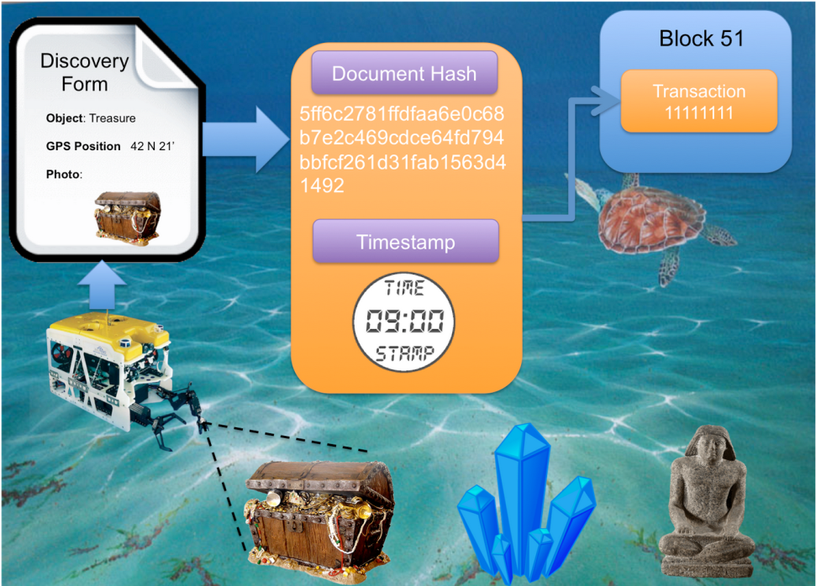
Blockchain structure

Slide 7
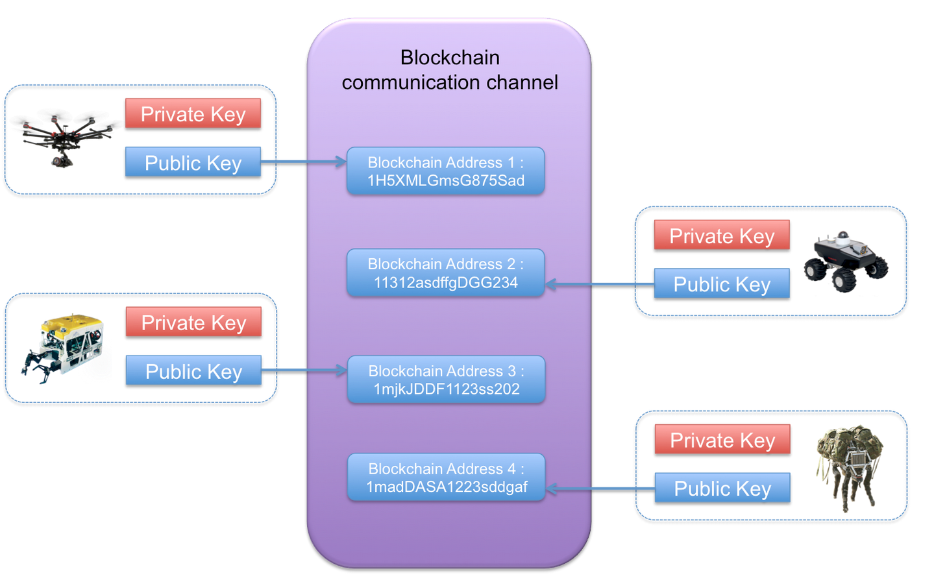
Security Structure 1/2

Slide 8
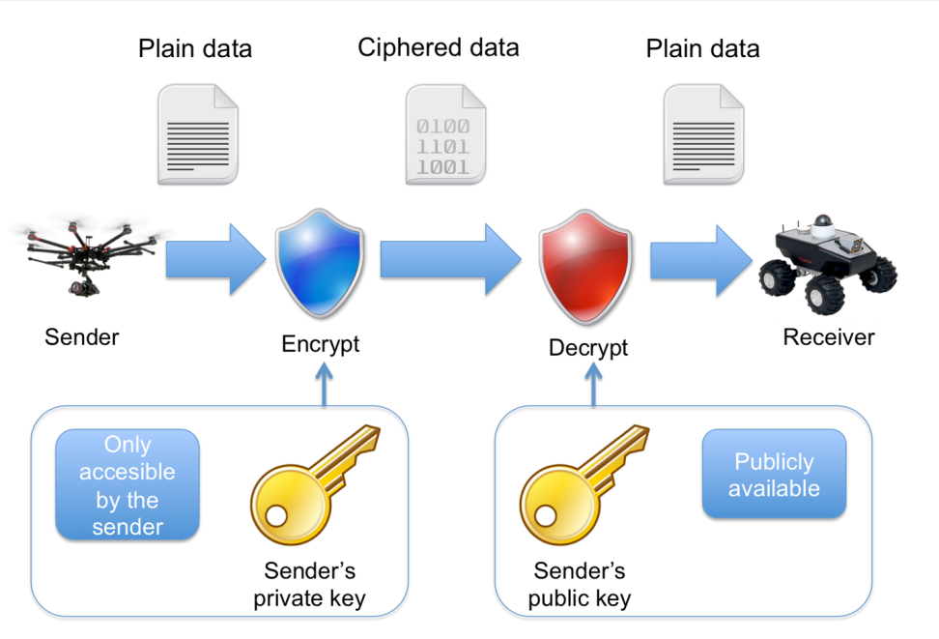
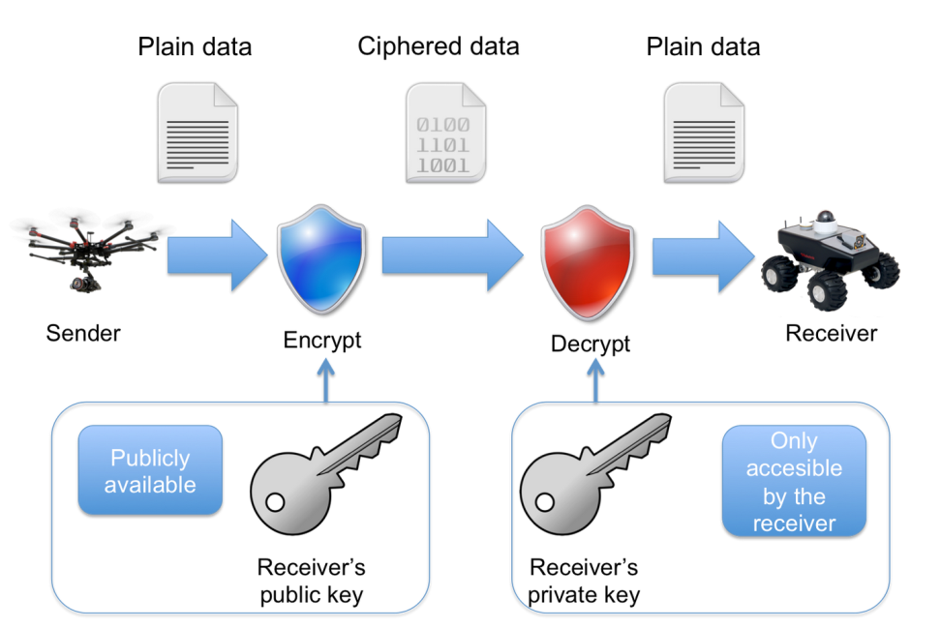
Security Structure 2/2
Sender
Receiver

Slide 9
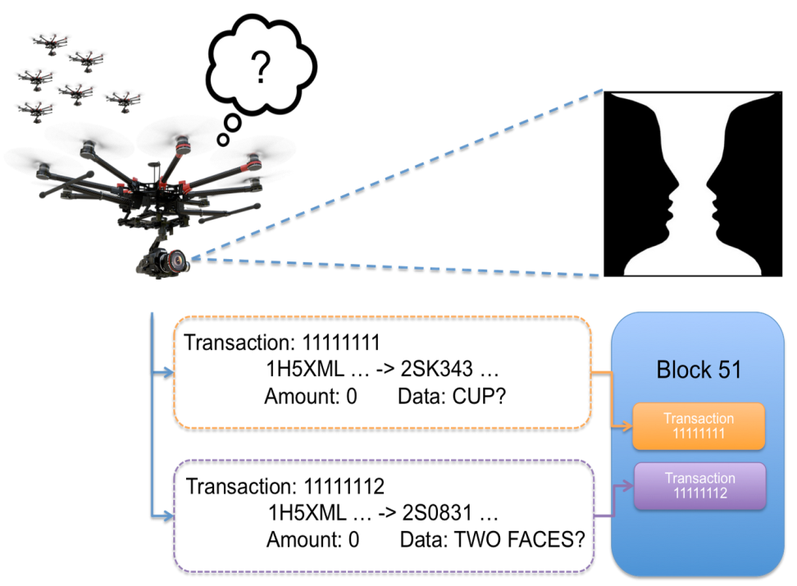
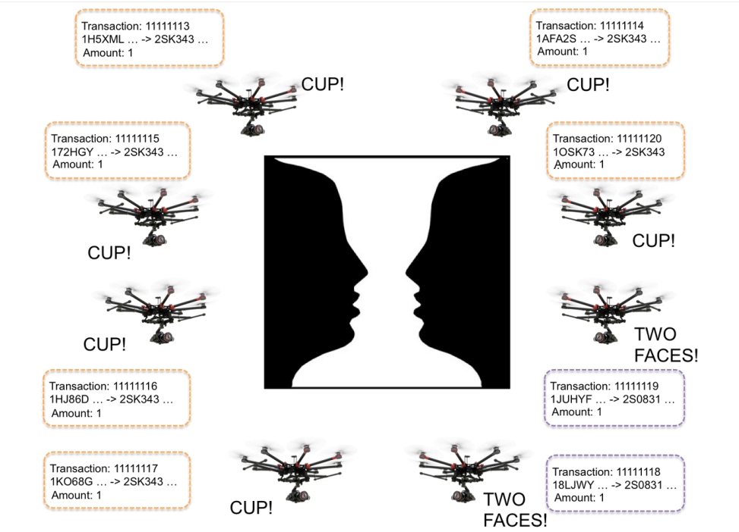
Swarm Robotics with blockchain Example
Step 1
Step 2

Slide 10

THANK You

