Slide 1


Integrating big data and blockchain technologies for securing data collected in vanet
Hadi Jibbawi
2020-2021

Slide 2
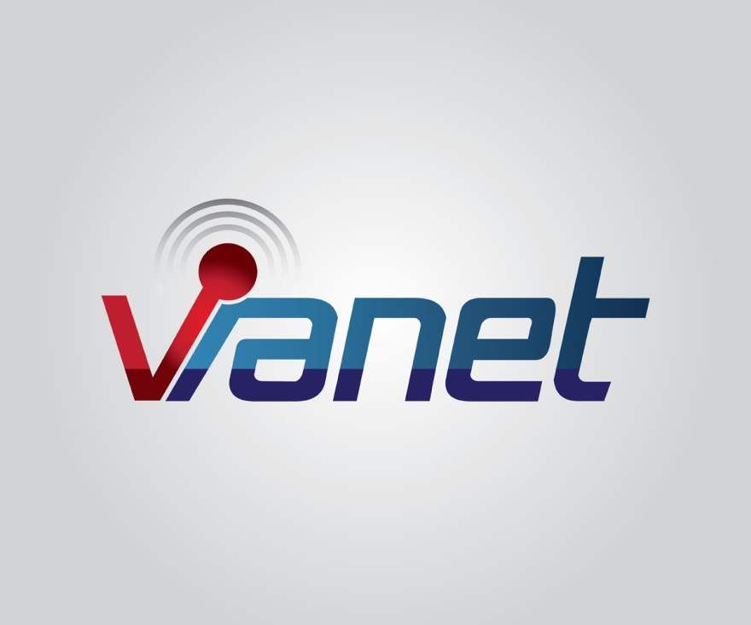
What is VANET?
Vehicular ad-hoc network
Part of the Intelligence Transportation System (ITS)

Slide 3
Why is vanet?
Enhance overall traffic
Reduce resources consumption
Condense congestions

Slide 4
Characteristics of vanet
High Mobility
Vehicle’s high speed move
Dynamic Network Topology
Network topology changes rapidly
Time Critical
Exchange of information in specific duration
Computing and Storage
Volatility
Processing large amount of information
Connections between vehicles may be lost
Difficult to ensure personal information

Slide 5
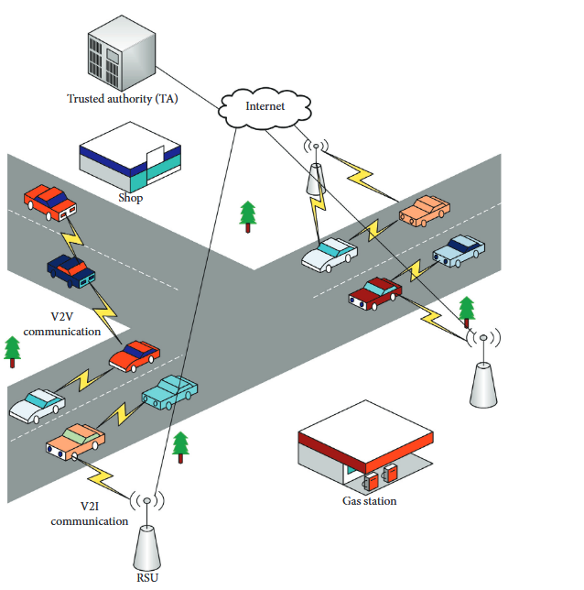
VANET Architecture
Core Components
On-board Unit (OBU)
shares vehicle information
Roadside Unit (RSU)
Provides local connectivity to the passing vehicles
Trust Authority (TA)
Manages the entire VANET system
RSU
OBU
OBU
OBU
RSU

Slide 6
VANET Applications (1/3)
VANET Application
Comfort Application
Safety Application

Slide 7
VANET Applications (2/3)
VANET Application
Comfort Application
Safety Application
Road Condition Warning
Post Crash Warning
Warning for violating stop sign
Wrong way driver warning
Notes:
The safety applications of VANETs are used to enhance the protection.

Slide 8
VANET Applications (3/3)
VANET Application
Comfort Application
Safety Application
Weather Information
Nearby Restaurants
Patrol Stations
Notes:
This VANET application is referred as a nonsafety application, which aims at enhancing drivers and passenger’s comforts.

Slide 9
VANET Challenges
Network Management
Congestion and collision control
Environmental Impact: VANET uses electromagnetic waves for communication
Real-time processing of data
Security challenges

Slide 10
VANET Security challenges Categories
Management
Trust
Network
Data
Generated Messages
Privacy
Balance
Security
Performance

Slide 11
Security Services
Services
Confidentiality
Integrity
Privacy
Authentication
State of keeping secret or private
Accuracy and completeness of data
Accessibility of node or data
Recognizing the user’s identity
Safeguarding of user identity
Availability

Slide 12
Security Threats
Threats
Denial of Service
Identity Spoofing
Spamming attack
Man-in-the-Middle Attack
Sybil Attack
Disrupting the availability of the services
False identity to gain an illegitimate advantage
Inject spam messages to cause collision by utilizing more bandwidth
In the middle of V2V communication to alter messages
Node holds many fake identities to disrupt the normal functioning of VANET

Slide 13
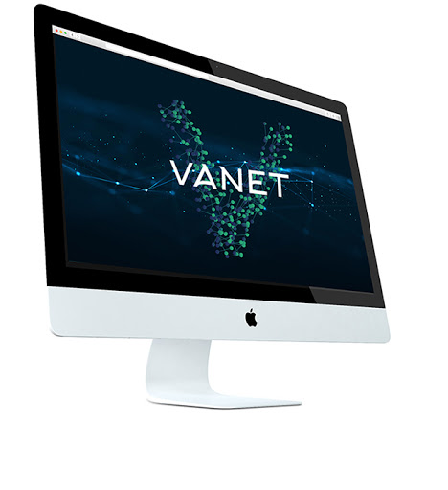
THANK You

