Slide 1
VANET
Hadi Jibbawi

Slide 2
What is VANET?
Vehicular ad-hoc network
Part of the Intelligence Transportation System (ITS)
Characterized by:
High Mobility
Dynamic Network Topology
Time Critical
Unbound Network Size
Frequent Exchange of Information
Aims to:
Enhance overall traffic
Reduce congestions

Slide 3
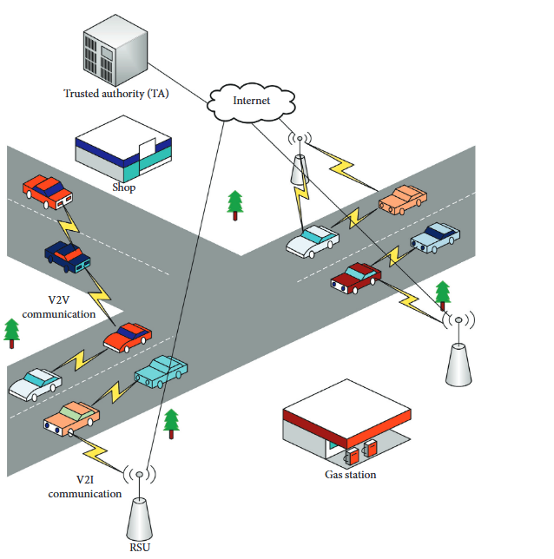
VANET Architecture
Core Components
On-board Unit (OBU)
Roadside Unit (RSU)
Trust Authority (TA)

Slide 4
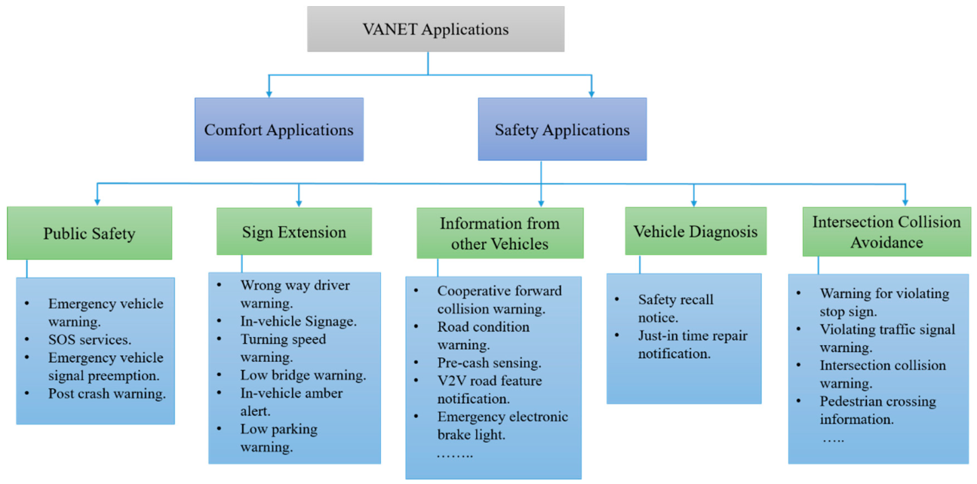
VANET Applications

Slide 5
Security Services
Services
Confidentiality
Integrity
Threats
Denial of Service
Identity Spoofing
Challenges
Secure Vehicular Communication
Node Authentication
Privacy
Authentication
Availability
Tampering
Information Disclosure
Sybil Attack
Localization
Data Security
Access Control

Slide 6
VANET challenges
Management
Trust
Network
Security
Generated Messages
Privacy
Balance
Security
Performance

Slide 7

THANK You

