Slide 1


Integrating big data and blockchain technologies for securing data collected in vanet
Hadi Jibbawi
2020-2021

Slide 2
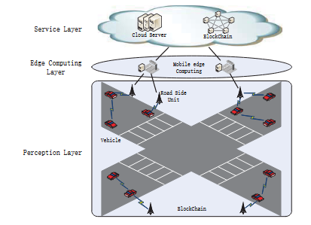
A security architecture of VANET based on blockchain and mobile edge Computing
Perceptual layer
Vehicles (wallet and network routing functions)
RSUs (Blockchain Functions)
Edge computing layer
MEC handles computational intensive work
Service layer
Blockchain Storage
Cloud Server Storage

Slide 3
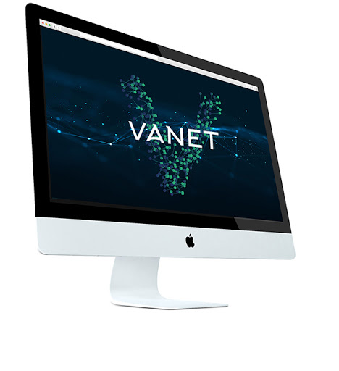
THANK You

