Slide 1
Vietnam and Phillipines COVID analysis
A quick insight of COVID events on Vietnam and Phillipines

Slide 2
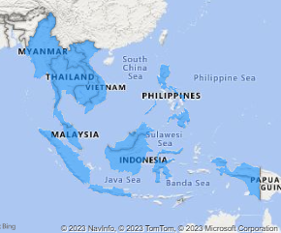
Get to know the area

Slide 3
What is it?
GDP
Gross Domestic Product
HDI
Human Development Index

Slide 4
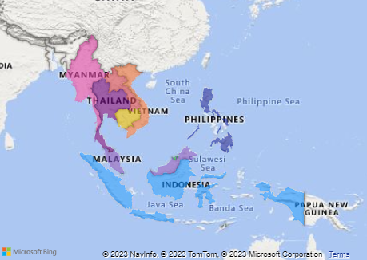
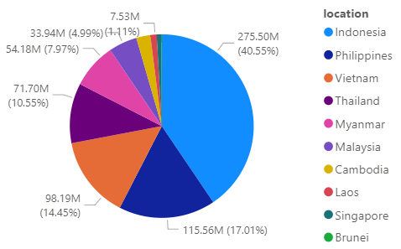
Number of Population
>600 Million
Total GDP
>230 Million

Slide 5

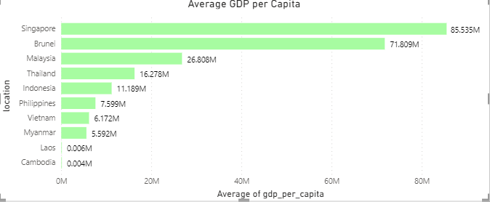

Slide 6
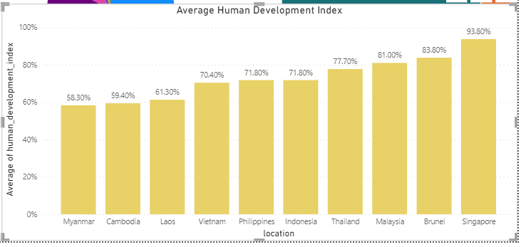

Slide 8
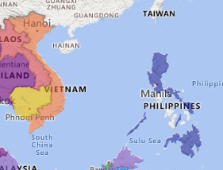
Vietnam and Phillipines quick recap
Vietnam

