Slide 1
Vietnam and Phillipines COVID analysis
A quick insight of COVID events on Vietnam and Phillipines

Slide 2
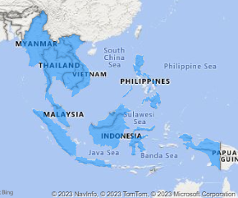
Get to know the area

Slide 3
Get to know things
Gross Domestic Product (GDP)
Measurement of the market value of all the final goods and services produced in a specific time period by a country or countries.
Human Development Index (HDI)
Measurement to capture three key dimensions of human development ( a long and healthy life, access to knowledge, and a decent standard of living).

Slide 4
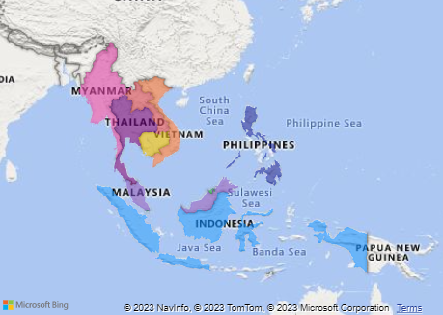
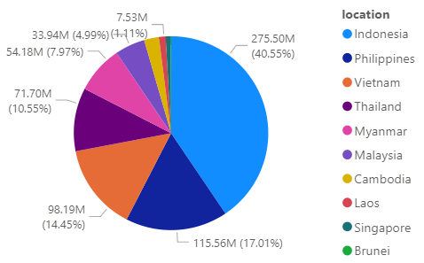
Number of Population
>600 Million
Total GDP
>230 Million

Slide 5

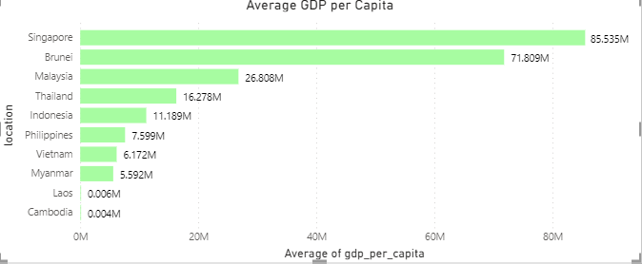

Slide 6
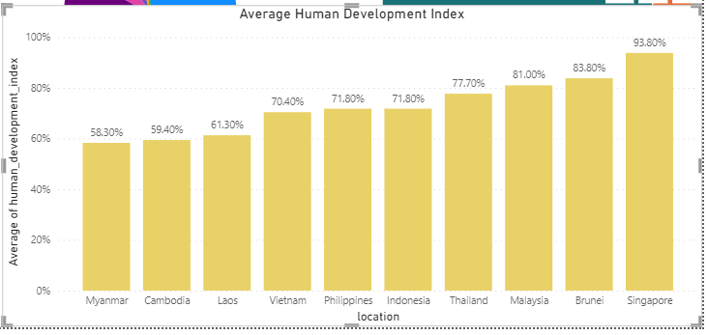

Slide 8
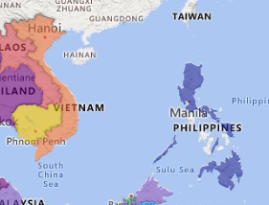
Vietnam and Phillipines quick recap
Vietnam

Slide 9
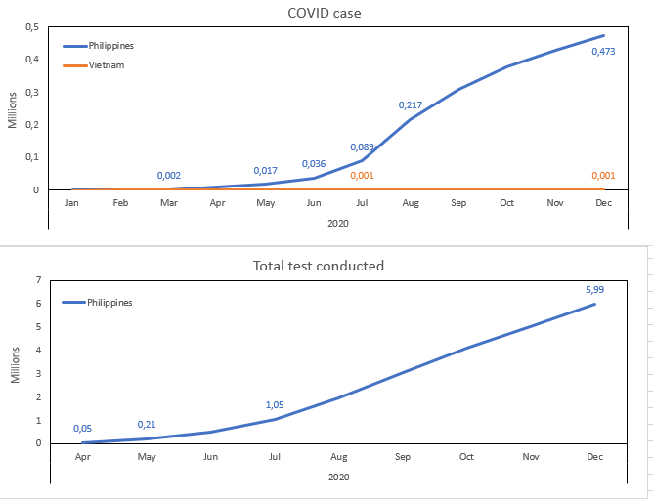
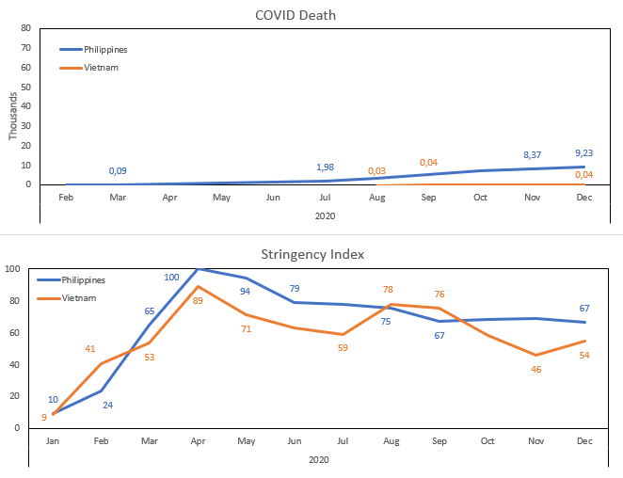
2020 COVID on Phillipines and Vietnam

Slide 10
What happened on that occurrence?

Slide 11
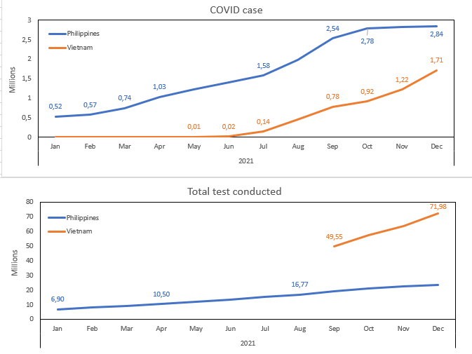
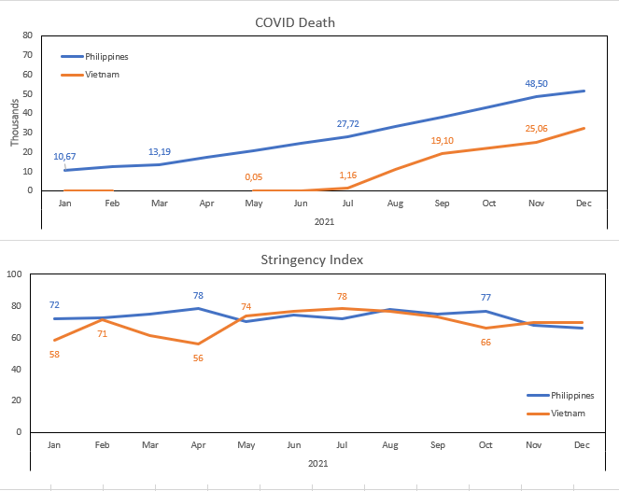
2021 COVID on Phillipines and Vietnam

Slide 12
What happened on that occurrence?

Slide 13
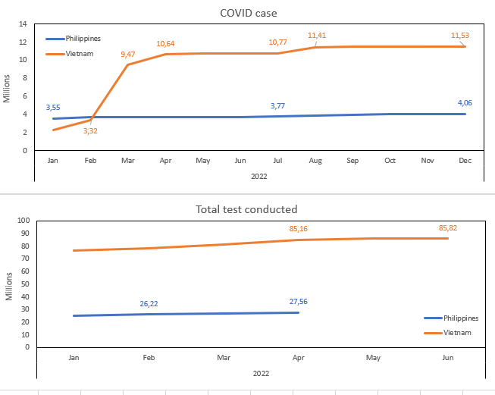
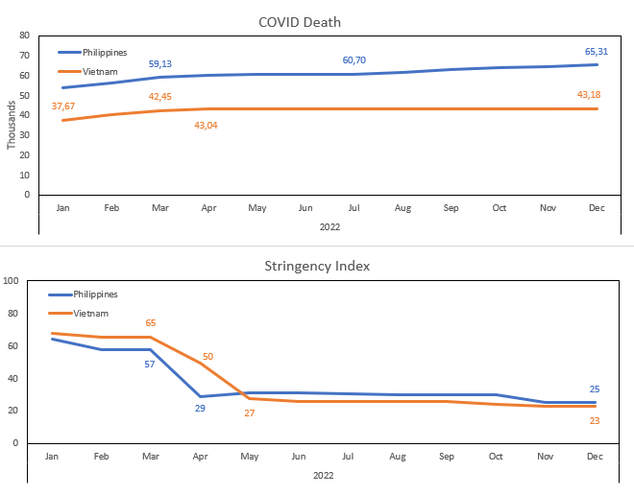
2022 COVID on Phillipines and Vietnam

Slide 14
What happened on that occurrence?

Slide 15
Conclusion

