Slide 1
Vietnam and Phillipines COVID analysis
A quick insight of COVID events on Vietnam and Phillipines

Slide 2
Conclusion

Slide 3
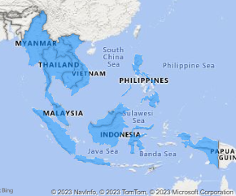
Get to know the area
ASEAN
Association of Southeast Asian Nations
What are the objective?
accelerate economic growth, social progress and cultural development in the region
promote regional peace and stability through abiding respect for justice and the rule of law in the relationship among countries in the region and adherence to the principles of the United Nation Charter

Slide 4
Get to know things
GDP
Gross Domestic Product
Measurement of the market value of all the final goods and services produced in a specific time period by a country or countries
HDI
Human Development Index
Measurement to capture three key dimensions of human development ( a long and healthy life, access to knowledge, and a decent standard of living).

Slide 5
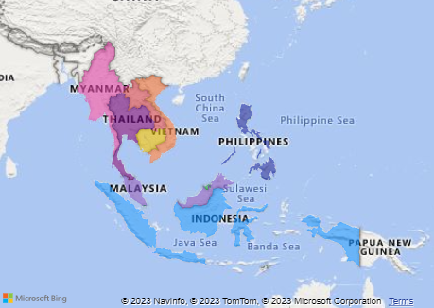
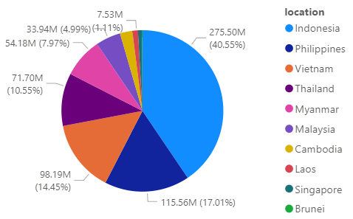
Get to know more about ASEAN
Number of Population
>650 Million
Total GDP
>230 Million

Slide 6
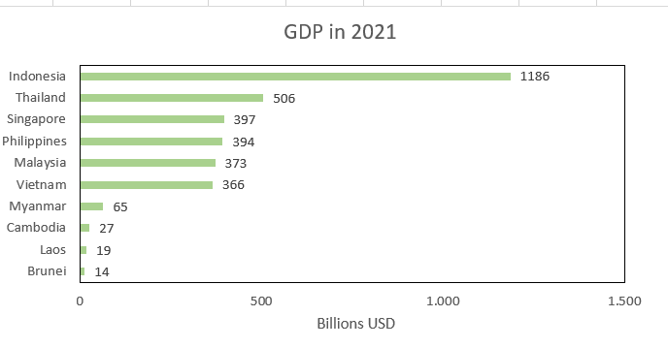
Country | Income_Group
Brunei | High income
Indonesia | Lower middle income
Cambodia | Lower middle income
Laos | Lower middle income
Myanmar | Lower middle income
Malaysia | Upper middle income
Philippines | Lower middle income
Singapore | High income
Thailand | Upper middle income
Vietnam | Lower middle income

Slide 7

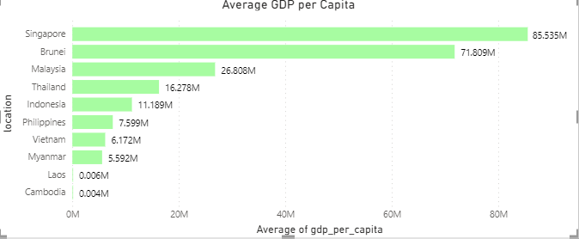
Country | Income_Group
Brunei | High income
Indonesia | Lower middle income
Cambodia | Lower middle income
Laos | Lower middle income
Myanmar | Lower middle income
Malaysia | Upper middle income
Philippines | Lower middle income
Singapore | High income
Thailand | Upper middle income
Vietnam | Lower middle income

Slide 8
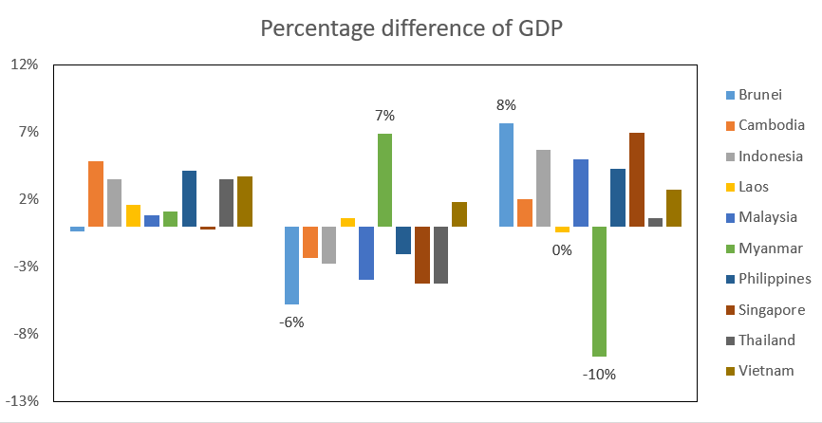
Country | Income_Group
Brunei | High income
Indonesia | Lower middle income
Cambodia | Lower middle income
Laos | Lower middle income
Myanmar | Lower middle income
Malaysia | Upper middle income
Philippines | Lower middle income
Singapore | High income
Thailand | Upper middle income
Vietnam | Lower middle income

Slide 9
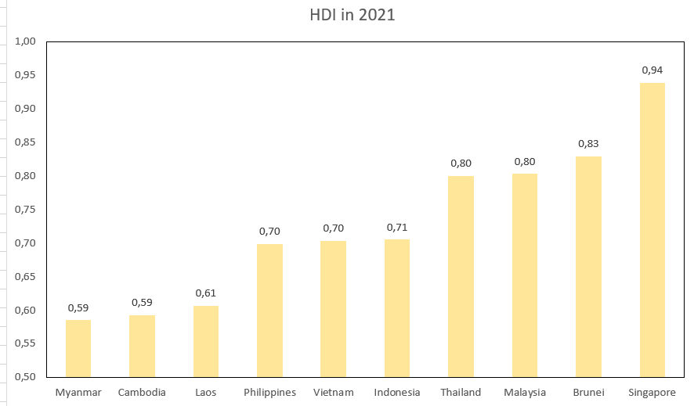

Slide 10
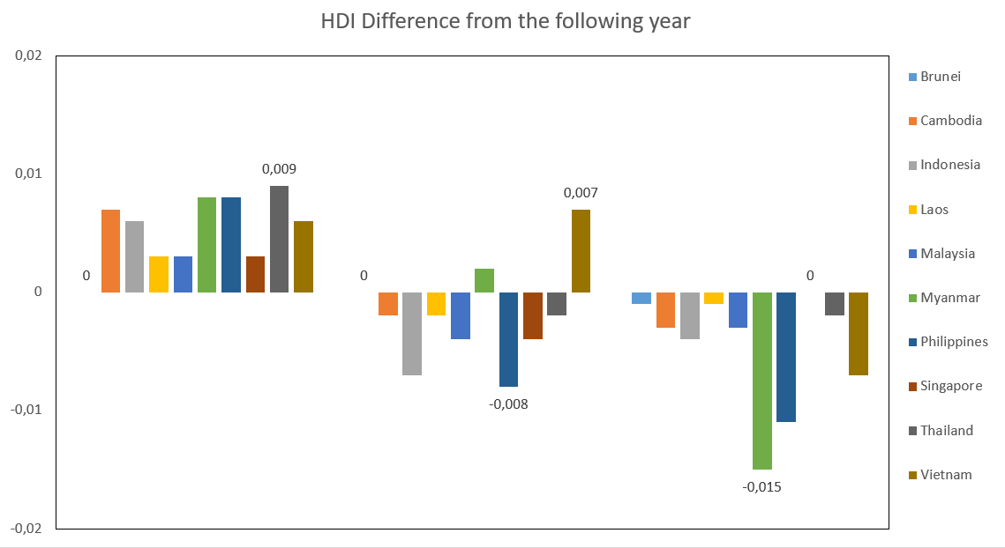

Slide 12
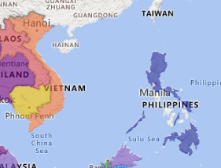
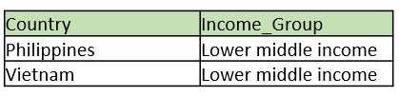
Vietnam and Phillipines quick recap
Vietnam

Slide 13
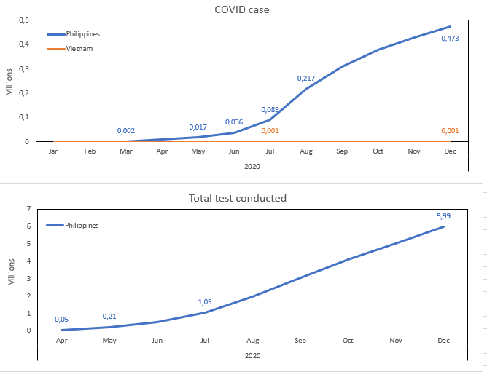
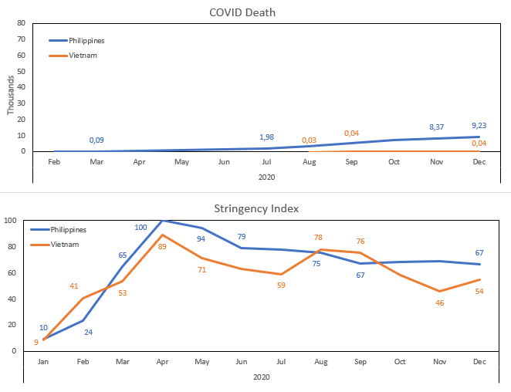
2020 COVID on Phillipines and Vietnam

Slide 14
What happened on that year?
Phillipine
August, The Philippine Genome Center (PGC) had detected a new variant of the SARS-CoV-2 virus originating in the Philippines.
Vietnam
July, The epicenter was in Da Nang, with the source of infection purported to be from Hospital C in the city.

Slide 15
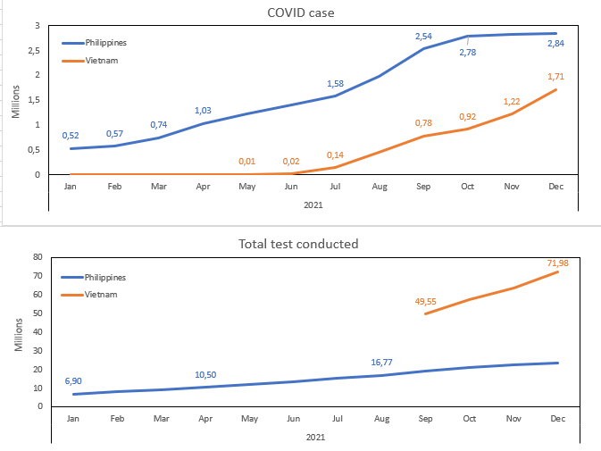
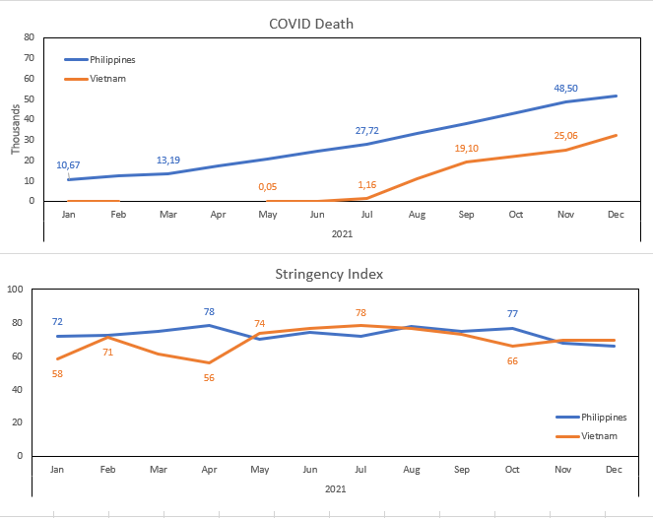
2021 COVID on Phillipines and Vietnam

Slide 16
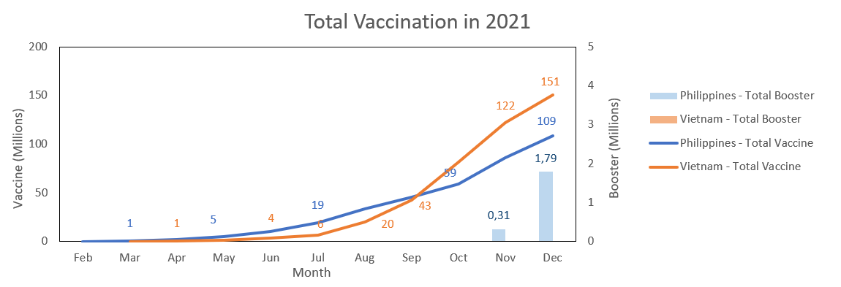

Slide 17
What happened on that year?
Phillipine
July 16
The country detected 16 new cases of the highly-transmissible COVID-19 Delta variant,
August 28
WHO declared that the Delta variant is already the dominant variant of SARS-CoV-2 in the Philippines.
October
The vaccination of minors under the Philippine national vaccination
Vietnam
August
A main cause of the outbreak was a four-day holiday for Reunification Day and International Workers' Day, during which many vacation destinations were packed with travelers.

Slide 18
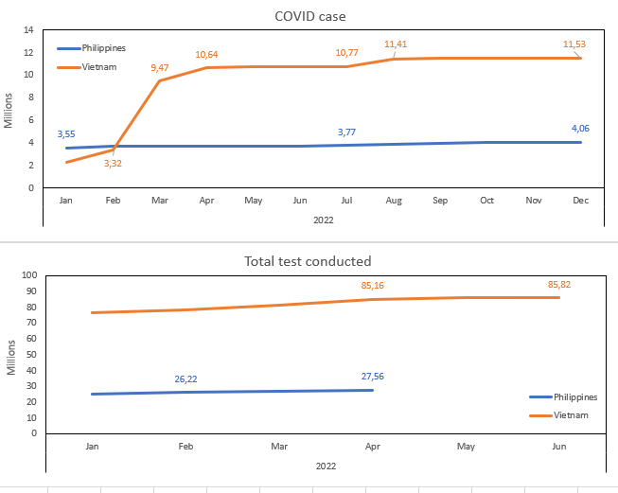
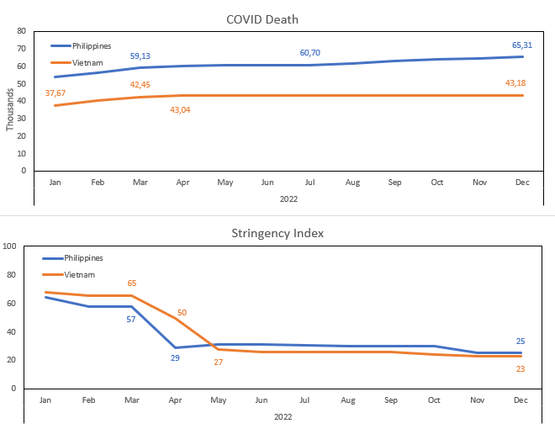
2022 COVID on Phillipines and Vietnam

Slide 19
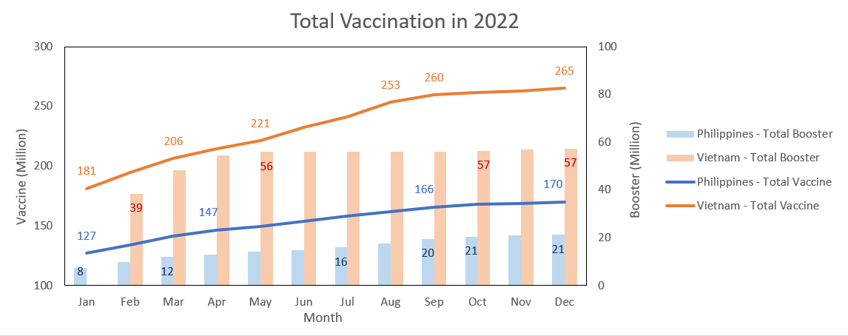

Slide 20
What happened on that year?

Slide 21
Conclusion

Slide 22
Data Source
Human Development Index
United Nations Development Programme , Human Development Report hdr.undp.org
Gross Domestic Product
The World Bank
data.worldbank.org
COVID Data
Our Wold In Data
ourworldindata.org

