Slide 1
Vietnam and Phillipines COVID analysis
A quick insight of COVID events on Vietnam and Phillipines

Slide 2
Conclusion
The most important aspect of handling the pandemic situation that vietnam used is:
Early Action
Strong Society
Clear Communication
Contact Tracing

Slide 3
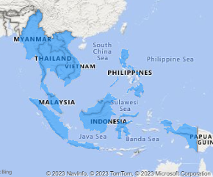
Get to know the area
ASEAN
Association of Southeast Asian Nations
What are the objective?
Accelerate economic growth, social progress and cultural development in the region
Promote regional peace and stability through abiding respect for justice and the rule of law in the relationship among countries in the region and adherence to the principles of the United Nation Charter

Slide 4
Get to know things
GDP
Gross Domestic Product
Measurement of the market value of all the final goods and services produced in a specific time period by a country or countries
HDI
Human Development Index
Measurement to capture three key dimensions of human development ( a long and healthy life, access to knowledge, and a decent standard of living).

Slide 5
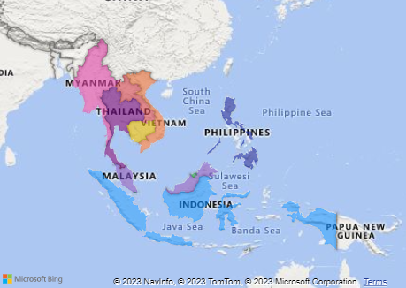
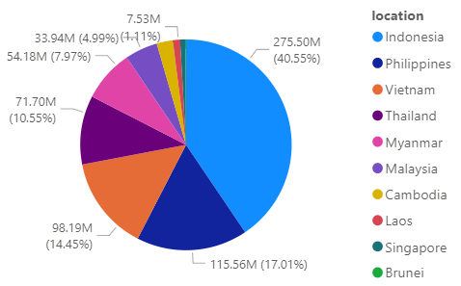
Get to know more about ASEAN
Number of Population
>650 Million
Total GDP
>230 Million

Slide 6
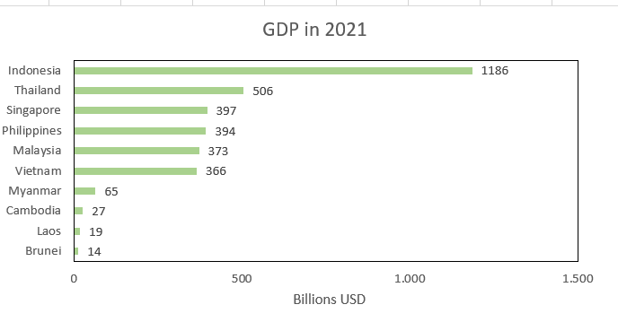
Country | Income_Group
Brunei | High income
Indonesia | Lower middle income
Cambodia | Lower middle income
Laos | Lower middle income
Myanmar | Lower middle income
Malaysia | Upper middle income
Philippines | Lower middle income
Singapore | High income
Thailand | Upper middle income
Vietnam | Lower middle income

Slide 7

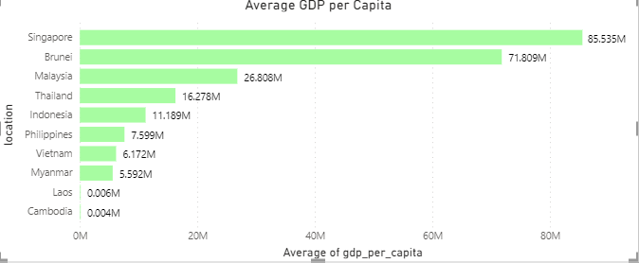
Country | Income_Group
Brunei | High income
Indonesia | Lower middle income
Cambodia | Lower middle income
Laos | Lower middle income
Myanmar | Lower middle income
Malaysia | Upper middle income
Philippines | Lower middle income
Singapore | High income
Thailand | Upper middle income
Vietnam | Lower middle income

Slide 8
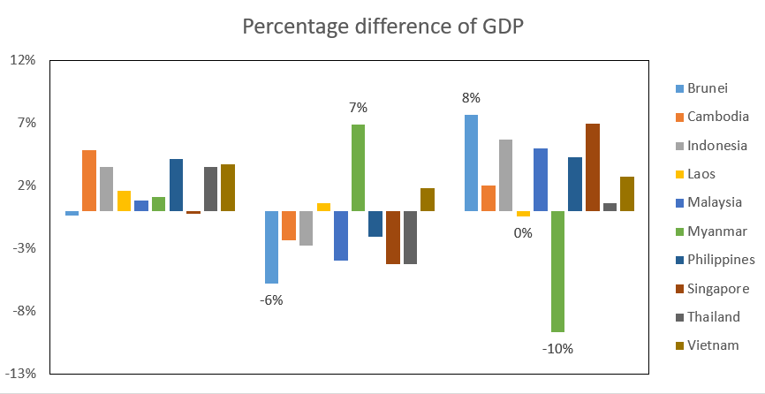
Country | Income_Group
Brunei | High income
Indonesia | Lower middle income
Cambodia | Lower middle income
Laos | Lower middle income
Myanmar | Lower middle income
Malaysia | Upper middle income
Philippines | Lower middle income
Singapore | High income
Thailand | Upper middle income
Vietnam | Lower middle income
2020
2021
2022

Slide 9
Country | point | classification
Singapore | 0,939 | Very high
Brunei | 0,829 | High
Malaysia | 0,803 | High
Thailand | 0,800 | High
Indonesia | 0,705 | Medium
Viet Nam | 0,703 | Medium
Philippines | 0,699 | Medium
Laos | 0,607 | Medium
Cambodia | 0,593 | Medium
Myanmar | 0,585 | Medium
Additional Information | Point
East Asia and the Pacific | 0,749
Developing Country | 0,685
Classification | point
Very high | 0,896
High | 0,754
Medium | 0,636
Low | 0,518

Slide 10
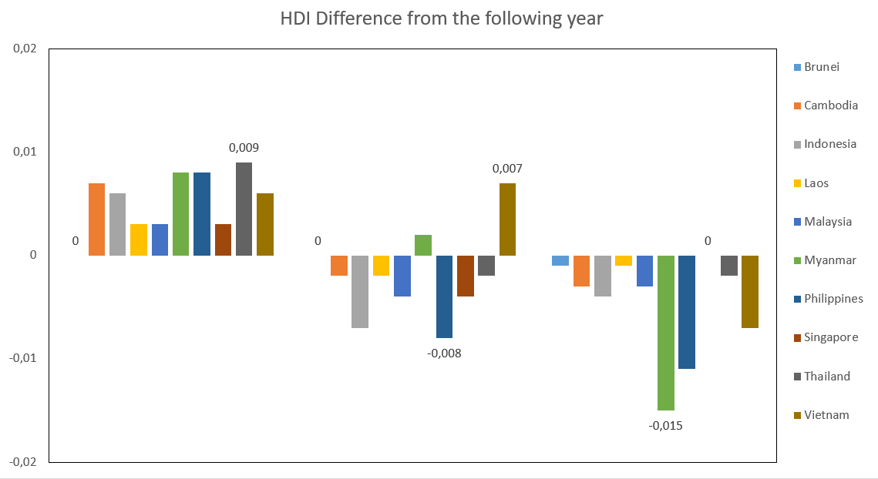
Country | point | classification
Singapore | 0,939 | Very high
Brunei | 0,829 | High
Malaysia | 0,803 | High
Thailand | 0,800 | High
Indonesia | 0,705 | Medium
Viet Nam | 0,703 | Medium
Philippines | 0,699 | Medium
Laos | 0,607 | Medium
Cambodia | 0,593 | Medium
Myanmar | 0,585 | Medium
2020
2021
2022

Slide 11
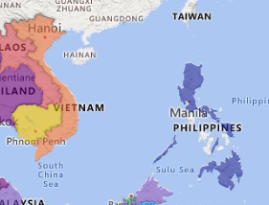
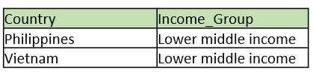
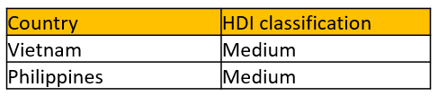
Vietnam and Phillipines quick recap
Vietnam

Slide 12
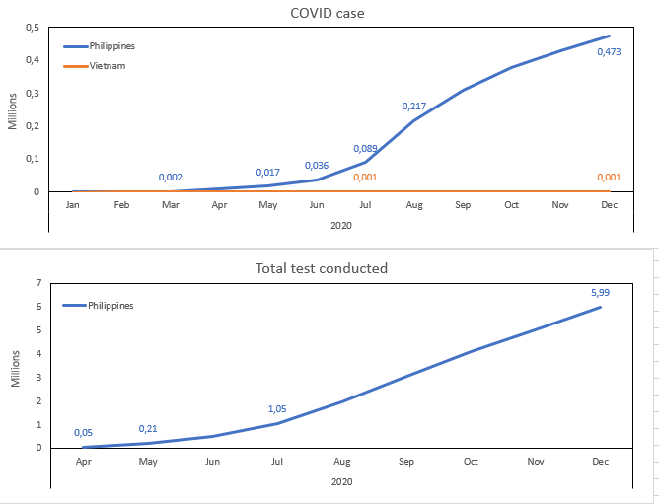
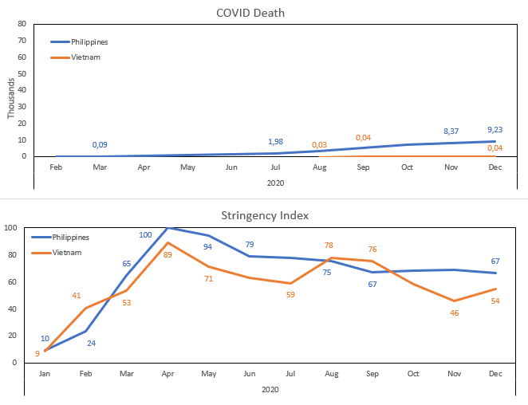
2020 COVID on Phillipines and Vietnam

Slide 13
What happened on that year?
Phillipine
August, The Philippine Genome Center (PGC) had detected a new variant of the SARS-CoV-2 virus originating in the Philippines.
Vietnam
July, The epicenter was in Da Nang, with the source of infection purported to be from Hospital C in the city.

Slide 14
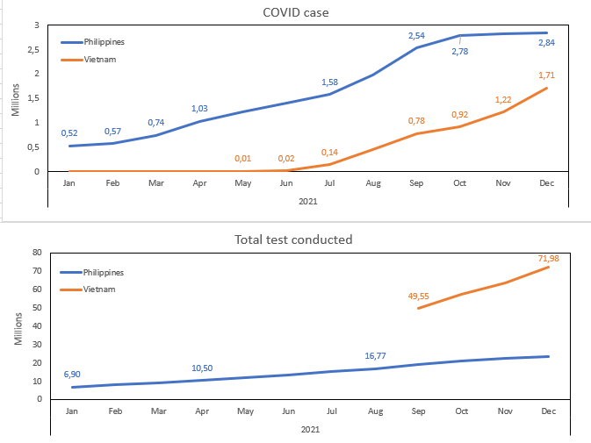
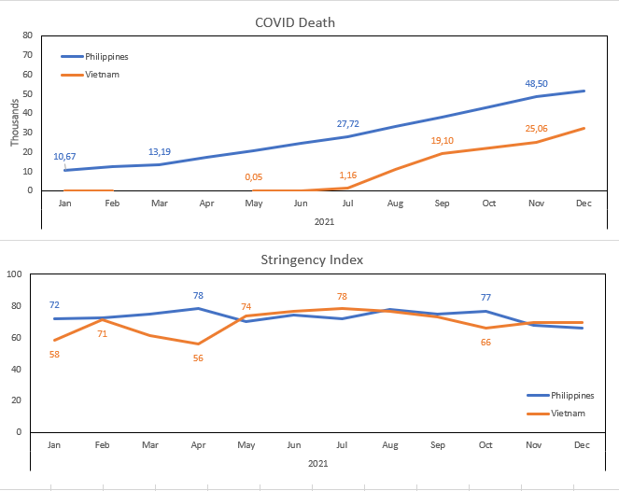
2021 COVID on Phillipines and Vietnam

Slide 15
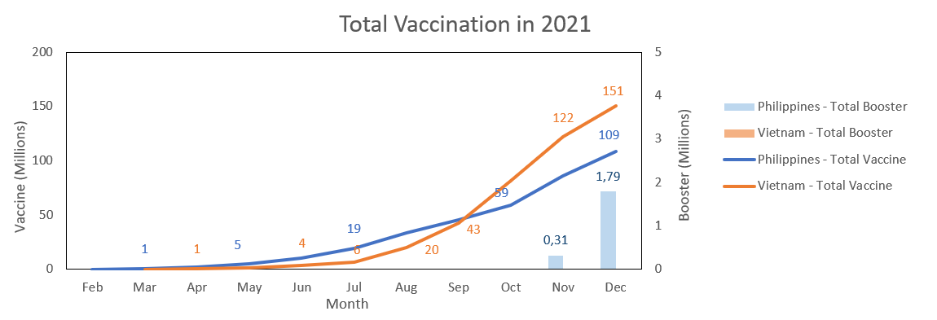

Slide 16
What happened on that year?
Phillipine
July 16
The country detected 16 new cases of the highly-transmissible COVID-19 Delta variant
August 28
WHO declared that the Delta variant is already the dominant variant of SARS-CoV-2 in the …Philippines
October
The vaccination of minors under the Philippine national vaccination
Vietnam
August
A main cause of the outbreak was a four-day holiday for Reunification Day and International …Workers' Day, during which many vacation destinations were packed with travelers.

Slide 17
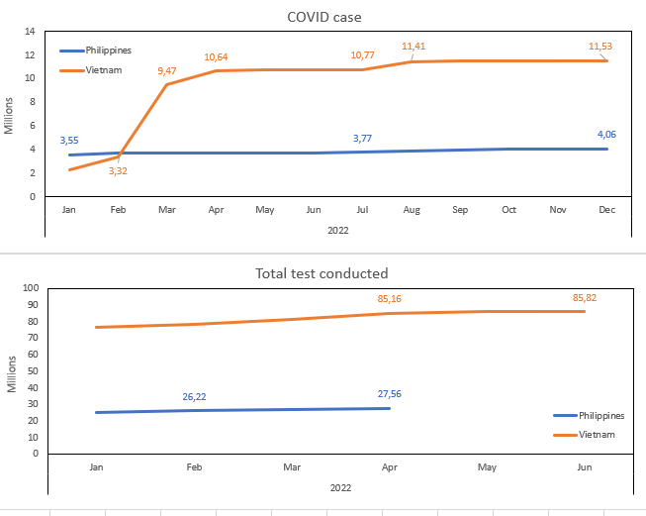
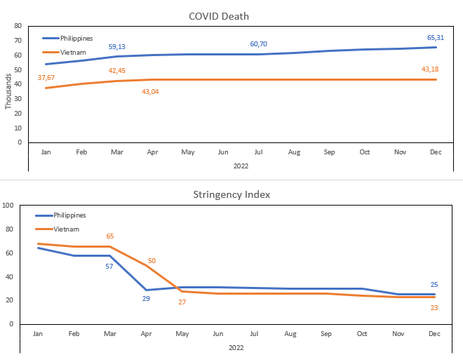
2022 COVID on Phillipines and Vietnam

Slide 18
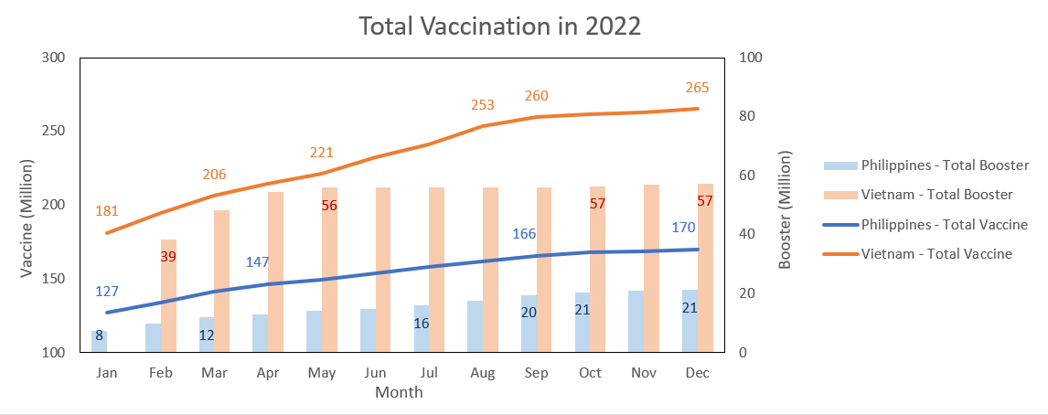

Slide 19
What happened on that year?
Phillipine
January
The DOH has confirmed that there is already a community transmission of the Omicron variant in …Metro Manila.
Vietnam
February
Omicron wave of COVID.

Slide 20
What makes Vietnam different?
Fast Act
January
First risk assesment
Vietnam tightened control at the Vietnam-China border.
Regional COVID-19 prevention task forces were establishedpersonal protective equipment was stockpiled
personal protective equipment was stockpiled
Vietnam confirmed its first case. Shortly afterward, Vietnam's response by issuing an urgent document to ministries, provinces, and broadcasting agencies addressing the dangerousness of the virus and the need for measures to prevent local transmission
Just one day after the first cases, the Civil Aviation Administration of Vietnam ordered the cancellation of all flights from and to Wuhan.

Slide 21
What makes Vietnam different?
Contact Tracing
Bluezone App
application that uses Bluetooth low energy positioning technology to detect people in close contact with infected people via smartphones quickly, and accurately.
5 Level of Contact
the infected person until the branchment of the contacted person up to 5 people.

Slide 22
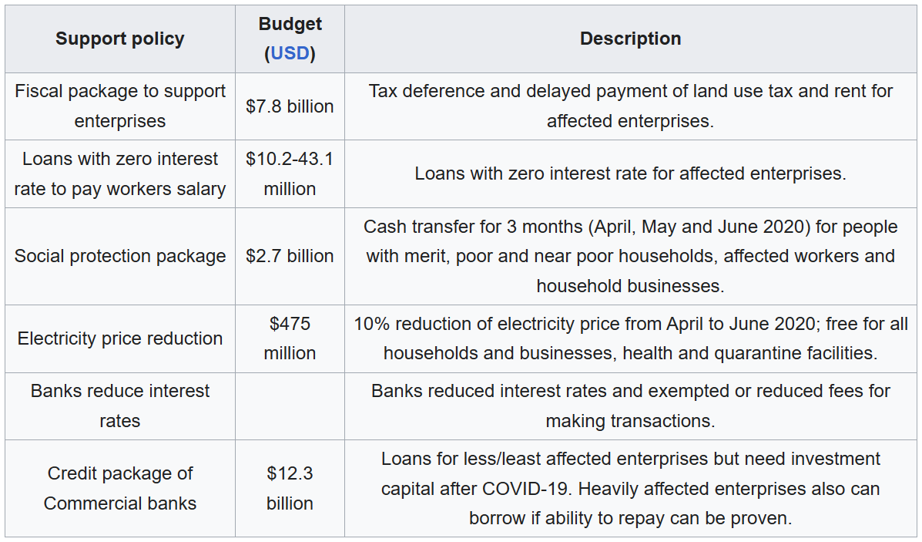
What makes Vietnam different?
High on incentive
UN ASSESSMENT OF THE SOCIAL AND ECONOMIC IMPACT OF COVID-19 IN VIET NAM (September 2020)

Slide 23
Conclusion
The most important aspect of handling the pandemic situation that vietnam used is:
Early Action
Strong Society
Clear Communication
Contact Tracing

Slide 24
Data Source
Human Development Index
United Nations Development Programme , Human Development Report hdr.undp.org
Gross Domestic Product
The World Bank
data.worldbank.org
COVID Data
Our Wold In Data
ourworldindata.org

