Slide 1
Miami Houses
Buy Your Dream House Credit: LIU

Slide 2
Why Choose Us ?
our aim is to simplify this process, making it more accessible and less stressful for homeowners.

Slide 3
Two Content Layout with SmartArt
Booking.com
Houses.com
Zillow.com
Only English
Only In Miami
Slow Response

Slide 4
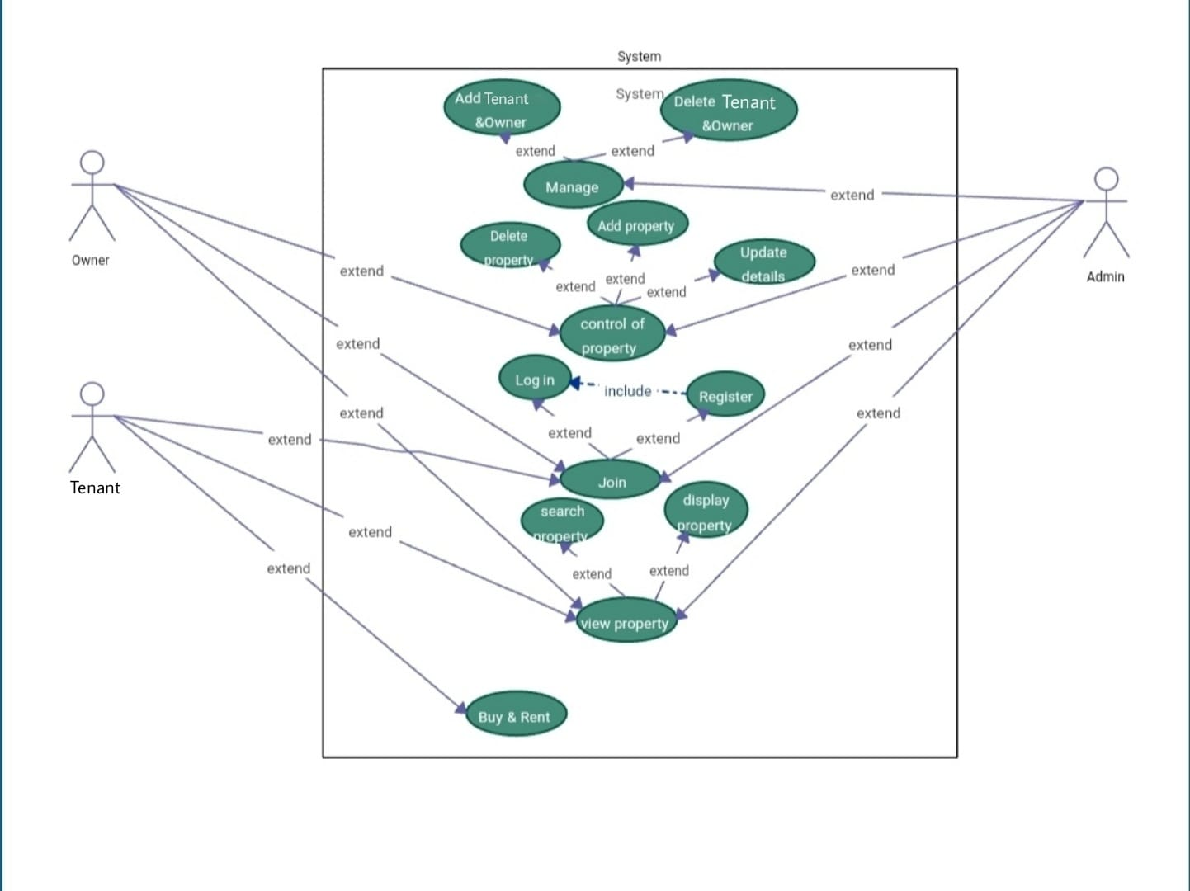

Slide 5
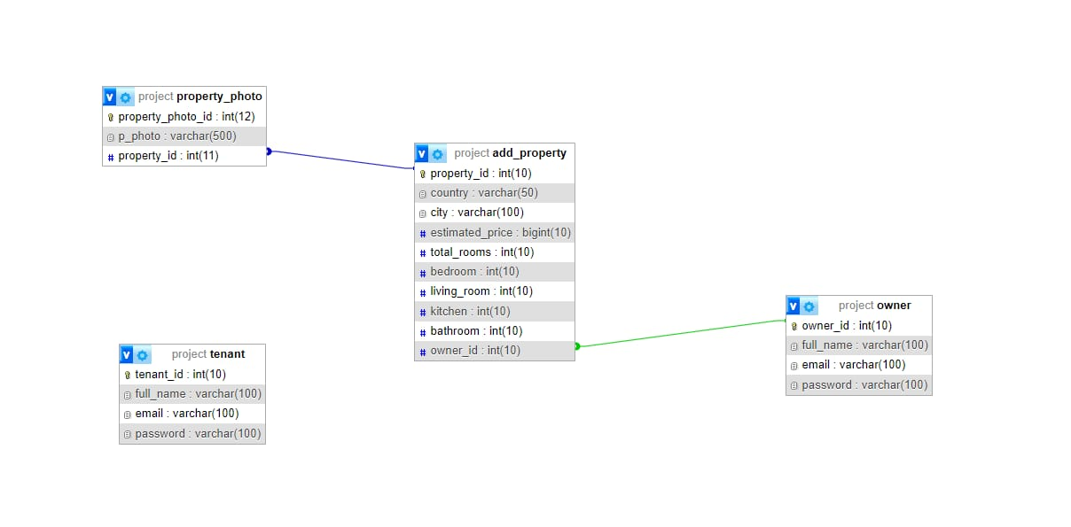

Slide 6
Live Demo>>>>>

Slide 7
Our site may not definitely be the best, but it will definitely make it easier and faster for you to find your dream house.
We learned so many things in designing sites and about how to make it easier access them later on such as such as the navbar we did.
Along with Team work some Css and some Html which we may not have learned otherwise.
Thank you for your time and thank you for being amazing Coaches for us.

Slide 9
Add a Slide Title - 4

Slide 10
Add a Slide Title - 5

