Slide 1
Analysis of time series for building an electric production prediction model
Hadi AlDhaywi / Hussein kshour
May 25, 2024
Notes:
Mr. President of the jury, themember of the jury, Ipresent today mythesis work titled by:

Slide 2
Problem
Time series
ARIMA
SARIMA
Comparison
Limitations
VAR
Conclusion
Hybrid method (ARIMA and SARIMA )
Hybrid methodology for short-term electric production forecasting using ARIMA and SARIMA
(Univariate models)
Notes:
I start with the firstcontribution entitledby :

Slide 3
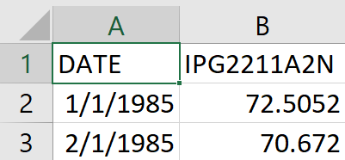
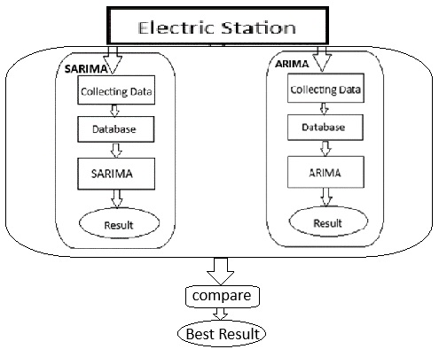
Problem
Time series
ARIMA
SARIMA
Comparison
Limitations
VAR
Conclusion
Entrance
Architecture
ARIMA
SARIMA
Notes:
The following figure showsthe overall architecture ofproposed system
This system takes as inputa file that contains thedaily datarelating to temperaturestation minimumBeirut between 1/1/2006 and12/31/2016.
The developed system generatesan ARIMA modelmaking it possible to predict thefuture values ​​of the first 4days of January 2017.
The generated results arecompared with ARPEGE.

Slide 4
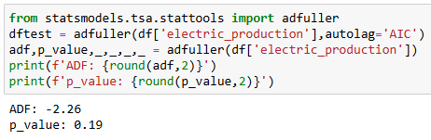
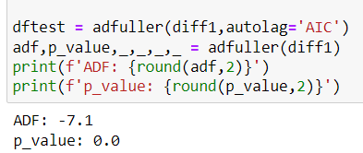
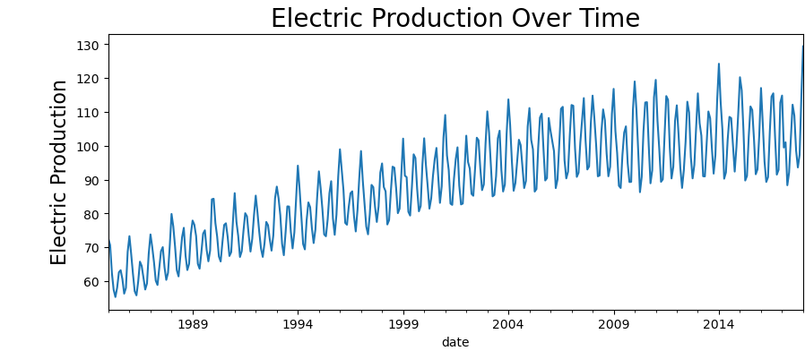
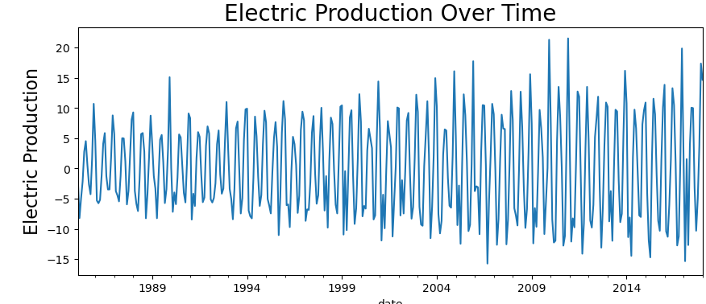
Problem
Time series
ARIMA
SARIMA
Comparison
Limitations
VAR
Conclusion
ARIMA
Treatment of
data
Data processing:
Monthly Electric production : 1/1/1985 -> 1/1/2018
Stationarity in trend (Test: ADF, d=1)
Test: ADF
Stationarity
Notes:
the steps that were followed for the development of the ARIMA model are as follows:
checked if there is missing data in the series for thereplaceby valuesequal to averagesmonthly valuesrelating to a year.
Then I checked the stationarity in trend of the series by the ADF statistical test in our case the series is stationary which meansthat we do not need to do the differentiation process therefore I=0 and by conclusion the model the ARIMA mode will be considered asan ARMA model.
Then I checked the seasonality within the series, then the series is subjected to a differentiation operation = xt-xt-365. by conclusionthe ARIMA mode model will be considered as a SARMA model.
Furthermore, I estimated the parameters p and q using respectively the 2 curves AC and PAC
P: AR model order
Q: MA model order.
The values ​​obtained for these parameters are: p=0, d=0 and q=35. this allowed us to conclude that the model is of type MA(35)
the Lujngbox statistical test shows that the preventive residuals of this model are white noise.
Finally the ARIMA(0, 0, 35) model is ready to predict future values ​​for the 5 days of the year from January 2017.
Listedeeeeeeeeeeeeeeeeeeeeeeeeeeeeeeeeeeee

Slide 5
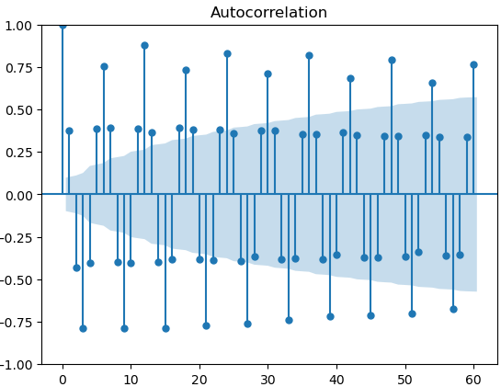
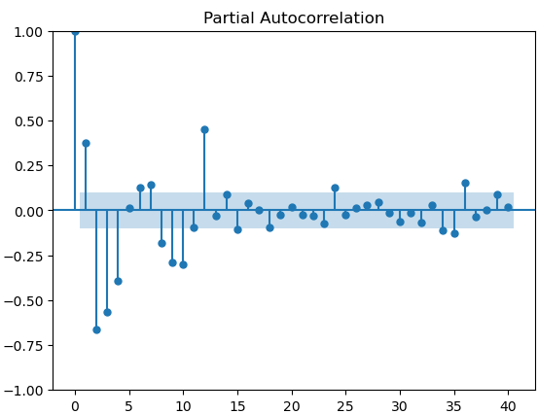
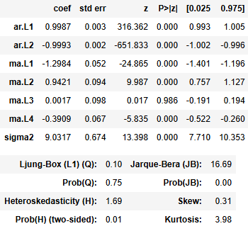

Problem
Time series
ARIMA
SARIMA
Comparison
Limitations
VAR
Conclusion
ARIMA
Parameter estimation:ARIMA p=2, d=1, and q=4
Estimate of
settings
Model Summary
Model Summary
ARIMA(2,1,4) model ready for prediction
ARIMA model
Notes:
the steps that have been takenfor the development ofARIMA model are likesequels:
check if we have datamissing in the series forTHEreplacebyvaluesequal to averagesof themonthly values ​​relating to ayear.
Then I checked the stationarity bytrend of the series by the testADF statistics in our case the seriesis stationary which means that we haveno need to do the process ofdifferentiation therefore I=0 and byconclusion the model the modeARIMA will be considered as aARMA model.
Then I checked the seasonalitywithin the series, then the series issubjected to an operation ofdifferentiation= xt-xt-365. byconclusion the model the modeARIMA will be considered as aSARMA model.
Furthermore, I estimated the parametersp and q using respectively the2 AC and PAC curves
P: AR model order
Q: MA model order.
The values ​​obtained from these parametersare: p=0, d=0 and q=35. this has usallowed us to conclude that the model istype MA(35)
the Lujngbox statistical test showsthat the considerate residuals of thismodel are white noise.
Finally the ARIMA(0, 0,35) is ready to predict the valuesfutures for the 5 days of the yearJanuary 2017.
Listedeeeeeeeeeeeeeeeeeeeeeeeeeeeeeeeeeeee

Slide 6
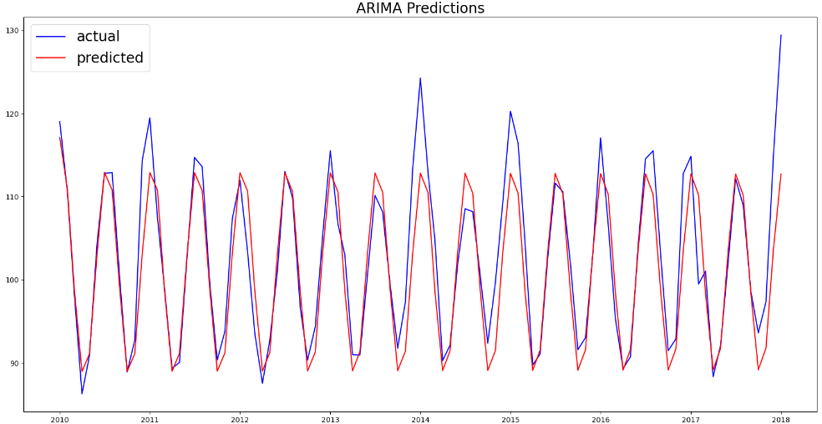
Problem
Time series
ARIMA
SARIMA
Comparison
Limitations
VAR
Conclusion
ARIMA
ARIMA Predictions:
Notes:
the steps that have been takenfor the development ofARIMA model are likesequels:
check if we have datamissing in the series forTHEreplacebyvaluesequal to averagesof themonthly values ​​relating to ayear.
Then I checked the stationarity bytrend of the series by the testADF statistics in our case the seriesis stationary which means that we haveno need to do the process ofdifferentiation therefore I=0 and byconclusion the model the modeARIMA will be considered as aARMA model.
Then I checked the seasonalitywithin the series, then the series issubjected to an operation ofdifferentiation= xt-xt-365. byconclusion the model the modeARIMA will be considered as aSARMA model.
Furthermore, I estimated the parametersp and q using respectively the2 AC and PAC curves
P: AR model order
Q: MA model order.
The values ​​obtained from these parametersare: p=0, d=0 and q=35. this has usallowed us to conclude that the model istype MA(35)
the Lujngbox statistical test showsthat the considerate residuals of thismodel are white noise.
Finally the ARIMA(0, 0,35) is ready to predict the valuesfutures for the 5 days of the yearJanuary 2017.
Listedeeeeeeeeeeeeeeeeeeeeeeeeeeeeeeeeeeee

Slide 7
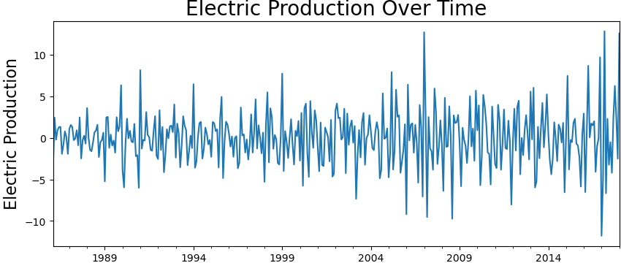
Problem
Time series
ARIMA
SARIMA
Comparison
Limitations
VAR
Conclusion
SARIMA
Treatment of
data
Data processing:
Monthly Electric production : 1/1/1985 -> 1/1/2018
Stationarity in trend (Test: ADF, d=1)
Removal of seasonality
Test: ADF
Seasonality
Xt-X(t-12)
Notes:
the steps that were followed for the development of the ARIMA model are as follows:
checked if there is missing data in the series for thereplaceby valuesequal to averagesmonthly valuesrelating to a year.
Then I checked the stationarity in trend of the series by the ADF statistical test in our case the series is stationary which meansthat we do not need to do the differentiation process therefore I=0 and by conclusion the model the ARIMA mode will be considered asan ARMA model.
Then I checked the seasonality within the series, then the series is subjected to a differentiation operation = xt-xt-365. by conclusionthe ARIMA mode model will be considered as a SARMA model.
Furthermore, I estimated the parameters p and q using respectively the 2 curves AC and PAC
P: AR model order
Q: MA model order.
The values ​​obtained for these parameters are: p=0, d=0 and q=35. this allowed us to conclude that the model is of type MA(35)
the Lujngbox statistical test shows that the preventive residuals of this model are white noise.
Finally the ARIMA(0, 0, 35) model is ready to predict future values ​​for the 5 days of the year from January 2017.
Listedeeeeeeeeeeeeeeeeeeeeeeeeeeeeeeeeeeee

Slide 8
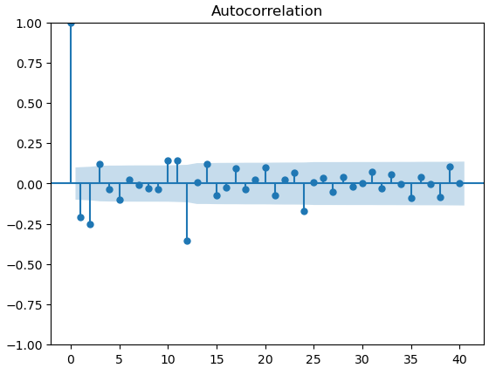
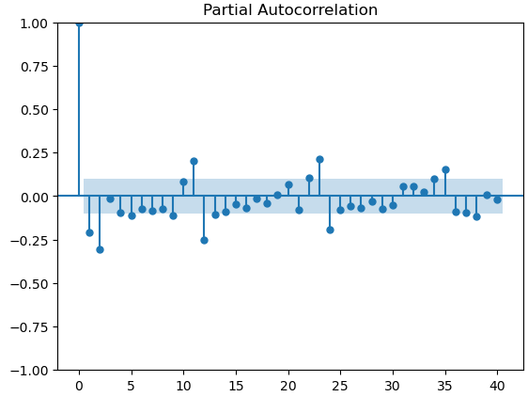

Problem
Time series
ARIMA
SARIMA
Comparison
Limitations
VAR
Conclusion
SARIMA
Parameter estimation:SARIMA P=2, D=1, and Q=3
Estimate of
settings
Ljungbox review
Verification and testing of residues (Ljungbox test)
SARIMA(2,1,4)(2, 1, 3, 12) model ready for prediction
Sarima(p,d,q)(P,D,Q,m)
ARIMA model
Notes:
the steps that have been takenfor the development ofARIMA model are likesequels:
check if we have datamissing in the series forTHEreplacebyvaluesequal to averagesof themonthly values ​​relating to ayear.
Then I checked the stationarity bytrend of the series by the testADF statistics in our case the seriesis stationary which means that we haveno need to do the process ofdifferentiation therefore I=0 and byconclusion the model the modeARIMA will be considered as aARMA model.
Then I checked the seasonalitywithin the series, then the series issubjected to an operation ofdifferentiation= xt-xt-365. byconclusion the model the modeARIMA will be considered as aSARMA model.
Furthermore, I estimated the parametersp and q using respectively the2 AC and PAC curves
P: AR model order
Q: MA model order.
The values ​​obtained from these parametersare: p=0, d=0 and q=35. this has usallowed us to conclude that the model istype MA(35)
the Lujngbox statistical test showsthat the considerate residuals of thismodel are white noise.
Finally the ARIMA(0, 0,35) is ready to predict the valuesfutures for the 5 days of the yearJanuary 2017.
Listedeeeeeeeeeeeeeeeeeeeeeeeeeeeeeeeeeeee

Slide 9
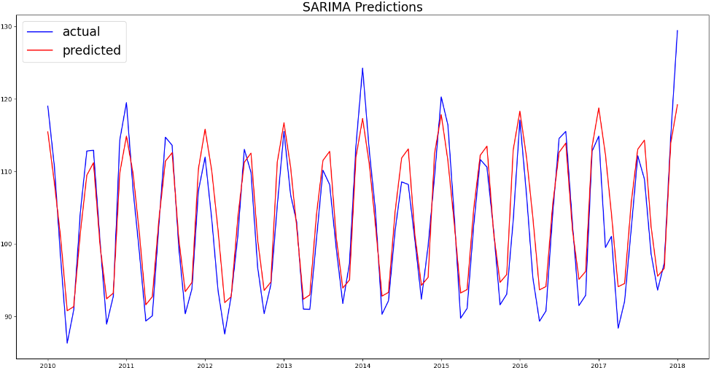
Problem
Time series
ARIMA
SARIMA
Comparison
Limitations
VAR
Conclusion
SARIMA
SARIMA Predictions:
Notes:
the steps that have been takenfor the development ofARIMA model are likesequels:
check if we have datamissing in the series forTHEreplacebyvaluesequal to averagesof themonthly values ​​relating to ayear.
Then I checked the stationarity bytrend of the series by the testADF statistics in our case the seriesis stationary which means that we haveno need to do the process ofdifferentiation therefore I=0 and byconclusion the model the modeARIMA will be considered as aARMA model.
Then I checked the seasonalitywithin the series, then the series issubjected to an operation ofdifferentiation= xt-xt-365. byconclusion the model the modeARIMA will be considered as aSARMA model.
Furthermore, I estimated the parametersp and q using respectively the2 AC and PAC curves
P: AR model order
Q: MA model order.
The values ​​obtained from these parametersare: p=0, d=0 and q=35. this has usallowed us to conclude that the model istype MA(35)
the Lujngbox statistical test showsthat the considerate residuals of thismodel are white noise.
Finally the ARIMA(0, 0,35) is ready to predict the valuesfutures for the 5 days of the yearJanuary 2017.
Listedeeeeeeeeeeeeeeeeeeeeeeeeeeeeeeeeeeee

Slide 10

Problem
Time series
ARIMA
SARIMA
Comparison
Limitations
VAR
Conclusion
Comparison:
SARIMA
SARIMA model has a lower RMSE compared to the ARIMA model which means SARIMA is more accurate
ARIMA
Notes:
the steps that have been takenfor the development ofARIMA model are likesequels:
check if we have datamissing in the series forTHEreplacebyvaluesequal to averagesof themonthly values ​​relating to ayear.
Then I checked the stationarity bytrend of the series by the testADF statistics in our case the seriesis stationary which means that we haveno need to do the process ofdifferentiation therefore I=0 and byconclusion the model the modeARIMA will be considered as aARMA model.
Then I checked the seasonalitywithin the series, then the series issubjected to an operation ofdifferentiation= xt-xt-365. byconclusion the model the modeARIMA will be considered as aSARMA model.
Furthermore, I estimated the parametersp and q using respectively the2 AC and PAC curves
P: AR model order
Q: MA model order.
The values ​​obtained from these parametersare: p=0, d=0 and q=35. this has usallowed us to conclude that the model istype MA(35)
the Lujngbox statistical test showsthat the considerate residuals of thismodel are white noise.
Finally the ARIMA(0, 0,35) is ready to predict the valuesfutures for the 5 days of the yearJanuary 2017.
Listedeeeeeeeeeeeeeeeeeeeeeeeeeeeeeeeeeeee

Slide 11
Problem
Time series
ARIMA
SARIMA
Comparison
Limitations
VAR
Conclusion
Limitations of ARIMA
Uni variable: receives a single variable as input
Interaction between parameters: ignores one variable over the others
Limitations of SARIMA
Uni variable: receives a single variable as input
Limited to Fixed Seasonality: assumes constant seasonal patterns, making it less effective for time series with evolving or irregular seasonal components
Notes:
Unfortunately, the ARIMA modelproposed is suomihas a limitationthrough hisinability to beapply to aset ofsettingsweatherat a time.
This leads us tothink of iintroduce amulti solutionvaried. byconsequence I haveoffers asecond solutiontitled by:

Slide 12
Problem
Time series
ARIMA
SARIMA
Comparison
Limitations
VAR
Conclusion
Outlook
Looking forward, we aim to explore multivariate time series analysis, which will allow us to incorporate multiple influencing factors simultaneously, enhancing the robustness and accuracy of our forecasting models. This advancement will enable us to adapt more dynamically to the complexities of electric production forecasting, ensuring our models remain effective in supporting energy management and policy development. Modify models more inorder to achieve better results
Notes:
Future workwill be focused onthe extension ofthe use ofalldataweather,as
the direction of the wind, thewind speed,humiditymaximum,humidityminimum, pointsdew andpressureatmospheric.

Slide 13
Problem
Time series
ARIMA
SARIMA
Comparison
Limitations
VAR
Conclusion
VAR method
Multivariate VAR model for short-term forecasting
Notes:
An additional solution that fits within the framework of STD:

Slide 14
Problem
Time series
ARIMA
SARIMA
Comparison
Limitations
VAR
Conclusion
MethodologyVAR
Data processing
ADF stationarity test
Stationarity in series trend
Offset selection
Model order estimation
Treatment of
data:
Test: ADF
Offset selection
Model order
Notes:
This figure illustratesarchitectureoverallVAR systempropose :
The systemproposed receives inenter a filewhich brings together allthe settingsmetrologicalfor the stationBeirut on aperiod of01/01/2006 to12/31/2016.
The settingsare: TMIN….
The systemdevelopedgenerates aVAR modelallowing topredict thefuture valuesof the first 4days of January2017.
Indeed, thesteps that wereexecuted for thedevelopmentof the VAR modelare as follows:
treatmentof thedatamissing,
a teststatisticalADF isnecessaryto checktherestationarityseriesin trend.
identifiesthe order ofmodelproposed bythe smallestamong the 4criteriafollowing:
AKAKI,FUCK, FINALPREDICTIONeh HANATHAT A.In ourmodel orderis 3.
estimates thecoefficientsmatricesfor themodels thatrepresentedthe 9settingsmeteorologyques.
The test ofcausality ofgranger,we haveallowed toknowthe interactionenter themvariablesmeteorologyques (foreachvariablemeteorologythataddicted,what arethe variablesendogenousWho,together,cancause oraffect thisvariable).
Example:for thevariablemeteorologicale depanadantRR, whatare variableendogenouswhich cansetscause oraffect the
precipitation.
_ Eventuallythe teststatisticalCUSUMconfirms thestability ofVAR model.
So the modelVAR(3) is readyto predict thefuture valuesfor the 4first days ofJanuary 20017,for the 9settingsweatherfrom the stationBeirut.

Slide 15
Problem
Time series
ARIMA
SARIMA
Comparison
Limitations
VAR
Conclusion
MethodologyVAR
Estimation of coefficients
matrices:This involves calculating how each variable affects the others over the specified lags.
5. Model stability test: CUSUM:(Cumulative Sum of Squares) test to verify that our model’s parameters remain consistent
Estimate of
coefficients
Stability test
of the model
Notes:
This figure illustrates the overall architecture of the proposed VAR system:
The proposed system receives as input a file which brings together all the metrological parameters for the Beirut station over a period from 01/01/2006 to 12/31/2016.
The parameters are: TMIN….
The developed system generates a VAR model to predict future values ​​for the first 4 days of January 2017.
Indeed, the steps that were carried out for the development of the VAR model are as follows:
processing of missing data,
an ADF statistical test is necessary to check the stationarity of the trending series.
identifies the order of the proposed model by the smallest among the following 4 criteria:
AKAKI, FUCK, FINAL PREDICTION eh HANA QUEUNE. In our model the order is 3.
estimates matrix coefficients for models that represent the 9 weather parameters.
The granger causality test allowed us to know the interaction between meteorological variables (for each dependent meteorological variable, what are the endogenous variables which, together, can cause or affect this variable).
Example: for the meteorological variable RR, what are the endogenous variables that can together cause or affect the
precipitation.
_ Finally, the CUSUM statistical test confirms the stability of the VAR model.
Therefore, the VAR(3) model is ready to forecast the future values ​​for the first 4 days of January 20017, for the 9 meteorological parameters of the Beirut station.

Slide 16
Problem
Time series
ARIMA
SARIMA
Comparison
Limitations
VAR
Conclusion
MethodologyVAR
LM tests residuals
VAR model ready for prediction
LM tests
residuals:
VAR model
Notes:
This figure illustrates the overall architecture of the proposed VAR system:
The proposed system receives as input a file which brings together all the metrological parameters for the Beirut station over a period from 01/01/2006 to 12/31/2016.
The parameters are: TMIN….
The developed system generates a VAR model to predict future values ​​for the first 4 days of January 2017.
Indeed, the steps that were carried out for the development of the VAR model are as follows:
processing of missing data,
an ADF statistical test is necessary to check the stationarity of the trending series.
identifies the order of the proposed model by the smallest among the following 4 criteria:
AKAKI, FUCK, FINAL PREDICTION eh HANA QUEUNE. In our model the order is 3.
estimates matrix coefficients for models that represent the 9 weather parameters.
The granger causality test allowed us to know the interaction between meteorological variables (for each dependent meteorological variable, what are the endogenous variables which, together, can cause or affect this variable).
Example: for the meteorological variable RR, what are the endogenous variables that can together cause or affect the
precipitation.
_ Finally, the CUSUM statistical test confirms the stability of the VAR model.
Therefore, the VAR(3) model is ready to forecast the future values ​​for the first 4 days of January 20017, for the 9 meteorological parameters of the Beirut station.

Slide 17
Problem
Time series
ARIMA
SARIMA
Comparison
Limitations
VAR
Conclusion
Conclusions
This project has demonstrated the application of SARIMA and ARIMA models to forecast the U.S. Electric Production Index. The SARIMA model, in particular, has shown a superior ability to account for seasonal variations, as evidenced by a lower RMSE compared to the ARIMA model. However, the presence of autocorrelation in the residuals, as indicated by the Ljung-Box test, suggests the need for further refinement of the model
Notes:
This thesis analyzes the advantages and disadvantages of numerical models by proposing alternative approaches.
Alternative approach to strengthening IM:
Data time series: SARMA, VAR and HP-VAR
Deep learning: LSTM recurrent neural network.
VAR solution
overcome the complexities of MN and overcome the shortcomings of those of ARIMA
reveal high precision and generalize over areas of reduced surface area (HP-VAR)

Slide 18
Thank you for your attention !

