Slide 1



Goertzel Filter
Microelectronics & HW/SW-Co-Design
Summer 2024 Homework
Prof. Dr. Peter Schulz
With VDHL Implementation
Ali Beiti Aydenlou
Roghieh Farajialamooti
Ghazaleh Hadian Ghahfarokhi
Seda Sensoy

Slide 2
Scope
Definition and Benefits of the Goertzel Algorithm
Design of a Goertzel Filter according to given specifications
Using Matlab to generate stimuli data
Goertzel Filter VHDL implementation
Development of a test bench
Test cases
EPWave Simulation Design
Verification
Conclusion
2 / 20

Slide 3
What is Goertzel Algorithm?
A digital signal processing algorithm
Efficient computation of individual discrete Fourier transform (DFT) bins
Detecting the presence of specific frequencies in a signal
An efficient alternative to the fast Fourier transform (FFT)
Notes:
Definition:
The Goertzel Algorithm is a digital signal processing algorithm used primarily for detecting specific frequencies within a signal.
Used for efficient computation of individual discrete Fourier transform (DFT) bins.
It is particularly useful for detecting the presence of specific frequencies in a signal. The algorithm provides an efficient alternative to the fast Fourier transform (FFT) for applications that require only a few frequency components.

Slide 4
Benefits of Goertzel Algorithm?
Efficiency in Frequency Detection
Simplicity and Ease of Implementation
Real-time Processing Capabilities
Versatility in Applications
Flexibility in Implementation
4 / 20
Notes:
The Goertzel Algorithm is a powerful tool in digital signal processing (DSP) used primarily for detecting specific frequencies within a signal. Here are some of its key benefits:
Efficiency in frequency detection:
The Goertzel Algorithm is designed to detect specific frequencies. This makes it particularly efficient for applications where only a few frequencies are of interest. This means unlike the Fast Fourier Transform (FFT), which analyzes the entire frequency spectrum.
Also when we have a resource-constrained environments like embedded systems, it is very beneficial to analyze small number of frequencies. So the Goertzel Algorithm can be more computationally efficient than FFT.
Simplicity and Ease of Implementation:
The Goertzel Algorithm is straightforward to implement. It primarily involves recursive calculations that are easier to code and understand compared to the more complex FFT.
Real-time Processing Capabilities:
It has low latency: The Goertzel Algorithm can process data in real time with minimal delay. This is crucial for applications like speech prosessing where timely detection and processing of specific frequencies are essential.
Versatility in Applications:
The Goertzel Algorithm can be used in many different areas. TV remote, smart home devices, factory machines, hearing aids, Music and Sound processing, car monitoring systems, this algorithm makes sure these devices work well by finding the right signals quickly and using minimal power.
Flexibility in Applications: The Goertzel Algorithm can be implemented to various programming environments and hardware setups. This means it can work well with various devices, from simple microcontrollers to complex systems.
Customization for Specific Needs: Users can tailor the algorithm to their specific requirements, optimizing it

Slide 5
MATLAB - Discrete Signal Properties
These parameters are essential inputs for setting up and using the Goertzel Filter.
fs = 4e6; % Sampling frequency
f0 = 150e3; % Desired frequency
N = 135; % Number of samples
t = (0:N-1)*(1/fs); % timesteps for the desired number of samples
Notes:
Sampling Frequency (fs) determines how frequently we measure the signal. 4 MHz in HW
Desired Frequency (f0) is the frequency component we are interested in. Signal Frequency to detect is 150 KHz
Number of Samples (N) tells us how many data points we have to work with.Number of Samples in the dataset is 135
Time Steps (t) helps us relate each sample to its specific point in time
These parameters are essential inputs for setting up and using the Goertzel Filter effectively. They define the characteristics of the signal we're analyzing and how finely we're sampling it in time.

Slide 6
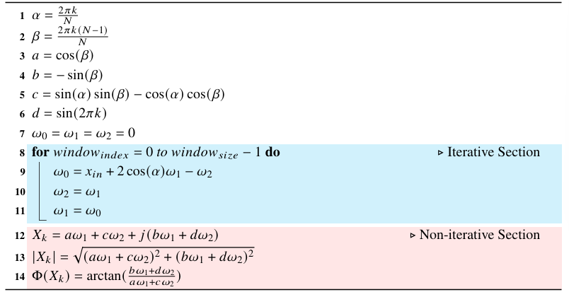
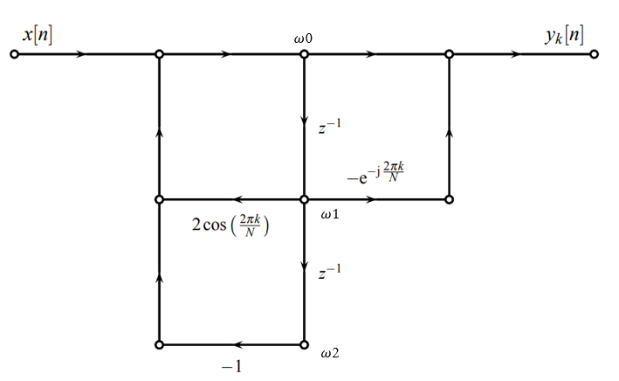
Goertzel Filter Basics
6 / 20
Notes:
State Variables (w0 w1 w2) Intermediate variables that store the state of the filter at each step. They represent the internal memory of the system.
The Goertzel algorithm operates by recursively updating these state variables, effectively filtering and detecting specific frequency components in the input signal. The signal flow graph illustrates how the input signal and state variables interact to produce the output signal, providing a clear visual representation of the process.

Slide 7
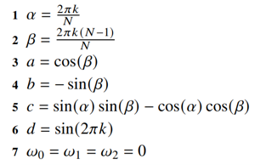
Goertzel Filter Basics
MATLAB
k = round(N * f0/fs) ; %frequency index(k=6)
alpha = 2 * pi * k / N;
beta = 2 * pi * k * (N-1)/N;
a = cos(beta)
b = -1 * sin(beta)
c = sin(alpha) * sin(beta) - cos(alpha) * cos(beta)
d = sin(2 * pi * k)
Notes:
1-6 These are the precalculated constants of goertzel filter
7-These are the internal states
These are calculated by the given values in our HW.

Slide 8
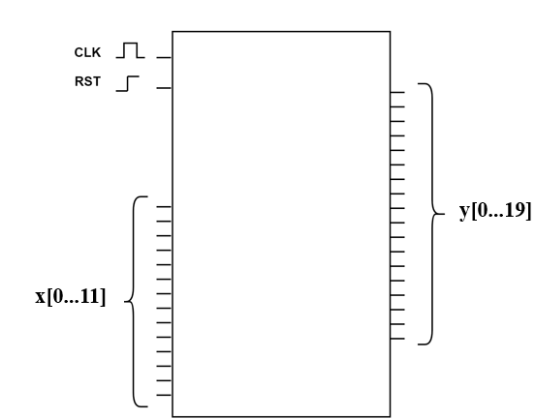
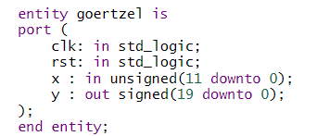
VHDL Implementation- Design
Notes:
clk: in std_logic; -- operations are performed on Rising and falling edge.
rst: in std_logic; -- rising edge signal, all internal and external signals are set to 0.
x : in unsigned(11 downto 0); -- input values have 5v DC bias and multiplied by 100 to remove the negative samples.

Slide 9
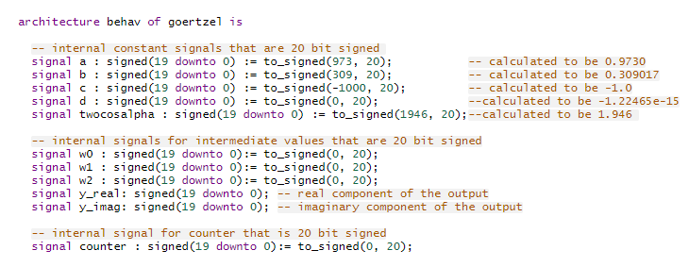
VHDL - Implementation- Design
Architectural Behaviour of Goertzel
Created by Ali
Notes:
All of them are signed
Signed: + and – values 20 bits
A,b,c,d size:20 bits. Declaration : initialisation
With to_signed we Convert 973(decimal) to 20 bit binary number
These are internal signals for intermediate values.
Y real and y imaginary are the outputs. As the output has imaginary real part.
W’s are extracted from paper,
When Counter reaches N(Number of samples)

Slide 10
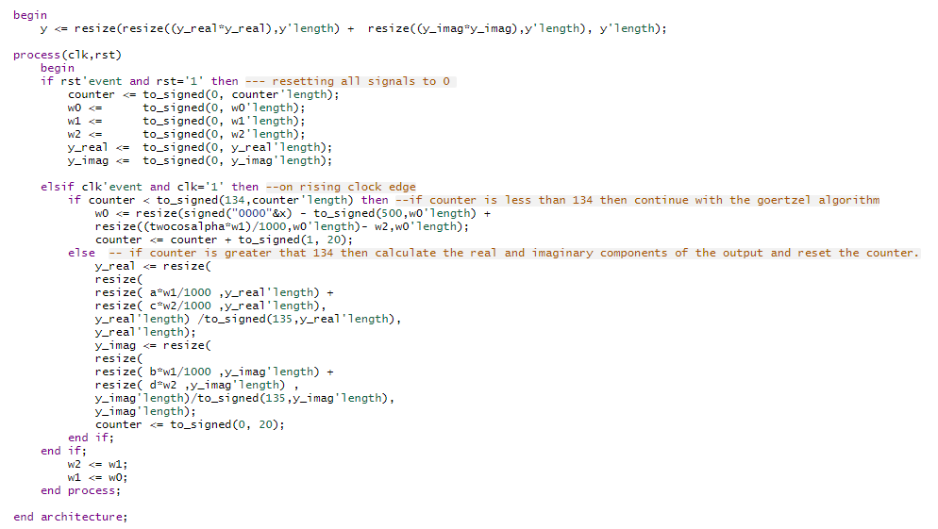
VHDL Implementation- Design
Created by Ali

Slide 11
Verification
11 / 20

Slide 12
MATLAB - Generate 12-bit offset binary data with phase shift
sine_freq = [150e3 149e3 151e3 5e3 200e3] ; % Different frequencies for sine waves
phases = [0 30 45 90 120] ; % Different phases in radians
for i = 1:length(sine_freq)
for j = 1:length(phases)
data(:,1) = round((sin(2*pi*sine_freq(i) *t + phases(j)* pi/180) + 5) *100);
filename = 'sine_'+string(sine_freq(i)) + 'KHz_' +string(phases(j)) + 'deg.txt';
dlmwrite(filename, data(:,1), ' ');
end
end
Created by Ghazaleh & Roghieh
Notes:
Similar code for all of these:
sine_freq
rect_freq
tria_freq

Slide 13
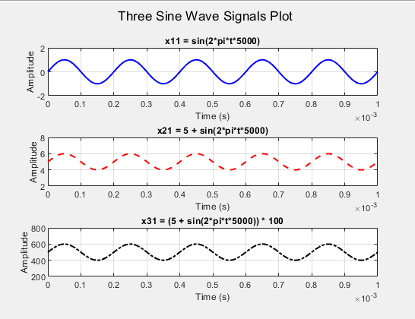
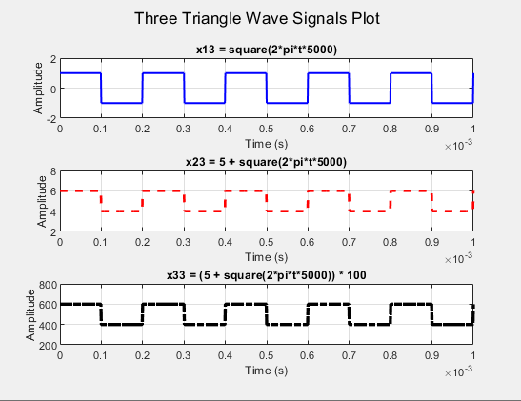
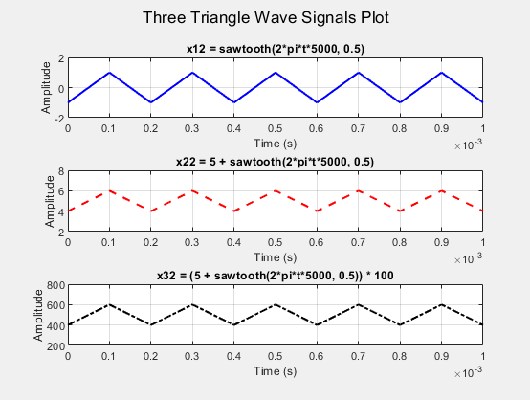
Scaled and Shifted Input Signal
Created by Ghazaleh & Roghieh
Notes:
Similar code for all of these:
sine_freq
rect_freq
tria_freq
Generating 12bit binary offset values

Slide 14
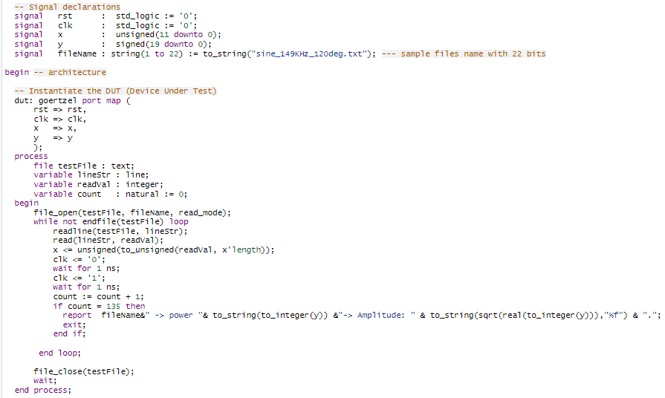
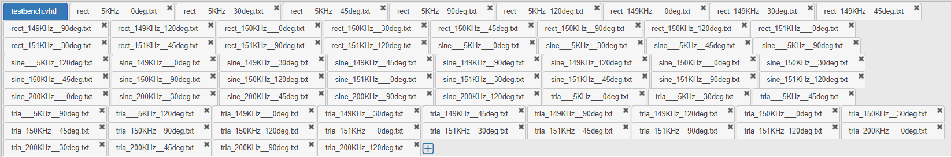
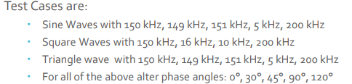
VHDL TEST BENCH
14 / 20
Created by Ali

Slide 15
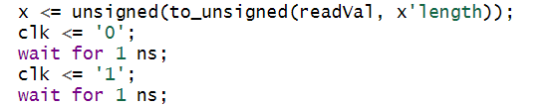
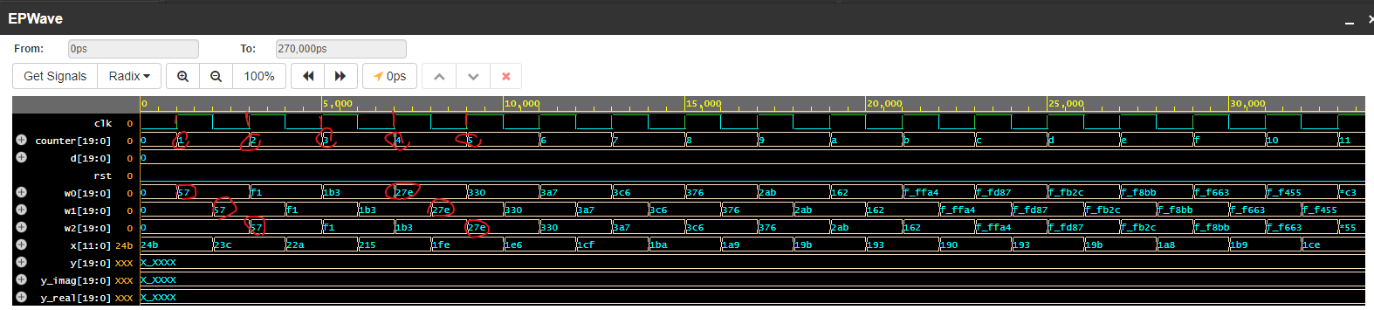
EPWave Simulation
Created by Ghazaleh & Roghieh

Slide 16
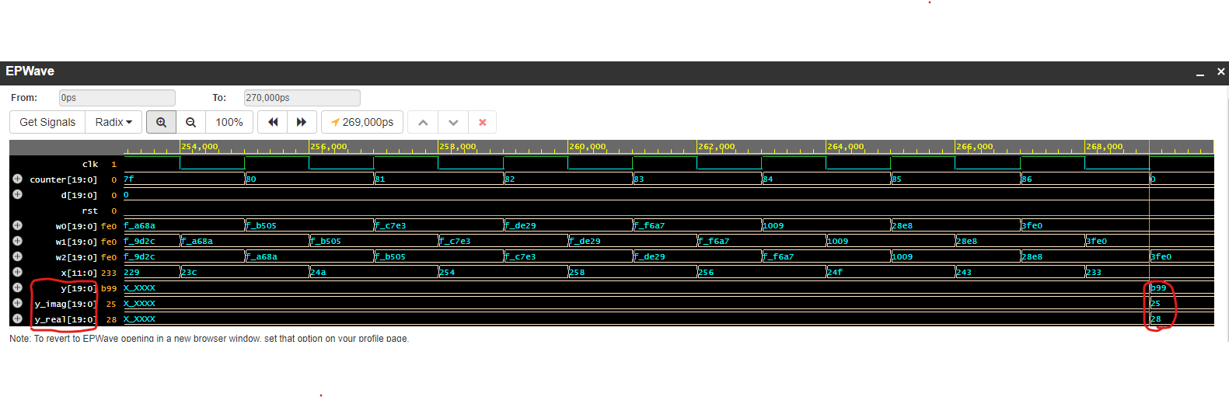
EPWave Simulation
Created by Ghazaleh & Roghieh

Slide 17
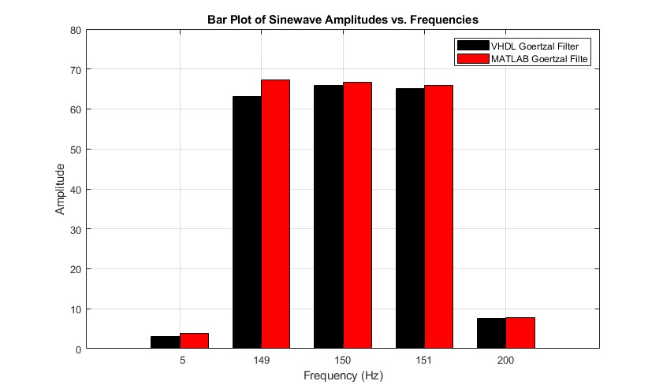
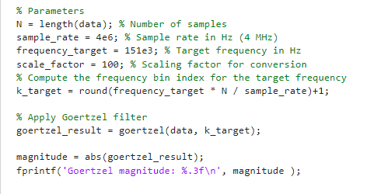
Result Comparison
150 Khz signal Detection of sinewave testcases
Created by Ghazaleh & Roghieh

Slide 18
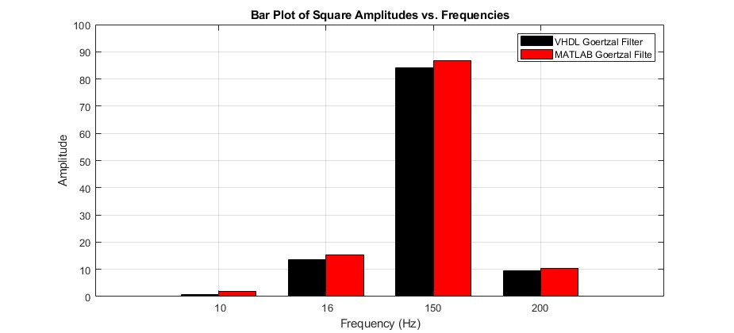
Result Comparison
150 Khz signal Detection of SQUAREWAVE testcases
Created by Ghazaleh & Roghieh

Slide 19
Conclusion
The Goertzel Algorithm is a Digital Signal processing technique used for efficient and fast calculation of individual DFT coefficients.
It provides a computationally efficient alternative to the Fast Fourier Transform (FFT) algorithm when the calculation of a specific frequency component is required rather than the entire spectrum. It is widely used in Dual-tone multi frequency(DTFM) application.
Created by Ghazaleh & Roghieh

Slide 20
References
Petr Sysel and Pavel Rajmic. “Goertzel algorithm generalized to non-integer multiples of fundamental frequency.” EURASIP Journal on Advances in Signal Processing 2012.
L. P. Ferreyro, M. García Redondo, M. R. Hampel, A. Almela, A. Fuster, J. Salum, J. M. Geria, J. Bonaparte, J. Bonilla-Neira, N. Müller, N. Karcher, O. Sander, M. Platino, M. Weber, A. Etchegoyen. “An Implementation of a Channelizer based on a Goertzel Filter Bank for the Read-Out of Cryogenic Sensors.” Journal of Instrumentation.

