Slide 1

Simulation of the SI and SIR Epidemiological Models
Hady Ziadeh
Shreyas Chaudhary
Subham Panda

Slide 2
Contents
Motivation
Introduction
Traditional Fully Mixed Modeling
Social Network based SI and SIR models
Methodology
Implementation - Code/Video/SS
Tables
Plots
Conclusion

Slide 3
Motivation
The SI (Susceptible-Infected) and SIR (Susceptible-Infected-Recovered) epidemiological models are essential for understanding infectious disease spread. The SI model, which focuses on susceptible and infected individuals, is useful for diseases that do not confer immunity post-infection. In contrast, the SIR model includes a recovered category, suitable for diseases were recovery grants immunity. Simulating these models helps predict outbreak trajectories, evaluate intervention impacts, and guide public health decisions. This is vital for efficient healthcare resource planning and reducing the societal impact of diseases.

Slide 4
Introduction
Agent-Based Modeling (ABM):
Utilizing Agent-Based Modeling (ABM) allows us to represent individuals as agents, each with specific characteristics and behaviors.
ABM is particularly effective in capturing the heterogeneity and interactions among individuals in a population.
Repast Simphony:
Repast Simphony serves as a powerful platform for implementing ABM and conducting simulations.
It provides a flexible and customizable environment for modeling complex systems, making it well-suited for studying disease spread dynamics.

Slide 5
Traditional Fully Mixed Modeling
Model Overview: Traditional fully mixed modeling in epidemiology employs Agent-Based Modeling (ABM) to study infectious disease spread within a population.
Homogeneous Interaction: Individuals in the population are considered homogeneous, with an equal chance of interacting with any other member.
Simulation Dynamics: Implemented through tools like Repast Simphony, the simulation tracks changes in the number of susceptible (S), infected (I), and recovered (R) individuals over time.
Key Model Parameters: Exploration of β (transmission rate) and γ (recovery rate) allows analysis of how contagiousness and recovery impact the epidemic trajectory.
Insights for Public Health: Findings from the simulation, visualized through charts, inform public health strategies by assessing the effectiveness of interventions and control measures.

Slide 6
Social Network based SI and SIR models
Realistic Interaction Modeling:
Acknowledges that individuals interact within specific social circles, unlike fully mixed models.
Network Structure Influence:
Represents individuals as nodes connected by social edges, impacting infectious disease transmission dynamics.
Contact-based Infection:
Individuals can only infect those directly connected in the social network, mirroring real-world transmission.
Synthetic Network Models:
Utilizes Small World and Barabasi-Albert models to generate realistic synthetic social networks.
Public Health Insights:
Enhances understanding of network impact on disease spread, assesses targeted interventions, and informs real-world public health strategies.

Slide 7
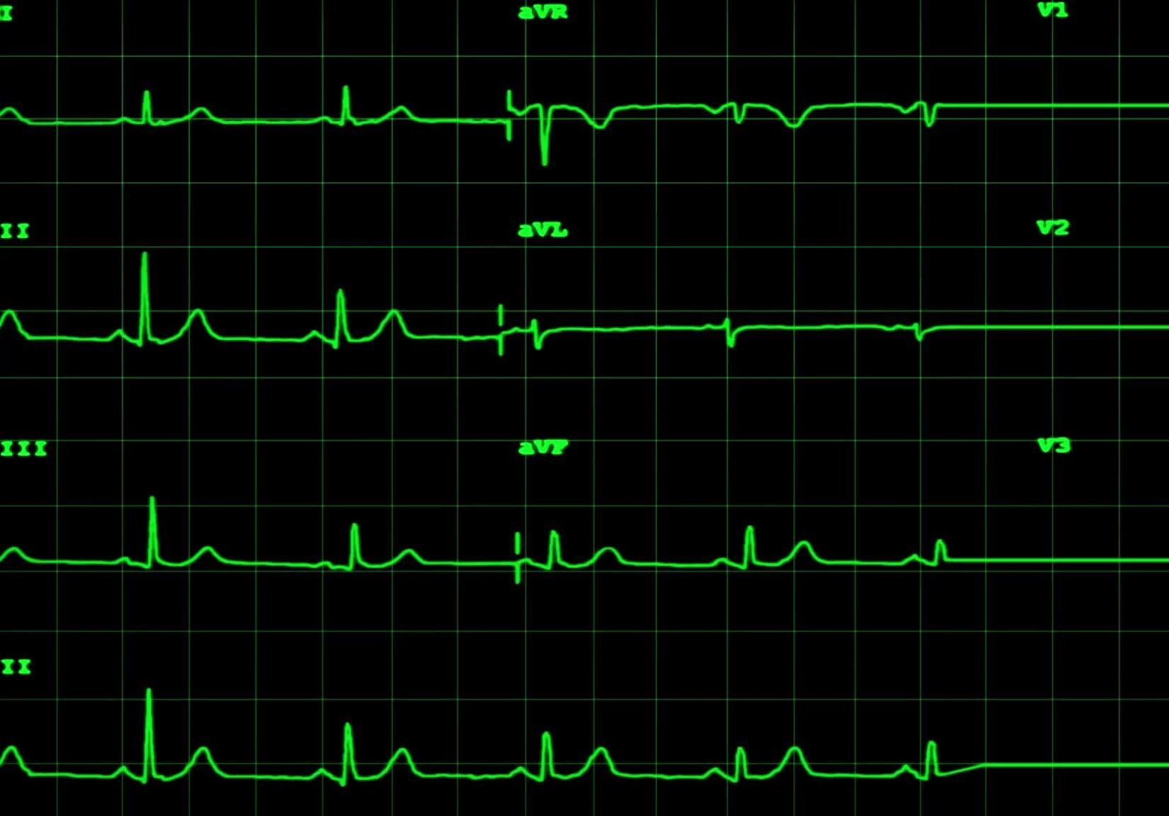
Methodology
We have used Repast Simphony to model disease spread scenarios with n number of individuals.
There are 2 parts of this project.
For Part A, we used the traditional fully mixed SI and SIR models
For Part B, The spread is limited to individuals in contact on the network. Small World and Barabasi-Albert models are used to generate the synthetic network. Similar to Part A, the objective is to analyze changes in the number of susceptible, infected, and recovered individuals over time with different β and γ values, using the synthetic networks

Slide 8
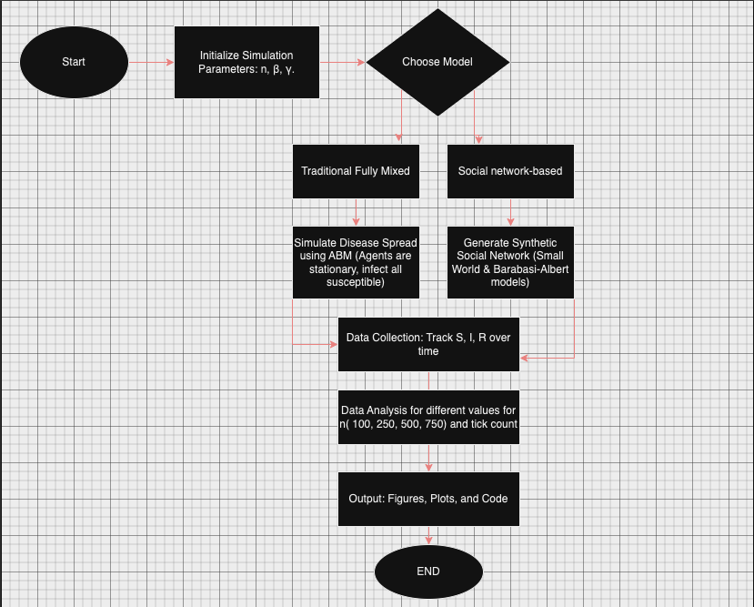

Slide 9
SI MODEL

Slide 10
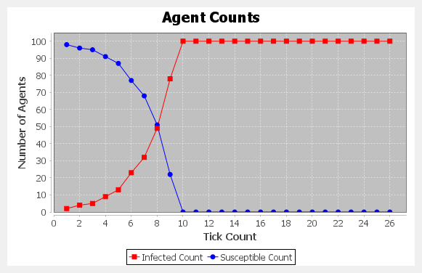
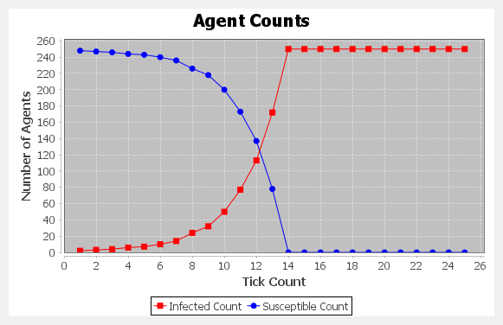
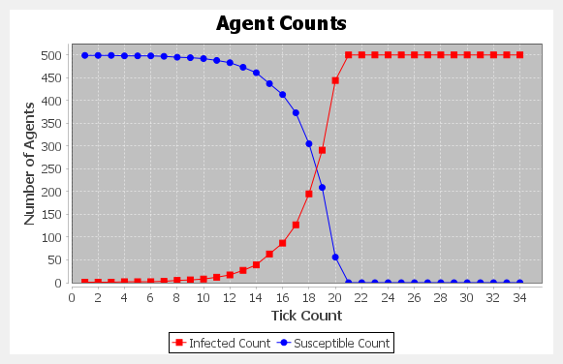
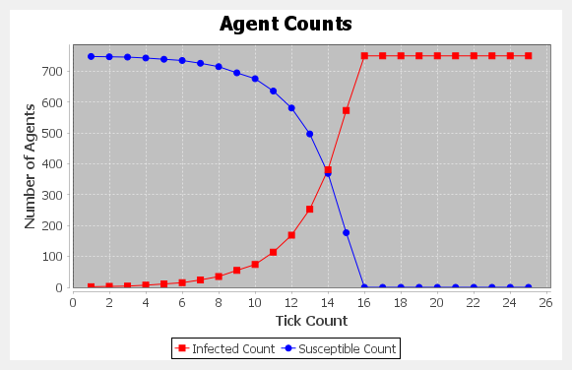
N = 100
N = 250
N = 500
β = 0.5
N = 750

Slide 11
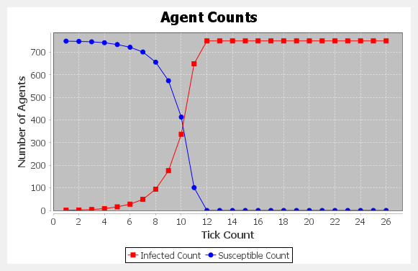
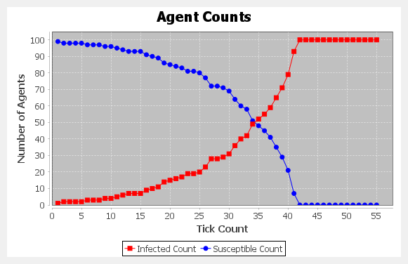
β = 0.1
β = 0.9

Slide 12
SIR MODEL

Slide 13
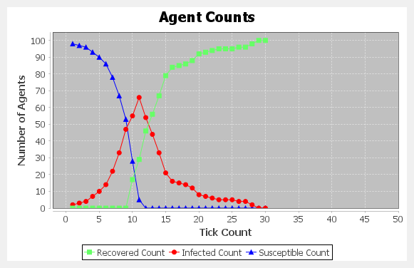
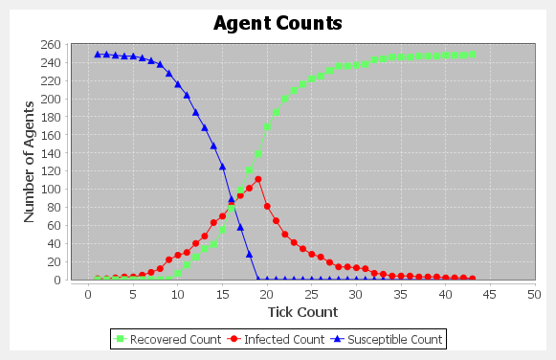
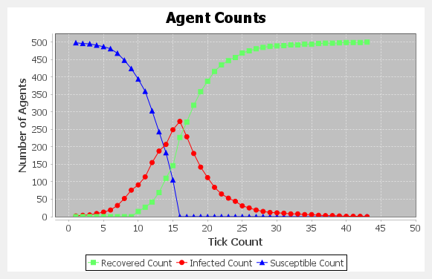
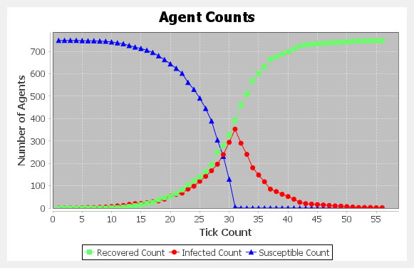
N = 100
N = 250
N = 500
β = 0.5 γ = 0.3
N = 750

Slide 14
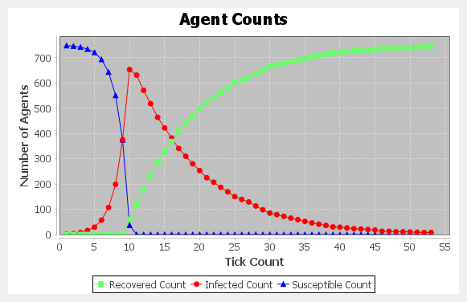
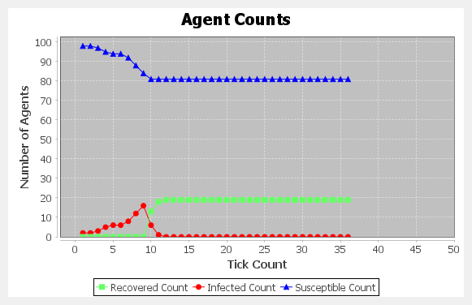
β = 0.3 γ = 0.8
β = 0.9
γ = 0.1

Slide 15
BARBASI – ALBERT / SI MODEL

Slide 16
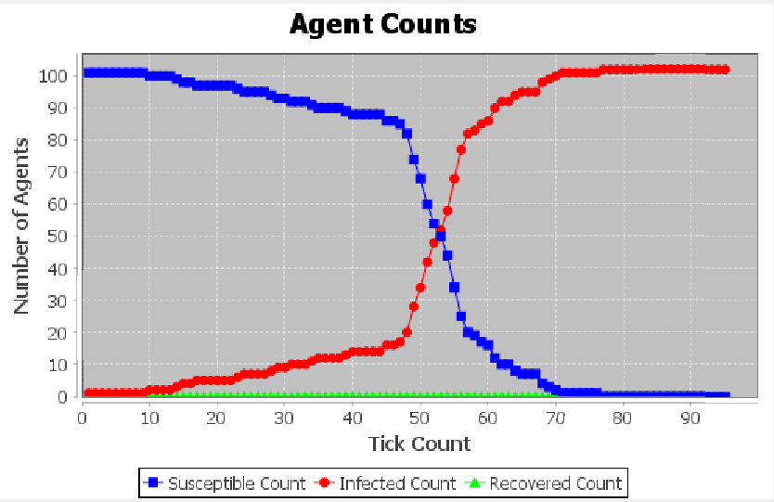
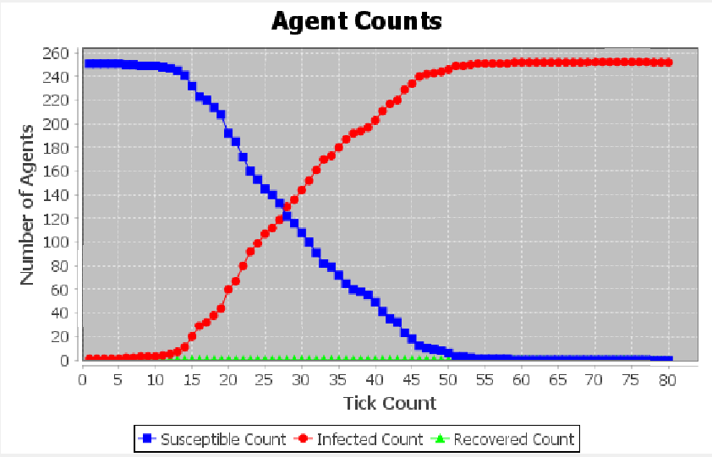
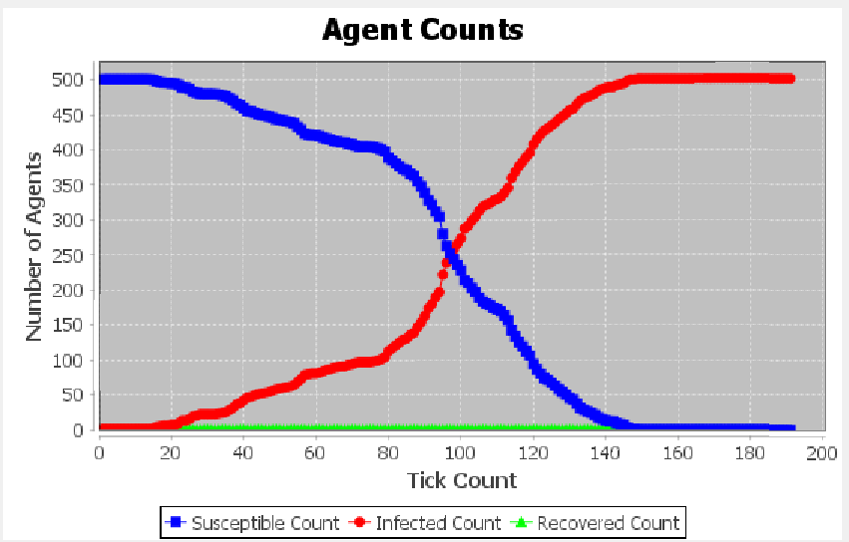
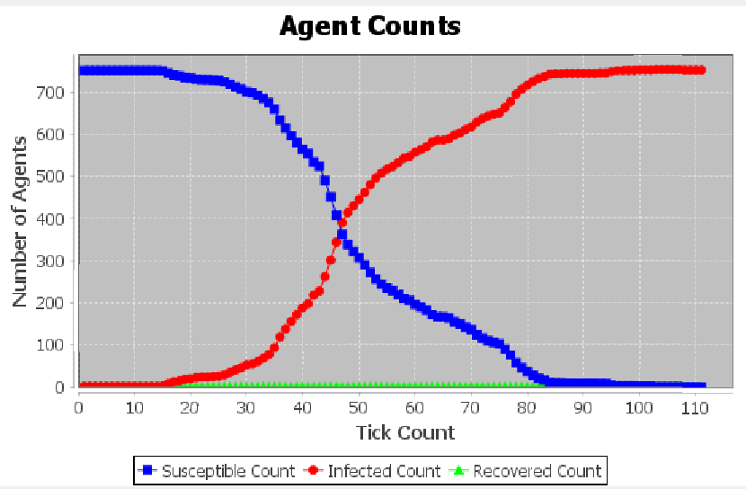
N = 100
N = 250
N = 500
β = 0.2
N = 750

Slide 17
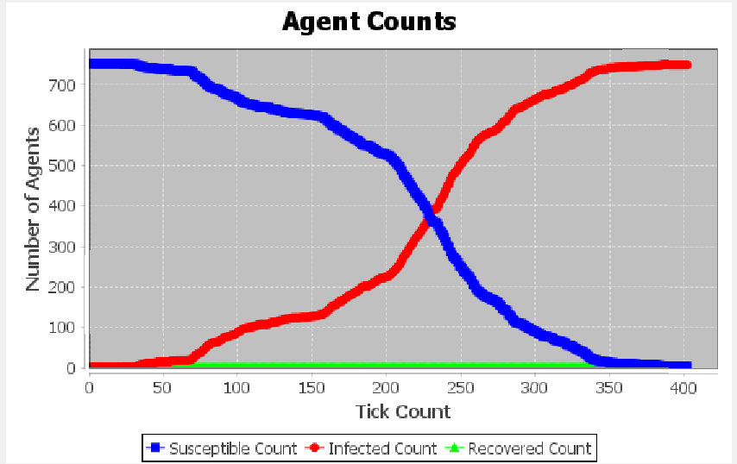
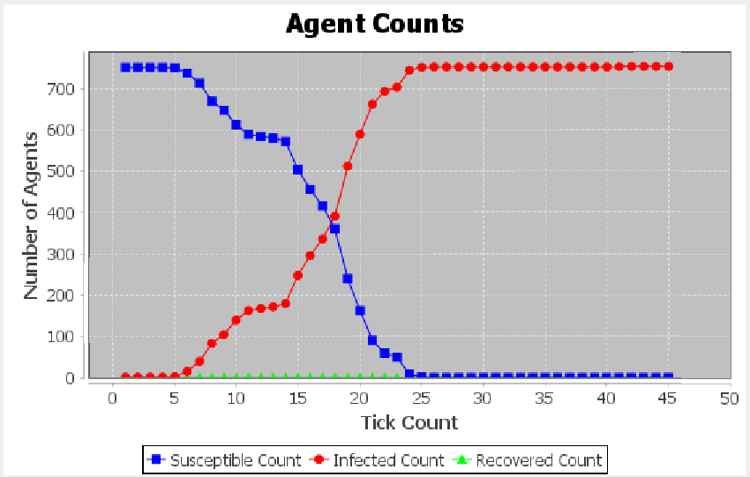
β = 0.8
β = 0.05

Slide 18
BARBASI – ALBERT / SIR MODEL

Slide 19
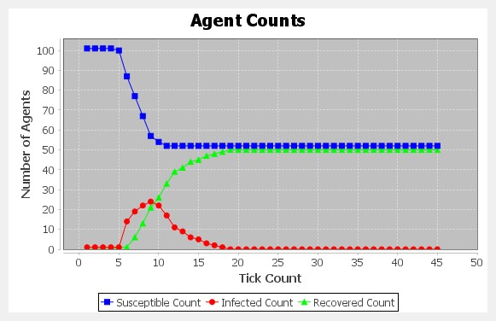
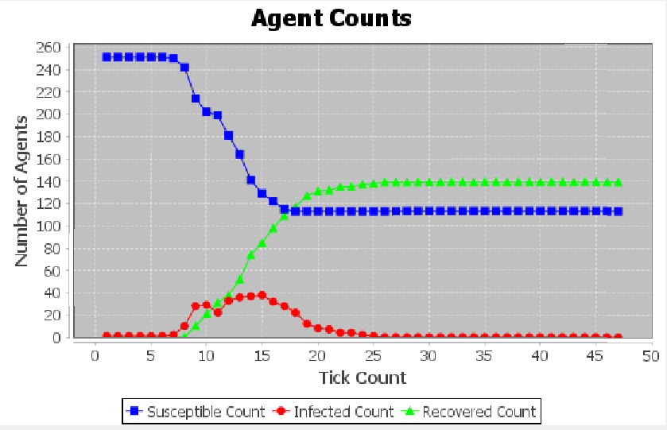
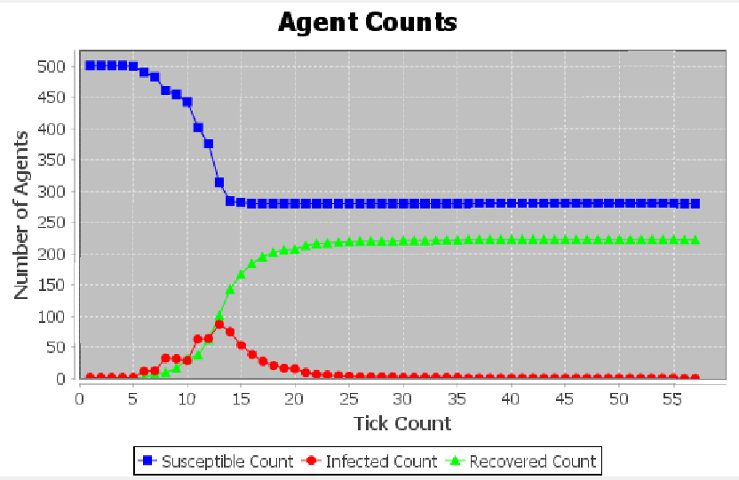
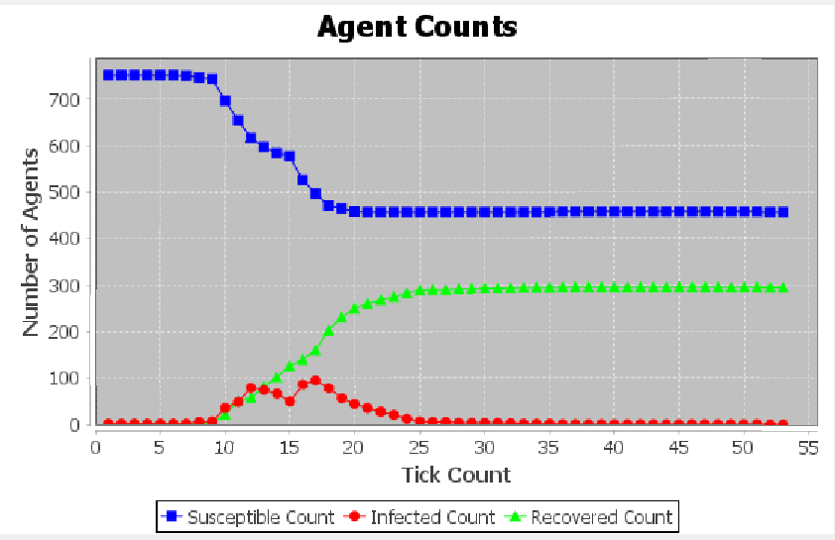
N = 100
N = 250
N = 500
β = 0.8 γ = 0.3
N = 750

Slide 20
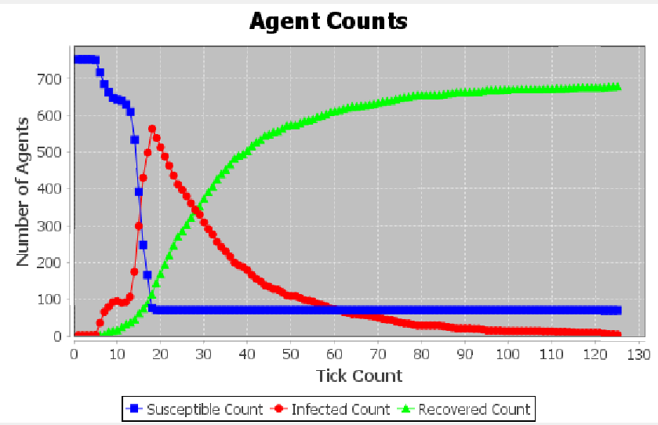
β = 1
γ = 0.05

Slide 21
WATTS STROGATZ - SI MODEL

Slide 22
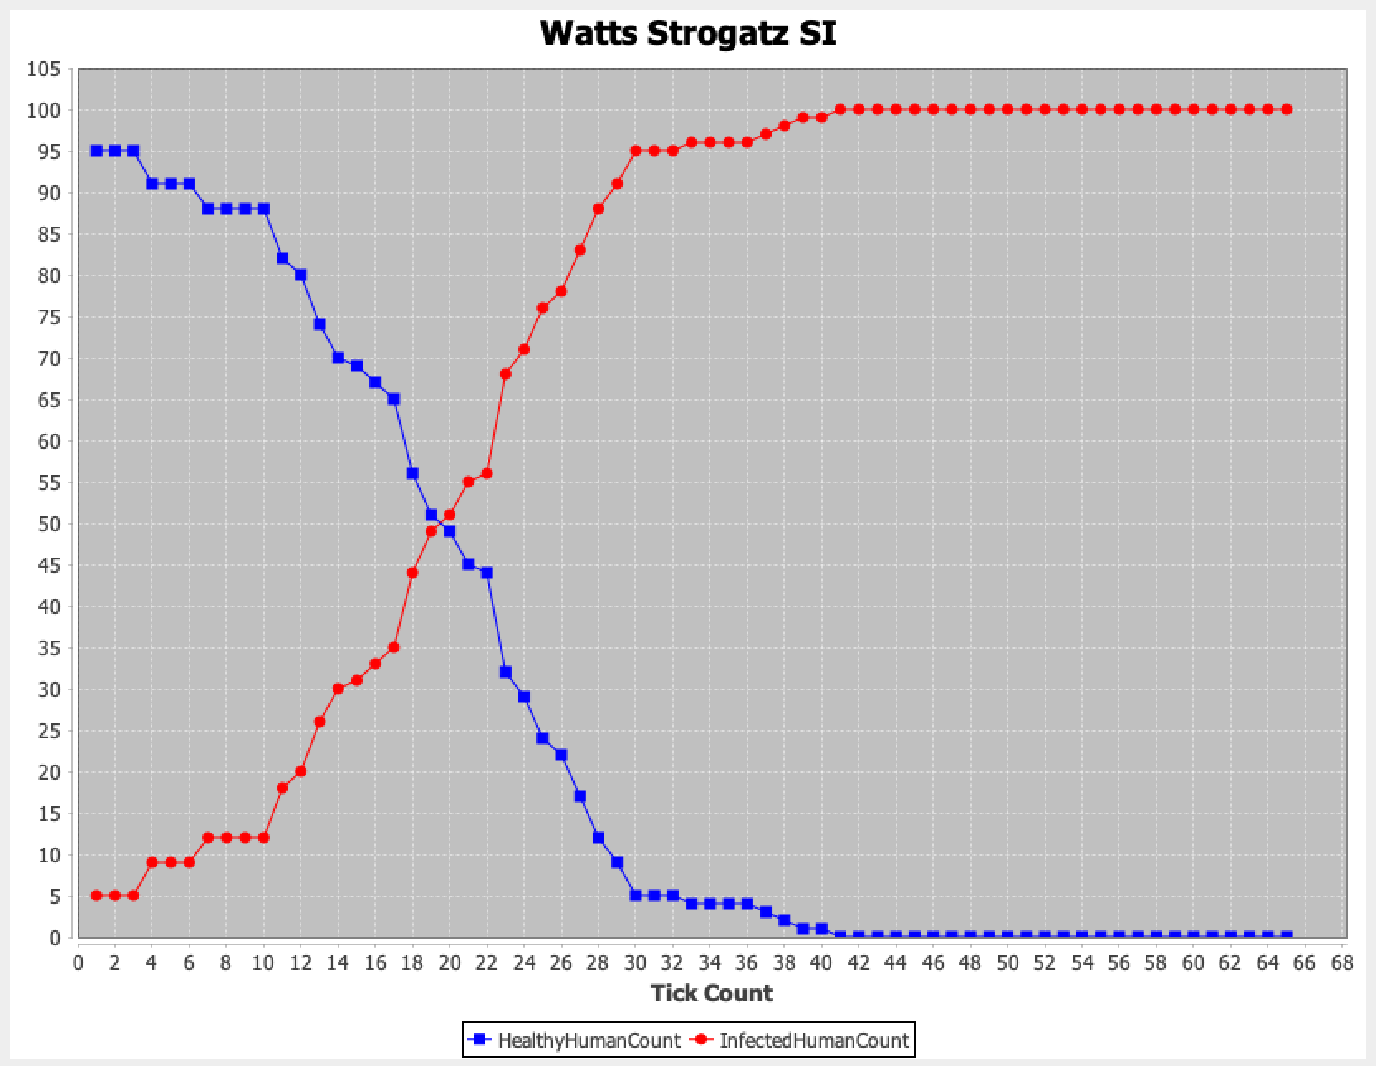
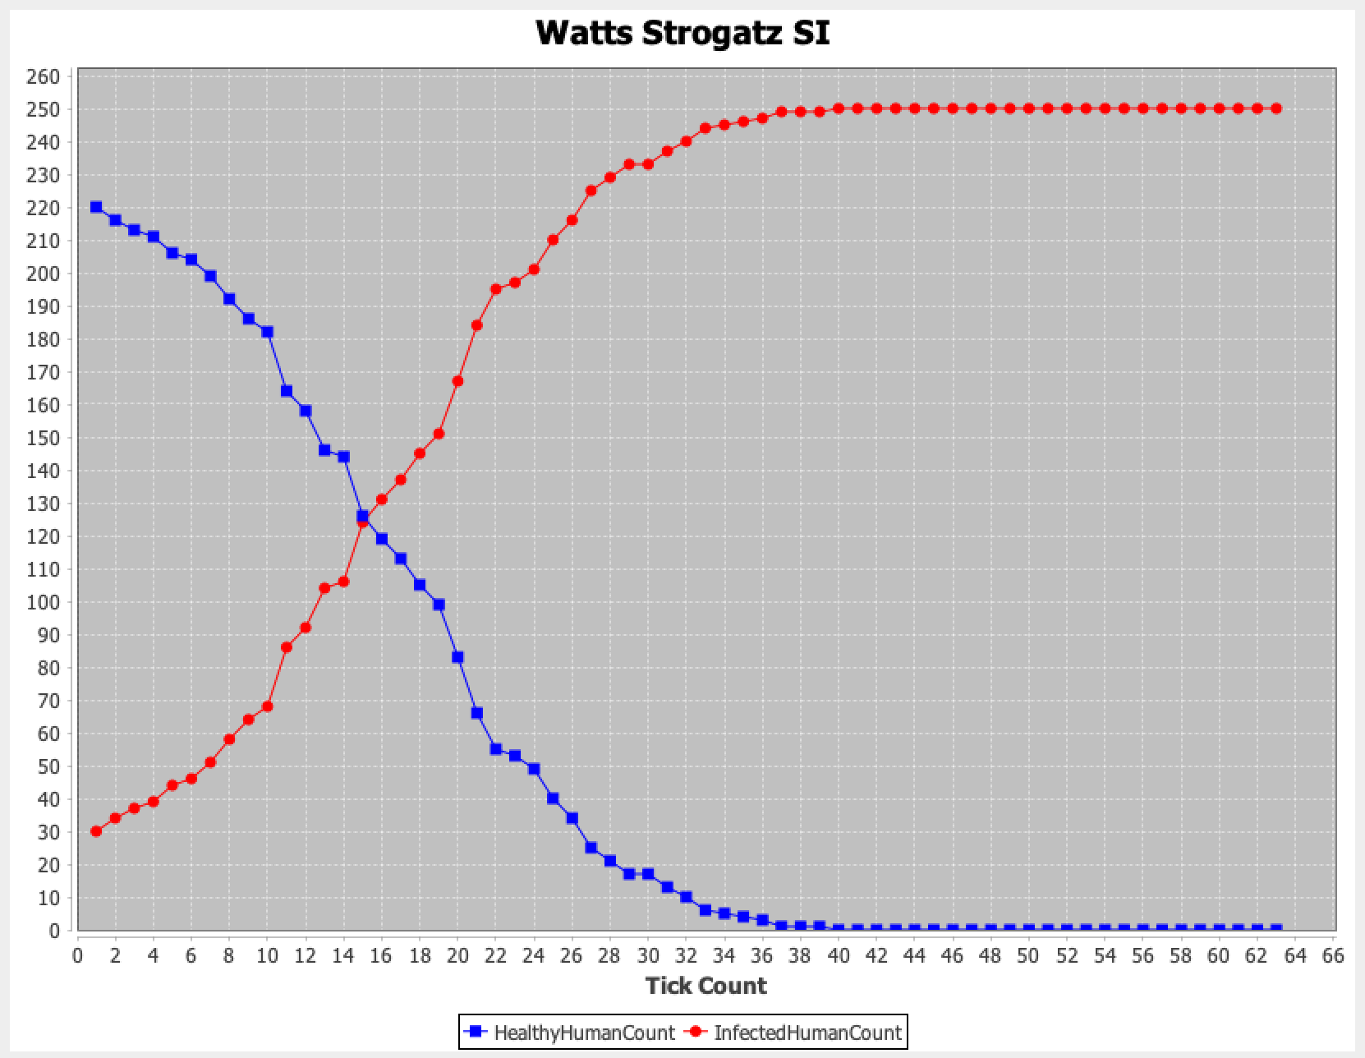
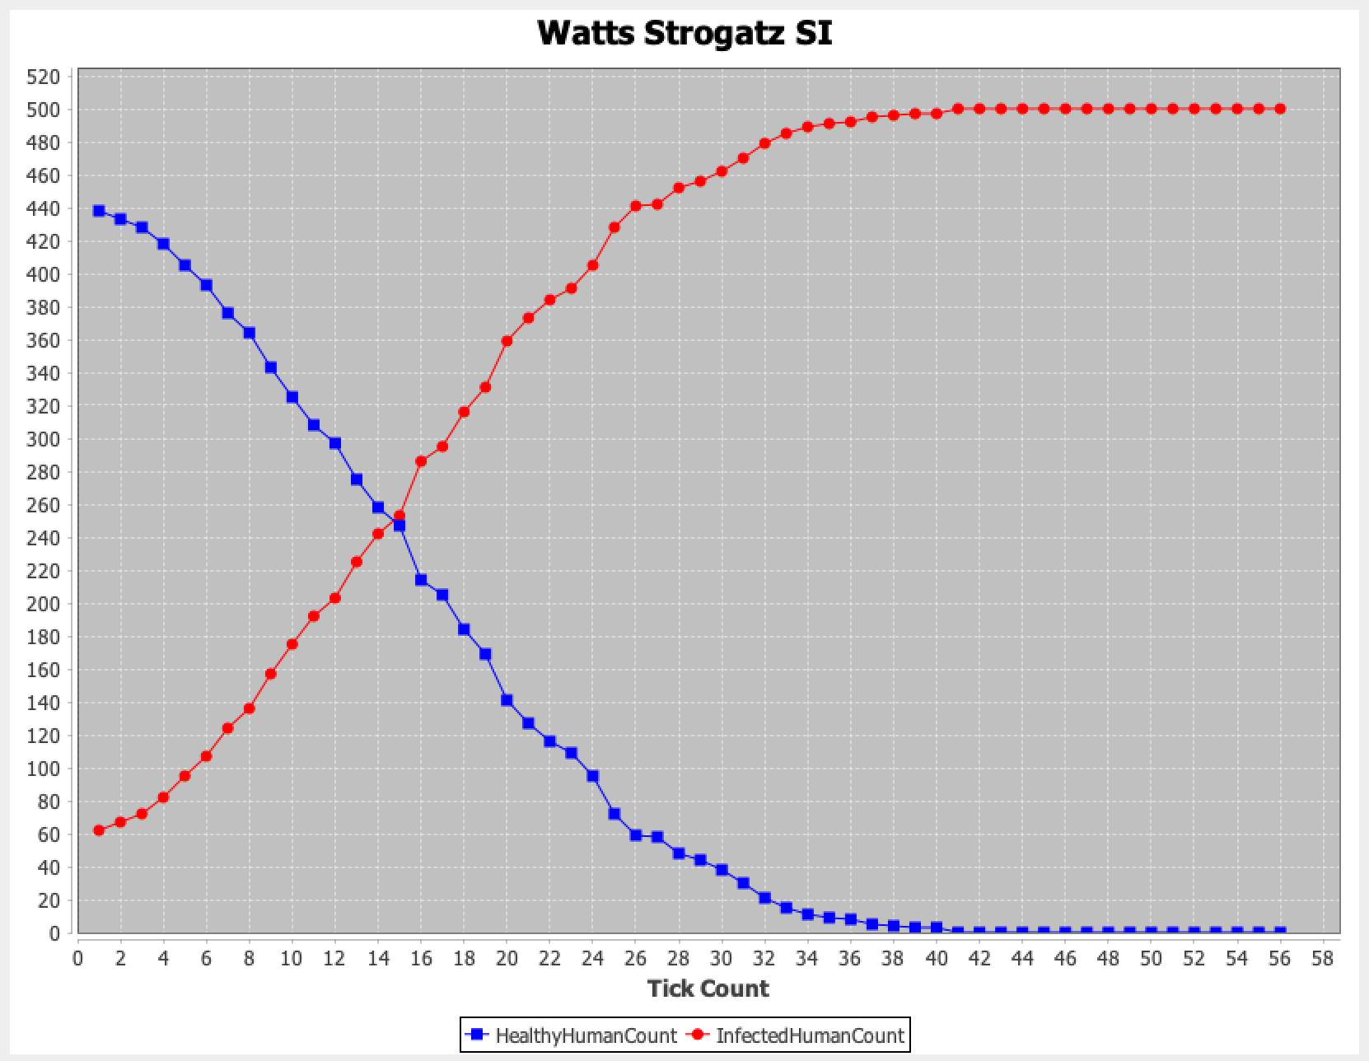
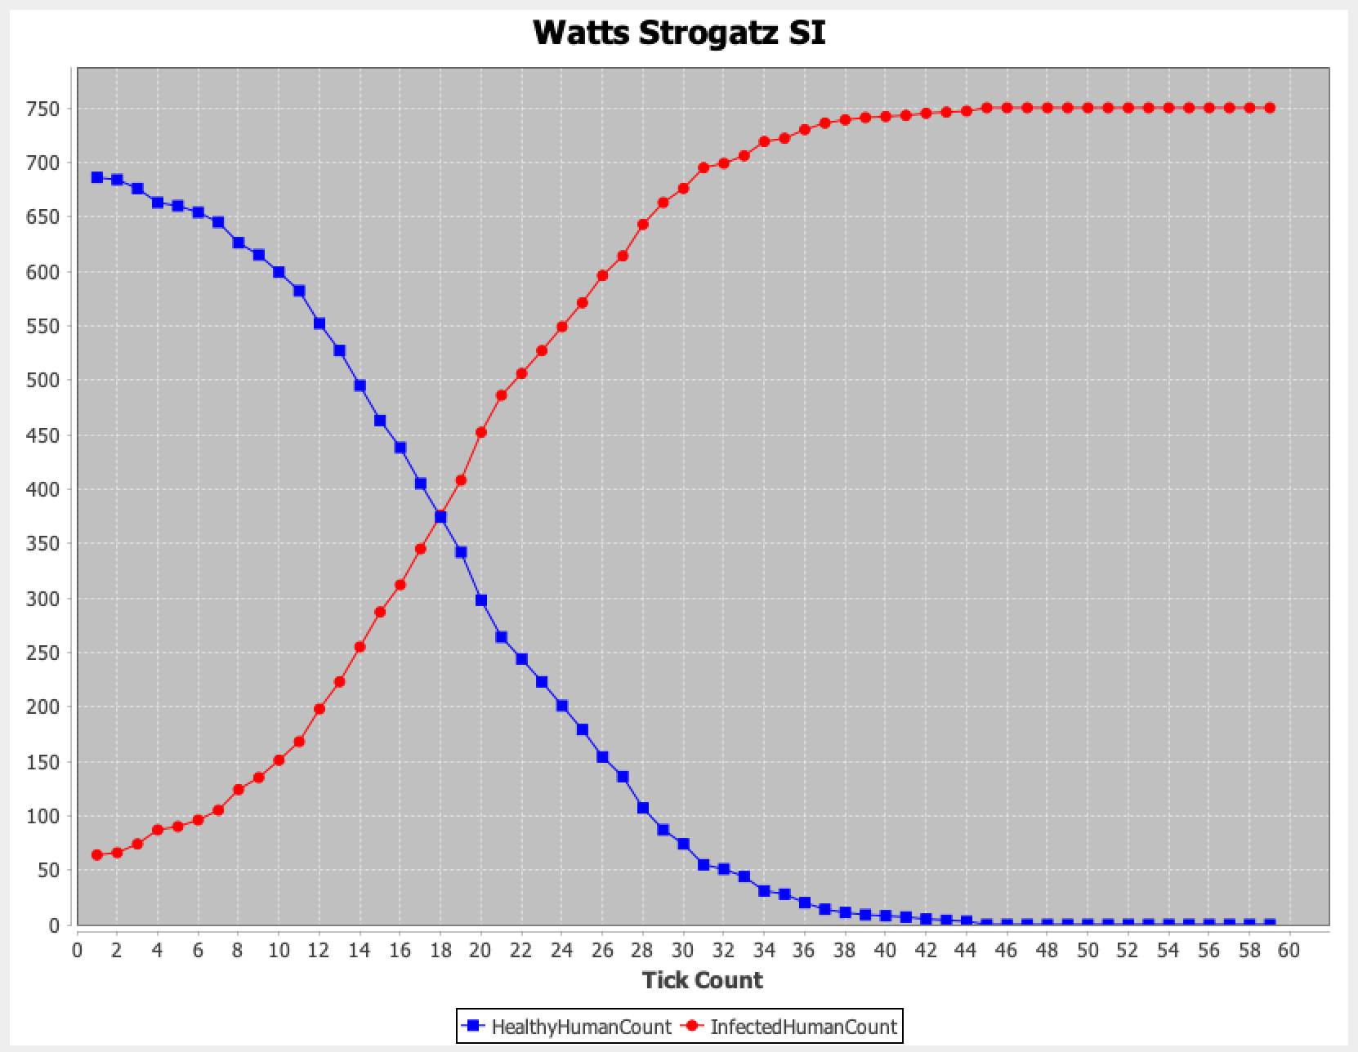
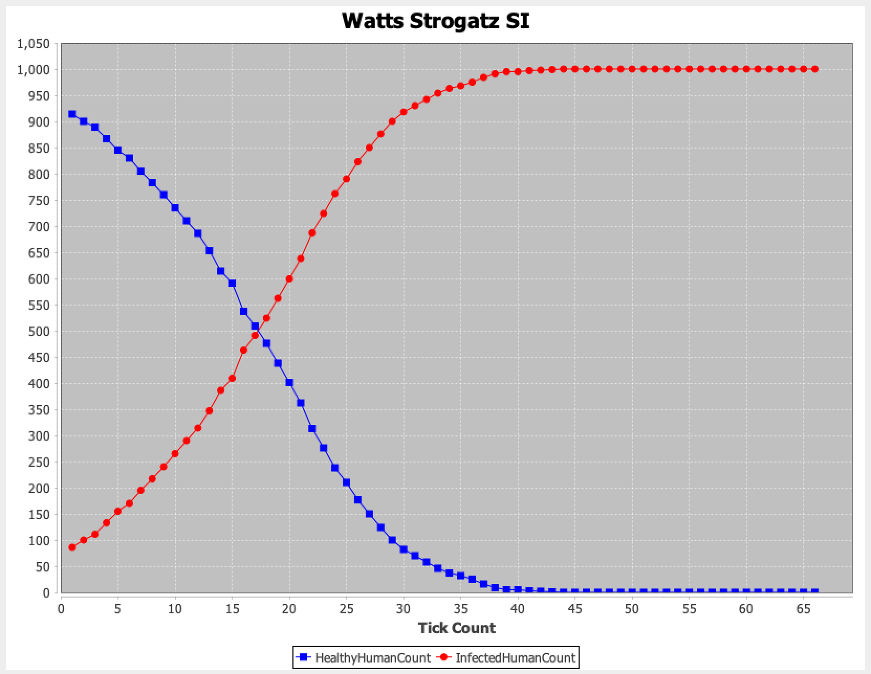
N = 100
N = 250
N = 500
β = 0.1
N = 750
N = 1000

Slide 23
WATTS STROGATZ - SIR MODEL

Slide 24
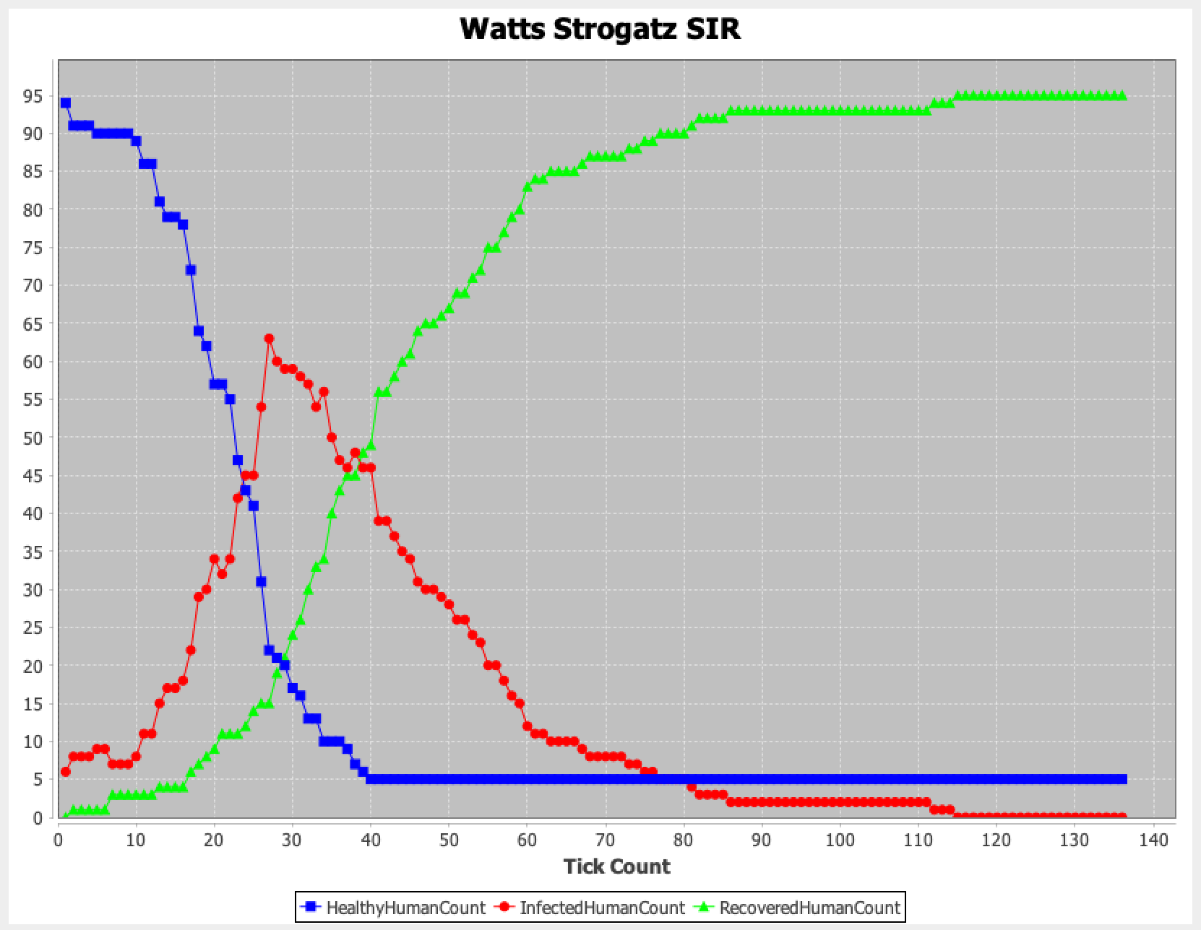
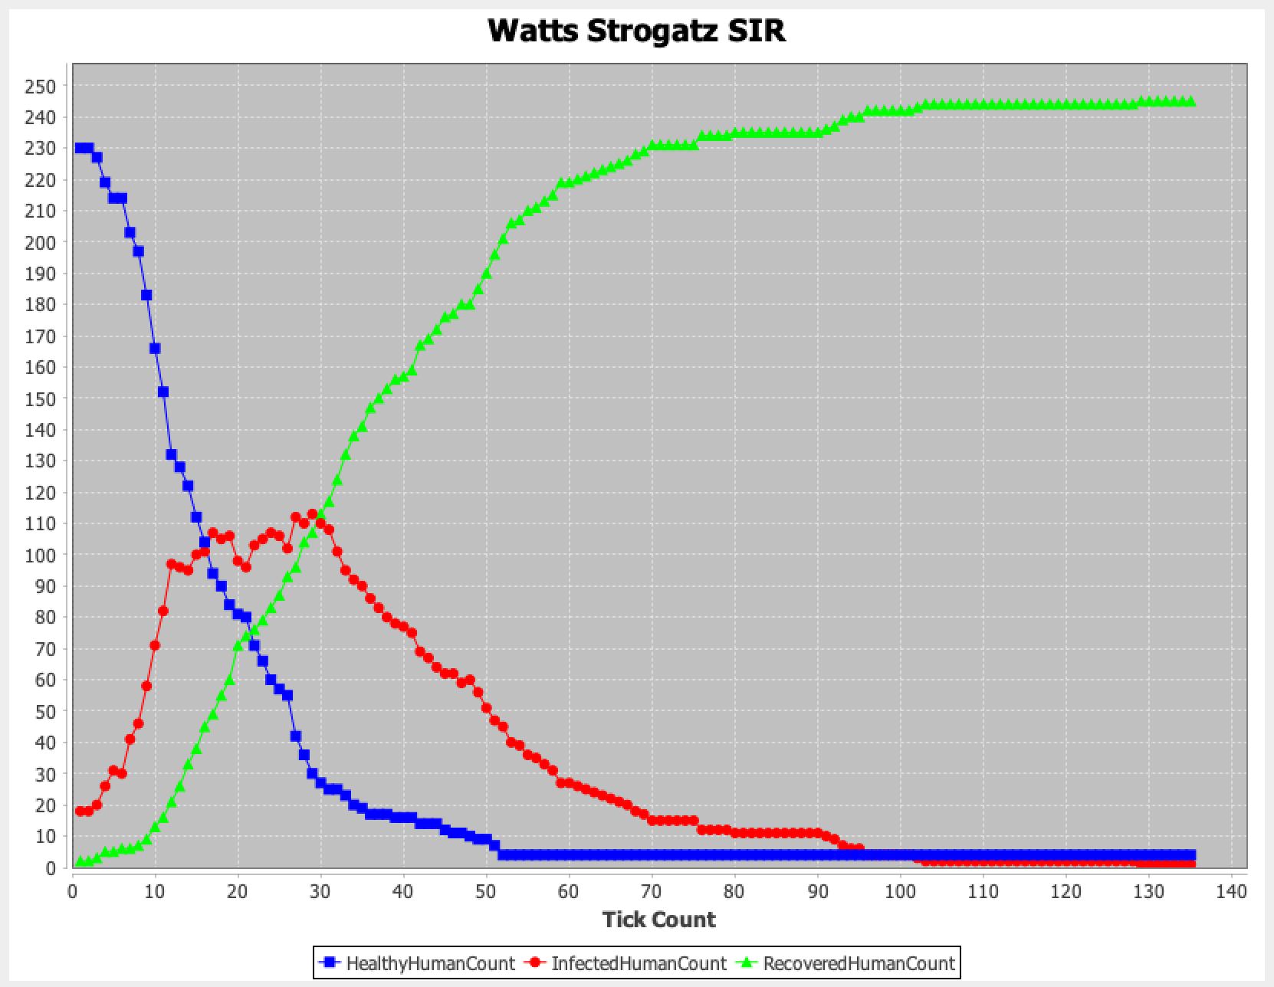
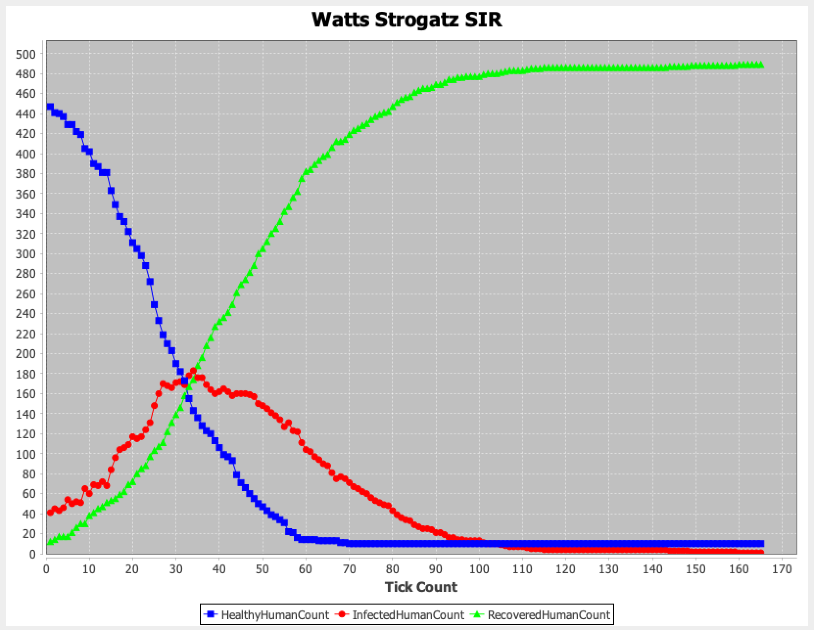
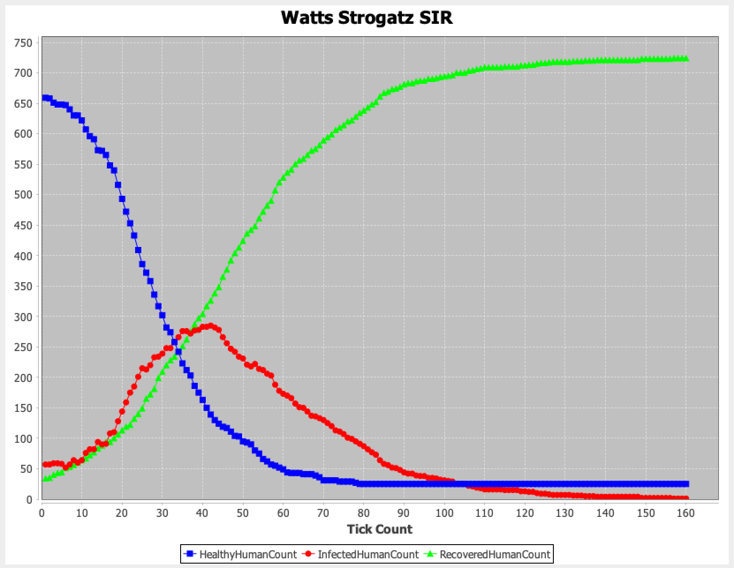
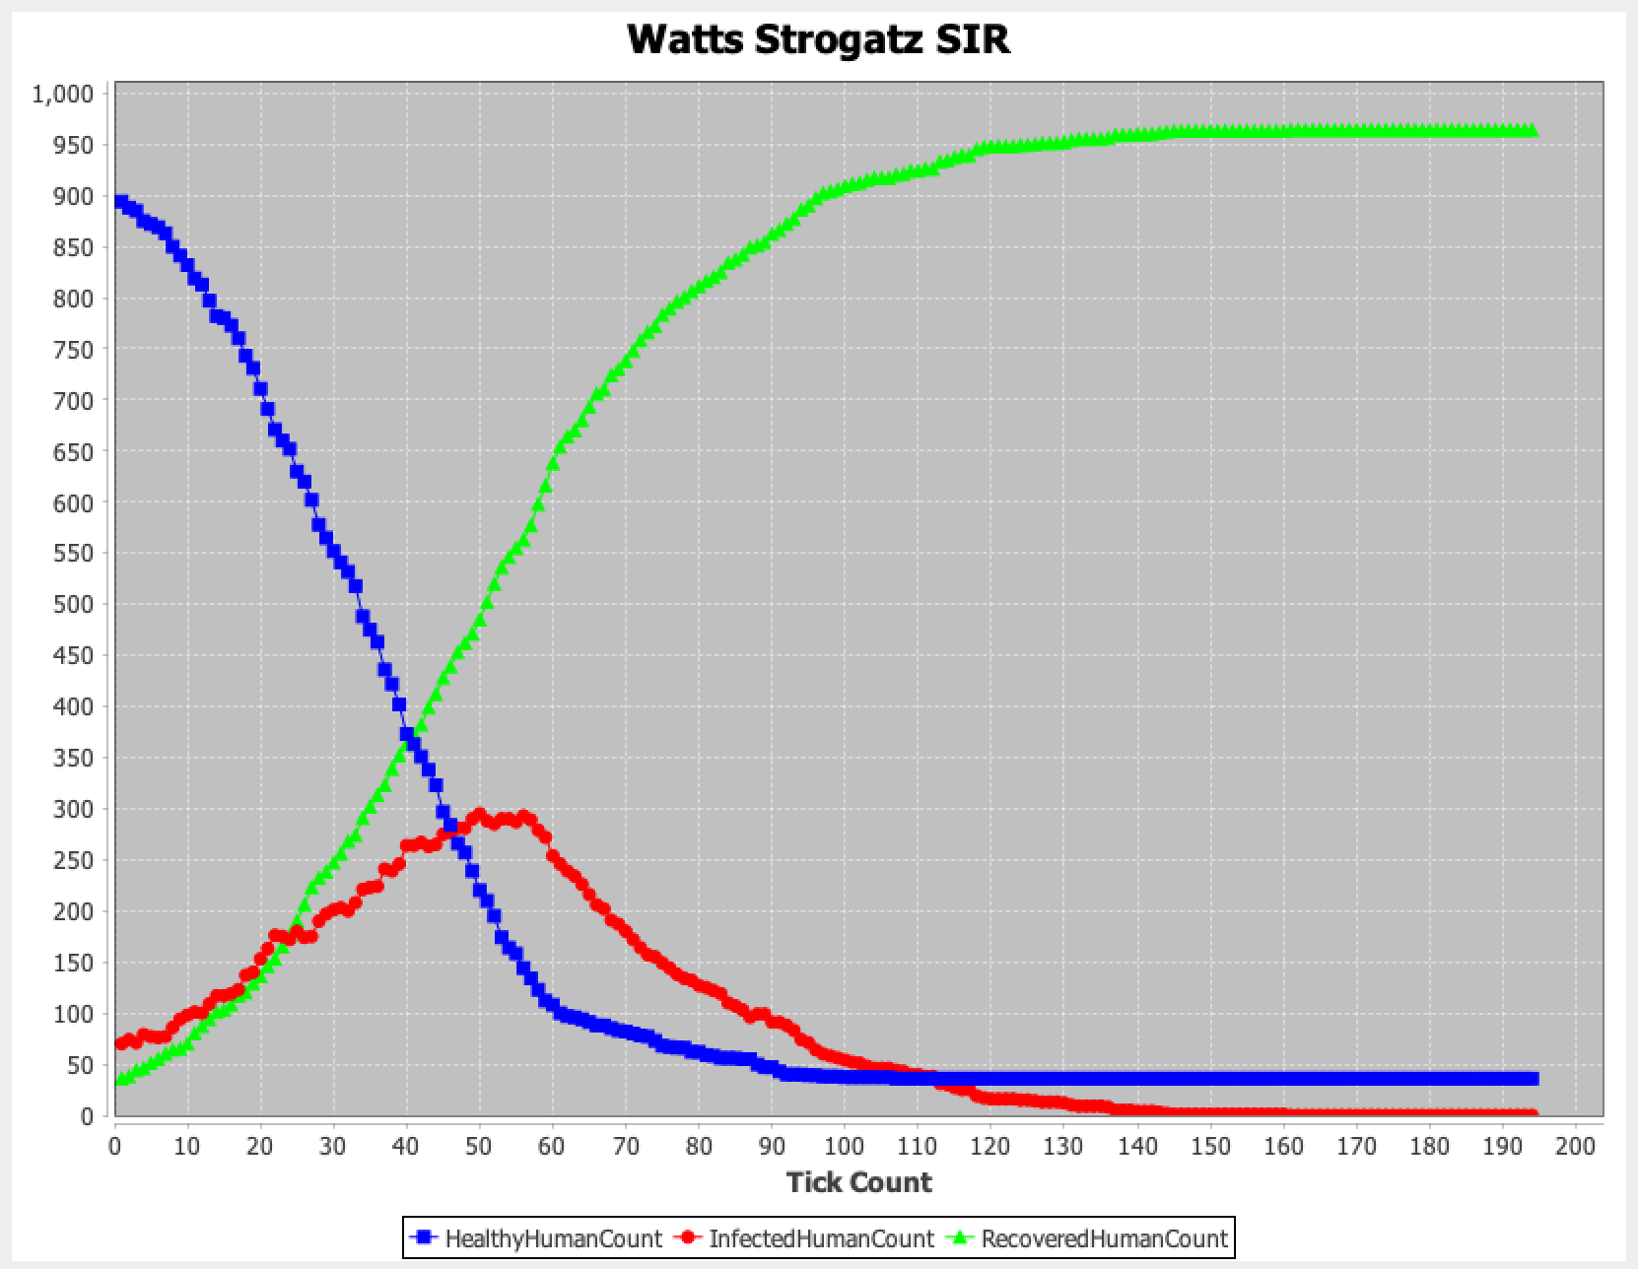
N = 100
N = 250
N = 500
β = 0.1 γ = 0.05
N = 750
N = 1000

Slide 25

Conclusion
We have implemented the following-
SI model
SI model – WATTS
SI model – Barabasi
SIR model
SIR model - WATTS
SIR model - Barabasi

Slide 26

Thank You :)

