Slide 1
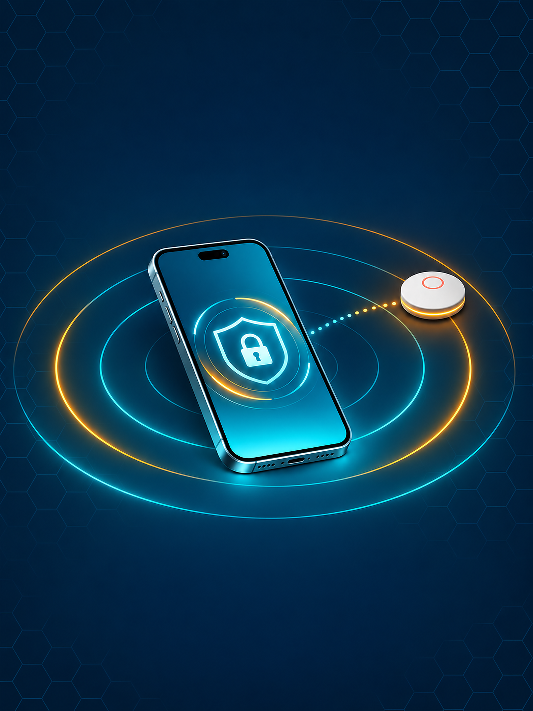

Is there an AirTag
following me?
I need to know now.
Elizabeth Hadik-Barkoczy
University of Arizona | APCV 498 Capstone
Field-tested on an iPhone SE, November 1 to 9, 2026
Notes:
That's the question. I'm Elizabeth Hadik-Barkoczy, and TagAlert is the iPhone app that answers it, right now.

Slide 2
A planted tag can follow you for hours
Made for keys, used on people
An AirTag is the size of a coin. Hidden in a bag or car, it shows someone else where you are.
8-24 h
before a separated AirTag makes a sound (MacTech, 2021)
The warning can take a day
A tag separated from its owner plays a sound at a random time inside an 8 to 24 hour window.
TagAlert is built for that window: open it, and know in minutes.
Notes:
An AirTag is the size of a coin. Drop one in someone's bag and you can follow them on a map. Apple built in protections, but a tag separated from its owner can wait 8 to 24 hours before it makes a sound. That's a full day of someone knowing where you sleep, where you work, and where your kids go to school. TagAlert is built for that window.

Slide 3
Three goals and one rule
1
Find the tag
2
Judge it
Detect AirTags near an iPhone, even though iOS hides them.
Tell a tag that is following you from one that is just nearby.
3
Locate it
!
Measure everything
Make the tag beep so you can physically find it, safely.
Every number in this talk comes from a test log.
Notes:
Three goals. Find the tag. Tell the difference between a tag that's following you and one that just happens to be nearby. And help you physically find it. Plus one rule I held myself to: every number you see today came from a test log.

Slide 4
iOS hides the signal, so the app asks the device
1
2
3
4
Queue
Connect
Ask
Decide
Every unnamed device, strongest signal first.
A brief connection: 6 s, or 10 s if weak.
Does it offer the AirTag service?
Yes: AirTag. Then disconnect, no pairing.
The marker
Service UUID 7DFC9000-7D1C-4951-86AA-8D9728F8D66C. Zero Apple Find My data reached the app in any scan.
Method based on published AirGuard research (SEEMOO Lab, TU Darmstadt). Code written independently in Swift.
10.4 s
median to confirm a tag (21 confirmations)
Notes:
First surprise: iOS doesn't let third-party apps see the signal that identifies an AirTag. In every scan I ran, with a tag a meter away, the phone reported zero Apple data. To an app, an AirTag looks like an anonymous Bluetooth device. So TagAlert knocks on the door. It connects to each anonymous device and asks whether it offers the AirTag's Bluetooth service. The method is based on published research from the AirGuard project at TU Darmstadt. I wrote TagAlert's code myself, in Swift. Median time to confirm a tag: about 10 seconds.

Slide 5
Nearby is not the same as following
Low
under 1 min, or not moving with you
Medium
1 to 2 min, moving with you
High
2 min or more, moving with you
Time since the tag was first seen
Moving with you
No location
No signal strength
50 m walked (or 60 s in a vehicle) while the tag was seen in 60% of scans, and seen in the last 25 s.
Movement comes from the step counter and activity type. Nothing leaves the phone.
Two tags side by side read about 15 dB apart, so signal is not used.
Why it matters Unknown AirTags turned up on 4 of 7 test walks through an ordinary neighborhood.
Notes:
Finding a tag is the easy part. Neighborhoods are full of them: I found unknown AirTags on four of my seven test walks. An app that panics at every one gets deleted by Tuesday. So TagAlert asks a better question: is this tag moving with you? It uses the phone's step counter, never your location. Low: seen under a minute, or not moving with you. Medium: a minute of moving together. High: two minutes. Signal strength isn't used at all, and I'll show you why.

Slide 6
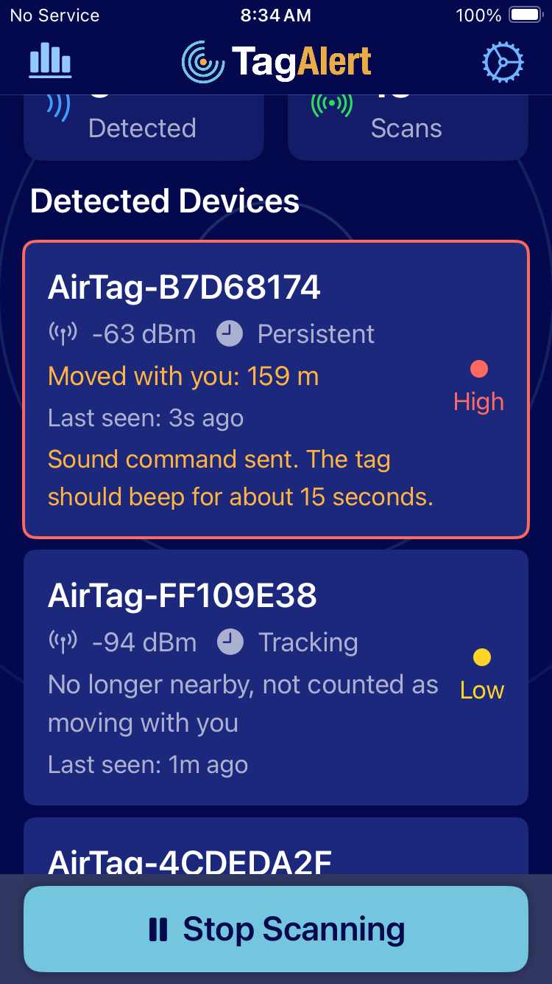
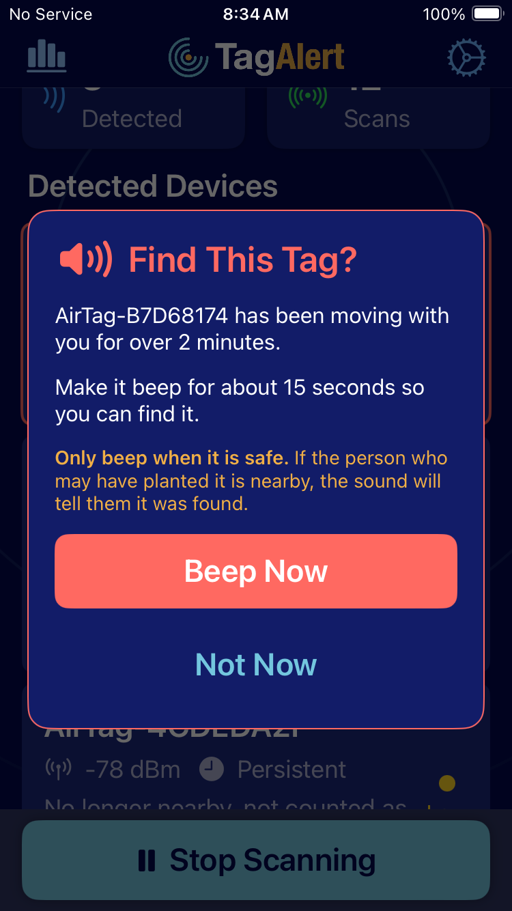
The app in the final walk
What it does
Confirms AirTags in about 10 s
Low, Medium, High from time and movement
Notifies at Medium and High
Asks before beeping the tag
Safety and reporting guide
CSV log behind every result
Walk B7, build 6b, November 9, 2026
Notes:
Tap Start Scanning. Each tag shows a level and a plain note, like "Moved with you: 77 meters." When a tag reaches High, the app asks one question: Find this tag? Tap Beep Now and the AirTag itself plays its sound. That's not automatic, on purpose. If the person who planted it is in the room, a beep tells them you found it. You decide when it's safe.

Slide 7
Results: measured, not estimated
10.4 s
123 s
0
Median time to confirm
To High in the final walk
Alerts, tags not moving
21 confirmations, 2.9 to 28 s
148 m walked; Medium at 72 s, 77 m
7 stationary tests, up to 47 min
26 / 27
0 / 3
17% / h
Beeps accepted, my tags
Beeps, owner nearby
Battery, screen on
separated from their owner
same tag: 1 / 1 with owner away
13% in a 47-minute run
Key finding Apple blocks the beep when the owner is nearby, so it works exactly in the planted-tag case.
Notes:
Walking tests, one tag in my pocket. Final build: confirmed in 6 seconds, Medium at 72 seconds and 77 meters, High at 123 seconds and 148 meters, and the app offered to make the tag beep. Stationary tests, three tags sitting by the phone: zero alerts across seven runs, the longest 47 minutes. The beep: 26 of 27 commands accepted by my own tags. And the finding I'm proudest of: same table, strong signal, two tags away from their owner beeped on the first try, and a tag whose owner was in the house refused all three times. Next morning, owner away, the same tag beeped on the first try. Apple blocks the sound when the owner is nearby. So it works exactly where it matters: a planted tag.

Slide 8
What went wrong, and how it got fixed
The pocket tag waited 94 s in line behind distant devices.
Strongest signal first: confirmed in 6 s.
A parked tag passed twice on a loop was flagged as following.
A tag must show up in most scans, and recently.
Two tags side by side read about 15 dB apart.
Signal strength removed from the rules.
28 builds, every change tied to a log. After the fixes: four walks, zero false alerts.
Notes:
Getting here took 28 builds, and every fix came from a log. On my first walk, the tag in my pocket waited 94 seconds in line behind distant devices. I reordered the queue to check the strongest signal first, and it dropped to 6. A parked tag I passed twice on a loop got flagged as following me, so now a tag has to show up in most scans. Two tags side by side read 15 decibels apart, so signal strength came out of the rules entirely. After those fixes: four walks, zero false alerts.

Slide 9
Limits and next steps
Limits
Next
Works only while the app is open
Can't see if a tag is with its owner
One phone, one home, one route
About 17% battery per hour, screen on
Android or a companion device to read the owner flag
Varied routes to tune alert times
Vehicle and GPS reference tests
A larger study with real users
Code, logs and report github.com/Hadik-UofA/TagAlert | hadik-uofa.github.io/TagAlert
Notes:
The limits. It works only while the app is open; iOS won't run this method in the background. It's tested on one phone, one home and one route. Battery: about 17% per hour with the screen on, measured over 47 minutes. It's built for a check, not all-day monitoring. And iOS hides whether a tag is with its owner, so a commuter's tag that rides your whole route gets flagged too. That's a false alarm, not a safety risk. Next: an Android version or a small companion device that can read the owner flag, varied-route testing to tune the alert times, and a larger study with real users.

Slide 10
AirTags are great for finding your keys.
TagAlert is great for when you're the one being found.
Thank you. Questions?
References
Heinrich, Bittner & Hollick (2022). AirGuard. ACM WiSec. doi:10.1145/3507657.3528546
Heinrich, Stute, Kornhuber & Hollick (2021). Who Can Find My Devices? PoPETs 2021(3). doi:10.2478/popets-2021-0045
IETF (2026). Detecting Unwanted Location Trackers Accessory Protocol. draft-ietf-dult-accessory-protocol-01
MacTech (2021, June 3). Apple is beefing up its AirTags privacy features
Notes:
AirTags are great for finding your keys. TagAlert is great for when you're the one being found. Thank you, and I'm happy to take questions.
Likely questions:
- How is this different from Apple's own alerts? Apple's alerts run in the background, which TagAlert can't. TagAlert adds an on-demand check you control, warnings after about a minute of shared movement in testing, and a one-tap beep.
- How is this different from AirGuard? AirGuard is built for background protection, and that's valuable. But phones deliberately limit what apps can do in the background. On Android, AirGuard can scan at most every 15 minutes, and it waits until it has seen a tracker in three different locations. So the warning comes later, and the trail it's based on is thin. TagAlert covers that gap: immediate feedback. Open it, and within seconds you know what's near you; within a minute or two, whether it's moving with you. It does that without your location, and the beep asks first. AirGuard watches your back over time. If you need to know right now, TagAlert is the one to open.
- Why not use signal strength for distance? Two tags inches from the phone read about 15 dB apart, and one never reached the old High threshold. It's not reliable enough to drive a warning.
- Does it work on other trackers? AirTags only for now. Samsung, Tile and other Find My accessories are future work, along with Android.
- Is it on the App Store? No. It uses an undocumented AirTag service, and submission was outside the course scope.

