Slide 1
IMU sensor fusion and orientation estimation
Lab: B4, HI1033

Slide 2
Components of an IMU
Accelerometer measures linear acceleration and is affected by gravity
Gyroscope measures angular velocity
Magnetometer measures earth's magnetic field
Applications: smartphones, drones, vr systems, navigation systems, motion tracking

Slide 3
Why sensor fusion?
Imu sensors provide motion data but, raw measurements cointains errors:
Accelerometer is sensitive to noise and dynamic motion
Gyroscope is accurate short-term but drifts over time
Magnetometer is affected by magnetic interference

Slide 4
Orientation angles
y
z
Pitch: rotation around the X-axis (forward-bakward tilt)
Roll Rotation around the Y-axix (sideways tilt)
Yaw: rotation around the z-axis (rotation around the vertical axis
x
x
z
y

Slide 5

Method 1: Accelerometer + EWMA
Uses gravity for orientation estimation
Can estimate picth and roll
Sensitive to dynamic acceleration
Cannot estimate yaw
Sensitive to motion noise

Slide 6

Method 2: complementary filter
Combines:
Accelerometer: long-term stability
Gyroskop: fast response
Advantages: smoother orientation estimation, better motion responsiveness
Limitations: gyroscope drift over time, yaw instability during long-term rotation

Slide 7

Method 3: Madgwick algoritm
Combines: accelerometer, gyroskop and magnetometer data
Estimates pitch, roll and yaw simultaneously
Features: quaternion-based orientation, real-time sensor fusion and stable yaw estimation
Fill 3d orientation
qt = updated quaternion orientation
q˙\dot{q}q˙ = gyroscope-based quaternion derivative
Δt\Delta tΔt = sampling interval
β\betaβ = correction factor
∇f(q)\nabla f(q)∇f(q) = gradient descent correction
Advantages: Full 3D orientation estimation, Reduced yaw drift, Low computational cost, Suitable for mobile systems
Limitations: Sensitive to magnetic interference, Requires magnetometer calibration, Yaw can become unstable in noisy environments

Slide 8
Comparison
Method | Sensors | Pitch | Roll | Yaw
EWMA | Acc | Yes | Yes | No
Complementary | Acc + Gyro | Yes | Yes | Partial
Madgwick | Acc + Gyro + Mag | Yes | Yes | Yes

Slide 9
Implementation Across mobile plattforms
Plattform | Sensor Framework | Notes
Android | SensorManager | Direct access to accelerometer, gyroscope and magnetometer
iOS | Core Motion | Built-in motion tracking and sensor fusion
React Native (Cross-plattform) | Expo Sensors / Native Modules | Cross-plattform developement for Android and iOS

Slide 10

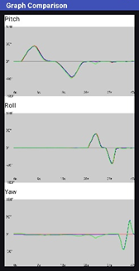
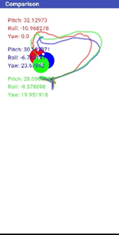
Android implementation
The center of the screen represents the origin position of the visualization.
Inner white marker representing yaw direction

Slide 11
Godot (Open source 2d and 3d game engine)
Visualize orientation in a 3d enviroment

Slide 12
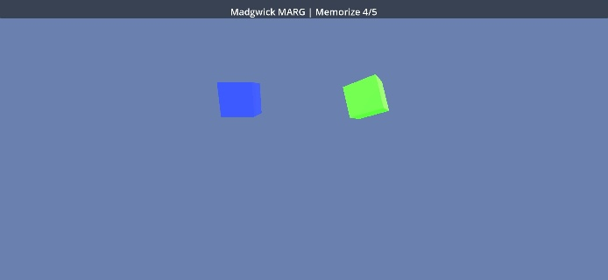
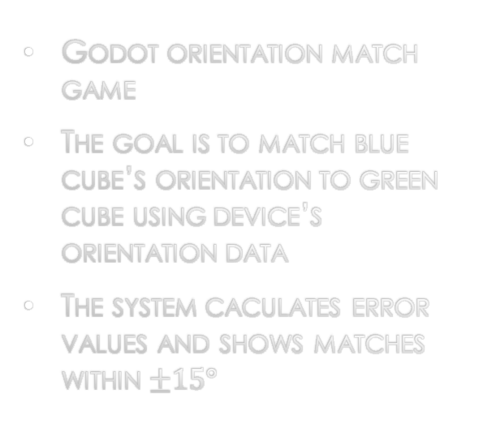
Godot Implementation
Godot orientation match game
The goal is to match blue cube’s orientation to green cube using device’s orientation data
The system caculates error values and shows matches within $±15°$

Slide 13
Upcoming laboratory exercise: Lab b.4
Real-time visualisation
Comparasion between orientation estimation methods

Slide 14
Resources
Godot Engine: https://godotengine.org/
Android implementation: https://github.com/Hadiseh04/Madgwick
Lab B.4 Instructions: Madgwick/Lab B.4.pdf at main · Hadiseh04/Madgwick

