Slide 1
Quran Code
Mathematical Structure of the Quran
Ali Adams
Physics Teacher
QuranCode.com
2009 - 2022

Slide 2
Overview
Science is One
Quran Understanding Levels
Quran Symmetry
Number Types
Prime Numbers and The Key
Book = Key + Message
Primalogy System - ©2008 Ali Adams
God’s Signature: From Allah
The Straight Path and 561
Twin Numbers: 114 and 506

Slide 3
Overview
Repeated Verses and 6555
19 Quran Parameters and 6555
Quran and the Golden Ratio
Chapter Groups and 4×229
God’s Five Challenges
Quran Encryption Levels
RSA Cryptography
Quran and the Human DNA
Human Lifecycle in the Quran
QuranCode Software

Slide 4
Science is One
Imam Ali (as) said:
  Science is a point splattered by ignorant people.
  All sciences are one whole and branch out smoothly without discontinuity.

Slide 5
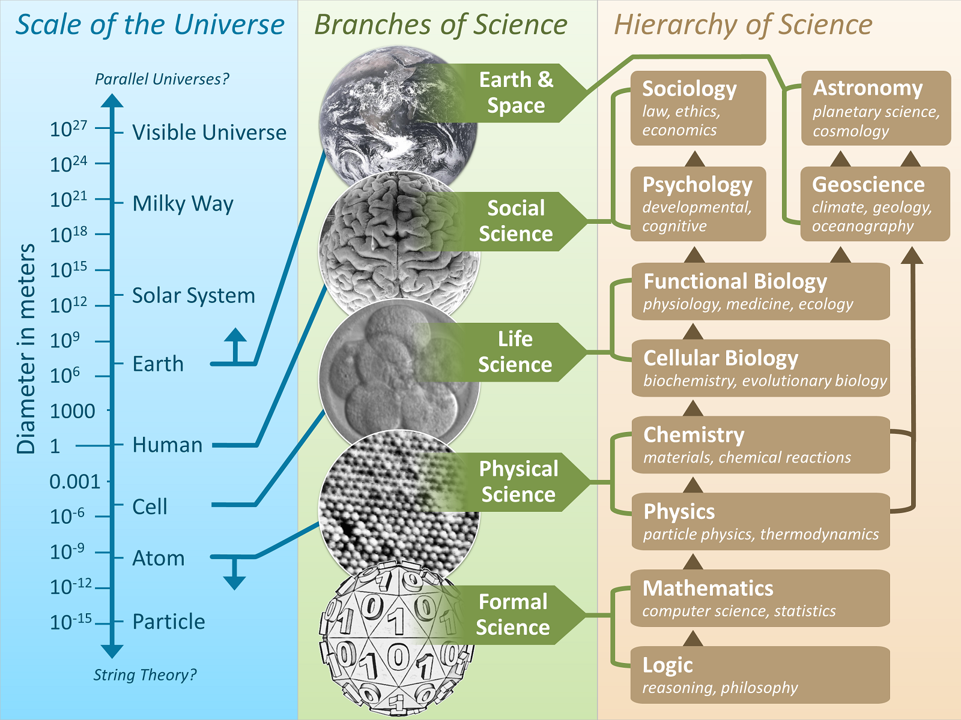

Slide 6
Quran Understanding Levels
Imam As-Sadiq (as) said:
The Book of God can be understood at four levels:
    expression for the layman,
    hints for the learned one,
    openings for the sincere follower,
    truths for the Prophets of God.

Slide 7
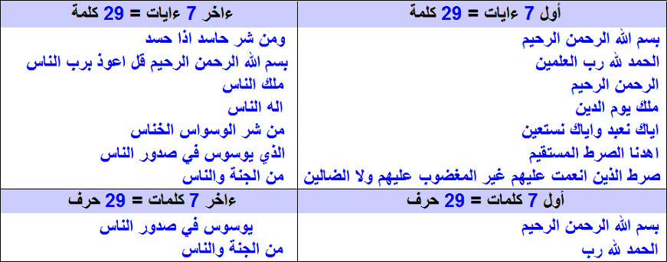
Quran Symmetry
29 is the 7th prime number with prime digit sum:
2 3 5 7 11 23 29 41 43 47 61 67 83 89
7th Fermat’s Prime = 29 = 4×7+1 = 2²+5² where 2+5 = 7

Slide 8
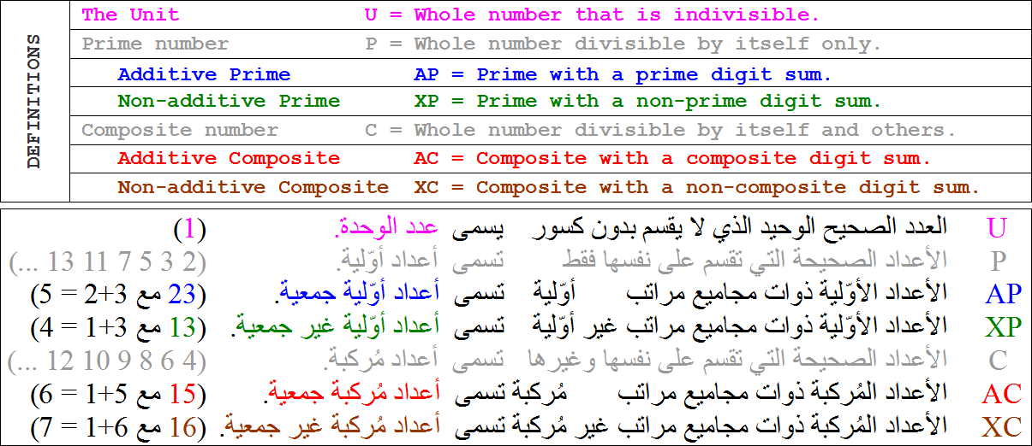
Number Types

Slide 9
Prime Numbers and The Key
Chapter #1 The Key (الفاتحة) has:
  7 verses, 29 words, 139 letters
  where:
  7, 29, 139 are additive prime numbers.
  Left-to-right 729139 is additive prime number.
  Right-to-left 139297 is additive prime number.
  124 letter diacritics, 56 letter dots
  where:
  139 + 124 + 56 = 319 = 6555 – 6236
  139 + 124 = 263 = 56th prime number.

Slide 10
Book = Key + Message
وَلَقَدْ ءَاتَيْنَٰكَ سَبْعًۭا مِّنَ ٱلْمَثَانِى وَٱلْقُرْءَانَ ٱلْعَظِيمَ
Book = Key + Message
114 chapters = 1 + 113
6236 verses = 7 + 6229
77878 words = 29 + 77849
327792 letters = 139 + 327653
where:
113, 6229 are additive prime numbers.

Slide 11
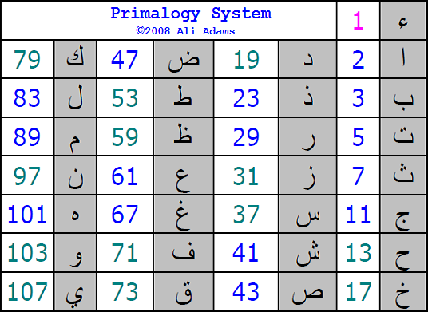
Primalogy System - ©2008 Ali Adams

Slide 12
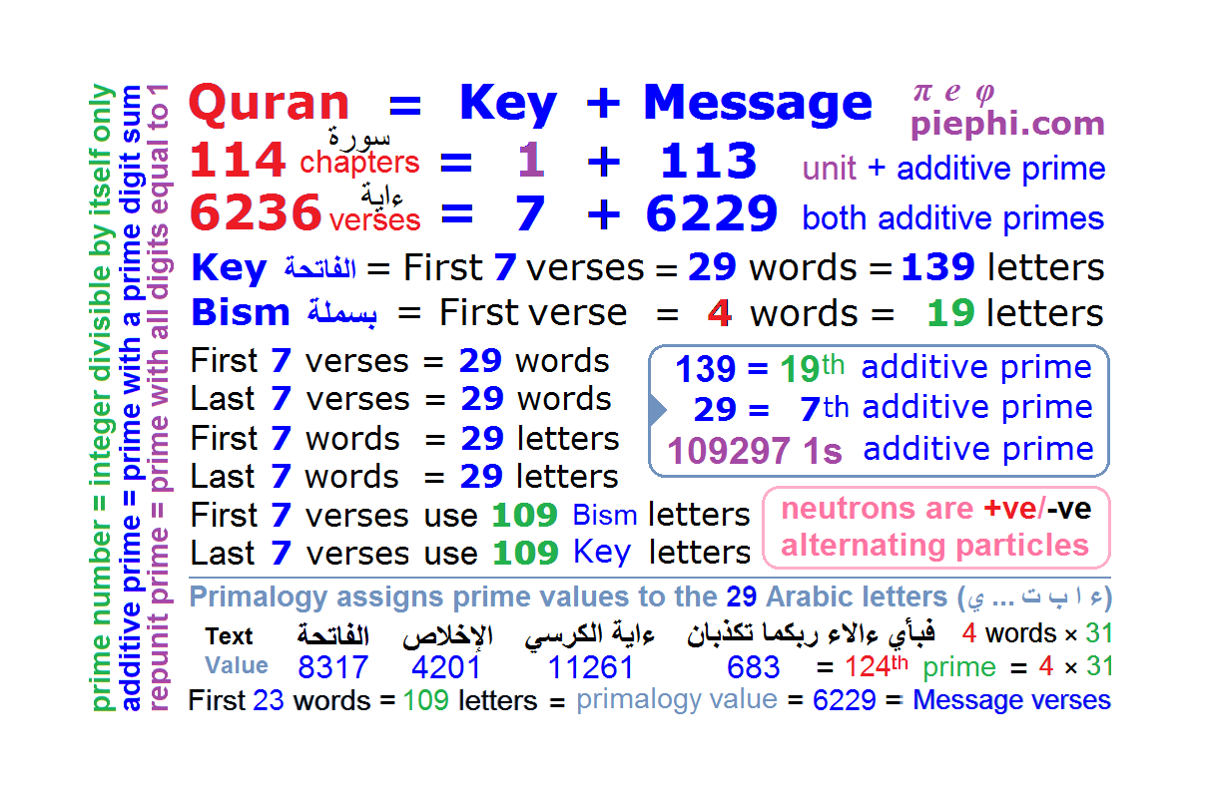

Slide 13
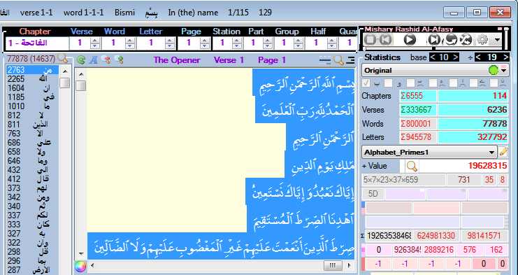
God’s Signature
Most repeated words in the Quran
  من 2763 From
  الله 2265 Allah

Slide 14
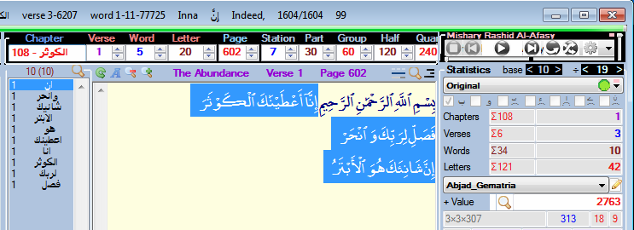
Most Repeated Word → Shortest Chapter
The most repeated word (من) is repeated 2763 times which is equal to the Abjad_Gematria value of the shortest chapter (سورة الكوثر) that promises a plentiful descendents of Fatimat AzZahraa (as).

Slide 15
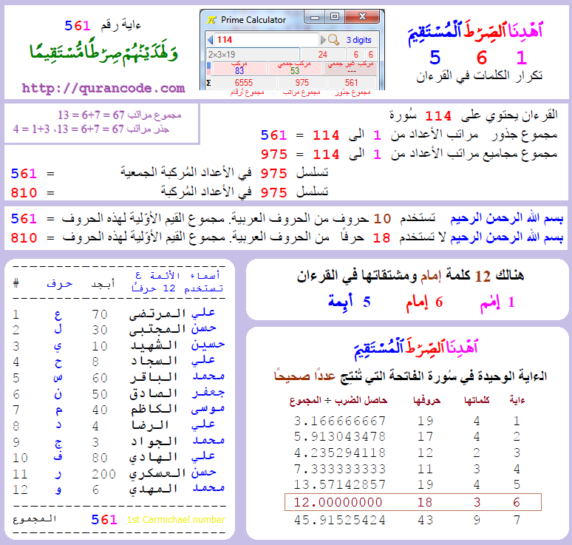
The Straight Path and 561

Slide 16
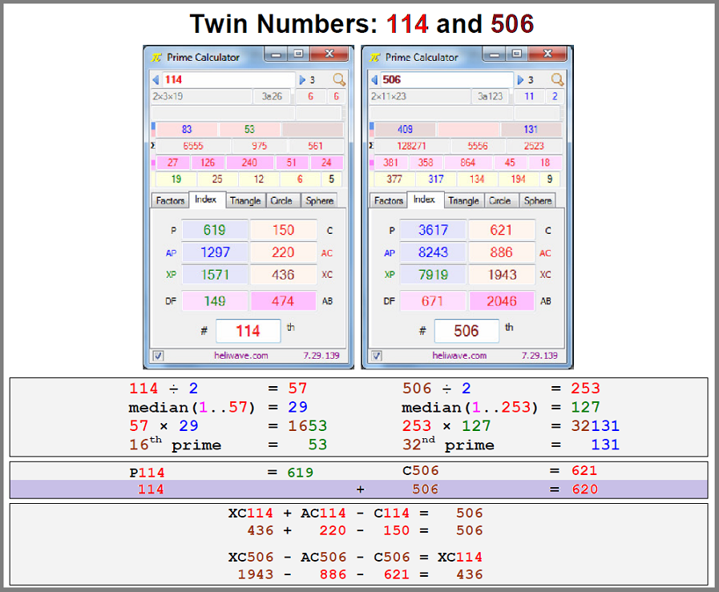
Twin Numbers: 114 and 506

Slide 17
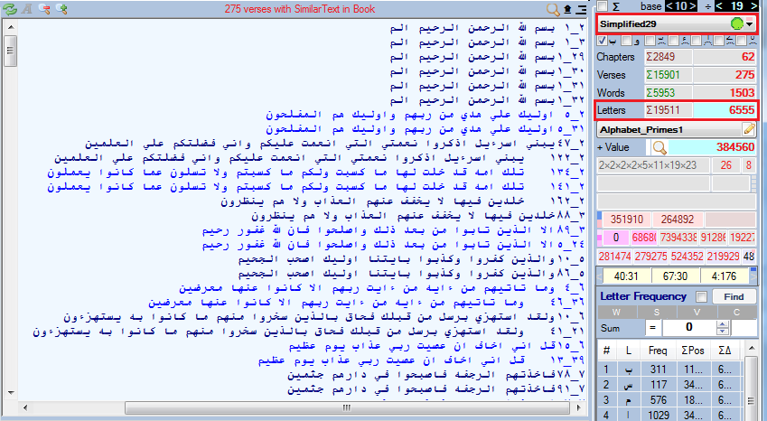
Repeated Verses and 6555

Slide 18
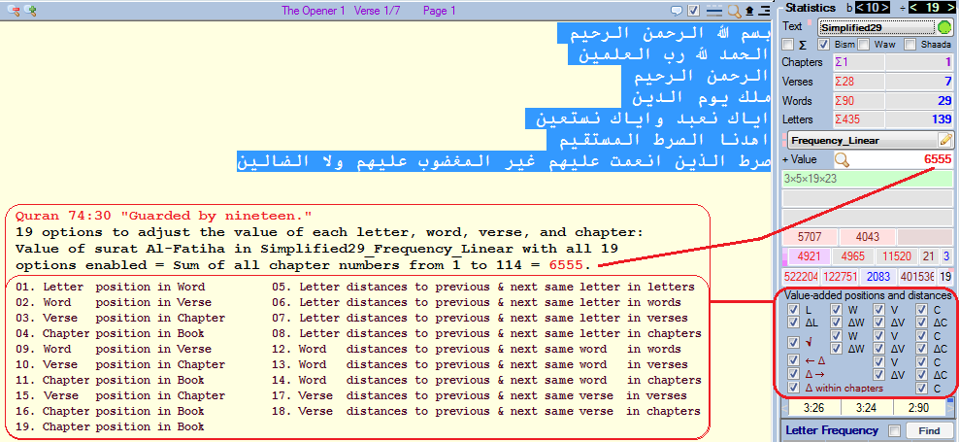
19 Quran Parameters and 6555

Slide 19
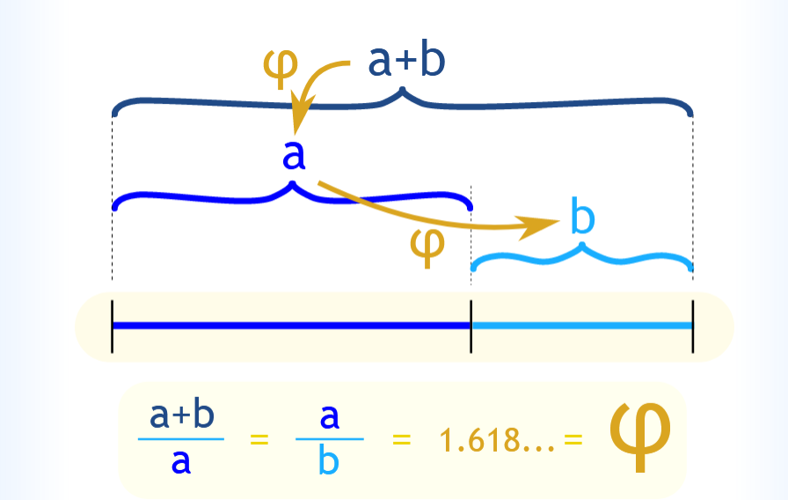
Quran and the Golden Ratio

Slide 20
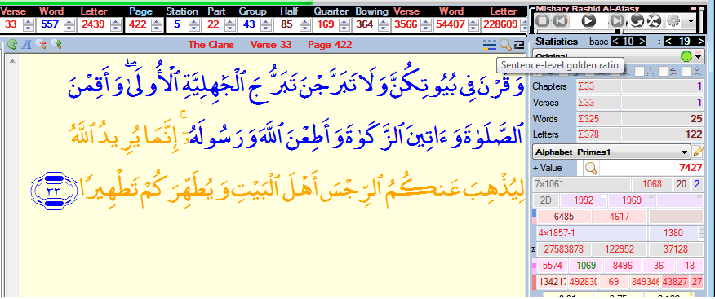
Quran and the Golden Ratio

Slide 21
Chapter Groups and 4×229
The Quran contains 114 chapters:
There are 229 4-chapter groups with
Sum of chapter numbers = 229 and
Sum of verses per chapter = 229.
16 groups have additive prime number of words,
53 groups have non-additive composite words.
The Primalogy value of "اهدنا الصرط المستقيم" is 4×229
Chapter #1 The Key (الفاتحة) contains 4 occurrences
of letter د at positions 24 + 57 + 67 + 81 = 229.

Slide 22
God’s Five Challenges
God challenges Quran to produce:
  a Hadith like it, (كِتَٰبًۭا مُّتَشَٰبِهًۭا مَّثَانِىَ )
  a Quran like it,
  10 chapters like its,
  1 chapter like its,
  1 chapter from its like.
  No challenge to produce a Verse!

Slide 23
  فَلْيَأْتُوا۟ بِحَدِيثٍۢ مِّثْلِهِۦٓ إِن كَانُوا۟ صَٰدِقِينَ
  ٱللَّهُ نَزَّلَ أَحْسَنَ ٱلْحَدِيثِ كِتَٰبًۭا مُّتَشَٰبِهًۭا مَّثَانِىَ تَقْشَعِرُّ مِنْهُ جُلُودُ ٱلَّذِينَ يَخْشَوْنَ رَبَّهُمْ ثُمَّ تَلِينُ جُلُودُهُمْ وَقُلُوبُهُمْ إِلَىٰ ذِكْرِ ٱللَّهِ ۚ ذَٰلِكَ هُدَى ٱللَّهِ يَهْدِى بِهِۦ مَن يَشَآءُ ۚ وَمَن يُضْلِلِ ٱللَّهُ فَمَا لَهُۥ مِنْ هَادٍ
  قُل لَّئِنِ ٱجْتَمَعَتِ ٱلْإِنسُ وَٱلْجِنُّ عَلَىٰٓ أَن يَأْتُوا۟ بِمِثْلِ هَٰذَا ٱلْقُرْءَانِ لَا يَأْتُونَ بِمِثْلِهِۦ وَلَوْ كَانَ بَعْضُهُمْ لِبَعْضٍۢ ظَهِيرًۭا
  أَمْ يَقُولُونَ ٱفْتَرَىٰهُ ۖ قُلْ فَأْتُوا۟ بِعَشْرِ سُوَرٍۢ مِّثْلِهِۦ مُفْتَرَيَٰتٍۢ
  وَٱدْعُوا۟ مَنِ ٱسْتَطَعْتُم مِّن دُونِ ٱللَّهِ إِن كُنتُمْ صَٰدِقِينَ
  أَمْ يَقُولُونَ ٱفْتَرَىٰهُ ۖ قُلْ فَأْتُوا۟ بِسُورَةٍۢ مِّثْلِهِۦ
  وَٱدْعُوا۟ مَنِ ٱسْتَطَعْتُم مِّن دُونِ ٱللَّهِ إِن كُنتُمْ صَٰدِقِينَ
  وَإِن كُنتُمْ فِى رَيْبٍۢ مِّمَّا نَزَّلْنَا عَلَىٰ عَبْدِنَا فَأْتُوا۟ بِسُورَةٍۢ مِّن مِّثْلِهِۦ
  وَٱدْعُوا۟ شُهَدَآءَكُم مِّن دُونِ ٱللَّهِ إِن كُنتُمْ صَٰدِقِينَ

Slide 24
Quran Encryption Levels
Fully Readable Outer Text
  Add initial letters (حروف مقطعة)
85 Readable Chapters
  Encrypt all chapters together
Unreadable Text 3
  Encrypt ten chapters at a time
Unreadable Text 2
  Encrypt one chapter at a time
Unreadable Text 1
  Encrypt one chapter at a time
Readable Inner Text
[القرءان العظيم]
[القرءان الكريم]

Slide 25
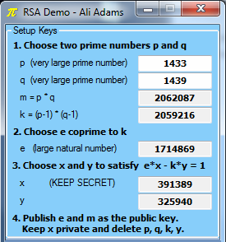
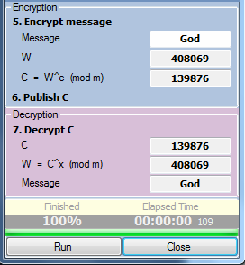
RSA Cryptography
Rivest–Shamir–Adleman’s Algorithm
Setup
Usage

Slide 26
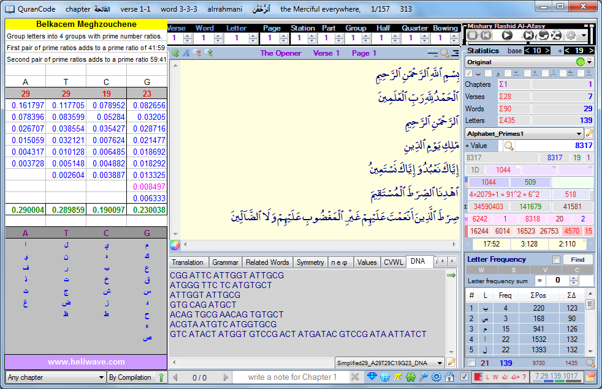
Quran and the Human DNA

Slide 27
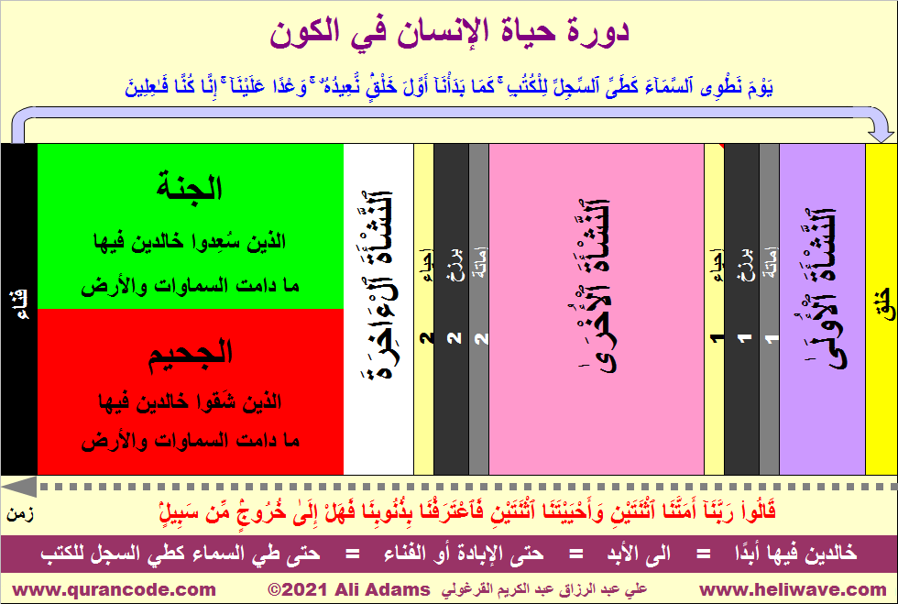

Slide 28
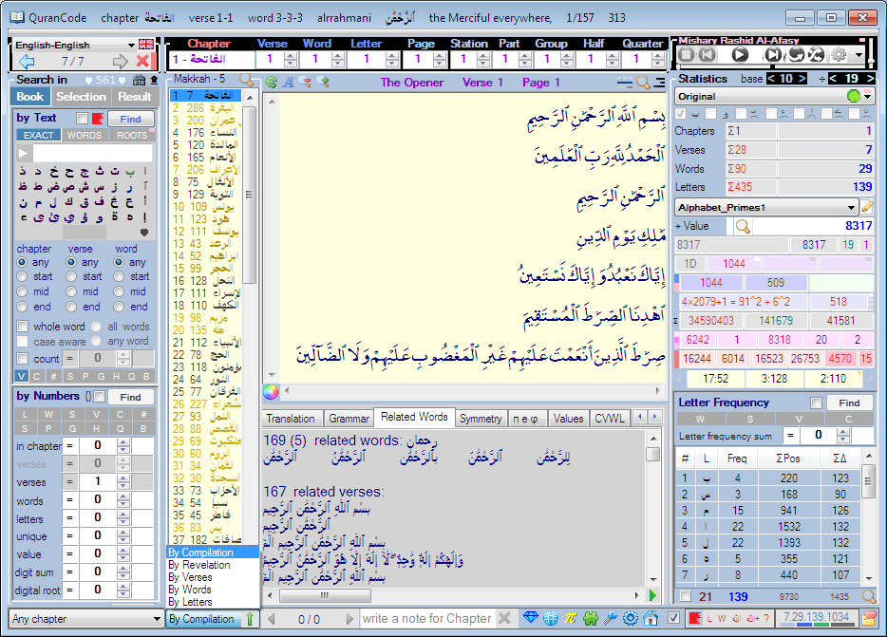
QuranCode

Slide 29

QuranCode

Slide 30
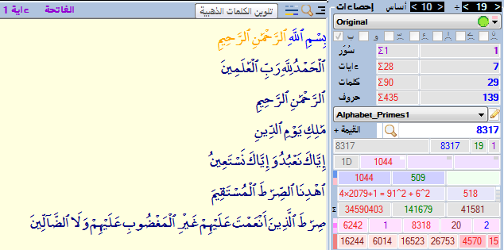
Quran Code Questions?
Mathematical Structure of the Quran
Ali Adams
Physics Teacher
QuranCode Free Software
http://qurancode.com
help yourself by helping others…

