Slide 1
Forecasting Tomorrow’s PM2.5 in Beijing with Machine Learning
2107541 MACHINE LEARNING FOR ENVIRONMENTAL APPLICATIONS · PROJECT 2
Ten models, explainable AI and a policy test: did the APEC 2014 emission controls really clean the air?
43,824
10
R² 0.855
hourly records, 2010–2014
machine-learning models compared
on the unseen test year 2014
Most Sonia Aktar (6870225321) · Hadiuzzaman (6870336321)
18 November 2026

Slide 2
Beijing’s Air Was Unhealthy on Most Days
THE PROBLEM
52 %
PM2.5, particles smaller than 2.5 µm, reach deep into the lungs. Our goal: forecast tomorrow’s PM2.5, so that people and authorities can act a day early.
of days above China’s 24-hour limit (75 µg/m³), 2010–2014
FOUR RESEARCH QUESTIONS
96 %
1
Prediction: how accurately can ML forecast tomorrow’s PM2.5, and which of ten models is best?
of days above the WHO guideline (15 µg/m³)
2
Drivers: which factors drive the forecast, and in which direction?
552 µg/m³
3
Information: how much comes from the pollution already in the air, and how much from the weather?
the worst daily mean, on 12 January 2013
4
Application: can it warn of polluted days, and did the APEC 2014 emission controls work?
Forecasting next-day PM2.5 in Beijing · 2107541 Project 2
2 / 18

Slide 3
Five Years of Hourly Air and Weather Data
DATA · UCI BEIJING PM2.5 DATASET (CHEN, 2015; LIANG ET AL., 2015)
43,824
2010–2014
US Embassy
Airport
hourly records, 13 columns
five full years, 1 Jan 2010 – 31 Dec 2014
PM2.5 monitor: the value we forecast
weather: temperature, dew point, pressure, wind, rain, snow
Missing values
Wind speed
4.7 % of PM2.5 hours were missing. We did not invent values: a day counts only with ≥ 20 valid hours (China’s GB 3095-2012 rule), which leaves 1,711 valid days.
The file stores a cumulated wind speed. We recovered the hourly speed from its increments; no negative values remained.
Humidity
Outliers
Relative humidity was not measured, so we computed it from temperature and dew point (Magnus formula).
4.2 % of hours lie above the 1.5 × IQR fence, but they are real events (New Year fireworks, the January 2013 haze, a dust storm), so we kept them.
Forecasting next-day PM2.5 in Beijing · 2107541 Project 2
3 / 18

Slide 4
From Hours to a Daily Forecasting Table
FEATURE ENGINEERING · HOURLY DATA → ONE ROW PER DAY
Evening of day t − 1
→
Day t
The forecast is issued; PM2.5 is known up to 23:00
The target: the daily mean PM2.5 of this day
3
Persistence
13
Weather of day t
5
Calendar
PM2.5 already in the air
how the air will mix, move and wash out
human emission cycles
Yesterday’s daily mean
Yesterday evening’s mean (18:00–23:00)
The daily mean two days ago
Temperature and its daily range
Dew point and relative humidity
Pressure and wind speed
Share of NW, SE and calm-wind hours
Hours of rain and of snow
Change in dew point and pressure since the day before
Season (day of year as sine and cosine)
Heating season (15 Nov – 15 Mar)
Weekend
Spring Festival (Lunar New Year)
Result: 21 features for 1,618 complete days. The observed weather of day t stands in for a perfect weather forecast (the usual “perfect-prognosis” assumption).
Forecasting next-day PM2.5 in Beijing · 2107541 Project 2
4 / 18

Slide 5
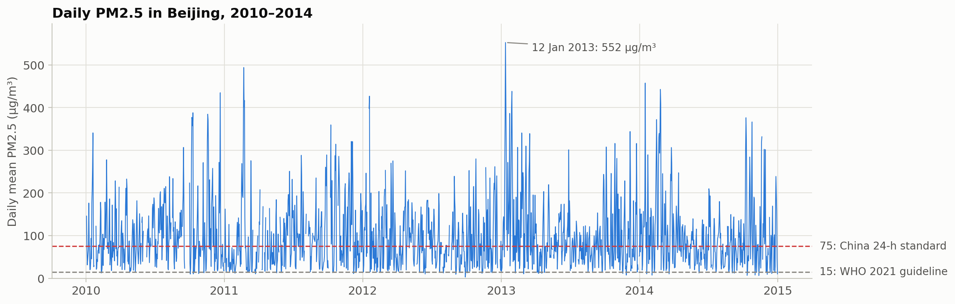
Severe, Seasonal and Controlled by Wind
EXPLORATORY DATA ANALYSIS · 1,711 VALID DAYS
higher mean PM2.5 in the heating season (15 Nov – 15 Mar)
µg/m³ median PM2.5: calm (≤ 1.5 m/s) vs windy (> 5 m/s) days
yesterday evening’s PM2.5 vs today’s: haze persists
+22 %
176 → 24
r = 0.68
Forecasting next-day PM2.5 in Beijing · 2107541 Project 2
5 / 18

Slide 6
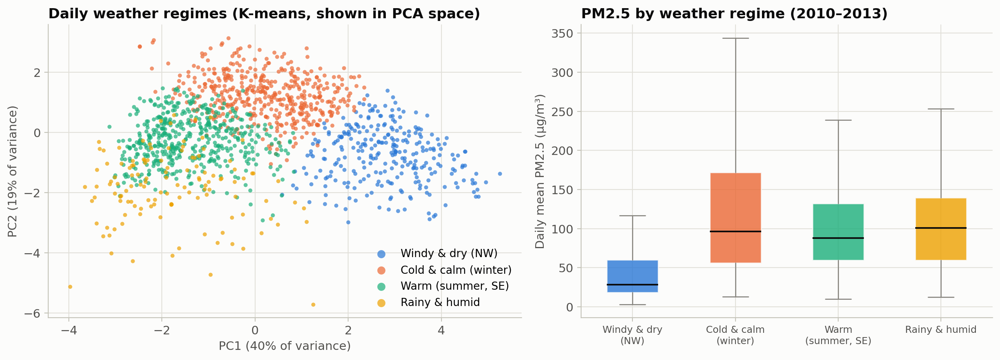
Four Weather Regimes Found by K-means
UNSUPERVISED LEARNING · K-MEANS ON 9 WEATHER VARIABLES
dirtier: cold & calm days (125 µg/m³) vs windy & dry days (47 µg/m³)
Both regimes are cold-season days (3–4 °C), so the weather, not only emissions, decides whether a winter day is clean or hazy. This is why we use the weather to forecast PM2.5.
2.7 ×
Forecasting next-day PM2.5 in Beijing · 2107541 Project 2
6 / 18

Slide 7
How We Trained, Tuned and Tested
METHOD · TIME-AWARE TRAINING AND TESTING
2010
2011
2012
2013
2014
CV fold 1
train
validate
CV fold 2
train
train
validate
CV fold 3
train
train
train
validate
Final test
train
train
train
train
test (unseen)
Forward-chaining cross-validation: a model is always validated on a later year than the years it learned from, as in real forecasting. The test year 2014 is used only once, at the very end.
10 models + a baseline
Tuning and selection
Linear Regression, Elastic Net, KNN, Decision Tree, Random Forest, Gradient Boosting, XGBoost, LightGBM, SVR and a stacking ensemble of RF, XGBoost, LightGBM and SVR. Baseline: “tomorrow = today”.
Grid search for small grids; random search with 150 settings for the three boosting models; every search range checked to contain the optimum. Selected: the lowest mean CV RMSE.
Forecasting next-day PM2.5 in Beijing · 2107541 Project 2
7 / 18

Slide 8
The Stacking Ensemble Forecasts Best
RESULTS · THE UNSEEN TEST YEAR 2014 (342 DAYS)
Test RMSE, the typical size of a forecast error (µg/m³): shorter is better
R² = 0.855
Stacking (selected)
31.3
Gradient Boosting
32.5
the forecast explains about 85 % of the day-to-day variation in 2014
XGBoost
32.8
LightGBM
33.1
−57 %
Random Forest
33.1
SVR (RBF kernel)
34.1
error compared with the persistence forecast (31.3 vs 73.1 µg/m³)
Linear Regression
39.4
Elastic Net
39.4
33.6
KNN
39.6
µg/m³ CV RMSE for stacking: also the best model in cross-validation, before any test
Decision Tree
42.6
Persistence (baseline)
73.1
Stacking weights: SVR 0.53 · LightGBM 0.44 · RF 0.08 · XGBoost 0
Forecasting next-day PM2.5 in Beijing · 2107541 Project 2
8 / 18

Slide 9
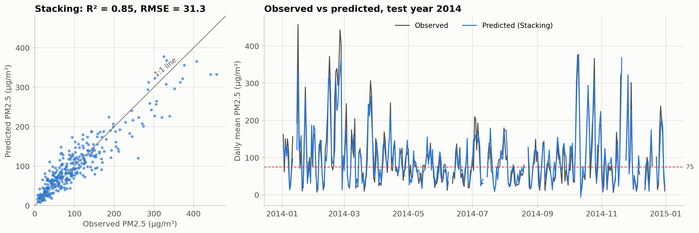
Forecasts Follow the Haze Episodes of 2014
RESULTS · EVERY DAY OF THE TEST YEAR 2014
22.7
µg/m³ mean absolute error: on a typical day the forecast is off by about 23 µg/m³
46
µg/m³ too low, on average, on the 24 days above 250 µg/m³: extreme peaks are under-forecast
Forecasting next-day PM2.5 in Beijing · 2107541 Project 2
9 / 18

Slide 10
From Forecast to Health Alert
APPLICATION · AN ALERT FOR DAYS ABOVE 75 µg/m³
Stacking model, alert if the forecast is above 75 µg/m³ · 342 test days
Alert if forecast | Caught | Correct | Missed | False alarms
Persistence > 75 | 70 % | 70 % | 54 | 53
Stacking > 75 | 91 % | 84 % | 16 | 32
Stacking > 70 | 93 % | 80 % | 13 | 42
No alert
Alert
Clean day
(≤ 75)
132
32
correctly quiet (TN)
false alarms (FP)
Polluted day
(> 75)
16
162
“Caught” = share of the 178 polluted days that received an alert (recall). “Correct” = share of alerts that were right (precision).
missed polluted days (FN)
correct alerts (TP)
Recall matters most: a missed day leaves people unprotected. The 70 µg/m³ setting was chosen on the validation years 2011–2013, not on 2014.
Forecasting next-day PM2.5 in Beijing · 2107541 Project 2
10 / 18

Slide 11
Memory and Weather Work Together
WHICH INFORMATION MATTERS? · SAME MODEL, DIFFERENT INPUTS
Test R² on 2014 (1 = perfect forecast) of the stacking model retrained on each group of features: longer is better
Pollution memory + calendar
0.522
8 features, no weather
Weather of day t + calendar
0.612
18 features, no PM2.5 history
No weather forecast
0.540
yesterday’s weather + memory + calendar
All information
0.855
weather of day t + memory + calendar
Each source alone explains only about half of the variation; together they reach 0.855. With yesterday’s weather instead of the forecast day’s, skill falls to 0.54: an accurate weather forecast is essential for early warning.
Forecasting next-day PM2.5 in Beijing · 2107541 Project 2
11 / 18

Slide 12
What Drives the Forecast? SHAP Values
EXPLAINABLE ML · SHAP ON THE STACKING MODEL
SHAP splits every forecast into one contribution per feature. Bars: the average size of each contribution on the 2014 days (µg/m³).
Weather · pollution memory · calendar.
Yesterday-evening PM2.5
29.7
dirty evening → dirty next day
Dew-point change
15.0
moist air arriving → up; drying → down
Relative humidity
15.0
humid air → up; dry air → down
Dew point
11.0
acts together with humidity
Wind speed
10.4
calm air → up; windy → down
Temperature
9.9
acts together with humidity
Yesterday’s mean PM2.5
7.9
same direction as the evening value
Season (winter–summer)
7.2
winter → up
63 % · 28 % · 9 %
0.09 µg/m³
4 of 4
of all attribution goes to weather · pollution memory · calendar
average change when recomputed with another random seed: stable
importance methods rank yesterday-evening PM2.5 first
Forecasting next-day PM2.5 in Beijing · 2107541 Project 2
12 / 18

Slide 13
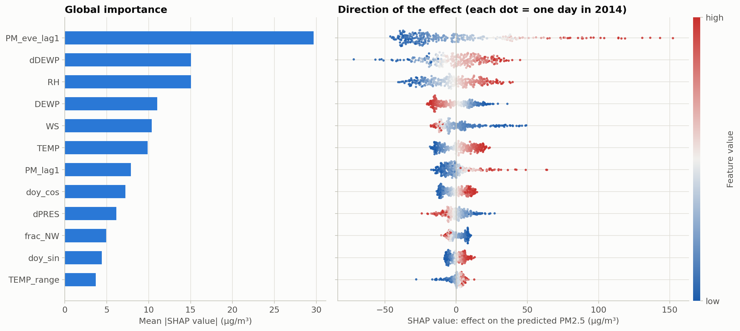
Summary of the SHAP Values
EXPLAINABLE ML · SHAP ON THE STACKING MODEL
Forecasting next-day PM2.5 in Beijing · 2107541 Project 2
13 / 18

Slide 14
Two Days, Explained Feature by Feature
EXPLAINABLE ML · SHAP FOR SINGLE FORECASTS
16 January 2014 · heavy haze
12 October 2014 · clean air
Forecast 332 µg/m³ · observed 458 µg/m³
Forecast −6 µg/m³ (read as 0) · observed 7 µg/m³
Yesterday-evening PM2.5 470
+131
Dew-point drop 11.9 °C
−34
Dew-point rise 8.6 °C
+45
Yesterday-evening PM2.5 28
−26
Yesterday’s PM2.5 192
+15
Relative humidity 41 %
−11
Temperature −0.9 °C
−15
Wind speed 3.9 m/s
−9
Wind speed 1.7 m/s
+13
Season: autumn
−7
Pressure fall 3.2 hPa
+13
Pressure rise 8.5 hPa
−7
Season: mid-winter
+12
NW wind in 80 % of hours
−6
Pressure 1028 hPa
−8
Rain in 4 hours
−6
13 other features
+26
13 other features
+1
average 99
forecast 332
forecast −6
average 99
Every forecast starts from the average day (98.7 µg/m³, dashed line). Red bars push it up, blue bars pull it down, and the solid line is that day’s forecast. Values in µg/m³.
Forecasting next-day PM2.5 in Beijing · 2107541 Project 2
14 / 18

Slide 15
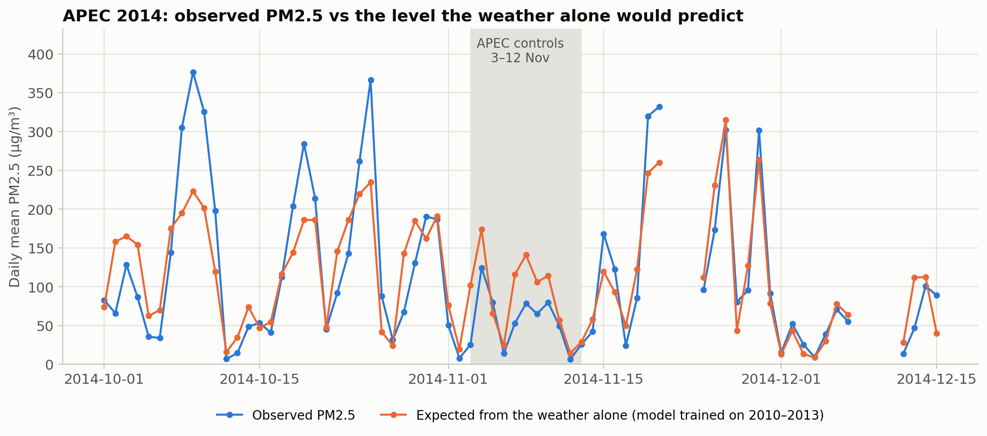
Did the APEC 2014 Emission Controls Work?
POLICY TEST · SEPARATING THE WEATHER FROM EMISSIONS
During the APEC summit (3–12 Nov 2014) Beijing restricted traffic, factories and construction. A weather-only model (no PM2.5 history, trained on 2010–2013) estimates the PM2.5 that the weather alone would have produced.
−60 %
observed PM2.5 during APEC vs the weeks before and after
−32 %
expected from the weather alone: unusually favourable weather
−41 %
the drop beyond the weather: attributed to the controls
Roughly half of “APEC blue” came from favourable weather and half from the controls (0.68 × 0.59 ≈ 0.40). But about 6 % of ordinary 10-day windows in 2014 show a gap this large, so the evidence is suggestive, not proof.
Forecasting next-day PM2.5 in Beijing · 2107541 Project 2
15 / 18

Slide 16
What We Learned
CONCLUSIONS · ANSWERS TO THE FOUR RESEARCH QUESTIONS
1 · PREDICTION
2 · DRIVERS
A stacking ensemble forecasts tomorrow’s PM2.5 best: R² 0.855 and RMSE 31.3 µg/m³, 57 % below persistence.
Yesterday evening’s PM2.5, moist air (rising dew point, high humidity) and calm wind raise PM2.5; dry north-westerly wind cleans the air.
3 · INFORMATION
4 · APPLICATION
Pollution memory and weather are complementary (R² 0.52 and 0.61 alone, 0.855 together): accurate weather forecasts are essential.
Alerts catch 91 % of polluted days (persistence: 70 %). APEC 2014: about half of the 60 % drop came from the controls (suggestive).
Forecasting next-day PM2.5 in Beijing · 2107541 Project 2
16 / 18

Slide 17
LIMITATIONS AND NEXT STEPS
Limitations:
Data from only one monitoring station
Observed weather stands in for a weather forecast
Extreme peaks are under-forecast
Recommendations:
Real weather forecasts
More stations in the same area over the same period
A similar analysis for Thailand
Forecasting next-day PM2.5 in Beijing · 2107541 Project 2
17 / 18

Slide 18
Follow the github link (https://github.com/Hadiuzzaman4713/Environmental-ML-Project), which includes:
Used and processed data
More figures
Detailed results from the models
More details about the overall project
Thank you
Questions are welcome
Forecasting next-day PM2.5 in Beijing · 2107541 Project 2
18 / 18

