Slide 1
CDC Flu Data
Group 1
Treva Winlock, Derek Kopecky, Jeff Hoffman, Patrick Passafiume, Nathan Thomas

Slide 2
Problem Definition
Gathering Information
Preliminary analysis
Choosing and fitting models
Using and evaluating a forecasting model

Slide 3

Problem Definition
Given the notoriety of the 2018 flu season, will 2019 will be worse?

Slide 4
Types of Flu Virus
Two main types of flu virus
Type A
Categorized by two external proteins on the surface of the virus, hemagglutinin (H) and the neuraminidase (N)
18 types of hemagglutinin and 11 types of neuraminidase (198 combinations)
Found in both animals and humans
e.g. H1N1 – “Swine Flu”, H7N4 – “Avian Flu”
Pandemic Strains
Type B
Two key lineages
Yamagata
Victoria
Only found in humans
Not believed to cause pandemics

Slide 5
Data Used
World Health Organization – Flu Data
http://apps.who.int/flumart

Slide 6
Analysis of Flu Data

Slide 7
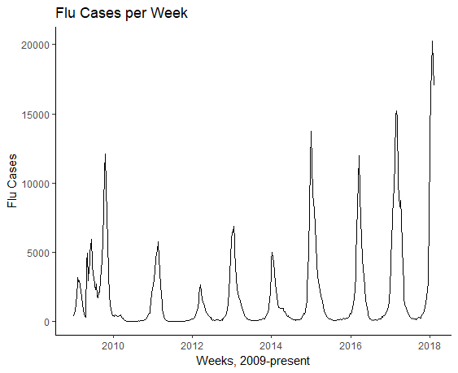
Flu Cases – All types since 2009
Clear increase in

Slide 11
Model of Flu Data

Slide 12
Forecast of Flu for 2019

Slide 13
Conclusion

Slide 14


