Slide 1
Aprendizaje Automático
Departamento de Informática – UC3M
TUTORIAL 3 – Búsqueda hiperparámetros en regresiones

Slide 2
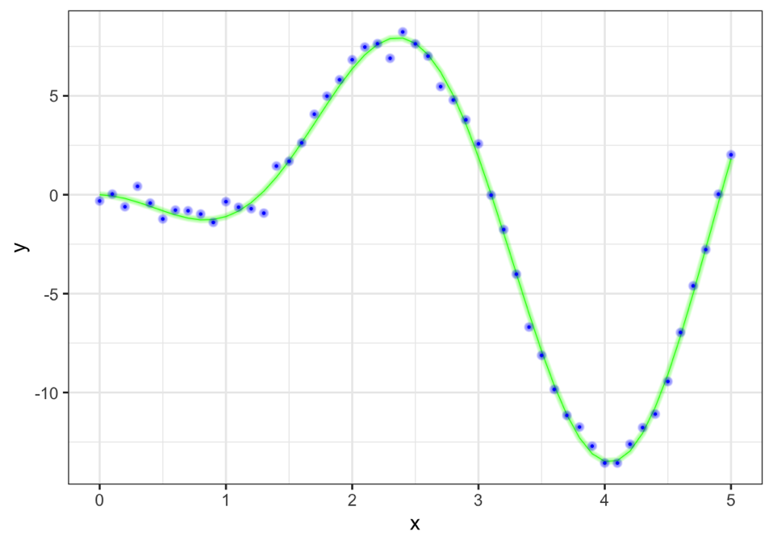
Tutorial 3
Recordando teoría
Los datos son los puntos azules
x es una secuencia uniforme, x = 0, 0.1, 0.2, …, 5
y puede expresarse como:
y(x) = f (x) + 𝛆
donde 𝛆 es ruido
En verde se muestra la curva “real” que no conocemos
Objetivo
Ajustar una curva a los puntos

Slide 3
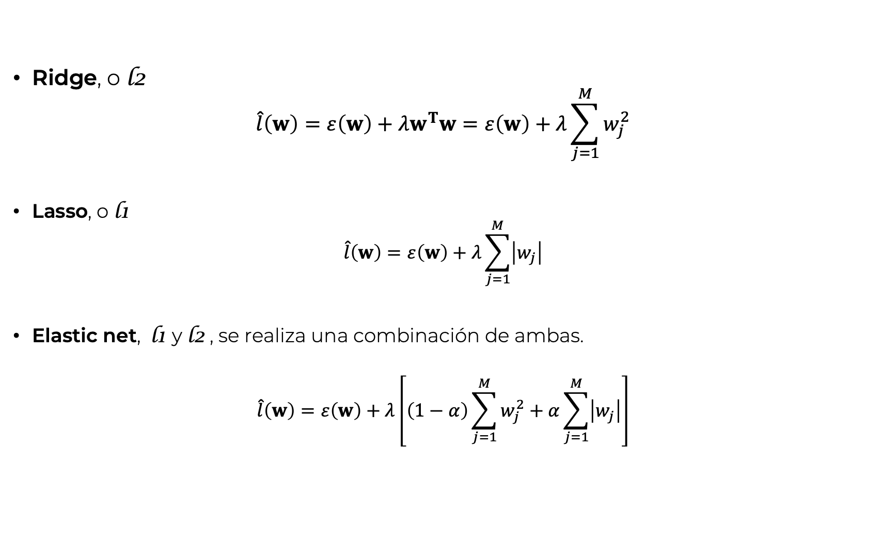
Tutorial 3
Recordando teoría. Regularización
En sklearn 𝜆 es 𝛼
Ridge, o l2
$$\hat{l}\left(w\right)=ε\left(w\right)+λw^{T}w=ε\left(w\right)+λ\sum_{j=1}^{M}{w_{j}^{2}}$$
Lasso, o l1
$$\hat{l}\left(w\right)=ε\left(w\right)+λ\sum_{j=1}^{M}{\left|w_{j}\right|}$$
Elastic net, l1 y l2 , se realiza una combinación de ambas.
$$\hat{l}\left(w\right)=ε\left(w\right)+λ\left[\left(1−α\right)\sum_{j=1}^{M}{w_{j}^{2}}+α\sum_{j=1}^{M}{\left|w_{j}\right|}\right]$$
En sklearn 𝛼 es l1_ratio.

Slide 4
Tutorial 3
Determinants of Wages from the 1985 Current Population Survey
EDUCATION: Number of years of education.
SOUTH: Indicator variable for Southern Region (1=Person lives in South, 0=Person lives elsewhere).
SEX: Indicator variable for sex (1=Female, 0=Male).
EXPERIENCE: Number of years of work experience.
UNION: Indicator variable for union membership (1=Union member, 0=Not union member).
WAGE: Wage (dollars per hour).
AGE: Age (years).
RACE: Race (1=Other, 2=Hispanic, 3=White).
OCCUPATION: Occupational category (1=Management, 2=Sales, 3=Clerical, 4=Service, 5=Professional, 6=Other).
SECTOR: Sector (0=Other, 1=Manufacturing, 2=Construction).
MARR: Marital Status (0=Unmarried, 1=Married)

Slide 5
Tutorial 3
ColumnTransformer
categorical_columns = X_train.select_dtypes(include="category").columns
numerical_columns = X_train.select_dtypes(exclude="category").columns
# Otra forma
# categorical_columns = ["RACE", "OCCUPATION", "SECTOR", "MARR", "UNION", "SEX", "SOUTH"]
# numerical_columns = ["EDUCATION", "EXPERIENCE", "AGE"]
preprocessor = make_column_transformer(
(OneHotEncoder(drop="if_binary"), categorical_columns),
(StandardScaler(), numerical_columns))
# Otra forma
# preprocesor = ColumnTransformer(
# [('categoricos', OneHotEncoder(drop="if_binary"),categorical_columns),
# ('numericos', StandardScaler(), numerical_columns)])

Slide 6
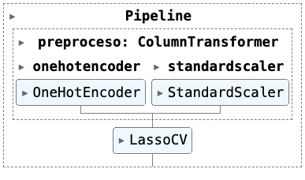
Tutorial 3
Pipeline
pipe_regrLasso = Pipeline([
('preproceso', preprocessor),
('regresor', LassoCV(
alphas = np.logspace(-9, 3, 200),
cv = 3))
])
np.random.seed(42)
pipe_regrLasso.fit(X = X_train, y = y_train)

Slide 7
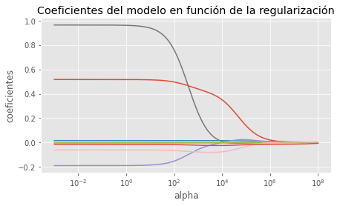
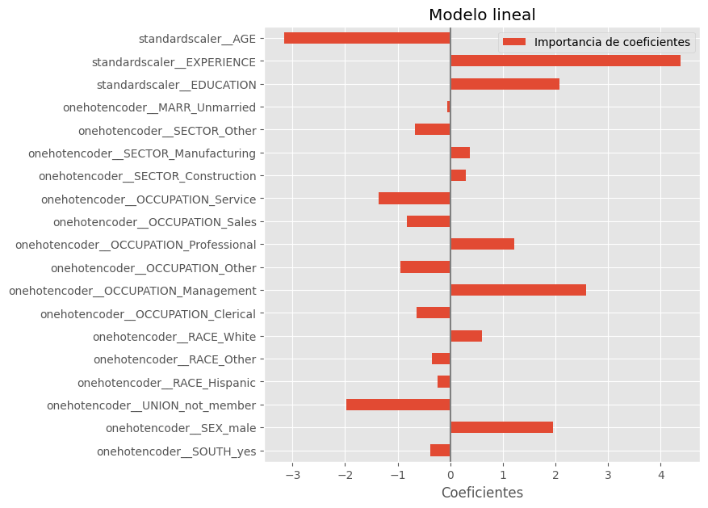
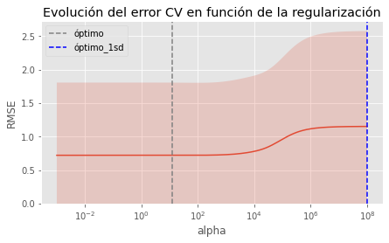
Tutorial 3
Ridge/Rasso/Elastic Net

