Slide 1
Machine Learning with Spotify
Monica Chen
Szeyeung Luk
Brian Vera
Notes:
We designed this template so that each member of the project team has a set of slides with its own theme. Members, here’s how you add a new slide to just your set:
Mark where you want to add the slide: Select an existing one in the Thumbnails pane, click the New Slide button, then choose a layout. The new slide gets the same theme as the other slides in your set.
Careful! Don’t annoy your fellow presenters by accidentally changing their themes. That can happen if you choose a different theme from the Design tab, which changes all of the slides in the presentation to that look.

Slide 2
Goal
To identify audio genres using Machine Learning.
Classification
Supervised learning
Create a model testing accuracy of predicting music genres
Logistic Regression
K-Nearest Neighbors (KNN)
Random Forest
Support Vector Machine (SVM)
Neural/Deep Neural Network
Identify for the model with the highest accuracy for future use.

Slide 3
Artists/Audio Features
Identify sub-genres of music through 12 descriptive audio features provided by Spotify
Acoustic
Tempo
Energy
Instrumental
Valence
Speechiness
Danceability
Loudness
Key
Mode

Slide 4

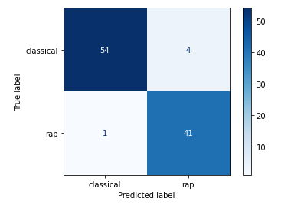
Feasibility Test
Confusion Matrix
Can the model successfully distinguish between classical and rap music?
Test feasibility of identifying two very distinct genres based on the audio features provided in the dataset
Logistic Regression Accuracy =
96%

Slide 5
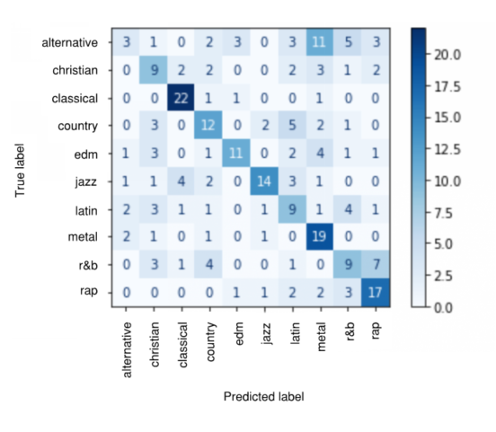

Primary Genre Model
Confusion Matrix
Introduce additional genres
Logistic regression accuracy dropped to below 50% after including additional genres
Classical
Rap
Latin
Country
R&B
Eliminate genres showing least accuracy, based on confusion matrix
Christian
EDM
Heavy Metal
Jazz
Alternative

Slide 6
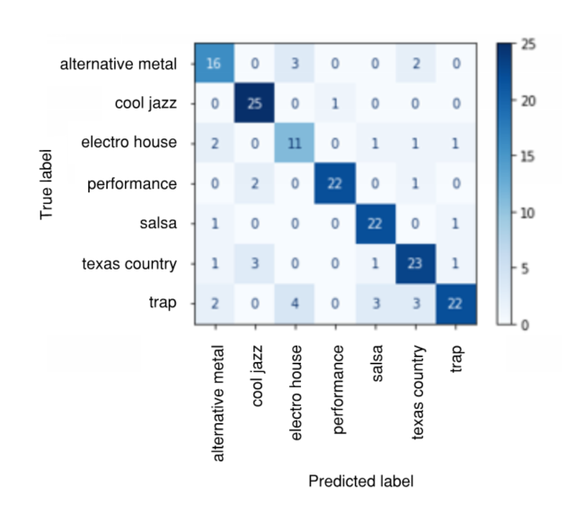
Sub-Genre Model
Confusion Matrix
Sub-genres have a smaller range of distinctive audio features
Produce higher accuracy
Example: Primary Genre: Latin
Sub-Genre: Salsa, Bachata, Merengue, etc.
Sample Size
Balanced Model: 100 samples for each sub-genre
700 samples total (7 sub-genres)
Testing: 175 samples
Training: 525 samples
Logistic Regression Accuracy =
76.6%

Slide 7
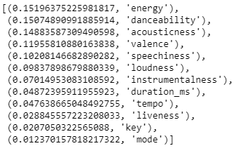
Decision Tree/Random Forest
Decision Tree: 70%
Random Forest: 81%
Hyperparameter Tuning
Feature Importance
Energy, Danceability, Acousticness, Valence, Speechiness

Slide 8
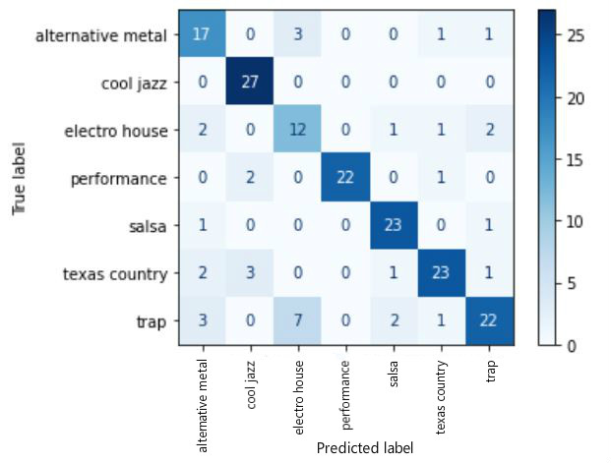
Support Vector Machine
Balanced multi classification
C=5, gamma=0.0001
MinMaxScaler for training data
Accuracy: 82.86%

Slide 9
Deep Neural Network
Model Assumptions
Sequential Model, Dense Layers
Input nodes: 12 audio features
Output nodes : 7 sub-genre classes
Neural Network
Hidden Layer 1: 36 nodes
Result: 75.4% accuracy
Deep Neural Network
Hidden Layer 1: 36 nodes
Hidden Layer 2: 95 nodes
Result: 80% accuracy
Notes:
Sequencial: model always goes forward, feed forward
Dense layer: layers are fully connected, all nodes are fully connected

Slide 10
Conclusion
SVM model outperforms more complicated models (ex. deep neural network)
Model | Accuracy
SVM | 82.8%
Logistic Regression | 80.6%
Random Forest | 80.6%
Deep Neural Network | 80.0%
KNN | 77.7%

Slide 11
Appendix
Works cited
Additional supporting data

