Slide 1









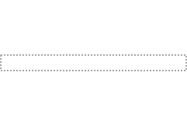

Prediction loss
wrt. the weak labels
Supervision Layer
Confidence Network
Goodness of the Sample
Representation Learning
Weak Annotator
True Labels

Slide 2

Prediction loss
wrt. the weak labels
Supervision Layer
Confidence Network
Goodness of the Sample
Representation Learning
Weak Annotator
True Labels

