Slide 1



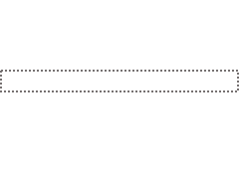
Prediction loss
wrt. the weak labels
Student
Representation Learning
Weak Annotator

