Slide 1







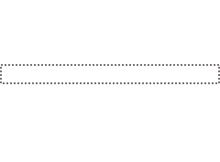
Prediction loss
wrt. the labels
generated by the teacher
Student
Teacher
Representation Learning
Learned Representations

