Slide 1
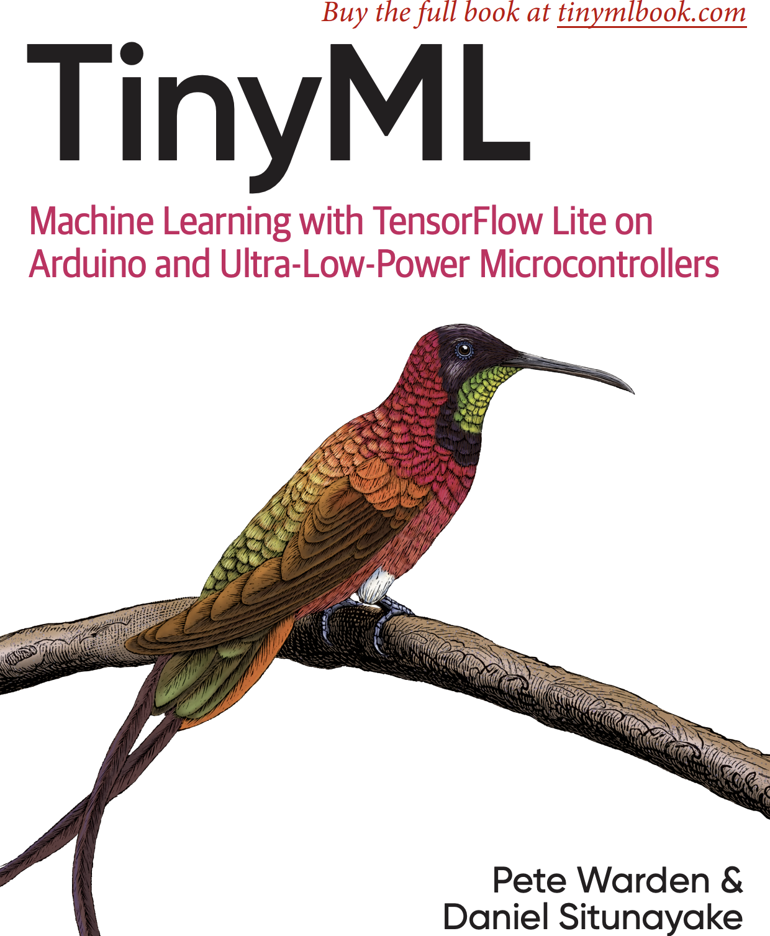

Slide 2
TinyML
TinyML: ML on low-power devices (1mW or below)
TensorFlow Lite: a version of Google’s TensorFlow framework designed for edge devices including microcontrollers https://www.tensorflow.org/lite

Slide 3
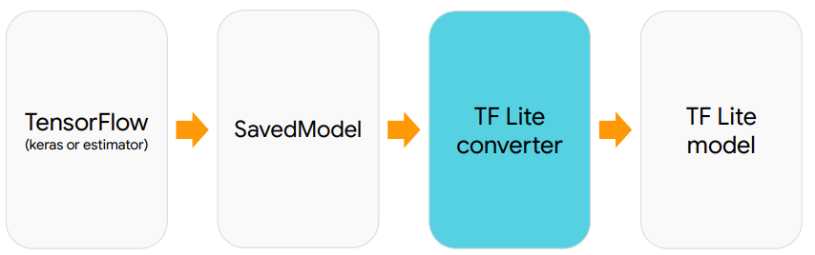
ML training output: .pb file

Slide 4
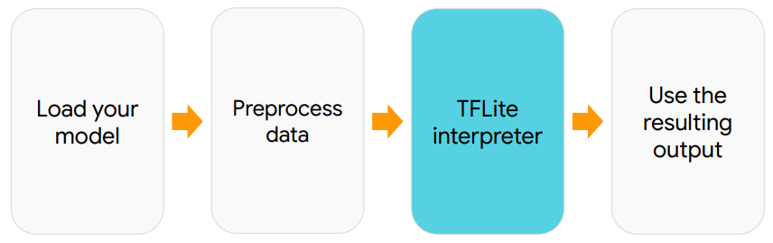
Inference flow

Slide 5
TensorFlow Lite vs TensorFlow
https://www.tensorflow.org/lite/guide/ops_compatibility
If you’re planning a new model, you should ensure at the outset that you aren’t relying on features or ops that aren’t supported. In particular, LSTMs, GRUs, and other recurrent neural networks are not yet usable.
There’s also currently a gap between what’s available in the full mobile version of TensorFlow Lite and the microcontroller branch. The simplest way to understand what operations are supported by TensorFlow Lite for Microcontrollers at the moment is to look at https://github.com/tensorflow/tensorflow/blob/master/tensorflow/lite/micro/kernels/all_ops_resolver.cc

Slide 6
TF Lite Custom Ops
TensorFlow supports more than 800 operations, TF Lite - only 122 ops
If you find that there are TensorFlow operations that you absolutely need that are not supported by TensorFlow Lite, it is possible to save them as custom operations inside the TensorFlow Lite file format, and then implement them yourself

Slide 7
How to find all TF ops types
you can access the underlying low-level operations from Keras, as long as you can retrieve the underlying Session object using tf.keras.backend.get_session() . If you’re coding directly in TensorFlow, it’s likely that you already have the session in a variable, so the following code should still work:
for op in sess.graph.get_operations ():
print ( op.type )
If you’ve assigned your session to the sess variable, this will print out the types of all the ops in your model. You can also access other properties, like name , to get more information. Understanding what TensorFlow operations are present will help a lot in the conversion process to TensorFlow Lite.

Slide 8
TF Lite convertor
The converter input supports SavedModels, frozen graphs (models generated via freeze_graph.py), and tf.Keras model files. Output: FlatBuffer file
The TensorFlow Lite FlatBuffer file can be shipped to client devices.
﻿In addition to creating a FlatBuffer, the TensorFlow Lite Converter can also apply optimizations to the model. These optimizations generally reduce the size of the model, the time it takes to run, or both. This can come at the cost of a reduction in accuracy, but the reduction is often small enough that it’s worthwhile. You can read more about optimizations in Chapter 13 . One of the most useful optimizations is quantization . By default, the weights and biases in a model are stored as 32-bit floating-point numbers so that high-precision calculations can occur during training. Quantization allows you to reduce the precision of these numbers so that they fit into 8-bit integers
https://www.tensorflow.org/lite/convert/index https://github.com/tensorflow/tensorflow/tree/master/tensorflow/lite/toco
https://www.tensorflow.org/guide/saved_model#using_savedmodel_with_estimators
https://github.com/tensorflow/tensorflow/blob/master/tensorflow/python/tools/freeze_graph.py

Slide 9
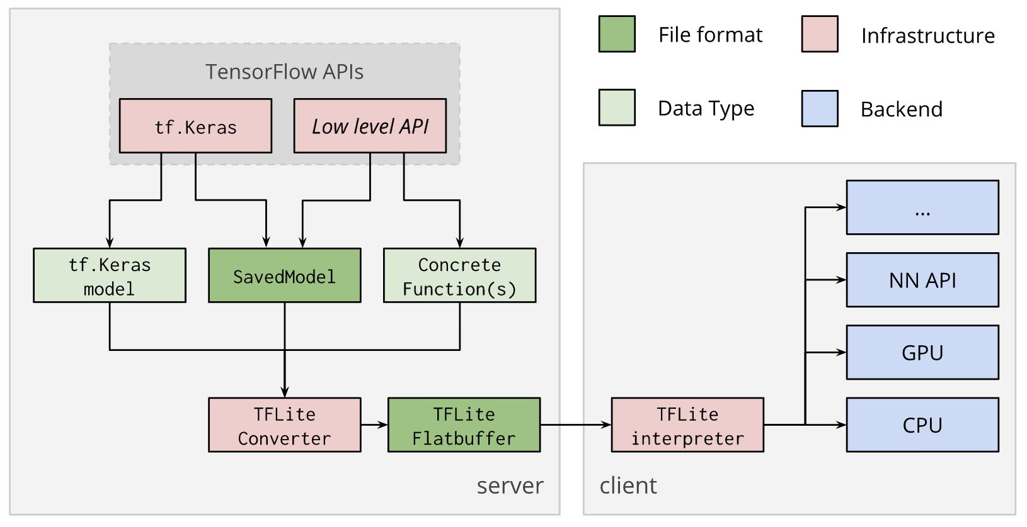
TF Lite Convertor

Slide 10
Example: sine model
https://github.com/tensorflow/tensorflow/blob/master/tensorflow/lite/micro/examples/hello_world/create_sine_model.ipynb # Convert the model to the TensorFlow Lite format with quantization
converter = tf.lite.TFLiteConverter.from_keras_model(model_2)
converter.optimizations = [tf.lite.Optimize.OPTIMIZE_FOR_SIZE]
tflite_model = converter.convert()
# Save the model to disk
open("sine_model_quantized.tflite", "wb").write(tflite_model)

Slide 11
Converting Flatbuffer to C
$ xxd -i sine_model_quantized.tflite > sine_model_quantized.cc
$ cat sine_model_quantized.cc
﻿unsigned char sine_model_quantized_tflite [] = { 0x1c , 0x00 , 0x00 , 0x00 , 0x54 , 0x46 , 0x4c , 0x33 , 0x00 , 0x00 , 0x12 , 0x00 , 0x1c , 0x00 , 0x04 , 0x00 , 0x08 , 0x00 , 0x0c , 0x00 , 0x10 , 0x00 , 0x14 , 0x00 , // ... 0x00 , 0x00 , 0x08 , 0x00 , 0x0a , 0x00 , 0x00 , 0x00 , 0x00 , 0x00 , 0x00 , 0x09 , 0x04 , 0x00 , 0x00 , 0x00 };
unsigned int sine_model_quantized_tflite_len = 2512 ;

Slide 12
TFLite on MCU:
int main ( int argc , char * argv []) {
setup (); // initialize the inference model
while ( true ) {
loop (); // get data from sensor and apply the inference to data
}
}

Slide 13
Wake-Word Detection
The model is trained to recognize 4 cases: the words “yes” and “no,” unknown words and silence. The model doesn’t take in raw audio sample data. It works with spectrograms , which are two-dimensional arrays that are made up of slices of frequency information, each taken from a different time window.
Spectrogram has 49 rows and 40 columns. Each row represents a 30-millisecond (ms) sample of audio split into 43 frequency buckets.
﻿To build the entire 2D array, we combine the results of running the FFT on 49 consecutive 30-ms slices of audio, with each slice overlapping the last by 10 ms.
(30-10)*49*0.001 = 0.98 sec Model training code: https://github.com/tensorflow/tensorflow/blob/master/tensorflow/lite/micro/examples/micro_speech/train_speech_model.ipynb

Slide 14
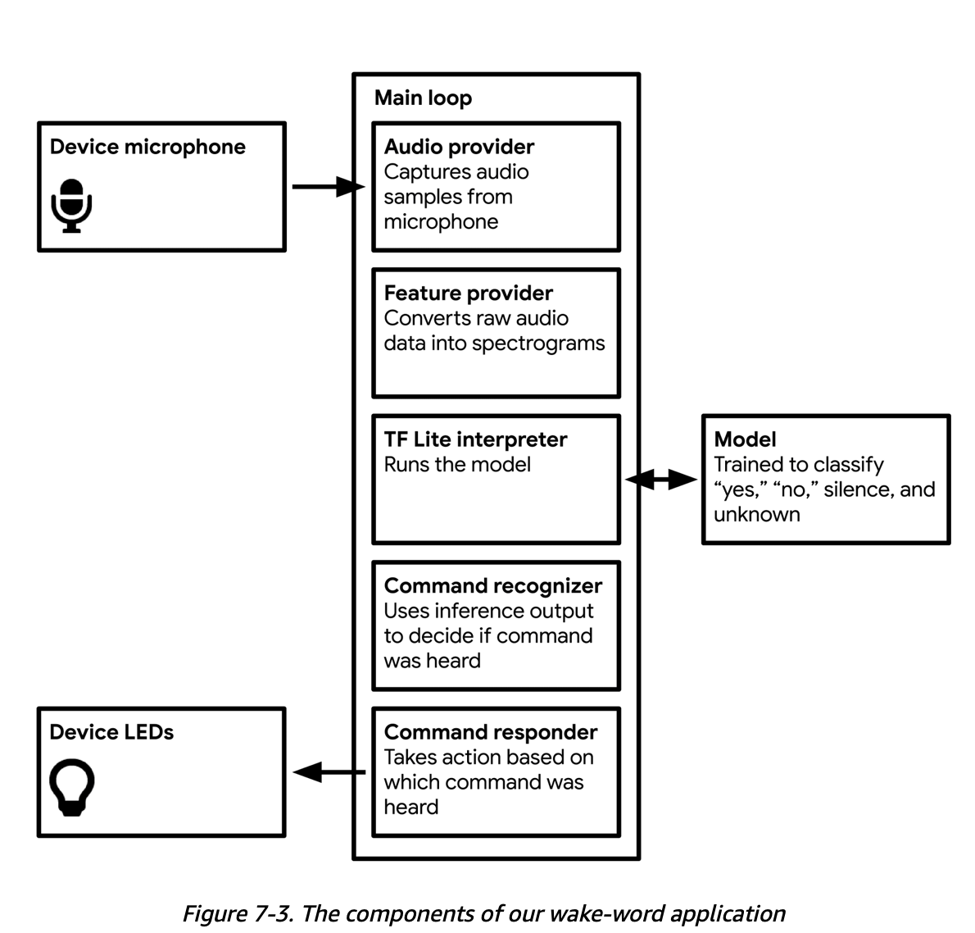

Slide 15
Audio Provider
﻿The core part of the audio provider is a function named GetAudioSamples() , defined in audio_provider.h . It looks like this:
TfLiteStatus GetAudioSamples ( tflite :: ErrorReporter * error_reporter , int start_ms , int duration_ms , int * audio_samples_size , int16_t ** audio_samples );
As described in audio_provider.h , the function is expected to return an array of 16-bit pulse code modulated (PCM) audio data. This is a very common format for digital audio. The function is called with an ErrorReporter instance, a start time ( start_ms ), a duration ( duration_ms ), and two pointers. These pointers are a mechanism for GetAudioSamples() to provide data. The caller declares variables of the appropriate type and then passes pointers to them when it calls the function. Inside the function’s implementation, the pointers are dereferenced and the variables’ values are set.

Slide 16
Audio Provider 2
https://github.com/tensorflow/tensorflow/tree/master/tensorflow/lite/micro/examples/micro_speech/sparkfun_edge https://github.com/tensorflow/tensorflow/tree/master/tensorflow/lite/micro/examples/micro_speech/arduino

Slide 17
Feature Provider
﻿It converts raw audio, obtained from the audio provider, into spectrograms that can be fed into our model. It is called during the main loop. ﻿discussed, its job is to populate an array that represents a spectrogram of one second of audio.
Each spectrogram is represented as a 2D array, with 40 columns and 49 rows, where each row represents a 30-millisecond (ms) sample of audio split into 43 frequency buckets. To create each row, we run a 30-ms slice of audio input through a fast Fourier transform (FFT) algorithm. This technique analyzes the frequency distribution of audio in the sample and creates an array of 256 frequency buckets, each with a value from 0 to 255. These are averaged together into groups of six, leaving us with 43 buckets. The code that does this is in the file micro_features/micro_features_generator.cc , and is called by the feature provider. To build the entire 2D array, we combine the results of running the FFT on 49 consecutive 30-ms slices of audio, with each slice overlapping the last by 10 ms. The 30-ms sample window is moved forward by 20 ms each time until it has covered the full one-second sample. The resulting spectrogram is ready to pass into our model. https://github.com/tensorflow/tensorflow/blob/master/tensorflow/lite/micro/examples/micro_speech/feature_provider.cc
https://github.com/tensorflow/tensorflow/blob/master/tensorflow/lite/micro/examples/micro_speech/micro_features/micro_features_generator.cc

Slide 18
Recognizer
﻿We’re running multiple inferences per second, each on a one-second window of data. This means that we’ll run inference on any given word multiple times, in multiple windows. ﻿Because the first syllable of “noted” sounds like “no,” it’s likely that the model will interpret this as having a high probability of being a “no.” This problem means that we can’t rely on a single inference to tell us whether a word was spoken. This is where Recognizer comes in! The recognizer calculates the average score for each word over the past few inferences, and decides whether it’s high enough to count as a detection. To do this, we feed it each inference result as they roll in.

Slide 19
https://github.com/tensorflow/tensorflow/blob/master/tensorflow/examples/speech_commands/models.py#L673
﻿This model consists of a convolutional layer, followed by a fully connected layer, and then a softmax layer at the end. In the figure the convolutional layer is labeled as “DepthwiseConv2D,” but this is just a quirk of the TensorFlow Lite converter (it turns out that a convolutional layer with a single-channel input image can also be expressed as a depthwise convolution).

Slide 20
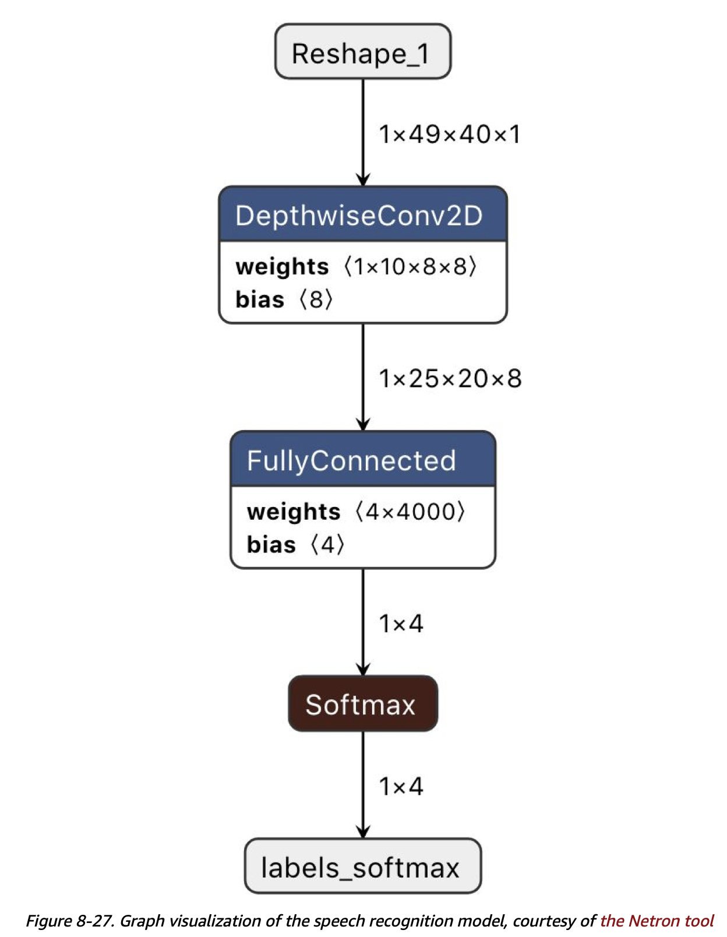

Slide 21
Output Layer
The end result of the model is the output of the softmax layer. This is four numbers, one for each of “silence,” “unknown,” “yes,” and “no.” These values are the scores for each category, and the one with the highest score is the model’s prediction, with the score representing the confidence the model has in its prediction. As an example, if the model output is [10, 4, 231, 80] , it’s predicting that the third category, “yes,” is the most likely result with a score of 231.

Slide 22
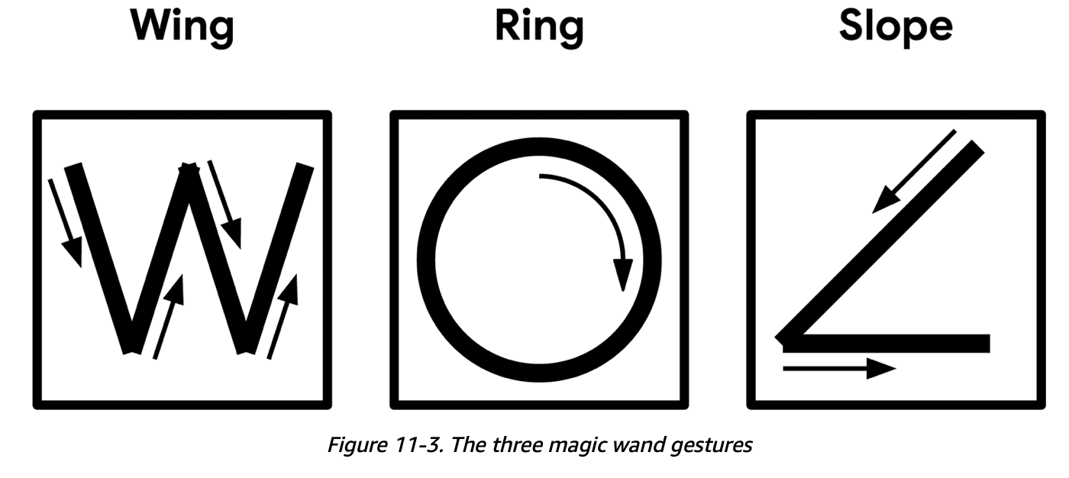
Magic Wand

Slide 23
Accelerometer
A three-axis accelerometer outputs three values representing the amount of acceleration on the device’s x, y, and z-axes.
The accelerometer on the SparkFun Edge board can do this 25 times per second (a rate of 25 Hz).
The accelerometer on the Arduino Nano 33 BLE Sense board returns measurements at a rate of 119 Hz. This means that in addition to capturing data, we need to downsample it to suit our model

Slide 24
Magic Wand Model
Model outputs probability scores for four classes: one representing each gesture (“wing,” “ring,” and “slope”), and one representing no recognized gesture. The probability scores sum to 1, with a score above 0.8 being considered confident. The model is a convolutional neural network (CNN) and that it transforms a sequence of 128 three-axis accelerometer readings, representing around five seconds of time, into an array of four probabilities: one for each gesture, and one for “unknown.”
https://github.com/tensorflow/tensorflow/blob/master/tensorflow/lite/micro/examples/magic_wand/train/train_magic_wand_model.ipynb

Slide 25
Magic Wand Inference
Because we’ll be running multiple inferences per second, we’ll need to make sure a single errant inference while a gesture is performed doesn’t skew our results. Our mechanism for doing this will be to consider a gesture as being detected only after it has been confirmed by a certain number of inferences.
Given that each gesture takes a different amount of time to perform, the number of required inferences is different for each gesture, with the optimal numbers being determined through experimentation.
Likewise, inference runs at varying rates on different devices, so these thresholds are also set per device

Slide 26
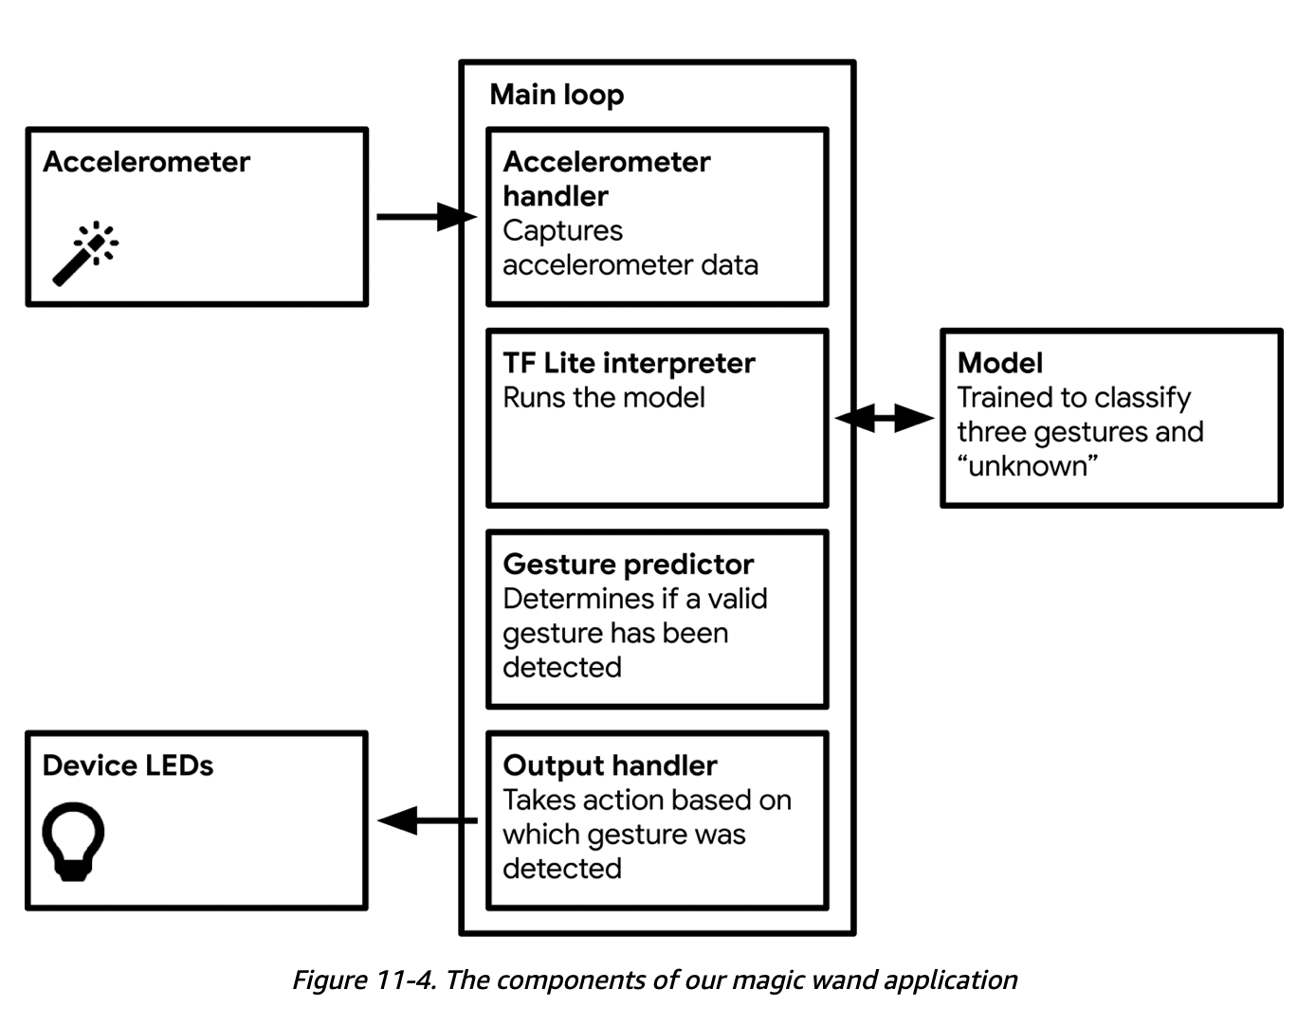

Slide 27
Links
https://www.tensorflow.org/lite/microcontrollers/get_started
https://github.com/tensorflow/tensorflow/tree/master/tensorflow/lite
https://community.arm.com/developer/research/b/articles/posts/sparse-architecture-search-sparse-democratizing-and-enabling-tinyml-on-arm-m-class
https://developer.arm.com/solutions/machine-learning-on-arm/developer-material/how-to-guides/build-arm-cortex-m-voice-assistant-with-google-tensorflow-lite/single-page
https://developer.arm.com/architectures/instruction-sets/dsp-extensions/dsp-for-cortex-m
https://github.com/tensorflow/tensorflow/blob/master/tensorflow/lite/micro/kernels/all_ops_resolver.cc
https://github.com/lutzroeder/netron

