Slide 1
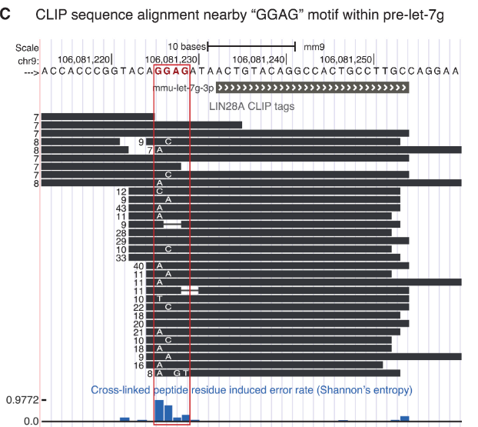
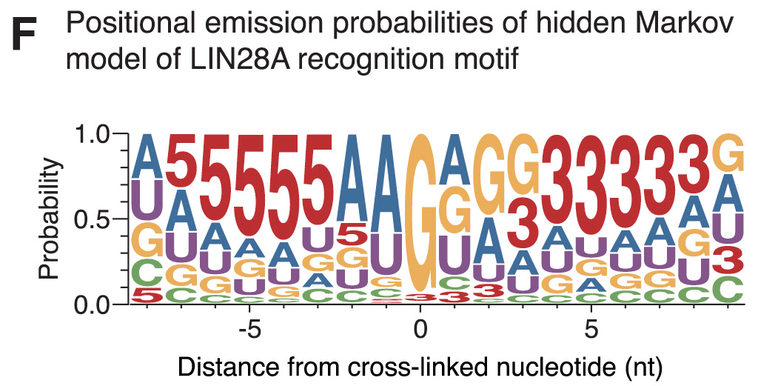
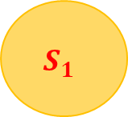

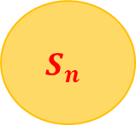
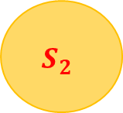
Hidden Markov Model을 이용한 Lin28A Binding Motif 학습
2023-31962 길해찬
Binding Motif
$$S_{1}$$
$$S_{2}$$
$$S_{n}$$
$$⋯$$
A: 0.2
C: 0.1
G: 0.3
T: 0.4
A: 0.3
C: 0.2
G: 0.1
T: 0.4
A: 0.6
C: 0.2
G: 0.1
T: 0.1

Slide 2
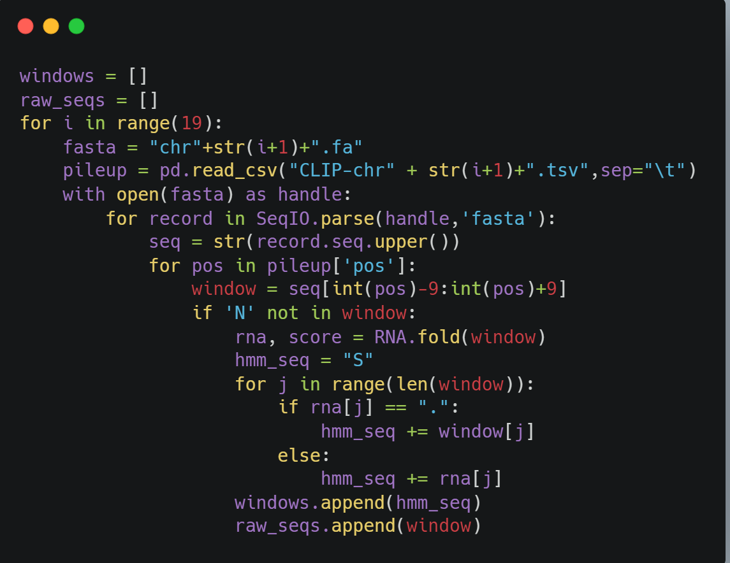
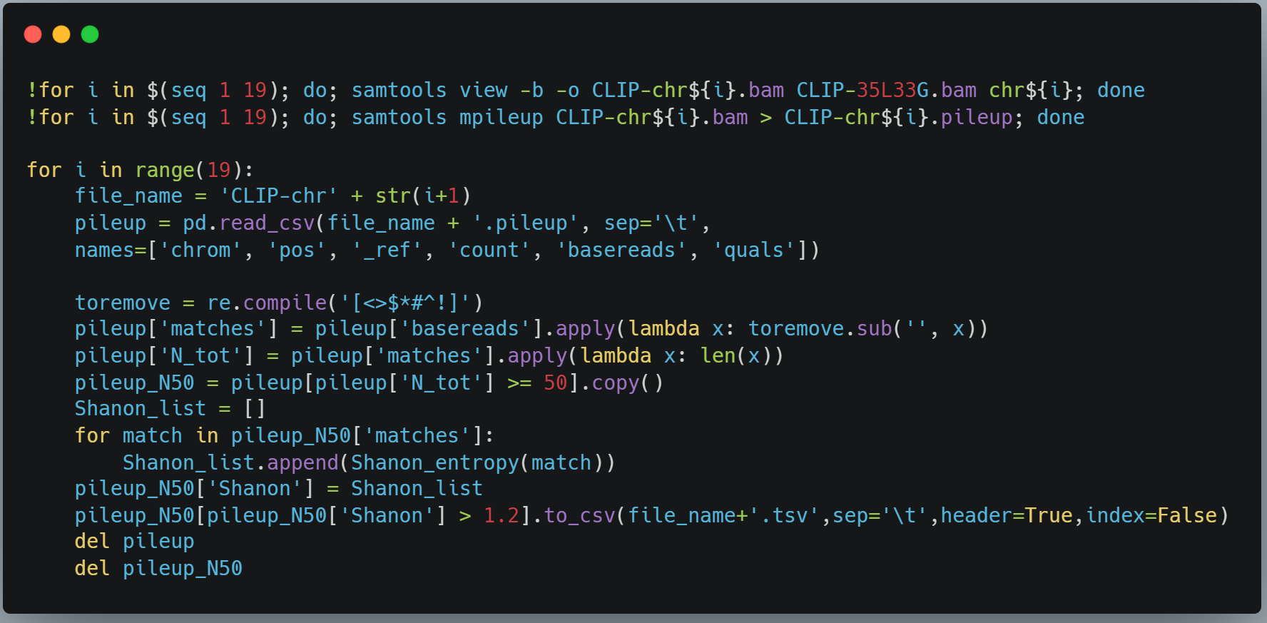
Hidden Markov Model을 이용한 Lin28A Binding Motif 학습
2023-31962 길해찬
samtools mpileup
Guided mission 3
Mouse mm39 Ref
CLIP-35L33G.bam
Chr1~Chr19 pileup
Depth & Shannon entropy filtering
Window (-9,+9)
Retrieving
Guided Mission 3 참고
스스로 작성

Slide 3
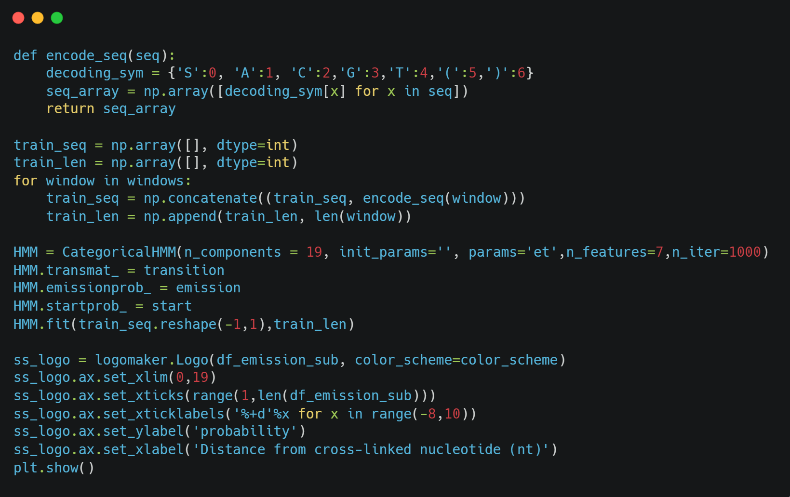
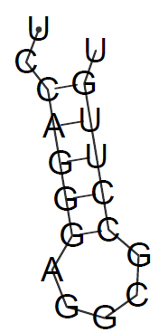
Hidden Markov Model을 이용한 Lin28A Binding Motif 학습
2023-31962 길해찬
Vienna RNA
Initial params
Logo maker
Retrieved window
RNA 2nd structure
prediction
CategoricalHMM learning
Emission prob Visualization
UC(((((AGGCG)))))U
2022년 1학기 생물정보학을 위한 기계학습 강의 참고하여 스스로 작성

Slide 4
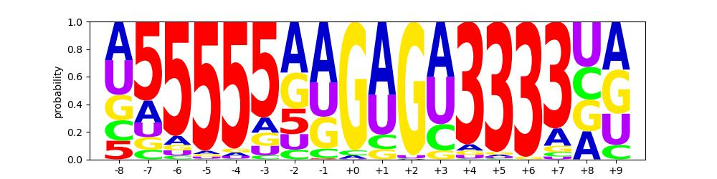
Hidden Markov Model을 이용한 Lin28A Binding Motif 학습
2023-31962 길해찬
Implication
Learning the characteristics of the binding motif of Lin28A by HMM
RNA secondary structure of the binding motif was important
Using the learned HMM model, we can predict binding sites from given mRNA
Limitation
Learned emission probabilities were not exactly the same as the results from paper (i.e., +3 position)
Can be attributed to multiple consensus sequences, differences in training sequences, or stochastic characteristics of HMM

