Slide 1
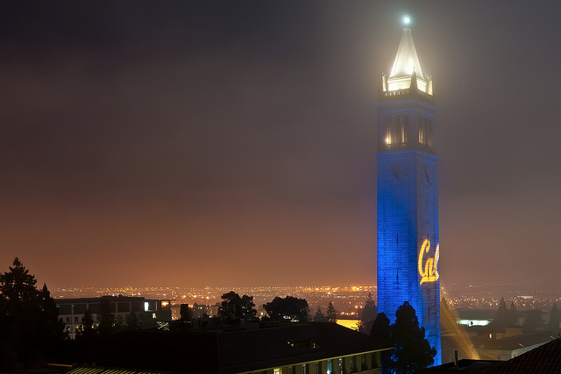
Quantum simulation
of spin-bath dynamics with trapped ions
Boerge Hemmerling
University of California, Berkeley

Slide 2
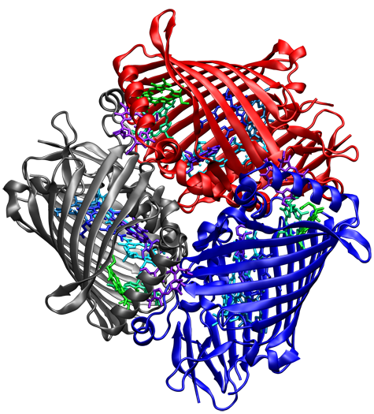
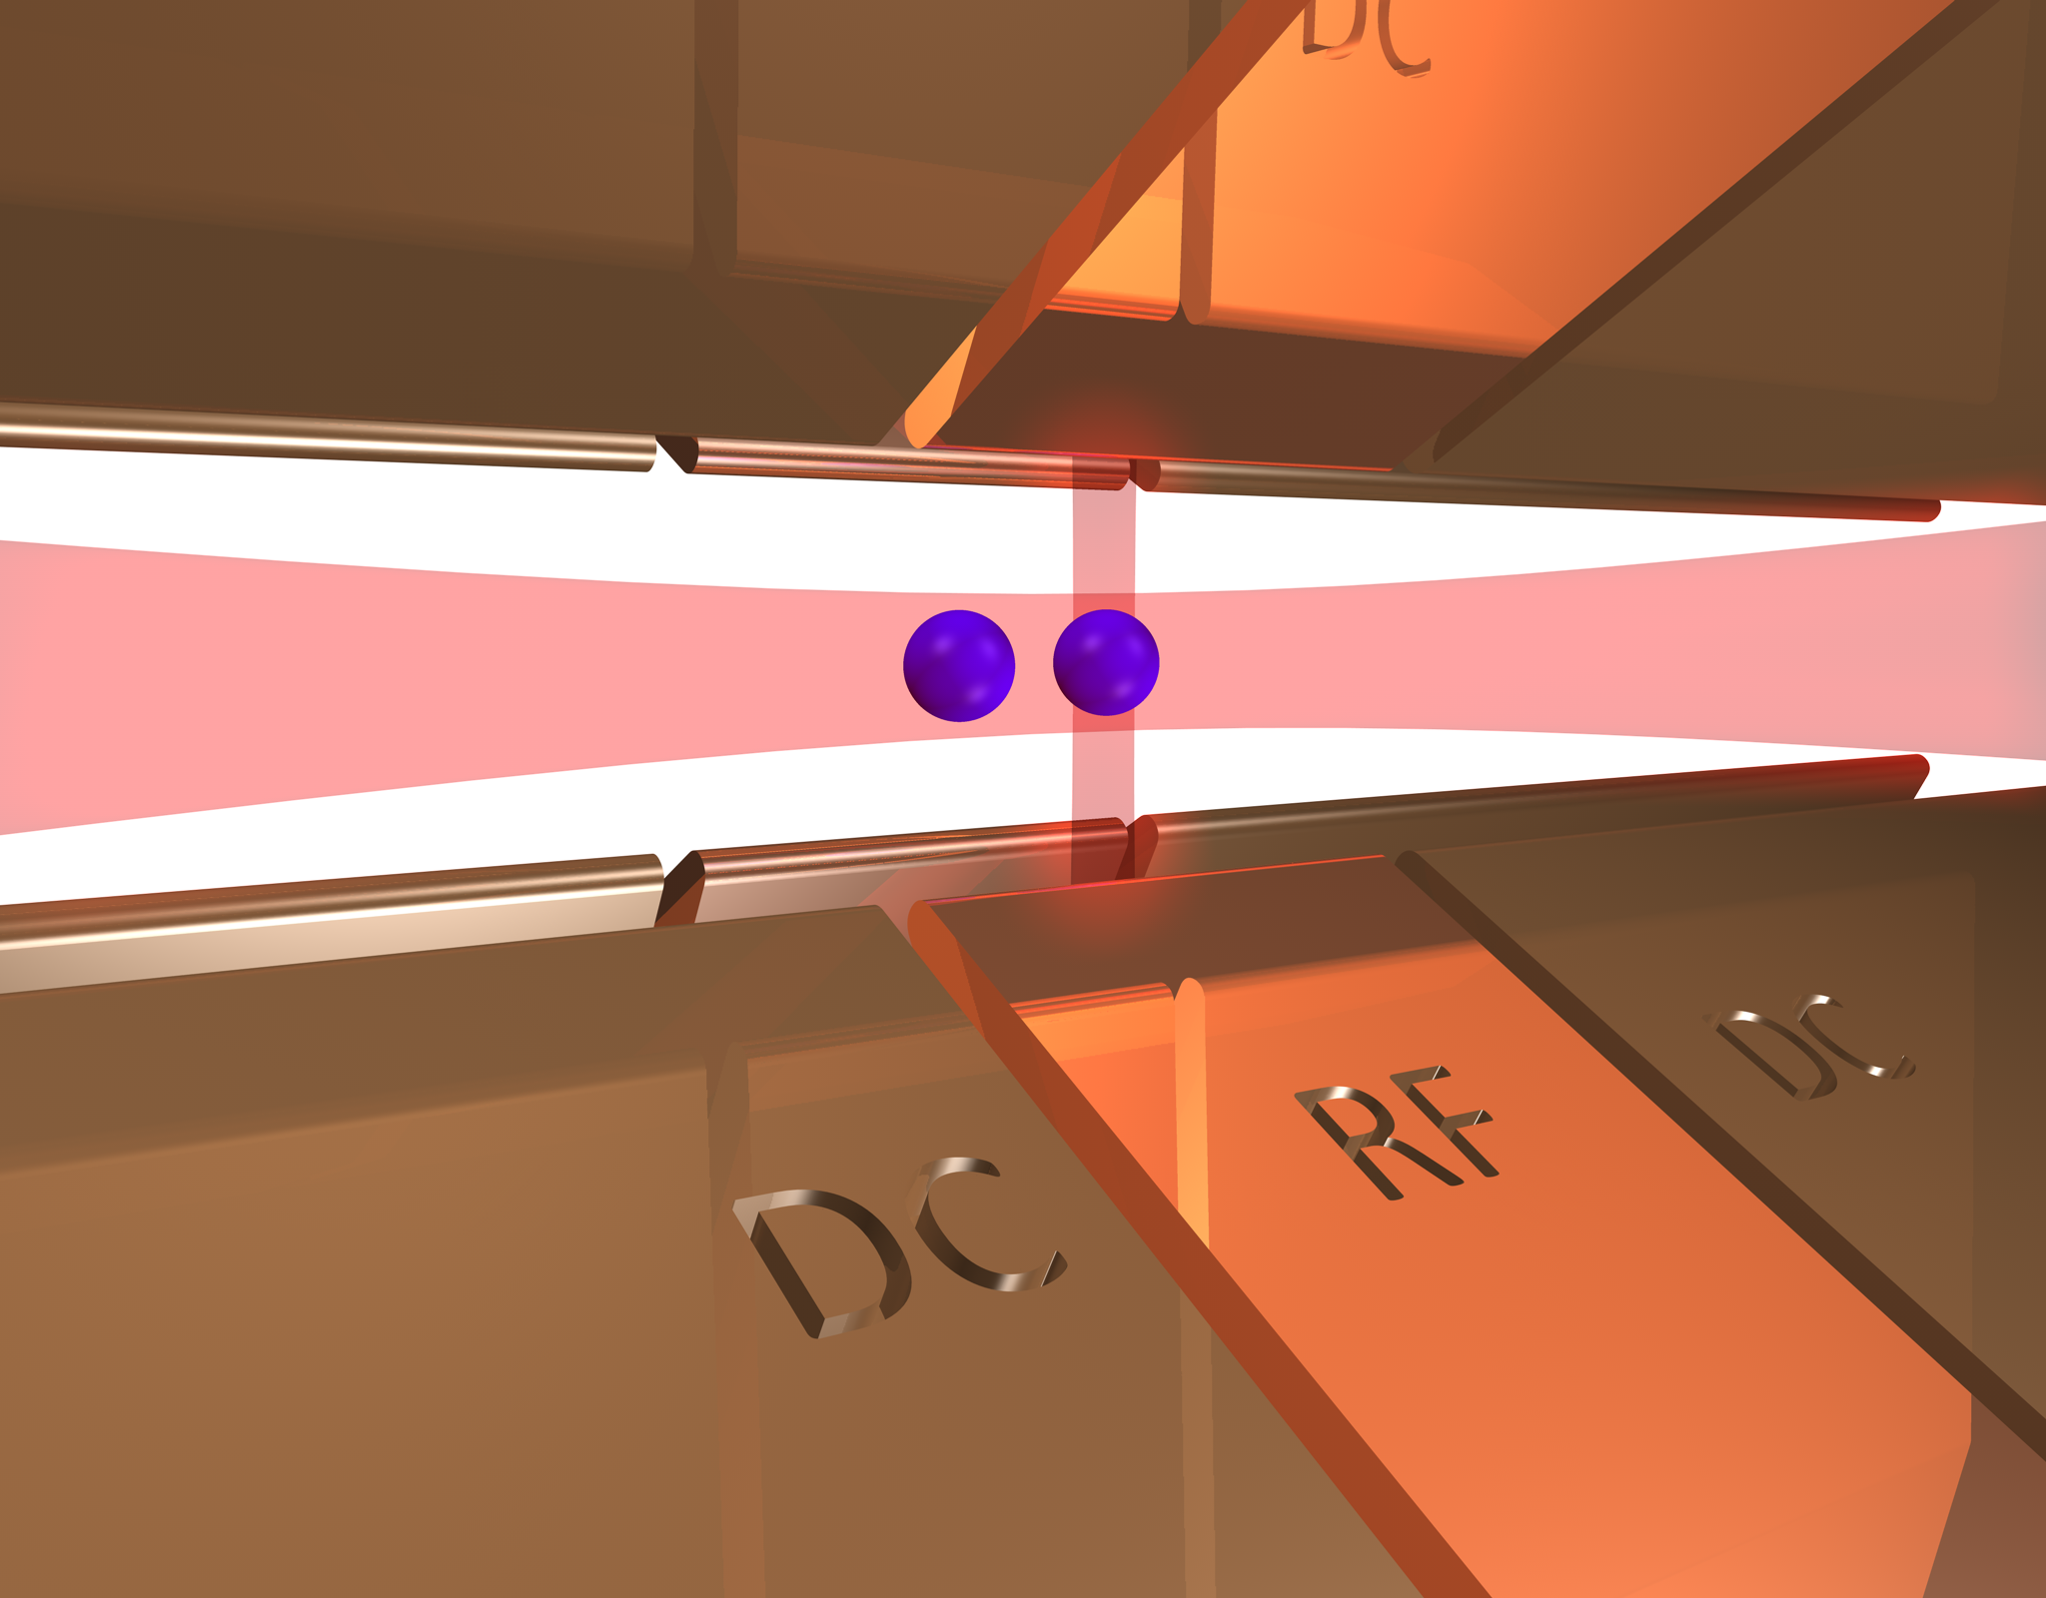
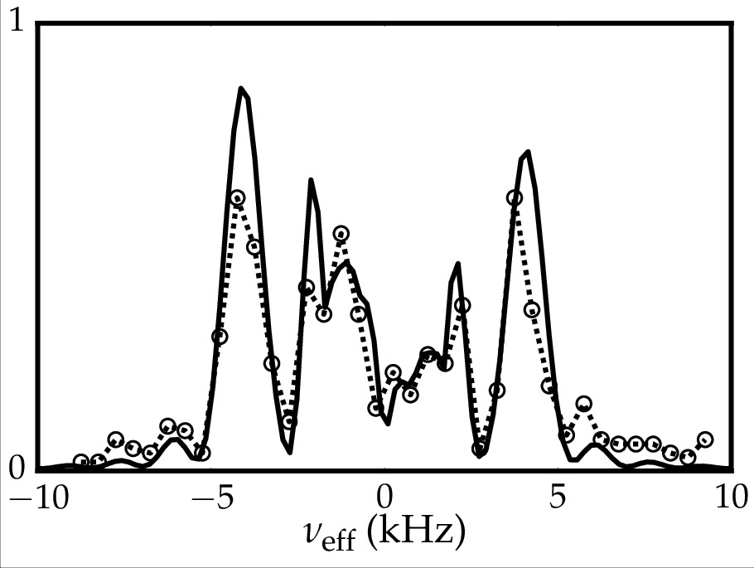
Outline
Goal: Simulating energy transport physics
Implementation of the simulation with ions
Experimental results:
  Vibrationally-assisted energy transport
Outlook

Slide 3
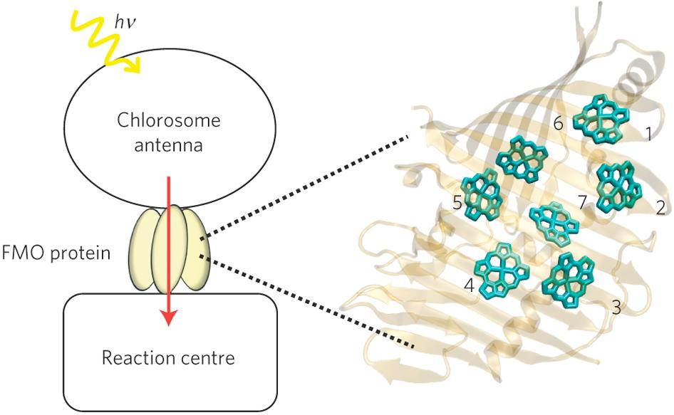
Energy transport problems are relevant in biology
Light harvesting
Fenna-Matthews-Olson complex
Very efficient energy
transport despite
noisy environment
PNAS 106, 17255 (2009)

Slide 4
Motivation to study transport phenomena
PNAS 106, 17255 (2009)

Slide 5
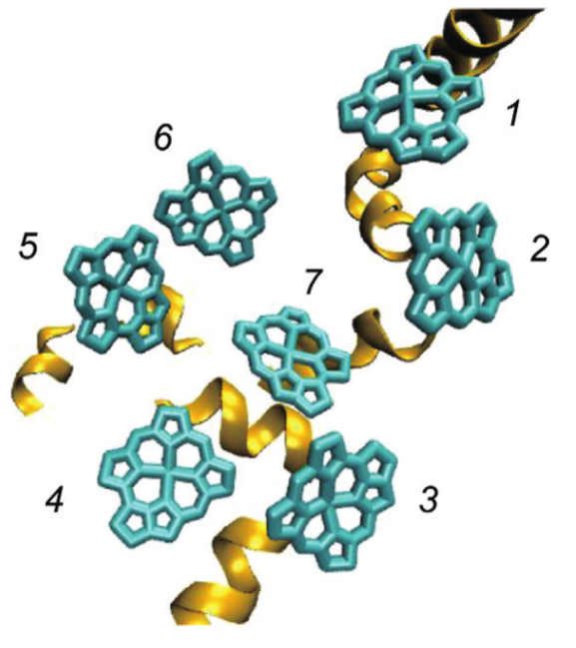
Motivation to study transport phenomena
PNAS 106, 17255 (2009)

Slide 6
Motivation to study transport phenomena
PNAS 106, 17255 (2009)

Slide 7
Motivation to study transport phenomena
Environment
Environment
Environment
PNAS 106, 17255 (2009)

Slide 8
Study transport and effect of environment in a controlled system
Site-to-site
coupling
On resonance: energy transfer

Slide 9
Study transport and effect of environment in a controlled system
Site-to-site
coupling
On resonance: energy transfer
Off resonance: no energy transfer

Slide 10
Study transport and effect of environment in a controlled system
Site-to-site
coupling
On resonance: energy transfer
Off resonance: no energy transfer

Slide 11
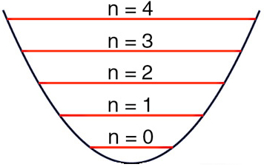
Study transport and effect of environment in a controlled system
Environment
Site-to-site
coupling
On resonance: energy transfer
Off resonance: no energy transfer
Environment can help to fulfill
the resonance condition:
Vibrationally assisted energy transport
→ Implementation: Quantum simulation using trapped Ca ions

Slide 12
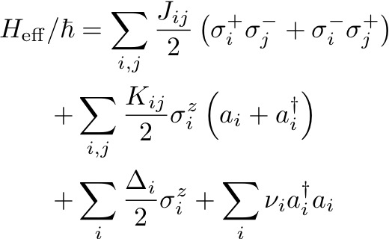
Study transport and effect of environment in a controlled system
Environment
Site-to-site
coupling
Hamiltonian for such a system can be complex

Slide 13
Initial step for transport simulation: Two sites
Environment
Site-to-site
coupling
Hamiltonian for such a system can be complex
→ We implemented the first building blocks
of the quantum simulator with two ions

Slide 14
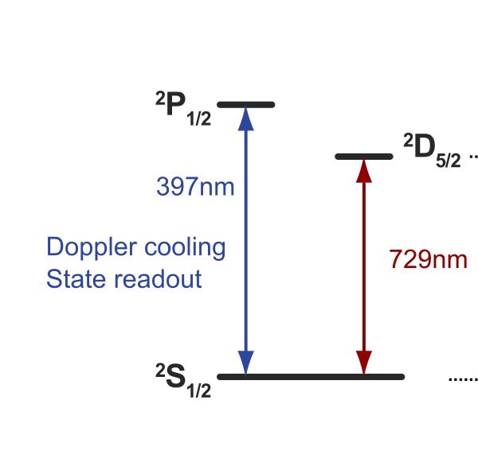
Our simulation uses Calcium ions in a Paul trap
D-state lifetime ~ 1s
Ion in D state = energy on one site

Slide 15
Our simulation uses Calcium ions in a Paul trap
Laser beams
D-state lifetime ~ 1s
Ion in D state = energy on one site
Laser-based interactions emulates
the Hamiltonian
Trap drive ~28 MHz
Calcium ions

Slide 16


Demonstration of the transfer dynamics
Ca⁺
Ca⁺
Notes:
energy transferred forth and back while on resonance

Slide 17
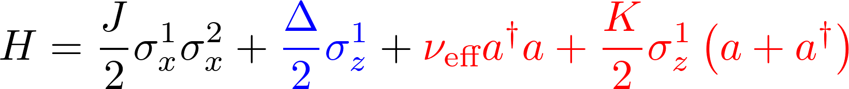
Demonstration of the transfer dynamics
J
Ca⁺
Ca⁺
Site-site coupling
Notes:
energy transferred forth and back while on resonance

Slide 18
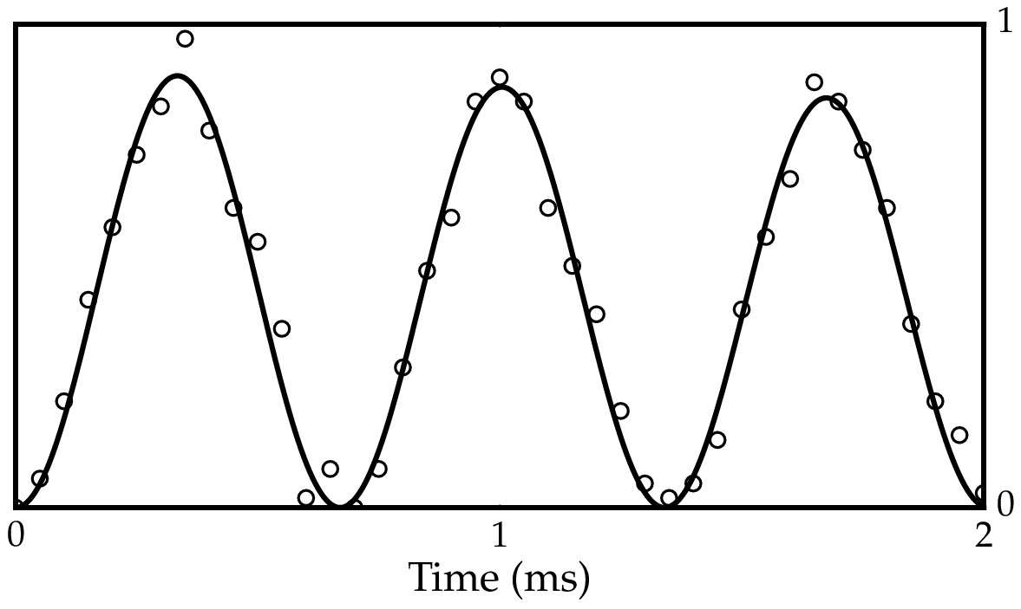
Demonstration of the basic transfer dynamics
Measured probability of population transfer
J
Ca⁺
Ca⁺
All parameters controllable!
Site-site coupling
Notes:
energy transferred forth and back while on resonance

Slide 19
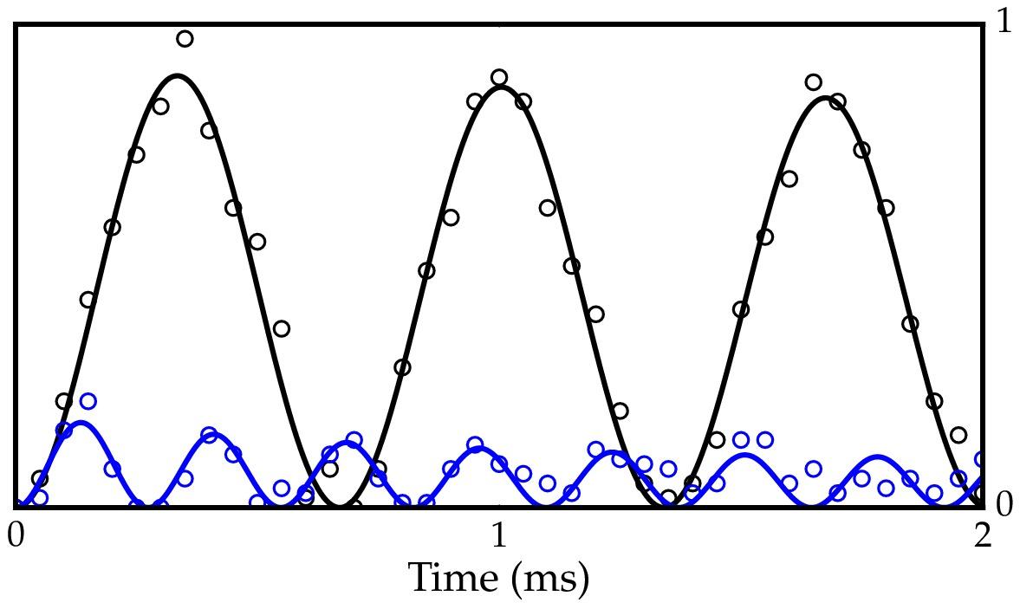

Demonstration of the basic transfer dynamics
Measured probability of population transfer
J
Ca⁺
Ca⁺
Site-site coupling
Detuning
Notes:
energy transferred forth and back while on resonance

Slide 20
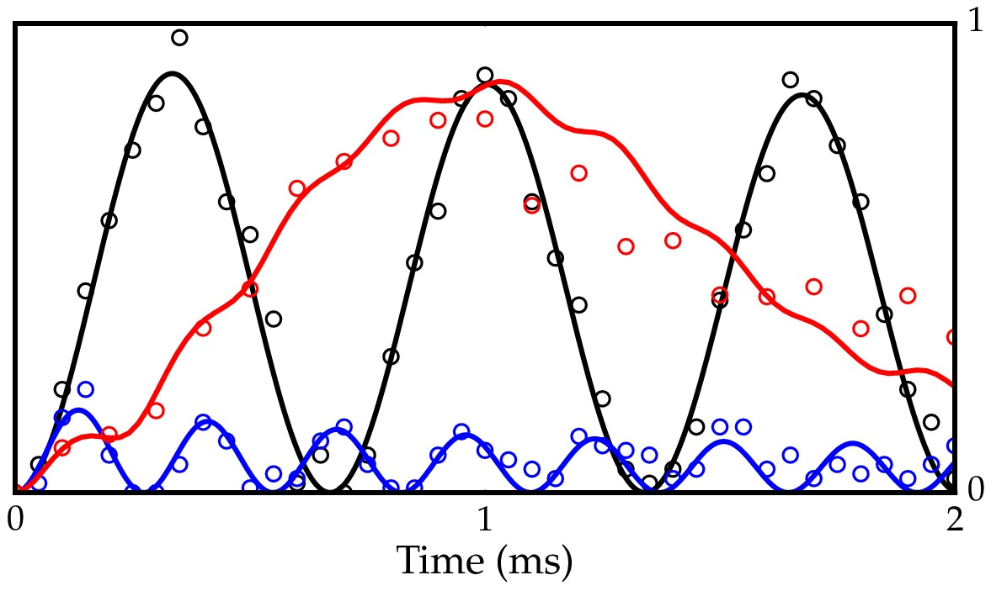
Demonstration of the basic transfer dynamics
Measured probability of population transfer
K
J
Ca⁺
Ca⁺
All parameters controllable!
Vibrationally
assisted
energy transport
Site-site coupling
Detuning
Spin-bath coupling
Notes:
energy transferred forth and back while on resonance

Slide 21
Outline
Goal: Simulating energy transport physics
Implementation of the simulation with ions
Experimental results:
  Vibrationally-assisted energy transport
Outlook

Slide 22
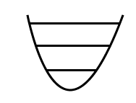
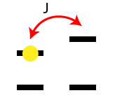
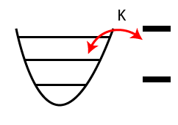
How do we implement the Hamiltonian terms?
Notes:
energy transferred forth and back while on resonance

Slide 23
How do we implement the Hamiltonian terms?
Ca+ Qubits
Detuning:
AC stark shift
Notes:
energy transferred forth and back while on resonance

Slide 24
How do we implement the Hamiltonian terms?
Ca+ Qubits
Detuning:
AC stark shift
Ions' motion
Notes:
energy transferred forth and back while on resonance

Slide 25
How do we implement the Hamiltonian terms?
Ca+ Qubits
Detuning:
AC stark shift
Ions' motion
Moelmer-Sorensen
interaction
Notes:
energy transferred forth and back while on resonance

Slide 26

Site-site coupling: Molmer-Sorensen interaction
Bichromatic laser interaction producing a Raman transition from

Slide 27
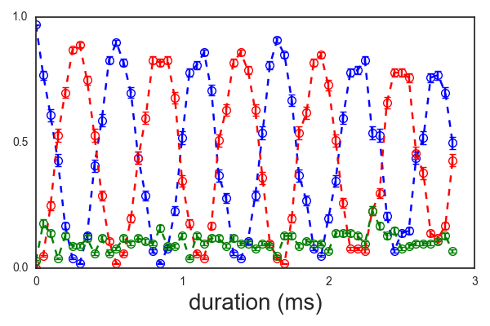
Site-site coupling: Molmer-Sorensen interaction
Probability of energy transfer between resonant sites
We can achieve couplings
of J = 2 pi x 1.5 kHz in our
system

Slide 28
How do we implement the Hamiltonian terms?
Ca+ Qubits
Detuning:
AC stark shift
Ions' motion
Moelmer-Sorensen
interaction
Spin-motion
coupling
Notes:
energy transferred forth and back while on resonance

Slide 29
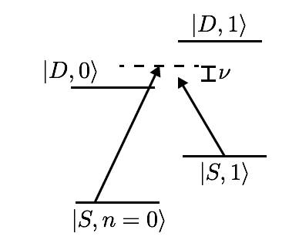

Spin-motion coupling
Generates coherent displacement of motional
state depending on electronic state
Intuitive picture: Amplitude modulated Stark shift
The effective mode frequency is determined
  by a laser detuning
Tuning this frequency can enhance or
prohibit the transport
Coupling to bath
Oscillator quantum number
PRA 77, 050303(R) (2008)

Slide 30
Simulation runs with two bichromatic interactions
Site-site interaction
Laser scheme

Slide 31
Simulation runs with two bichromatic interactions
Environmental coupling +
AC Stark shift via power imbalance
Site-site interaction
Interactions are implemented
by applying two radio frequencies
tones to acousto-optic modulator
Laser scheme

Slide 32
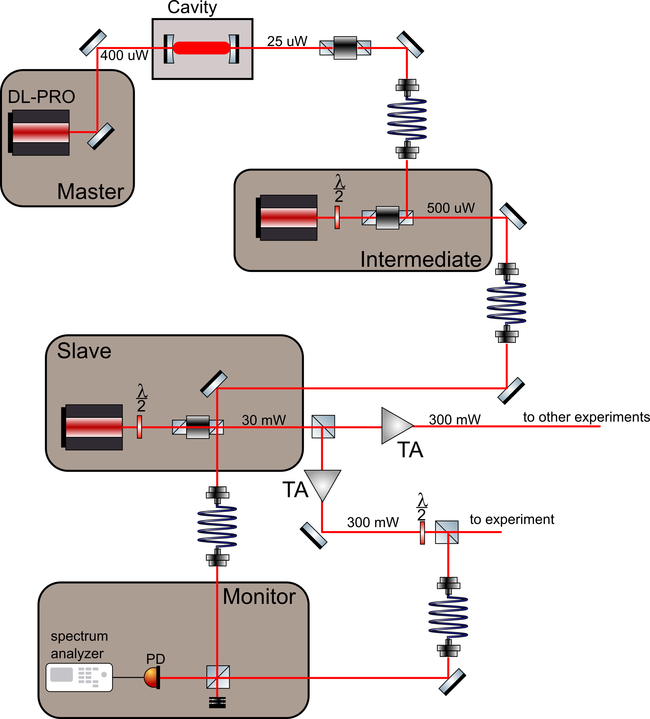
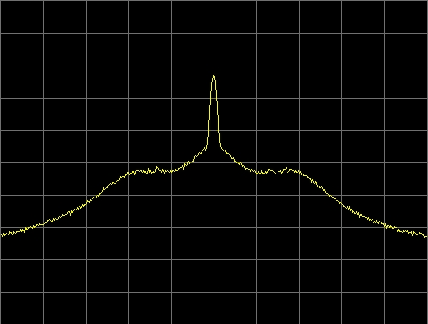
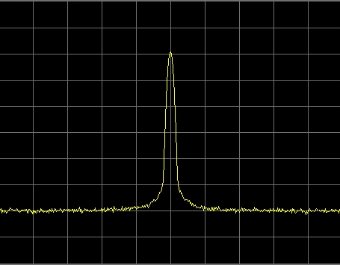
Master-intermediate-slave injection-locked cavity transmission-locked ECDL tapered-amplified qubit laser
Before: Beat signal with
servo bumps
F ~ 200,000
~30 dB
~600 kHz
After (filter cavity):
~60 dB
AOM
Ozeri Group: 2015 NJP 17 113060

Slide 33
Outline
Goal: Simulating energy transport physics
Implementation of the simulation with ions
Experimental results:
  Vibrationally-assisted energy transport
Outlook

Slide 34
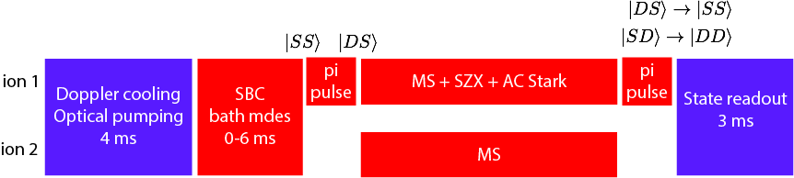
Experimental sequence
Excite the donor
Turn on simulation
donor
acceptor
Time
Measure population in acceptor state |SD>

Slide 35


Varying environmental frequency enhances/prohibits transport
Resonances = Excitation transfer
Probability of transfer
Theory
J = 1.3 kHz
K = 1.4 kHz
∆ = 4 kHz
P(acceptor)
Data

Slide 36
Varying environmental frequency enhances/prohibits transport
Environment
absorbs energy
Probability of transfer
Theory
J = 1.3 kHz
K = 1.4 kHz
∆ = 4 kHz
P(acceptor)
Data

Slide 37
Varying environmental frequency enhances/prohibits transport
Environment
absorbs energy
Environment
gives up energy
Probability of transfer
Theory
J = 1.3 kHz
K = 1.4 kHz
∆ = 4 kHz
P(acceptor)
Data

Slide 38
Environment can't give up energy in the ground state
<n> = 5
<n> = 0.5
Lower
temperature
Probability of transfer
P(acceptor)
Peaks suppressed because environment
cannot provide energy to enable transfer

Slide 39
Environment can't give up energy in the ground state
<n> = 5
<n> = 0.5
Lower
temperature
Probability of transfer
P(acceptor)
Probability of transfer
P(acceptor)
Model includes no free parameters

Slide 40

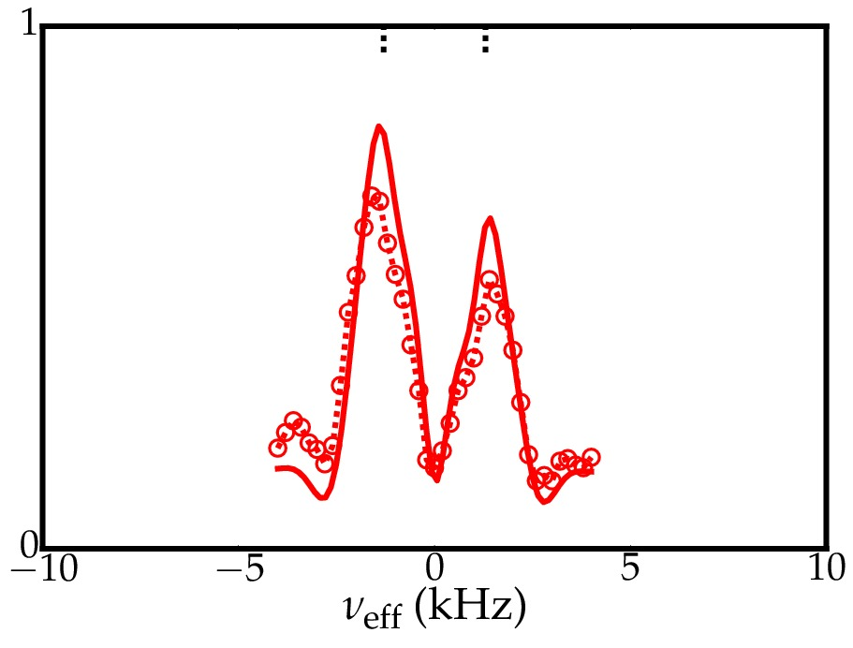

Resonances not resolved for Δ ~ J
Δ = 4.0 kHz
Probability of transfer
Probability of transfer
Single- and multi-phonon resonances
overlap for comparable Δ ~ J
Interesting regime since perturbation
theory is not applicable
Δ = 1.2 kHz
Probability of transfer

Slide 41
Access to regimes where perturbation theory fails
Time dynamics
Perturbation theory
K = 0.2 kHz
Data and exact calculation
Time scans taken here
J = 1.2 kHz
∆ = 1.2 kHz
Probability of transfer

Slide 42
Access to regimes where perturbation theory fails
Time dynamics
Perturbation theory
K = 0.2 kHz
Data and exact calculation
K = 0.4 kHz
Δ = 1.2 kHz
J = 1.2 kHz
∆ = 1.2 kHz
Probability of transfer
K = 0.6 kHz

Slide 43
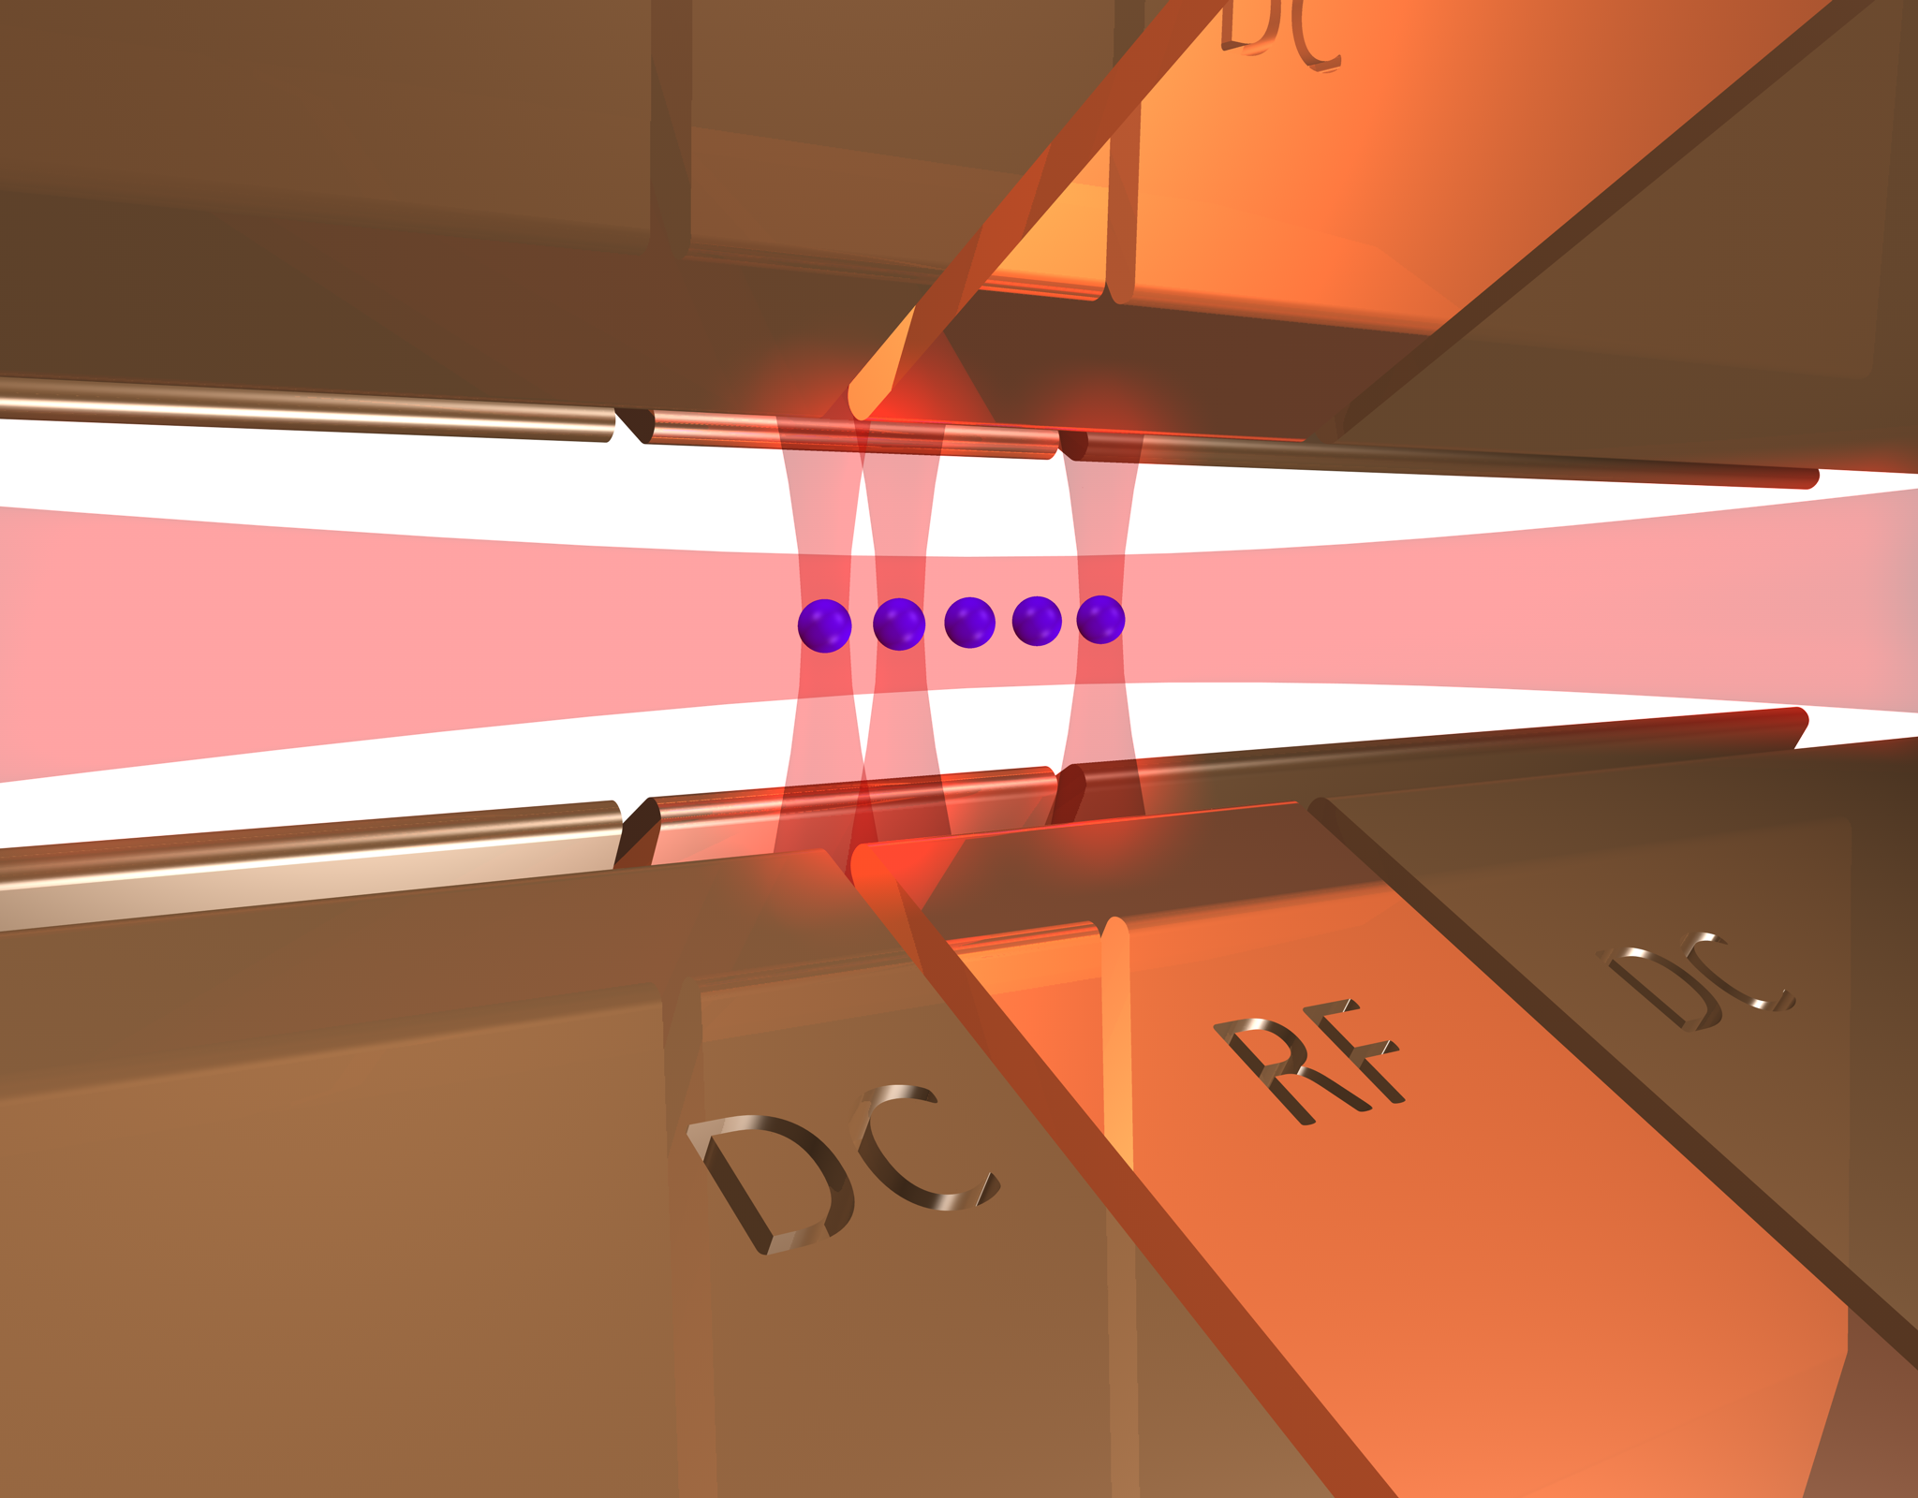
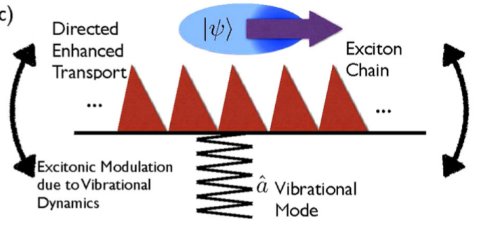
Outlook
Current status:
2 ions and 1 vibrational mode with up to 5 quanta
→ Effective Hilbert space dimension 30
Future prospects:
3 ions and 3 vibrational modes
→ Hilbert space dimension 10,000 (equivalent of 13 qubits)
Study directed energy transport
NJP 17, 093030 (2015)

Slide 44
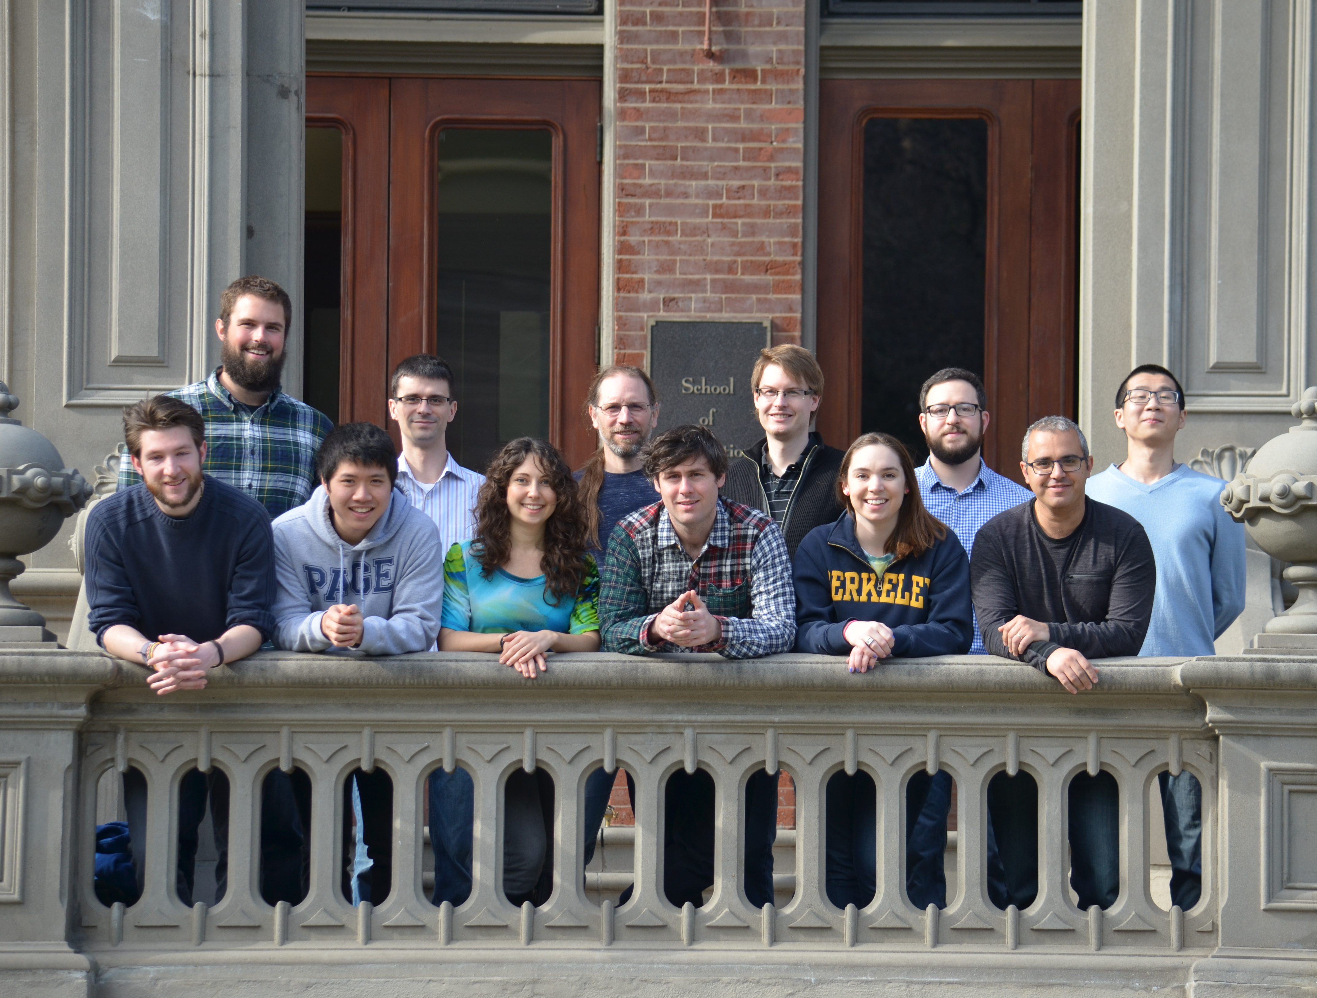

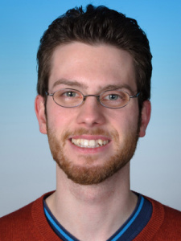
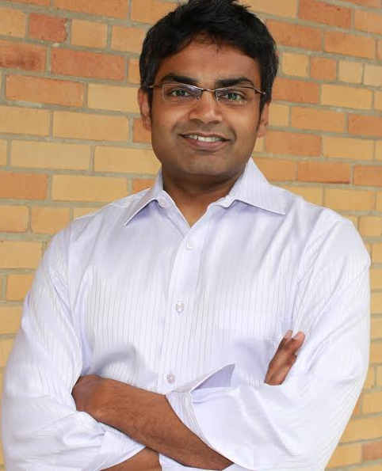
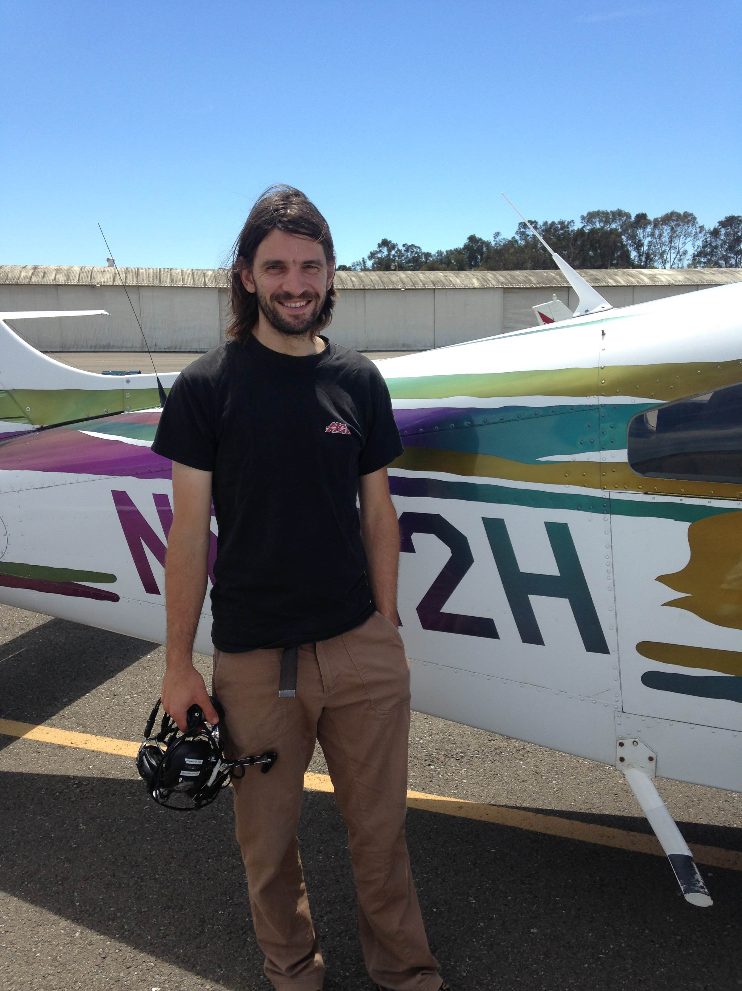

Acknowledgements
BH
H. Haeffner
D. Gorman
E. Megidish
Funding:
S. Moeller
P. Schindler
M. Sarovar
Innsbruck
Sandia National Labs

Slide 45
Summary
Our motivation is the study of
aspects of transport problems
Implemented a basic model
featuring vibrationally assisted energy transfer
with two sites
The environment can enhance the
energy transport under certain conditions

Slide 46
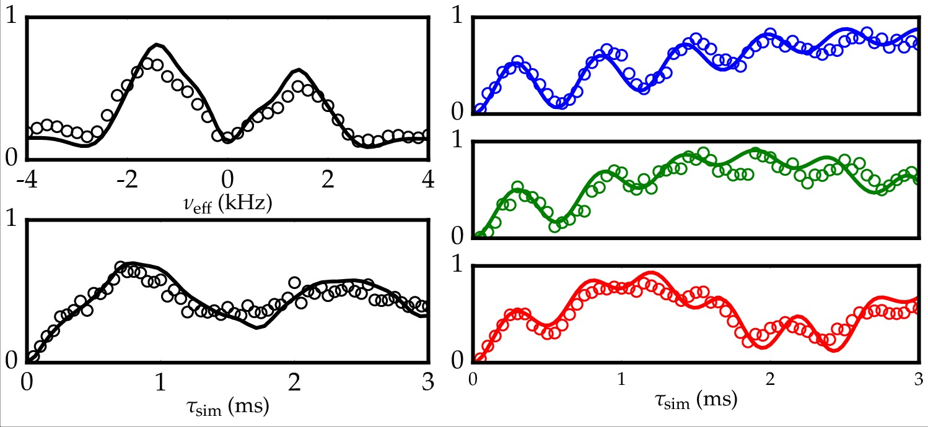


Effect of spin-bath coupling in time dynamics
Low temperature
K ~ 0.2 kHz
Theory has no free parameters
K ~ 0.4 kHz
High temperature
K ~ 0.6 kHz
K ~ 0.6 kHz
1.3 kHz
1.2 kHz

Slide 47
Spin-motion dynamics
Spin-dependent force measurement scheme:
,
,
Probes
SZX Interaction
MEASURE
Time

Slide 48
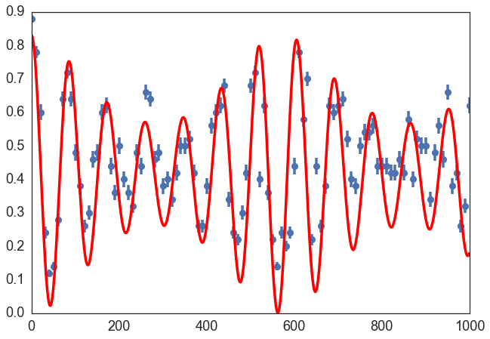
Spin-motion dynamics
“D State”
probability
Time (us)

Slide 49
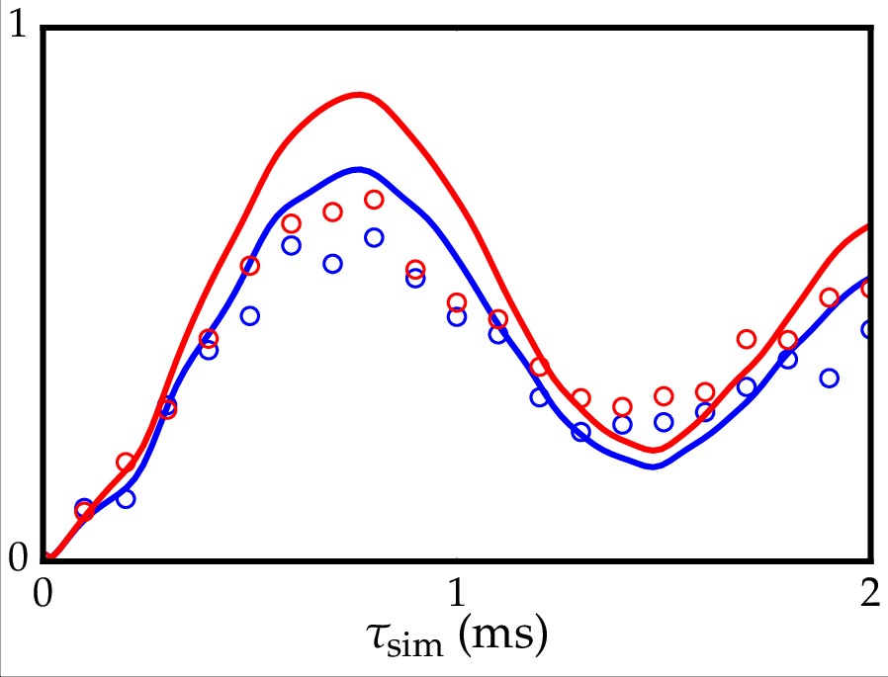
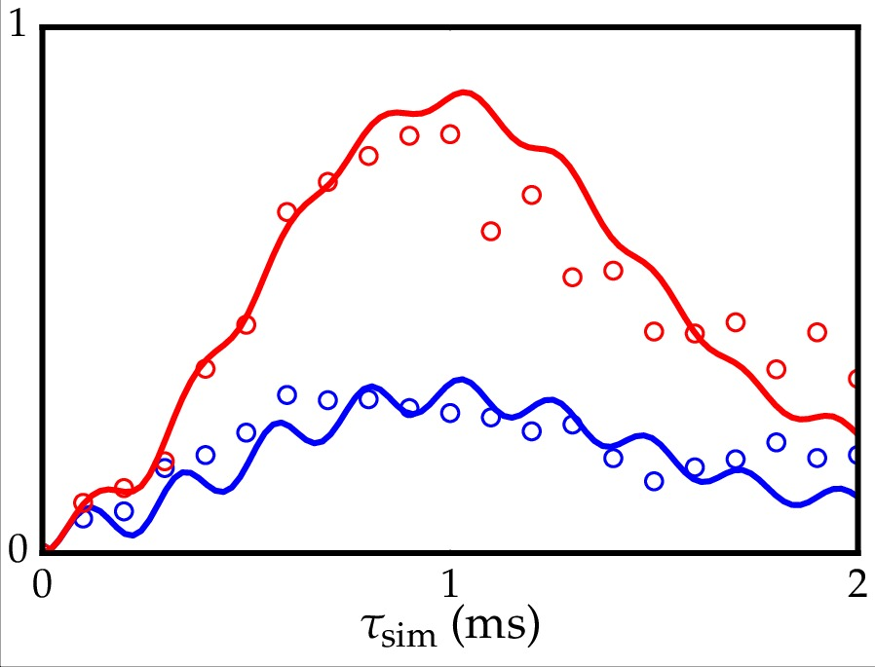
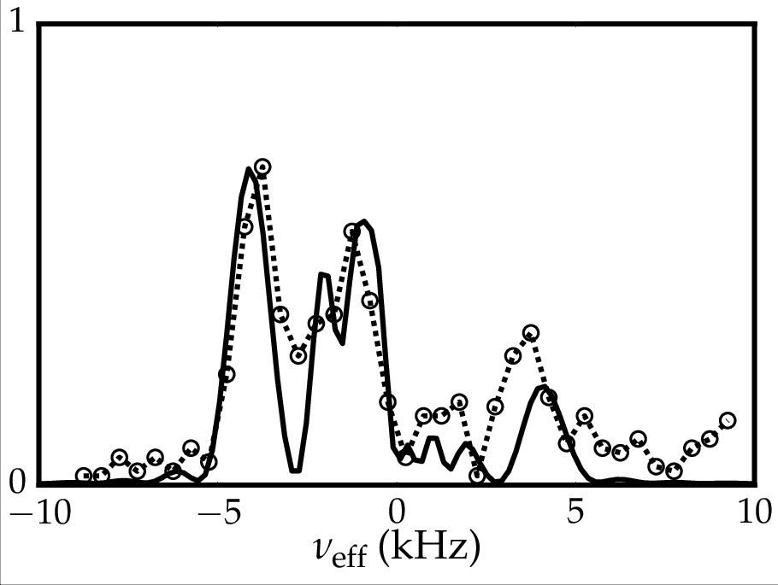
Spectroscopy of VAET

Slide 50


Transport corresponds to a multi-photon resonance
Intermediate
states
Theory
Data
Probability of transfer
Δ
n
n
donor state
n-1
n-2
target state

Slide 51

Transport corresponds to a multi-photon resonance
Intermediate
states
Theory
Data
Probability of transfer
Δ
n
n
donor state
n-1
n-2
target state

Slide 52
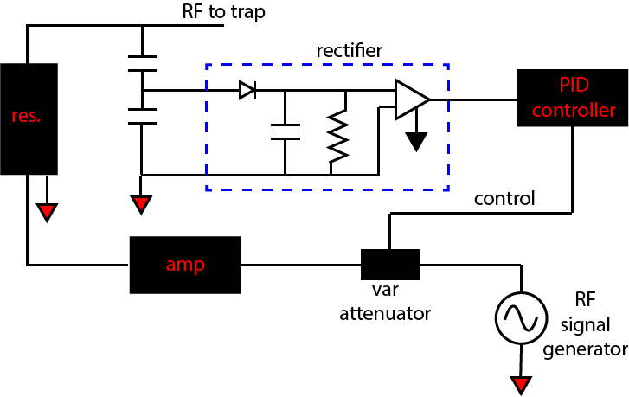
RF Stabilization

Slide 53
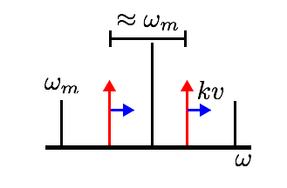
Intuitive picture of szx interaction
Amplitude modulated AC Stark shift
If v = 0, no Stark shift
Stark shift occurs when ion moves w.r.t. laser beam
Stark shift modulated near the trap frequency
Laser
Laser
In RWA, the only surviving time dependence is at frequency

Slide 54
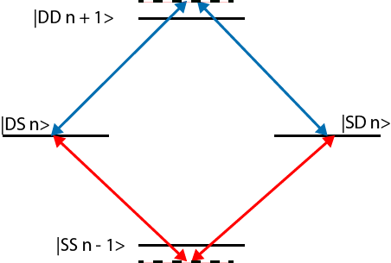
Molmer-Sorensen Interaction

