Slide 1
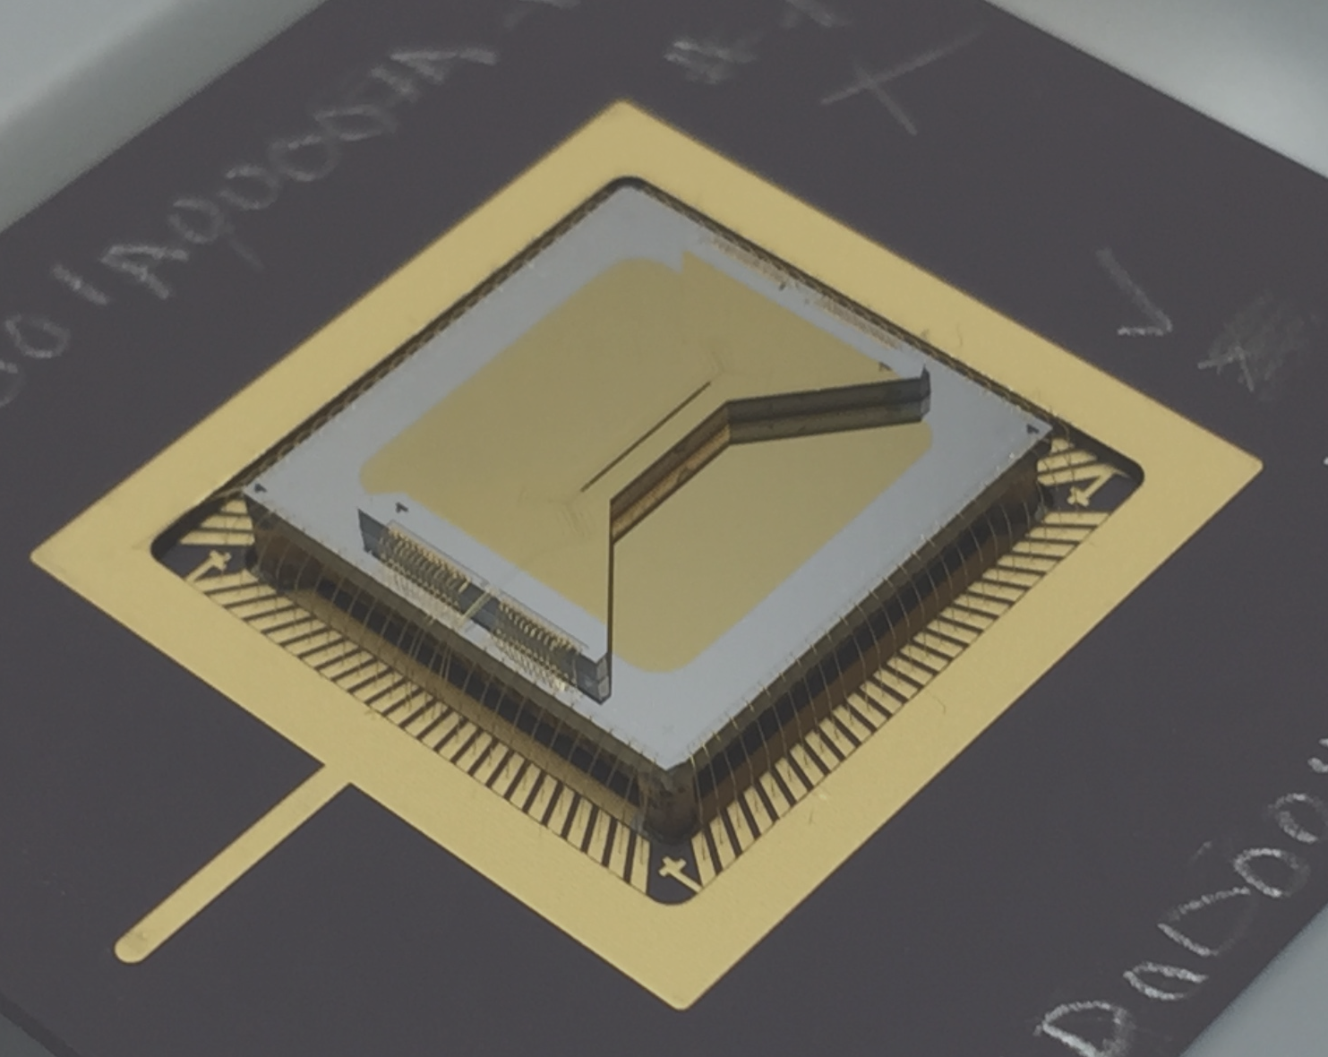

Novel validation methods for multi-qubit systems
Ryan Shaffer, Eli Megidish, Joseph Broz, Wei-Ting Chen
UC Berkeley
- Motivation for novel validation methods
- Methods for validation
- Experimental progress
- Plans
- Conclusions

Slide 2
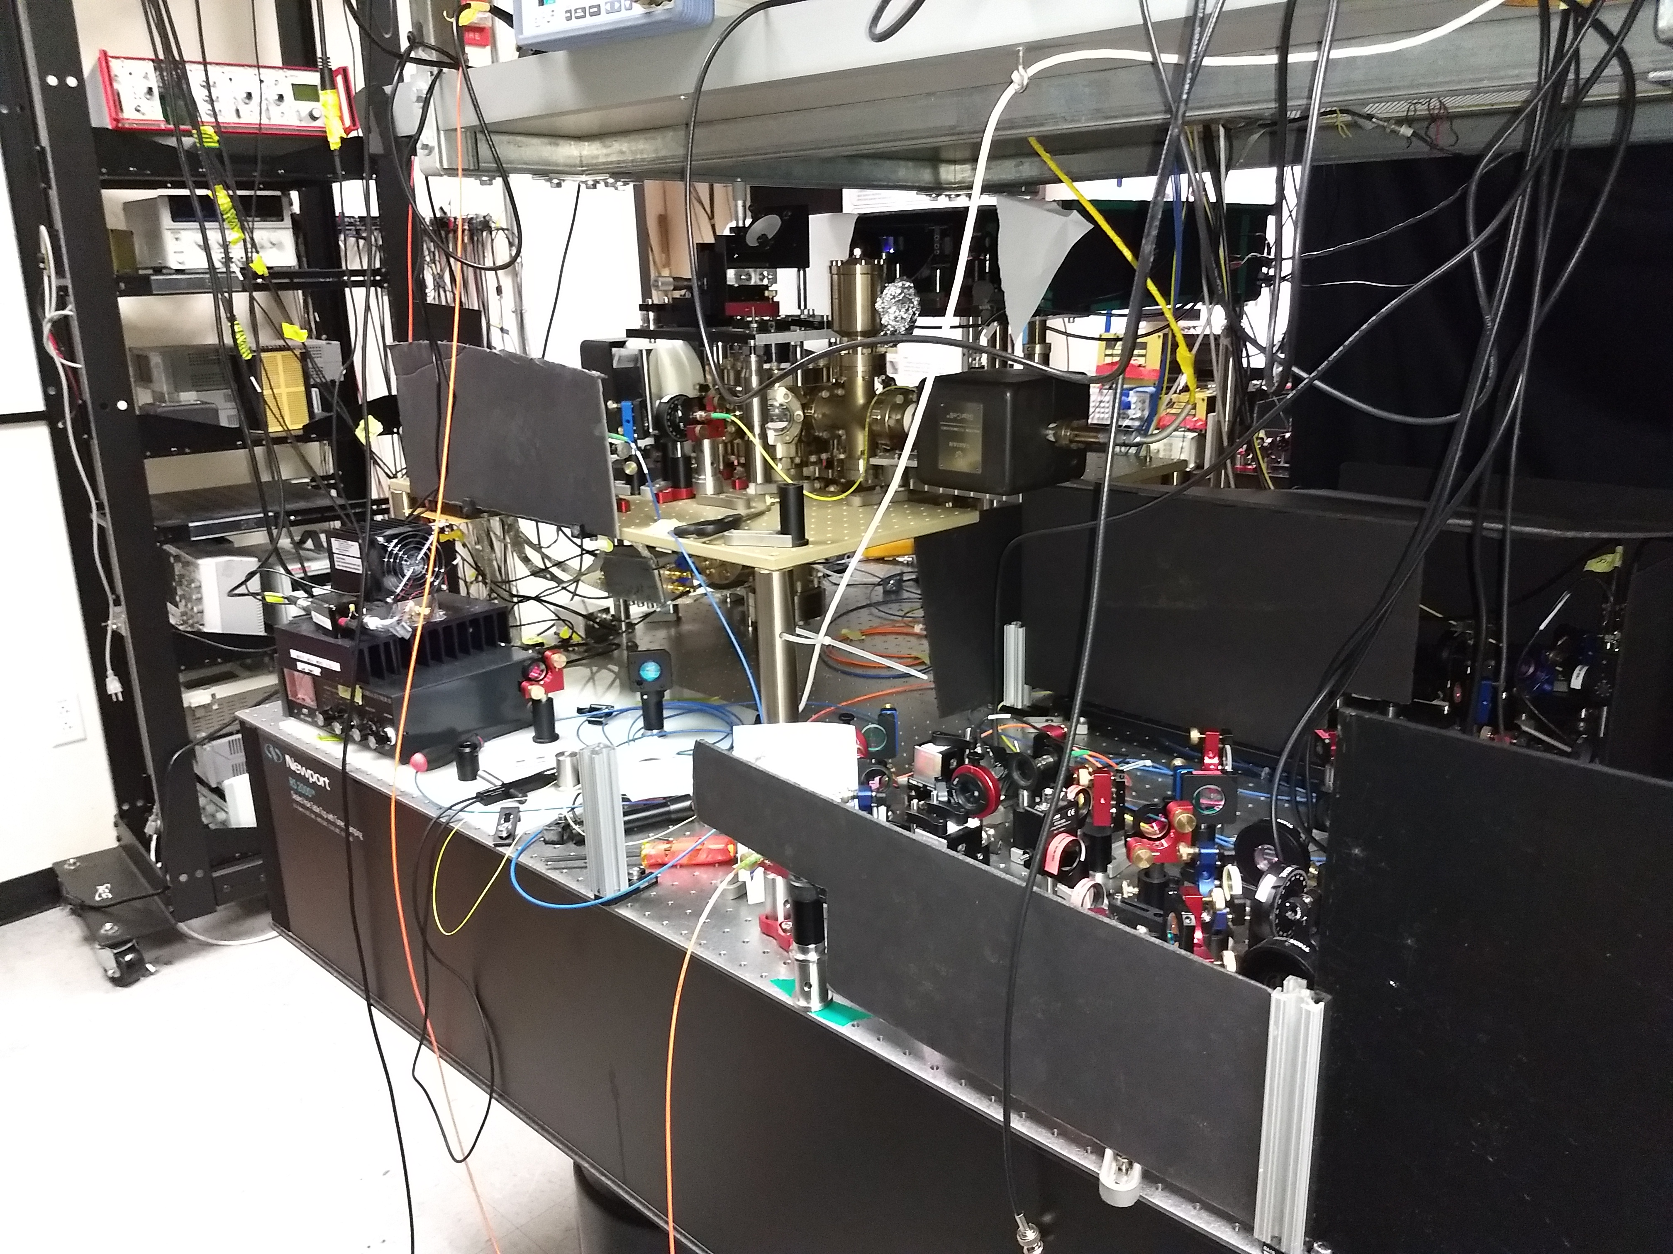
Motivation
Quantum computers are very complex apparatuses
- how do we make sure that they function properly ?
- can we trust the results ?

Slide 3
Motivation
Quantum computers are very complex apparatuses
- how do we make sure that they function properly ?
- can we trust the results ?

Slide 4
Motivation
Some ideas on making sure the result is correct ?
1) Result may be easily verifiable
works for specific problems
2) Use a fault-tolerant quantum computer
not yet available
3) Make sure the building blocks work
cross fidelity / cycle benchmarking
3) requires extrapolation into the classically
intractable regime

Slide 5
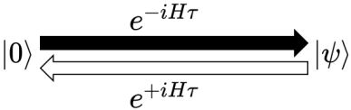
How to make sure the full algorithm works ?
Run computation forward and backward in time [Cirac and Zoller 2012]
- insensitive to systematic errors
Measure variance of energy measurements [Kokail et al. 2019]
- Verifies only that an eigenstate has been reached
Run the computation on multiple devices
[Greganti et al. 2019]
- Requires ability to run computation of interest on multiple
platforms

Slide 6
An experimentalist’s approach
Apply methods from precision metrology to quantum
information
1) identify which errors may affect the result
2) quantify the impact of the errors
3) make the measurement as robust as possible
4) capstone: independent test with a different
measurement method

Slide 7
Capstone: distinct implementations
Goal: gain trust in the result
- repeat the measurement with a different method
- checking a result with another quantum computing approach may not be feasible
- many different measurement bases needed, does not
scale well
Distinctively different implementation on the same device?

Slide 8

Distinct implementations
Somewhat trivial example:
Suppose one wanted to implement the quantum algorithm
Problem: a priori the resulting quantum state is not known,
especially in the cases where a quantum computer is useful
At least three different possibilities for implementation:
MS
gate
geometric
phase gate
Cirac-
Zoller
approach

Slide 9
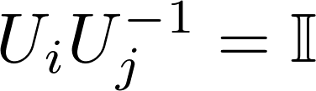




Considerations to test this approach
However, we know we should get:
MS
gate
geometric
phase gate
and should be have different error sensitivities.
Can be checked by adding noise

Slide 10
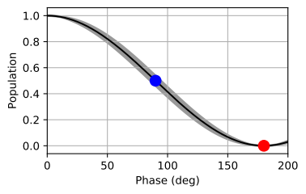
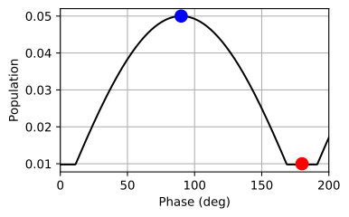
Strengths of the inversion method
Rotating into close to a measurement eigenstate minimizes quantum
projection noise
largest sensitivity to noise and decoherence
only one measurement basis required
much fewer measurement cycles than other methods
detects errors of 10⁻³ in 20 seconds (instead of 2 h)
Noise for 100 Ramsey experiments:

Slide 11
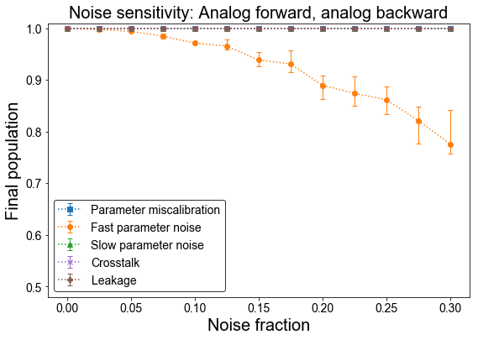
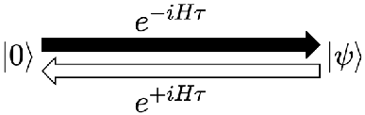
Vary implementation: different operations
Process
Process’
Inversion layer
Problem: does not detect most errors
Slow noise, miscalibrations, cross-talk

Slide 12
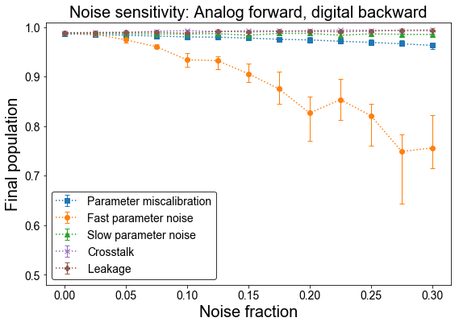
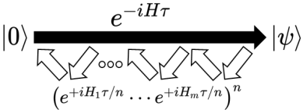
Vary implementation: different operations
Process
Digitized
process
Our original idea of the proposal does not work because gate based quantum simulations (computations) are analog processes !
However: if we can find methods to validate analog process we can use them
to validate gate based algorithms !
Inversion layer

Slide 13
Verification methods
Idea: run analog forward and digital backwards
Without quantum error correction, algorithms are analog processes !
analog simulator ideas carry over to gate based systems
Problem: does not detect most errors
Slow noise, miscalibrations, cross-talk

Slide 14
Overarching verification strategy
Closed loops in state space
  Equivalent to identity
Measurement in a basis state
  Avoid tomography or sampling
  Reduce effect of projection noise
How to drive these closed loops?

Slide 15
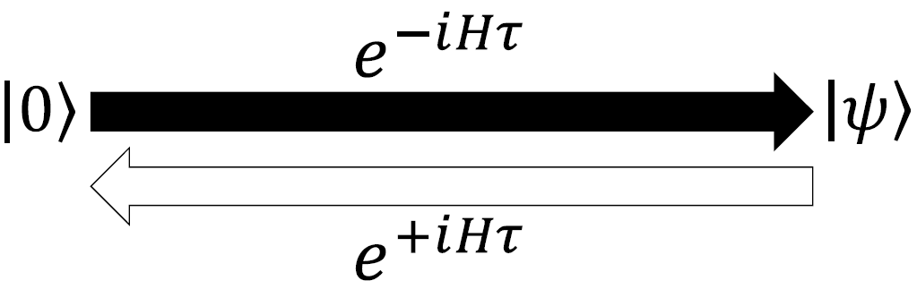
Strategy 1: Time-reversal benchmarking
Drive the system forward and backward with the same dynamics
Sensitive to decoherence, fast noise, ...
Insensitive to slow fluctuations or miscalibrations of H

Slide 16
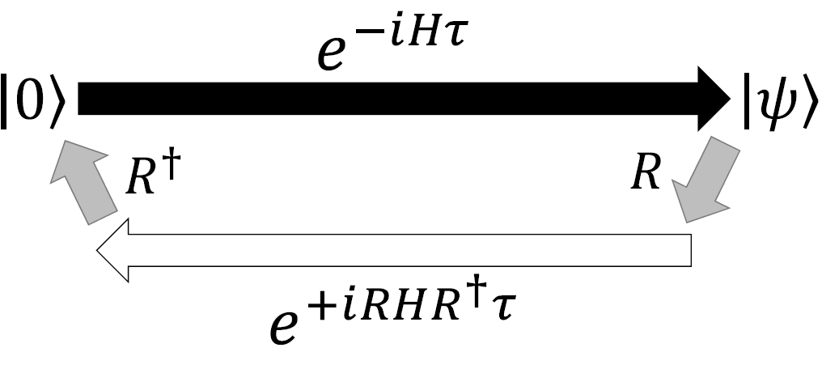
Strategy 2: Multi-basis analog benchmarking
Drive the system forward and backward
in different bases (ideally w/different physics)
Sensitive to noise that differs in the two basis implementations
Insensitive to correlated noise or global miscalibrations

Slide 17
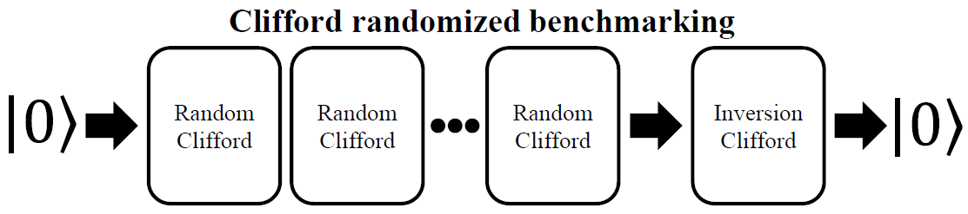
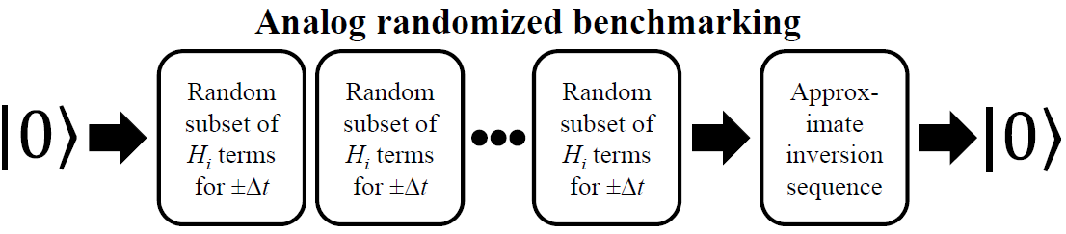
Strategy 3: Analog randomized benchmarking (ARB)
Drive the system in a closed loop randomly
Randomizes correlated errors

Slide 18
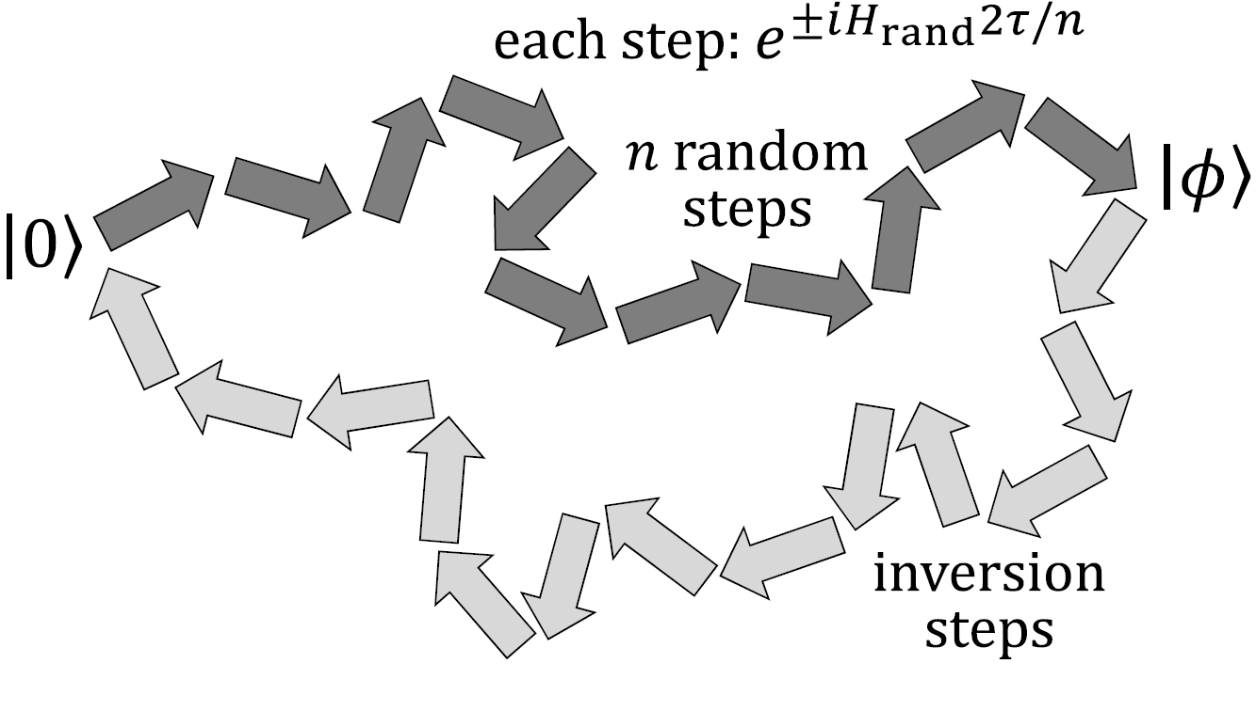
Strategy 3: Analog randomized benchmarking (ARB)
Drive the system in a closed loop randomly
Sequences are dependent on particular H
How to generate the inversion sequence?

Slide 19
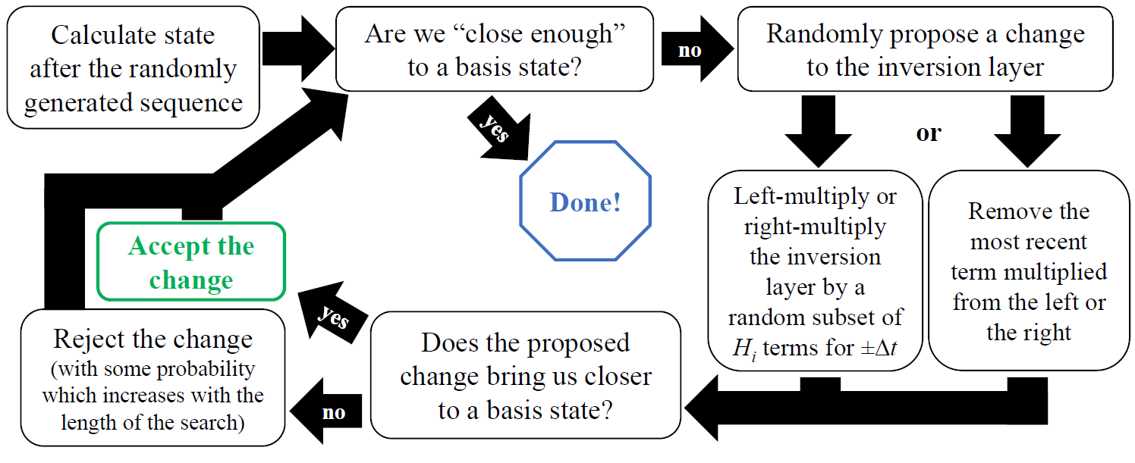
Generating the ARB inversion sequence
Markov chain Monte Carlo search (Metropolis algorithm) for generating inversion sequence:
Generating the inversion sequence is computationally expensive

Slide 20
Summary of benchmarking strategies
Protocol | Illustration | Error sensitivity | Hardware requirements | Scalability limits
Time-reversal benchmarking |  | Fast noise | Implement time-reversal | None inherent
Multi-basis analog benchmarking |  | Fast noise, slow noise | Implement time-reversal in alternate basis and single-qubit rotations | None inherent
Analog randomized benchmarking (ARB) |  | Fast noise, slow noise, miscalibration, crosstalk | Implement time-reversal and ability to turn Hamiltonian terms on/off individually | Inversion step requires simulation of dynamics; protocol must be performed on subsets of larger systems

Slide 21
Experimental proof-of-concept
We first demonstrate the protocols on our trapped-ion system
Simplest example: 2-qubit Ising model
How to implement the benchmarking protocols?

Slide 22
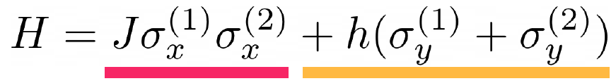
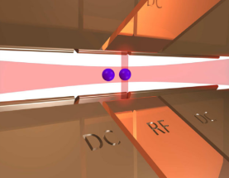
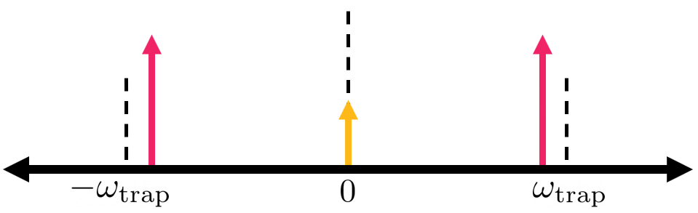
Experimental proof-of-concept
Forward evolution implemented via three tones in a laser beam along the trap axis:
Frequency (relative to carrier transition)

Slide 23
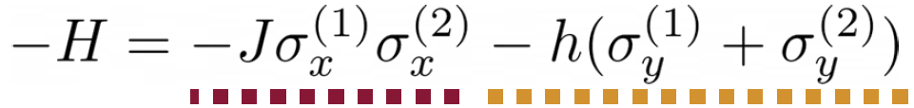
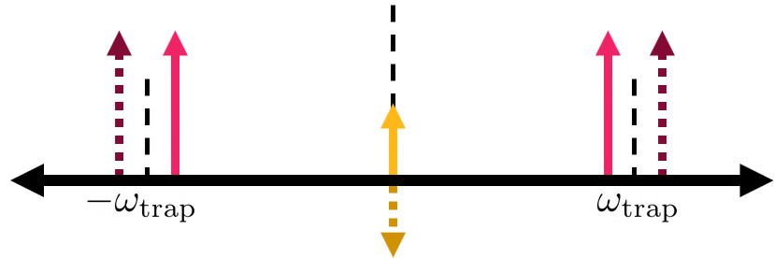
Experimental proof-of-concept
Also need to implement the inverse:
Frequency (relative to carrier transition)

Slide 24
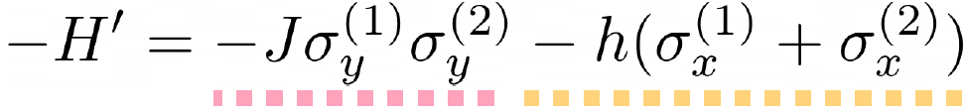
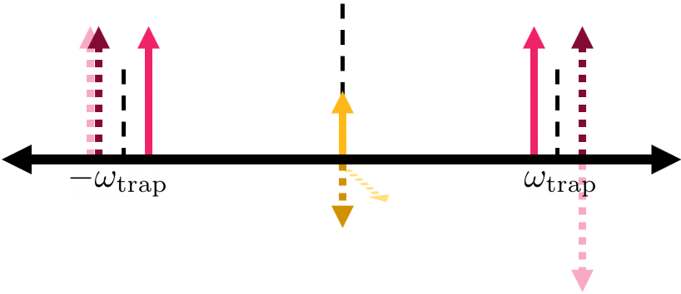
Experimental proof-of-concept
and the inverse in a rotated basis:
Frequency (relative to carrier transition)

Slide 25
Experimental proof-of-concept
What about ARB?
Protocols like ARB require repeatedly switching frequencies and/or phases
  Must be done in a phase-coherent way
  Also want to inject noise for testing
Solution: integrate new ARTIQ control system

Slide 26
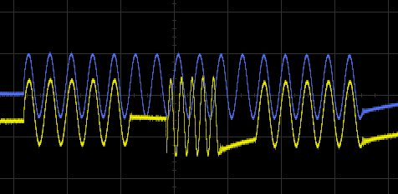
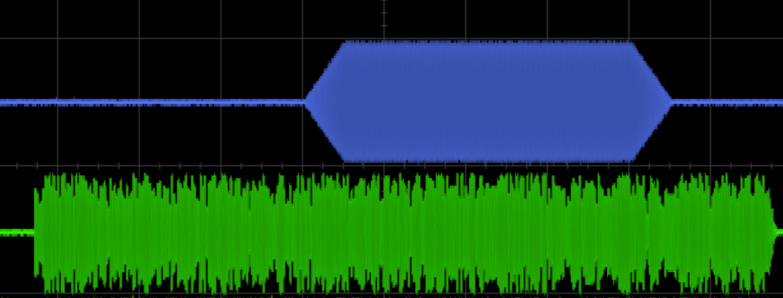


Experimental proof-of-concept
M-Labs implemented phase-coherent switching for us; available now to other groups
- Reduces number of DDS sources required
- Can now control tens of ions simultaneously
Phase-coherent frequency switching
Pulse shaping and noise injection

Slide 27
Experimental proof-of-concept
Experimental procedure:
Set up a two-qubit Ising simulation
Run each benchmarking protocol:
  Without additional noise
  With injected slow noise
  With additional miscalibrations

Slide 28
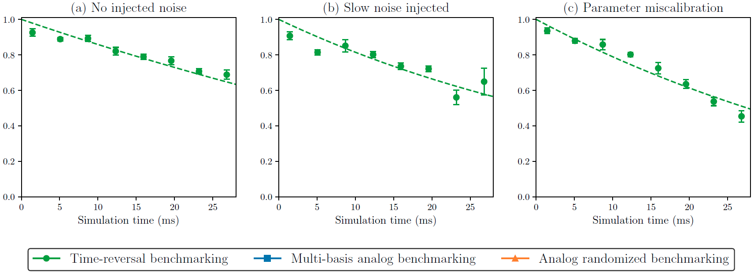
Experimental proof-of-concept

Slide 29
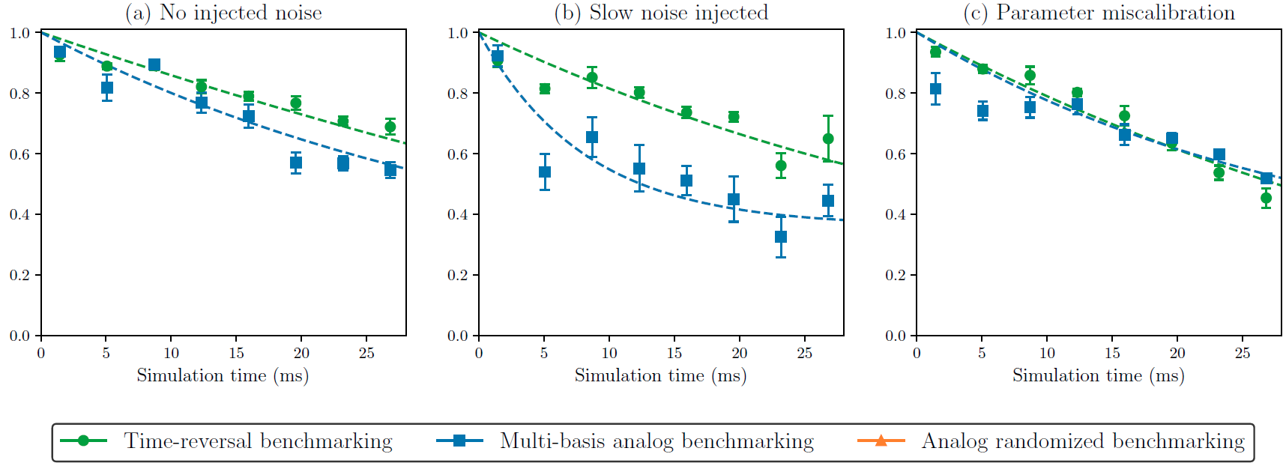
Experimental proof-of-concept

Slide 30
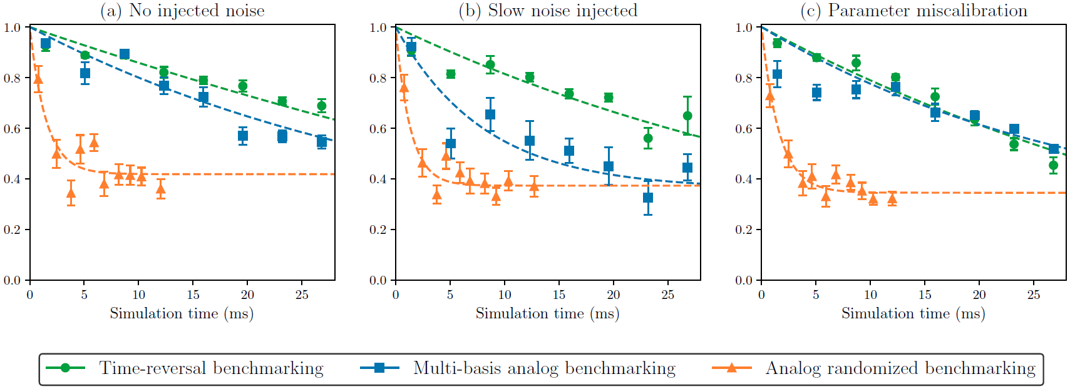
Experimental proof-of-concept

Slide 31
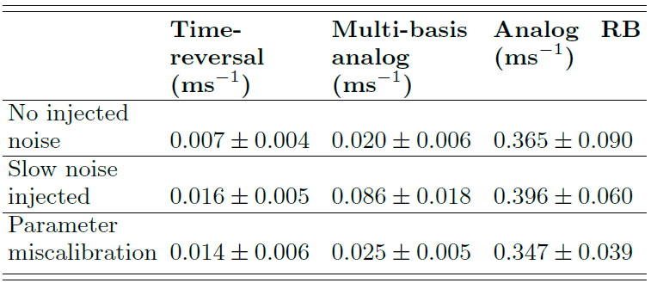
Experimental proof-of-concept

Slide 32
Experimental proof-of-concept
Fast noise is <1% per ms
Basis dependent slow noise is <1% per ms
Why is ARB decay so fast?

Slide 33
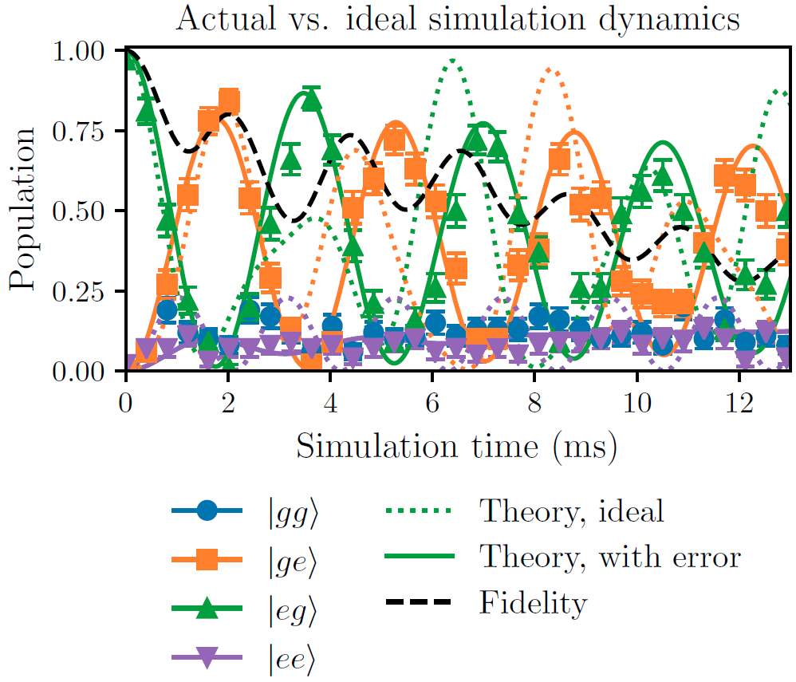
Experimental proof-of-concept
ARB detects miscalibrations with respect to the target Hamiltonian
ARB decay time of ~3 ms is consistent with fidelity decay time seen here
Dotted line: J ~ 139 Hz, h ~ 227 Hz
Solid line: J ~ 250 Hz, h ~ 102 Hz, with 120 Hz dephasing

Slide 34
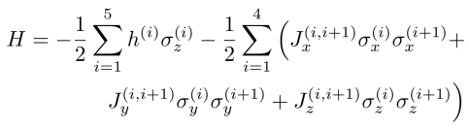
Numerical simulation on a 5-qubit system
Does this easily scale to a less-trivial system size, e.g., 5 qubits?
Simulate the benchmarking protocols on a 5-qubit Heisenberg model under various types of noise:
Fast incoherent noise
Slow parameter fluctuation
Parameter miscalibration
Idle crosstalk

Slide 35
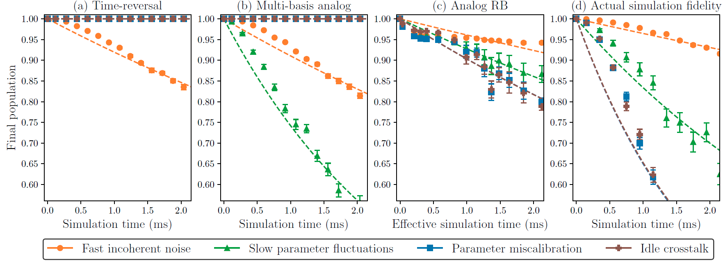
Numerical simulation on a 5-qubit system
(all noise strengths 10% relative std. dev.)
Again, we observe that ARB detects miscalibrations and correlated errors

Slide 36
Next steps: Improving and extending ARB
Application to gate-based devices
  All near-term quantum computers are analog (until we have error correction)
  ARB can characterize the native analog interactions rather than just discrete gates
  Approximate nature of inversion sequence may provide better scalability
  Much more efficient measurement procedure than tomography or sampling methods (e.g., cross-entropy benchmarking)

Slide 37
Next steps: Improving and extending ARB
Noise sensitivity and scalability
  Increase “area” of closed loop in state space
  Improve efficiency/parallelization of stochastic search algorithm for inverse generation
  Formalize scheme for benchmarking subsystems – what can this tell us about behavior of the full system?

Slide 38
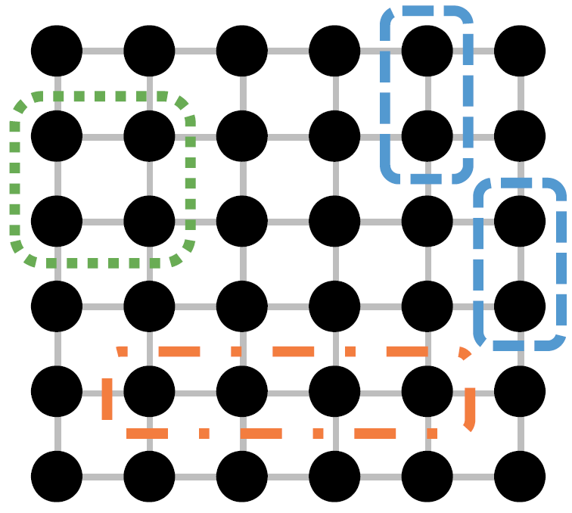
Next steps: Scalability of ARB
Scaling ARB to larger systems: apply the protocol to many/all subsystems
Assumes no highly-correlated errors that appear only in large subsystems

Slide 39
Next steps: Applications of ARB
Protocol for efficient characterization and tune-up
  ARB is a very flexible tool, as it can act on arbitrary subsets of the system and on arbitrary unitaries (e.g., a QEC circuit)
  Use as part of feedback loop in automated optimization to tune-up the physical parameters of the system, e.g., laser frequencies and amplitudes

Slide 40
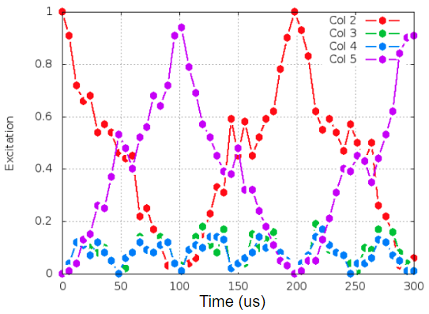
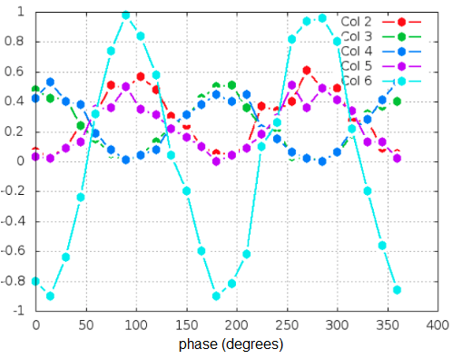
Experimental improvements
Cause | Estimated fidelity loss
Laser intensity noise | ~ 0.2%
Global magnetic field fluctuations | ~ 0.1%
Magnetic field gradient | ~ 0.5%
Pulse shaping | ~ 1.0% - 1.5%
Laser phase noise | ~ 0.1%
State preparation (2 ions) | ~ 1%
Measurement error (2 ions) | ~ 1%
Servo bumps, laser frequency fluctuations | negligible
TOTAL | ~ 3.9% - 4.4%
Solutions
magnetic shield
five-fold reduction
ARTIQ implemented
M2-laser system (more power)
optimized procedure
new camera

Slide 41
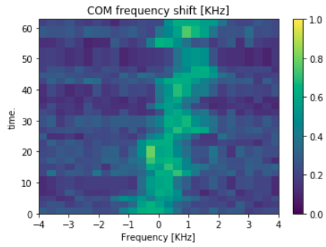
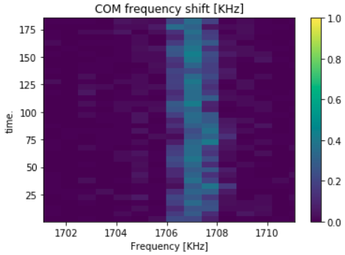
Improved radial trap frequency stability
Unstabilized
With active feed-back

Slide 42
ARTIQ: phase coherent switching
Phase-coherent frequency switching

Slide 43
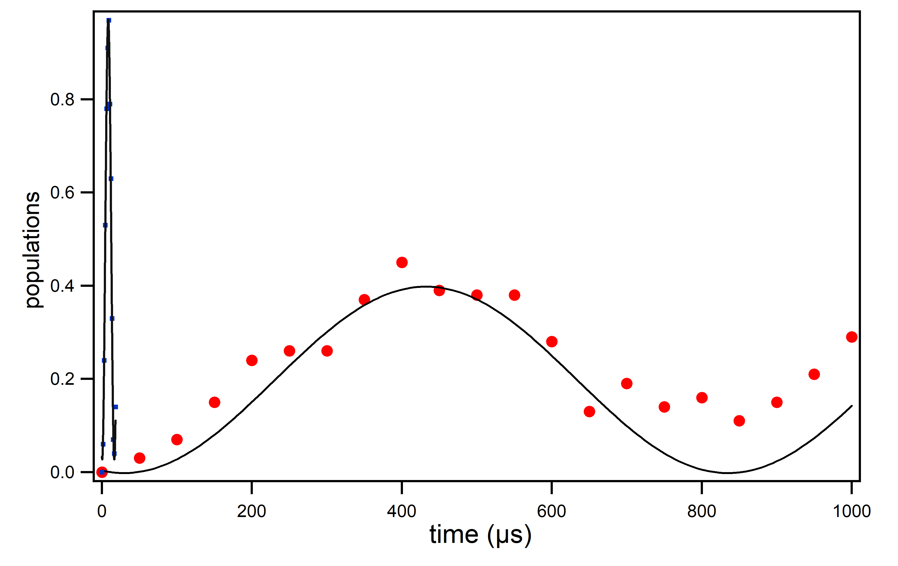
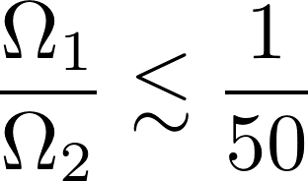
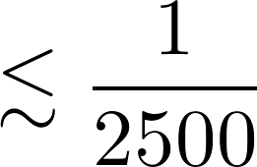

Single-ion addressing
crosstalk

Slide 44
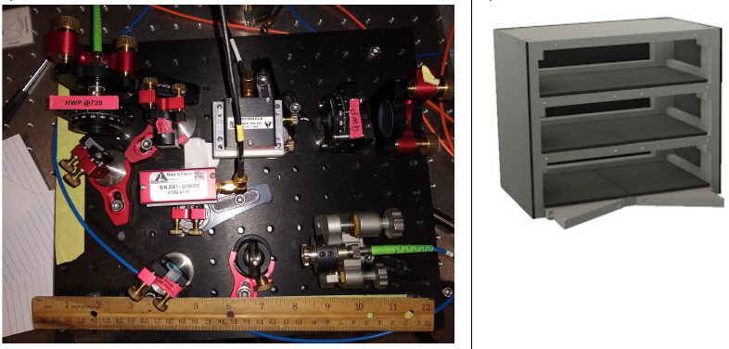
Compact AOM-setups
- Typical effeciency: ~60 %
- Small Robust, can be stacked

Slide 45
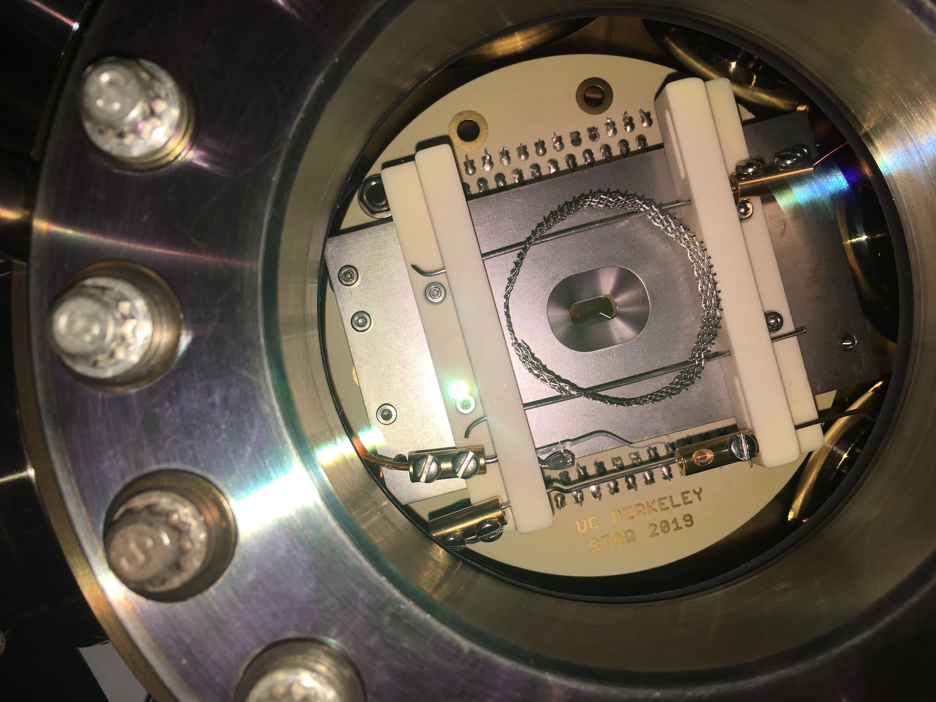
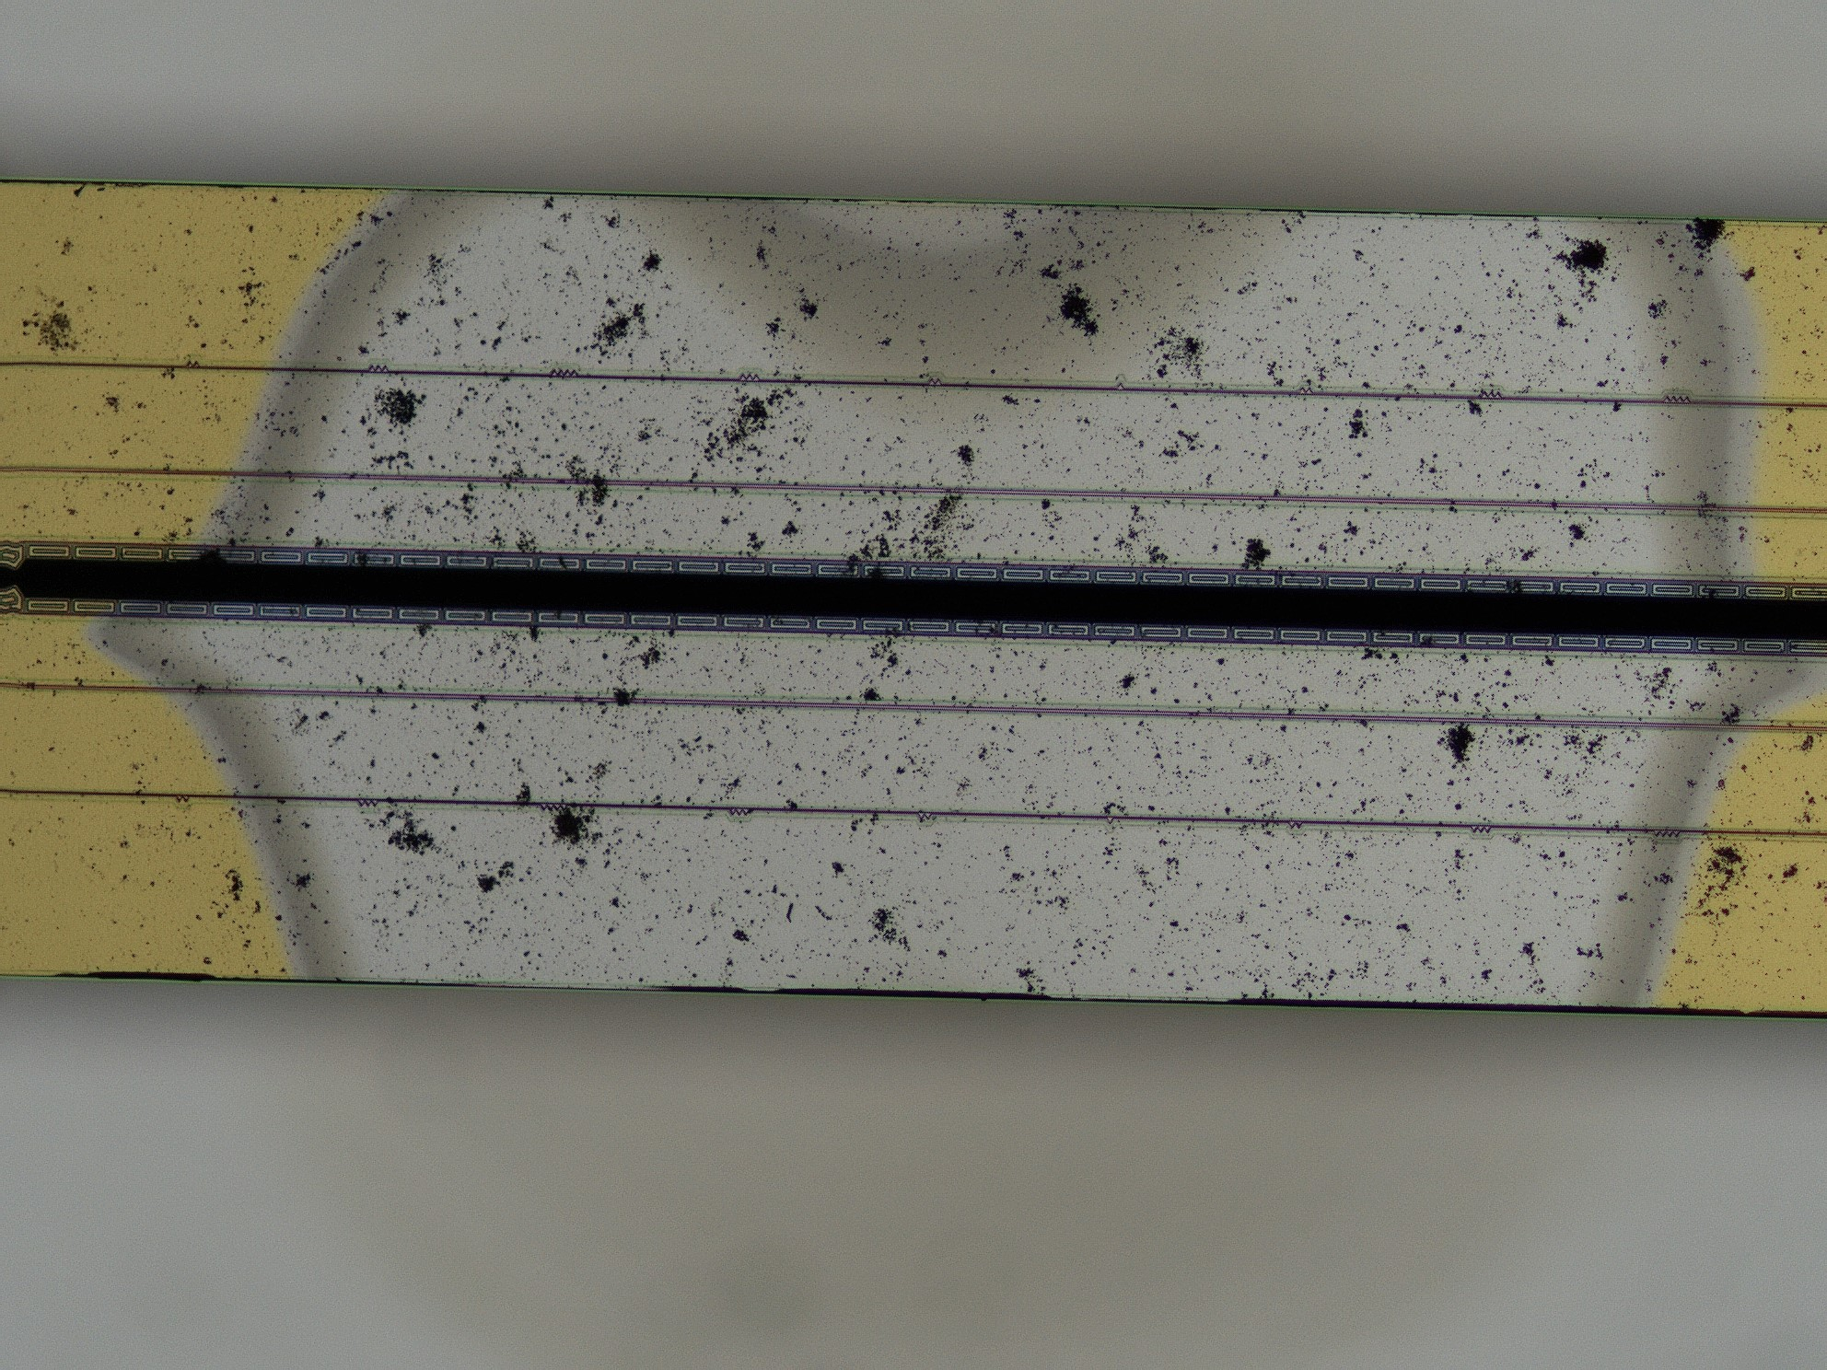
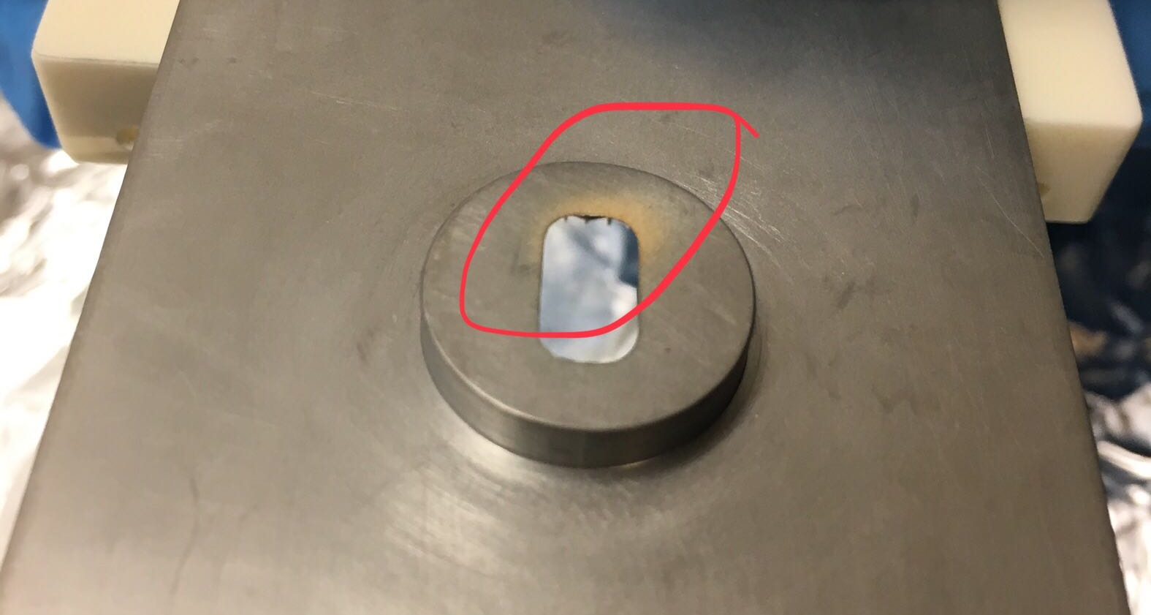
Ar⁺-milling of the HOA trap
Sputtered gold
from the trap

Slide 46
Summary of results
Results
Three efficient validation schemes (two analogue, one digital)
Test on a two-site Ising model (draft nearly ready)
Experimental improvements: trap frequency stabilized,
better read-out, single-ion addressing, ARTIQ, surface treatment,
better fidelities
working on three ion simulations
Our validation methods allow to diagnose the type of noise in a (scalable) fashion.
Promised for year #1:
compare 2-ion analogue and digital quantum simulation
Promised for year #2:
improve system, 3-ion verification

Slide 47
Outlook
1) Open questions:
- How to scale the ARB method
- Are there other methods based on inversion?

Slide 48
Strategy 3: Analog randomized benchmarking (ARB)
Scaling ARB to larger systems: apply the protocol to many/all subsystems
Assumes no highly-correlated errors that appear only in large subsystems

Slide 49
Outlook
1) Open questions:
- How to scale the ARB method
- Are there other methods based on inversion?
2) Learn how to extract information on errors
- discriminates between fast noise and slow noise
Can we use inversion methods
- to help with debugging ?
- to tune up the systems ?

Slide 50
Strengths of the inversion method
Rotating into close to a measurement eigenstate minimizes quantum
projection noise
orders of magnitude more efficient
Choose the linear response regime
ARB-methods allows one to choose the “right”
measurement basis.
However: little information on how to improve and
tune the system.

Slide 51
How to tune up a system ?
What is it we want to learn?
The fidelity of operations is governed by mainly by technical noise sources such as:
- intensity noise
- magnetic field noise
- cross talk
Systematic errors in physical parameters
lead to correlated errors on gates
we want to learn how to optimize these parameters, not the gates

Slide 52
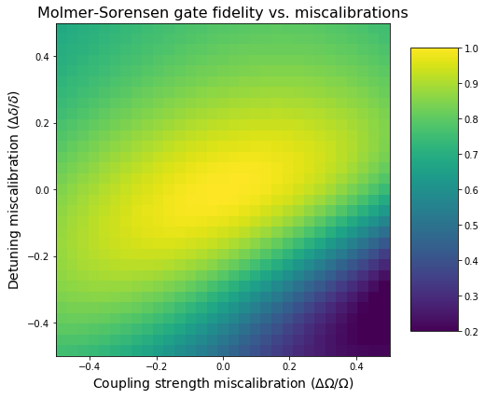
Outlook
Goals:
1) determine sensitivity of operations to errors control parameters
to learn what to pay attention to
2) tune up building blocks, such as gates, rapidly
Guiding principles:
- Choose calibration points wisely in parameter space
- Choose the right basis to learn most
Steepest
gradiient

Slide 53
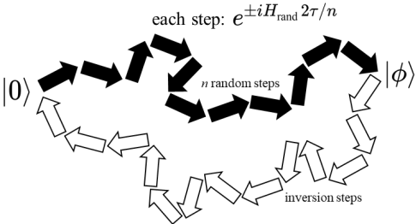
Conclusions
- Validation of quantum processes in the computationally
intractable regime can be challenging
- Experimentalist’s approach: noise assessment and consistency tests
- forward/backward evolution of independent implementations
distinguish between various noise types
- can be applied to arbitrary processes
- Keeps advantage of RB, speed up: 1/(1-F).
Coming soon:
- scaling of ARB
- rapid tune-up of a small quantum information processor
- further experimental improvements

Slide 54
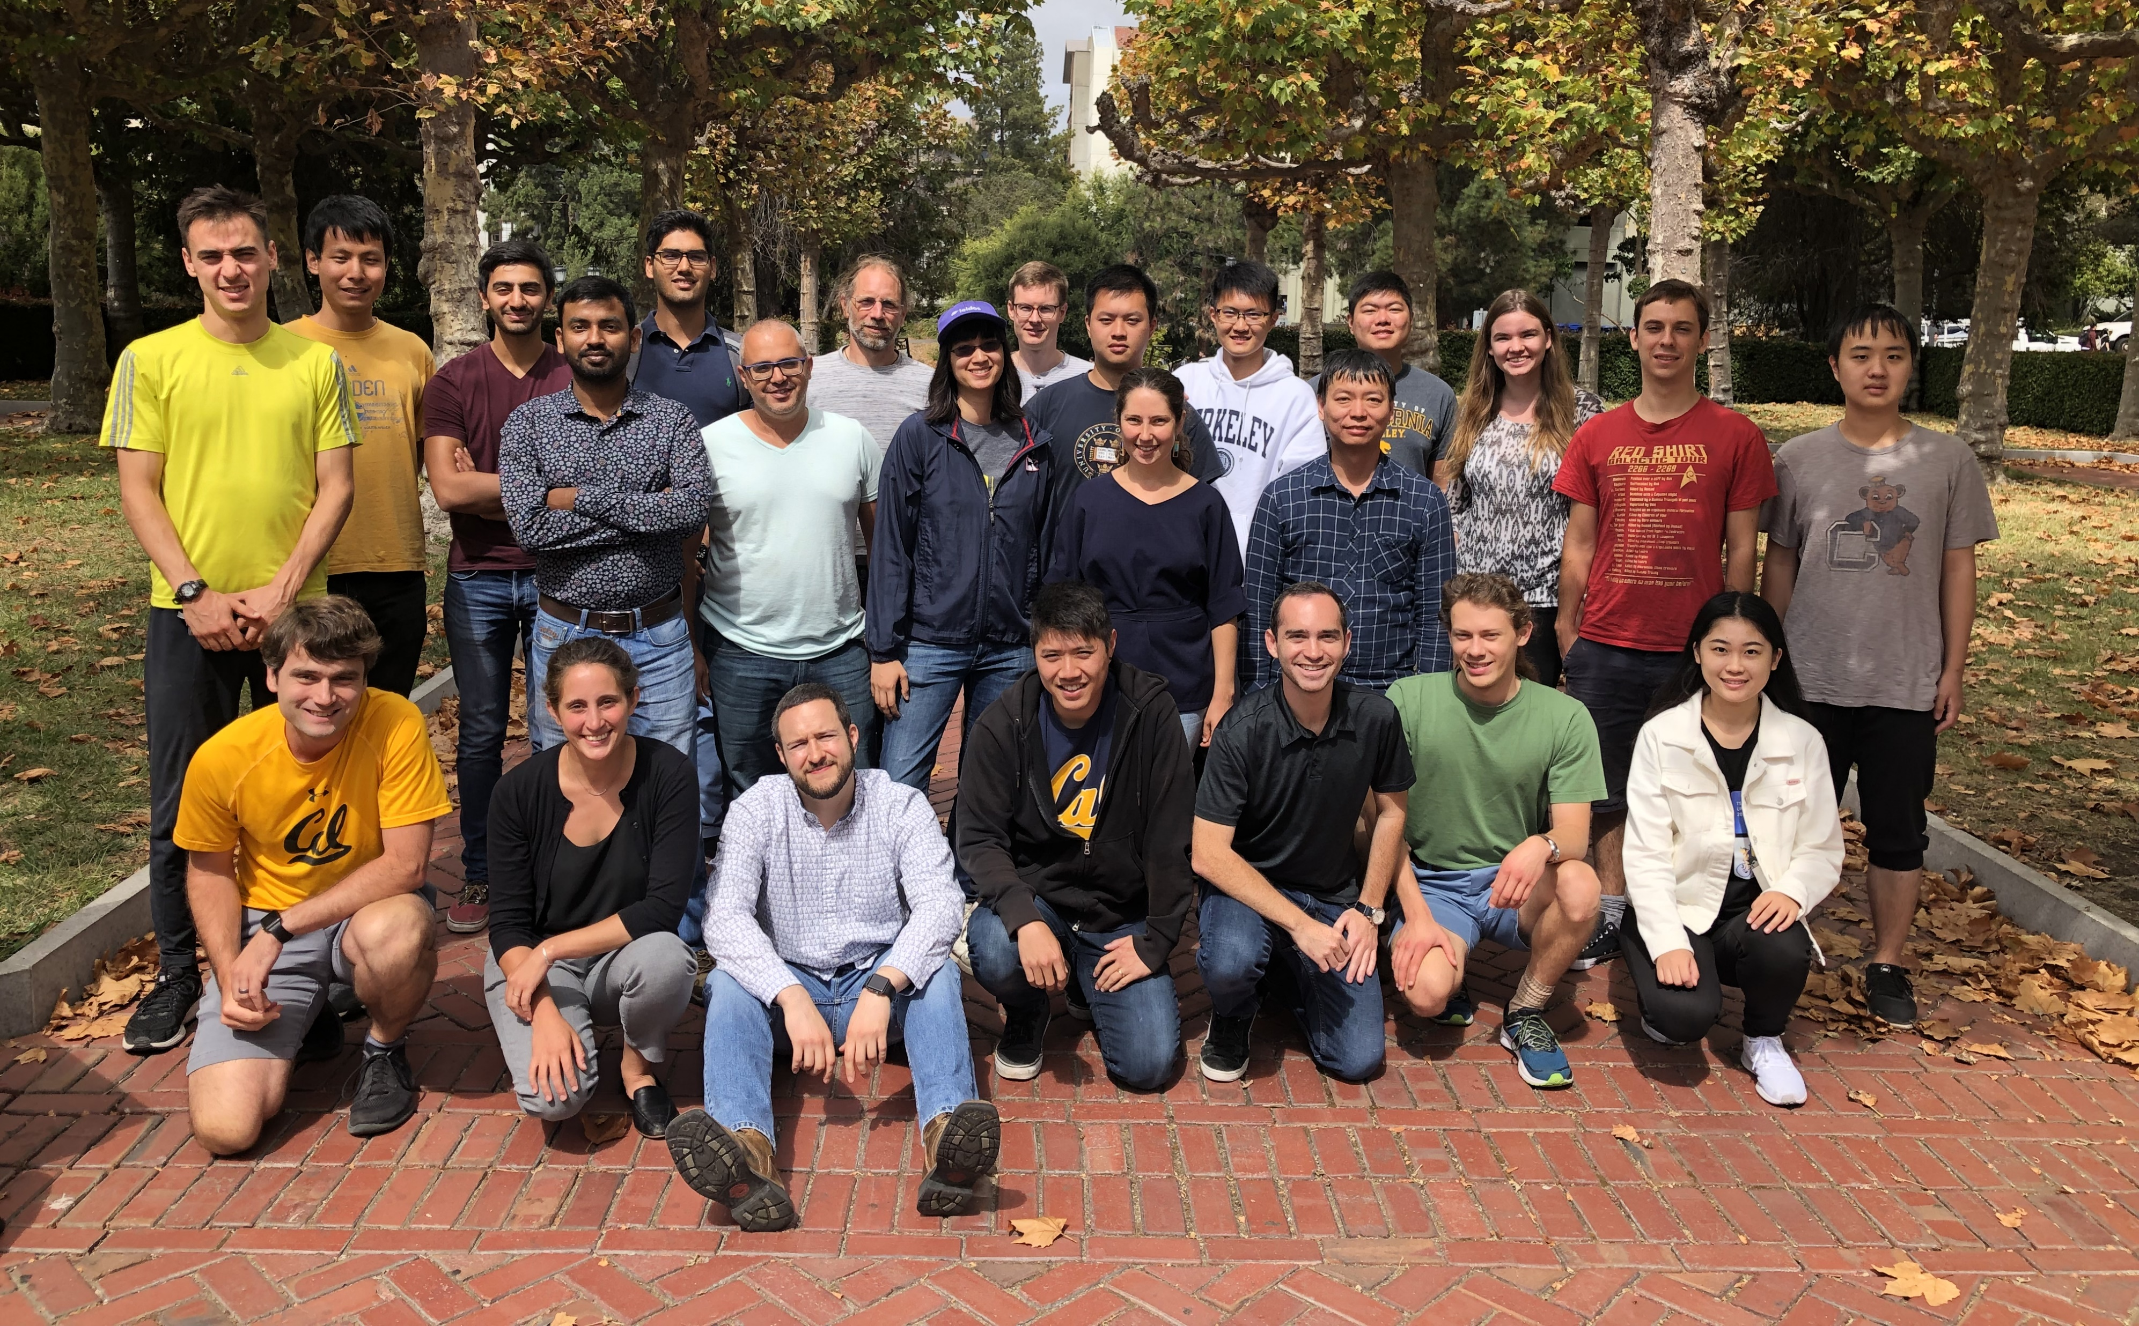
The group
Eli
Megidish
Sumanta
Khan
Wei-Ting
Chen
Ryan
Shaffer
Joseph
Broz

