Slide 1
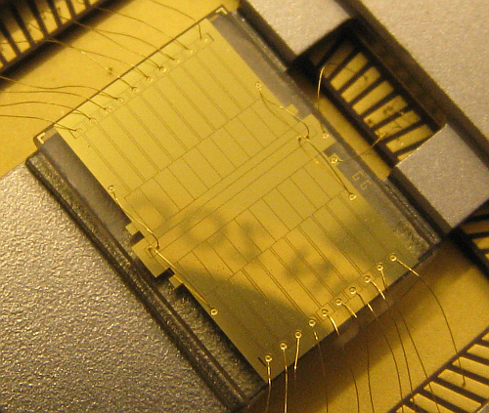
Quantum applications of ion trapping
Hartmut Häffner, UC Berkeley
1. Introduction to ion trapping
2. Quantum computing
3. Sources of decoherence
4. Quantum emulation/simulation
5. Applications of QIP to precision measurements

Slide 2
Plan
Lecture #1: Introduction
- Paul traps
- Laser ion-interaction
Lecture #2: Quantum computing
- Quantum gates
- Quantum state engineering
Lecture #3: Decoherence I/Scaling
- Qubit decoherence
- Scaling
Lecture #4: Decoherence II/Quantum/emulation
- Anomalous heating
- Quantum emulation
Lecture #5: Applications
- Atomic clocks
- Fundamental symmetry tests

Slide 3
Plan
Lecture #1: Introduction
- Paul traps
- Laser ion-interaction
Lecture #2: Quantum computing
- Quantum gates
- Quantum state engineering
Lecture #3: Decoherence I/Scaling
- Qubit decoherence
- Scaling
Lecture #4: Decoherence II/Quantum emulation
- Anomalous heating
- Quantum emulation
Lecture #5: Applications
- Atomic clocks
- Fundamental symmetry tests

Slide 4
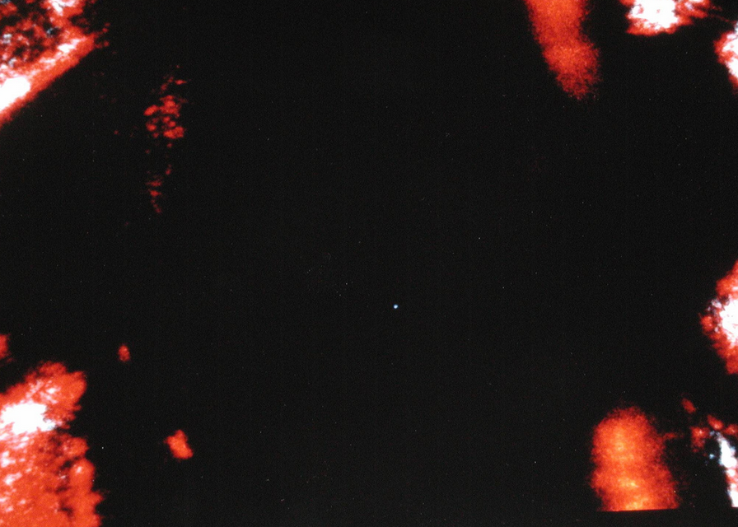
“In the first place it is fair to state that we are not experimenting with single particles,
anymore than we can raise Ichtyosauria in the zoo.”
“…we never experiment with just one electron or atom or (small) molecule. In thought-experiments we sometimes assume that we do; this invariably entails ridiculous consequences.“
E. Schrödinger (1952)
Photo credit: Warren Nagourney at the University of Washington, c. 2000
retrieved from: https://www.flickr.com/photos/fatllama/43155091/

Slide 5
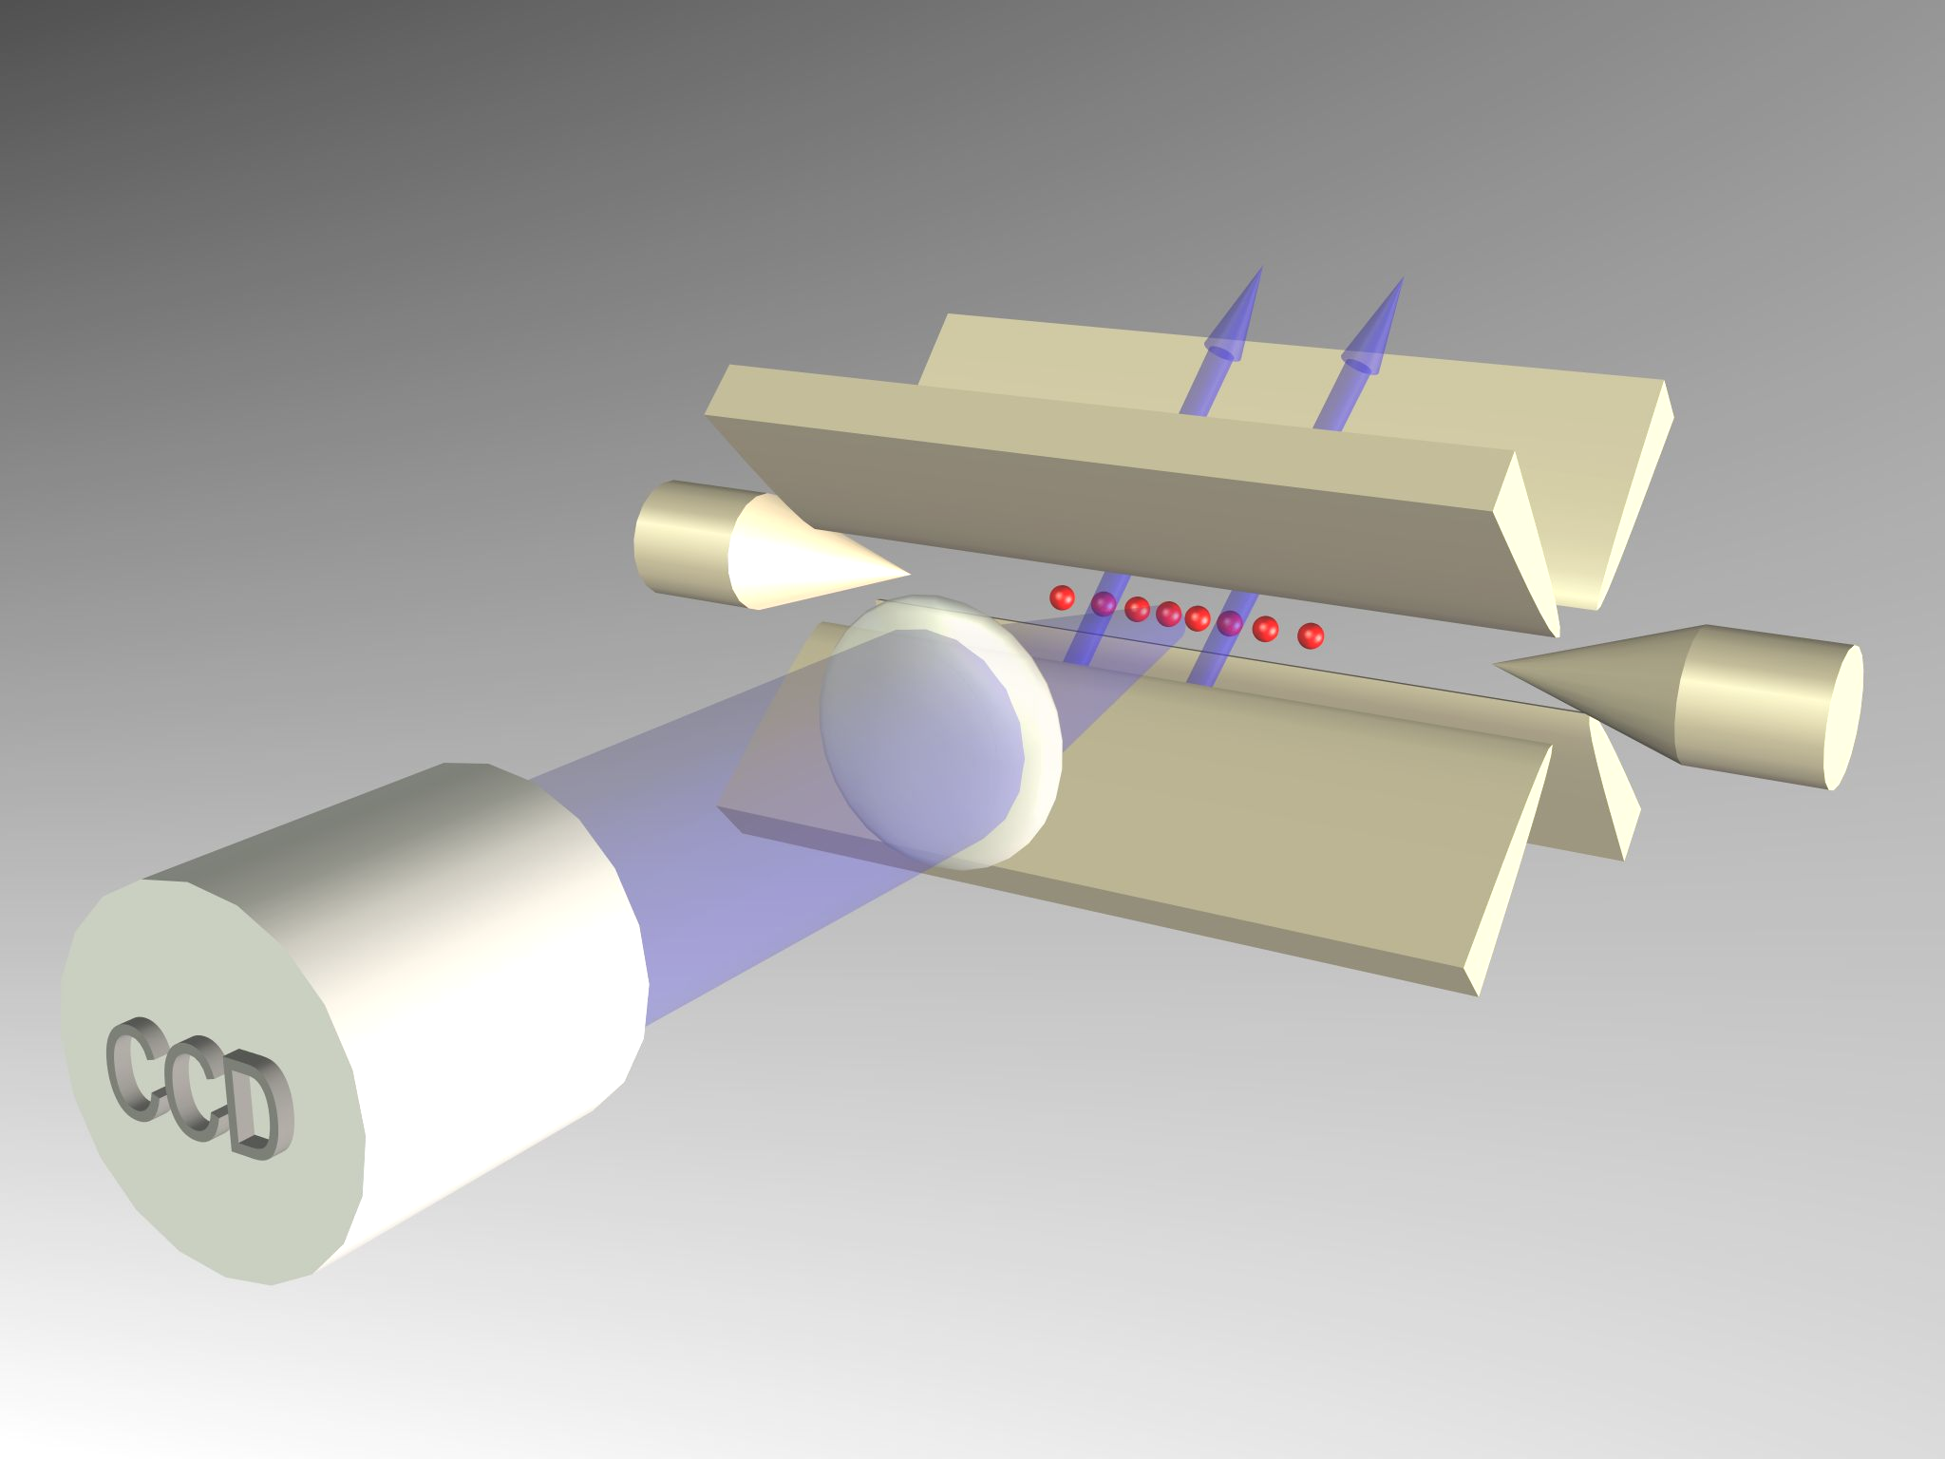
Laser pulses manipulate individual ions
A CCD camera reads out the ion`s quantum state
Notes:
This ion crystal then develops normal modes of collective motion with center-of-mass frequencies on the order of 1 MHz. Here we see a parametrically excited mode

Slide 6
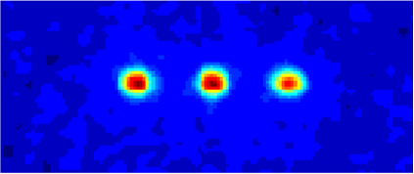
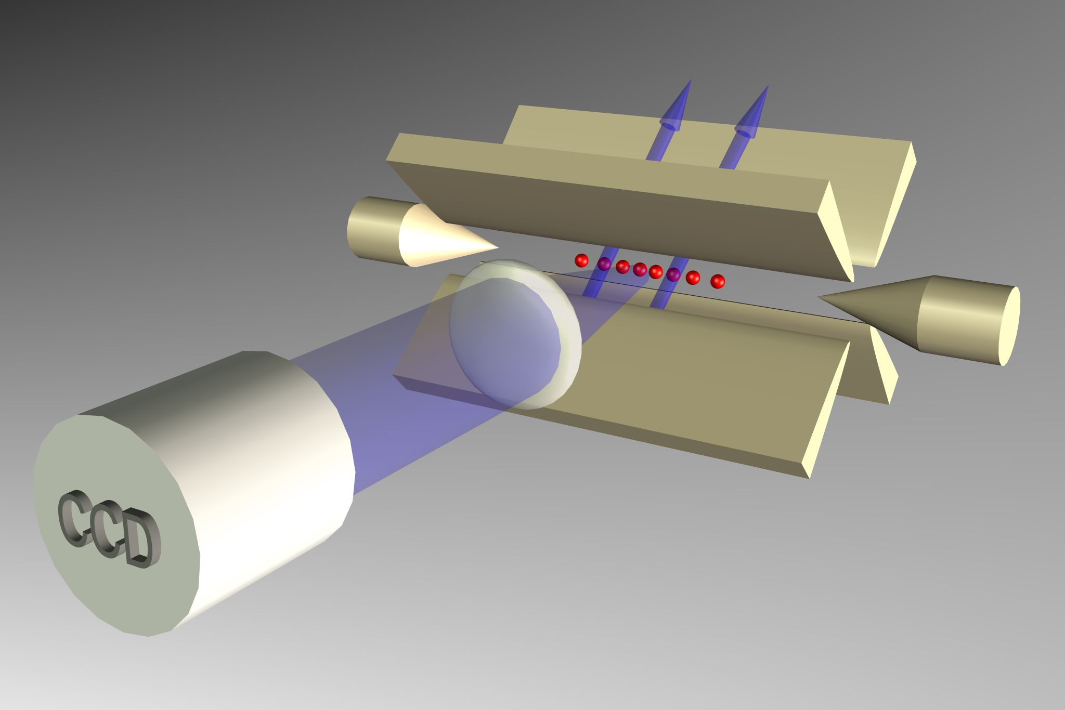
Motivation for trapped ions
Special trait: individually controllable quantum systems
- far away from noise sources
- positive charge separates them
- switchable control via laser-light
and 100% read-out fidelity

Slide 7
Literature
“Quantum dynamics of single trapped ions“
D. Leibfried, R. Blatt, C. Monroe, D. Wineland
Rev. Mod. Phys. 75, 281-324 (2003)
“Experimental Issues in Coherent Quantum-State
Manipulation of Trapped Atomic Ions“
D. Wineland et al.
J. Res. Natl. Inst. Stand. Technol. 103, 259-328 (1998)
“Quantum Computing with Trapped Ions“
H. Häffner, C. Roos, R. Blatt
Physics Reports 469, 155-203 (2008).

Slide 8
Trapping
+
+
+

Slide 9
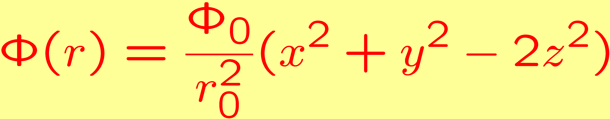
Trapping ions
Charged particles
⇒
Confinement by electric (and magnetic) fields
Ion confinement requires a binding force in three dimensions:
harmonic binding force
quadrupole potential
Laplace theorem
Electrostatic potential with rotational symmetry:
confinement in one or two dimensions
Penning trap :
Paul trap :

Slide 10
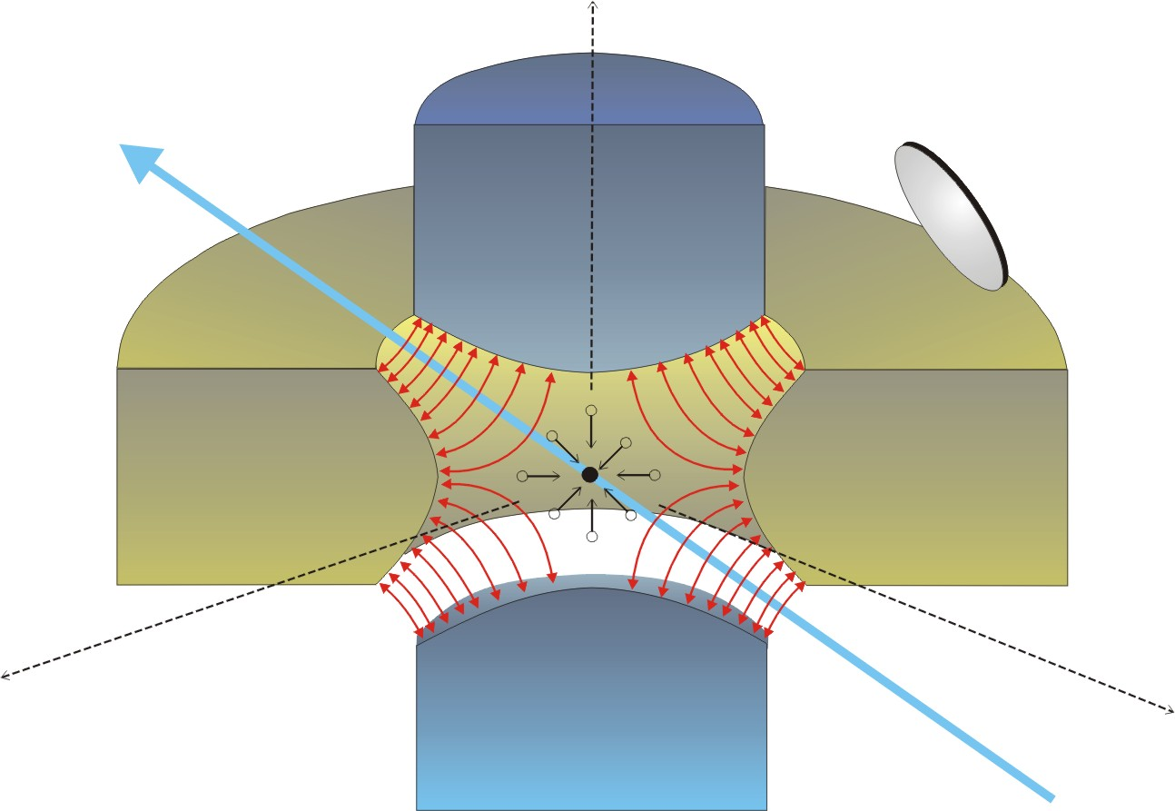
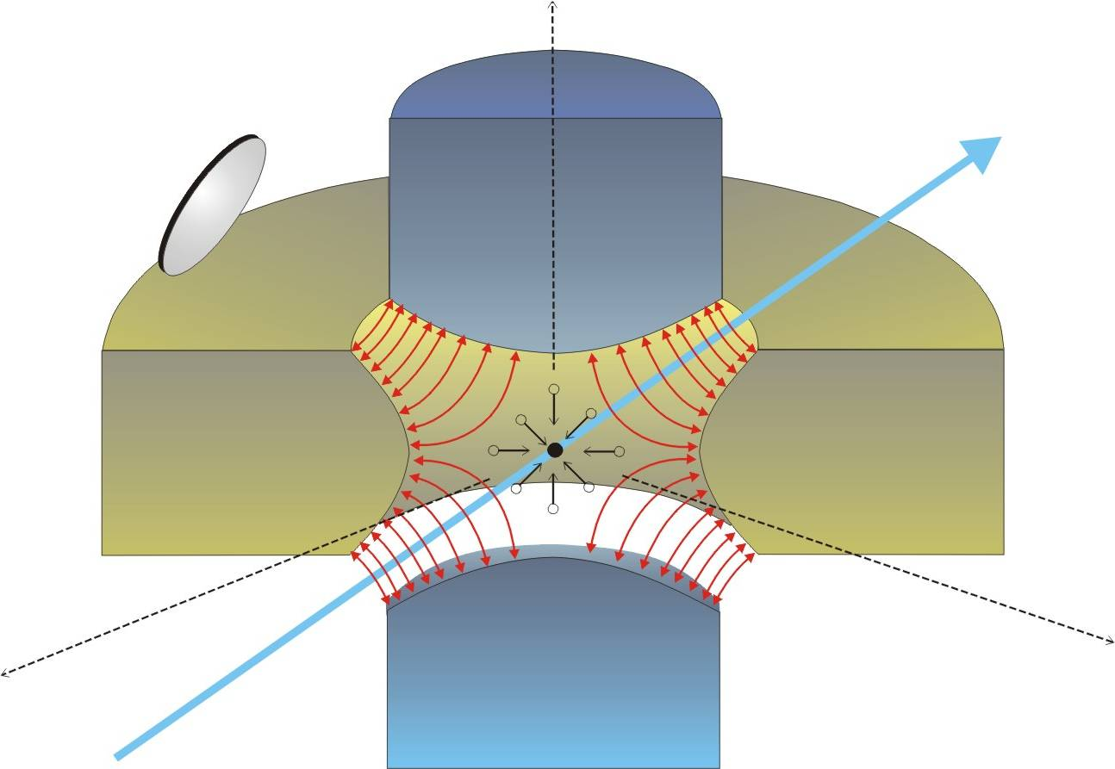
Penning trap
Static quadrupole electric field:
z
confinement in axial (z) direction
Axial magnetic field:
hyperbolic
endcaps
ring
electrode
+
confinement in x/y plane
B
-
-
+
x
+
y

Slide 11
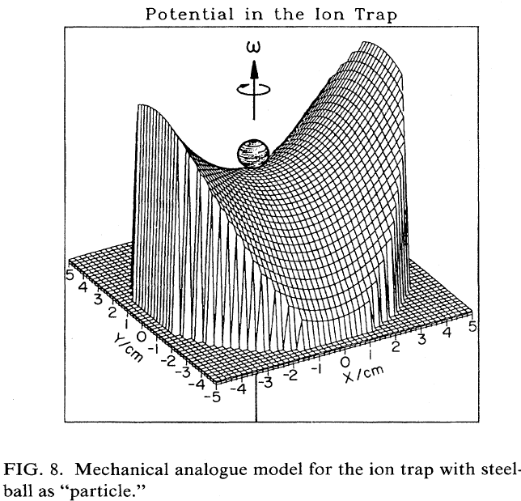
Paul or RF trap
Static and dynamic quadrupole electric field:
z
confinement in all directions
for suitably chosen parameters
hyperbolic
endcaps
ring
electrode
Mechanical analogue:
rotating saddle potential
+/-
+
+/-
x
y
(W.Paul, RMP 62,531 (1990)

Slide 12
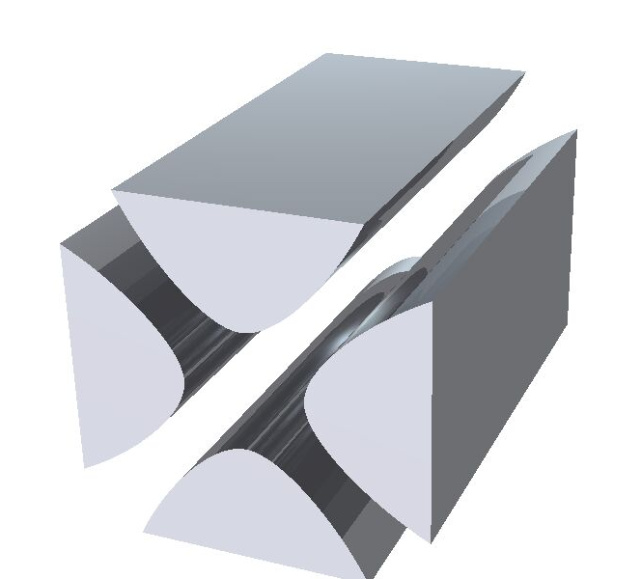
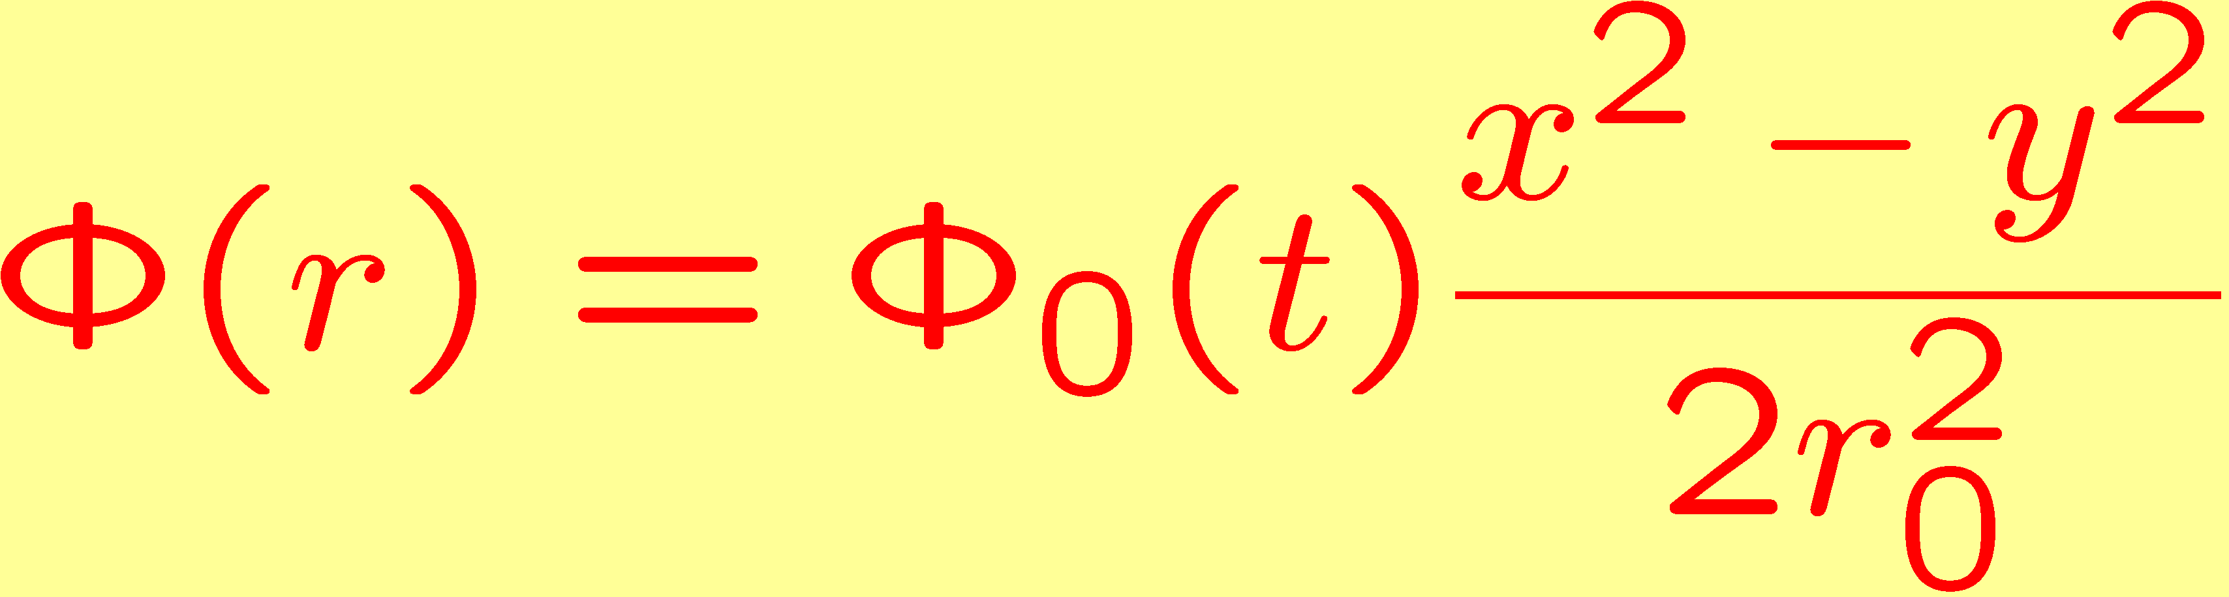
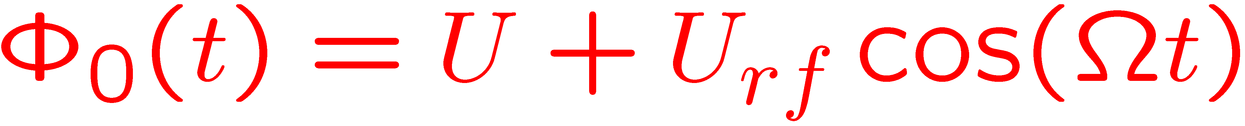
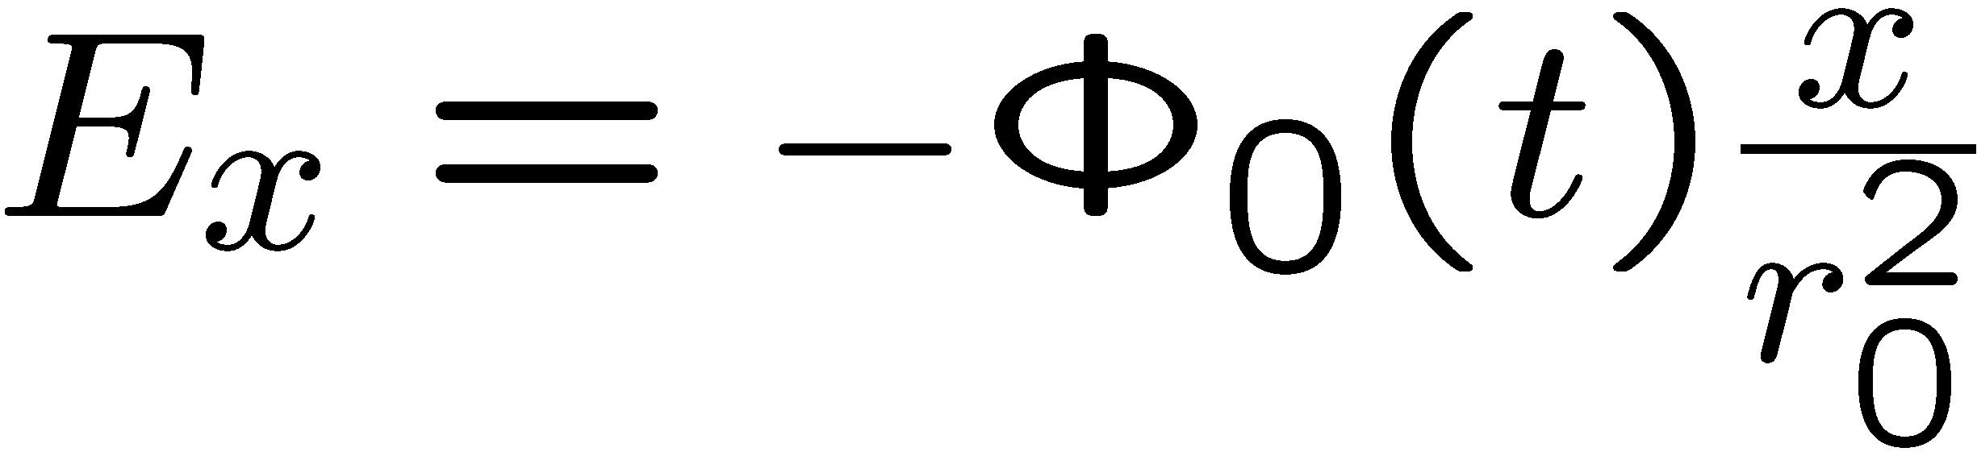
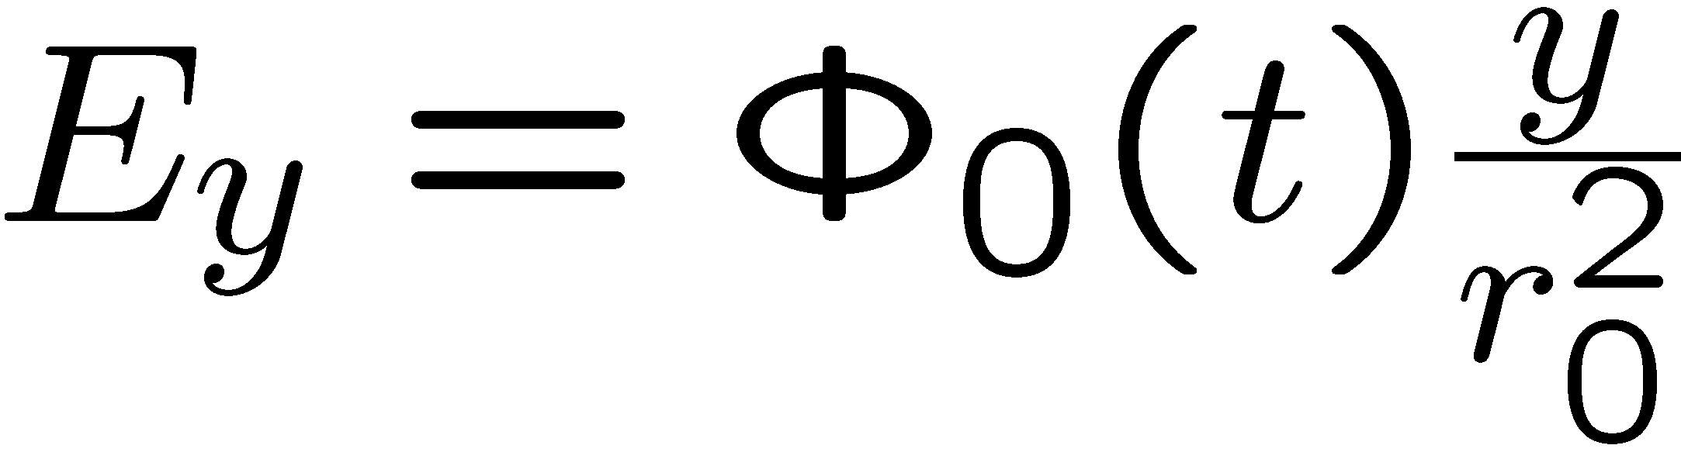

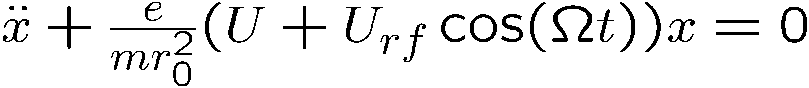
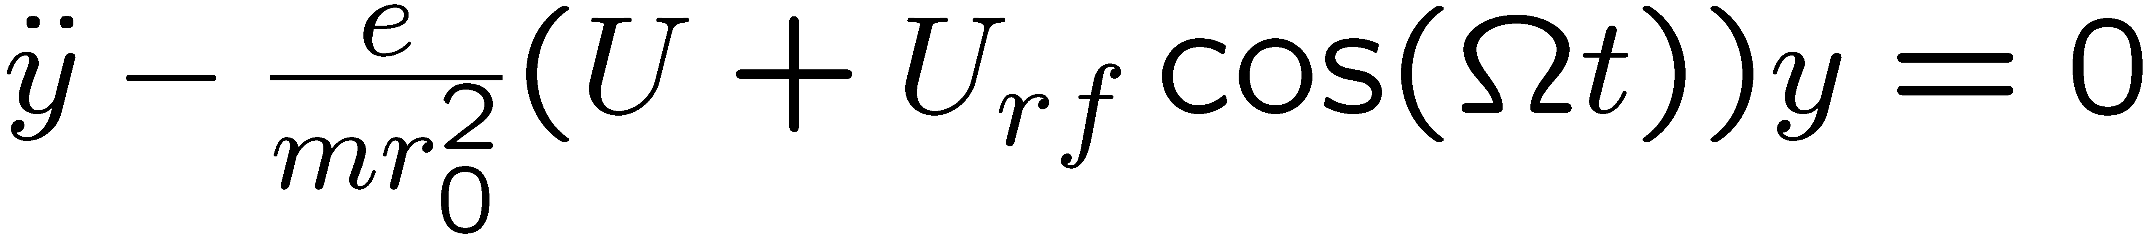
2D trapping
2r₀
Equations of motion:

Slide 13
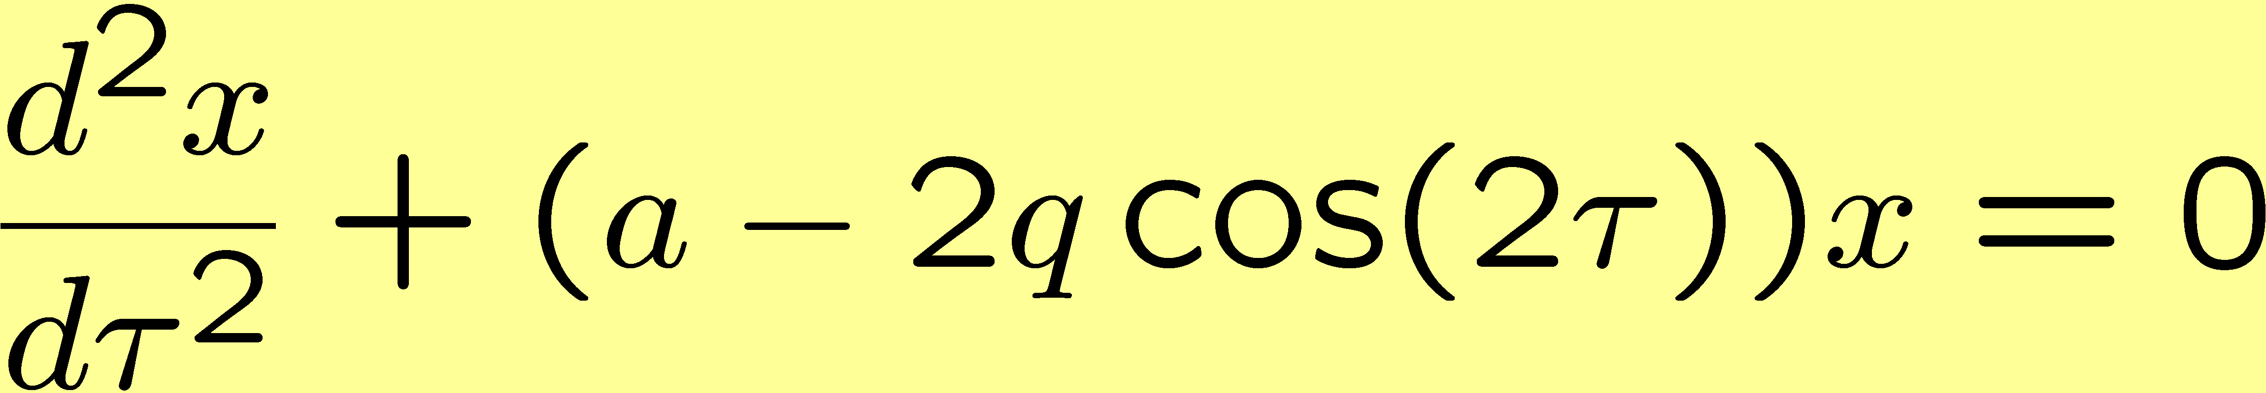
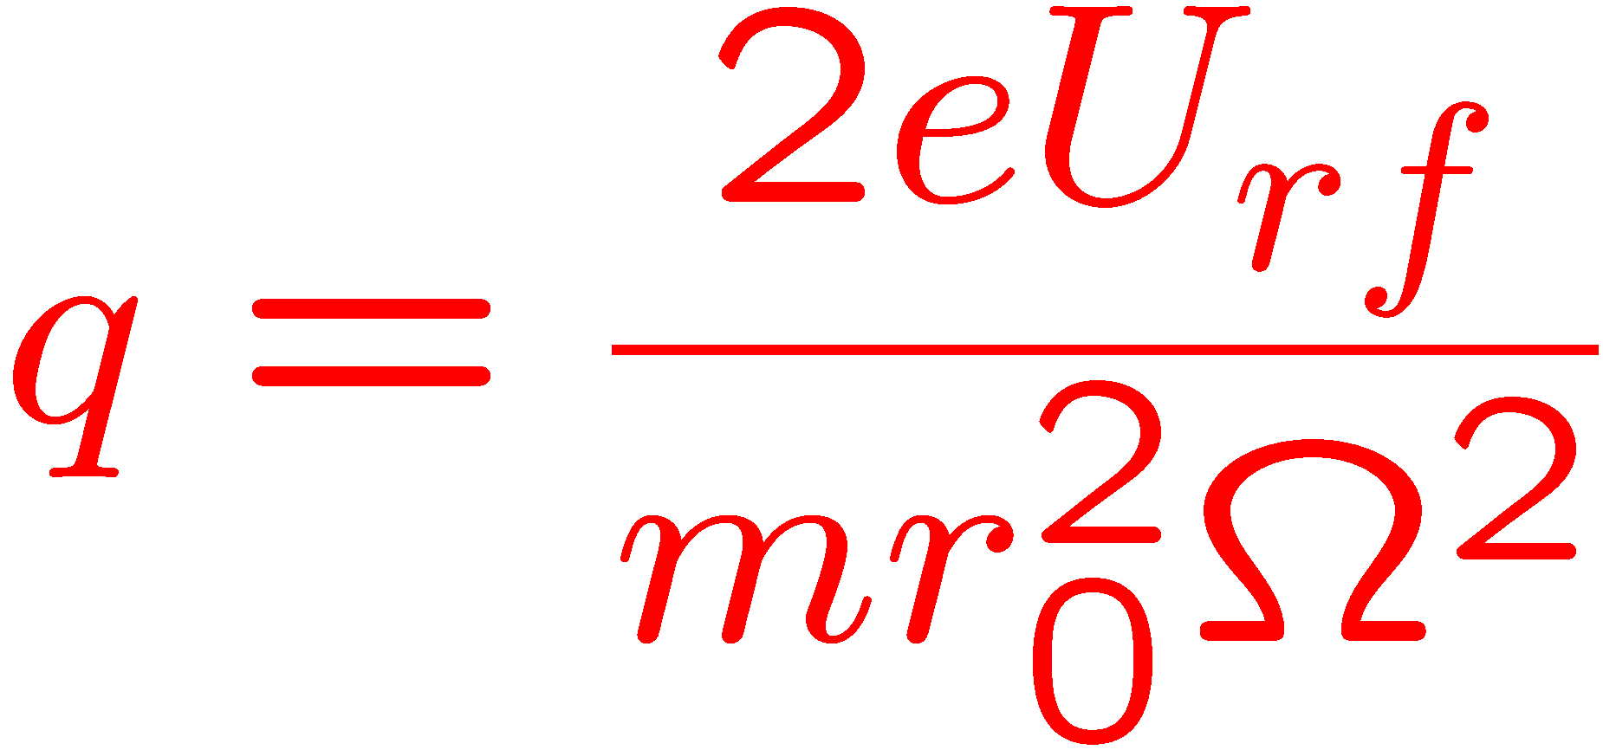
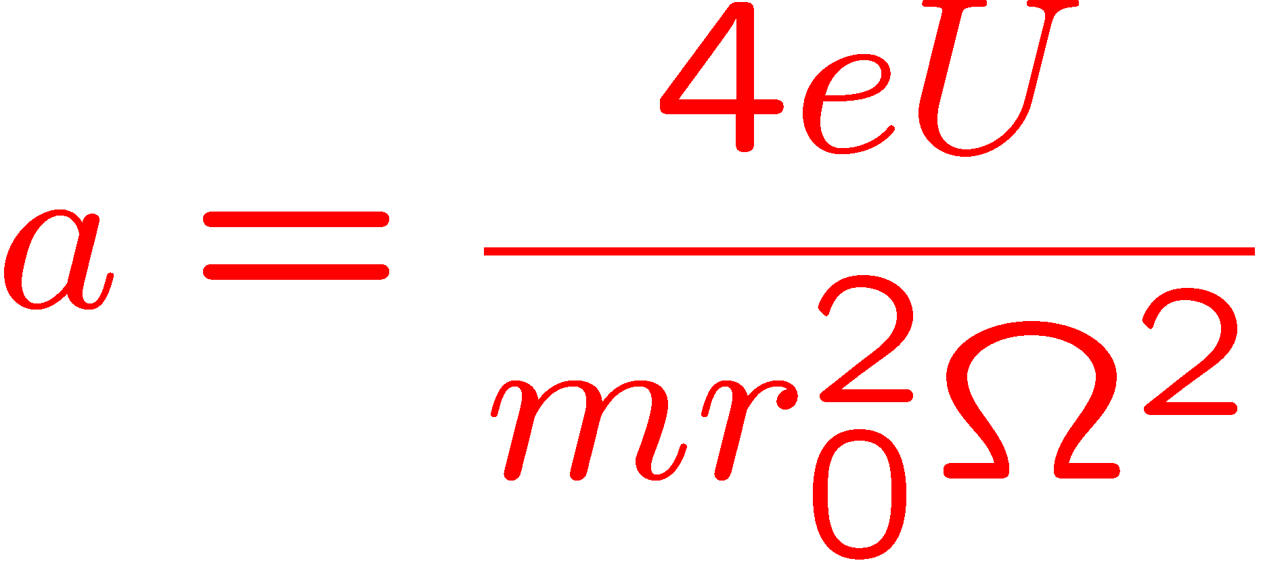
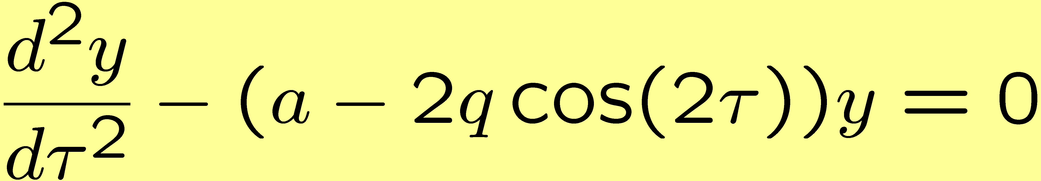
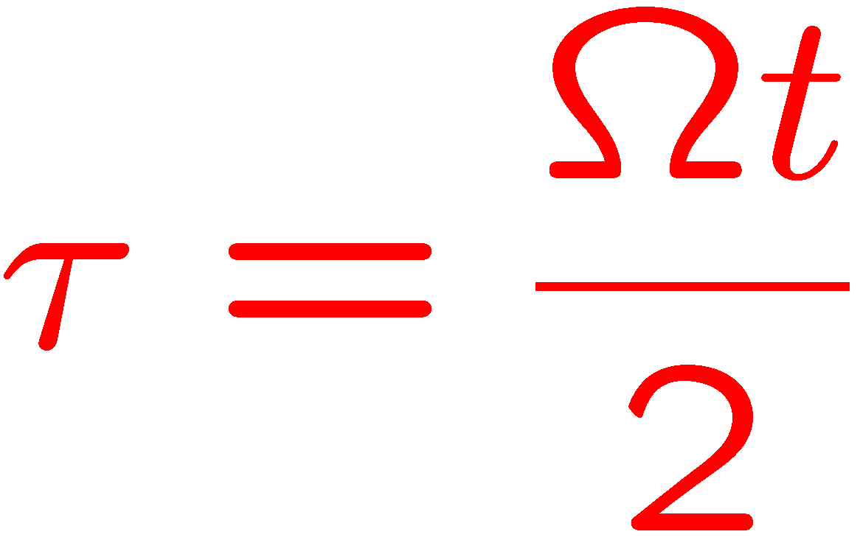
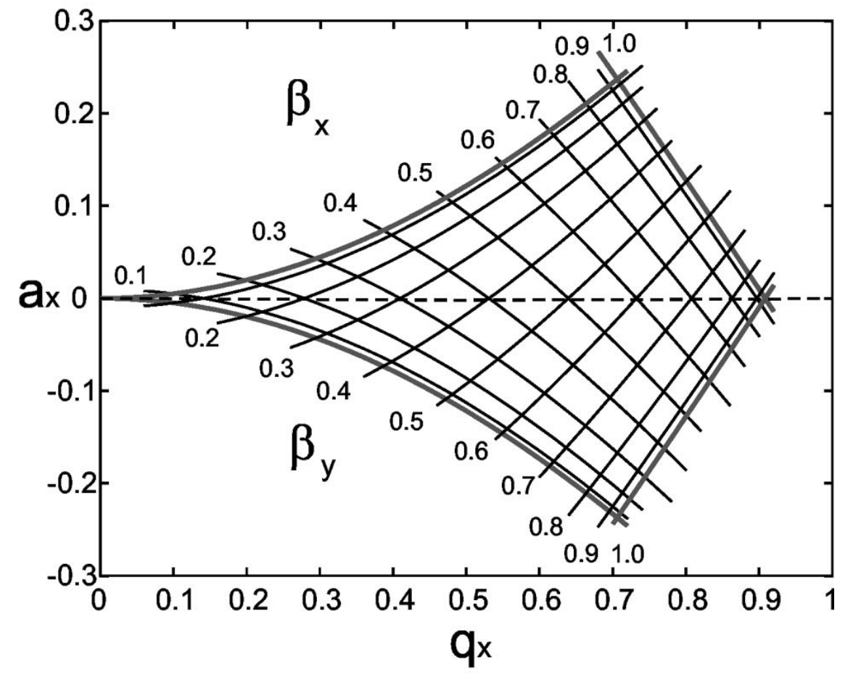
Mathieu equations
q - and a - parameter
Stability diagram
see D. Leibfried et al., Rev. Mod. Phys. 75, 281 (2003)

Slide 14
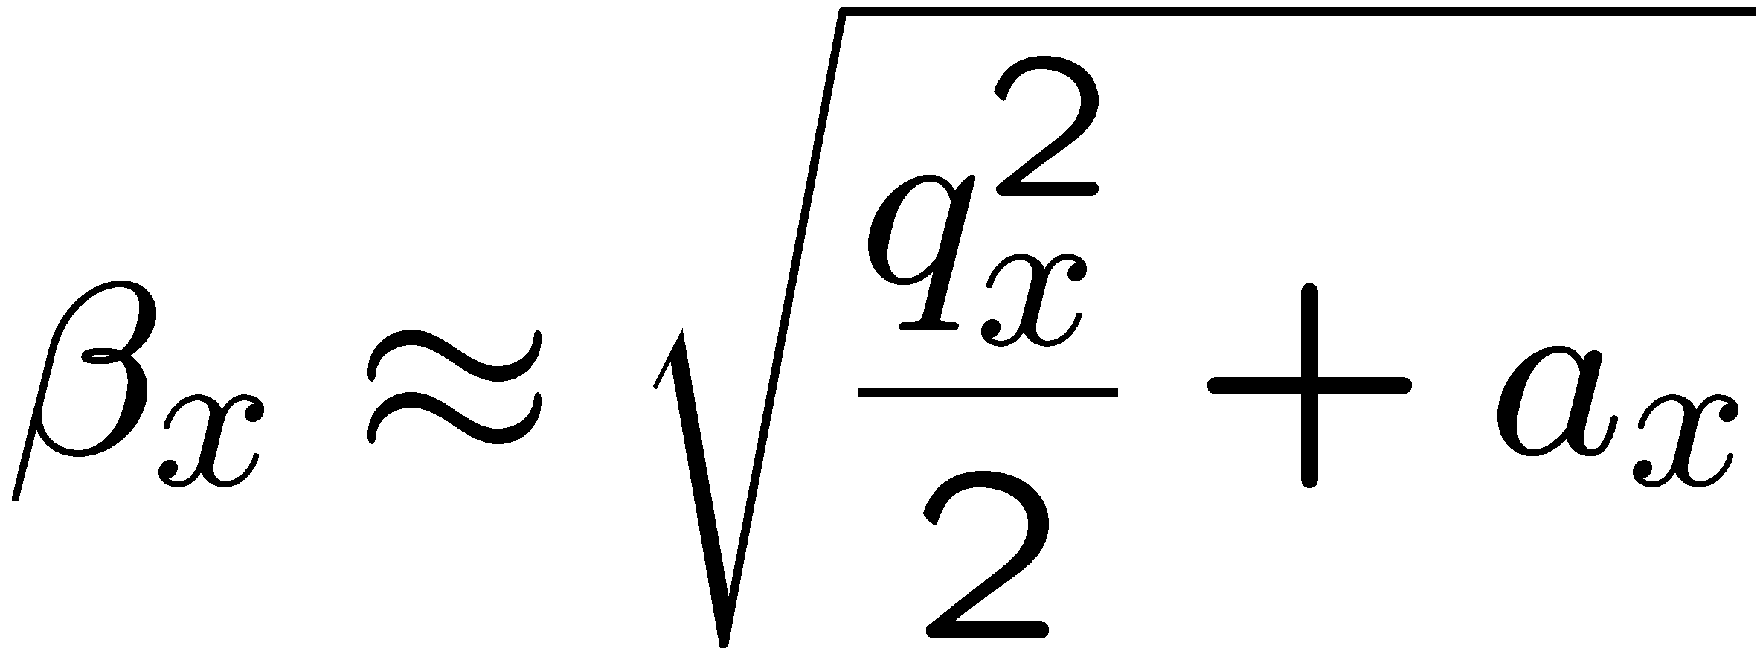
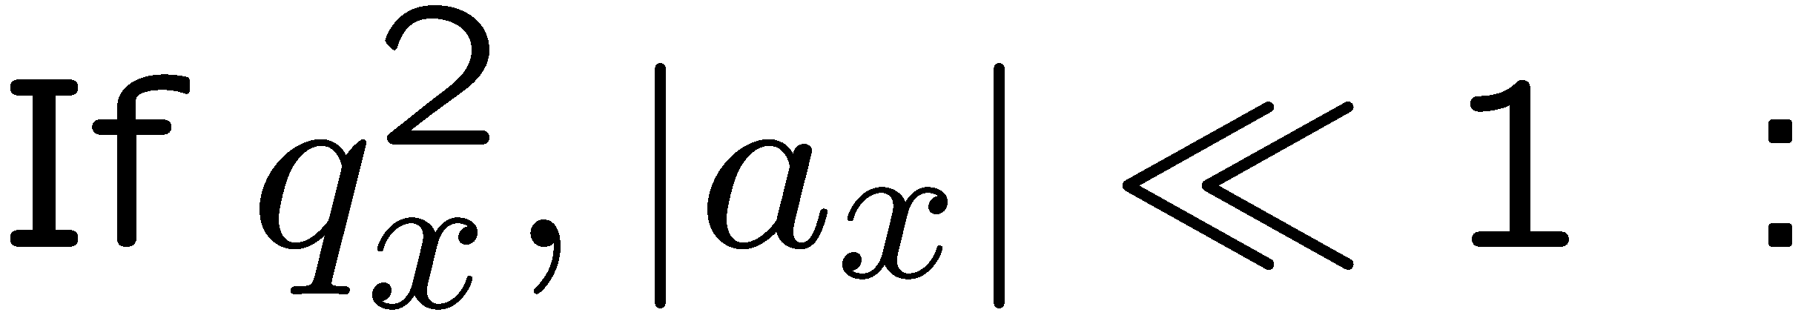
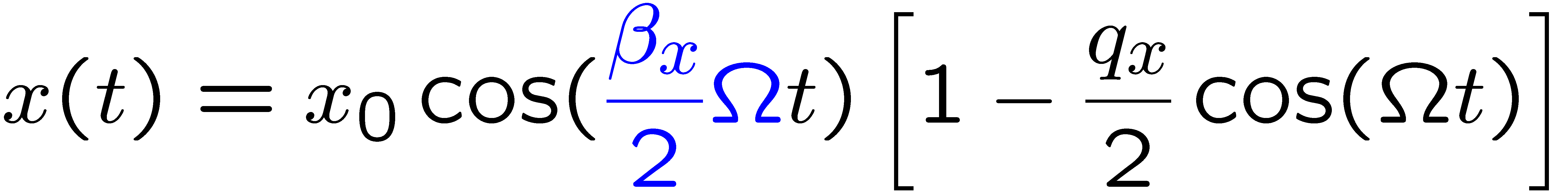




Micromotion
1D-solution of Mathieu equation
macromotion
(motion in pseudopotential)
Position
micromotion (driven motion)
Time

Slide 15
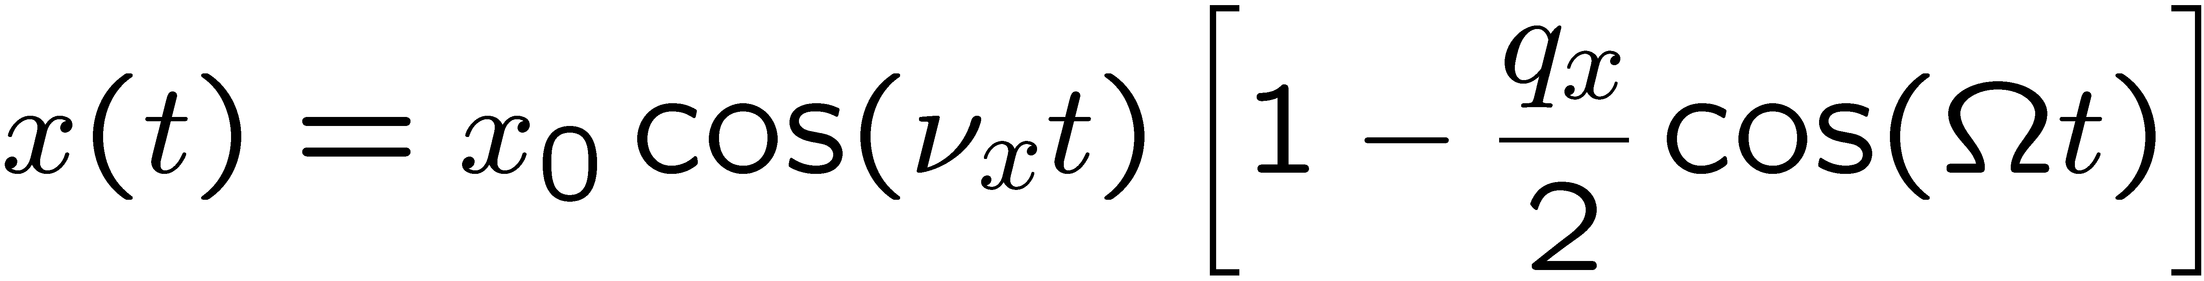
Micromotion
1D-solution of Mathieu equation
macromotion
(motion in pseudopotential)
Position
micromotion (driven motion)
Time

Slide 16
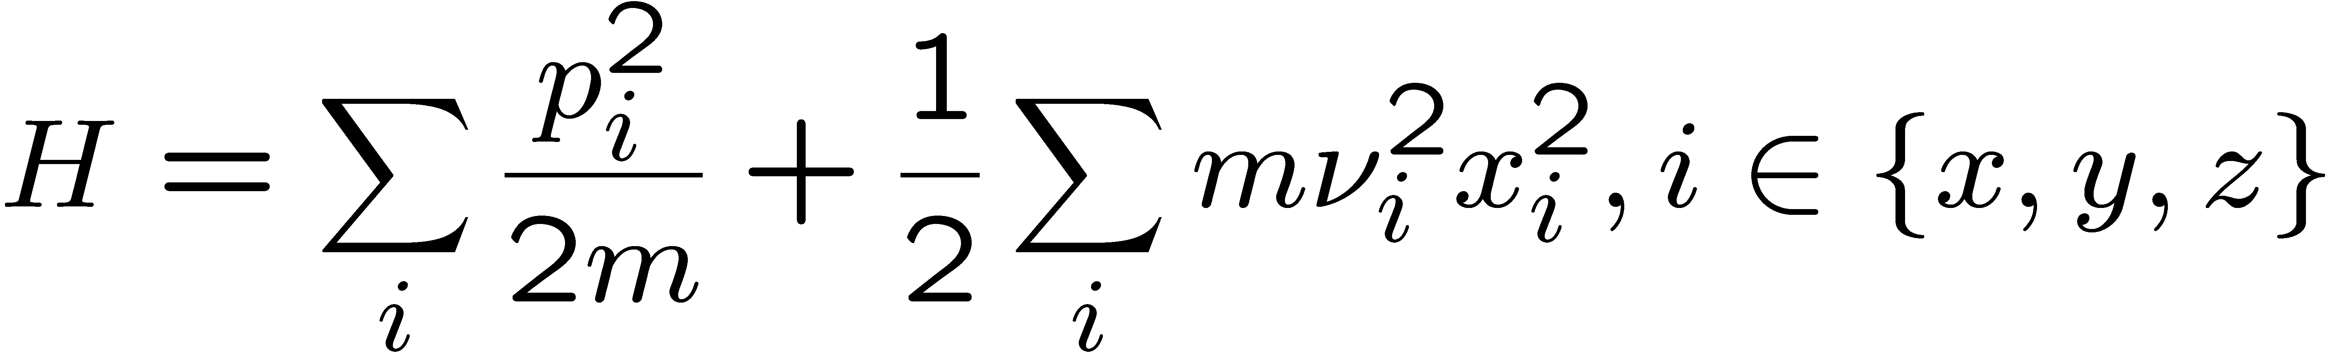
All you need, most of the time
Quantum mechanical motion
Quantization of the ion motion:
Secular approximation:
  Neglects micromotion and interprets motion as generated by “pseudo-potential“ (see D. Leibfried et al, Rev. Mod. Phys. 75, 281 (2003))

Slide 17
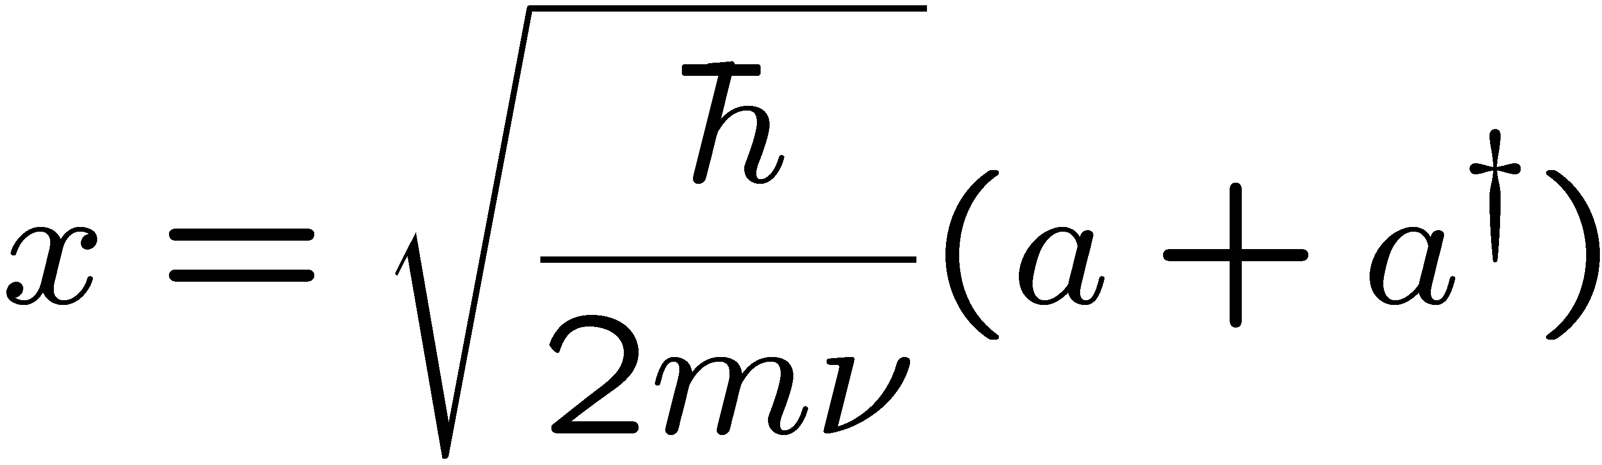
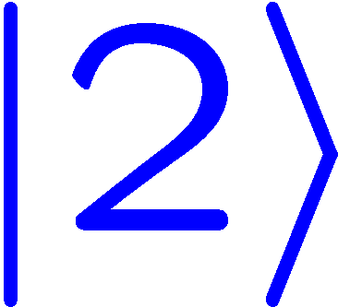
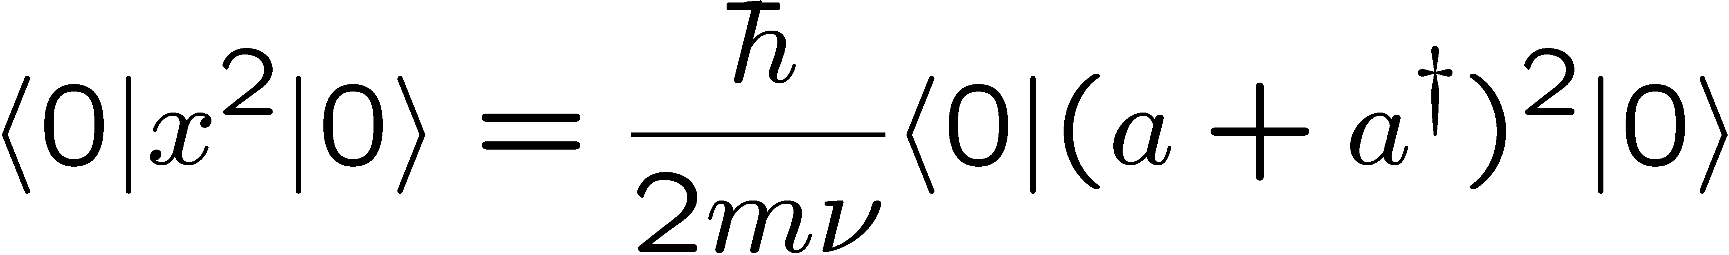
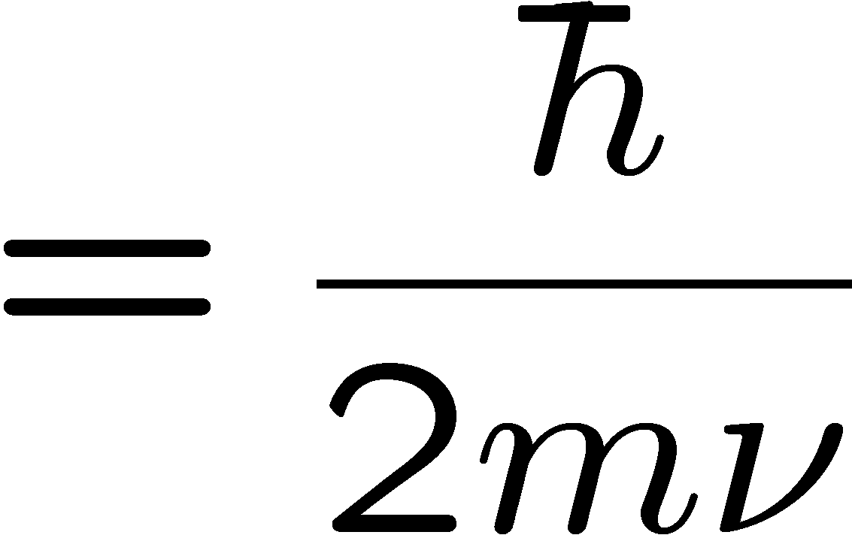
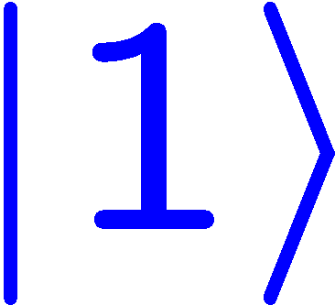


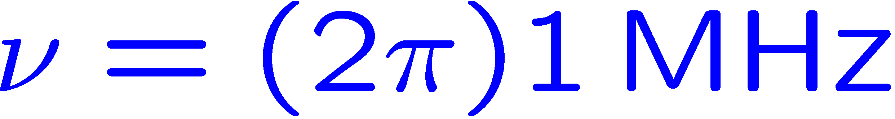
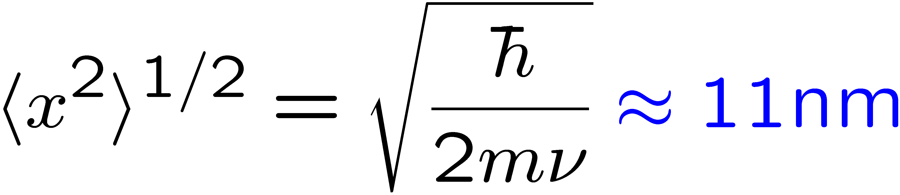

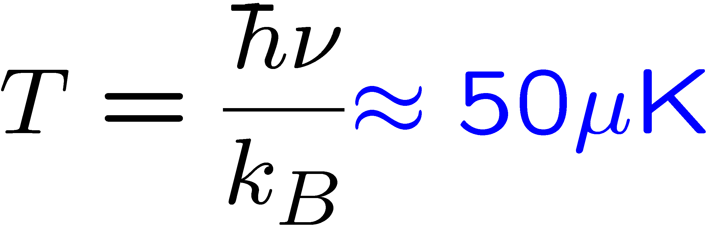

Typical numbers
harmonic trap
Extension of the ground state:
Size of the wave packet << wavelength of visible light
Energy scale of interest:

Slide 18
1D-solution of Mathieu equation
macromotion
(motion in pseudopotential)
micromotion (driven motion)

Slide 19
1D-solution of Mathieu equation
single Al dust particle in trap
Wuerker, Shelton, Langmuir, J. Appl. Phys. 30, 342 (1959)
micromotion

Slide 20
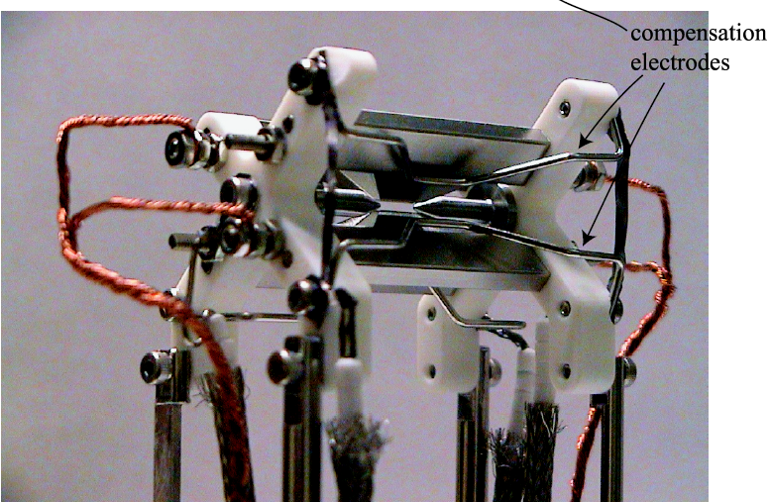
”Classic” linear trap
Compensation electrodes: used to null residual electric stray fields in the
transverse directions

Slide 21

Experimental set-up
atomic
beam
oven

Slide 22
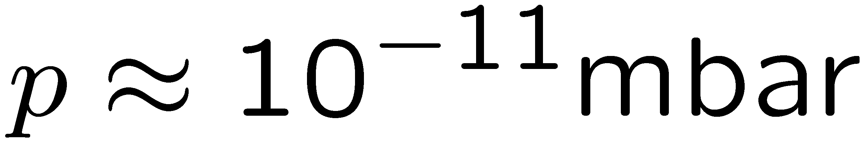
Experimental set-up
windows
atomic
beam
Vacuum
pump
oven

Slide 23
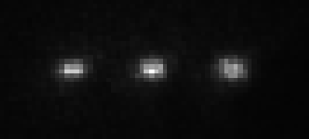
Experimental set-up
Fluorescence
detection by
CCD camera
photomultiplier
atomic
beam
CCD
camera
Photo-
multiplier
oven
Laser beams for:
photoionization
cooling
quantum state manipulation
fluorescence excitation
Vacuum
pump

Slide 24
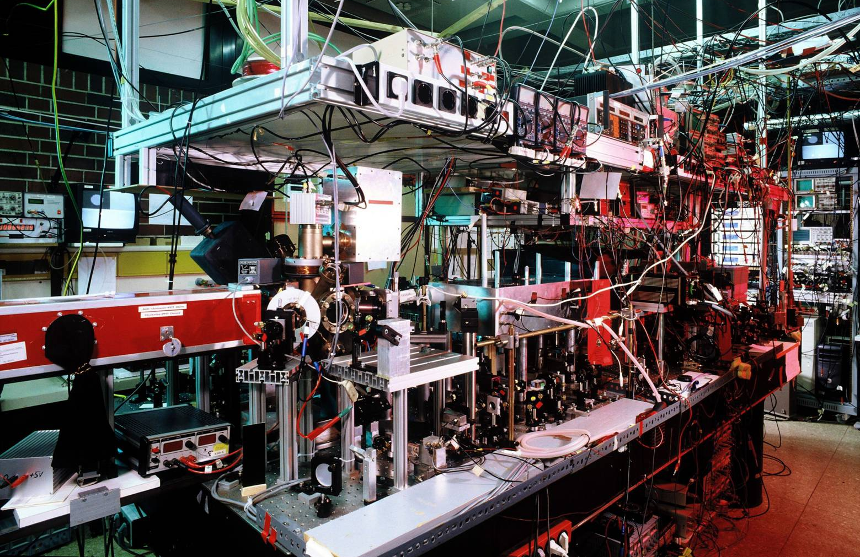
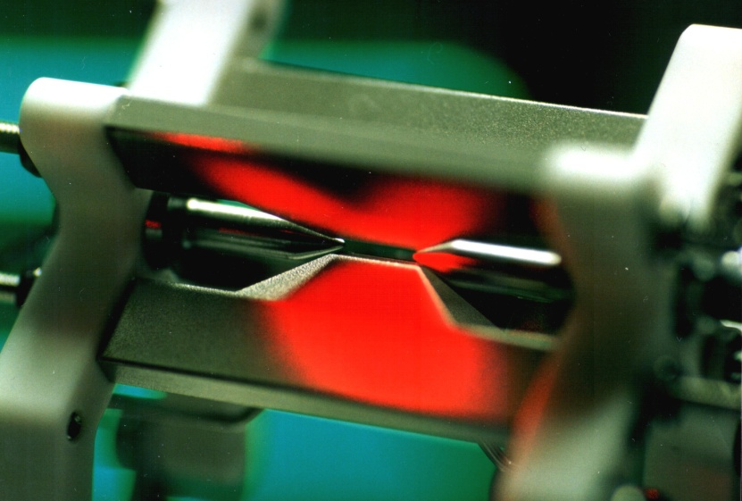
The hardware

Slide 25
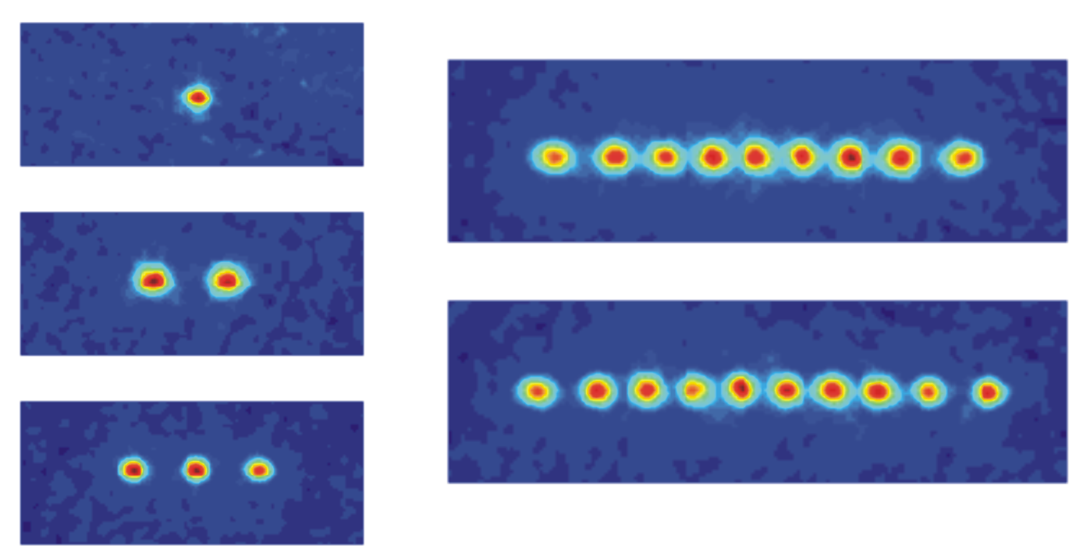


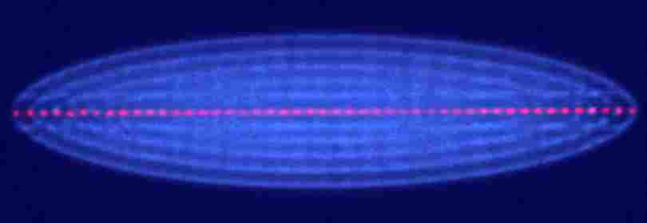
Cold ion crystals
Oxford, England: ⁴⁰Ca⁺
Innsbruck, Austria: ⁴⁰Ca⁺
Boulder, USA: Hg⁺
Aarhus, Denmark: ⁴⁰Ca⁺ (red) and ²⁴Mg⁺ (blue)

Slide 26
Experimental procedure
Initialization in a pure quantum state
Initialization in a pure quantum state
P_{1/2}
P
D_{5/2}
D_{5/2}
τ =1s
⁴⁰Ca⁺
S_{1/2}
S_{1/2}
Notes:
3 experimentelle Schritte

Slide 27
Experimental procedure
Initialization in a pure quantum state
Initialization in a pure quantum state
P
D_{5/2}
2. Quantum state manipulation on
S_{1/2} – D_{5/2} transition
Quantum state
manipulation
2. Quantum state manipulation on
S_{1/2} – D_{5/2} transition
S_{1/2}
Notes:
3 experimentelle Schritte

Slide 28

Experimental procedure
Initialization in a pure quantum state
P_{1/2}
P
D_{5/2}
D_{5/2}
τ =1s
2. Quantum state manipulation on
S_{1/2} – D_{5/2} transition
Fluorescence
detection
⁴⁰Ca⁺
S_{1/2}
3. Quantum state measurement
by fluorescence detection
S_{1/2}
Notes:
3 experimentelle Schritte

Slide 29

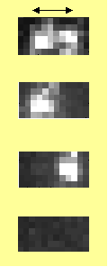




Experimental procedure
Initialization in a pure quantum state
P_{1/2}
P
D_{5/2}
D_{5/2}
τ =1s
2. Quantum state manipulation on
S_{1/2} – D_{5/2} transition
Fluorescence
detection
⁴⁰Ca⁺
S_{1/2}
3. Quantum state measurement
by fluorescence detection
S_{1/2}
Two ions:
5 µm
Spatially resolved
detection with
CCD camera
50 experiments / s
Repeat experiments
100-200 times
Notes:
3 experimentelle Schritte

Slide 30
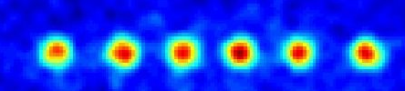

Adressing single ions
coherent
manipulation
of qubits
Paul trap
0.8
0.7
electrooptic
deflector
0.6
Excitation
0.5
0.4
0.3
0.2
0.1
0
-10
-8
-6
-4
-2
0
2
4
6
8
10
dichroic
Deflector Voltage (V)‏
- inter ion distance: ~ 4 µm
- addressing waist: ~ 2 µm
< 0.1% intensity on neighbouring ions
beamsplitter
Fluorescence
detection
CCD

Slide 31

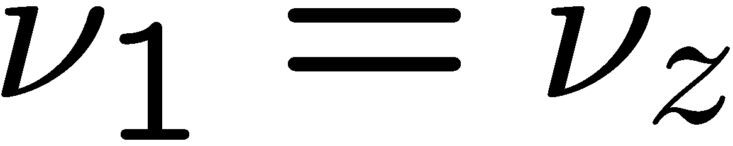
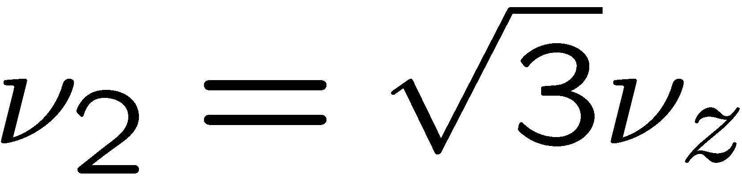
Motion of ion crystals
2 ions:
center of mass mode
breathing mode

Slide 32
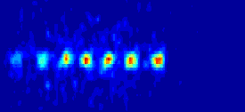
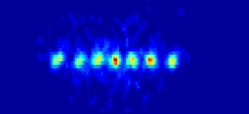
Normal modes
„center-of-mass mode“
„stretch mode“
See: H.C. Nägerl, et al., Opt. Express 3, 89 (1998)

Slide 33


How does the motion modify the spectrum ?
Laboratory rest frame
spectrum
harmonic trap
rest frame of the ion
In the rest frame of the ion,
the laser appears to be
frequency-modulated.
spectrum
harmonic trap
Absorption on the sideband
possible

Slide 34




Ion motion
harmonic trap
…
…
Notes:
Now let's have a look at the qubit transition in the presence of the motional degrees of freedom. If we focus on just one motional mode ..., we just get a ladder of harm osc levels.

Slide 35










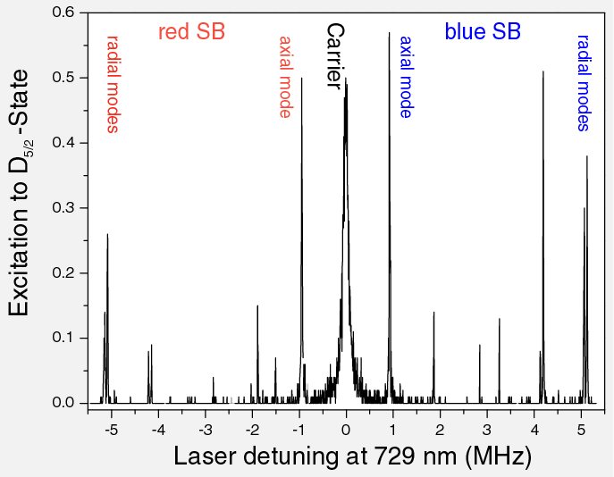
Ion motion
joint energy levels
2-level-atom
harmonic trap
…
…
Notes:
The joint system shows a double ladder structure. With our narrow laser we can selectively excite the carrier transition, where the motional state remains unchanged...
or the blue sideband ...
and red sideband transitions, where we can change the motional state

Slide 36
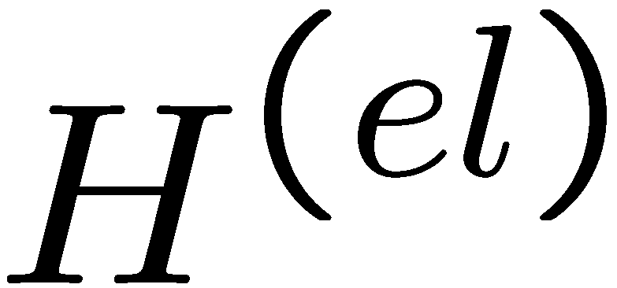



Ion motion
joint energy levels
2-level-atom
harmonic trap
…
…
Approximations:
Ion:
Electronic structure of the ion approximated by two-level system
(laser is (near-) resonant and couples only two levels)
Trap:
Only a single harmonic oscillator taken into account
Notes:
The joint system shows a double ladder structure. With our narrow laser we can selectively excite the carrier transition, where the motional state remains unchanged...
or the blue sideband ...
and red sideband transitions, where we can change the motional state

Slide 37


Laser-ion interaction
General description for the interaction between the ion and a running-wave
laser beam
Hamiltonian:
laser frequency
laser phase
Rabi frequency
(coupling strength between laser and ion)

Slide 38




Laser-ion interaction
with
with the Lamb-Dicke parameter:
Rotating-wave approximation:
keep only terms slowly evolving with
neglect

Slide 39



Laser-ion interaction
with the Lamb-Dicke parameter:
For
Taylor expansion of the exponential
up to first order:
Control parameters:
Rabi frequency (coupling strength)
Detuning of laser with respect to atomic transition
Phase of laser

Slide 40



Lamb-Dicke regime
Carrier resonance:
The laser couples ground and excited state without affecting the motional state.
The coupling does not depend on |n>.

Slide 41




Single qubit gates
P_{1/2}
D_{5/2}
S_{1/2}
D-state population

Slide 42


Single qubit gates
P_{1/2}
D_{5/2}
S_{1/2}
D-state population

Slide 43

Single qubit gates
P_{1/2}
D_{5/2}
S_{1/2}
D-state population

Slide 44
The phase ...
+
+
+
=
-
+
+
+e
-iωt
=
-

Slide 45
The phase ...
+
+
+
=
-
+
+
+e
-iωt
=
-

Slide 46

The phase ...

Slide 47
The phase ...

Slide 48
The phase ...

Slide 49

The phase ...

Slide 50



Lamb-Dicke regime
Carrier resonance:
The laser couples ground and excited state without affecting the motional state.
The coupling does not depend on |n>.
2. Red sideband:
As compared to the carrier resonance, the coupling strength on the
sidebands is reduced.
The coupling strength depends on the motional quantum number.

Slide 51
Lamb-Dicke regime
joint energy levels
…
Which statement is true?
1) the ion motion stays unaffected.
2) the motional quantum number
is reduced.
3) the ion gets micromotion
4) the motional quantum number
increases by 1.
Laser excitation

Slide 52

Sideband cooling
NO!
optical pumping into the ground state
Signature: no further excitation possible
„dark state“ |0>

Slide 53







Ion motion
carrier
carrier and sideband
Rabi oscillations
with Rabi frequencies
Lamb-Dicke parameter

Slide 54
Plan
Lecture #1: Introduction
- Paul traps
- Laser ion-interaction
Lecture #2: Quantum computing
- Quantum gates
- Quantum state engineering
Lecture #3: Decoherence I/Scaling
- Qubit decoherence
- Scaling
Lecture #4: Decoherence II/Quantum emulation
- Anomalous heating
- Quantum emulation
Lecture #5: Applications
- Atomic clocks
- Fundamental symmetry tests

Slide 55
Plan
Lecture #1: Introduction
- Paul traps
- Laser ion-interaction
Lecture #2: Quantum computing
- Quantum gates
- Quantum state engineering
Lecture #3: Decoherence I/Scaling
- Qubit decoherence
- Scaling
Lecture #4: Decoherence II/Quantum emulation
- Anomalous heating
- Quantum emulation
Lecture #5: Applications
- Atomic clocks
- Fundamental symmetry tests

