Slide 1
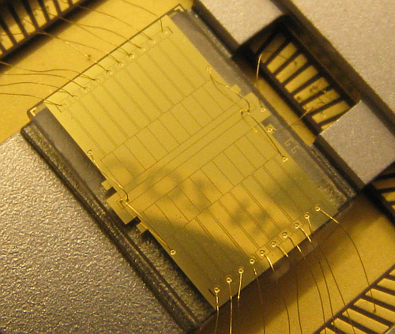
Quantum applications of ion trapping
Hartmut Häffner, UC Berkeley
1. Introduction to ion trapping
2. Quantum computing
3. Sources of decoherence
4. Quantum emulation/simulation
5. Applications of QIP to precision measurements

Slide 2
Plan
Lecture #1: Introduction
- Paul traps
- Laser ion-interaction
Lecture #2: Quantum computing
- Quantum gates
- Quantum state tomography
Lecture #3: Decoherence
- Qubit decoherence
- Scaling
Lecture #4: Challenges and quantum simulation
- Scaling and anomalous heating
- Quantum simulation
Lecture #5: Applications
- Atomic clocks, quadrupole shifts
- Michelson-Morley experiment

Slide 3
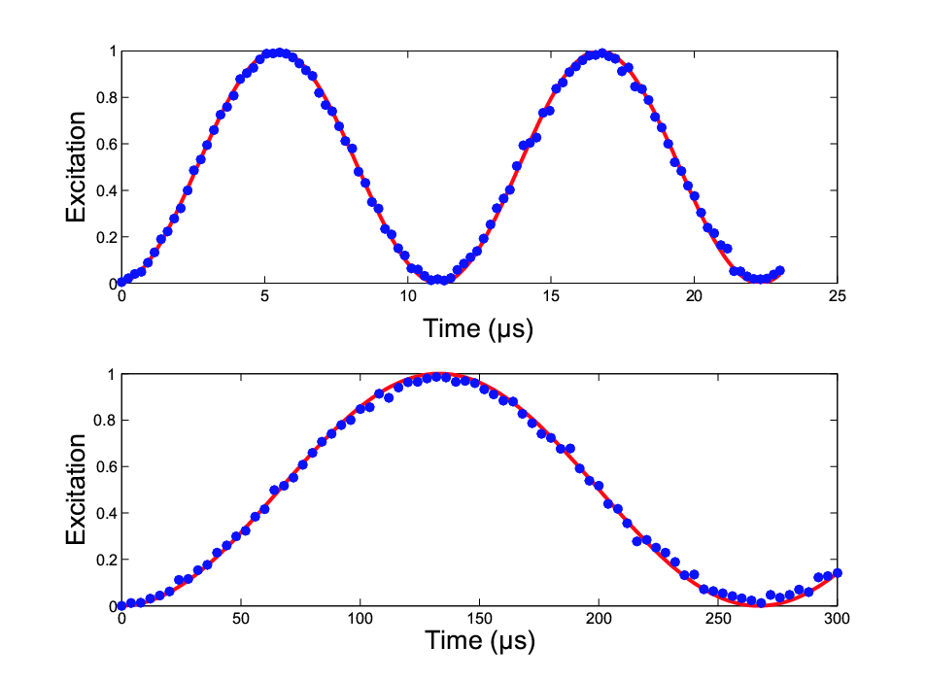




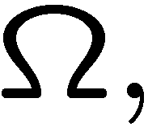
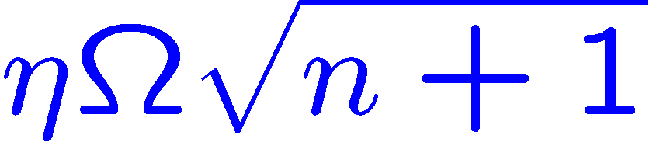
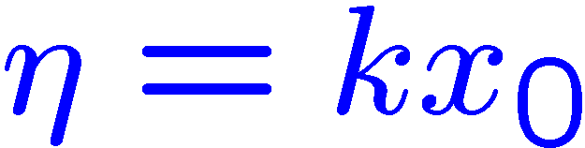
Ion motion
carrier
carrier and sideband
Rabi oscillations
with Rabi frequencies
Lamb-Dicke parameter

Slide 4


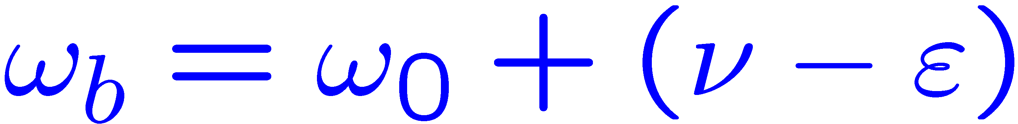
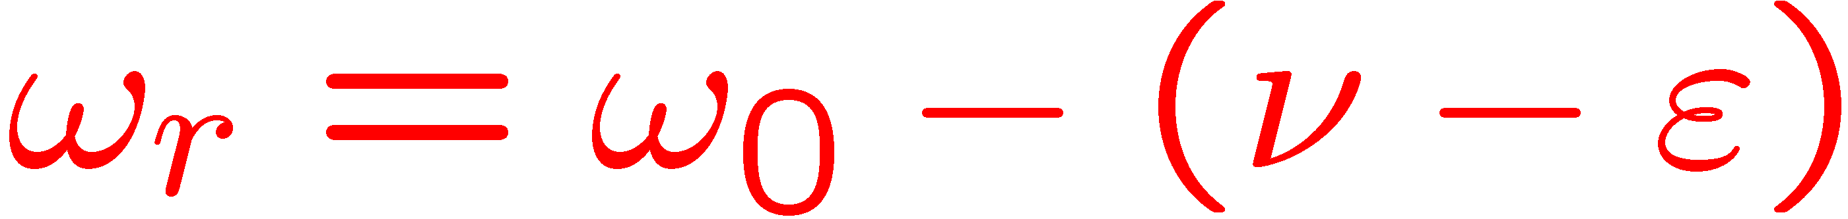
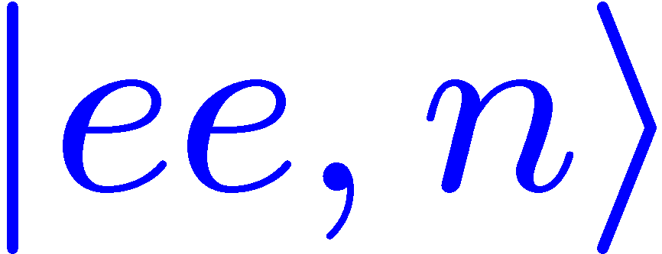
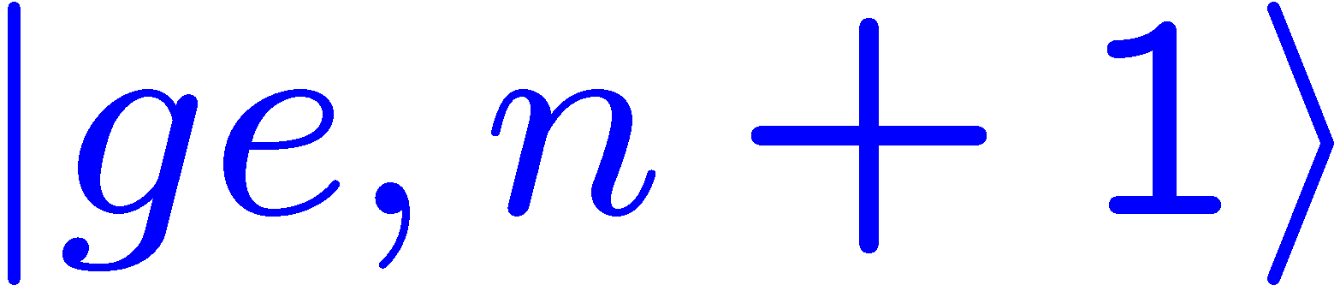
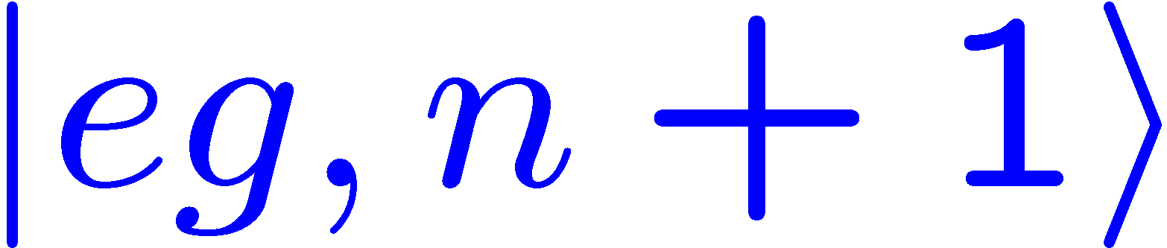

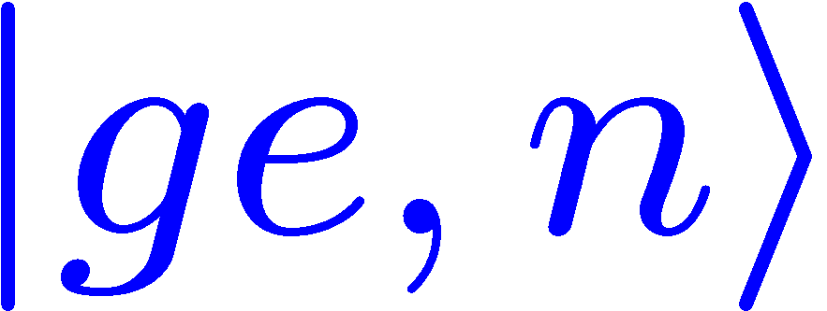
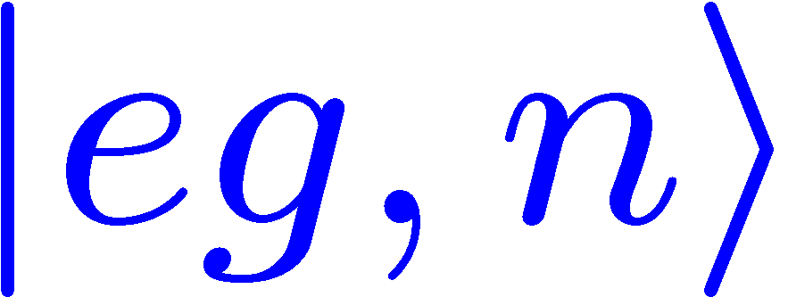
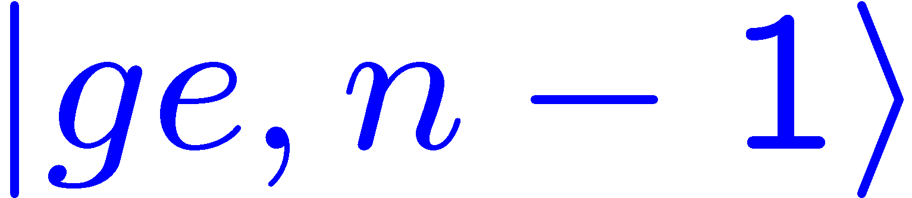
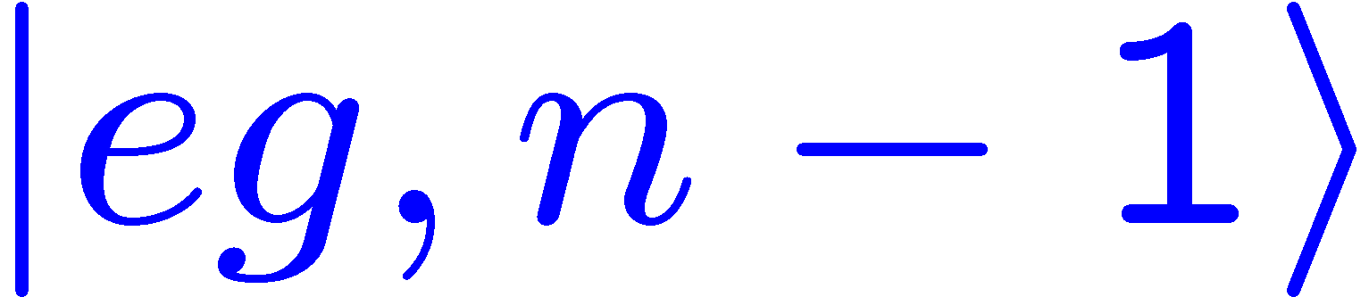

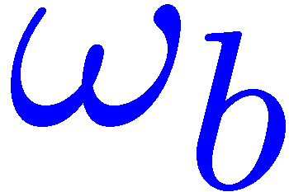

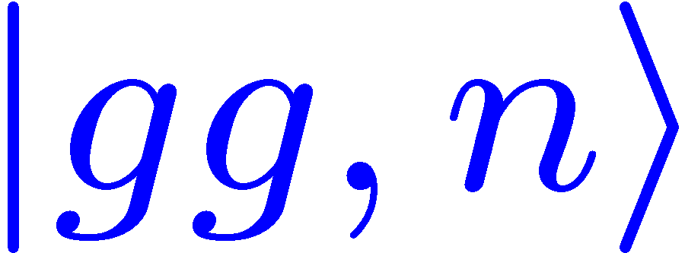
Mølmer - Sørensen gate
K. Mølmer, A. Sørensen,
Phys. Rev. Lett. 82, 1971 (1999)
C. A. Sackett et al.,
Nature 404, 256 (2000)

Slide 5
Plan
Lecture #1: Introduction
- Paul traps
- Laser ion-interaction
Lecture #2: Quantum computing
- Quantum gates
- Quantum state tomography
Lecture #3: Decoherence
- Qubit decoherence
- Scaling
Lecture #4: Challenges and quantum simulation
- Scaling and anomalous heating
- Quantum simulation
Lecture #5: Applications
- Atomic clocks, quadrupole shifts
- Michelson-Morley experiment

Slide 6
The DiVincenczo criteria for quantum computing
Scalable physical system, well characterized qubits
Ability to initialize the state of the qubits
Long relevant coherence times, much longer than gate operation time
“Universal” set of quantum gates
Qubit-specific measurement capability

Slide 7
The DiVincenczo criteria for quantum computing
Scalable physical system, well characterized qubits
Ability to initialize the state of the qubits with sufficient fidelity
Long relevant coherence times, much longer than gate operation time
“Universal” set of quantum gates with sufficient fidelity
Qubit-specific measurement capability with sufficient fidelity
need to beat the fault-tolerant “threshold” of 99% to 99.99% for
(all) operations.

Slide 8
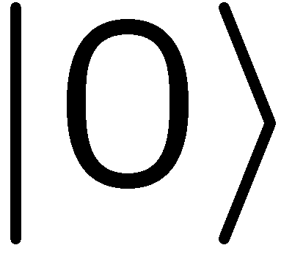

Quantum error correction

Slide 9
Anything that can go wrong, will go wrong.
See: http://en.wikipedia.org/wiki/Murphy's_law
- Qubits decohere
- spontaneous emission
- magnetic field fluctuations
- laser frequency fluctuations
- Initialization and read-out errors
- Control errors
- frequency/phase errors of the control field
- calibration errors
- laser intensity noise
- unwanted side effects (off-resonant excitations)

Slide 10
Anything that can go wrong, will go wrong.
See: http://en.wikipedia.org/wiki/Murphy's_law
- Qubits decohere
- spontaneous emission
- magnetic field fluctuations
- laser frequency fluctuations
- Initialization and read-out errors
- Control errors
- frequency/phase errors of the control field
- calibration errors
- laser intensity noise
- unwanted side effects (off-resonant excitations)

Slide 11
A typical quantum algorithm
π/2
x
x
-π/2
U_{f}
π/2
z
z + f(x)‏
-π/2
Quantum algorithms can be viewed
as generalized Ramsey experiments.

Slide 12
The qubit
τ= 7 ns
P_{1/2}
τ= 1.2 s
D_{5/2}
397 nm
729 nm
„quantum bit“
S_{1/2}

Slide 13




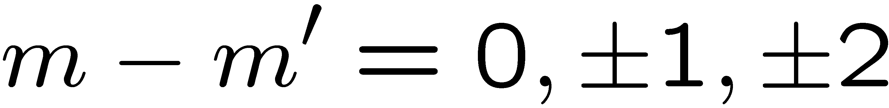
What else can go wrong ?
Zeeman structure in non-zero magnetic field:
3/2
5/2
δf
D_{5/2}
1
/2
- /2
1
-3/2
δB
-5/2
S_{1/2}
1
/2
δB
- /2
1
Selection rule for electric quadrupole transition:
Notes:
3 experimentelle Schritte

Slide 14
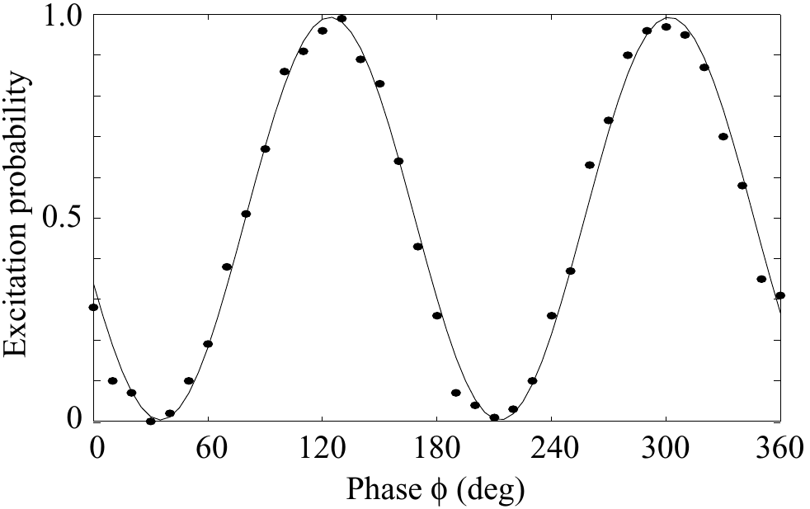
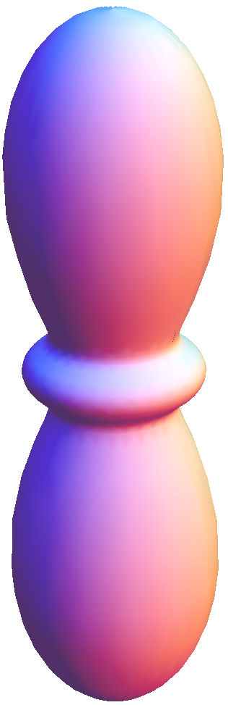
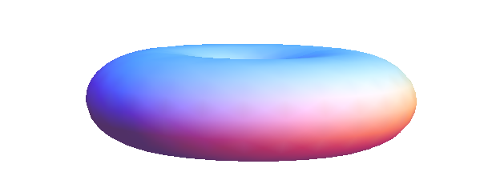
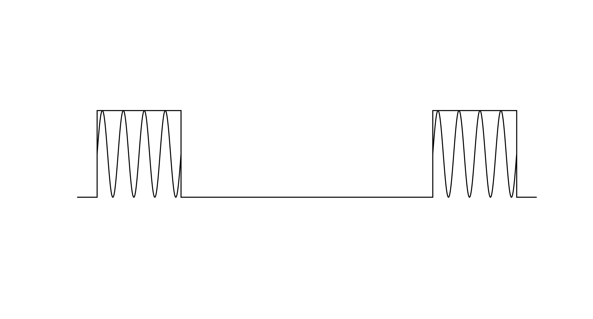
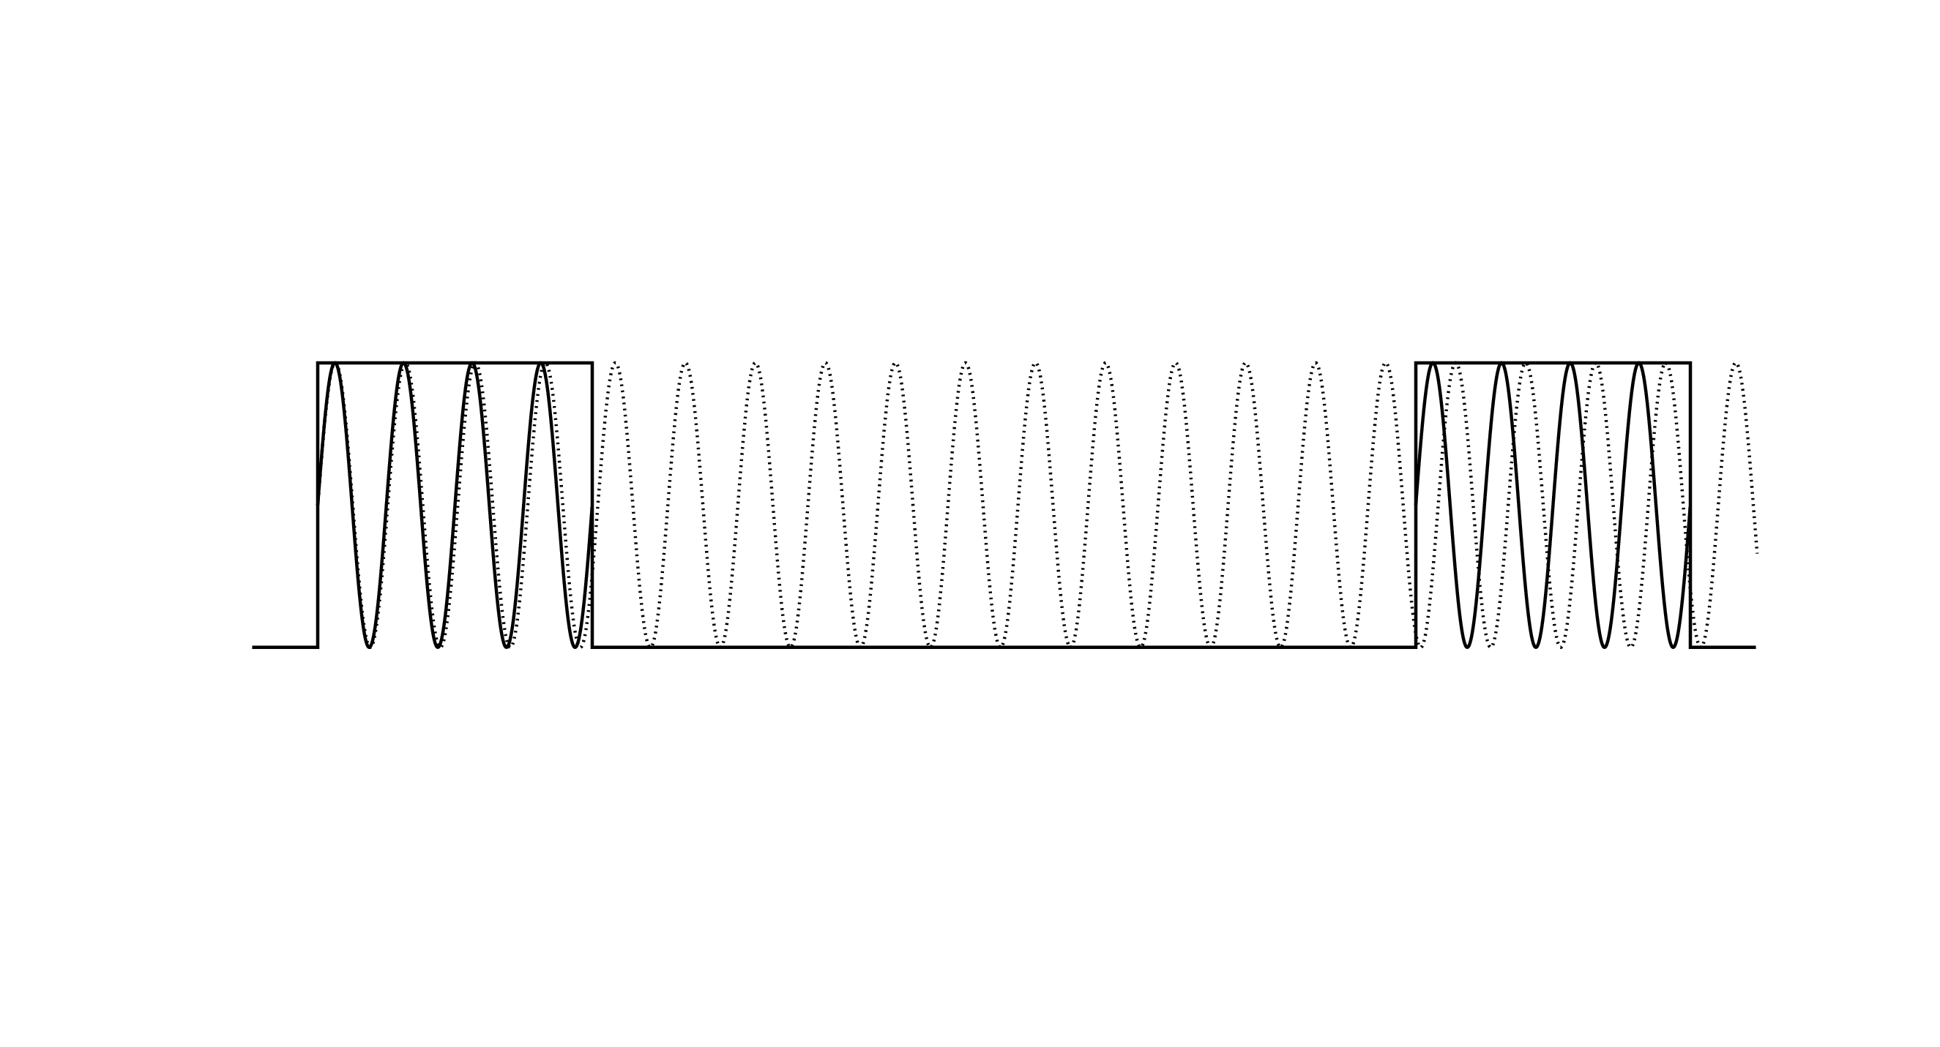
Read-out of the phase evolution
=
+
e^{iωt}
π/2-pulses
Quadrupole moment
From: PhD thesis, Riebe 2005, Innsbruck

Slide 15
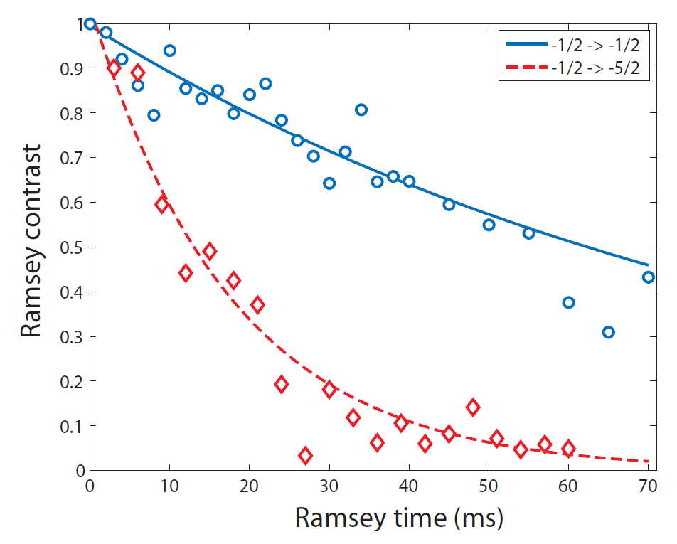

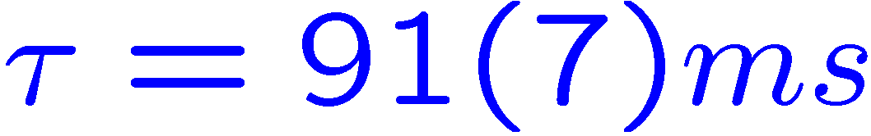

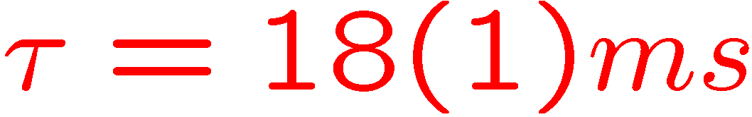
Phase coherence
Laser frequency noise: <10 Hz
Magnetic field noise: ~10 μG
5/2
3/2
1/2
-1/2
-3/2
-5/2
1/2
-1/2
Δ
M. Chwalla, T. Monz, P. Schindler, Innsbruck 2010

Slide 16
Time scales
10⁻⁶ s
Single qubit gates
10⁻⁵ s
Two qubit gates ‏
10⁻⁴ s
10⁻³ s
10⁻² s
10⁻¹ s
Single qubit coherence
10⁰ s
10¹ s
10² s
10³ s

Slide 17
Long lived qubits
Raman transitions:
Excited state
spontaneous decay
suppressed
qubit
Ground state

Slide 18
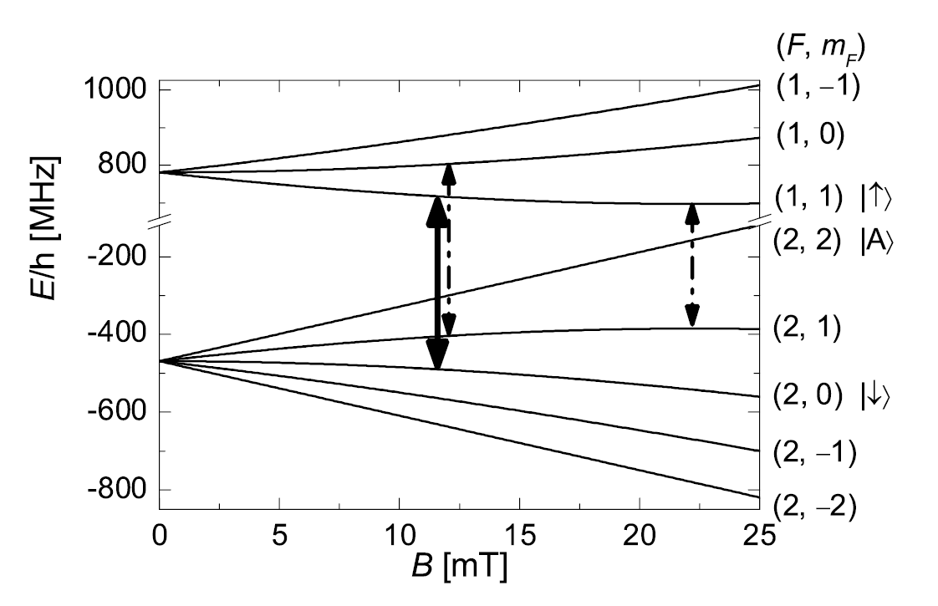
Long lived qubits
Raman transitions:
Excited state
Ground state

Slide 19
Long lived qubits
Be⁺ ion

Slide 20
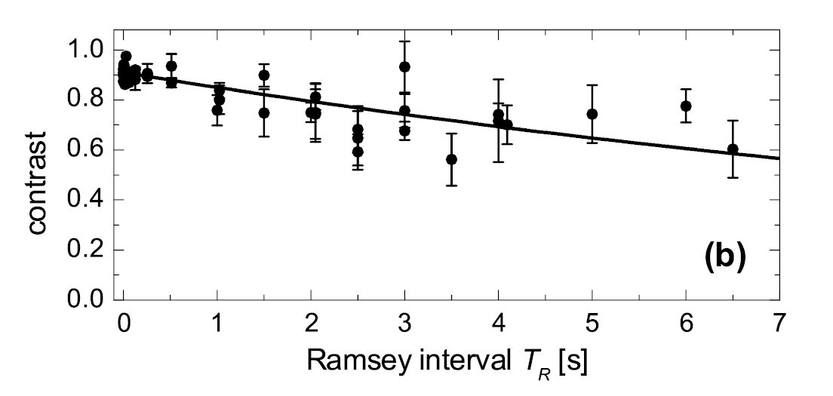
Long lived qubits
From: C. Langer et al., PRL 95, 060502 (2005), NIST

Slide 21
Time scales
10⁻⁶ s
Single qubit gates
10⁻⁵ s
Two qubit gates ‏
10⁻⁴ s
10⁻³ s
10⁻² s
10⁻¹ s
Single qubit coherence
10⁰ s
Single qubit coherence magnetic field insensitive
10¹ s
10² s
10³ s

Slide 22
Anything that can go wrong, will go wrong.
- Qubits decohere
- spontaneous emission
- magnetic field fluctuations
- laser frequency fluctuations
- Initialization and read-out errors
- Control errors
- frequency/phase errors of the control field
- calibration errors
- laser intensity noise
- unwanted side effects (off-resonant excitations)
See: http://en.wikipedia.org/wiki/Murphy's_law

Slide 23

Qubit initialization
Algorithm consists of:
  Initialization
  Computation
  - single-qubit gates
  - two-qubit gates
  Read-out
P_{1/2}
σ⁺
S_{1/2}
Pumping limited by
  polarization
  beam-field alignment
View port

Slide 24
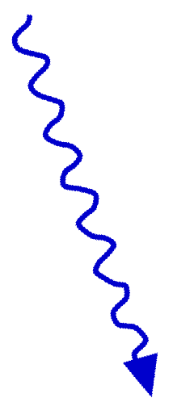
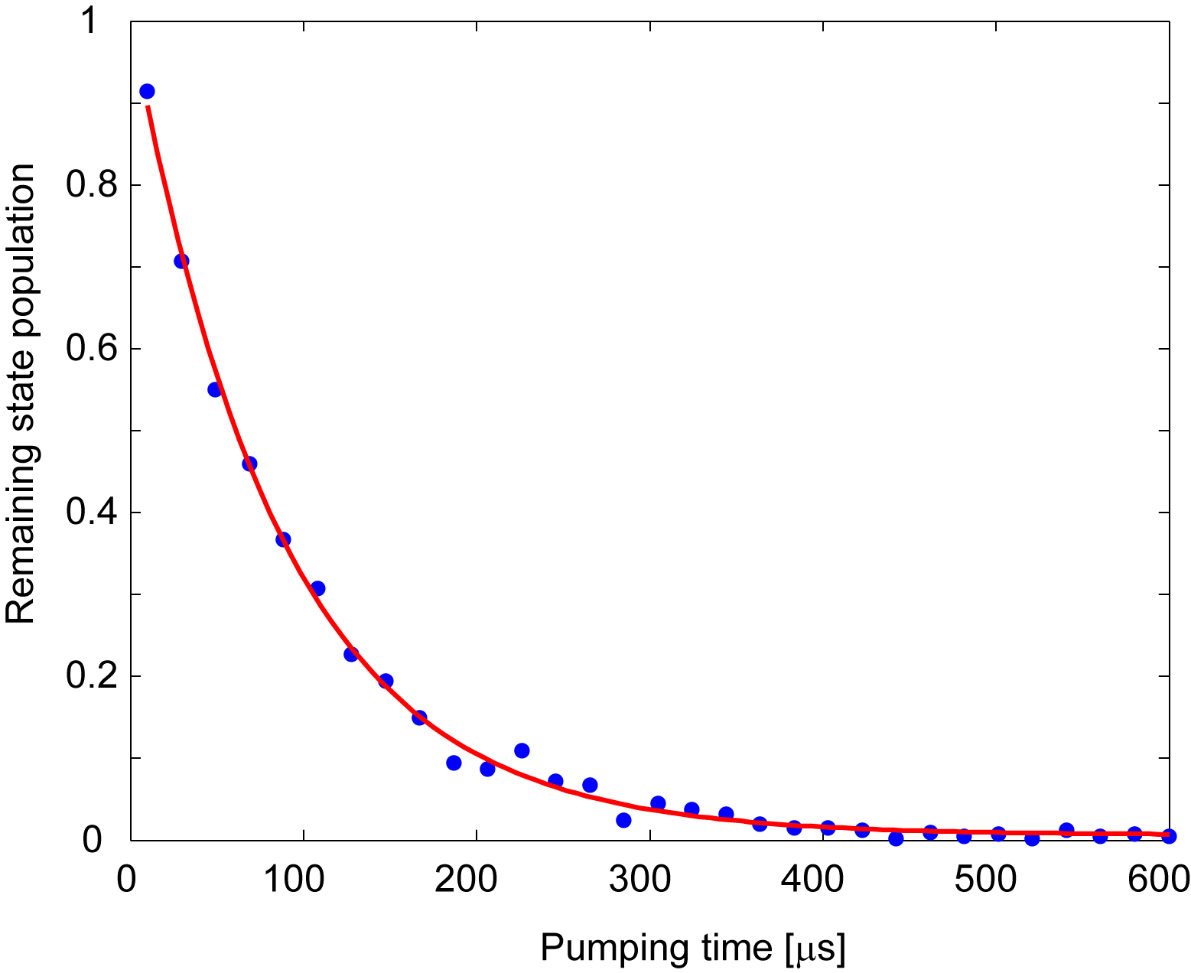
Qubit initialization
Better fidelities can be reached with frequency selectivity.
P_{3/2}
D_{5/2}
Qubit initialization: >0.999
S_{1/2}
Remaining population
Pumping time (μs)

Slide 25
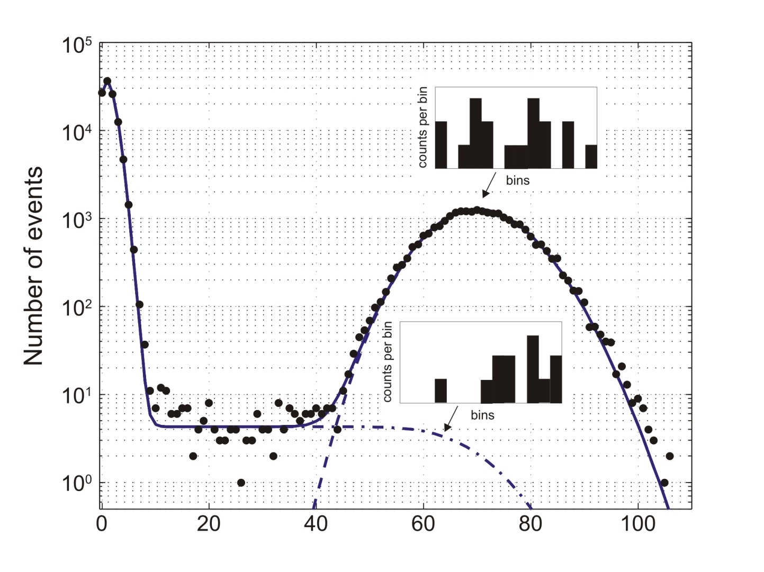
Qubit read out
One ion detection histogram
(200 μs collection time, 99% fidelity)
for Bayesian analysis
collect in time bins of 10 µs
detection threshold
detection by maximum likelihood method reduces error due to spontanous decay
Number of detected photons (counts)
high-fidelity readout: A. H. Myerson et al. (Oxford), Phys. Rev. Lett. 100, 200502 (2008)

Slide 26
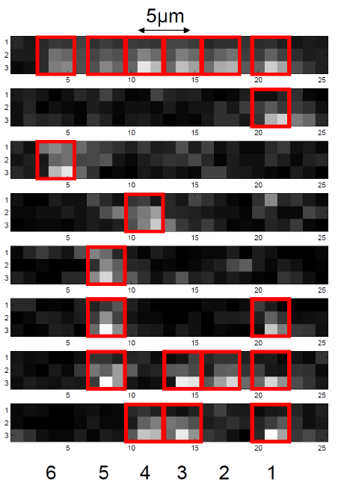
Qubit read-out
Infidelities:
  Camera: 1% @ 5 ms
  PMT: <1% @ 200 μs
Further improvements possible:
- Adaptive read-out
( Myerson, PRL 100, 200402 (2008 ))
- CNOT
( Schätz, et al., PRL 94, 010501 (2005) )
- Repeated mapping
( Hume et al., PRL 99, 120502 (2007) )

Slide 27
Anything that can go wrong, will go wrong.
- Qubits decohere
- spontaneous emission
- magnetic field fluctuations
- laser frequency fluctuations
- Initialization and read-out errors
- Control errors
- frequency/phase errors of the control field
- calibration errors
- laser intensity noise
- unwanted side effects (off-resonant excitations)
See: http://en.wikipedia.org/wiki/Murphy's_law

Slide 28
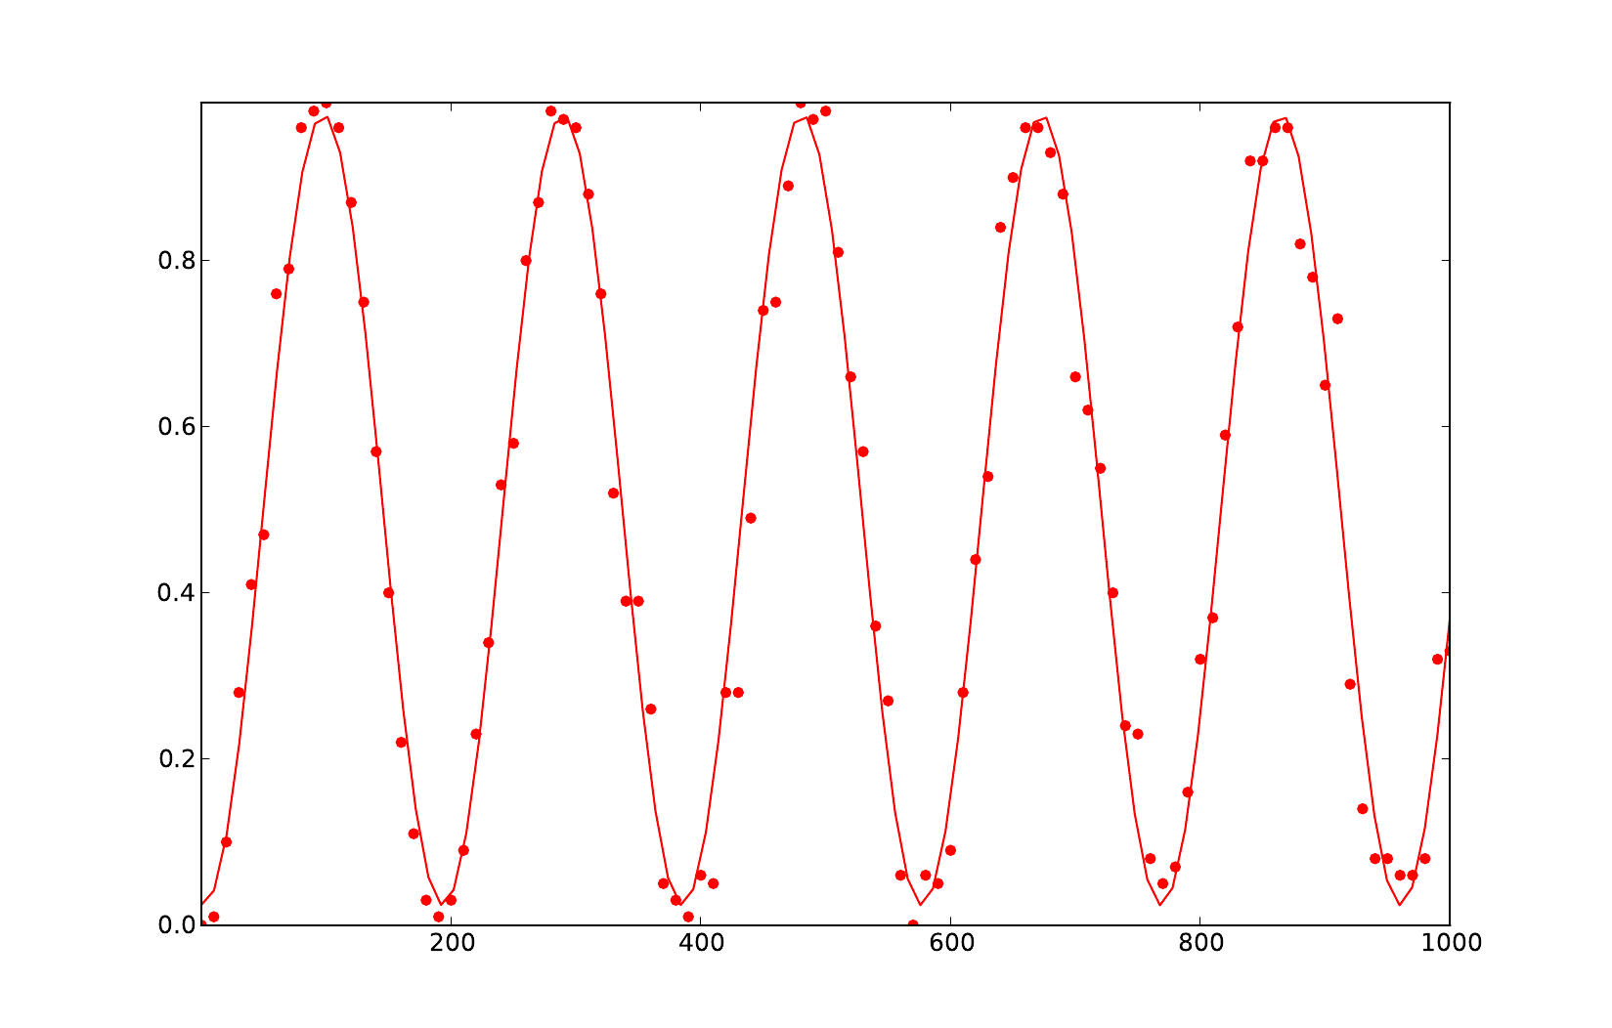
Single qubit operations
Excitation
Time (μs)
=> Laser intensity noise is about 1.5%

Slide 29
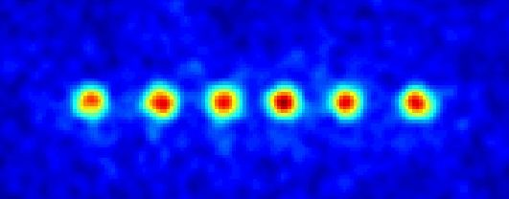
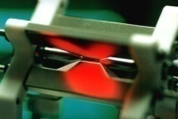
Adressing single qubits
coherent
manipulation
of qubits
Paul trap
0.8
0.7
electrooptic
deflector
0.6
Excitation
0.5
0.4
0.3
0.2
0.1
0
-10
-8
-6
-4
-2
0
2
4
6
8
10
Deflector Voltage (V)‏
Dichroitic
beamsplitter
- inter ion distance: ~ 4 µm
- addressing waist: ~ 2 µm
< 0.1% intensity on neighbouring ions
Fluorescence
detection
CCD
Notes:
The ions can be addressed individually on the qubit transition with an EO deflector which can quickly move the focus of the 729 light from one ion to another, using the same optical path as the fluorescence detection via the CCD camera.
How well the addressing works is shown here: The graph shows the excitation of the indiviual ions as the deflector is scanned across the crystal.

Slide 30
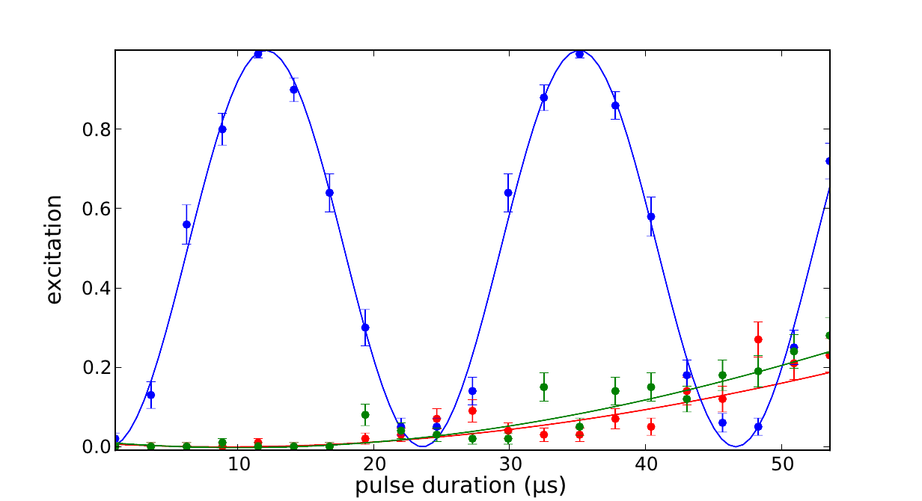
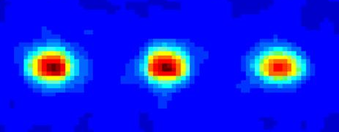
Adressing single qubits
Correlated operational errors can be taken care of
Passive cross talk < 1 Hz
Drive on Resonance - 8% unwanted rotation
Use AC stark shift - addressing error < 1%
Innsbruck, 2010

Slide 31
Mølmer - Sørensen gate
K. Mølmer, A. Sørensen,
Phys. Rev. Lett. 82, 1971 (1999)
C. A. Sackett et al.,
Nature 404, 256 (2000)

Slide 32

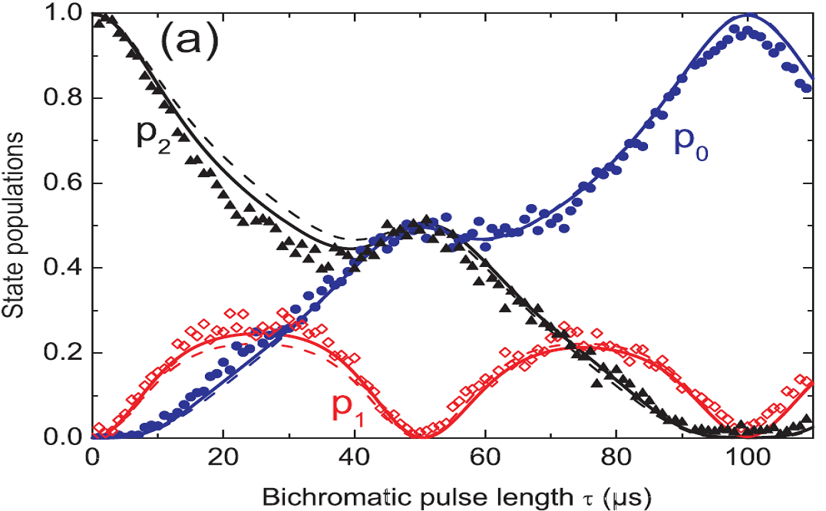

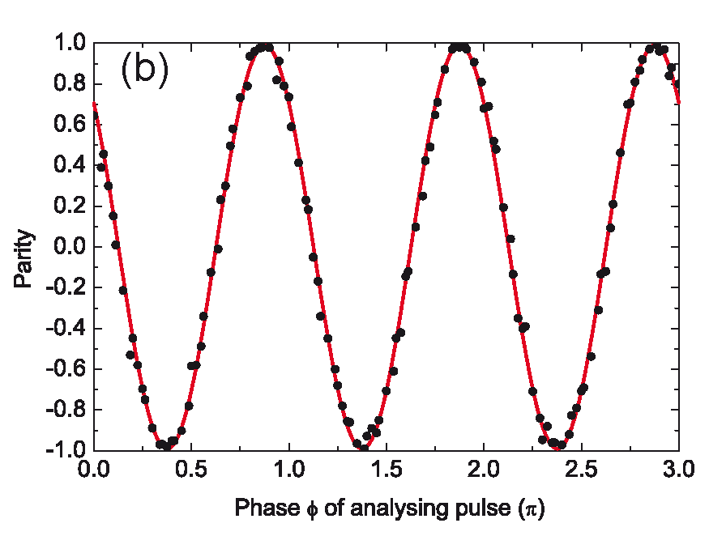
Mølmer - Sørensen gate
entangled ?
measure entanglement
via parity oscillations
gate duration 50 μs

Slide 33
Multiple gates
Infidelity:
  detection and initialization enter only once
  qubit dephasing
  trap frequency stability
maximally entangled states

Slide 34
Multiple gates
Fidelityafter 20 operations corresponds
to single-gate fidelity of 98.9%

Slide 35
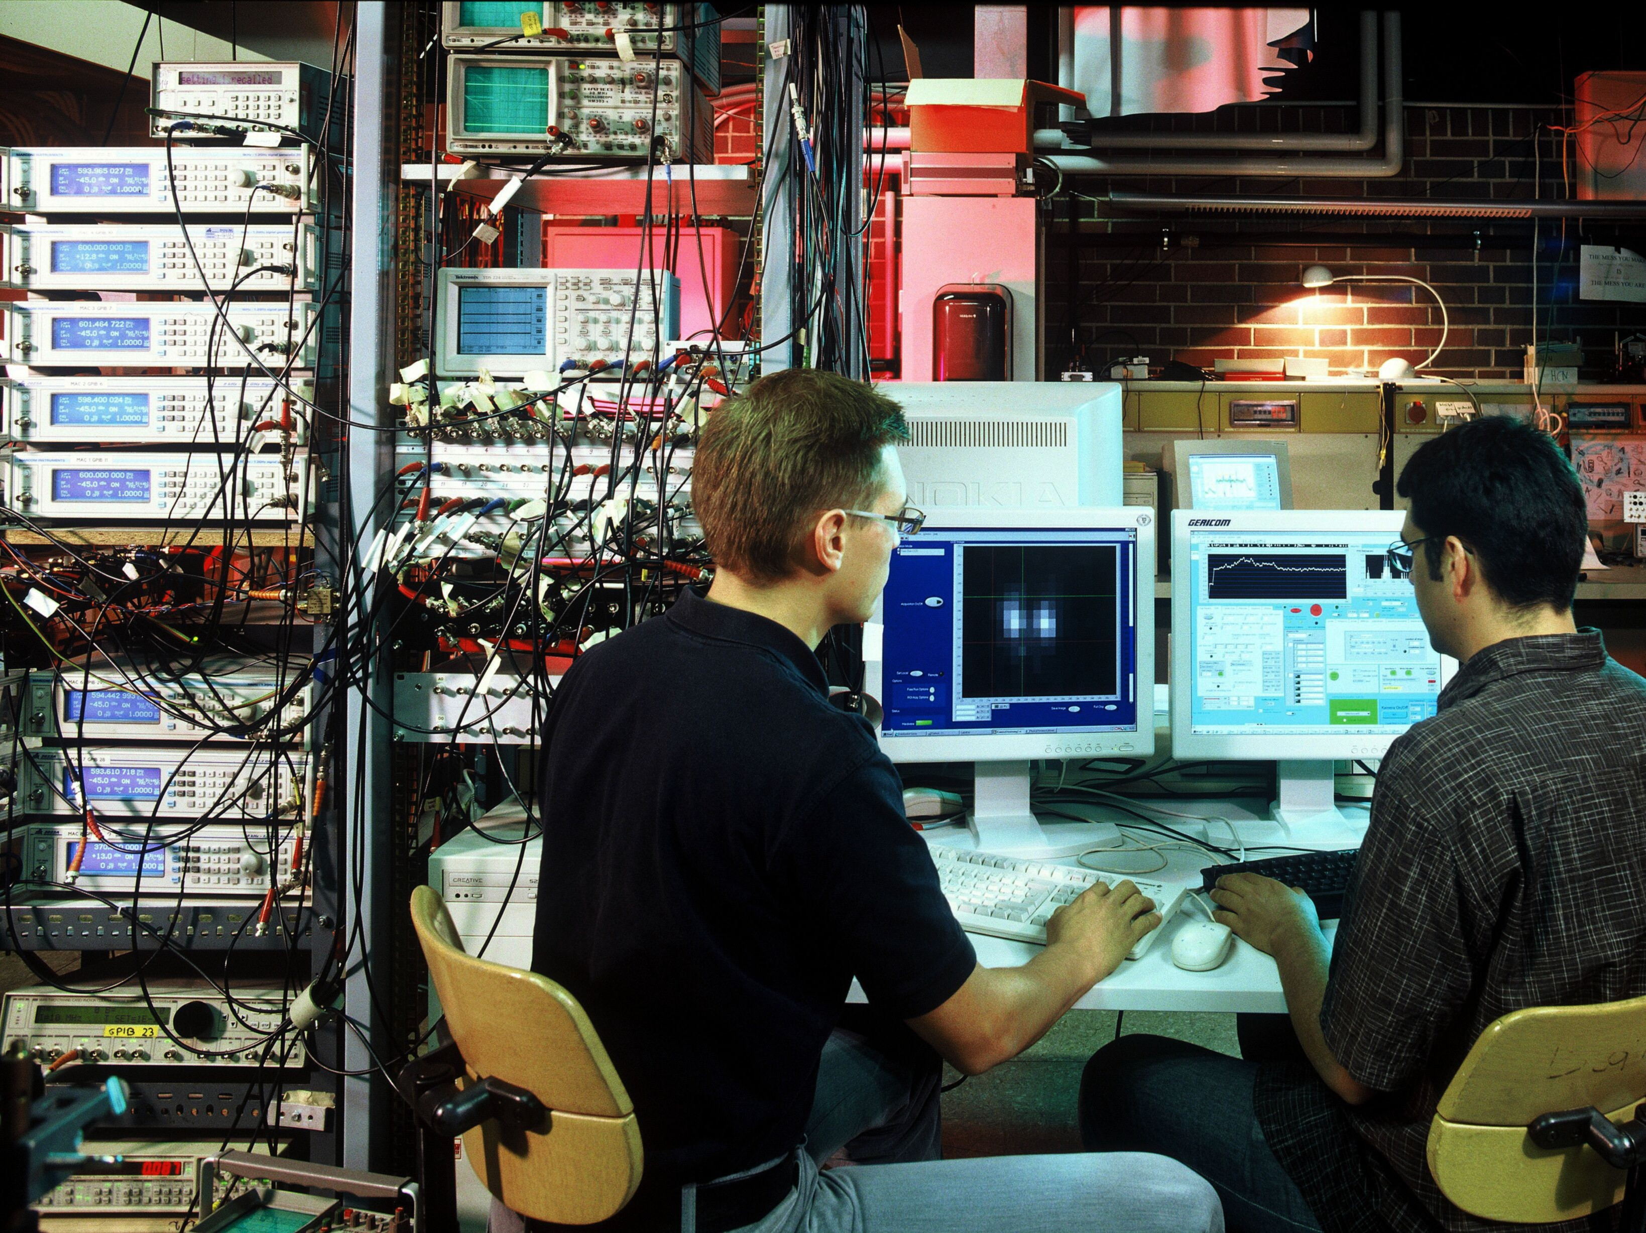
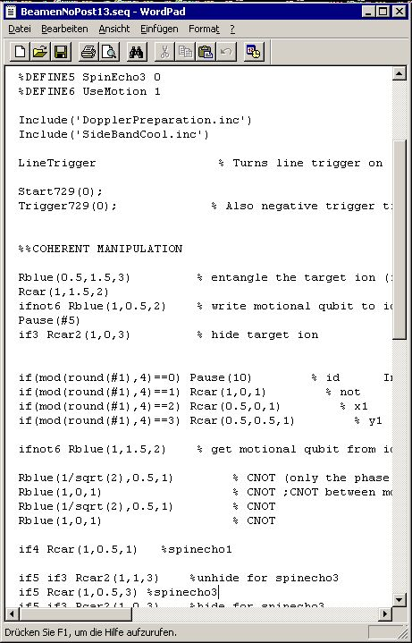

Slide 36
Quantum error correction

Slide 37
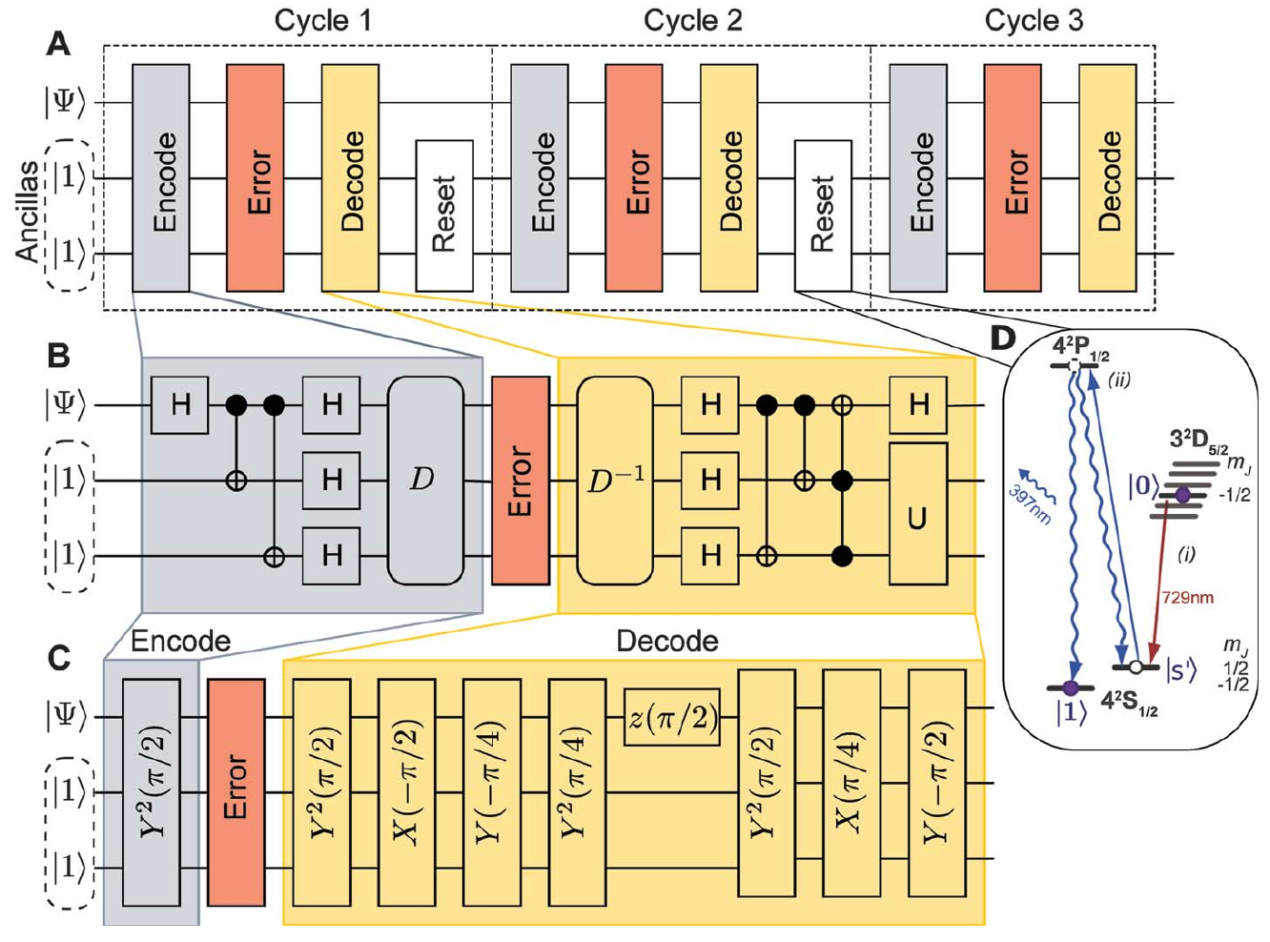
Error correction implementation

Slide 38
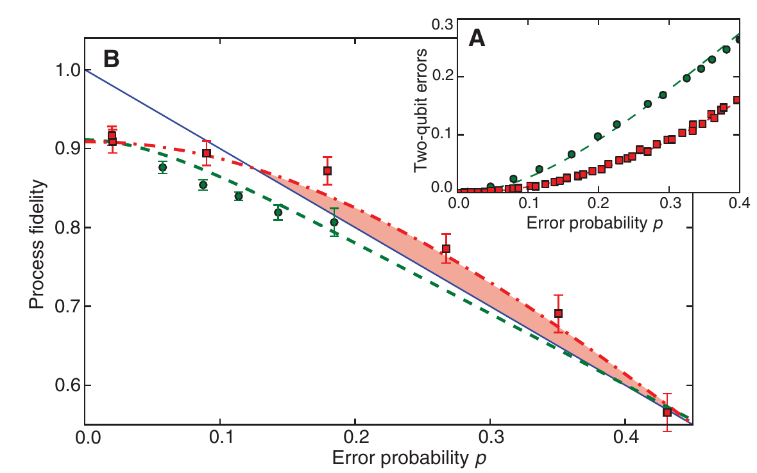
Error correction implementation
Repeatable quantum error correction:
  P. Schindler et al, Science 332, 1059 (2011)

Slide 39
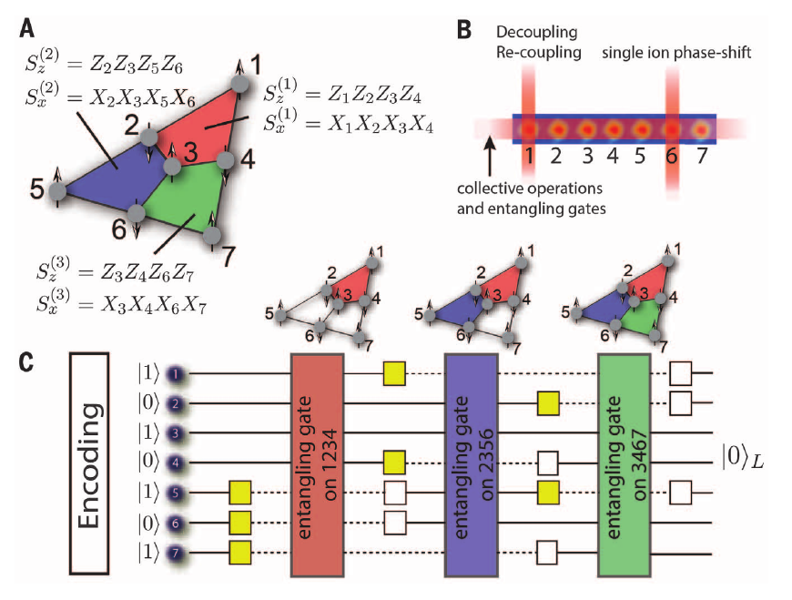
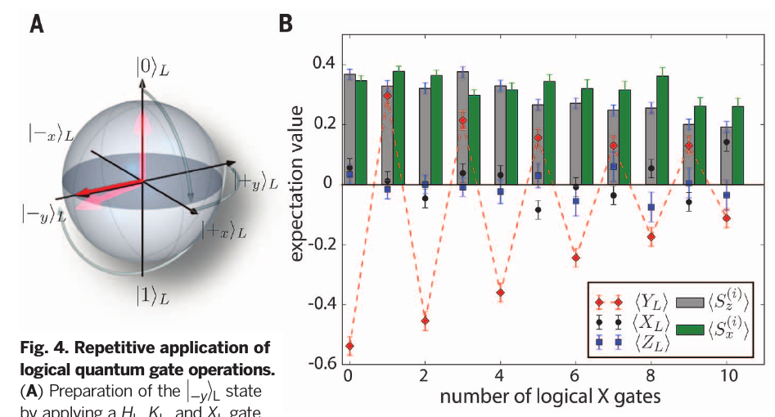
Operating on a topologically corrected qubit
Single qubit operations
Fully protected qubit
D. Nigg et al., Science 345, 302 (2014)

Slide 40
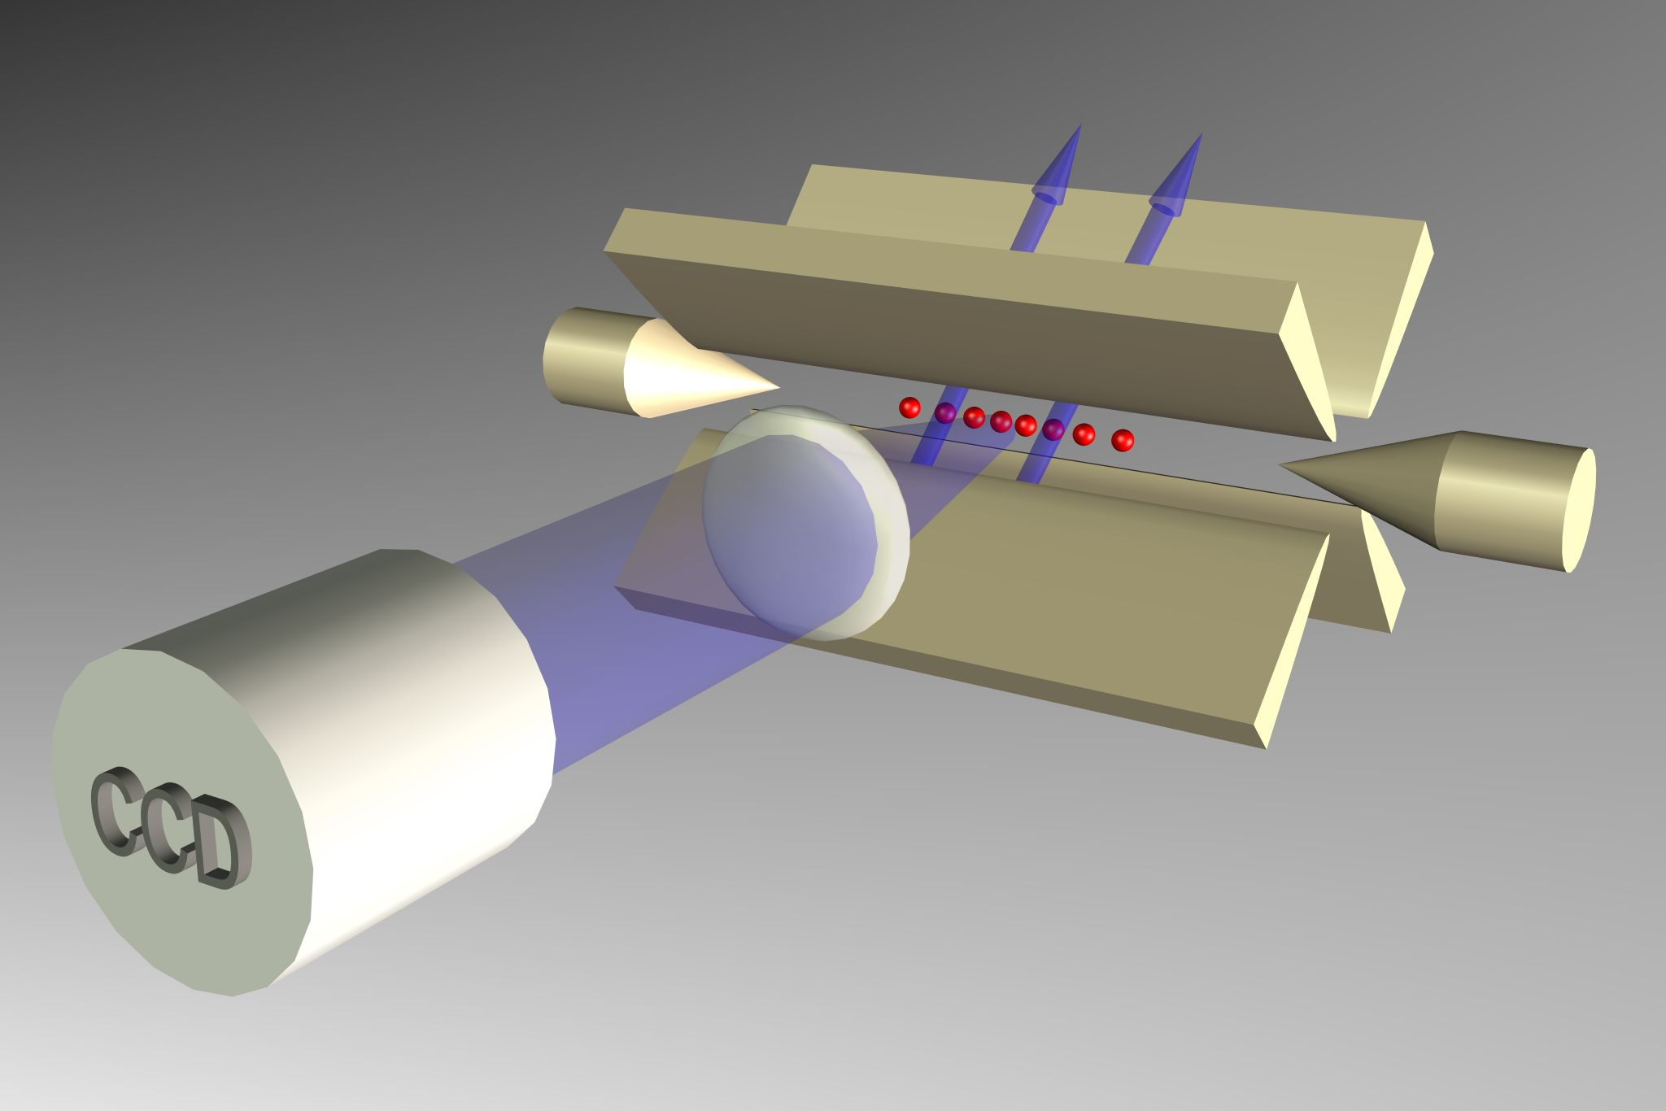
Anticipated requirements for QEC
 | Actual | Required
Spontaneous decay | 1.2 s | 1 s
Magnetic field fluctuations (slow noise) | 10 μG | 1 μG
Laser frequency (slow noise) | 10 Hz | 1 Hz
Laser intensity fluctuations | 1.5 % | 0.01 %
Cross talk | 0.1 % / qubit | 0.01 % / qubit
Initialization error | 0.3 % / qubit | 0.01 % / qubit
Read-out | 0.5 % / qubit | 0.01 % / qubit
Heating rate | 3 quanta / s | 10 quanta / s
Secular frequency stability in planar trap | ~100 Hz | 10 Hz

Slide 41
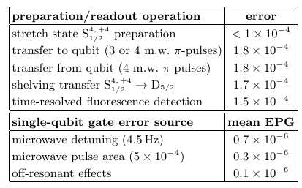
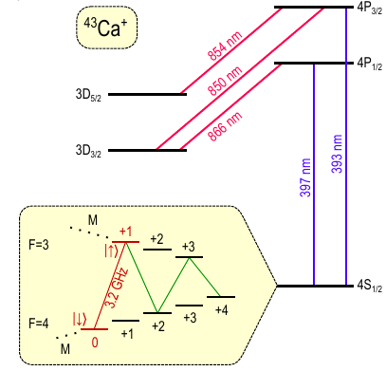
High-fidelity gates
Harty et al., arxiv.org:1403.1524 [quant-ph]

Slide 42
Mølmer - Sørensen gate

Slide 43
High-fidelity gates
spontaneous
emission

Slide 44
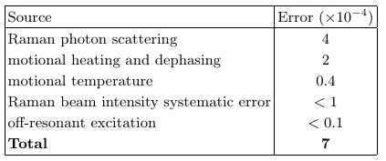
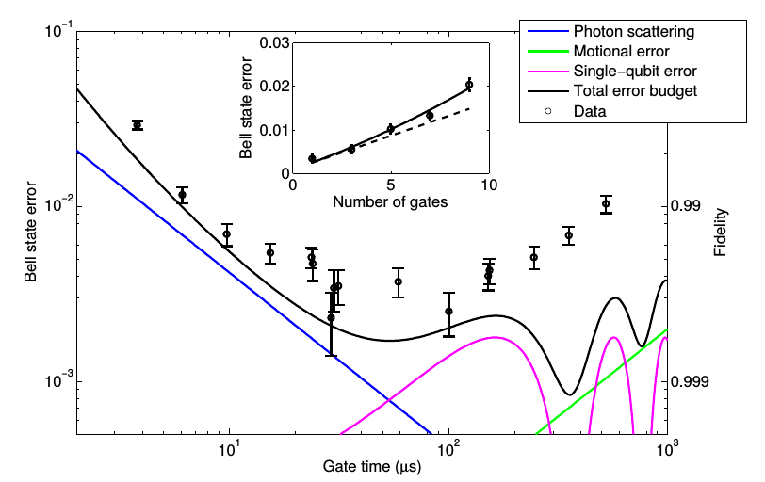
High-fidelity gates
Ballance et al., arxiv.org:1406.5473 [quant-ph]

Slide 45
Anticipated requirements for QEC
Harty et al., arxiv.:1403.1524
Ballance et al., arxiv.org:1406.5473

Slide 46
Quantum error correction

Slide 47
Error correction implementation
Repeatable quantum error correction:
  P. Schindler et al, Science 332, 1059 (2011)

Slide 48
Plan
Lecture #1: Introduction
- Paul traps
- Laser ion-interaction
Lecture #2: Quantum computing
- Quantum gates
- Quantum state tomography
Lecture #3: Decoherence
- Qubit decoherence
- Scaling
Lecture #4: Quantum simulation/emulation
- Scaling and anomalous heating
- Quantum simulation
Lecture #5: Applications
- Atomic clocks, quadrupole shifts
- Michelson-Morley experiment

Slide 49
The DiVincenczo criteria for quantum computing
Scalable physical system, well characterized qubits
Ability to initialize the state of the qubits with sufficient fidelity
Long relevant coherence times, much longer than gate operation time
“Universal” set of quantum gates with sufficient fidelity
Qubit-specific measurement capability with sufficient fidelity

Slide 50
The DiVincenczo criteria for quantum computing
Scalable physical system, well characterized qubits
Ability to initialize the state of the qubits with sufficient fidelity
Long relevant coherence times, much longer than gate operation time
“Universal” set of quantum gates with sufficient fidelity
Qubit-specific measurement capability with sufficient fidelity

Slide 51

The hardware

Slide 52

The hardware
Quantum computer, 2005
ENIAC, 1950

Slide 53

The hardware
Quantum computer, 2009
ENIAC, 1950

Slide 54

Scaling this approach ?

Slide 55



Scaling ion trap quantum computers
D. Leibfried, D. Wineland et al., NIST

Slide 56
Scaling ion trap quantum computers
All ingredients for this approach have been shown to work together!
=> Home et al. , "Complete methods set for scalable ion trap quantum information processing," Science 325, 1227 (2009).
D. Leibfried, D. Wineland et al., NIST

Slide 57

Scaling ion trap quantum computers
D. Leibfried, D. Wineland et al., NIST

Slide 58
Scaling ion trap quantum computers
© D. Leibfried

Slide 59
Scaling ion trap quantum computers

Slide 60
Scaling ion trap quantum computers

Slide 61
Scaling ion trap quantum computers

Slide 62

Scaling ion trap quantum computers
„Architecture for a large-scale ion-trap quantum computer“,
D. Kielpinski et al., Nature 417, 709 (2002).

Slide 63



Coherent transport through junctions
Blakestad, et al., arXiv:0901.0533v1

Slide 64

”Classic” linear trap
DC
DC
RF
RF
DC

Slide 65
Surface traps
DC
DC
RF
RF
DC

Slide 66

Microfabricated surface traps
DC
RF
DC
RF
DC

Slide 67



Microfabricated surface traps
Sandia National Labs
Georgia Tech
Research Institute
NIST, Amini et al., NJP 2010

Slide 68


Ion trap quantum computing
Need to split and merge ion strings fast for
multi-qubit gates.
Wineland (1998)
Speed ~ 1/d:
d
Notes:
This ion crystal then develops normal modes of collective motion with center-of-mass frequencies on the order of 1 MHz. Here we see a parametrically excited mode

Slide 69
Mølmer - Sørensen gate

Slide 70
Motional decoherence
...
d ~ 30 100 μm

Slide 71
Motional decoherence

Slide 72

Motional decoherence
From: Labaziewicz et al., PRL 100 (2008)

Slide 73

Excessive heating in ion traps
- Need to know what is causing it to deal with it
- Other technologies have similar problems:
scanning probe microscopy, Casimir force measurements,
free fall of charged particles, tests of general relativity
From: http://www.quantum.gatech.edu/heating_rate_plot.shtml
Scaled electric field noise ωSE ( (V/m)² )
1 Ohm - Johnson noise
Fault tolerant “threshold”
Ion-electrode distance (μm)

Slide 74
What is causing “the” anomalous heating ?
- fluctuating patch potentials, ad-atom diffusion (Wineland 1998)
- independently fluctuating dipoles (Daniilidis 2010)
- fluctuating strength of dipoles (Safavi-Naini 2011, 2013)

Slide 75


Surface science with ions
Ca⁺
Auger-unit (loan from the Crommie lab)

Slide 76

Auger spectra of a Cu-Al surface

Slide 77

Heating rates
Pre-treatment
Post-treatment
Johnson noise limit

Slide 78

Findings
Structure of surface and/or
contaminants matter
Surface treatment
1
Oxygen
Relative peak height
- Heating rate can be low despite
full oxidation
- Heating rate low despite
50% of original Carbon level
Carbon
0
Time

Slide 79

Excessive heating in ion traps
From: http://www.quantum.gatech.edu/heating_rate_plot.shtml
Scaled electric field noise ωSE ( (V/m)² )
NIST,
Hite et al.
This work
1 Ohm - Johnson noise
Fault tolerant “threshold”
Ion-electrode distance (μm)

Slide 80
Status
Quantum memory
~10³ longer than gates,
Operational errors
<10⁻² infidelity
Noise from planar traps
300 K: ~ 5000 quanta / s
4 K: 5 quanta / s
Cross talk
10⁻³ / qubit, well understood, can be used to our advantage
Modelling of noise/crosstalk
predicts results of simple experiments

Slide 81
Status and goals
Quantum memory
~10³ longer than gates, need: 10⁴
Operational errors
<10⁻² infidelity need: 10⁻⁴
Noise from planar traps
300 K: ~ 500 quanta / s need: 10 quanta / s now 3 quanta / s
Cross talk
10⁻³ / qubit, well understood, can be used to our advantage
Modelling of noise/crosstalk
predicts results of simple experiments in progress

Slide 82
Status and goals
Quantum memory
~10³ longer than gates, need: 10⁴
Operational errors
<10⁻² infidelity need: 10⁻⁴
Noise from planar traps
300 K: ~ 500 quanta / s need: 10 quanta / s now 3 quanta / s
Cross talk
10⁻³ / qubit, well understood, can be used to our advantage
Modelling of noise/crosstalk
predicts results of simple experiments in progress
Technical:
  Laser intensity stability
  Magnetic field stability
  Voltage stability
  Master segmented planar traps
  Cross talk can be eliminated
  with NMR techniques
Fundamental:
  Scaling and complexity
  Anomalous heating

Slide 83
Anticipated requirements for fault tolerant QIP
 | Actual | Required
Spontaneous decay | 1.2 s | 1 s
Magnetic field fluctuations (slow noise) | 10 μG | 1 μG
Laser frequency (slow noise) | 10 Hz | 1 Hz
Laser intensity fluctuations | 1.5 % | 0.01 %
Cross talk | 0.1 % / qubit | n.a.
Initialization error | 0.3 % / qubit | 0.01 % / qubit
Read-out | 0.5 % / qubit | 0.01 % / qubit
Heating rate | 3 quanta / s | 10 quanta / s
Secular frequency stability in planar trap | ~100 Hz | 10 Hz

Slide 84
Plan
Lecture #1: Introduction
- Paul traps
- Laser ion-interaction
Lecture #2: Quantum computing
- Quantum gates
- Quantum state tomography
Lecture #3: Decoherence
- Qubit decoherence
- Scaling
Lecture #4: Challenges and quantum simulation
- Scaling and anomalous heating
- Quantum simulation
Lecture #5: Applications
- Atomic clocks, quadrupole shifts
- Michelson-Morley experiment

Slide 85
Plan
Lecture #1: Introduction
- Paul traps
- Laser ion-interaction
Lecture #2: Quantum computing
- Quantum gates
- Quantum state tomography
Lecture #3: Decoherence
- Qubit decoherence
- Scaling
Lecture #4: Challenges and quantum simulation
- Scaling and anomalous heating
- Quantum simulation
Lecture #5: Applications
- Atomic clocks, quadrupole shifts
- Michelson-Morley experiment

