Slide 1
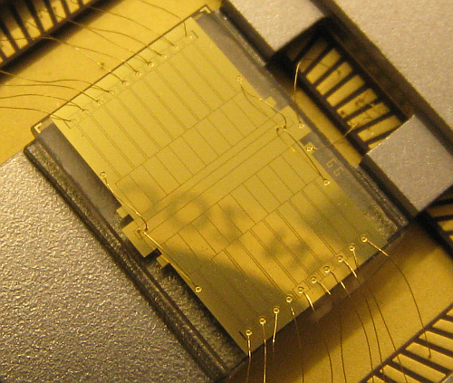
Quantum applications of ion trapping
Hartmut Häffner, UC Berkeley
1. Introduction to ion trapping
2. Quantum computing
3. Sources of decoherence
4. Scaling and quantum simulations
5. Quantum many-body physics
and precision measurements

Slide 2
Plan
Lecture #1: Introduction
- Paul traps
- Laser ion-interaction
Lecture #2: Quantum computing
- Quantum gates
- Quantum state tomography
Lecture #3: Decoherence
- Qubit decoherence
- Scaling
Lecture #4: Scaling and quantum simulation
- Scaling and anomalous heating
- Quantum simulation
Lecture #5: Applications
- Quantum many-body physics
- Precision measurements

Slide 3
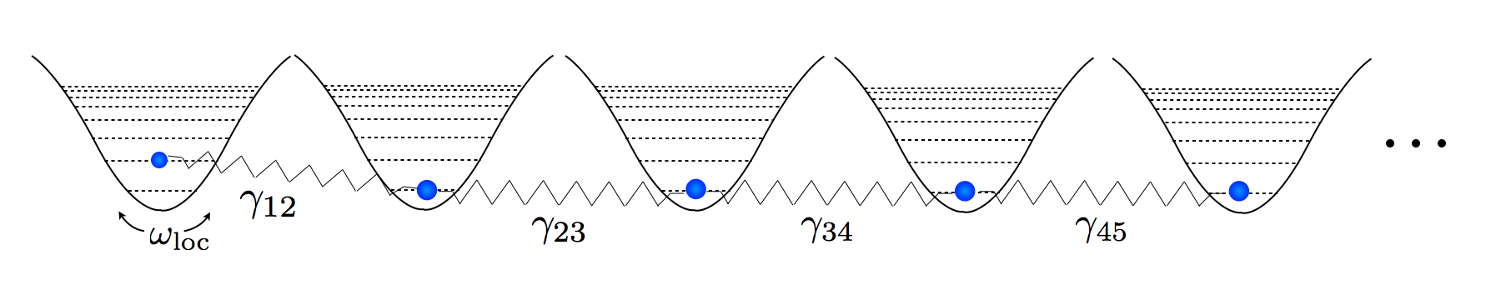
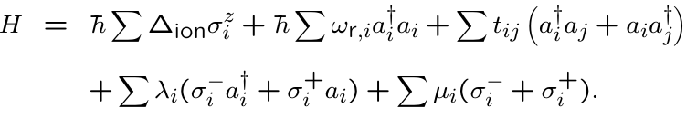
Many-body physics
Oscillator chain of ions

Slide 4
Many-body physics
Oscillator chain of ions
Coulomb interaction

Slide 5
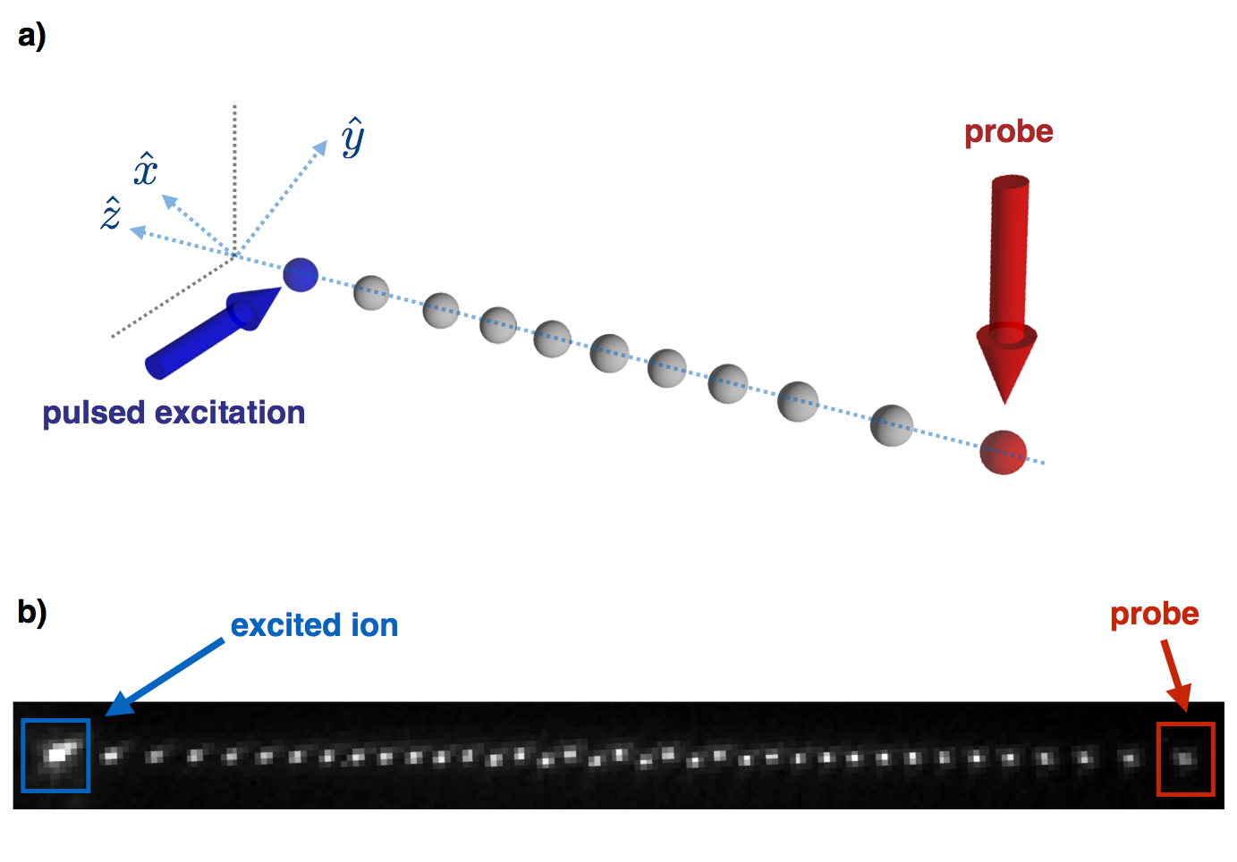
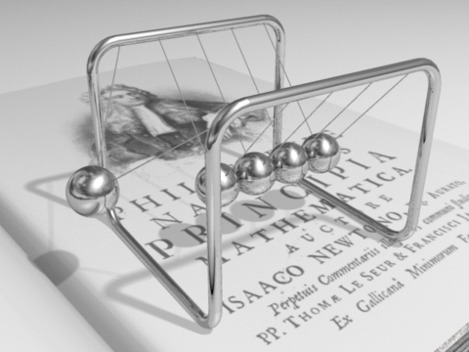



Energy Transport in Ion Chains
source: wiki
Excite locally
Let the system evolve
Read out locally

Slide 6
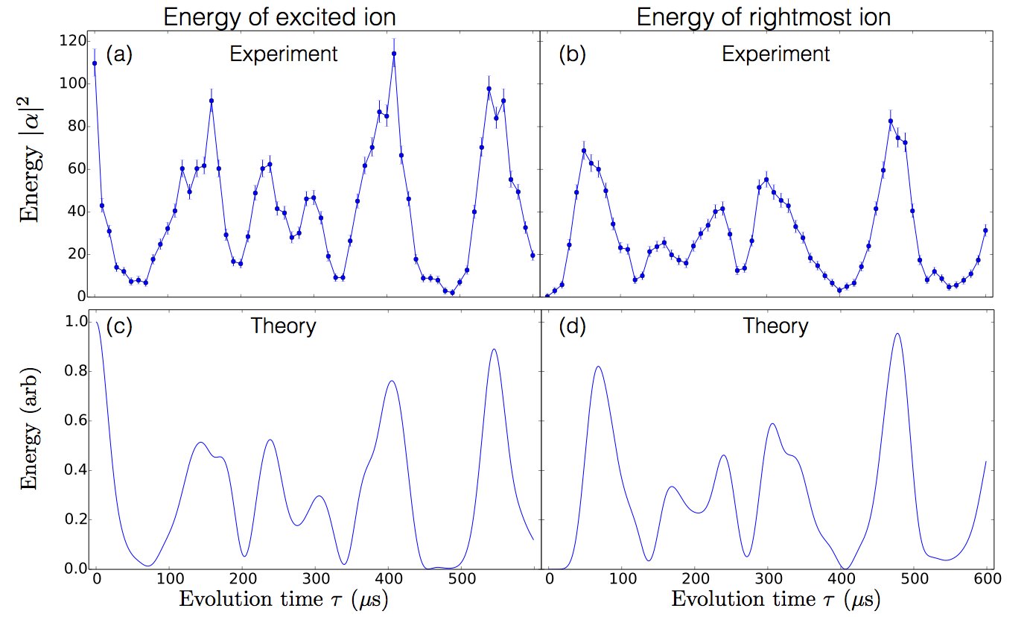
Theory vs Experiment for 5 ions

Slide 7
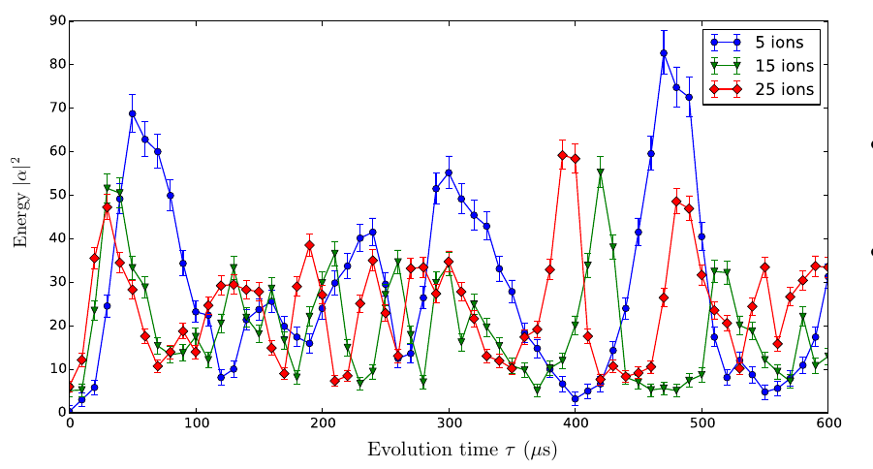
Ion number dependency
Transport speed through the chain increases with the ion number

Slide 8
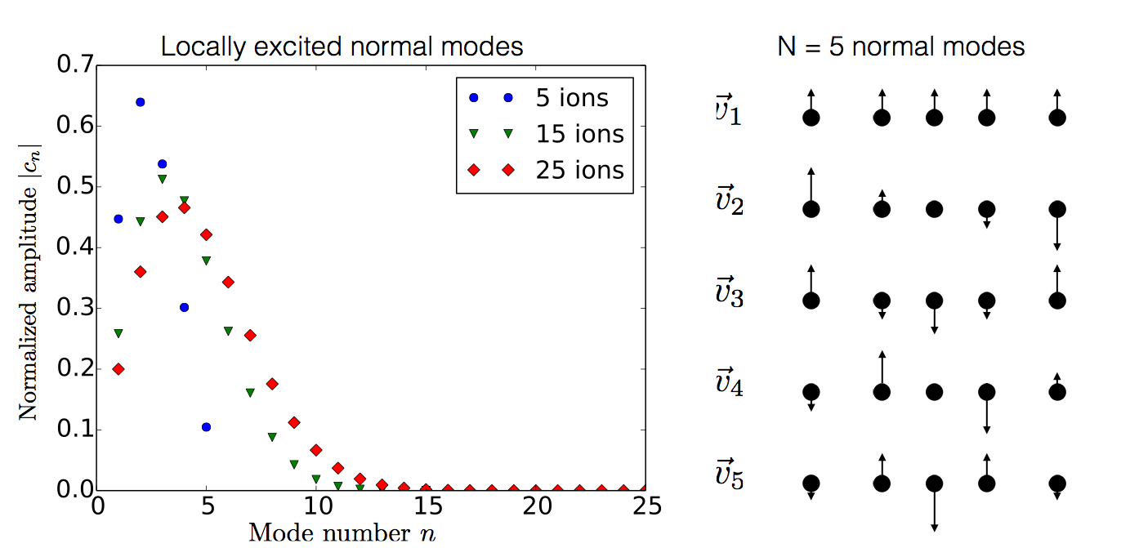
Normal Mode Decomposition
Key feature: all ions are in the same harmonic well

Slide 9
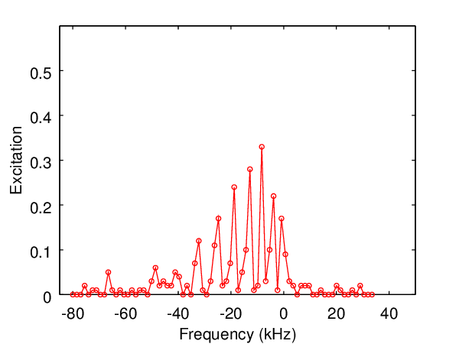
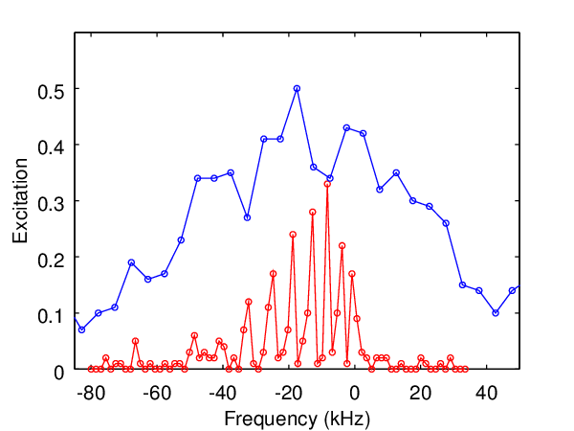
Energy Transport in Ion Chains
10 μs excitation
500 μs excitation

Slide 10
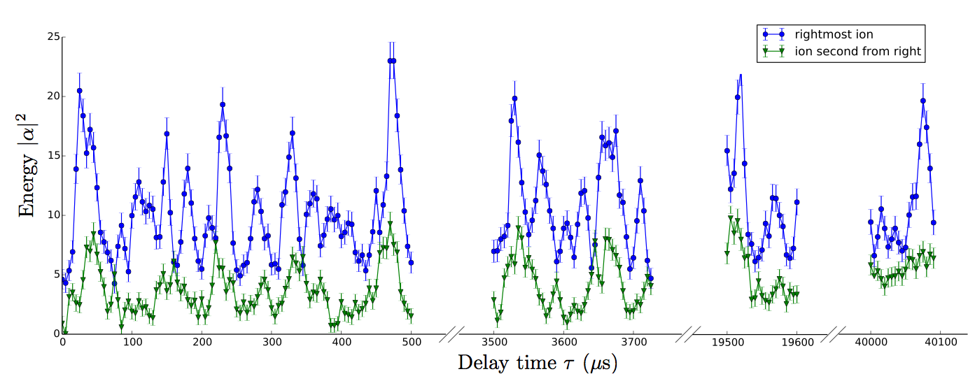
How closed is this (quantum) many-body system?
Dynamics go on for very long time
System well-isolated from the environment
Add non-linearities in a controlled manner
Ramm et al., NJP 16 063062 (2014)
Notes:
Each point repeated 500 times

Slide 11
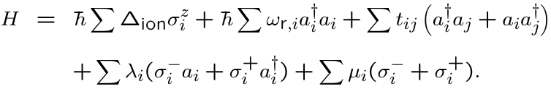
Extension to non-linear systems ?
Blue sideband
Single qubit rotations
How do quantum correlations propagate ?
Study dynamics and equilibration in a closed system
Spin-impurities in crystals, dissipation and decoherence, quantum phase transitions

Slide 12



Generating and detecting quantum correlations
wait
Notes:
Each point repeated 500 times

Slide 13
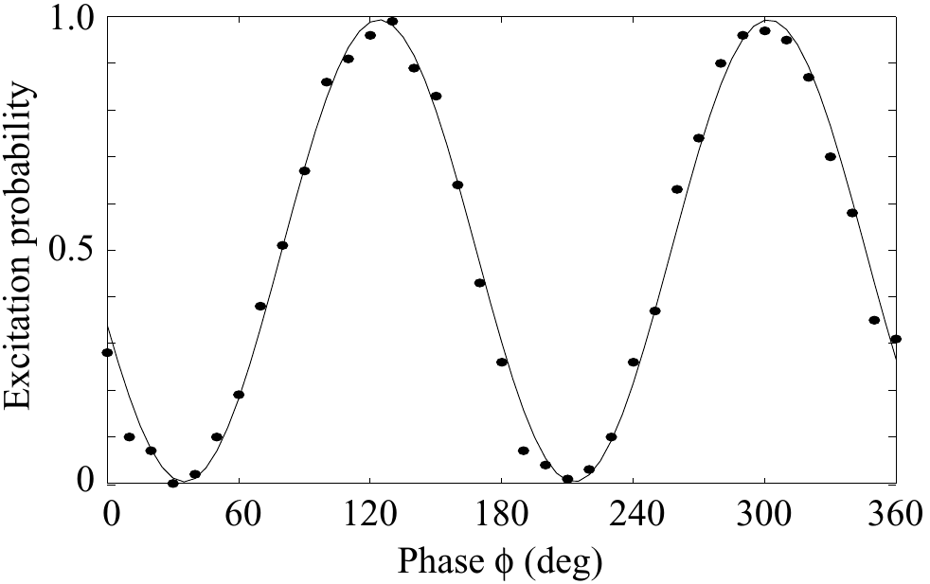
Generating and detecting quantum correlations
From: PhD thesis, Riebe 2005, Innsbruck
wait
Notes:
Each point repeated 500 times

Slide 14
Generating and detecting quantum correlations
From: PhD thesis, Riebe 2005, Innsbruck
wait
Phase contrast proves quantum correlations between
the electronic state and the (local) motion of the ion.
Local detection of quantum correlations:
M. Gessner et al., Nature Phys. 10, 105 (2014).
Notes:
Each point repeated 500 times

Slide 15
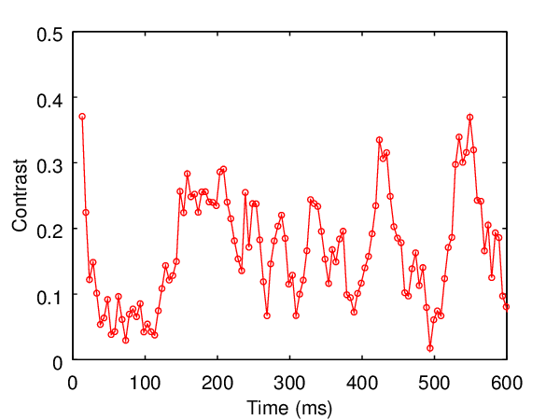
Dynamics of quantum correlations
Revivals of quantum correlations in a 35-ion chain
Time (μs)
Notes:
Each point repeated 500 times

Slide 16
Plan
Lecture #1: Introduction
- Paul traps
- Laser ion-interaction
Lecture #2: Quantum computing
- Quantum gates
- Quantum state tomography
Lecture #3: Decoherence
- Qubit decoherence
- Scaling
Lecture #4: Scaling and quantum simulation
- Scaling and anomalous heating
- Quantum simulation
Lecture #5: Applications
- Quantum many-body physics
- Precision measurements

Slide 17
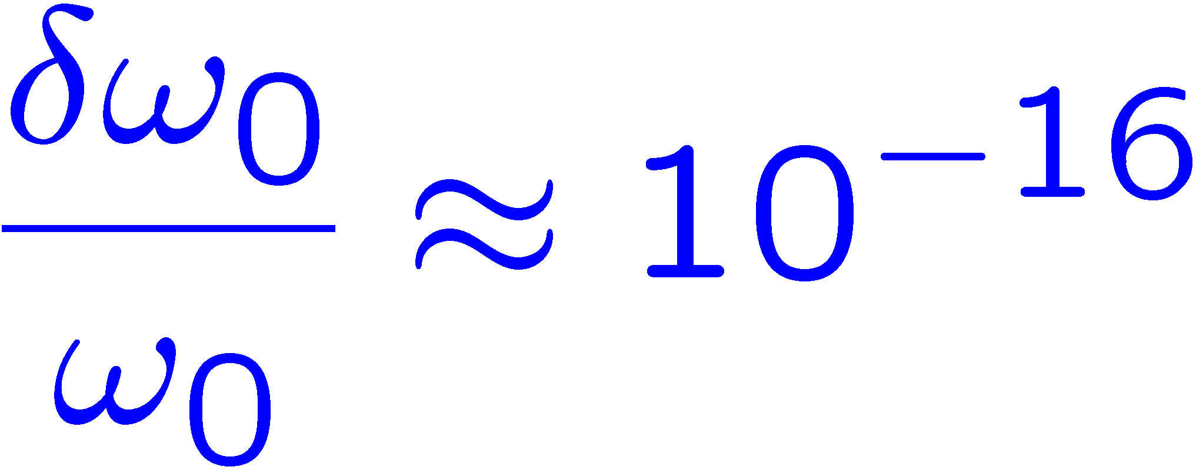
High resolution spectroscopy
Optical frequency
standards
Quantum information
processing
Clock ions: Sr⁺, Yb⁺, Hg⁺, Al⁺,…
perfect quantum control
entanglement
fundamental gates
Using entanglement to improve metrology
Improved S/N ratio
J. J. Bollinger et al, Phys. Rev. A 54, 4649 (1996)
Read out with quantum logic
P.O.Schmidt et al., Science 309, 749 (2005)
Spectroscopy with decoherence free subspaces
C. F. Roos et al., Nature 443, 316 (2006)

Slide 18
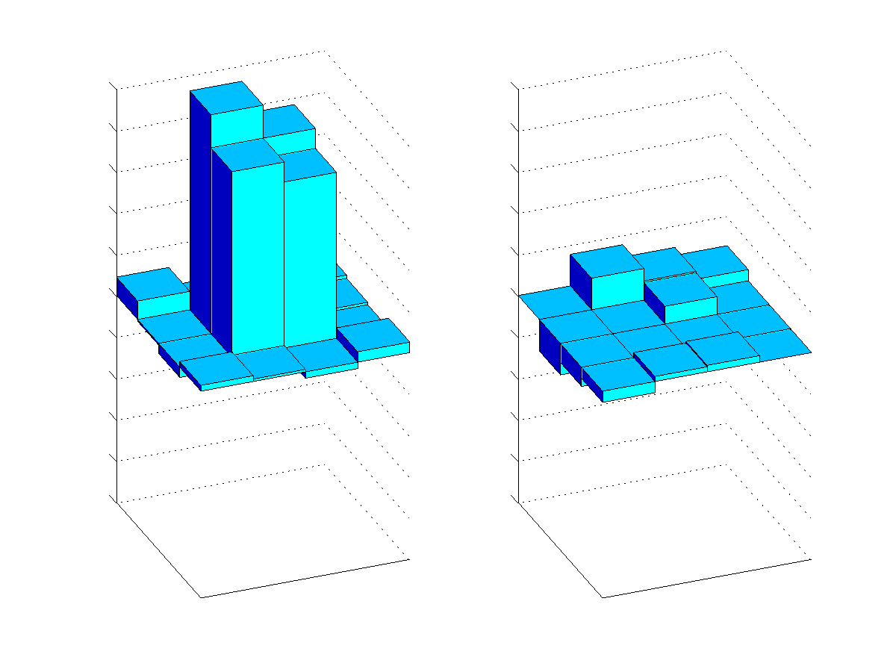
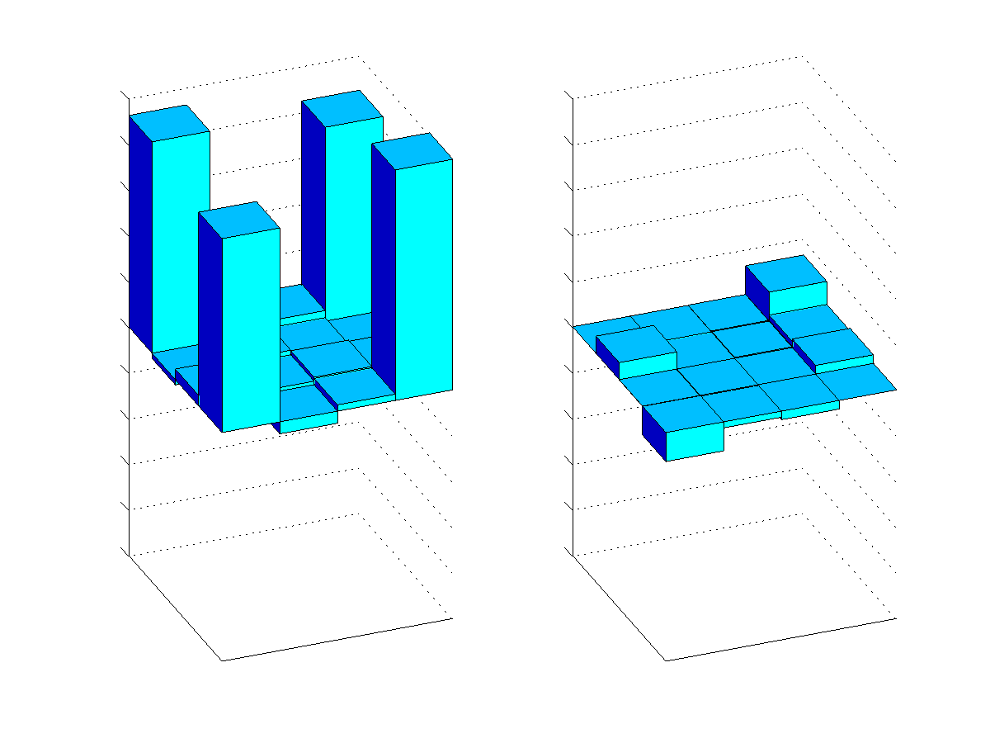
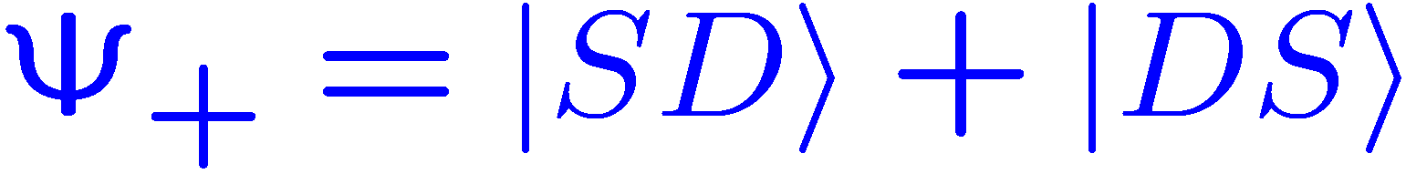
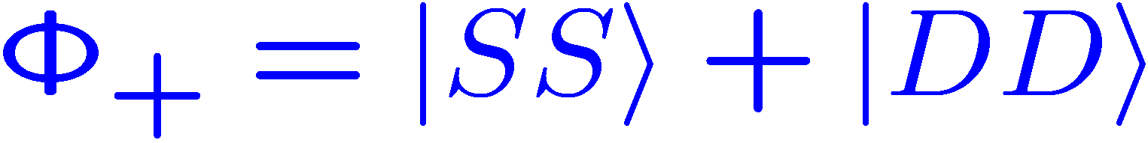

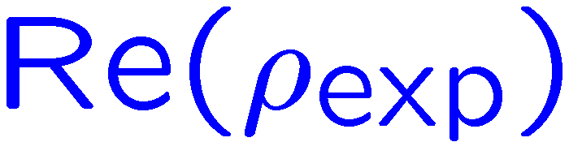

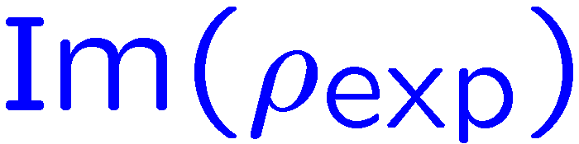
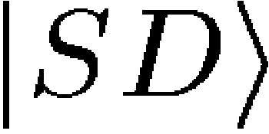
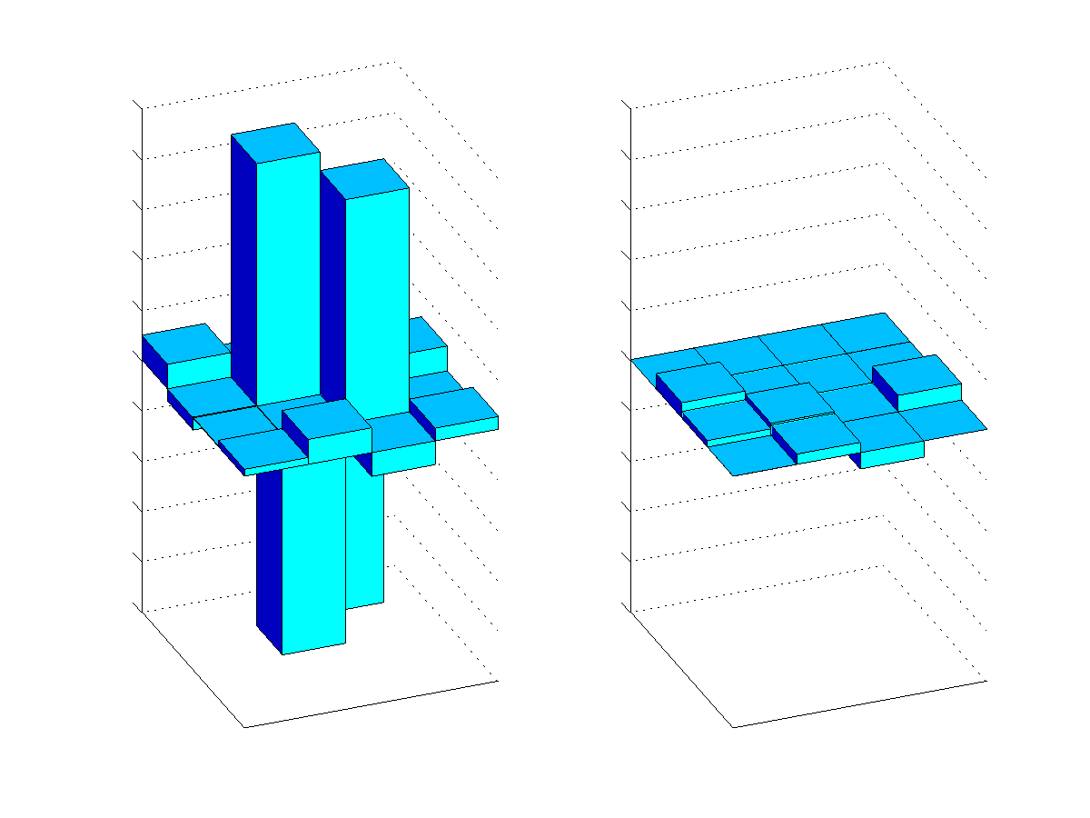
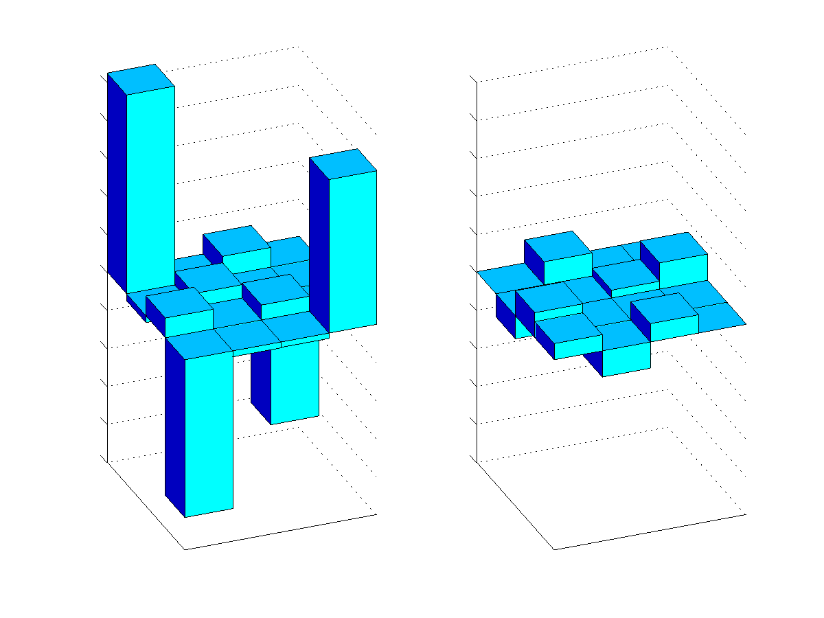


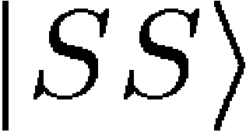
Taking advantage of correlated noise
long lived (~ 1000 ms)
short lived (~ ms)
SS
SD
SS
DS
SS
SD
DD
DD
DS
SD
DS
SS
DD
DD
DS
SD
Energy
Energy
SS
SS
SD
SD
DS
SS
DS
DD
DD
DS
SD
DD
SD
SS
DD
DS
(see e.g. Kielpinski et al.,Science 291, 1013-1015 (2001)

Slide 19
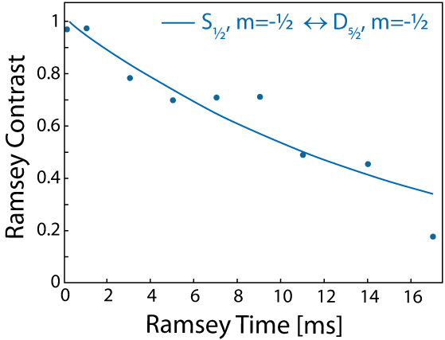
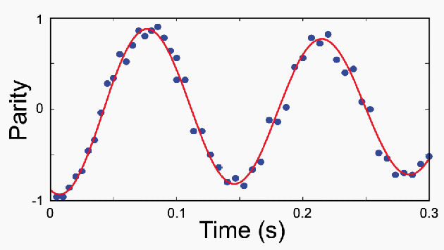

Decoherence-free subspaces
Physical Qubit
Ramsey Experiment
Logical Qubit
Parity Oscillations
= 16 ms
= 1050 ms
C.F. Roos et al., PRL 92, 220402 (2004).

Slide 20
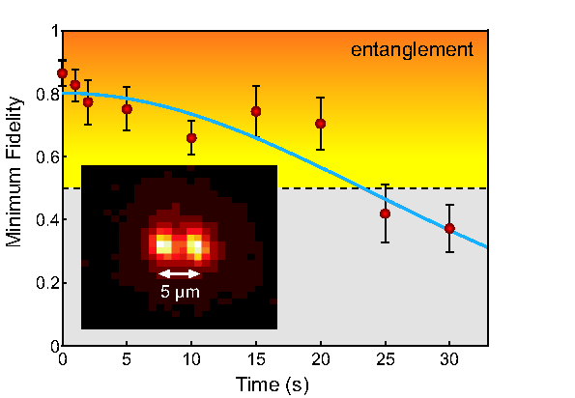


Robust entanglement
D_{5/2}
S_{1/2}

Slide 21
Robust entanglement
Lifetime of entanglement > 20 s
H. Häffner et al., App. Phys. B 81 151 (2005).

Slide 22
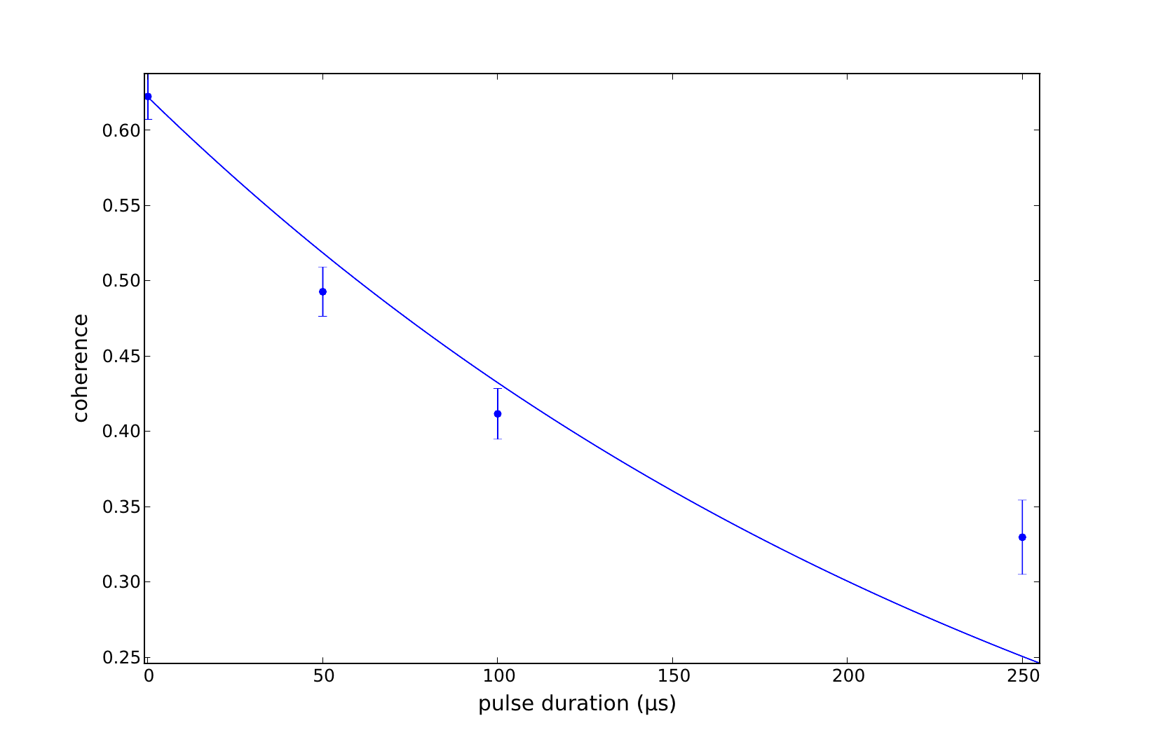
Robust entanglement
Parity fringe contrast
Waiting time (ms)

Slide 23
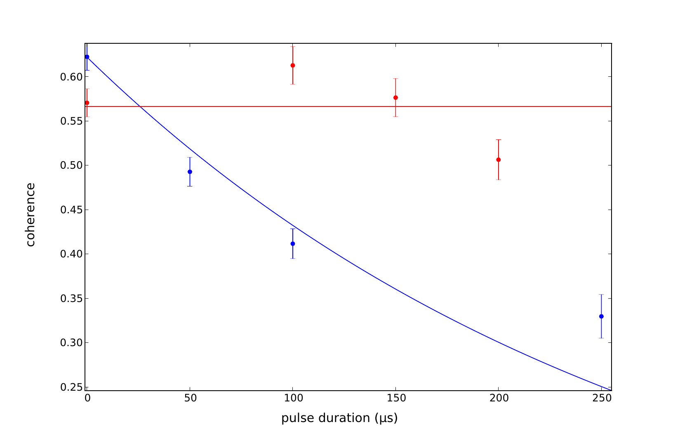

Robust entanglement
Parity fringe contrast
Parity fringe contrast
Phase sensitivity:
Perfect as a clock
Waiting time (ms)
Waiting time (ms)

Slide 24
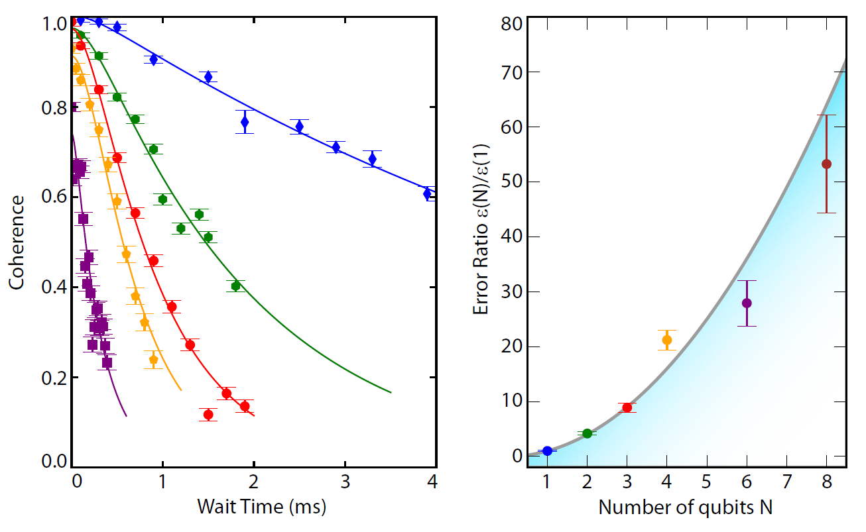
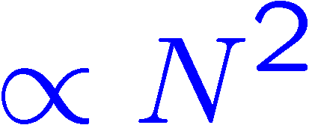
However ...
one qubit
relative
error probability
correlated noise
superdecoherence
two qubits
T. Monz et al., Phys. Rev. Lett. 106, 130506 (2011)

Slide 25
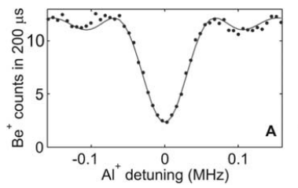
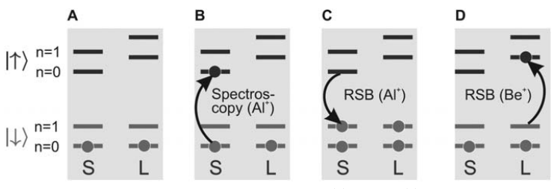
Quantum logic spectroscopy
Can do measurements on almost any
ion species, including molecular ions.
Al⁺
Be⁺
S
L
P. O. Schmidt et al.,, Science 309, 749-752 (2005).

Slide 26
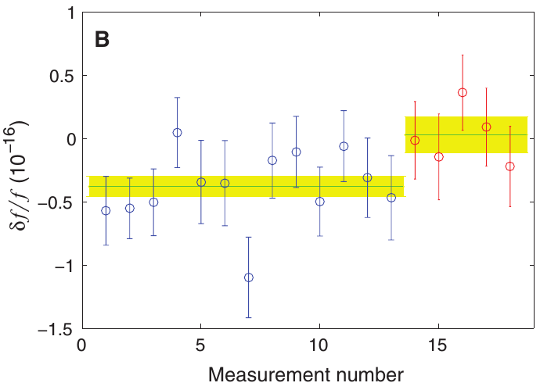
Testing general relativity
Increased the height of the clock by 30 cm
C.W. Chou et al., Science 329, 1630 (2010).

Slide 27
Testing relativity
Another test of relativity with tools from quantum information ….

Slide 28
A most famous null experiment
Test for “aether”.
expected fringe shift due to aether
observation
Michelson-Morley experiment confirms Lorentz symmetry to 10⁻⁹
Michelson & Morley, Am. J. Science 34, 427 (1887).
Notes:
Of course Einstein doesn’t just dream about his postulates. There’s a strong experimental reason behind this too. Before SR, people believe that there is a thing called Aether. This is because we believe that “waves” need “medium” to travel through. This Aether is the medium for elec. waves (light). The Earth’s relative velocity to Aether will create a frequency shift. Then by performing this kind of Michelson interferometer at different orientation, then you should be able to detect a shift in the fringe. But MM didn’t see anything. Actually this expected shift is “8” times what it should be. You don’t see anything here.

Slide 29
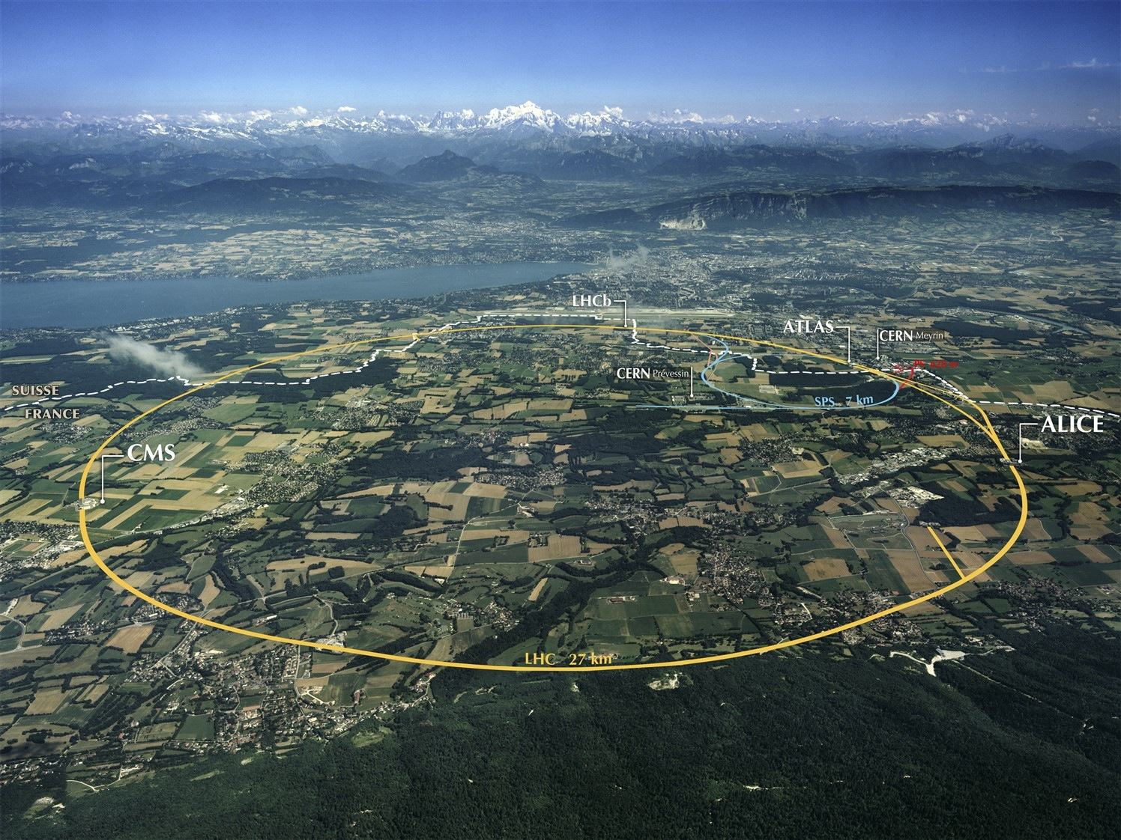
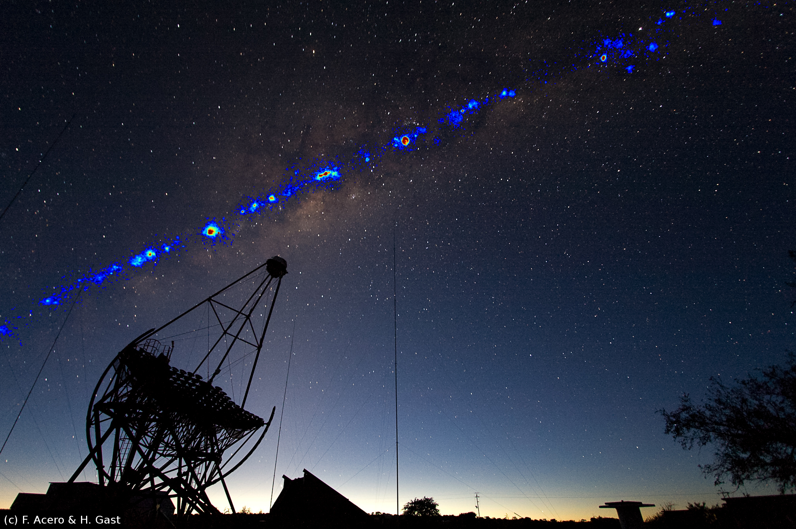
Modern tests of Lorentz symmetry
Accelerator
Optical cavities
Michimura (2013)
Herrmann (2009)
Spectroscopy
Astrophysics
HESS telescope, Altschul (2006)
Hughes-Drever (1960/1961)
Hohensee (2013)

Slide 30
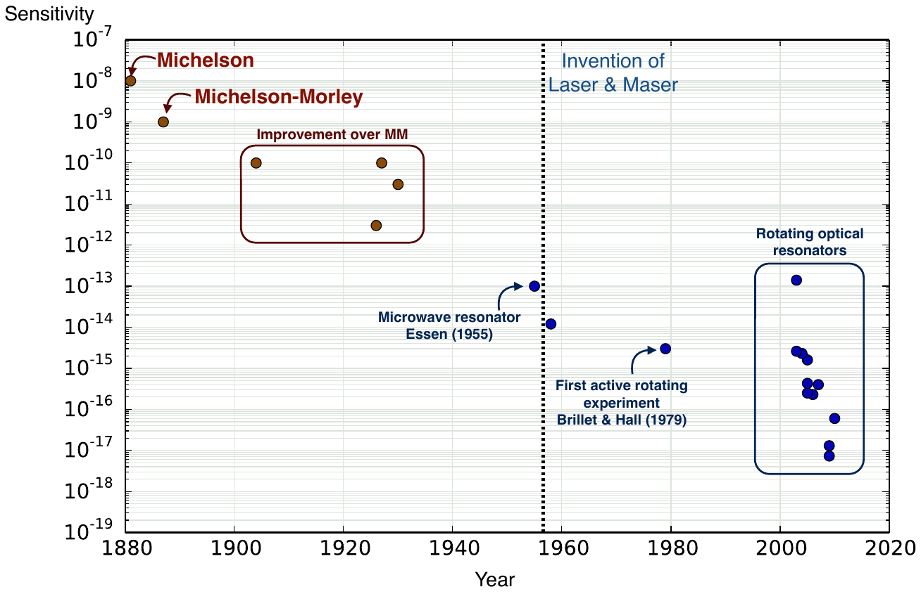
A most famous null experiment
Notes:
This is the history of MM-kind test.

Slide 31
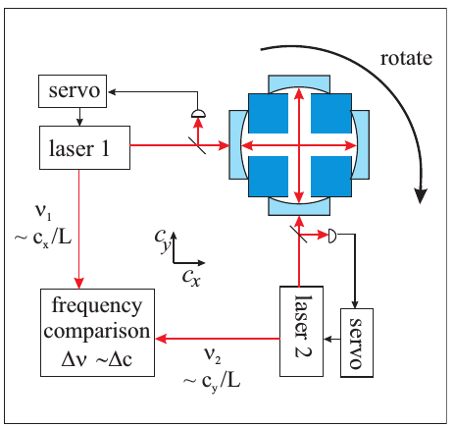

Lorentz-violating effects?
Modern Michelson-Morley
experiments
Herrmann (2009)
Electrons
  - maximum attainable speed is (not) “c”
  - dependence of energy on direction of velocity
e
e
electron
same energy?
Others . . . .
  - neutron, proton, . . . .
        Hughes-Drever experiments

Slide 32
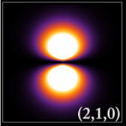
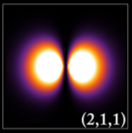
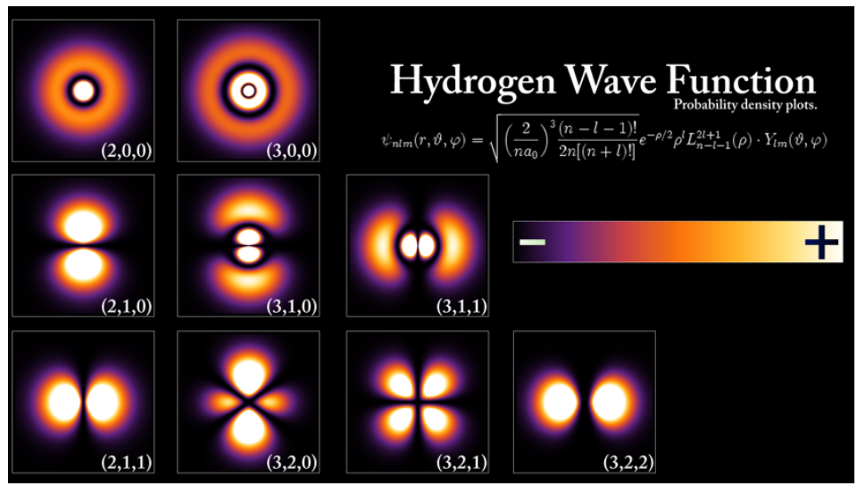
Interferometer with electrons?
e
e
source
Standing waves for electrons:
detector
Michelson interferometer
http://www.photonicquantum.info/Research/Hydrogen_Density_Plots.png

Slide 33

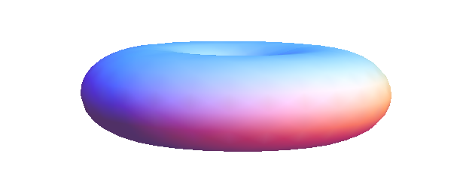

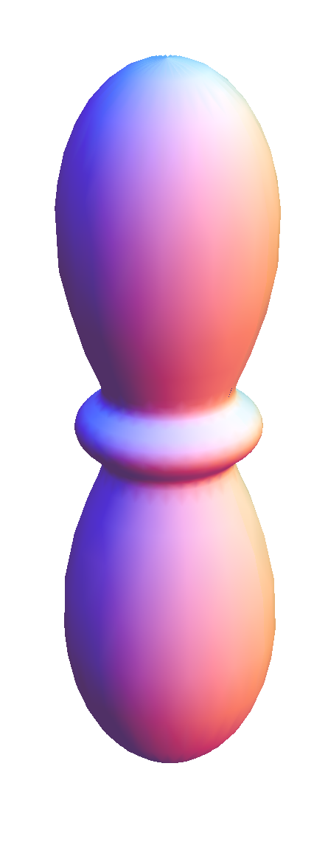




Interferometer with electrons?
Use the D_{5/2}-manifold of 40Ca+
Zeeman splitting
Electron distribution
P_{1/2}
D_{5/2}
S_{1/2}

Slide 34
Measurement scheme
=
+
e^{iωt}
Preferred
direction ?
e^{iωt}
=
+
Preferred direction due to Lorentz violation ?
energy modulated with the Earth’s rotation

Slide 35
State preparation
Zeeman splitting
Electron distribution
P_{1/2}
D_{5/2}
π/2
S_{1/2}

Slide 36
State preparation
Zeeman splitting
Electron distribution
π
P_{1/2}
D_{5/2}
π/2
S_{1/2}

Slide 37
State preparation
Zeeman splitting
Electron distribution
π
P_{1/2}
D_{5/2}
S_{1/2}

Slide 38
Decoherence-free subspace
e^{iωt}
Problem: Zeeman effect
swamps phase evolution
=
+
Use two ions:
μeff=0
μeff=0
=
-1/2, 1/2
+
-5/2, 5/2
=
+
e^{i2ωt}

Slide 39
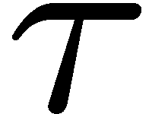
Quadrupole shift: Spectroscopy with entangled states
Prepare the two-ion Bell state
sensitive to quantities ~ m²
insensitive to linear Zeeman shift
? Hz
5 MHz
D_{5/2}
D_{5/2}
m = -5/2
-3/2
-1/2
1/2
3/2
5/2
m = -5/2
-3/2
-1/2
1/2
3/2
5/2
Decoherence-free subspace !

Slide 40
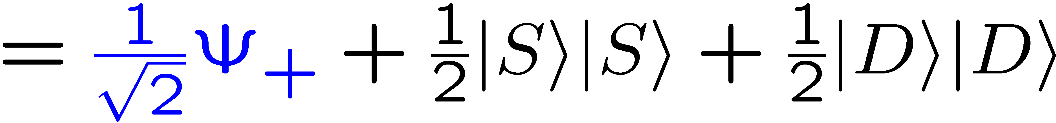
Correlation measurements with two unentangled ions
Prepare the product state
… and let it decohere:
time
contributes to the signal
no contribution
Parity signal contrast only 50%
Additional quantum projection noise from ρ_{SS} and ρ_{DD} ,
… but much easier to produce !

Slide 41
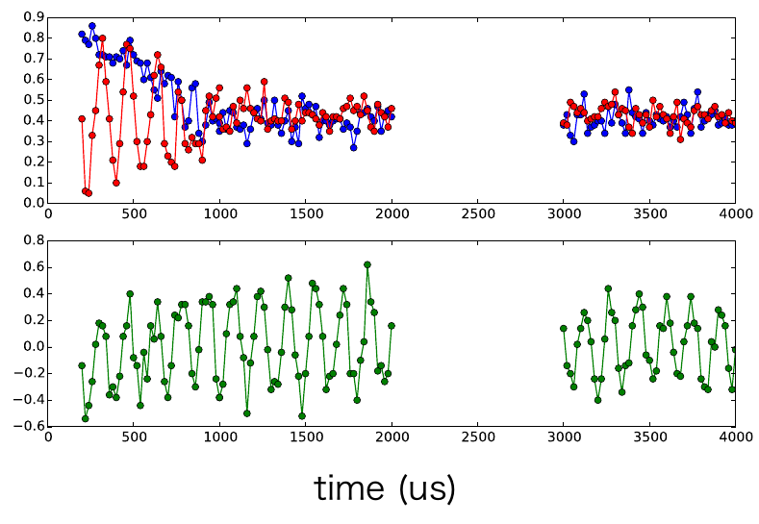


Decoherence-free subspace
Coherence time improved by 10⁴
decoherence-free subspace
ion 1
ion 2
Excitation
Correlated
excitation
Time (μs)

Slide 42
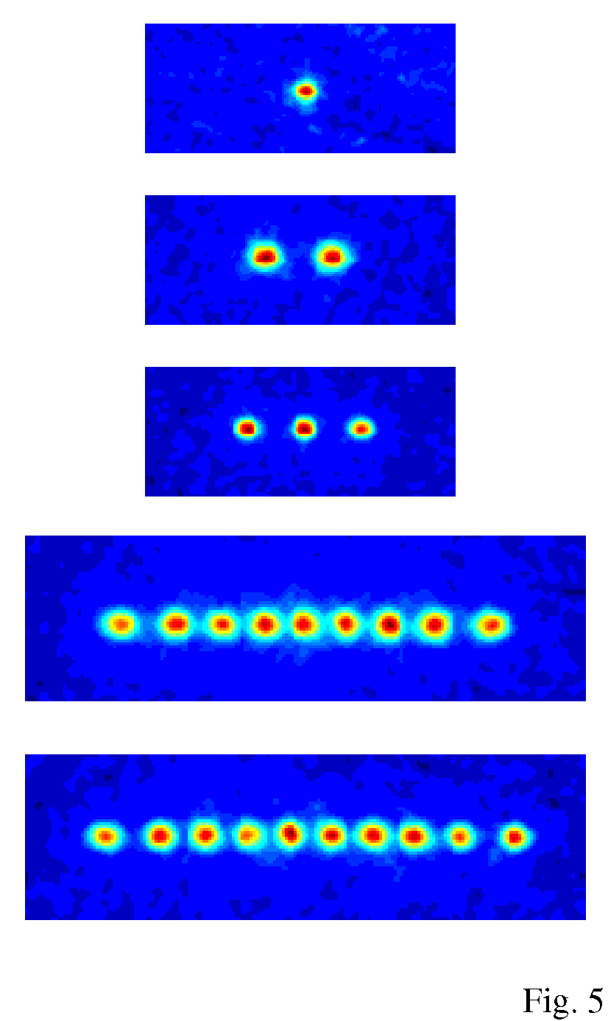
Measurement scheme
Two ions:
π/2
π-pulse
π
π/2
Laser
cooling
State
read-out
Ion #1
· · · · 100 ms · · · ·
π/2
π-pulse
π
π/2
Laser
cooling
State
read-out
Ion #1
· · · · 100 ms · · · ·

Slide 43
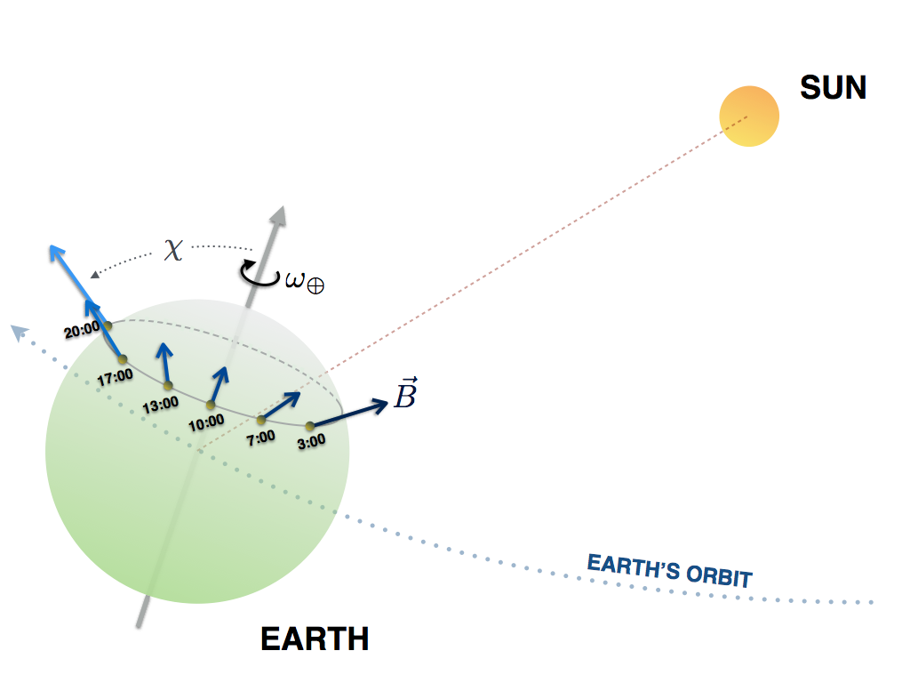
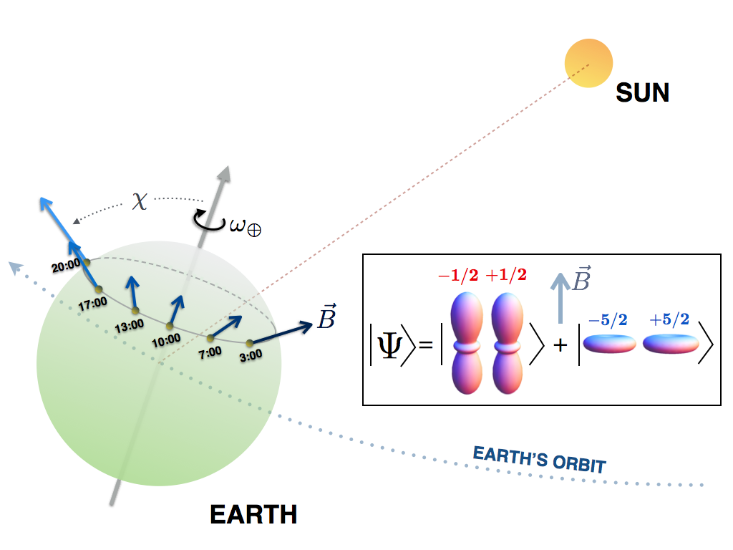
Measurement scheme
Magnetic field and wavefunction change direction.
Lorentz-violation will modulate the energy shift correlated with the Earth’s motion.
Notes:
Finally, our measurement scheme relies on the rotation of the Earth to rotate our ions or “interferometer.” Experimentally, this is the easiest because in the lab you don’t have to do anything other than just keep measuring the energy. If there’s a shift in the electron energy, then we should see it as the Earth rotates and changes the direction.

Slide 44

Data
Energy variations of a pair of ⁴⁰Ca⁺ ions on April 19th 2014
12h-modulation bounded to 11 mHz
Notes:
So this is the result. We started the data on 19th April and ran it for 23 hours. In case you are curious, there’s no particular reason on this date. The data shows no clear modulation of the ion energy in the time scale of the Earth rotation. We also analyse the data using Allan analysis. Other than some short-term fluctuation (probably due to some laser noise and some beam pointing stability), in the long term the stability of the ions frequency still averages down during out measurement time.

Slide 45



Results
Energy variations of a pair of ⁴⁰Ca⁺ ions on April 19th 2014
12h-modulation bounded to 11 mHz
Bound as a function of averaging time
Still averaging down with ,
no signs of systematic drifts.
Expected quantum projection noise.

Slide 46

Lorentz tests for the electron
Hohensee, Leefer, Budker et al.
7∙10⁻¹⁹
Notes:
We can fit our data and extract parameters in the SME. There are four parameters for our experiment. For us we don’t have to care know much the difference between these, but basically they characterize anisotropy in different direction. Comparing our result to previous works…

Slide 47
Interpretation
To analyze the experiment, we need to pick a reference.
Assumption: Coulomb force is symmetric.
any LV-signal is attributed to the electron
or: electron obeys Lorentz symmetry
photon violates Lorentz symmetry
e
e
We probe the difference between the electron and photon dispersion !

Slide 48
Interpretation of the Michelson Morley experiment
To analyze the experiment, we need to pick a reference.
arm gets shorter
photon
travels faster
source
source
detector
detector
Arm length determined by the Coulomb force and electron dispersion

Slide 49

Lorentz invariance tests for light
Both experiments compare
the photon and the electron dispersion relation.
Notes:
So if we interpret our result as a test for photons, then we can actually compare our result to other experiments which test isotropy of the speed of light. Doing this we also improve on the best result by about five times.

