Slide 1
Fun with entangled states ...

Slide 2


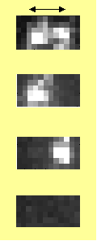

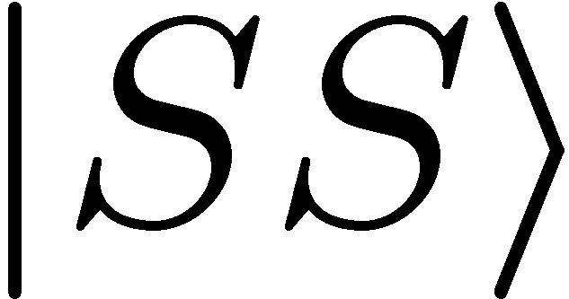
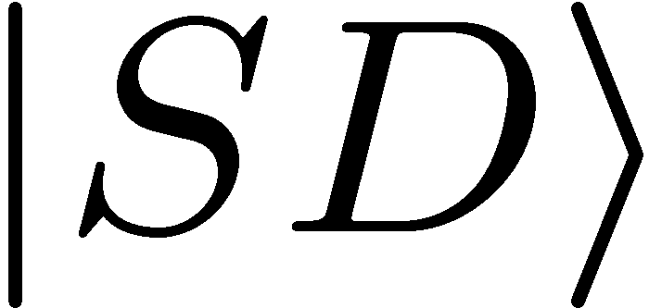
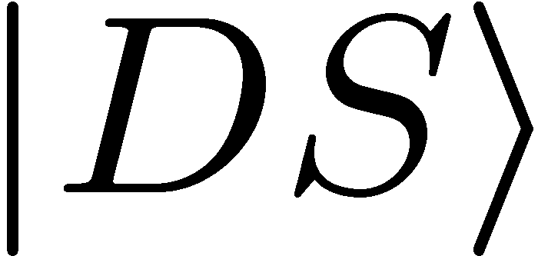
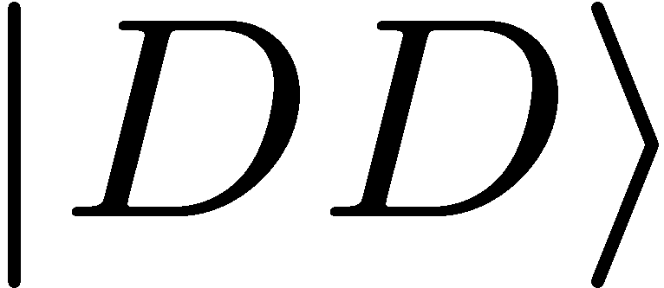
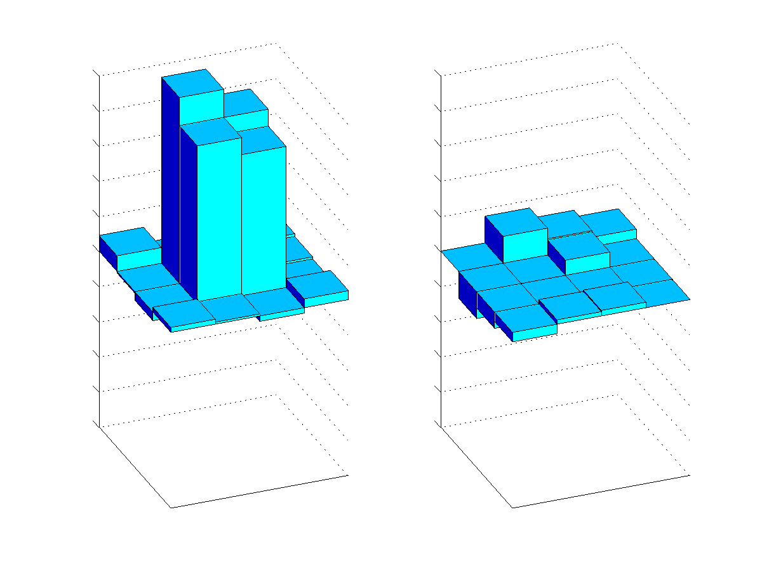
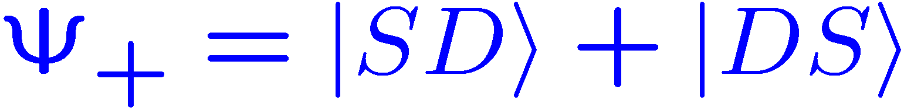
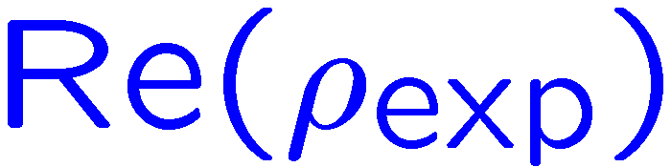
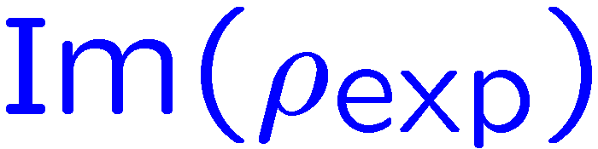
Analysis of Bell states
Fluorescence
detection with
CCD camera:
Coherent superposition or incoherent mixture ?
What is the relative phase of the superposition ?
SS
Measurement of the density matrix:
SD
DS
SS
DD
SD
DS
DD

Slide 3
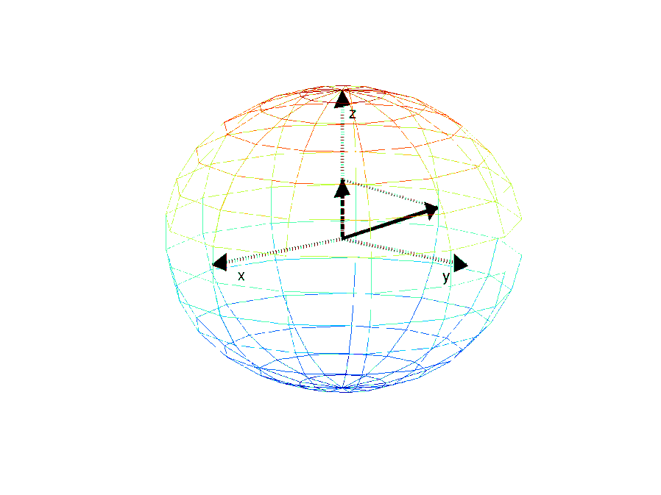

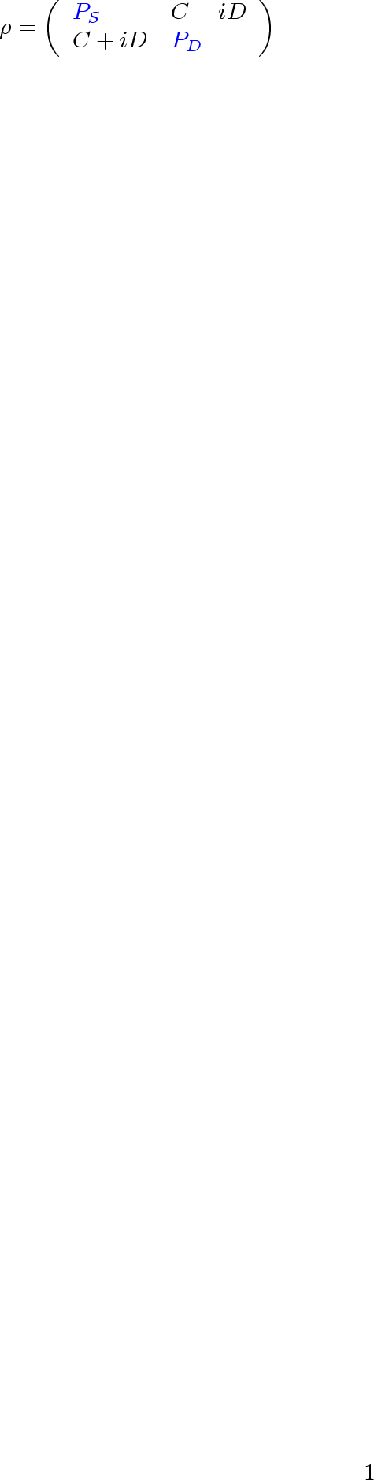

Measuring a density matrix
A measurement yields the z-component of the
Bloch vector
=> Diagonal of the density matrix

Slide 4
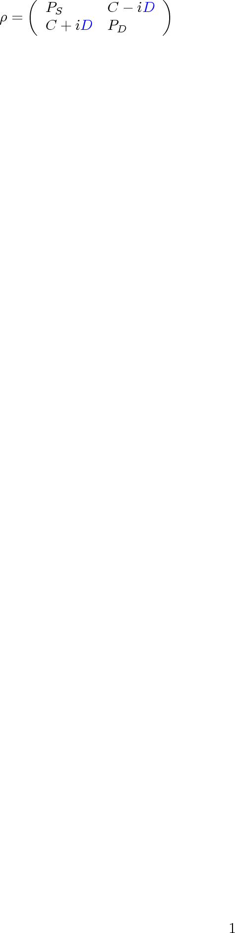
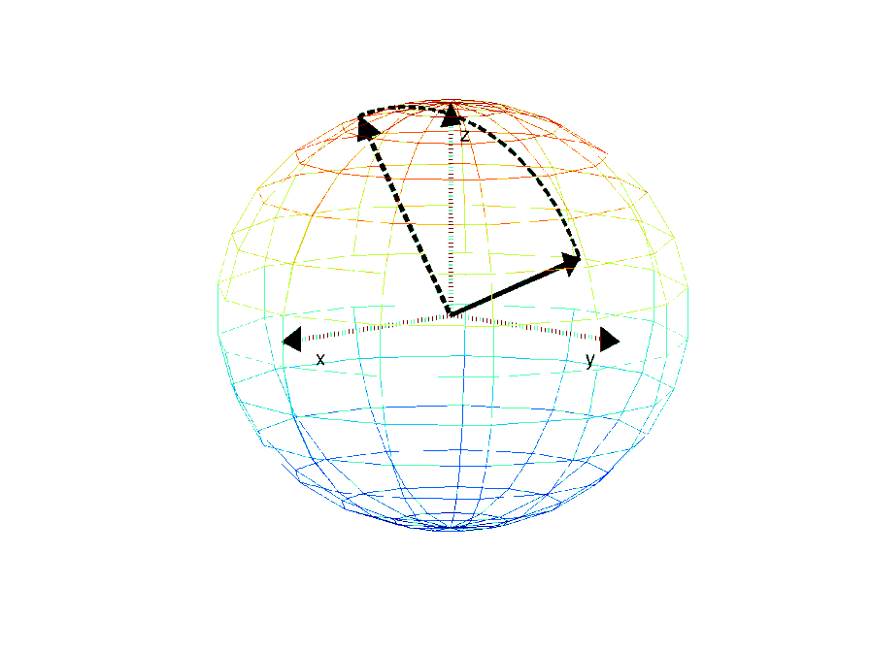
Measuring a density matrix
A measurement yields the z-component of the
Bloch vector
=> Diagonal of the density matrix
Rotation around the x- or the y-axis prior to
the measurement yields the phase information
of the qubit.

Slide 5

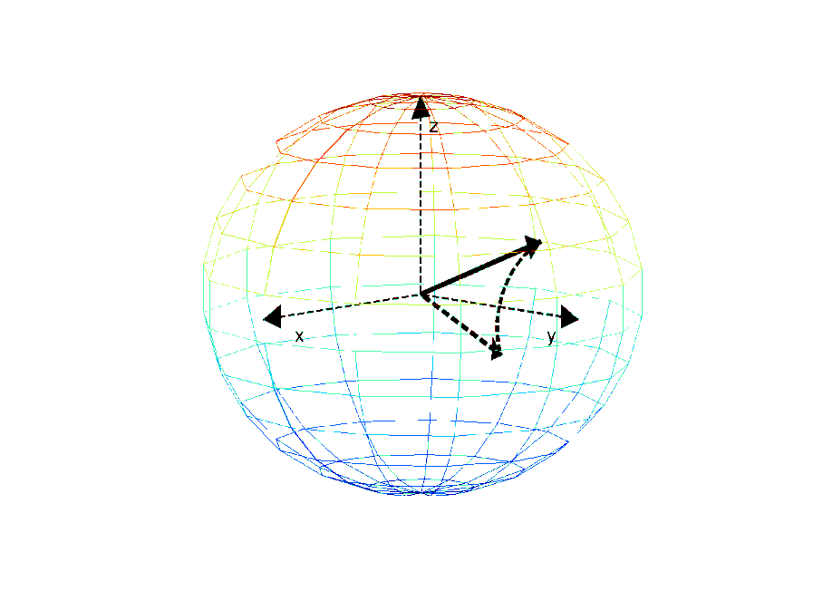
Measuring a density matrix
A measurement yields the z-component of the
Bloch vector
=> Diagonal of the density matrix
Rotation around the x- or the y-axis prior to
the measurement yields the phase information
of the qubit.
=> coherences of the density matrix

Slide 6
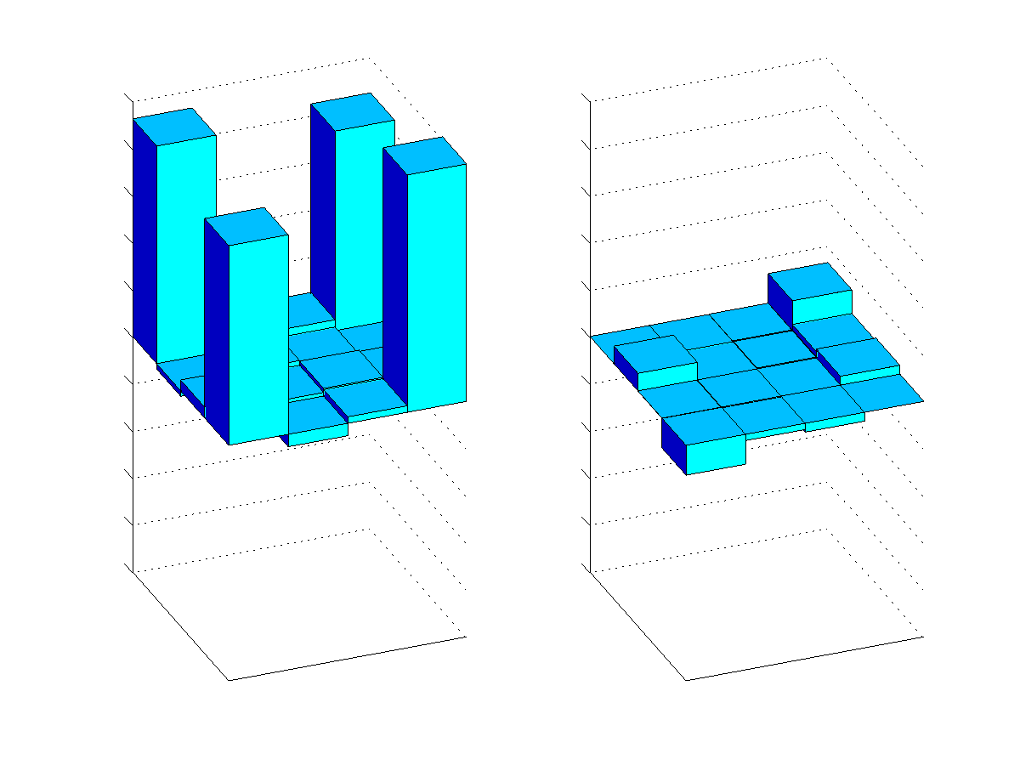
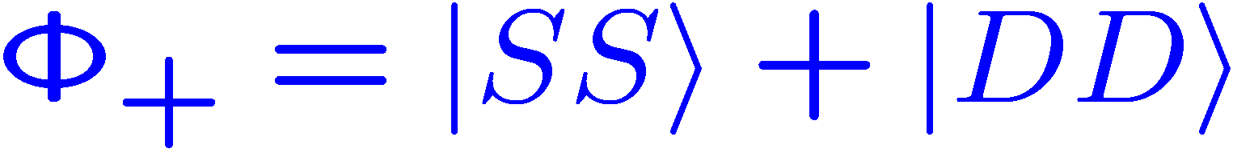
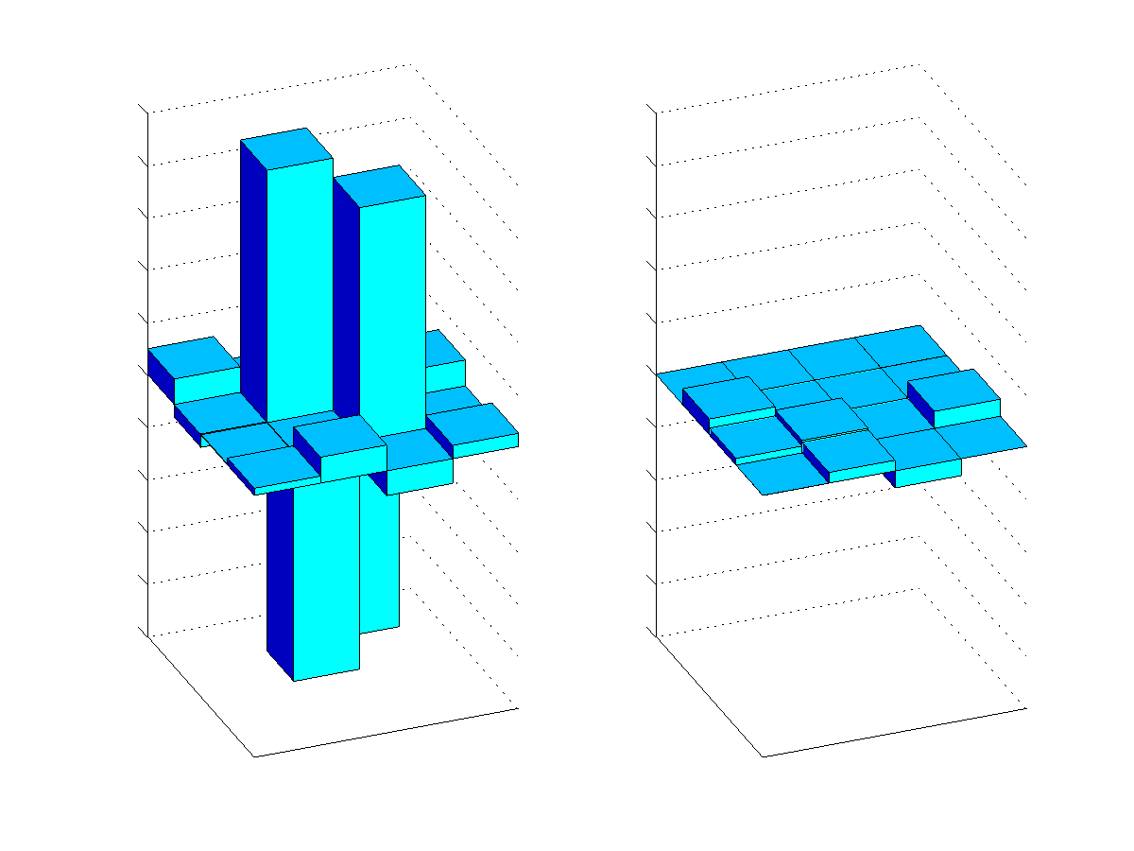
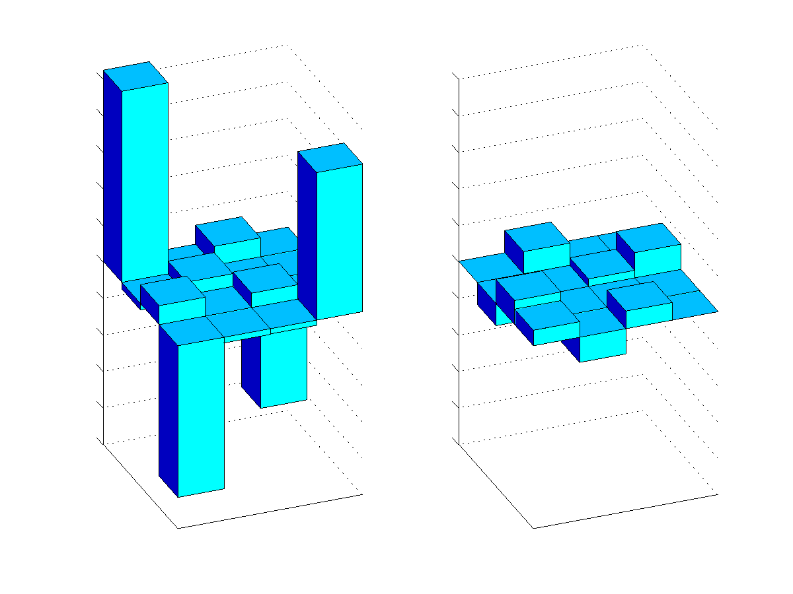
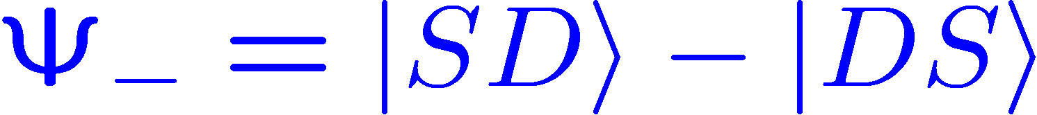

Decoherence properties of qubits
SS
SD
DS
SS
DD
DD
DS
SD
SS
SS
SD
SD
DS
SS
DS
DD
DD
DS
SD
DD
SD
SS
DD
DS

Slide 7
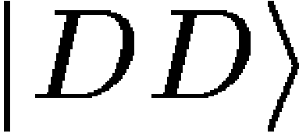
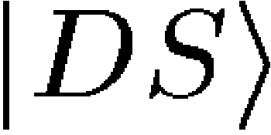
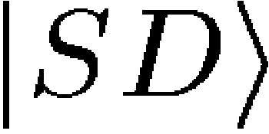
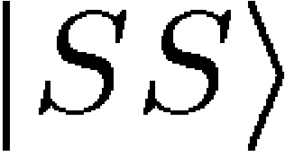
Decoherence properties of qubits
long lived (~ 1000 ms)‏
short lived (~ ms)‏
SS
SD
SS
DS
SS
SD
DD
DD
DS
SD
DS
SS
DD
DD
DS
SD
Laser frequency stability
Energy
Energy
Spontanteous decay of the D level
SS
SS
SD
SD
DS
SS
DS
DD
DD
DS
SD
DD
SD
SS
DD
DS
(see e.g. Kielpinski et al.,Science 291, 1013-1015 (2001)‏

Slide 8
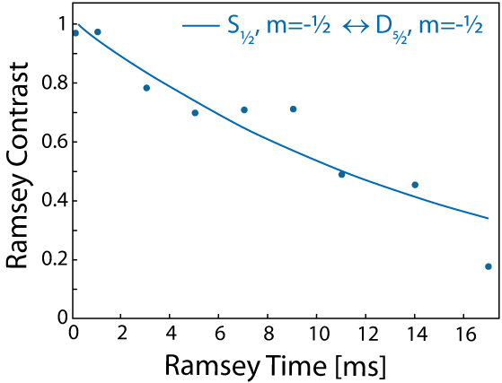
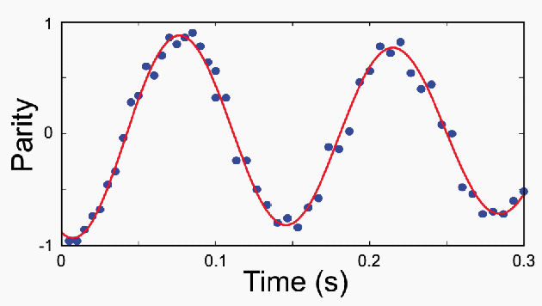
Memory performance of qubits
Physical Qubit
Ramsey Experiment
Logical Qubit
Parity Oscillations
= 16 ms
= 1050 ms
C.F. Roos et al., PRL 92, 220402 (2004).

Slide 9
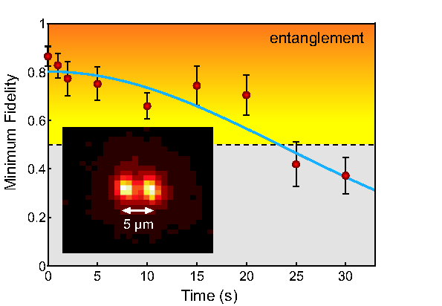


Ultra long lived entanglement
D_{5/2}
S_{1/2}

Slide 10
Ultra long lived entanglement
Lifetime of entanglement > 20 s
H. Häffner et al., App. Phys. B 81 151 (2005).

Slide 11
Realized time scales
Single qubit gates
10⁻⁶ s
Two qubit gates (Geometric phase gates: Boulder, Innsbruck) ‏
10⁻⁵ s
10⁻⁴ s
Two qubit gates (Cirac-Zoller approach)‏
10⁻³ s
10⁻² s
Single qubit coherence (magnetic field sensitive)‏
10⁻¹ s
Coherence of the motion (Innsbruck)‏
10⁰ s
10¹ s
Single qubit coherence (magnetic field insensitive, Boulder)‏
Decoherence free subspaces
10² s
10³ s
Well chosen single qubit coherence (Boulder)‏

Slide 12
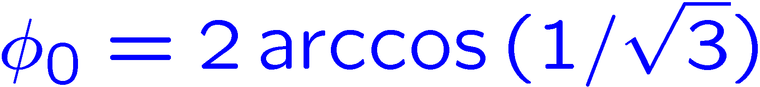
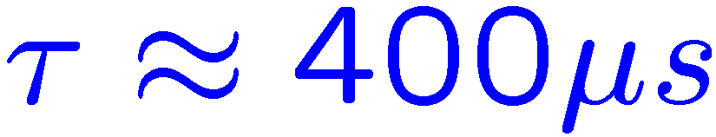
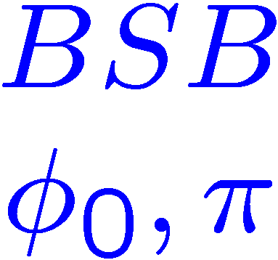

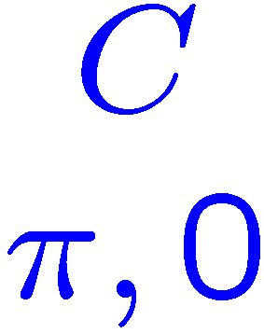
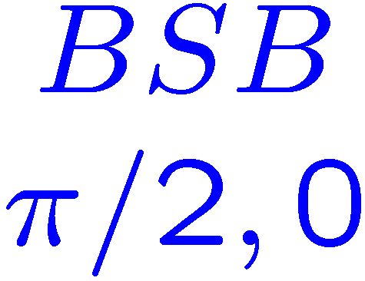
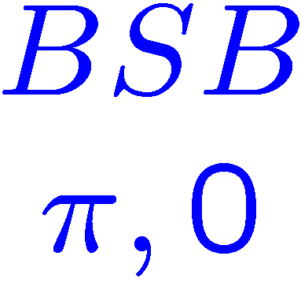

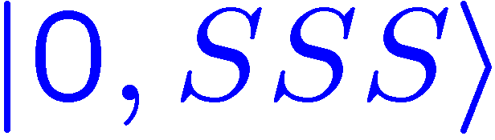
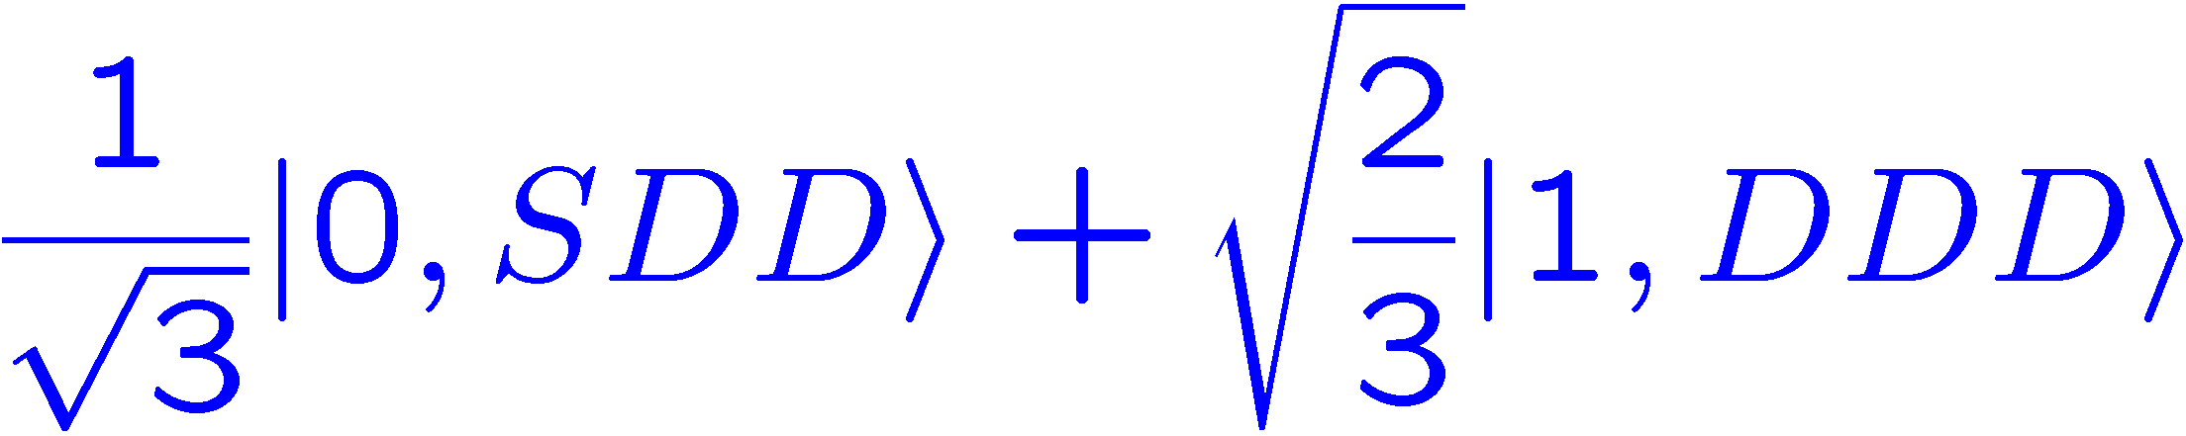

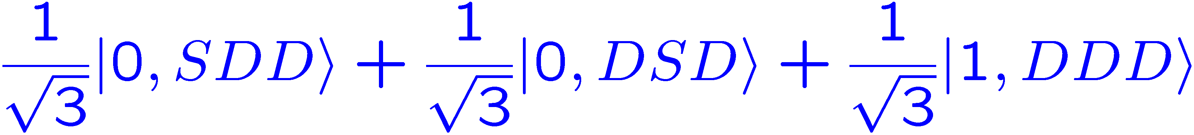
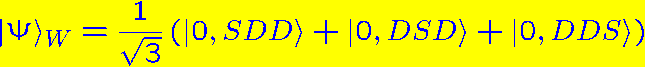
3 Ions: Preparation of W – states
Ion 1
Ion 2
Ion 3

Slide 13
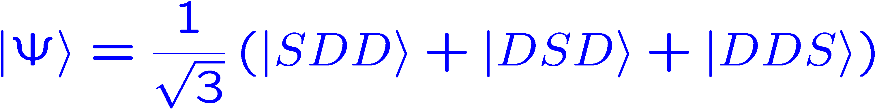
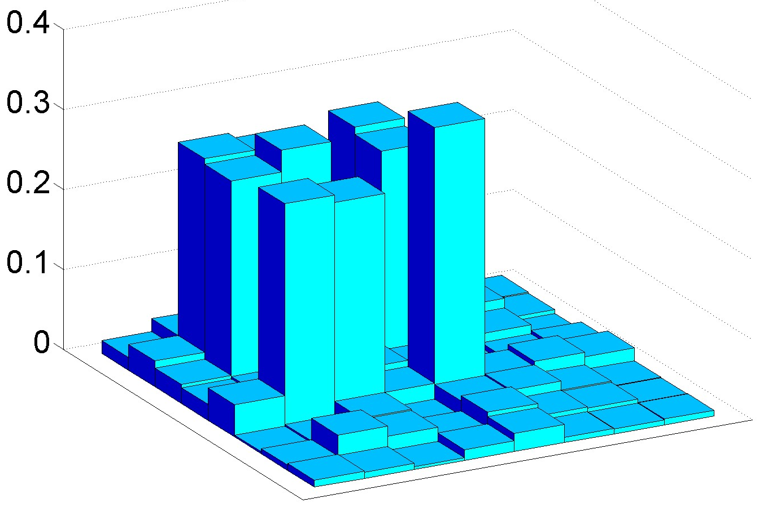
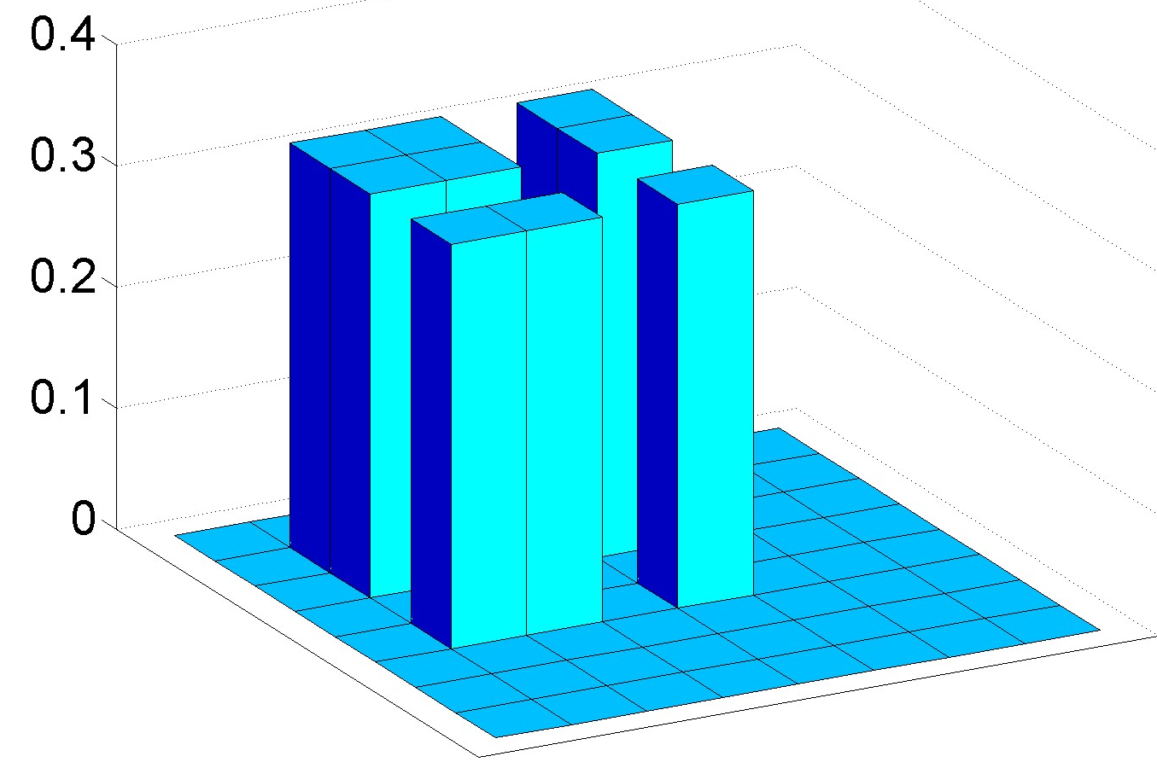
W – states: populations
Fidelity: 85 %
DDD
DDD
DDS
DDS
DSD
DSD
DSS
DSS
SDD
SDD
SDS
SDS
SSD
SSD
SSS
SSS
experimental result
theoretical expectation

Slide 14

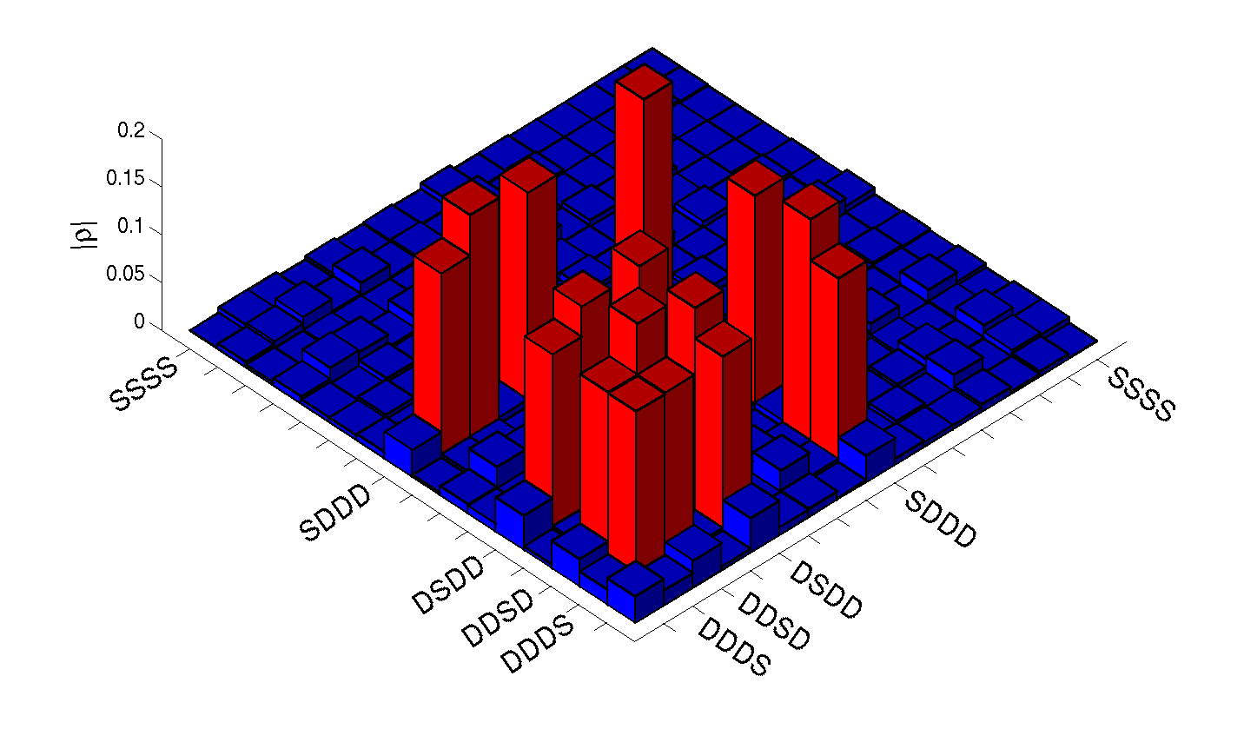
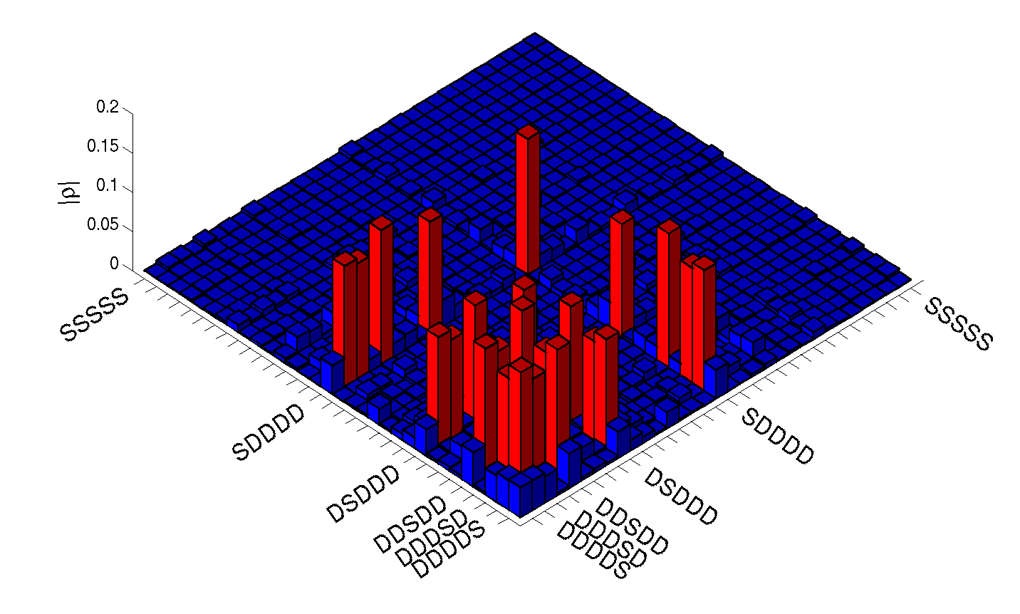
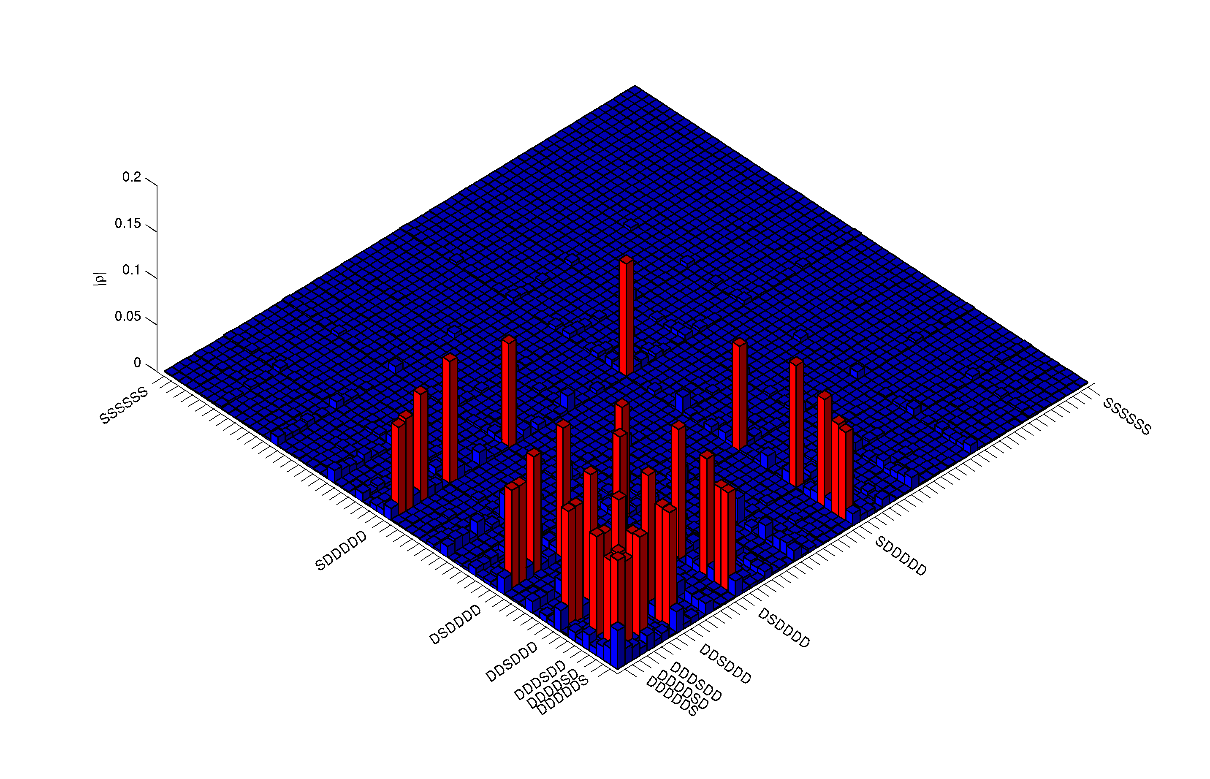
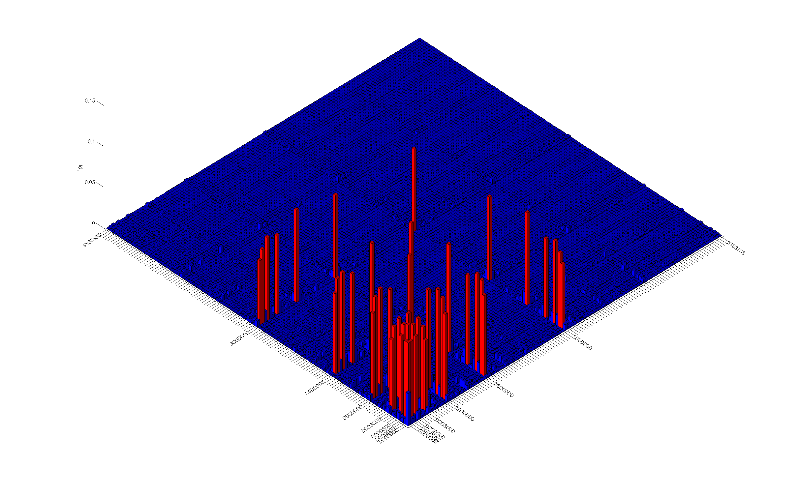
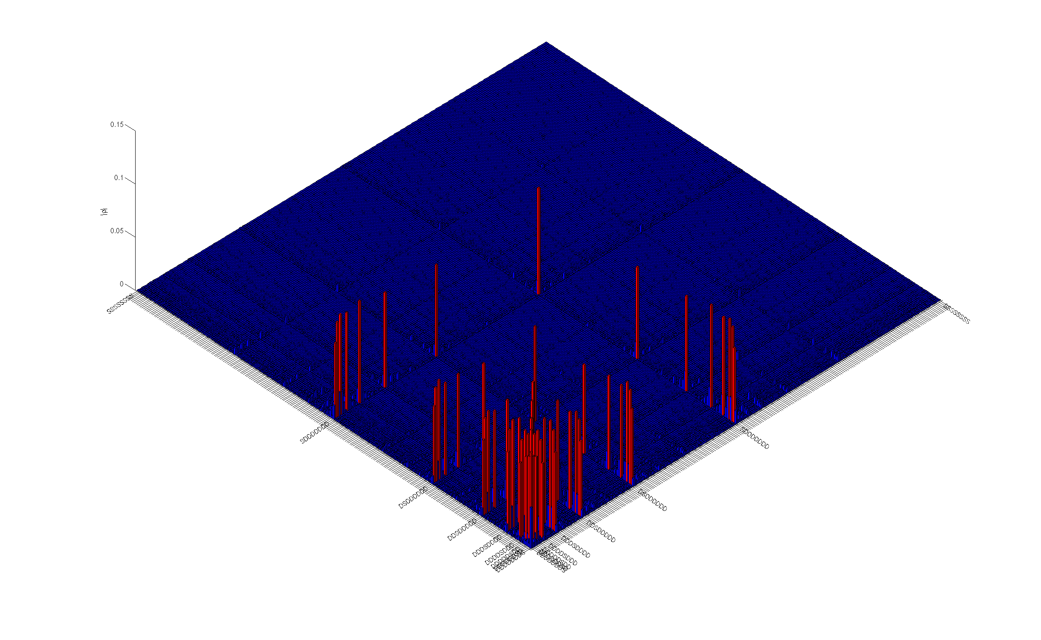

Generalized Bell states
N=4
F=0.85
N=5
F=0.78
N=6
F=0.79
N=7
F=0.76
N=8
F=0.72

Slide 15
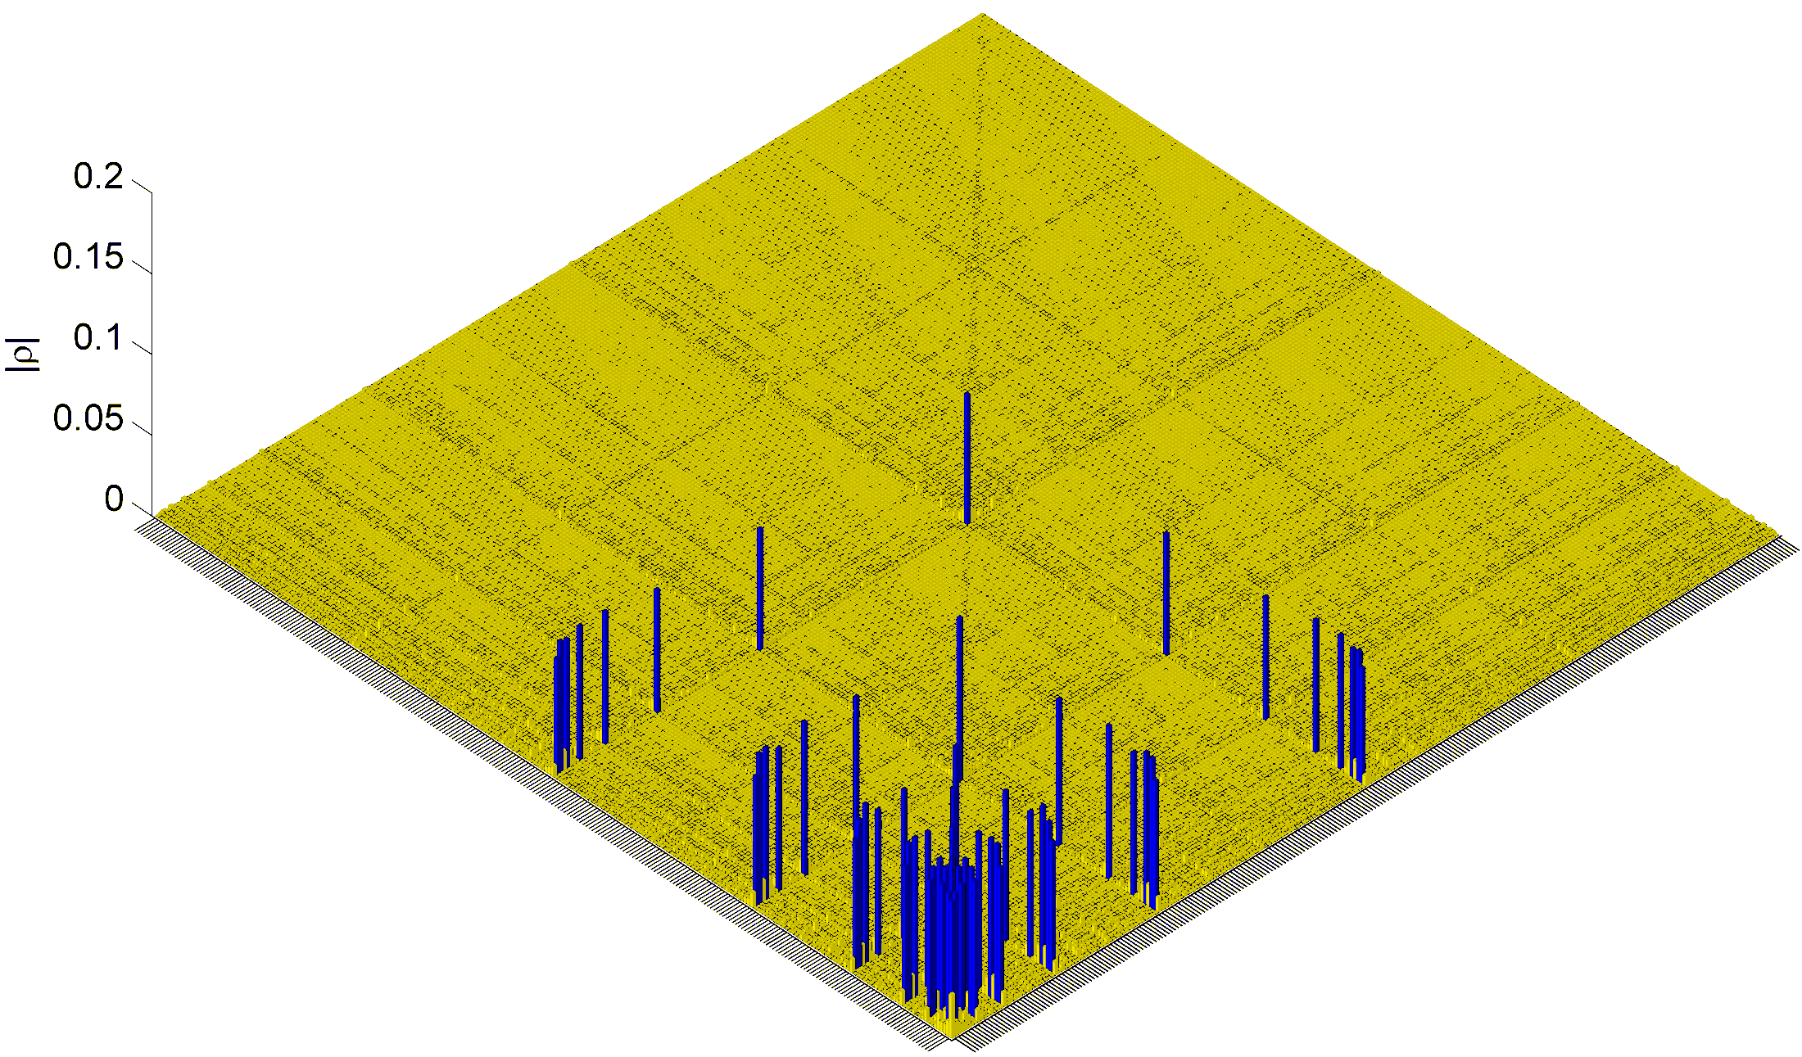
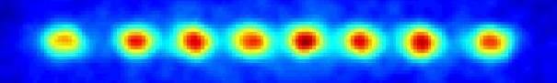
Generalized Bell states
Genuine 8-particle entanglement
656100 measurements
~ 10 h measurement time
Häffner et al., Nature 438, 643 (2005)

Slide 16
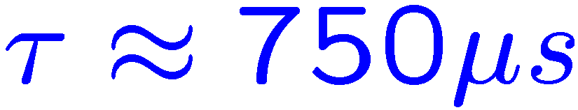
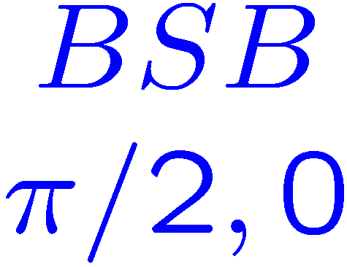
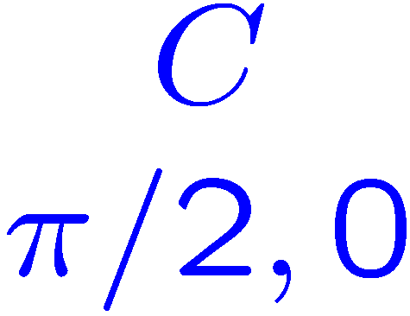
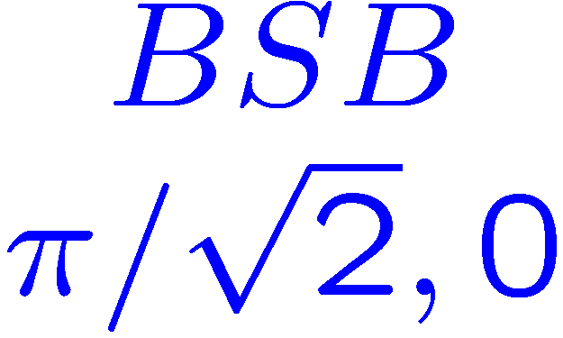





Preparation of a GHZ state
Ion 1
Ion 2
Ion 3

Slide 17



Generalized Bell states

Slide 18









Decay of W and GHZ states
(A naive approach of an experimentalist)‏
= 3 ms
(limited by global phase noise)‏
= 6 ms
(limited by global phase noise)‏
= 220 ms
(limitation: laser was not turned off properly)‏

Slide 19
Hiding a qubit
D_{5/2}
D_{5/2}
D_{5/2}
S_{1/2}
S_{1/2}
S_{1/2}
S_{1/2}
S_{1/2}
S_{1/2}
ion #1
ion #2
ion #3
qutrits

Slide 20

Hiding a qubit
ion 1 is
measured
photon
scattering
protected !
D_{5/2}
D_{5/2}
D_{5/2}
S_{1/2}
S_{1/2}
S_{1/2}
S_{1/2}
S_{1/2}
S_{1/2}
ion #1
ion #2
ion #3
detect quantum state of ion #1 only

Slide 21





A “real” thought experiment
Measurement
of the center ion
Bell-state survives
Roos et al., Science 304, 1478 (2004)‏

Slide 22


Selective read out of a qubit
Threshold
ion #1 in |D>
ion #1 in |S>
Tomography after the measurement result is available!

Slide 23



Transfer of entanglement by local operations
Start: GHZ state in rotated basis
π –pulse + measurement on ion #1
Fidelity: 74 %
Conditioned on ion #1:
π–pulse ion #1
Z-gate on ion #3
Mixture of two Bell states
(Fidelity: 78 %)‏
Also known as a quantum eraser!
End: a pure Bell state
(Fidelity: 77 %)‏

Slide 24
Decoherence mechanisms
Memory errors:
- Bit-flips (spontaneous decay, electrical noise)‏
- Dephasing (magnetic field, laser and trap frequency noise)‏
- line phase
Operationial errors:
- imperfect optical pumping
- AC Stark effects
- addressing of the qubits
- laser intensity (fiber coupling, beam steering)‏
- AOM magic
- ….
- read-out

Slide 25
DiVincenzo criteria
Scalable physical system, well characterized qubits
Ability to initialize the state of the qubits
Long relevant coherence times, much longer than gate operation time
“Universal” set of quantum gates
Qubit-specific measurement capability

Slide 26
Quantum gates …

Slide 27








Having the qubits interact
...allows the realization of a
universal quantum computer !
control
target
Notes:
One condition for universal quantum computing is the realization of a two-qubit gate such as a controlled-NOT operation. It is the quantum version of the classical XOR gate. It was first proposed ten years ago by C&Z and realised a couple of years ago in our lab. BY now quite a few alternative gate proposals exist, like the ones shown in this list.

Slide 28
Having the qubits interact
...allows the realization of a
universal quantum computer !
control
target
Most popular gates:
- Cirac-Zoller gate (Schmidt-Kaler et al., Nature 422, 408 (2003)).
- Geometric phase gate (Leibfried et al., Nature 422, 412 (2003)).
- Mølmer-Sørensen gate (Sackett et al., Nature 404, 256 (2000)).
Notes:
11
One condition for universal quantum computing is the realization of a two-qubit gate such as a controlled-NOT operation. It is the quantum version of the classical XOR gate. It was first proposed ten years ago by C&Z and realised a couple of years ago in our lab. BY now quite a few alternative gate proposals exist, like the ones shown in this list.

Slide 29

A controlled-NOT operation
Control bit
Target bit
Target

Slide 30


A controlled-NOT operation
Ion 1:
SWAP
SWAP⁻¹
Control qubit
Vibration:
Ion 2:
Target qubit

Slide 31




Mapping the qubit to the bus
Notes:
11

Slide 32


A controlled-NOT operation
Ion 1
SWAP
SWAP⁻¹
Control qubit
Vibration
Ion 2
Target qubit
Pulse sequence:
Laser frequency
Pulse length
Optical phase
Ion 1

Slide 33










A phase gate
Composite 2π-rotation:
Notes:
11
It’s operation simply consists in flipping the phases of the input states except for one, D,0. Using blue SB pulses this state remains unchanged, so that’s good. Now just have to implement 2pi rotations on all other three input states. Problem is that the coupling depends on the motional quantum number so that when doing a 2 pi rotation on S0 <-> D1, it will not be that for the S1 state. A solution to this problem is the use of composite pulses which ensure that all states get rotated by 2pi.

Slide 34

Composite phase gate
1
2
3
4
Notes:
11

Slide 35
Composite phase gate
1
0.9
0.8
0.7
0.6
0.5
D_{5/2} - excitation
0.4
0.3
0.2
0.1
0
0
20
40
60
80
100
120
140
160
180
Time (µs)‏
Notes:
11

Slide 36


A phase gate
?
Composite 2π-rotation:
Notes:
11
It’s operation simply consists in flipping the phases of the input states except for one, D,0. Using blue SB pulses this state remains unchanged, so that’s good. Now just have to implement 2pi rotations on all other three input states. Problem is that the coupling depends on the motional quantum number so that when doing a 2 pi rotation on S0 <-> D1, it will not be that for the S1 state. A solution to this problem is the use of composite pulses which ensure that all states get rotated by 2pi.

Slide 37


Coherent manipulation of the oscillator
Notes:
11

Slide 38

Action on the |1,S> |2,D> manifold
2
4
3
1
Notes:
11

Slide 39
A phase gate
Composite 2π-rotation:
Notes:
11
It’s operation simply consists in flipping the phases of the input states except for one, D,0. Using blue SB pulses this state remains unchanged, so that’s good. Now just have to implement 2pi rotations on all other three input states. Problem is that the coupling depends on the motional quantum number so that when doing a 2 pi rotation on S0 <-> D1, it will not be that for the S1 state. A solution to this problem is the use of composite pulses which ensure that all states get rotated by 2pi.

Slide 40
Single-ion CNOT
π/2
Phase gate
-π/2
1
0.9
0.978 (5)‏
0.8
0.7
0.6
D_{5/2} - excitation
0.5
0.4
0.3
0.2
0.1
0
0
50
100
150
200
250
300
Time (µs)‏
Notes:
11

Slide 41

A controlled-NOT operation
Ion 1
SWAP
SWAP⁻¹
Control qubit
Vibration
Ion 2
Target qubit
Pulse sequence:
Laser frequency
Pulse length
Optical phase
Ion 1
Ion 2

Slide 42

Truth table of the CNOT
Probability
Input
Output

Slide 43

Using a CNOT to create a Bell state
prepare
CNOT
output
detect
Notes:
11

Slide 44
Cirac-Zoller gate
Draw backs of the Cirac-Zoller gate:
- slow (200 trap periods)‏
- single ion addressing required
Notes:
11
11

Slide 45



Mølmer-Sørensen gate
Raman transitions between
Interaction of two ions via common motion.
n=1
n=0
Notes:
11
11

Slide 46
Mølmer-Sørensen gate
Raman transitions between
Interaction of two ions via common motion.
Notes:
11
11

Slide 47
Mølmer-Sørensen gate
Raman transitions between
Interaction of two ions via common motion.
Notes:
11
11

Slide 48


Technical realization
bicromatic beam
applied to both ions
Notes:
11

Slide 49



Entangling ions
entangled ?
J. Benhelm et al., Nature Physics 4, 463 (2008)‏
Theory: C. Roos, NJP 10, 013002 (2008)
Notes:
11

Slide 50



Entangling ions
entangled
measure entanglement
via parity oscillations
gate duration
average fidelity: 99.3 (2) %
J. Benhelm et al., Nature Physics 4, 463 (2008)‏
Theory: C. Roos, NJP 10, 013002 (2008)
Notes:
11

Slide 51

Notes:
11

Slide 52
Gate concatenation
maximally entangled states
Notes:
11

Slide 53
Gate performance
Notes:
11

Slide 54


Optimization of the gate
The MS gate operation is optimized by
pulse shaping, minimizes off-resonant excitation
phase relation of amplitude modulated dual-frequency beam
C. Roos, NJP 10, 013002 (2008).
Notes:
11

Slide 55



Slide 56
DiVincenzo criteria
Scalable physical system, well characterized qubits / ?
Ability to initialize the state of the qubits
Long relevant coherence times, much longer than gate operation time
“Universal” set of quantum gates
Qubit-specific measurement capability
Often neglected:
exceptional fidelity of operations
low error rate also for large quantum systems
all requirements have to met at the same time
Notes:
11

