Slide 1




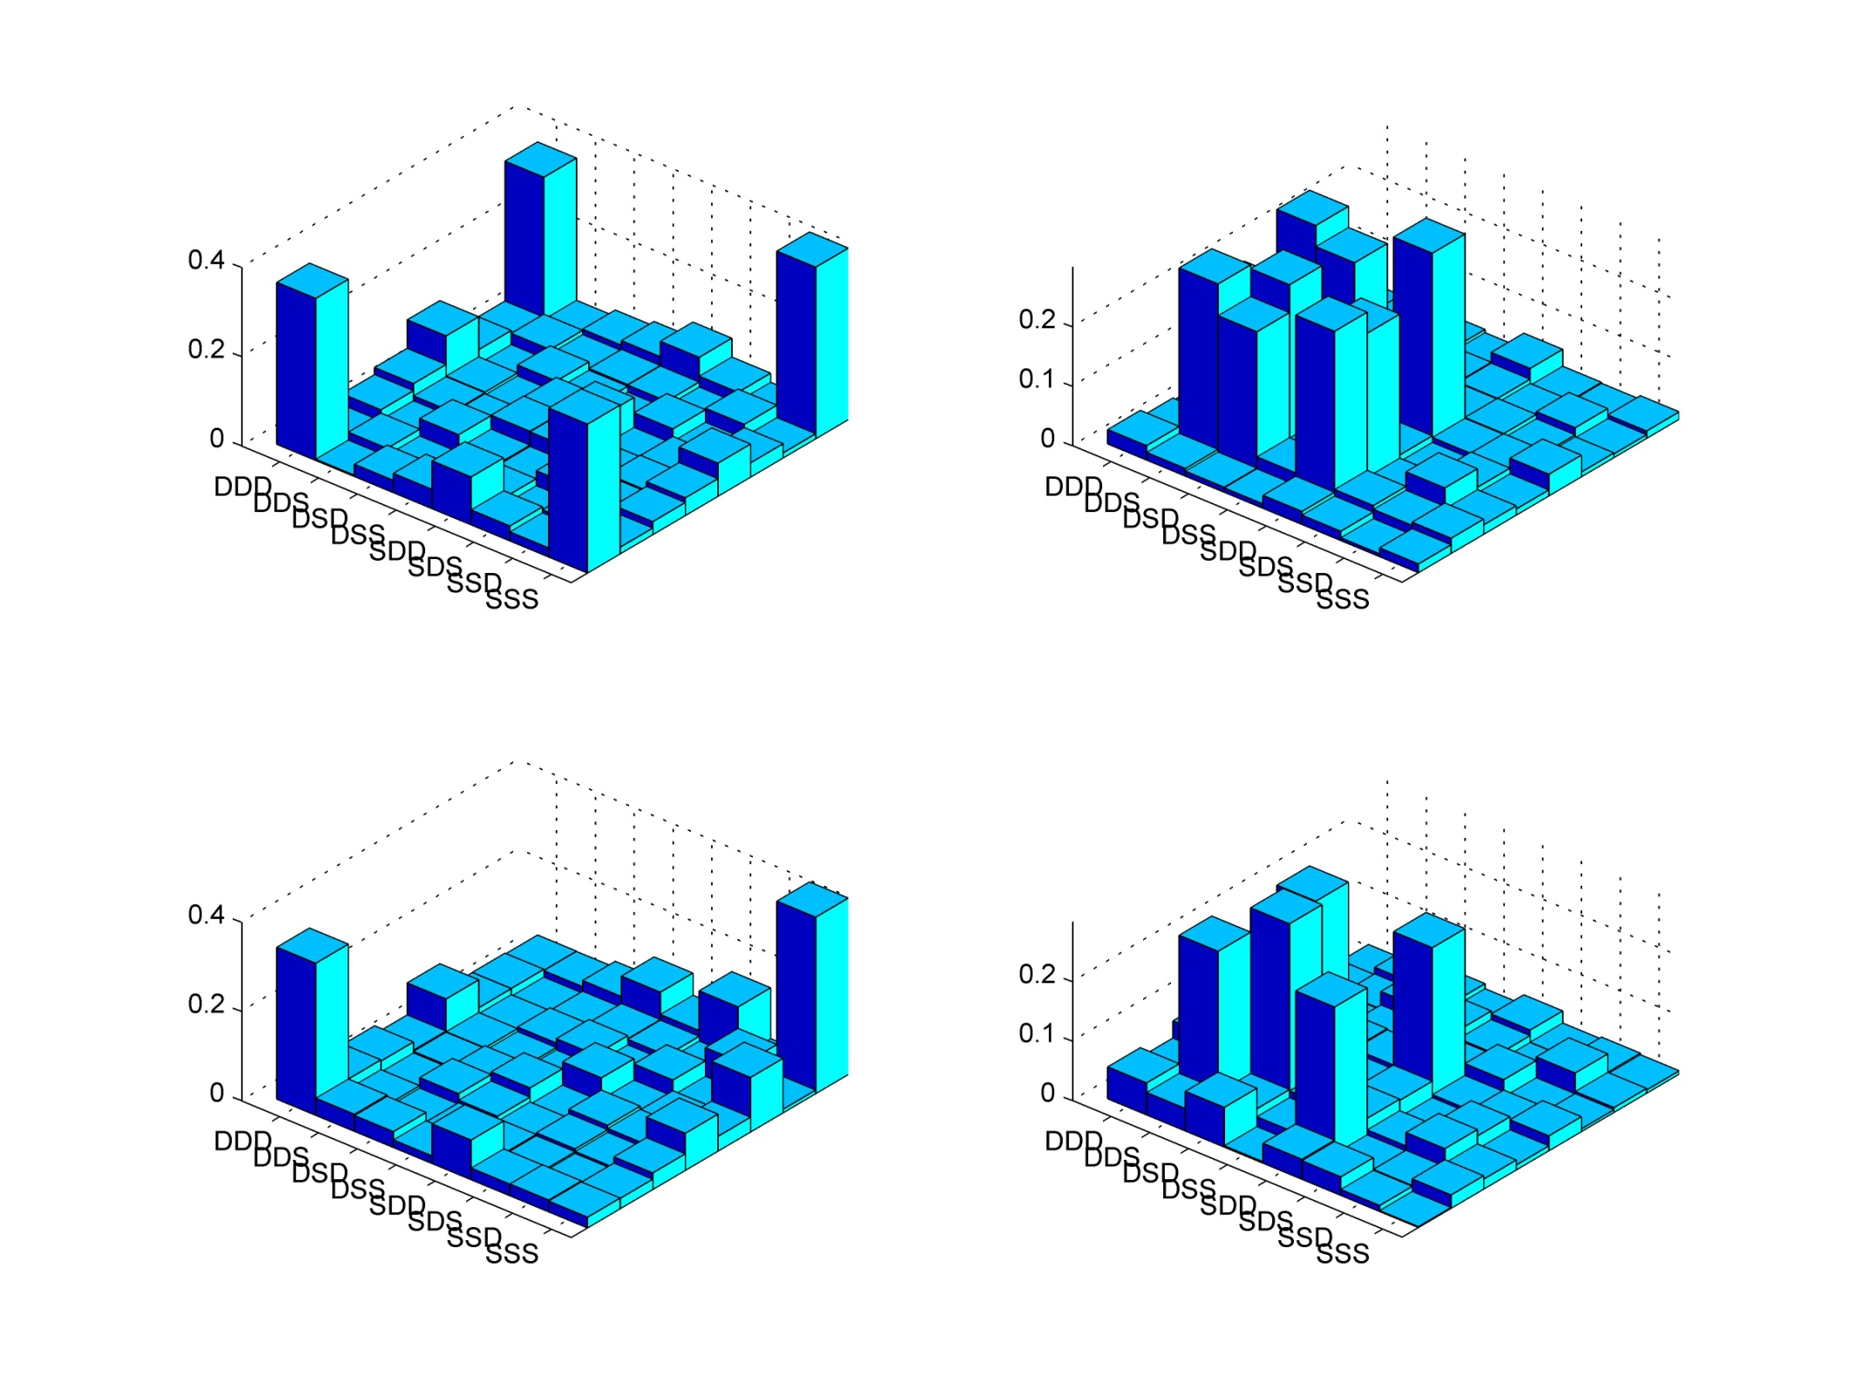
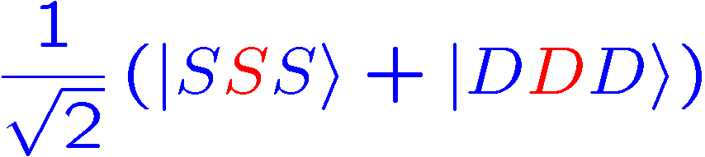
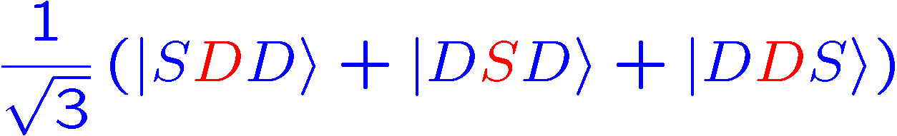
A “real” thought experiment
Measurement
of the center ion
Bell-state survives
Roos et al., Science 304, 1478 (2004)‏

Slide 2
Hiding a qubit
D_{5/2}
D_{5/2}
D_{5/2}
S_{1/2}
S_{1/2}
S_{1/2}
S_{1/2}
S_{1/2}
S_{1/2}
ion #1
ion #2
ion #3
qutrits

Slide 3

Hiding a qubit
ion 1 is
measured
photon
scattering
protected !
D_{5/2}
D_{5/2}
D_{5/2}
S_{1/2}
S_{1/2}
S_{1/2}
S_{1/2}
S_{1/2}
S_{1/2}
ion #1
ion #2
ion #3
detect quantum state of ion #1 only

Slide 4
A “real” thought experiment
Measurement
of the center ion
Bell-state survives
Roos et al., Science 304, 1478 (2004)‏

Slide 5
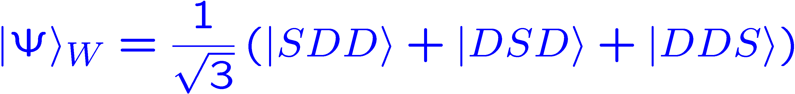
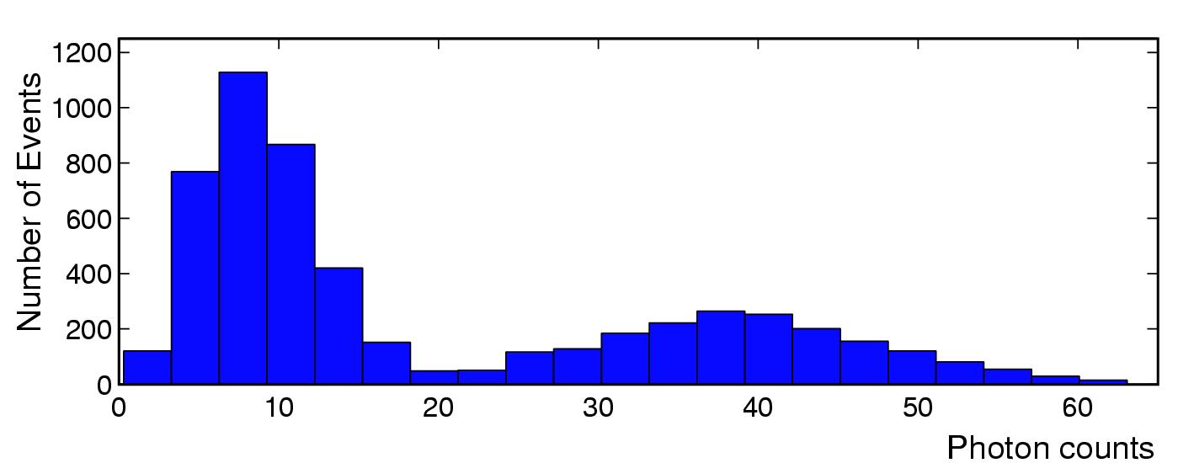
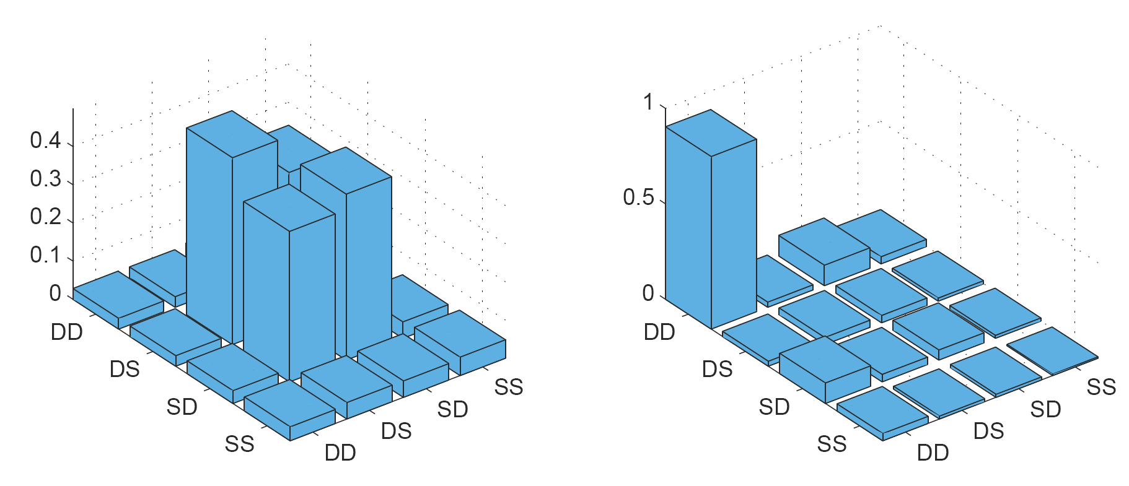
Selective read out of a qubit
Threshold
ion #1 in |D>
ion #1 in |S>
Tomography after the measurement result is available!

Slide 6
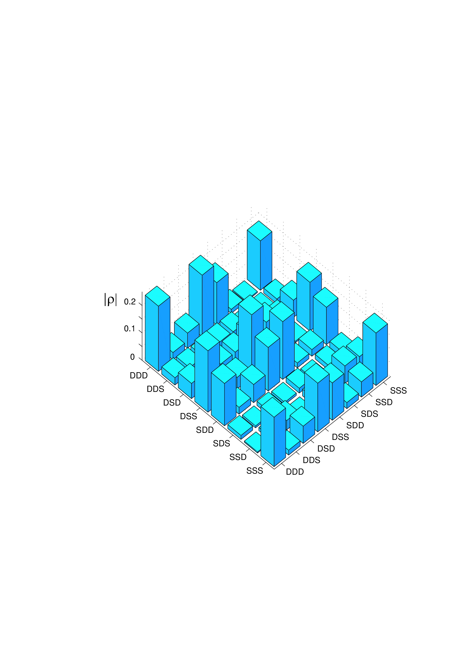
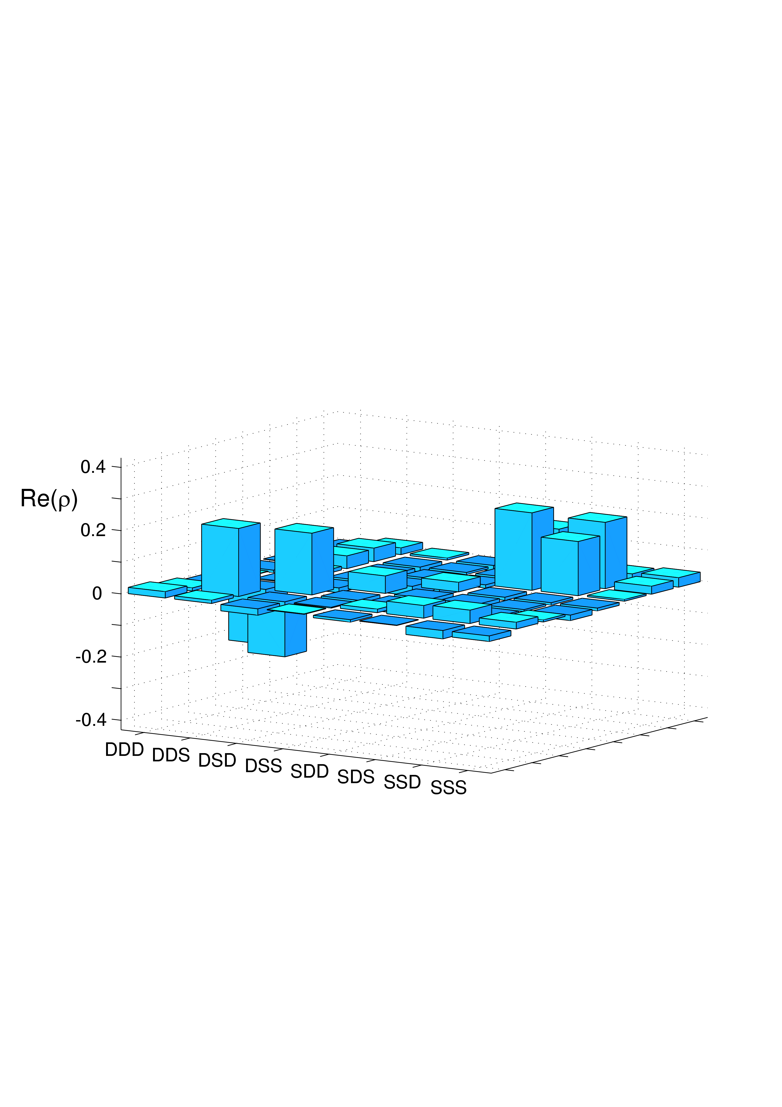
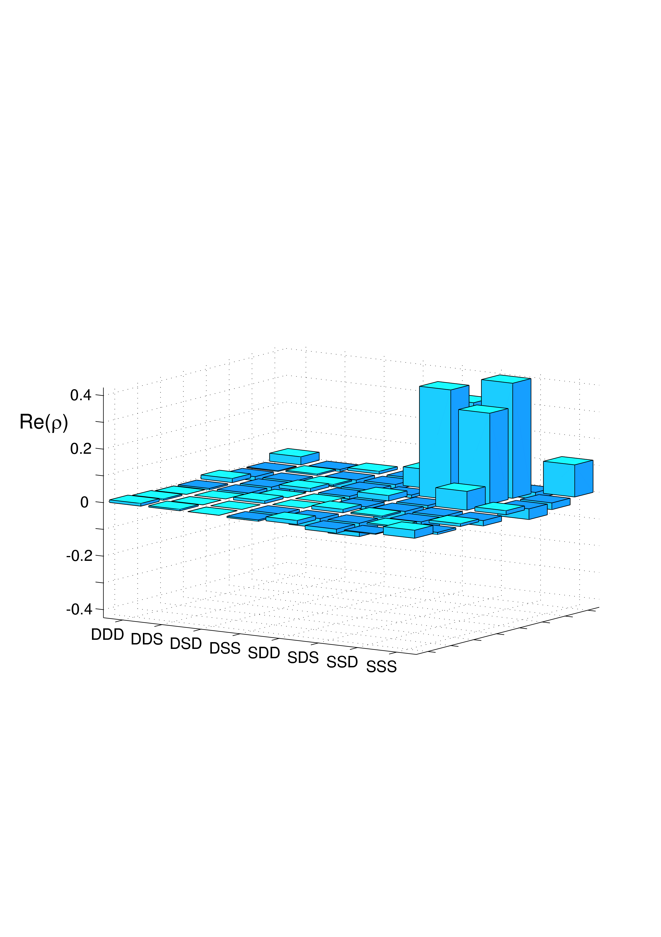
Transfer of entanglement by local operations
Start: GHZ state in rotated basis
π –pulse + measurement on ion #1
Fidelity: 74 %
Conditioned on ion #1:
π–pulse ion #1
Z-gate on ion #3
Mixture of two Bell states
(Fidelity: 78 %)‏
Also known as a quantum eraser!
End: a pure Bell state
(Fidelity: 77 %)‏

Slide 7
Decoherence mechanisms
Memory errors:
- Bit-flips (spontaneous decay, electrical noise)‏
- Dephasing (magnetic field, laser and trap frequency noise)‏
- line phase
Operationial errors:
- imperfect optical pumping
- AC Stark effects
- addressing of the qubits
- laser intensity (fiber coupling, beam steering)‏
- AOM magic
- ….
- read-out
Notes:
21
21

Slide 8
Universal set of gates in a DFS
single qubit operations
- Z gates
- X gates
two –qubit operations
- phase gate
Notes:
21
21

Slide 9
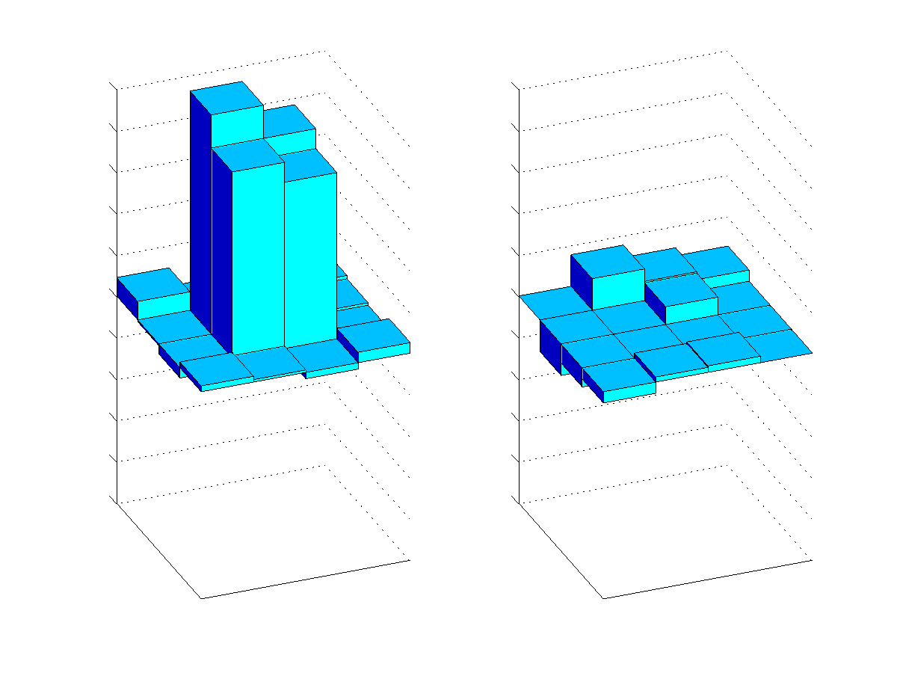
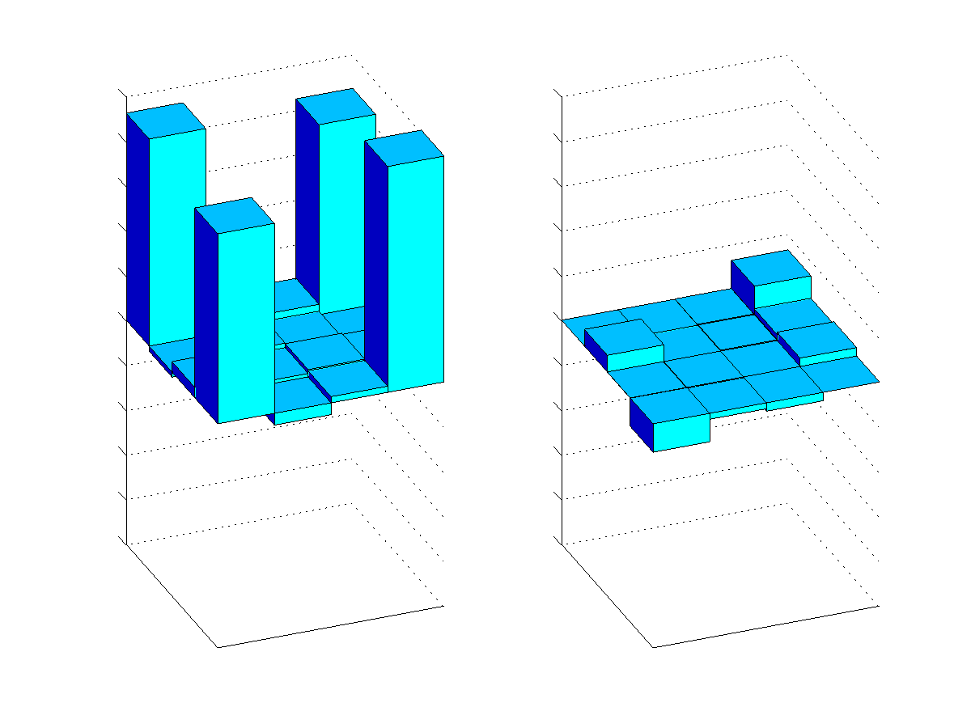
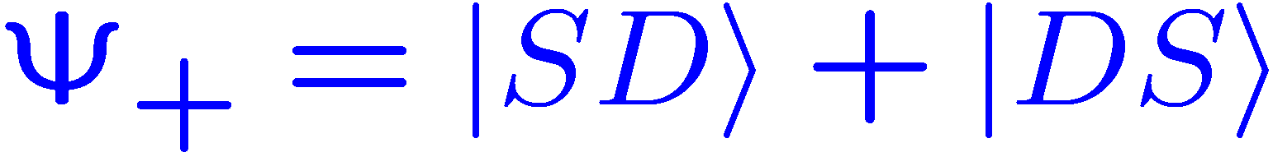
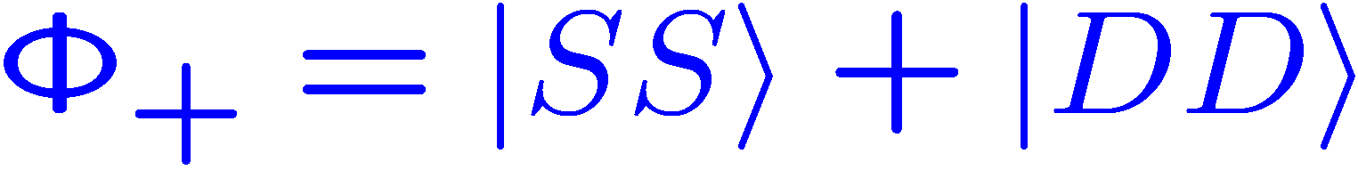




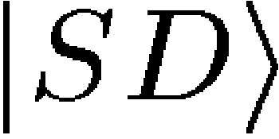
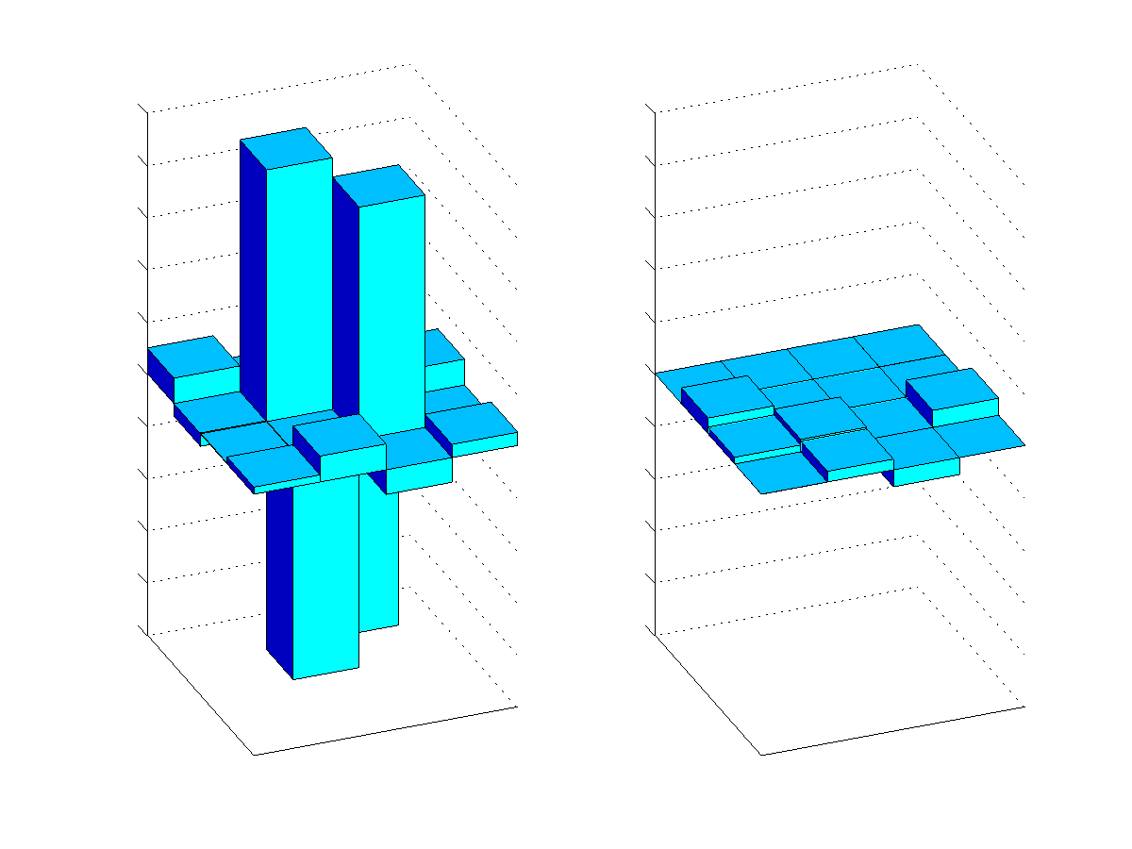
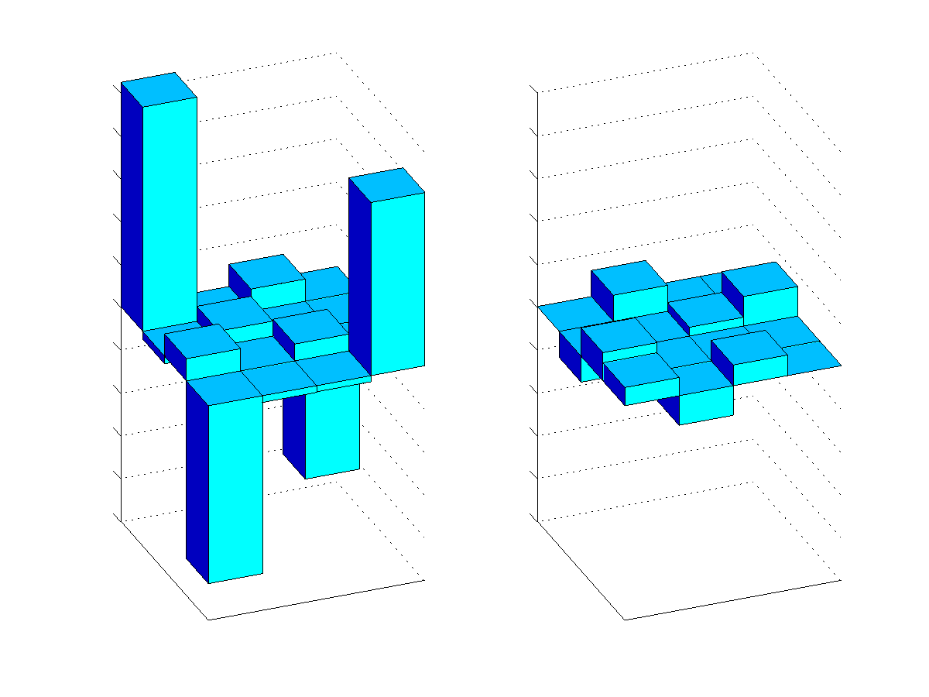


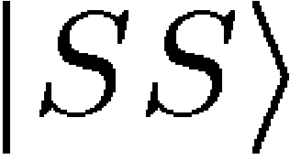
Decoherence properties of qubits
long lived (~ 1000 ms)‏
short lived (~ ms)‏
SS
SD
SS
DS
SS
SD
DD
DD
DS
SD
DS
SS
DD
DD
DS
SD
Laser frequency stability
Energy
Energy
Spontanteous decay of the D level
SS
SS
SD
SD
DS
SS
DS
DD
DD
DS
SD
DD
SD
SS
DD
DS
(see e.g. Kielpinski et al.,Science 291, 1013-1015 (2001)‏

Slide 10
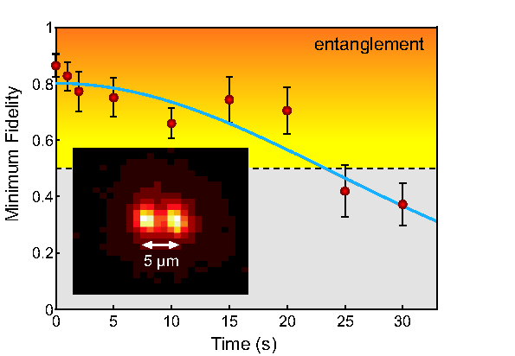


Ultra long lived entanglement
D_{5/2}
S_{1/2}
Notes:
21

Slide 11
Ultra long lived entanglement
Lifetime of entanglement > 20 s
H. Häffner et al., App. Phys. B 81 151 (2005).
Notes:
21

Slide 12
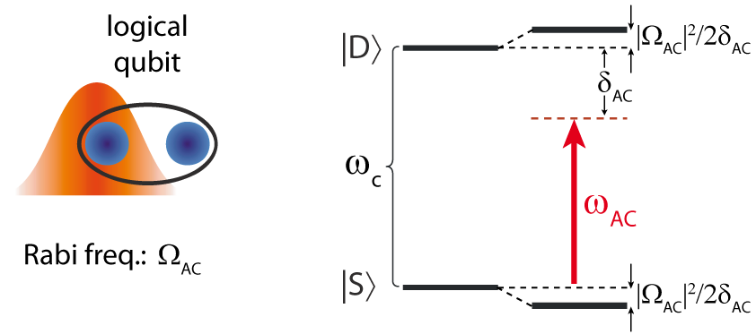
Z gate
Notes:
21
21

Slide 13



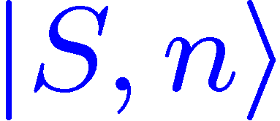



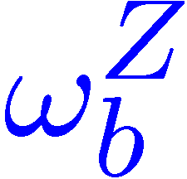
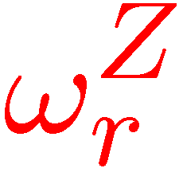

Universal set of gates in a DFS
Z
single qubit phaseshift by
AC Stark shifts
X
Z
?
Z
Notes:
21

Slide 14
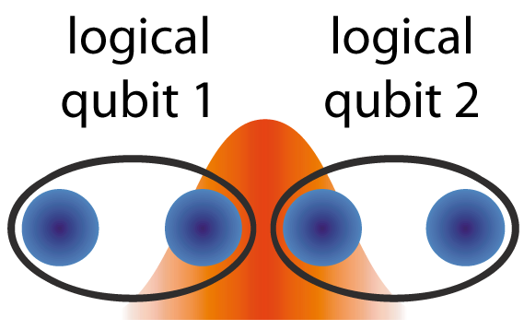
Two logical qubit gate
Two body interactions preferred:
Most interactions cause the state to leave
the decoherence free subspace.
Some solutions: L. Aolita et al., PRA 75 052337 (2007)‏
Notes:
21
21

Slide 15
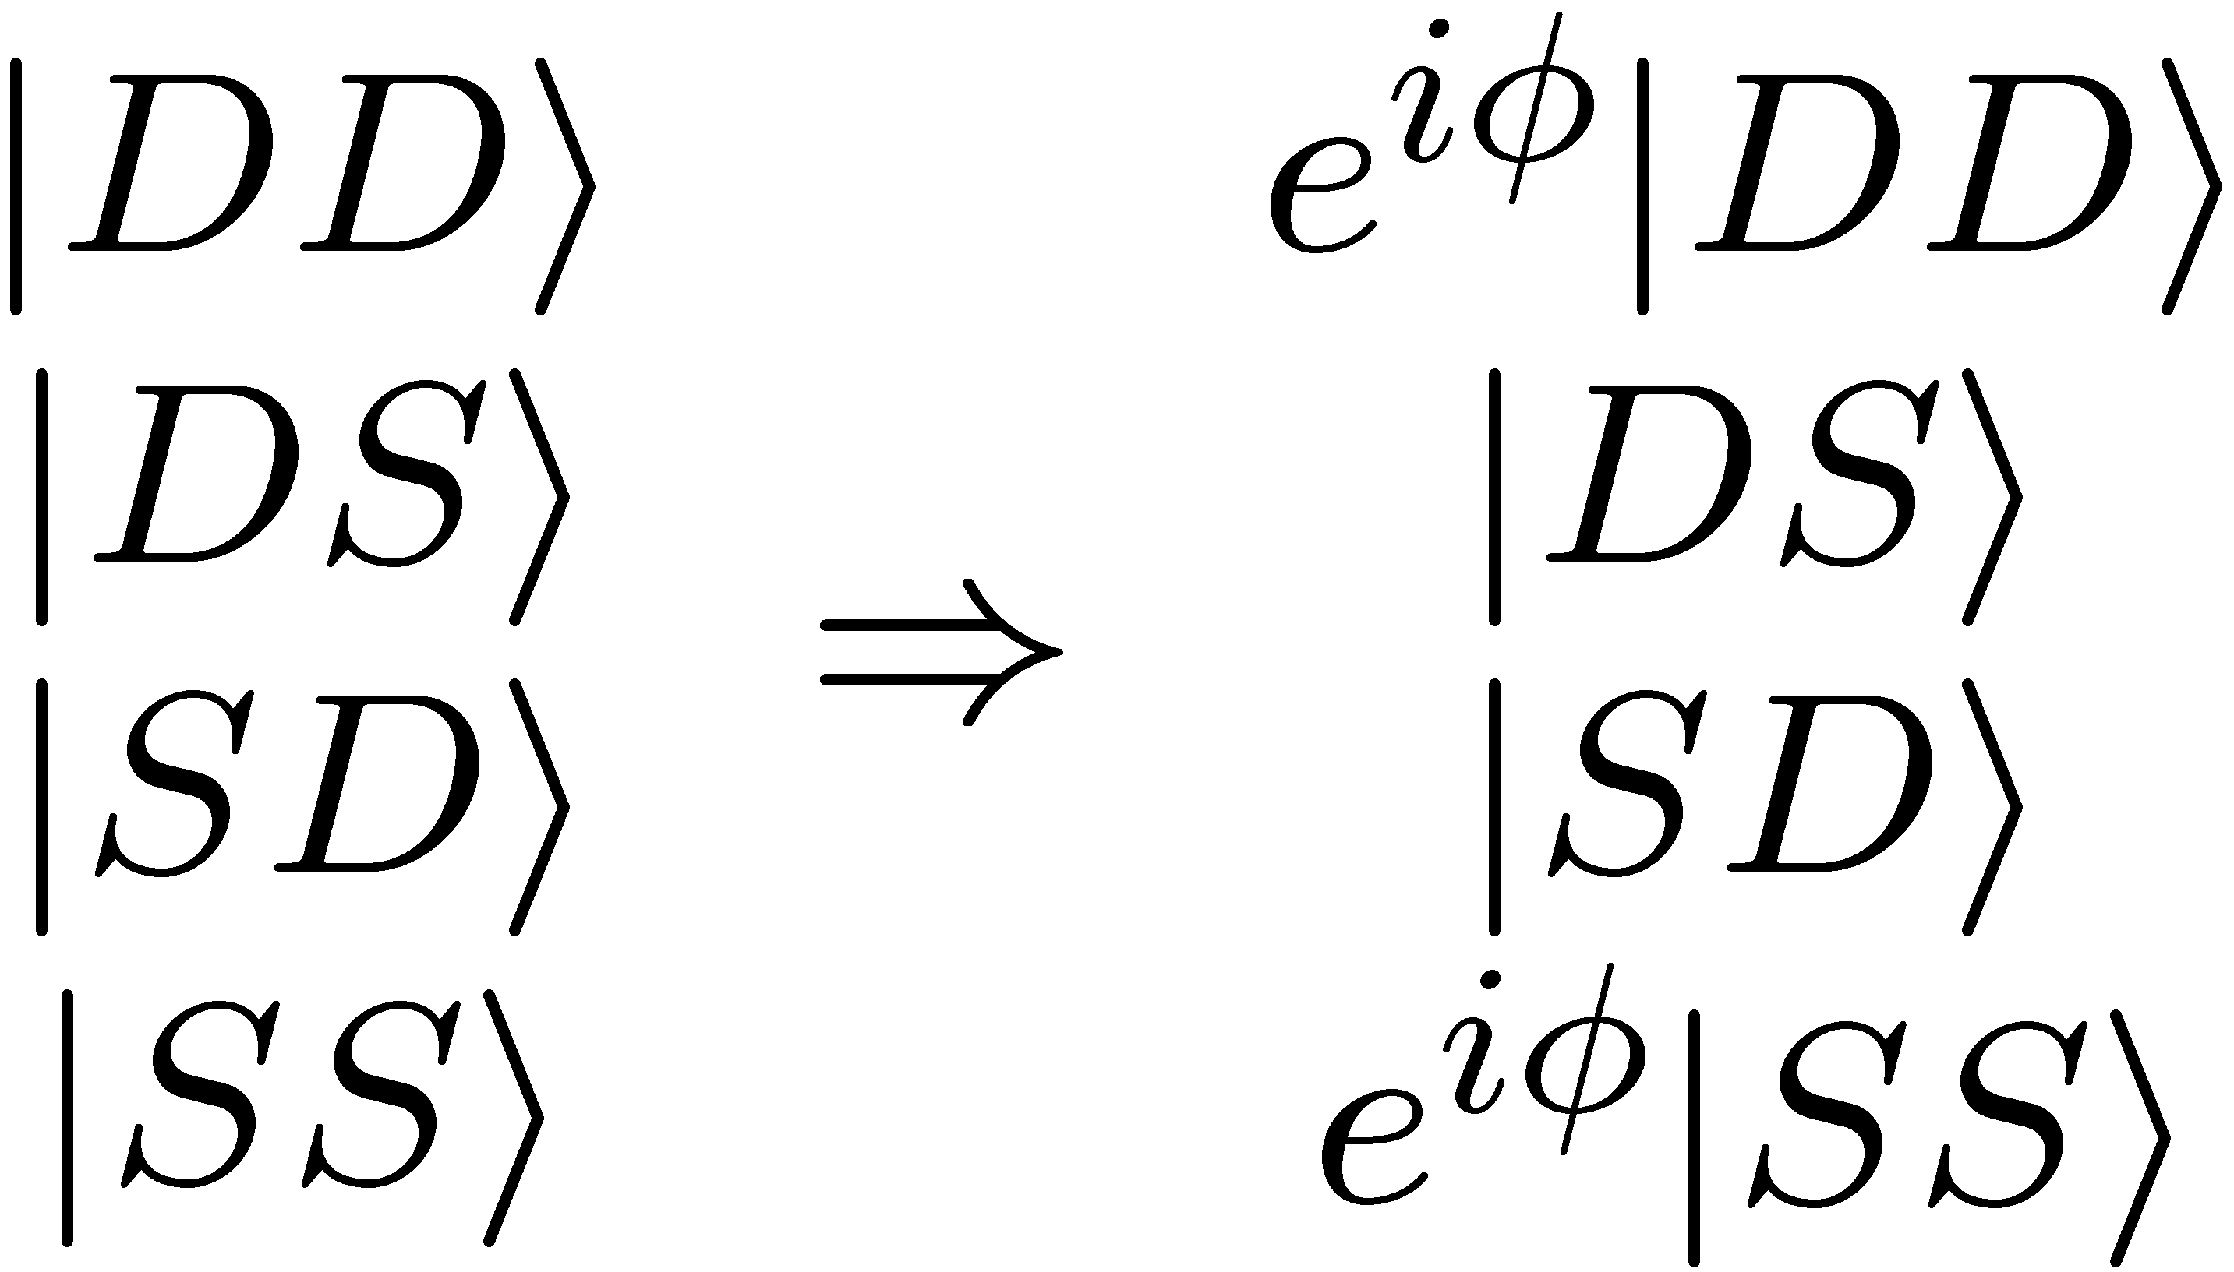
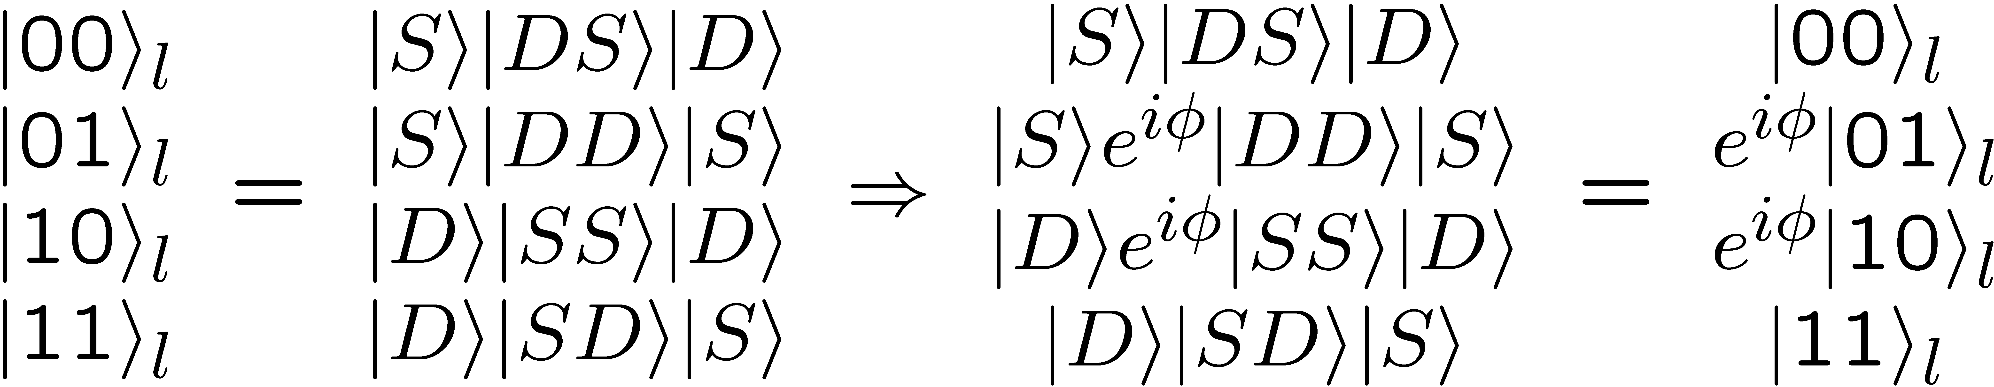
Two logical qubit phase gate
Action of the phase gate on two physical qubits:
...and on the logical qubits:
Notes:
21
21

Slide 16
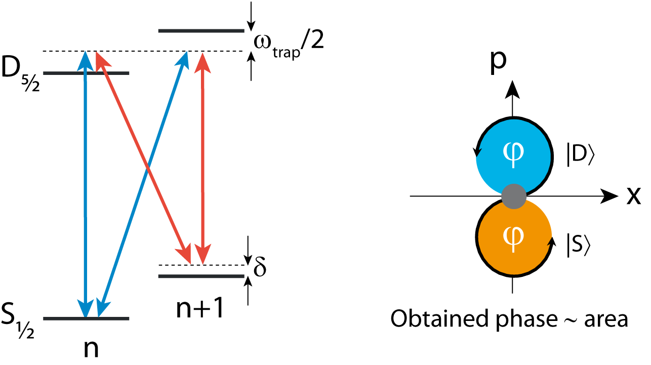
Two qubit phase gate
D. Leibfried, et al., Nature 422 412 (2003)
K. Kim et. al., Phys. Rev. A77, 050303 (2008)‏
Notes:
21
21

Slide 17
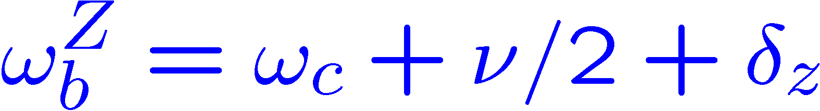
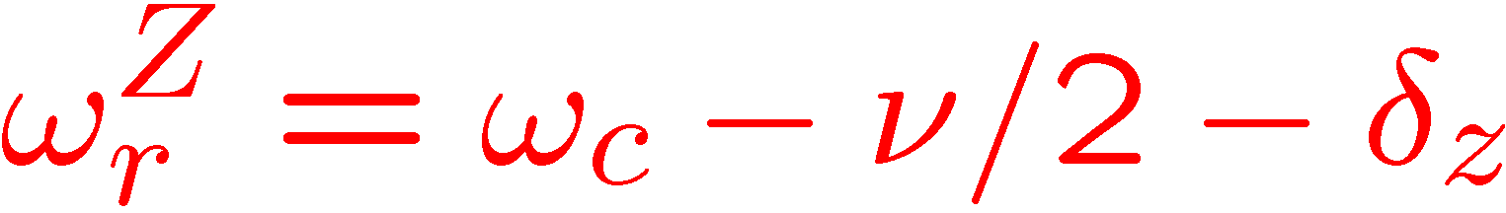
Universal set of gates in a DFS
Z
single qubit phaseshift by
AC Stark shifts
X
Z
Z
Notes:
21

Slide 18
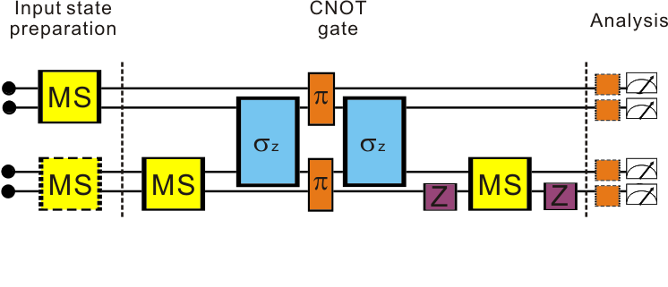

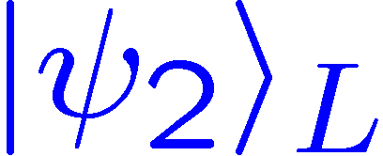
A CNOT in a DFS
spin echo
Notes:
21

Slide 19
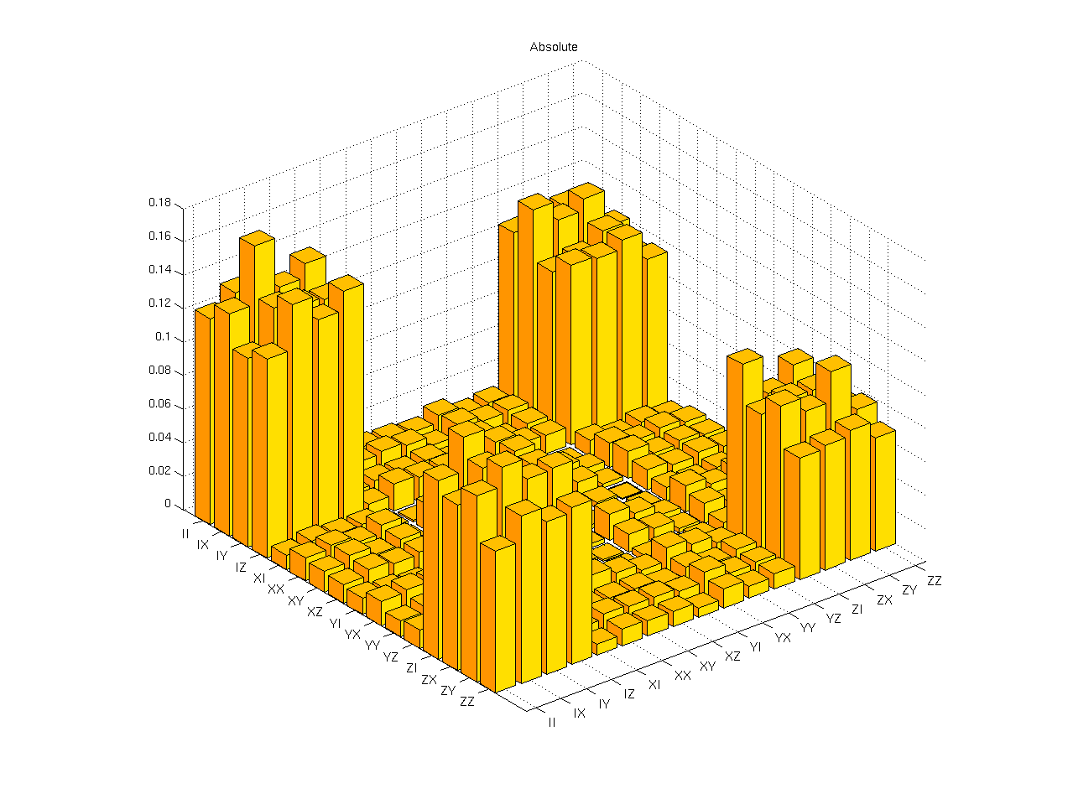

Process tomography of the CNOT
mean gate fidelity
Notes:
21

Slide 20
Discussion
mean gate fidelity: 89(4)%
(after DFS postselection)‏
Main limitations:
- spurious laser frequency components
- off-resonant coupling to other levels
- intensity stability on ions
- addressing errors
Notes:
21

Slide 21
Discussion
Advantages:
lifetime limited coherence time
insensitive to laser linewidth
insensitive to AC-Stark shifts
Notes:
21

