Slide 1
Level scheme ⁹Be⁺

Slide 2
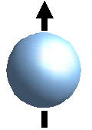
P3/2
P1/2
F=1
S1/2
F=2

Slide 3
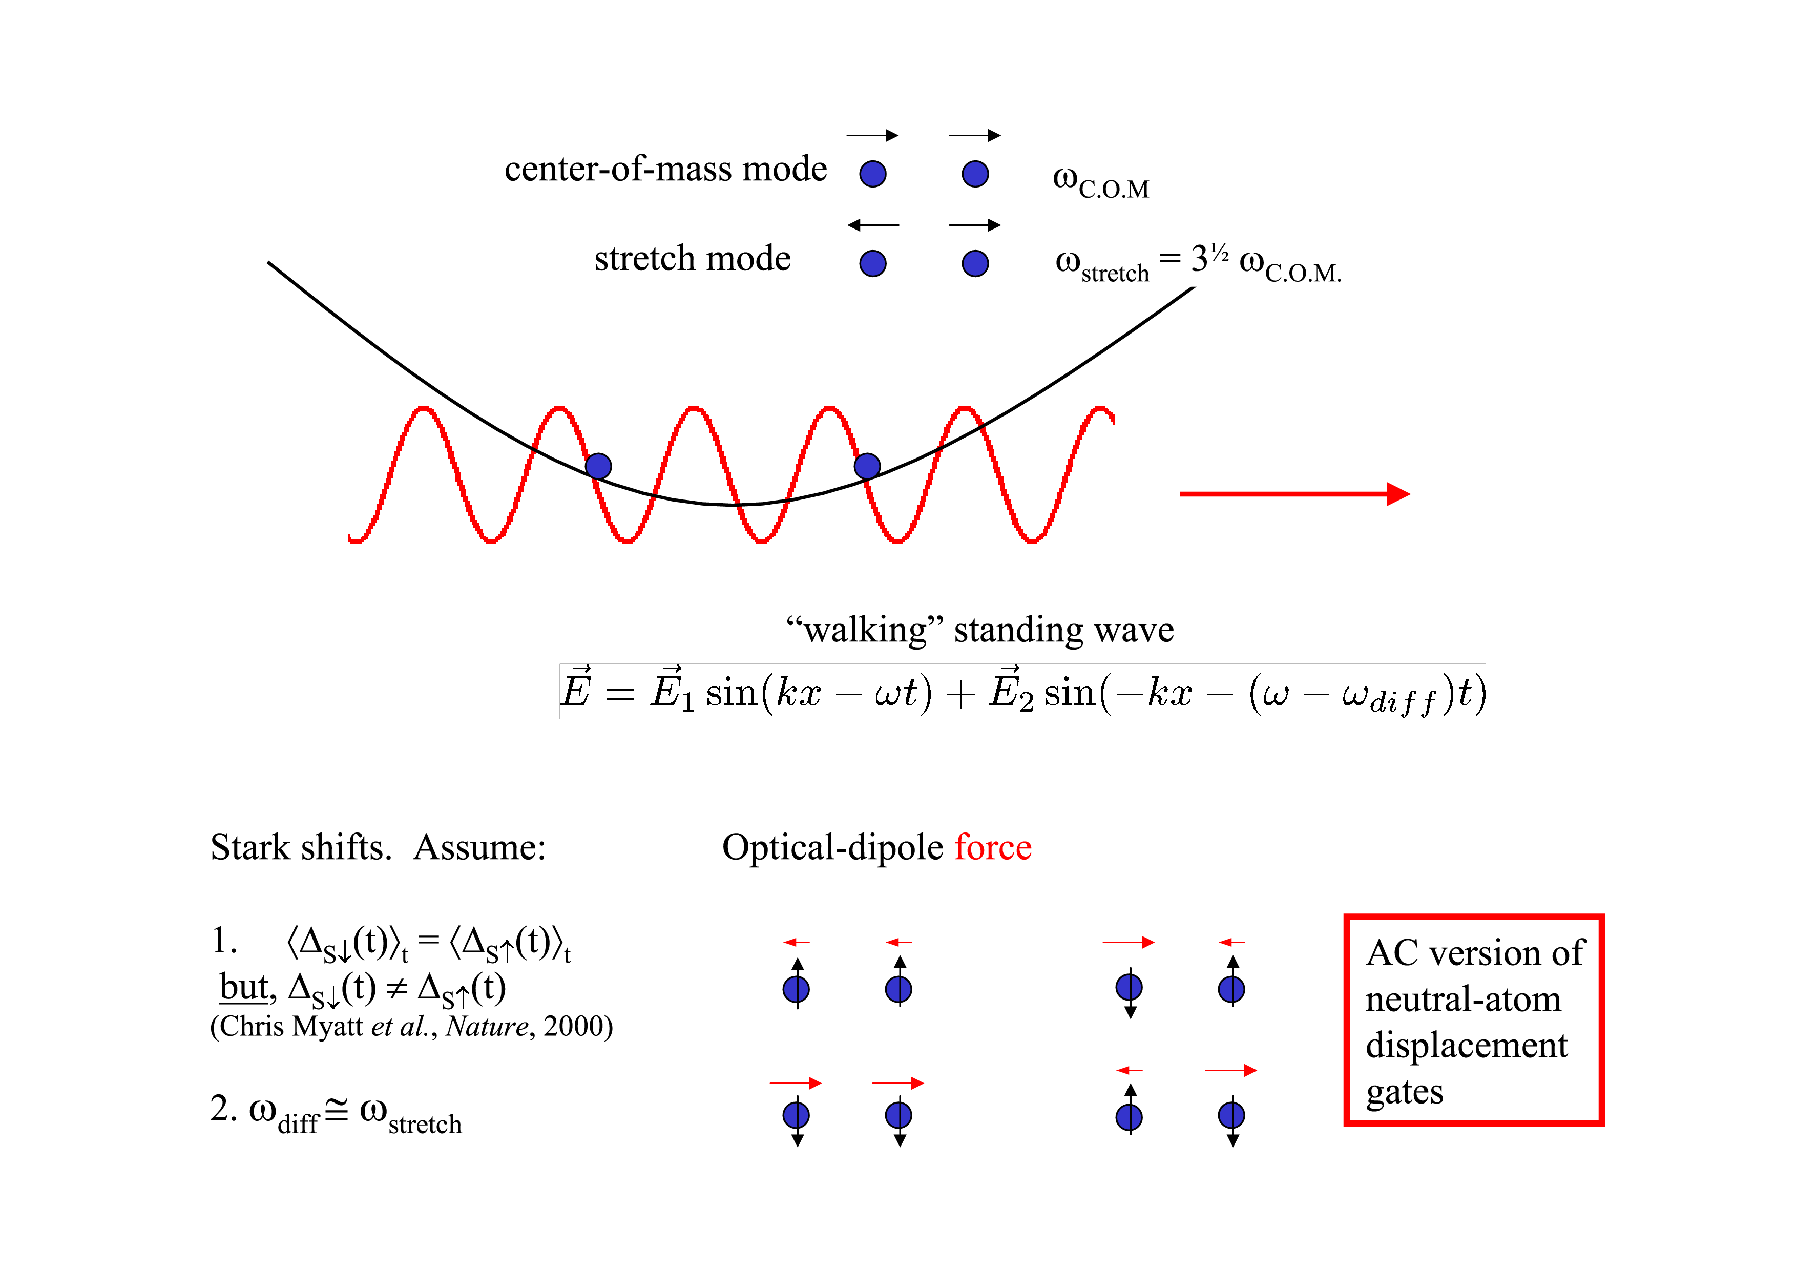
Transparency: Didi Leibfried

Slide 4
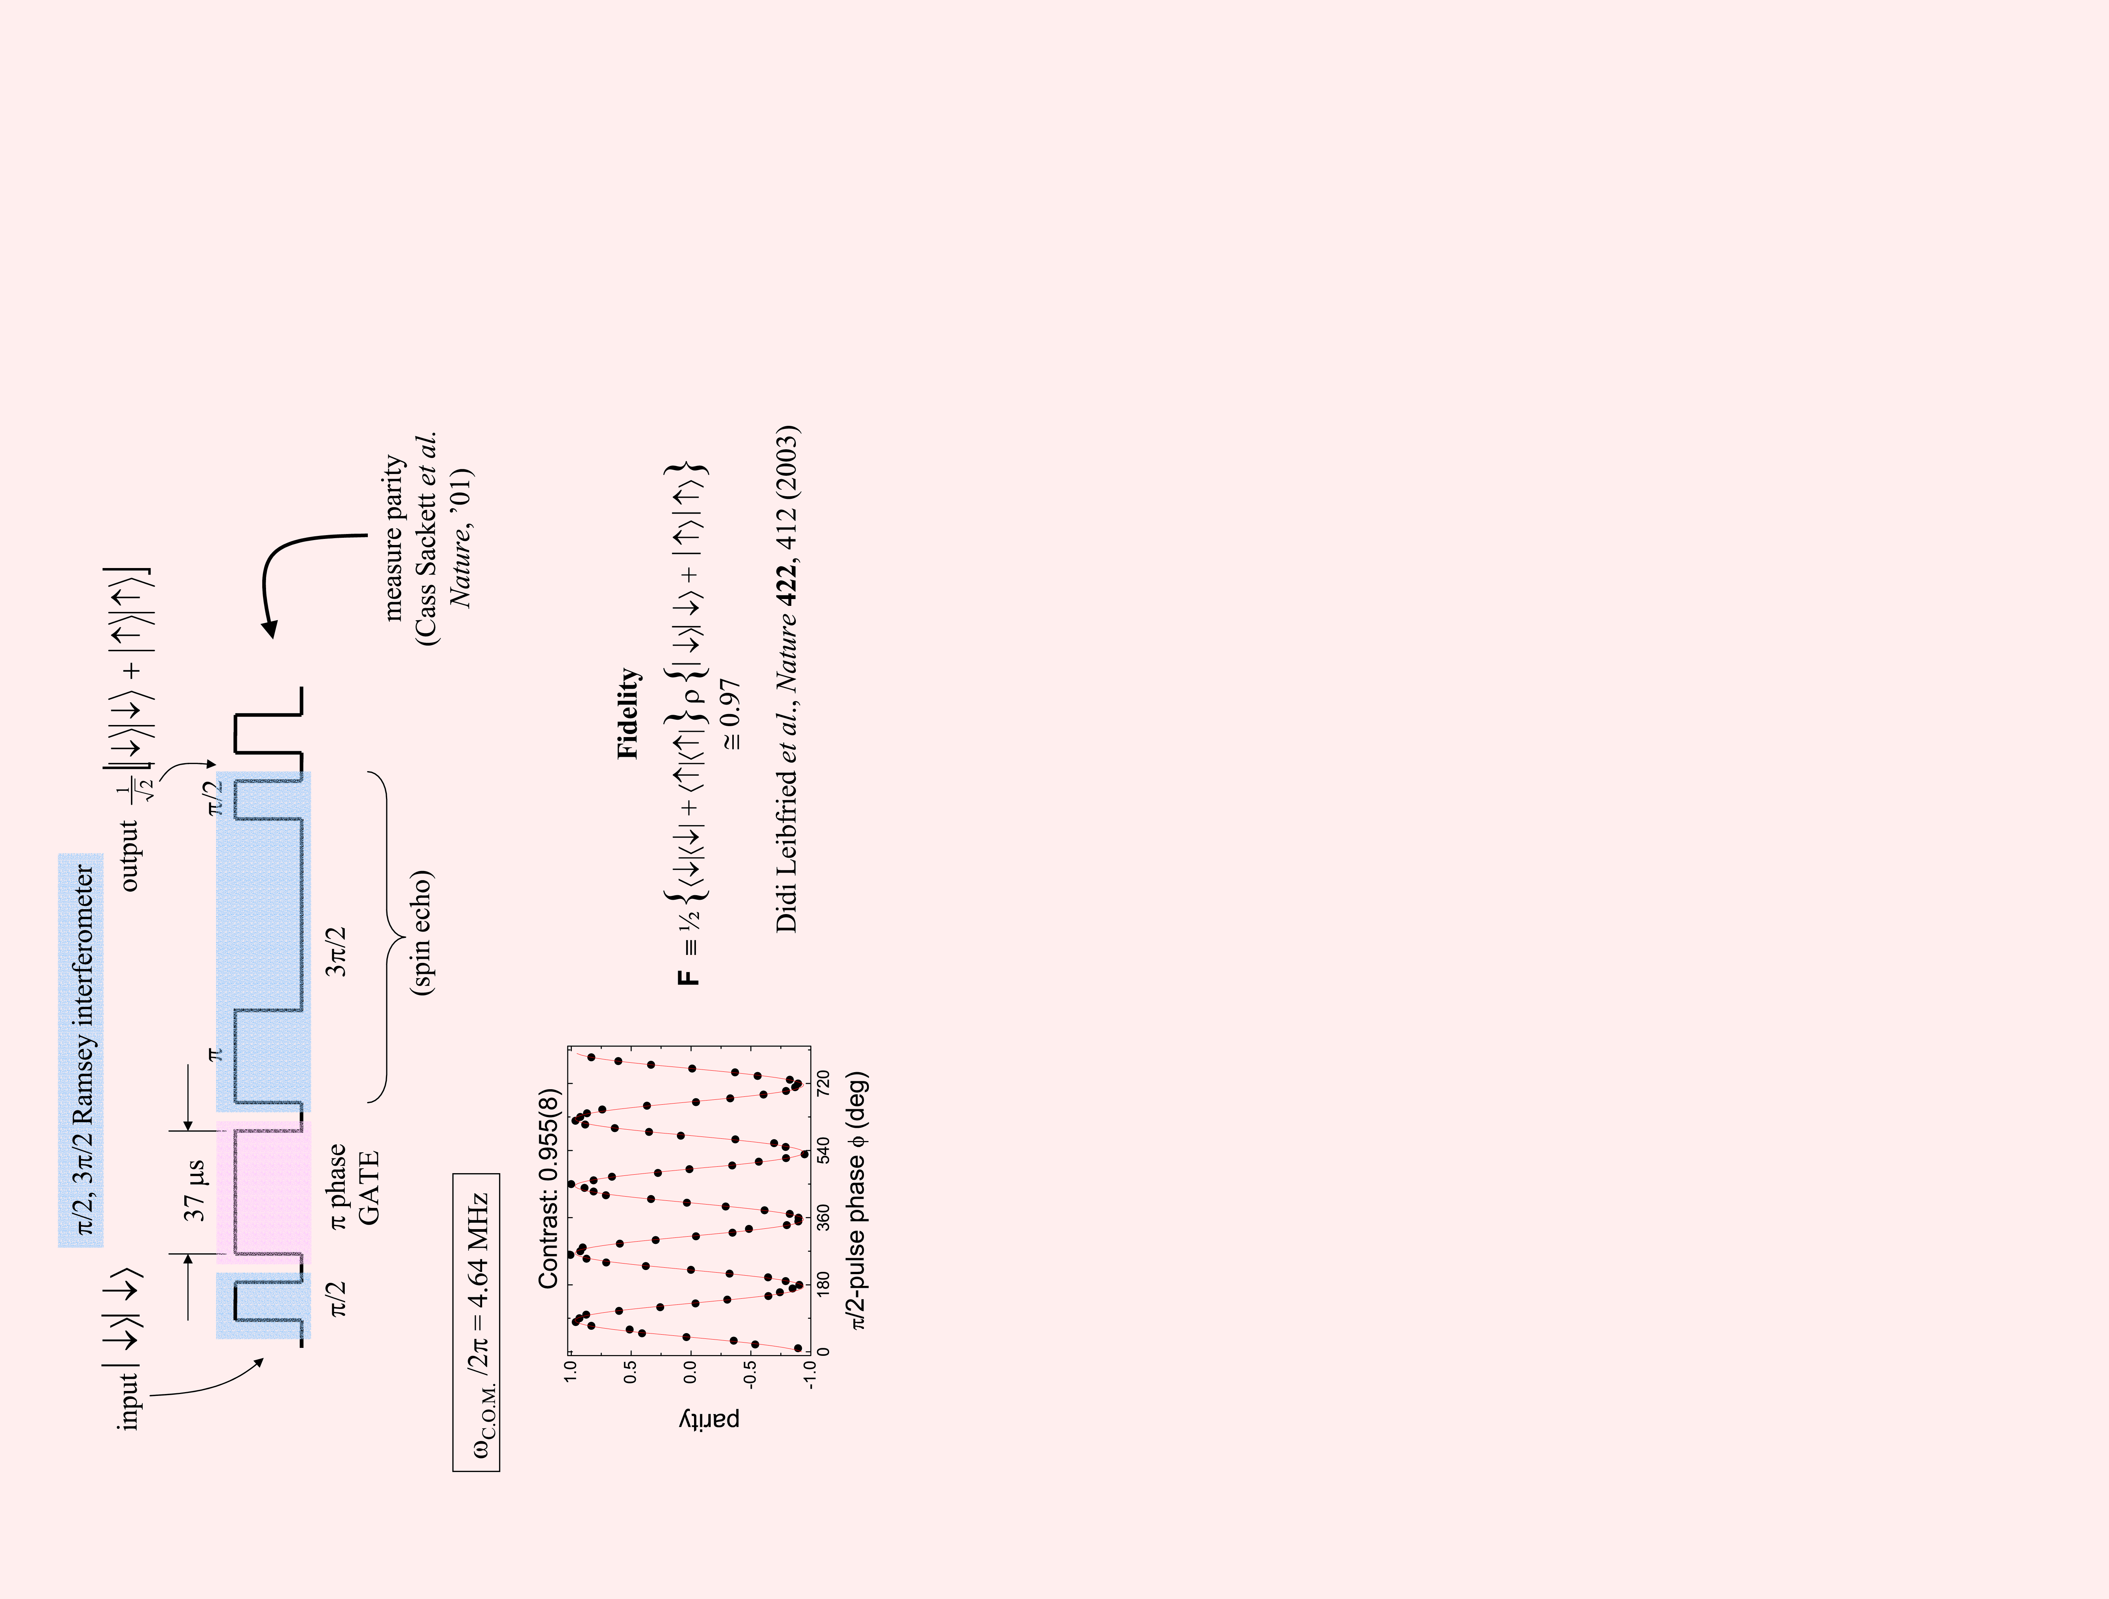
Transparency: Didi Leibfried

Slide 5
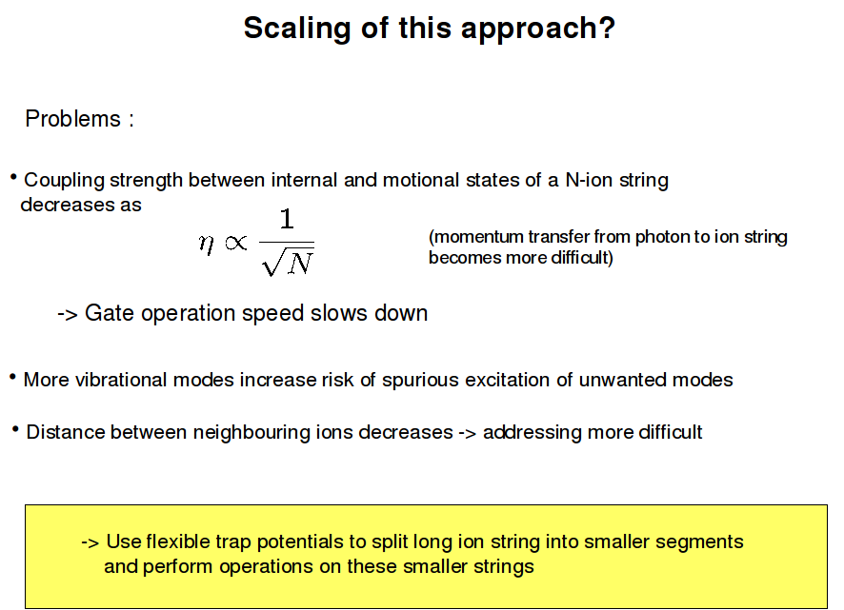
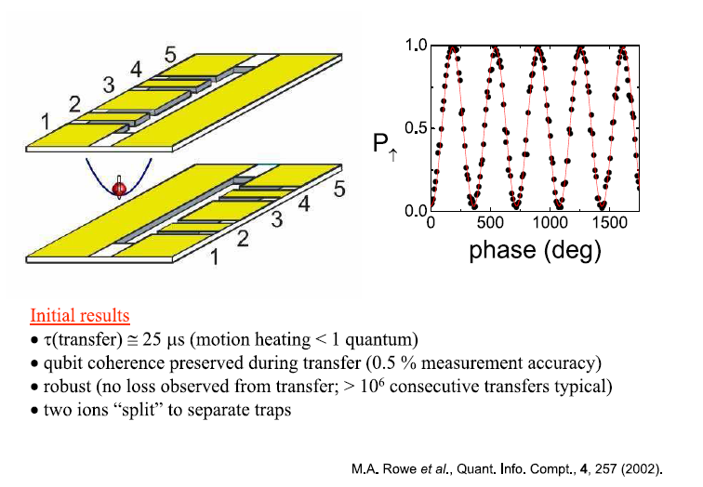

Slide 6


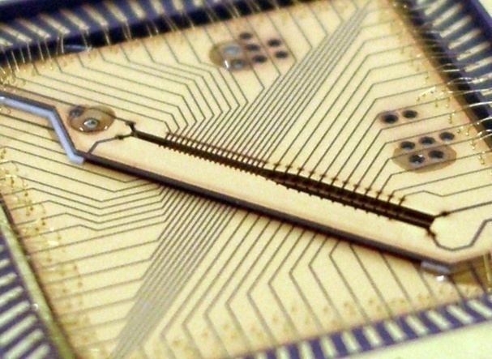
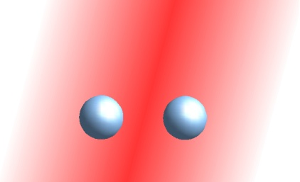

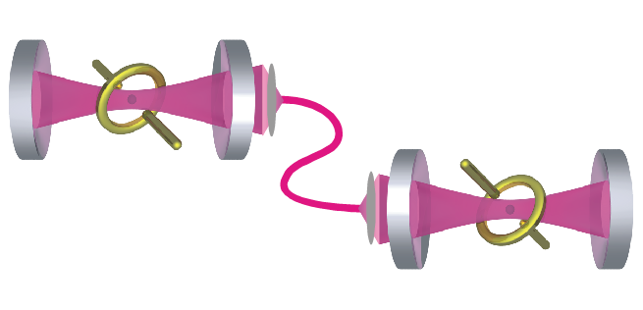
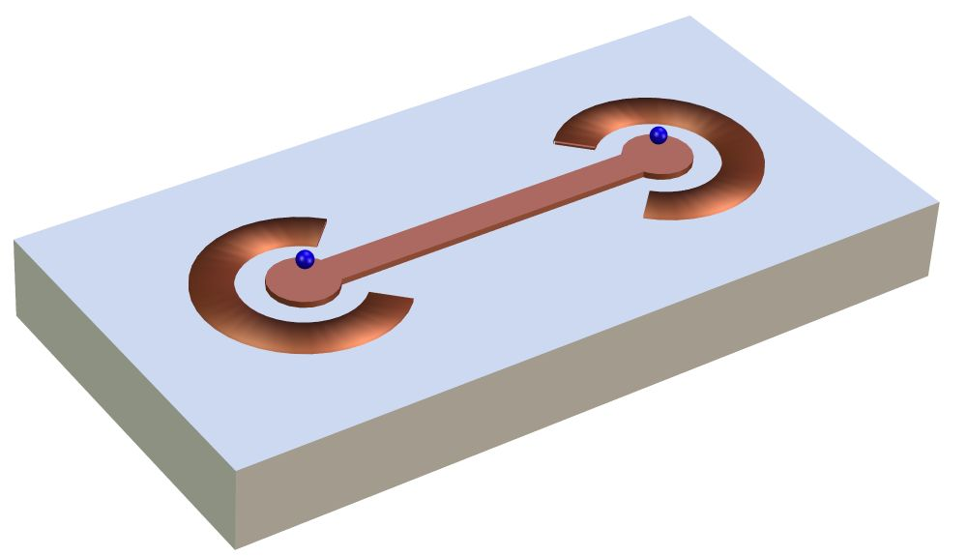
Scaling of ion trap quantum computers
Its easy to have thousands of coherent qubits …
but hard to control their interaction
Kielpinski, Monroe, Wineland
Cirac, Zoller, Kimble, Mabuchi
Zoller, Tian, Blatt
Notes:
5

Slide 7

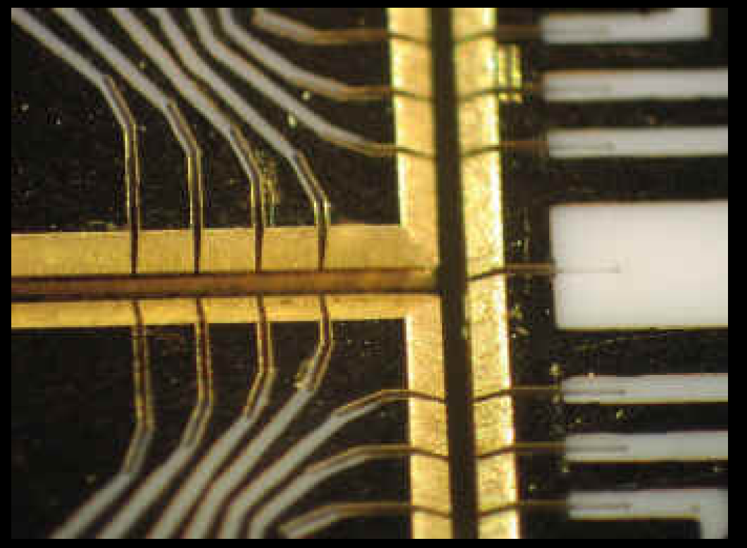
The Michigan T trap
Notes:
5

Slide 8
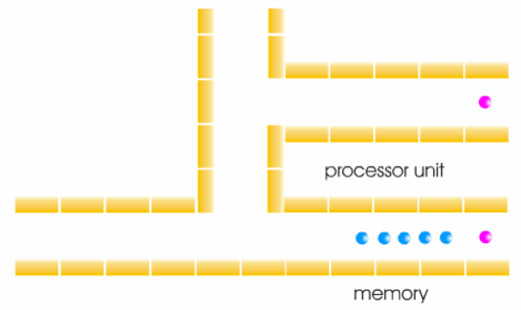
Scaling of ion trap quantum computers
© D. Leibfried
Notes:
5

Slide 9
Scaling of ion trap quantum computers
Notes:
5

Slide 10
Scaling of ion trap quantum computers
Notes:
5

Slide 11

Scaling of ion trap quantum computers
„Architecture for a large-scale ion-trap quantum computer“, D. Kielpinski et al, Nature 417, 709 (2002)
Notes:
5

Slide 12
Segmented ion traps as scalable trap architecture
(ideas pioneered by D. Wineland, NIST)‏
Segmented trap electrode allow to
transport ions and to split ion strings
State of the art:
Transport of ions
Splitting of two-ion crystal
1 mm within 50 µs
t_{separation} ≈ 200 µs
no motional heating
small heating n ≈1
„Architecture for a large-scale ion-trap quantum computer“, D. Kielpinski et al, Nature 417, 709 (2002)
„Transport of quantum states“, M. Rowe et al, quant-ph/0205084
Notes:
5

Slide 13
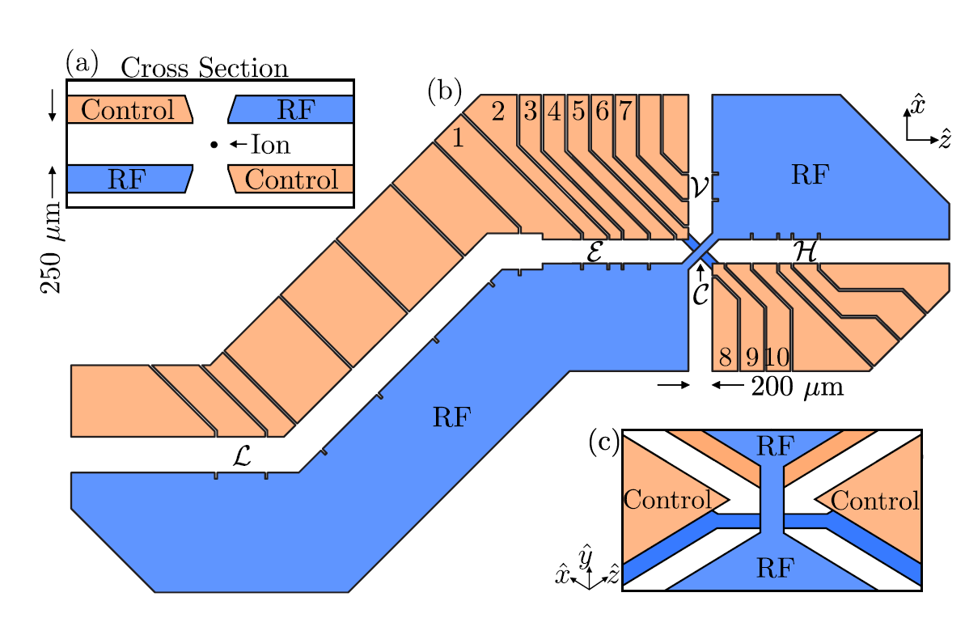
From: Blakestad et al., arXiv: 0901.0533v1 [quant-ph]
Notes:
5

Slide 14
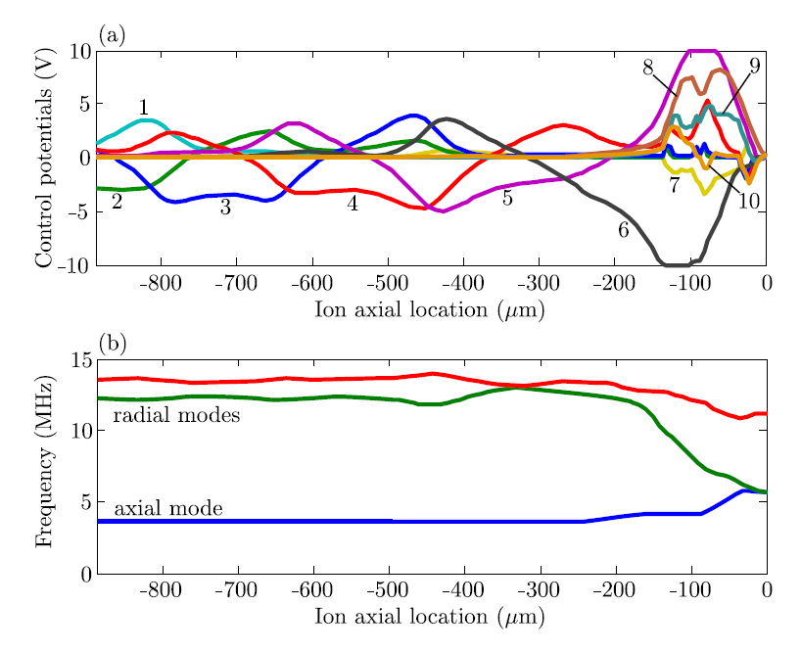
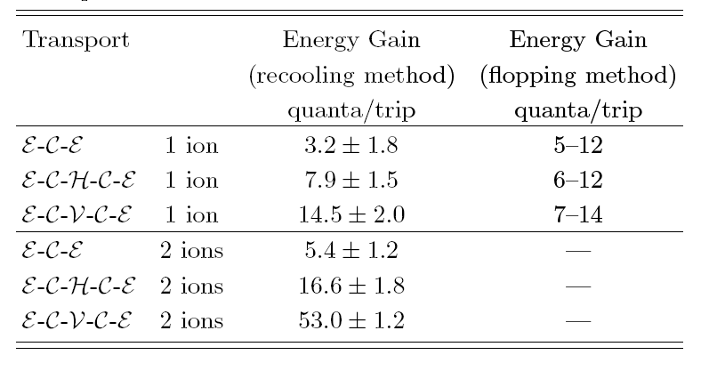
Notes:
5

Slide 15
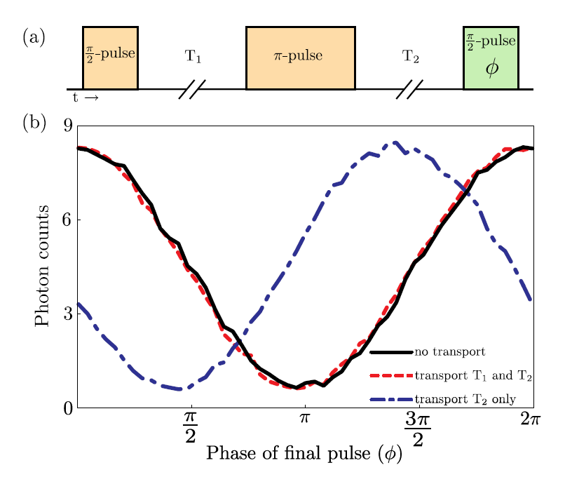
Notes:
5

Slide 16
Realized time scales
Single qubit gates
10⁻⁶ s
Two qubit gates (Geometric phase gates: Boulder, Innsbruck) ‏
10⁻⁵ s
10⁻⁴ s
Two qubit gates (Cirac-Zoller approach)‏
10⁻³ s
10⁻² s
Single qubit coherence (magnetic field sensitive)‏
10⁻¹ s
Coherence of the motion (Innsbruck)‏
10⁰ s
10¹ s
Single qubit coherence (magnetic field insensitive)‏
Decoherence free subspaces
10² s
10³ s
Well chosen single qubit (Boulder)‏
Notes:
5

