Slide 1
QUANTUM COMPUTING
with neutral atoms
Most material courteously from Antoine Browaeys
Groupe d’Optique Quantique,
Institut d’Optique, Orsay

Slide 2
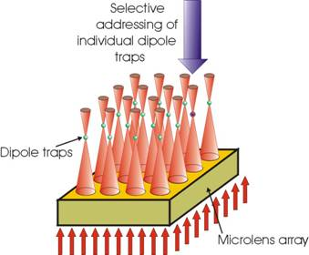
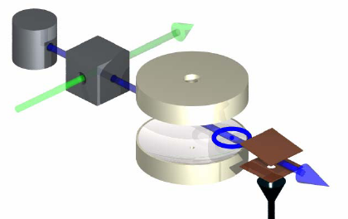
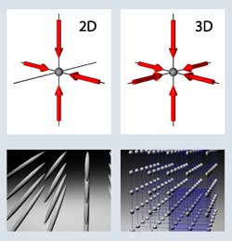
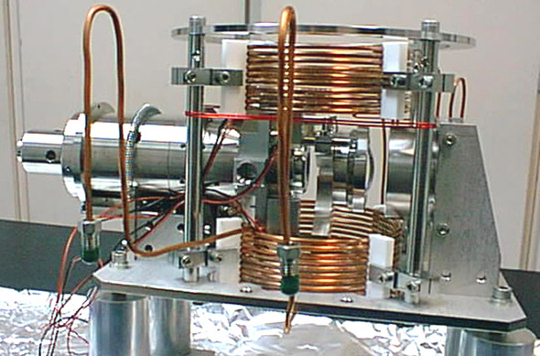
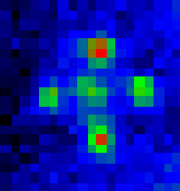
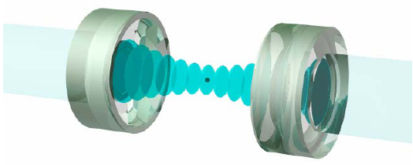
Neutral atom systems
CQED
Optical tweezers, single atoms
BEC + optical lattices
Mainz, NIST
Paris (micro-wave)
MPQ Garching, Bonn,
Caltech (optical CQED)
Bonn, Darmstadt, Orsay, Munich
« Atom chips »
Heidelberg, Orsay, Paris…

Slide 3
ALKALIES QUBIT
Qubit encoded on the internal state of ⁸⁷Rb, or ¹³³Cs
-2
-1
0
1
2
F = 2, |1>
D₂ 780 nm
D₁ 795 nm
6.8 GHz
F = 1, |0>
-1
0
1
Various choices of m states possible

Slide 4
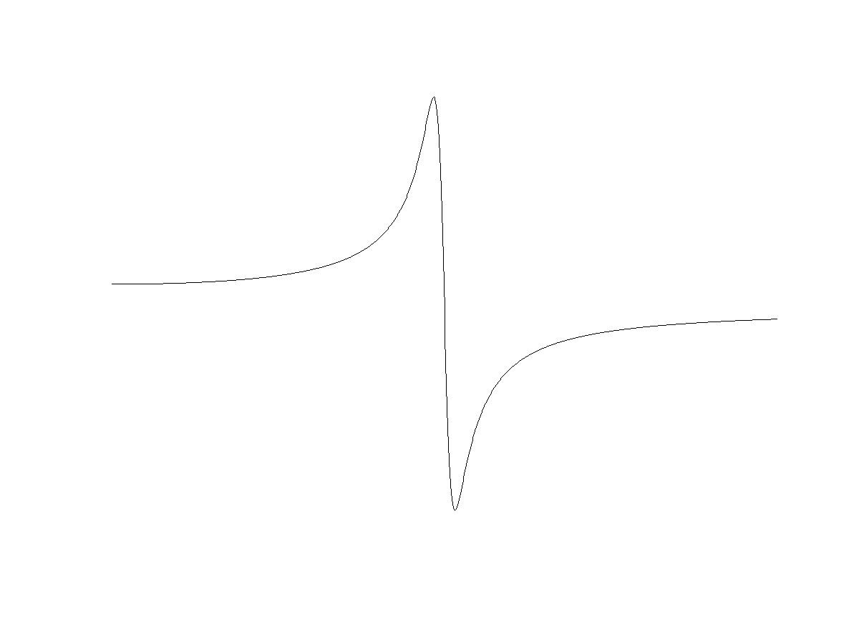
LASER DIPOLE TRAPPING
d = α E
E
laser
Polarizable neutral particle (α, ω₀)
k, ω
Laser – particle interaction energy : U(x) ~ - α E(x)²
POTENTIAL
Harmonic oscillator model of the atom
1 / ω₀ - ω
α(ω)
Depending on the sign of α,
E² maximum = trap
or potential hill
0
ω₀
ω

Slide 5
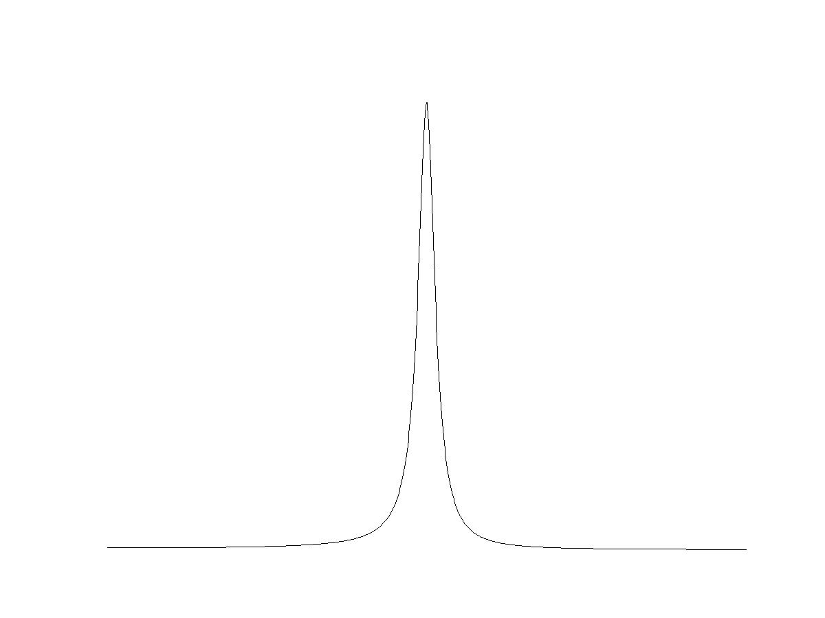
LASER DIPOLE TRAPPING
1 / ( ω₀ – ω )²
Spontaneous
emission
0
ω₀
ω
U ~ Ω² / (ω₀ - ω)
If ω far from ω₀ ,
no spontaneous emission,
U is a conservative potential
Spontaneous emission ~ Ω² / ( ω₀ – ω)²
Problem : weak interaction
Small trap depth (100 mK – 1 mK)
Cold atoms

Slide 6

QUANTUM MECHANICAL POINT OF VIEW: LIGHT - SHIFT
In the dressed state picture (atom dressed by the laser photons) :
The laser induces an AC stark shift through – d.E
|e>
|e>
ω₀
ω
|g>
|g>
U
U
ω₀ > ω
ω₀ < ω
Light shift
( |ω – ω₀| >>Γ )

Slide 7

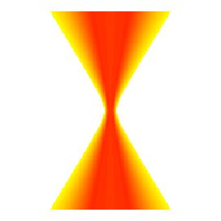
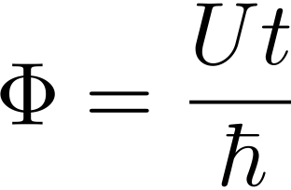


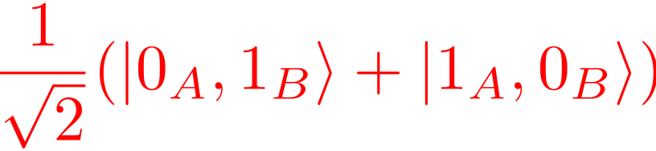
Ideas for controlled atom-atom interactions
Atom-atom collisions
Photon detection
conditioned
(heralded)
Ultra-cold collisions
Dipole-dipole
(Rydberg)
A
B
C/R⁶
R ~ 3 μm
U ~ h × 1 – 100 MHz
(|0_{A}> + |1_{A}>) ⊗ (|0_{B}> + |1_{B}>)
interaction induced
by a measurement
(single photons
+ coalescence)
|0_{A},0_{B}> + |0_{A},1_{B}> +
|1_{A},0_{B}> + e^{iΦ}|1_{A},1_{B}>

Slide 8
Tweezer experiments: Rydberg blockade
Orsay (Grangier), Wisconsin (Saffman)
Conveyor belt: cavity QED (not yet really)
Bonn (Meschede)
Mott state: ultra cold collisions
Bloch, Hänsch (Munich / Mainz)
Porto, Phillips (NIST)

Slide 9
Tweezer experiments: Rydberg blockade
Orsay (Grangier), Wisconsin (Saffman)

Slide 10


TRAPPING A SINGLE ATOM
Dipole force : if ω < ω₀ , trapping at the focal point of the laser
~ w
2πw² / λ
If the beam is focused down to the diffraction limit: w ~ λ
Rayleigh length ~ λ
STRONG TRAPPING IN ALL DIRECTIONS
Trapping volume ~ λ³

Slide 11
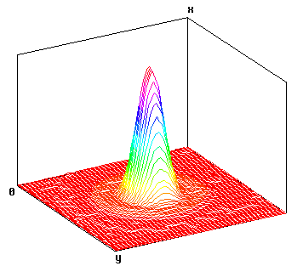
THE (HOME MADE) FOCUSING OBJECTIVE
Operated @ 810 nm
Diffraction limited,
N.A. = 0.7 , Ω/ 4π = 15 %
Focalization on ~ λ = 0.78 μm
Small laser power :
10 mW → I = 10 MW / cm²
Oscillation freq. : 130 kHz, 40 kHz
Vacuum compatible ( ~ 10⁻¹⁰ mbar)
Focal point
Intensity
x
y
5 cm
0.7 μm
Orsay experiment

Slide 12
TRAPPING THE ATOM
Dipole trap
Rb
Oven
200 m/s
Slowing
200 m / s→ ~ 1 m / s
Dilute atomic cloud
T ~ 100 μK

Slide 13
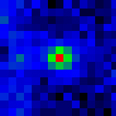

OBSERVING THE ATOM
MOT & dipole trap
Avalanche
photodiode
1 μm
CCD camera
780 nm filter
Dipole trap beam
(810 nm)
Fluorescence light induced by
the MOT beams (780 nm)

Slide 14
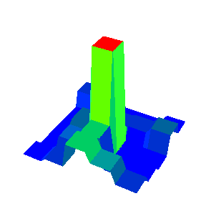
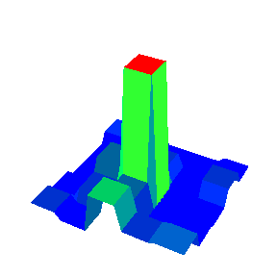
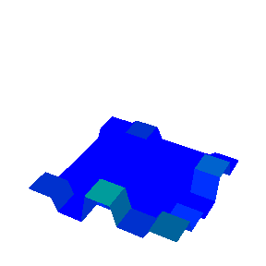
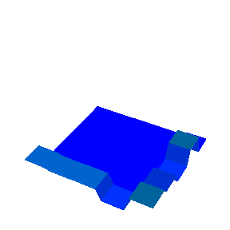
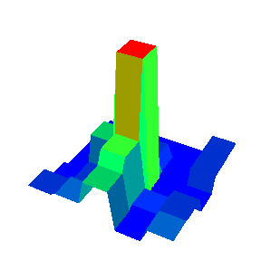





TRAPPING SINGLE ATOMS
Resolution of the imaging system ~ 1 μm
1 / 2
1 μm
CCD
5 μm
12
8
counts / ms
4
0
0
5
10
15
20
25
time (sec)
Schlosser et al., Nature 411, 1024 (2001)

Slide 15
ARRAYS OF TRAPPED ATOMS
Phase hologram generated by a Spatial Light Modulator (Hamamatsu)
E
x
Ee^{iφ(x,y)}
y
PC
Lens (Objective)
Fourier plane
~ TF (e^{iφ(x,y)})
SLM
(programmable
liquid crystal)
A single beam allows for the generation of an arbitrary pattern in a plane
Diffraction efficiency ~ 80 %

Slide 16
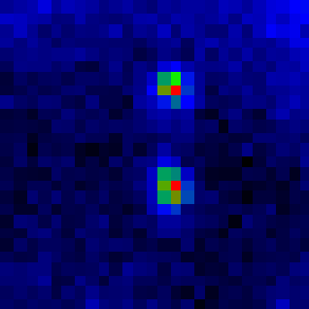
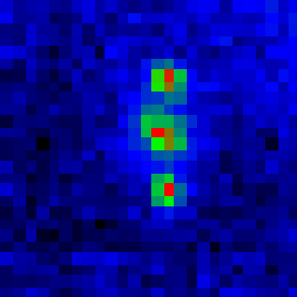
EXAMPLE OF CONFIGURATIONS
Few atoms / site
Bergamini et al.
JOSA B 21, 1889 (2004)
~ 20 μm
~ 20 μm
Plane of 3D traps

Slide 17
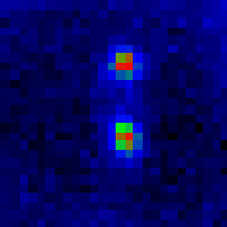


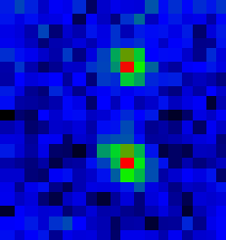
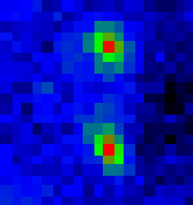
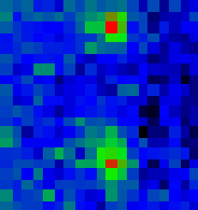
CONTROLLING THE GEOMETRY
Changing the modulation
Control the distance between traps ∝ 1 / hologram period
4 μm
6 μm
7 μm
9 μm
12 μm

Slide 18
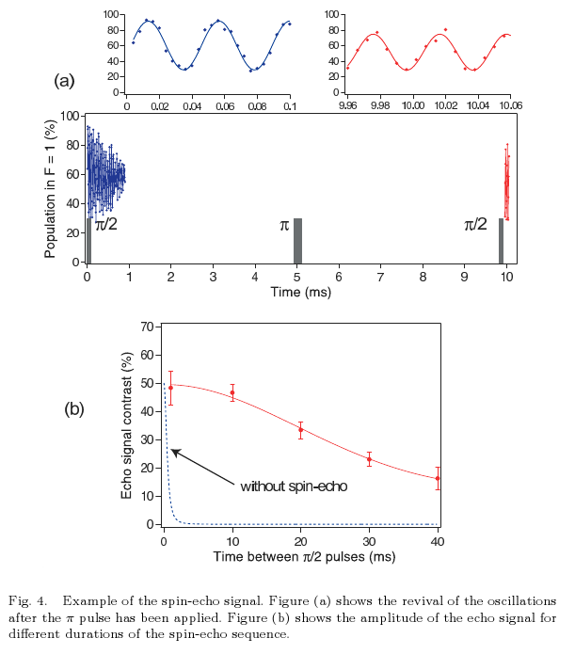
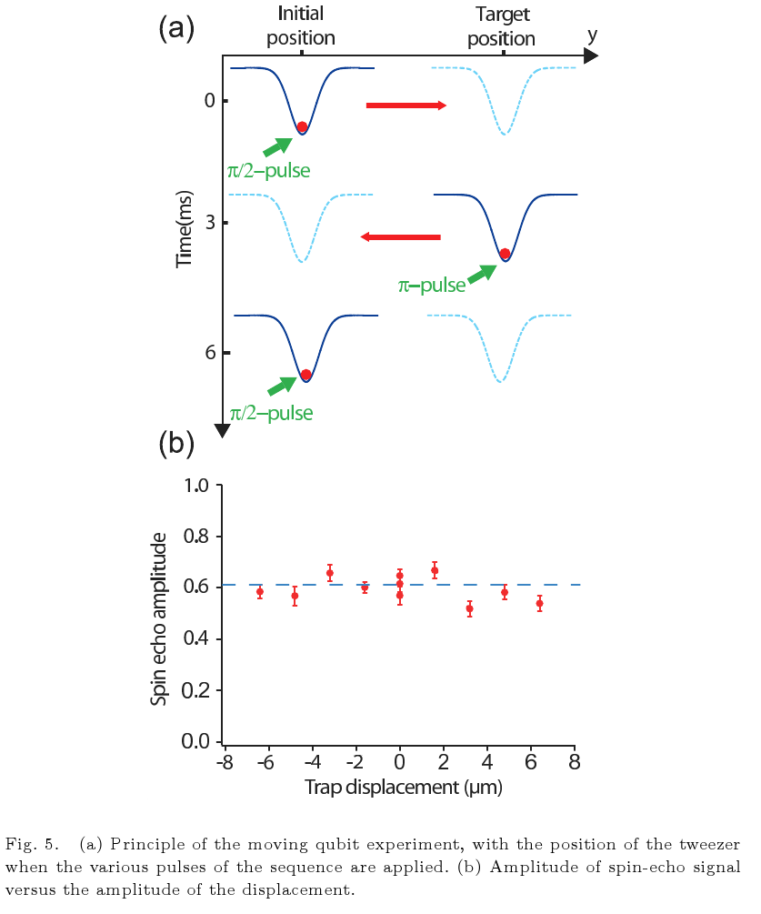
CONTROLLING THE GEOMETRY
6 ms roundtrip time

Slide 19
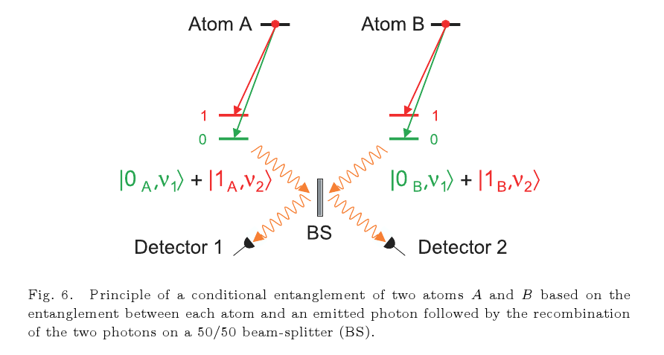
CONTROLLING THE GEOMETRY

Slide 20
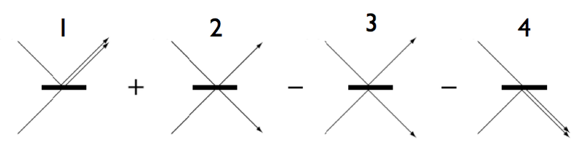
CONTROLLING THE GEOMETRY

Slide 21
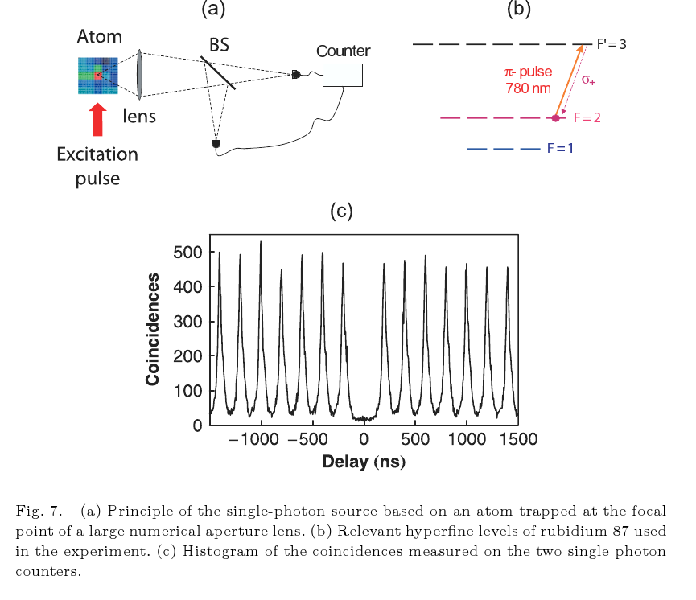
CONTROLLING THE GEOMETRY

Slide 22
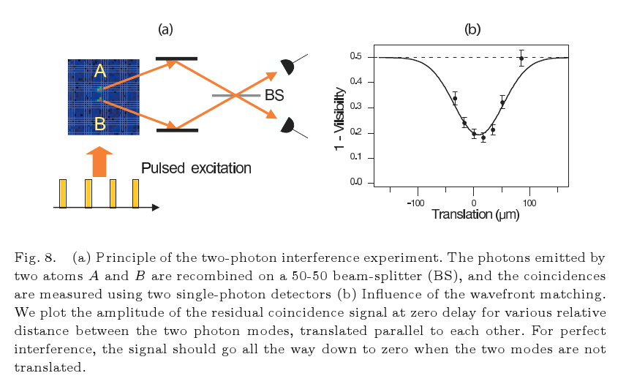
CONTROLLING THE GEOMETRY

Slide 23
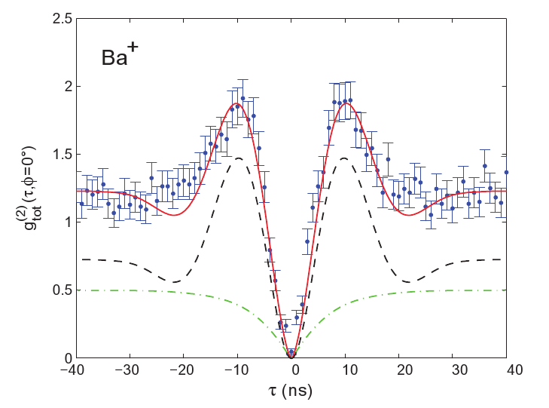
CONTROLLING THE GEOMETRY
Gerber et al., NJP 11, 013032 (2009)

Slide 24
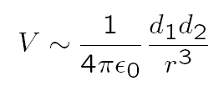

Rydberg gate
Jaksch et al, PRL 85, 2208 (2000)
r
Large n :
n = 40
r = 5 μm
⇒ V / h ≈ 160 MHz

Slide 25
Rydberg gate
r
r
1
1
0
0
Atom 1
Atom 2
r
0 0 0 0 - 0 0 - 0 0
0 1 0 1 - 0 1 - 0 1
1 0 r 0 - r 0 - 1 0
1 1 r 1
π₁
2π₂
−π₁

Slide 26
Rydberg gate
r
r
r r
1
1
0 r
r 0
r1 or 1r
0
0
Atom 1
Atom 2
r
00
01
10
11
0 0 0 0 -0 0 -0 0
0 1 0 1 -0 1 -0 1
1 0 r 0 -r 0 -1 0
1 1 r 1 r 1 11
π₁
2π₂
−π₁

Slide 27
Rydberg gate
r
r
V
r r
1
1
0 r
r 0
r1 or 1r
0
0
Atom 1
Atom 2
r
00
01
10
11
0 0 0 0 - 0 0 - 0 0
0 1 0 1 - 0 1 - 0 1
1 0 r 0 - r 0 - 1 0
1 1 r 1 r 1 1 1
blockade

Slide 28
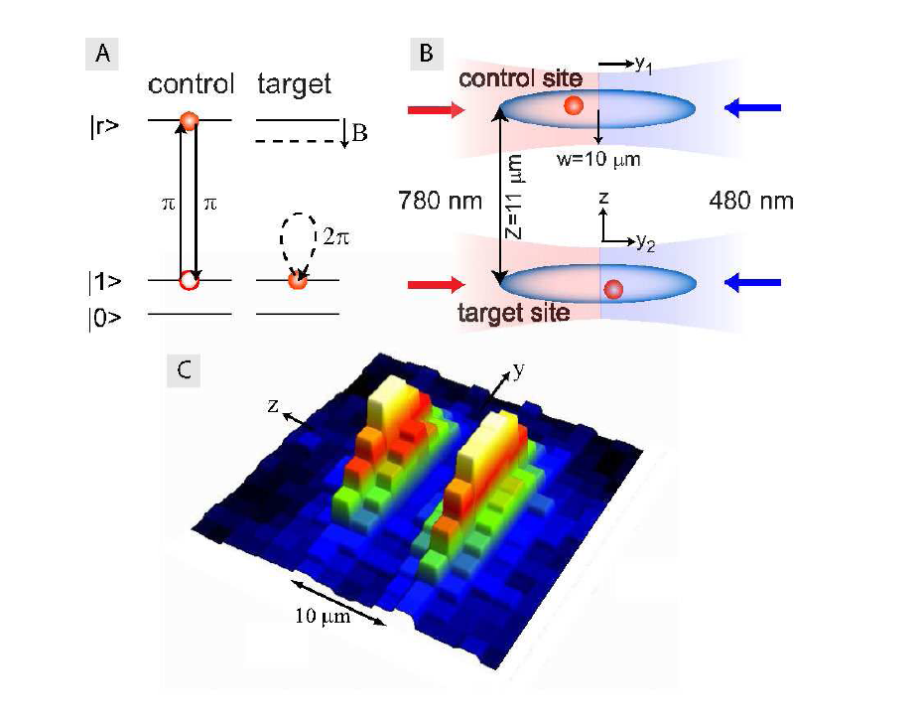
Urban et al., Nature Physics 5 110 (2009)

Slide 29
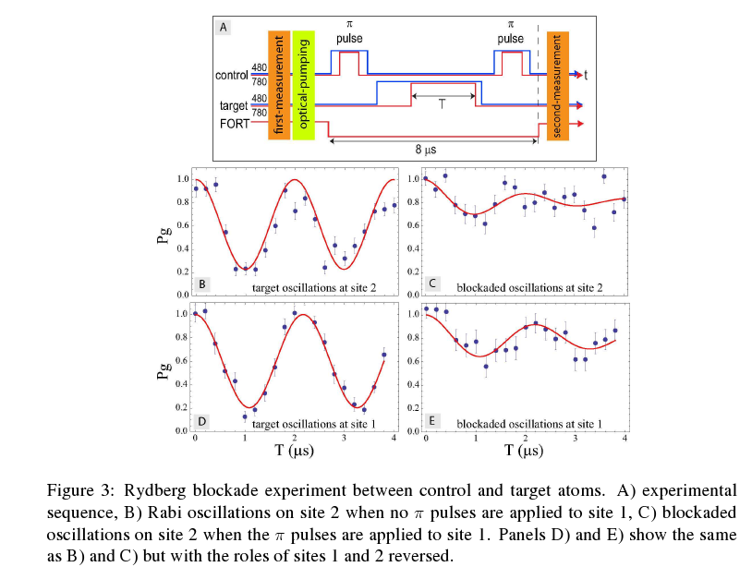
Detection: measuring atom loss due to FORT when atom is in a Rydberg state
Urban et al., Nature Physics 5 110 (2009)

Slide 30
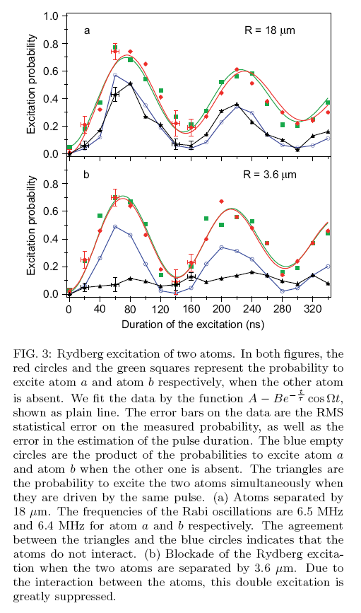
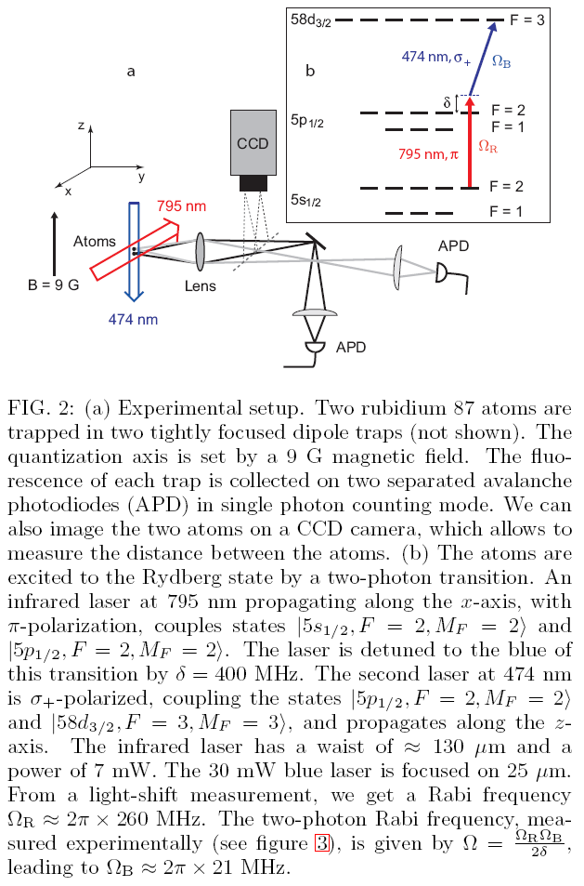
Gaetan et al., Nature Physics 5 115 (2009)

Slide 31
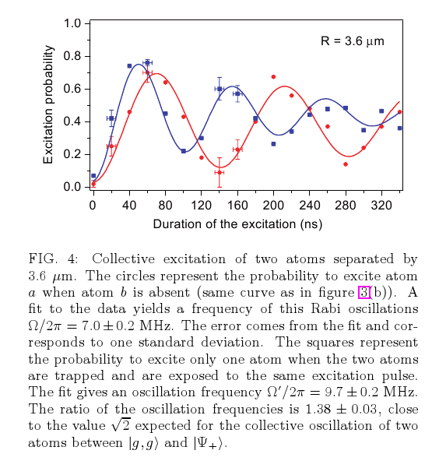
Gaetan et al., Nature Physics 5 115 (2009)

Slide 32
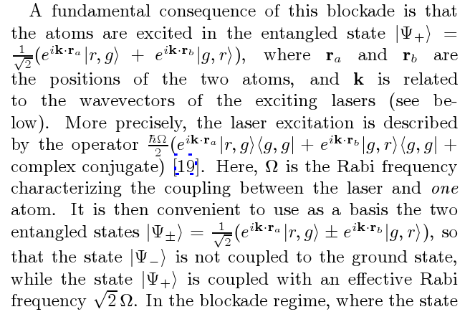
Gaetan et al., Nature Physics 5 115 (2009)

Slide 33
Rydberg gate : pros and cons
No excitation of (r, r) ⇒ no mechanical force
Low sensitivity to the exact distance between the atoms
Fast (typically ~ h / V)
BUT
Adressability required
Mastering the Rydberg (production, low lifetime…)

Slide 34
CONCLUSION ON QC WITH SINGLE ATOMS IN TWEEZER
Large numerical aperture lens provides
1 Sub-micron resolution
Array of trapped atoms + adressability if used as a tweezer
Spatial resolution for the detection
2 Large Collection efficiency → fast manipulation
Initialisation ~ 100 μs
1 – Qubit operation ~ 1 μs
2 – Qubit operation: < 1 μs (Rydberg gate)
Detection ~ 0.5 ms

Slide 35

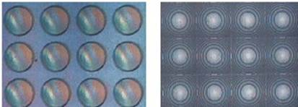
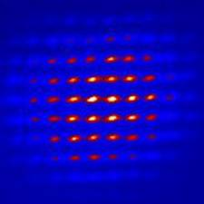
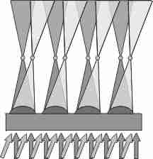
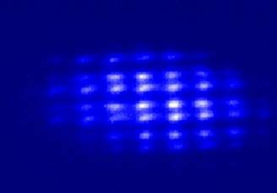
Array of microlenses
Dumke et al, PRL 89, 097903 (2002)

Slide 36
Conveyor belt: cavity QED (not yet really)
Bonn (Meschede)

Slide 37
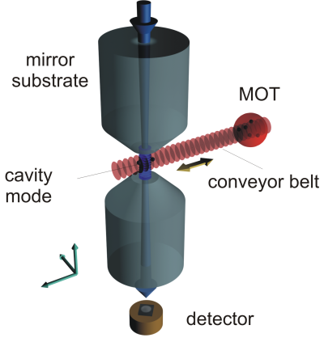

Slide 38

Conveyor belt for neutral atoms
Kuhr et al, Science 293, 278 (2001)

Slide 39
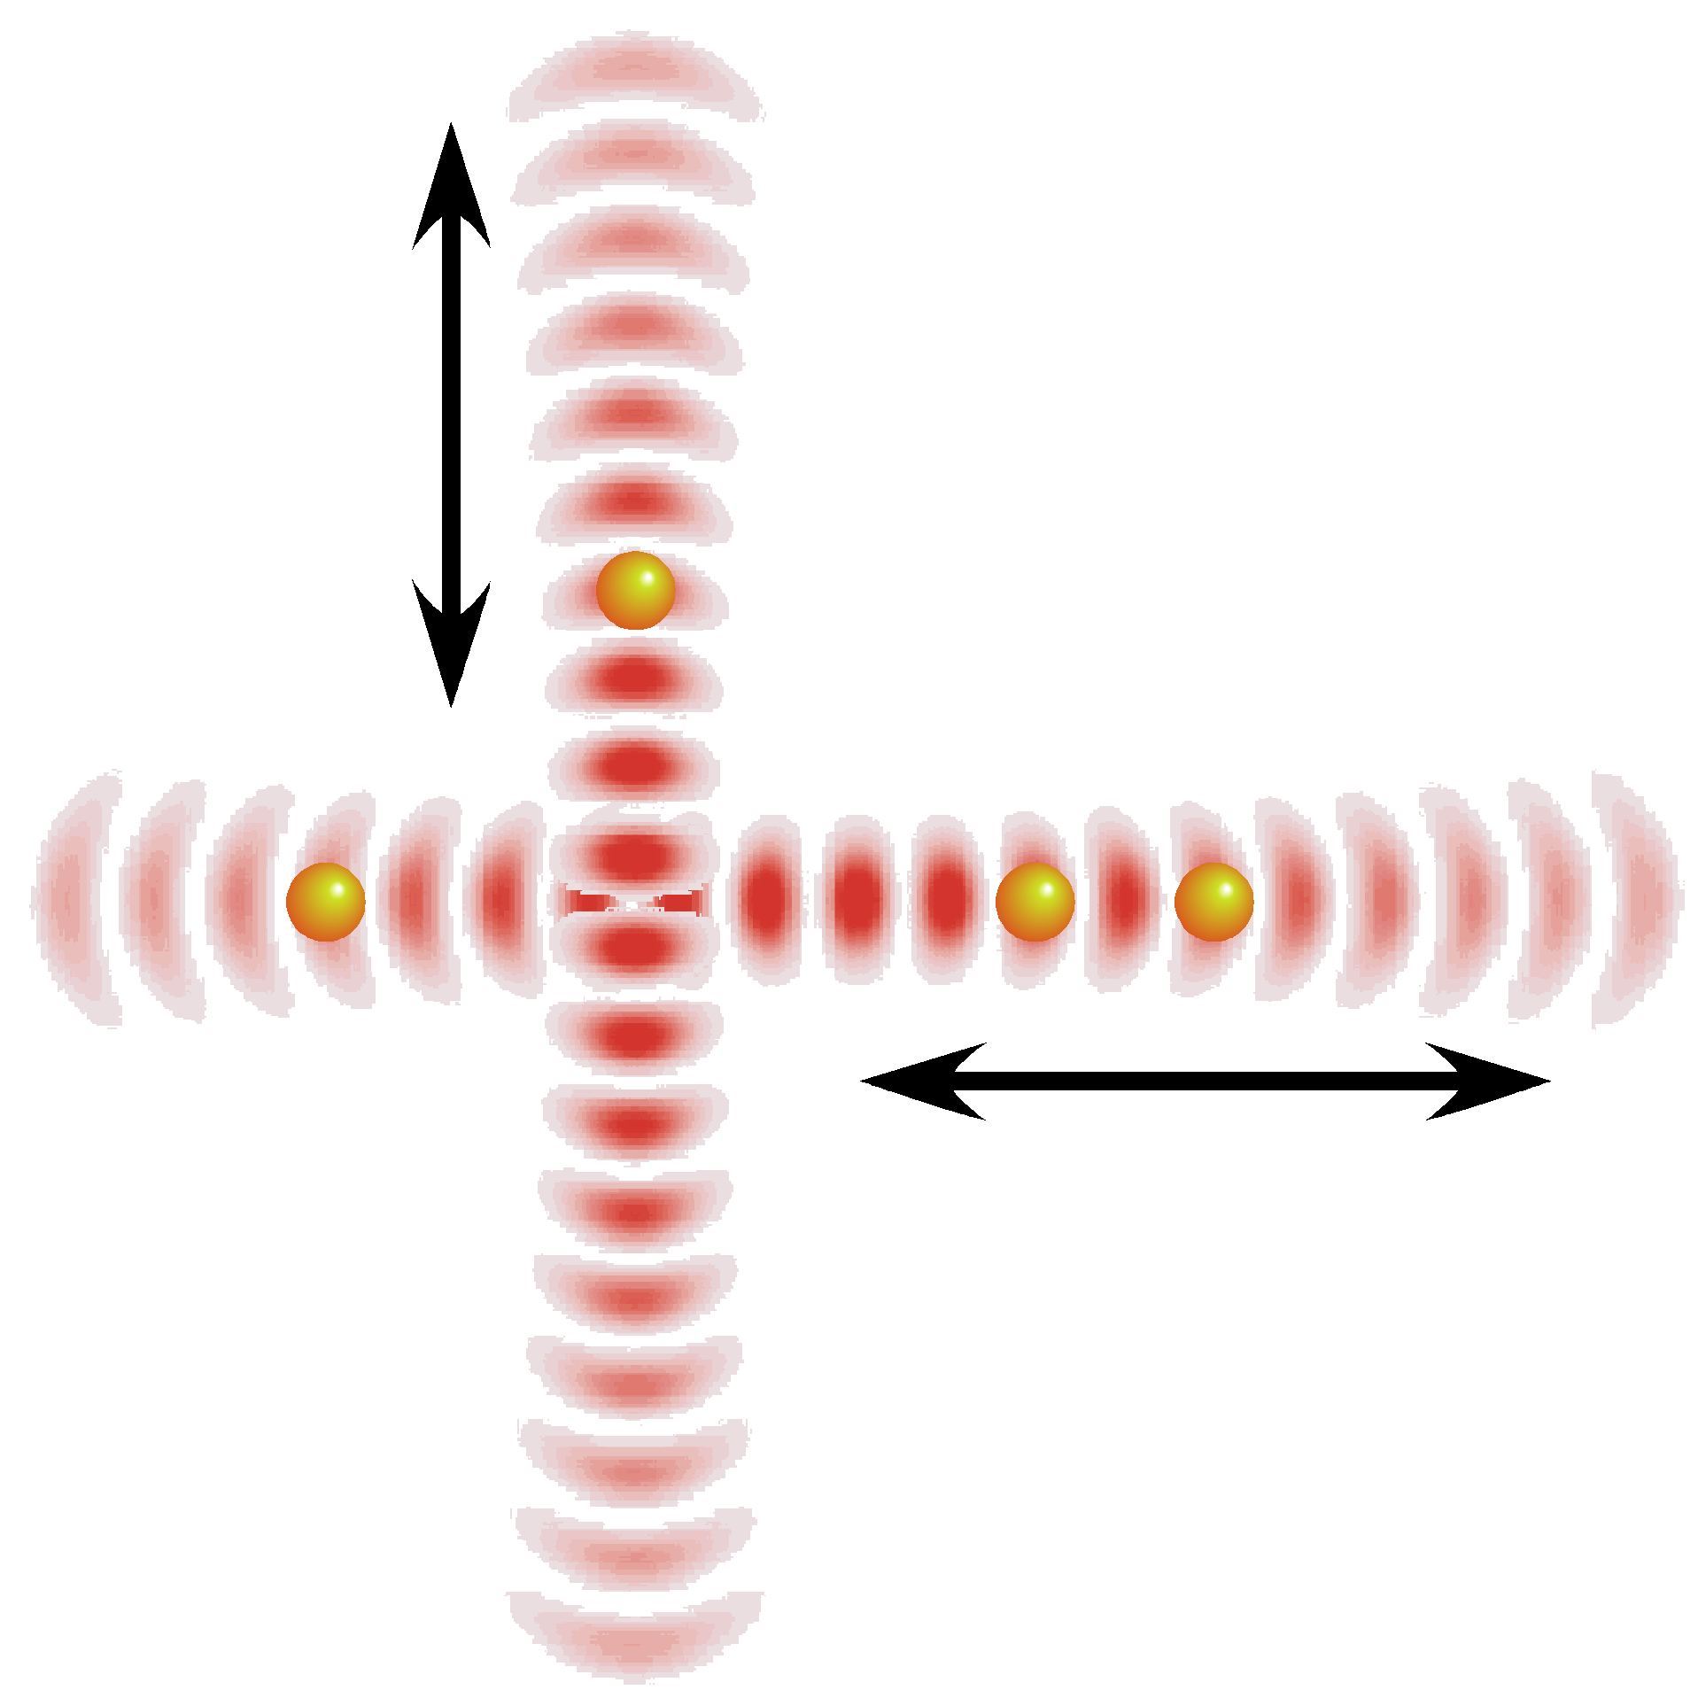
Sorting of atom qubits and distance control
2 crossed atom conveyor-belts

Slide 40
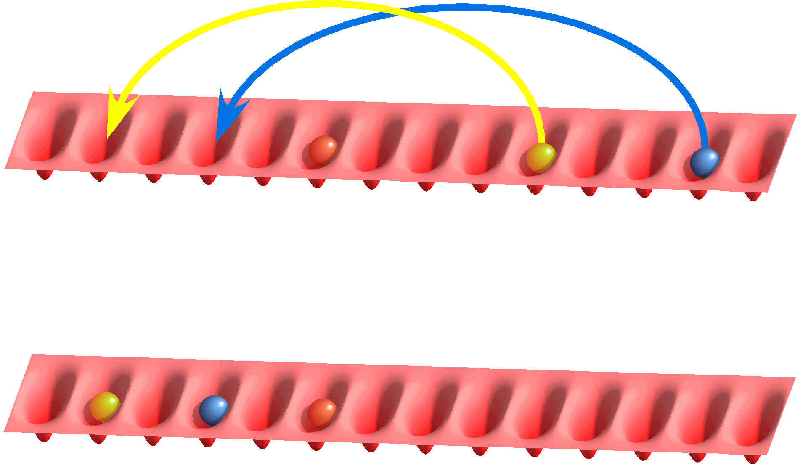
Sorting of atom qubits and distance control
Initial state
Final state

Slide 41

Sorting of atom qubits and distance control

Slide 42

Sorting of atom qubits and distance control

Slide 43

Sorting of atom qubits and distance control

Slide 44

Sorting of atom qubits and distance control

Slide 45

Sorting of atom qubits and distance control

Slide 46
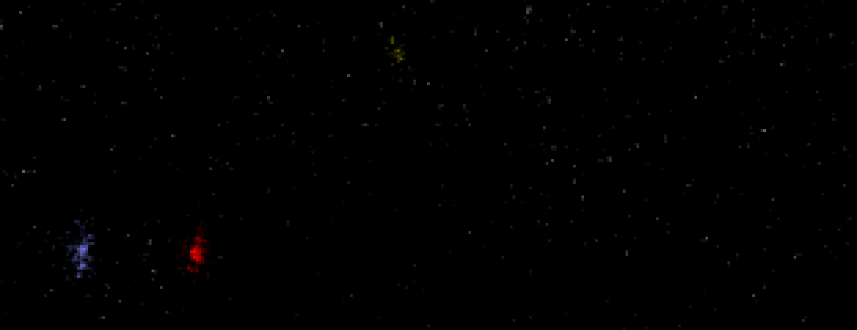
Sorting of atom qubits and distance control

Slide 47

Sorting of atom qubits and distance control

Slide 48

Sorting of atom qubits and distance control
Δx
Δx
Δx = 20 μm
Efficiency: 86%

Slide 49
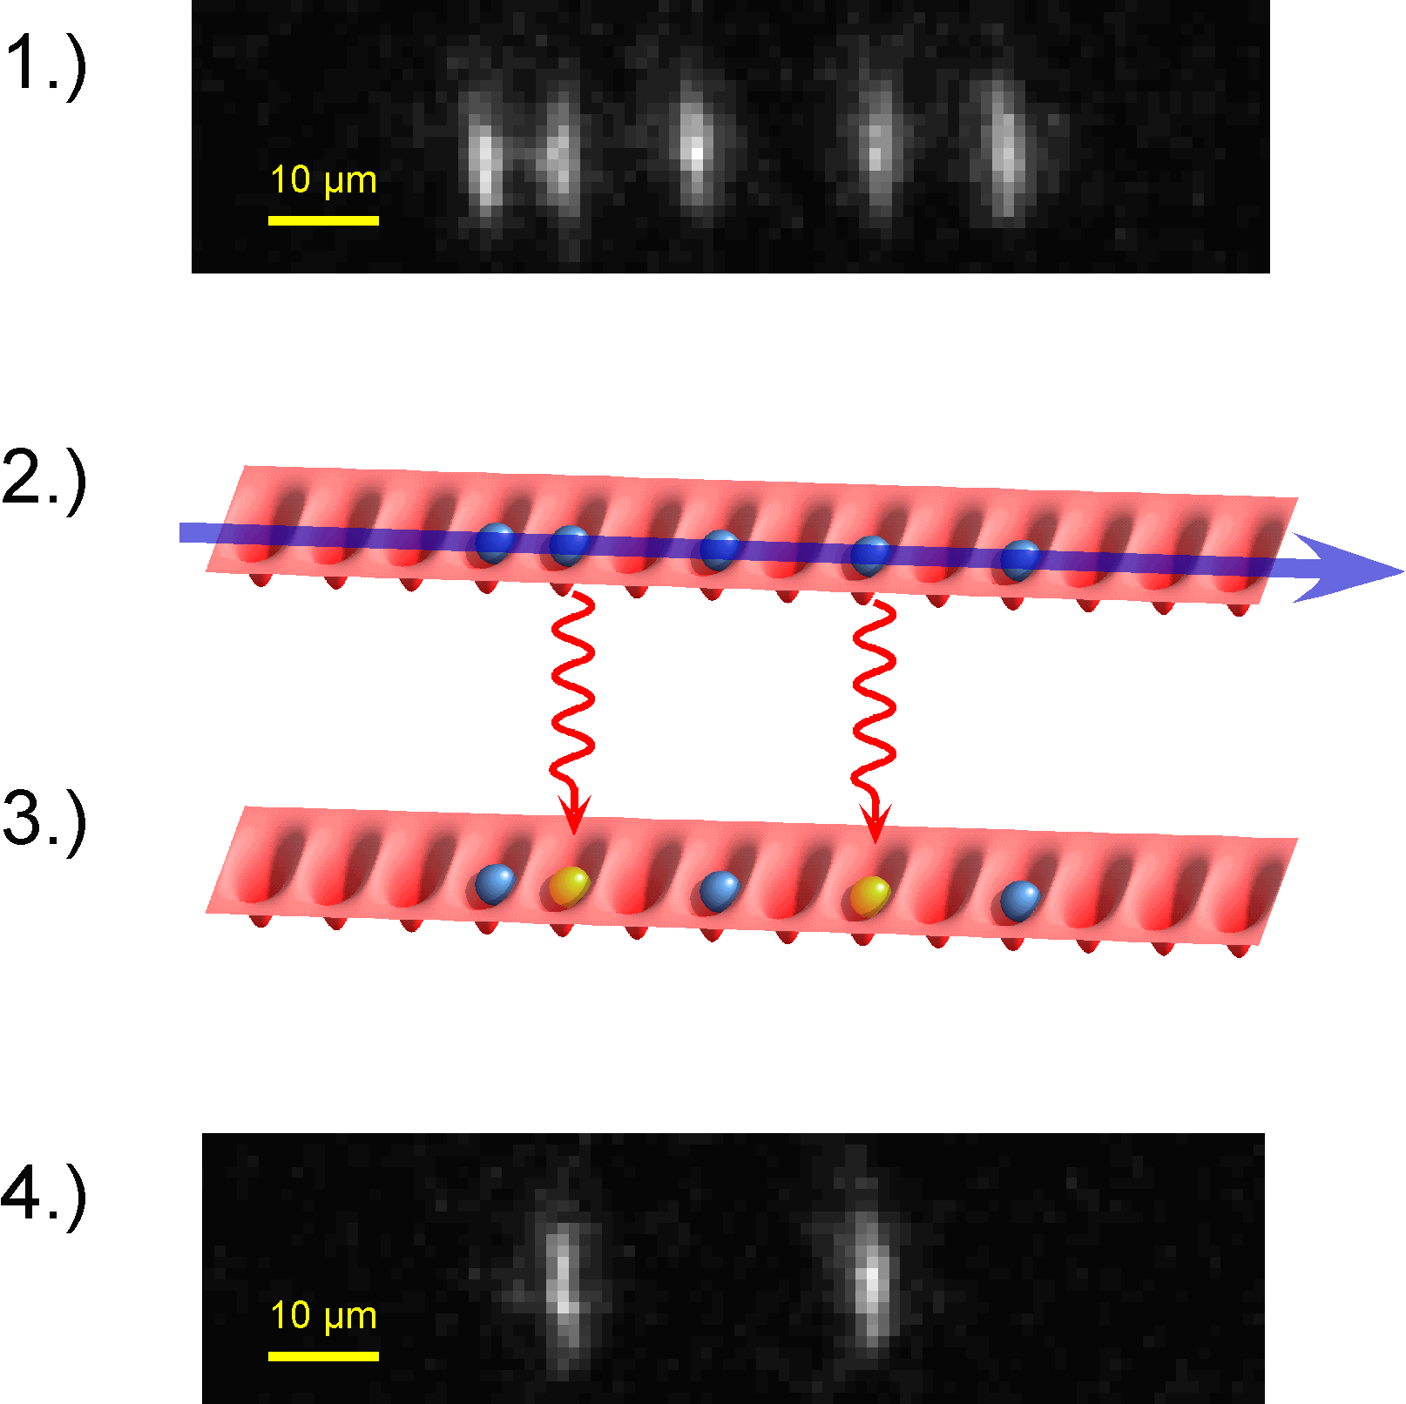
A neutral atom quantum register
Schrader et al, PRL 93, 150501 (2004)
String of single atoms
in a 1D optical lattice
B’
Initialization |00000>
RF
|01010>, or any
single qubit operation
Read out
Switching time: 16 µs
Resolution: 2,5 µm
Efficiency: 99%
magnetic field gradient

Slide 50
STATE - SELECTIVE DETECTION
probe
Fluorescence rate of 50 000 /sec
0.3 ms is enough to decide
that the atom is in |1> or |0>
with 99 % confidence
|1>
|0>

Slide 51
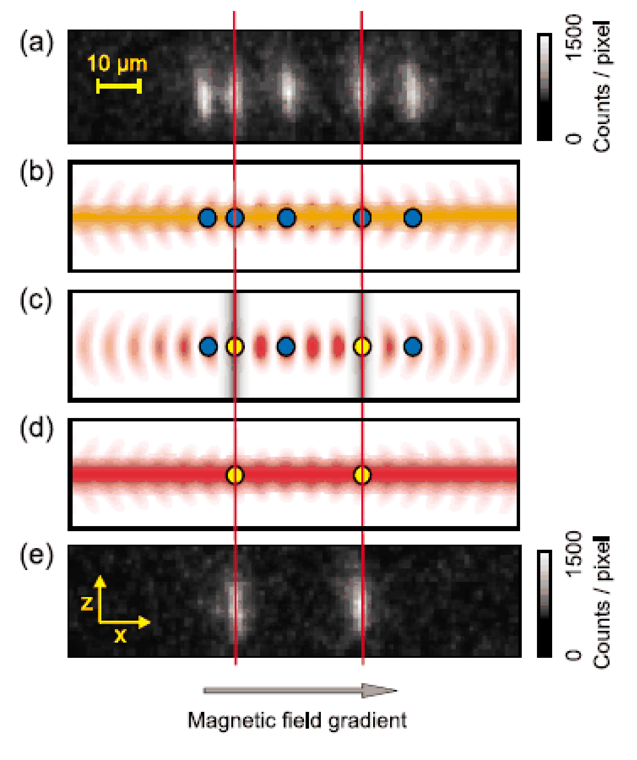
Single Qubit manipulation (Bonn)

Slide 52
Mott state: ultra cold collisions
Bloch, Hänsch (Munich / Mainz)
Porto, Phillips (NIST)

Slide 53


Phase gate with controlled collision
|0,0> → |0,0>
|0,1> → |0,1>
|1,0> → e^{iΦ} |1,0>
|1,1> → |1,1>
Phase gate ⇒ CNOT gate (using single qubit operation )
Use cold controlled collision combined with
state – dependent motion
Low energy collision («s-wave»)
V(r)
Brennen et al, PRL 82, 1060 (1999)
Jaksch et al, PRL 82, 1975 (1999)

Slide 54
BEC in optical lattices
K
θ
k₂
k₁
Reciprocal lattice vector
K = 2 × 2π / λ sin(θ/2)

Slide 55
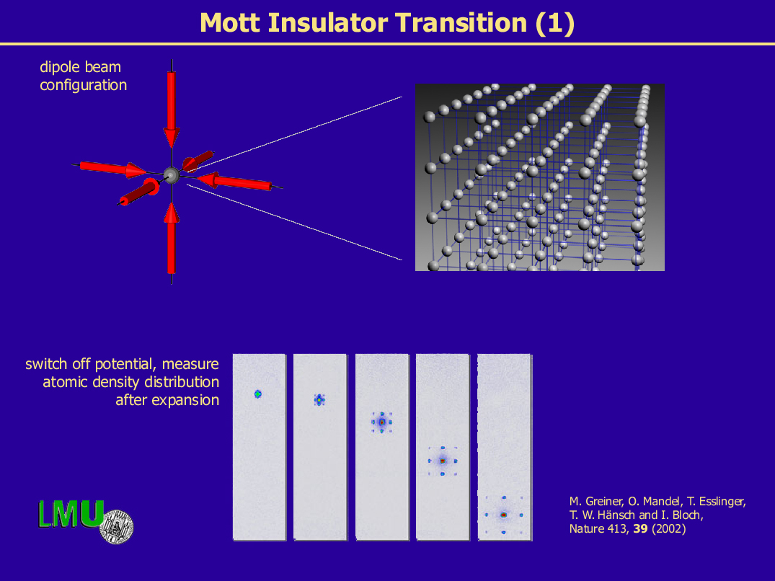
© I. Bloch

Slide 56
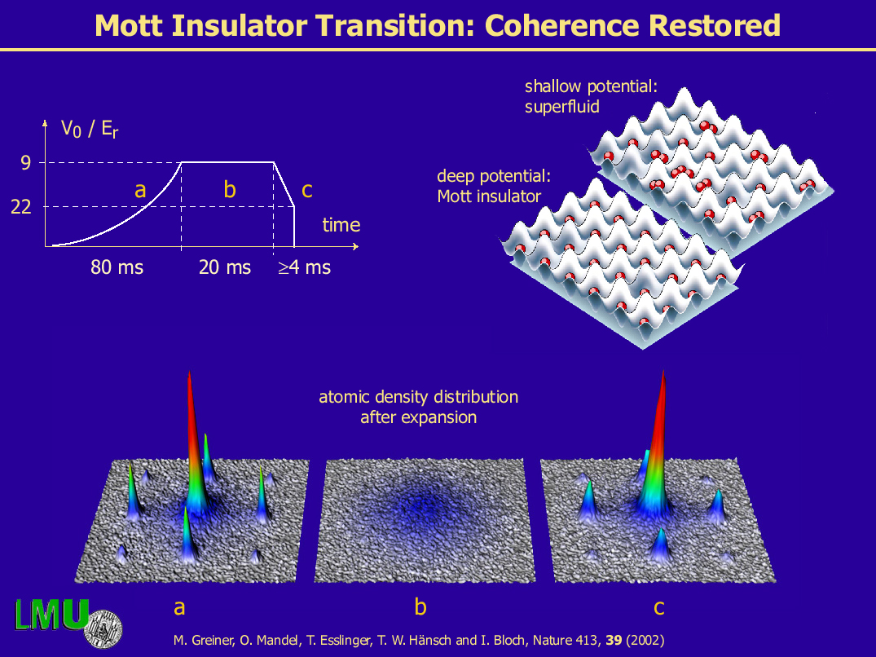

© I. Bloch

Slide 58


Controlled collisions in an optical lattice
Preparation in
|0> + |1>
⁸⁷Rb
|1>
|0>
Mandel et al, Nature 425, 937 (2003)

Slide 59
Controlled collision in an optical lattice
+ phase α
t_{hold} = 30 μs
t_{hold} = 210 μs
t_{hold} = 450 μs
Frequency ⇒ interaction
energy ≈ 2 kHz
Mandel et al, Nature 425, 937 (2003)

Slide 60



√SWAP gate with neutral atoms
Cold atoms in a double well potential
Interaction
U
Combined effect of indistinguishability and interaction
Superexchange interaction
Anderlini, Nature 448, p. 452 (2007)

Slide 61

√SWAP gate with neutral atoms
The eigenstates of the atoms are:
The singlet state must vanish for x2=x1
=> no interaction between the atoms.

Slide 62
√SWAP gate with neutral atoms
Cold atoms in a double well potential
Interaction
U
Combined effect of indistinguishability and interaction
Superexchange interaction
Anderlini, Nature 448, p. 452 (2007)

