Slide 1
Cavity QED with Rydberg atoms
© M. Brune, LKB (Paris)

Slide 2
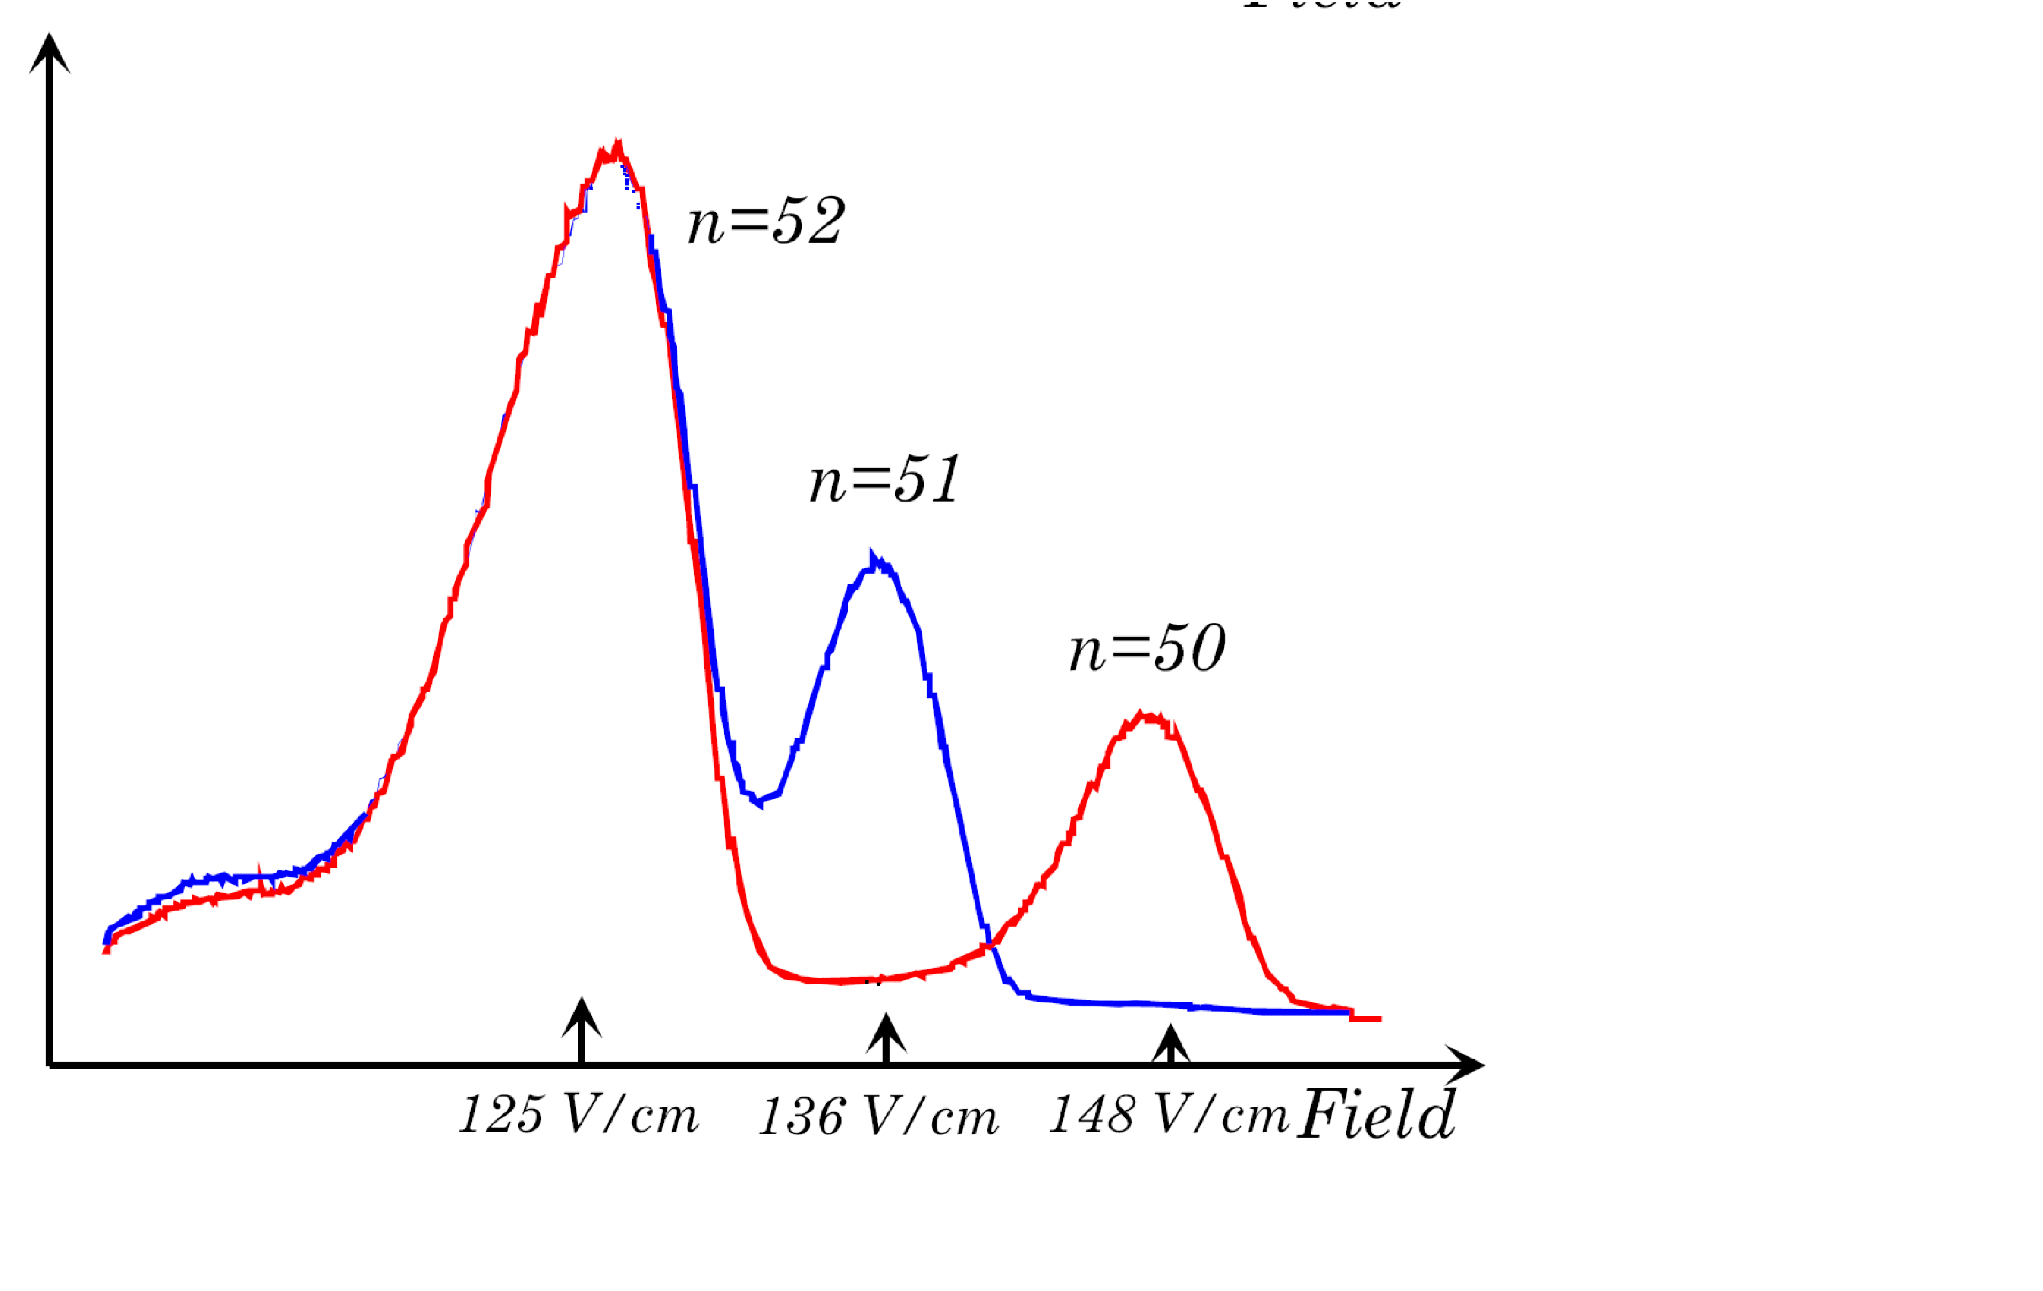
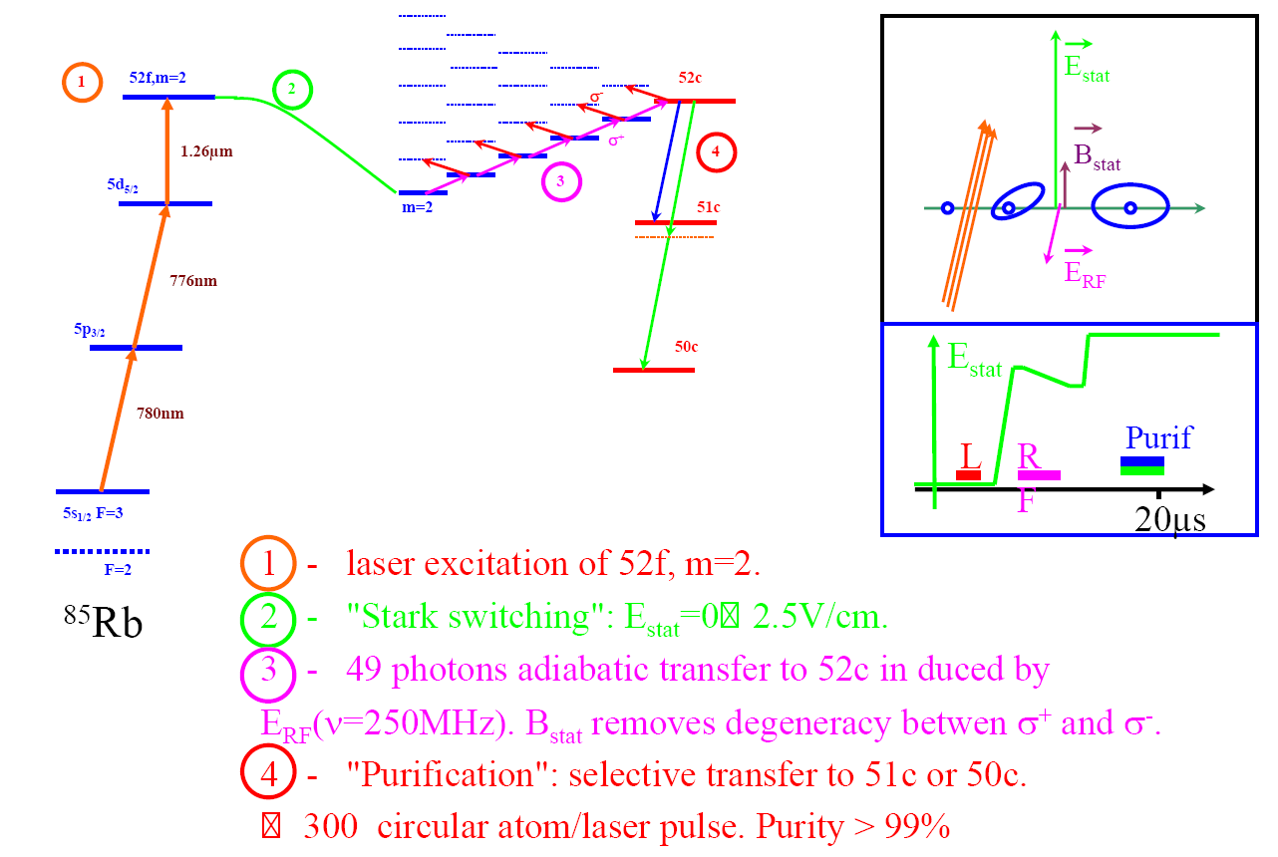
Cavity QED with Rydberg atoms

Slide 3
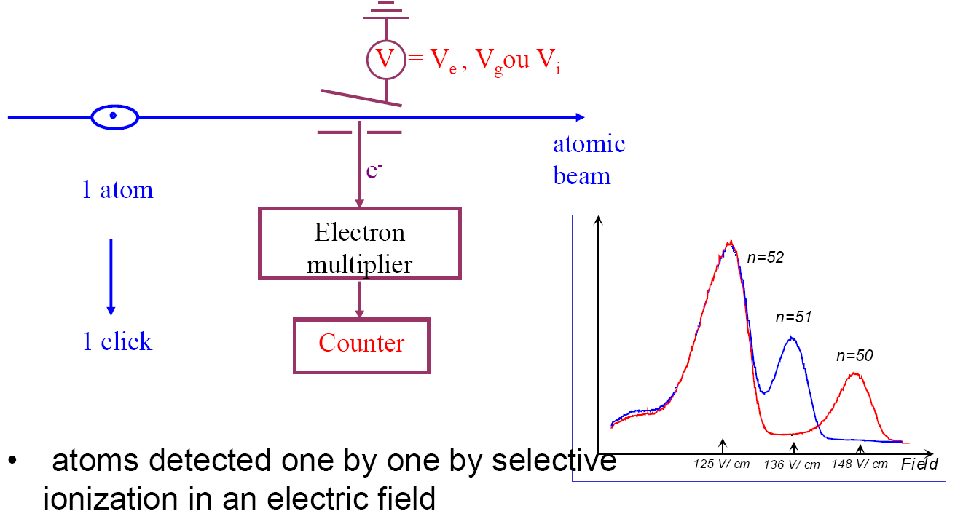
Cavity QED with Rydberg atoms

Slide 4
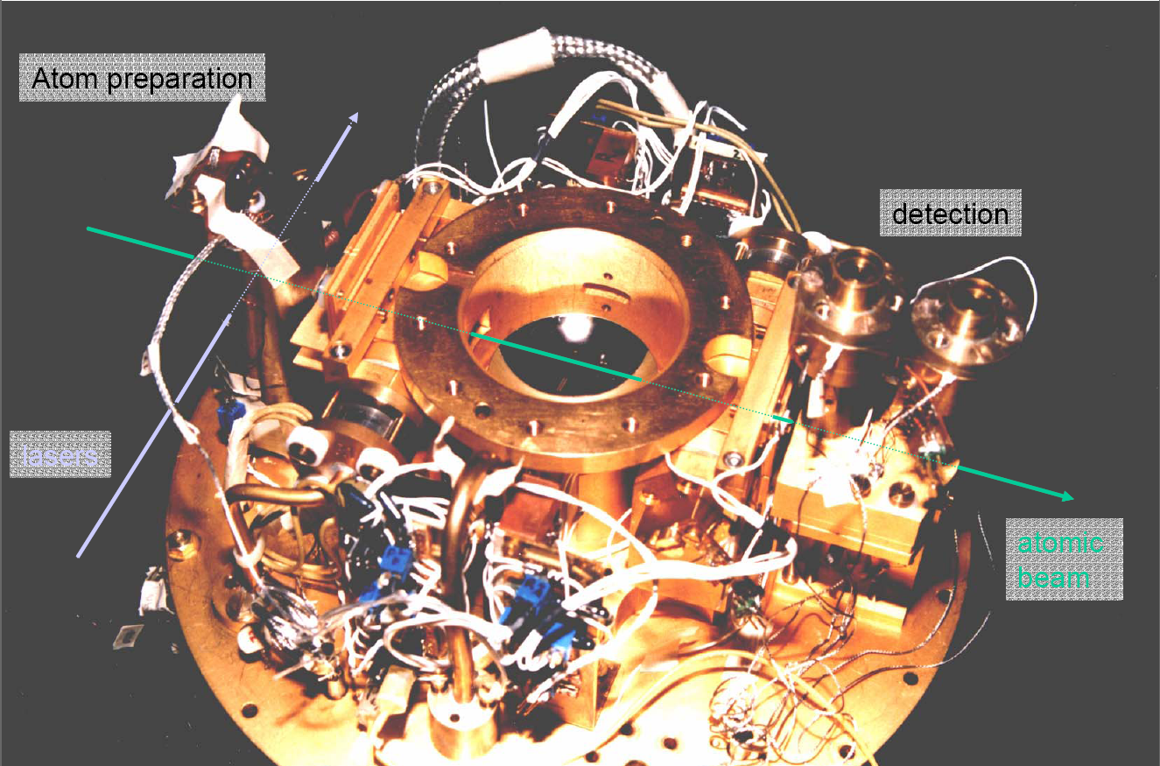

Slide 5
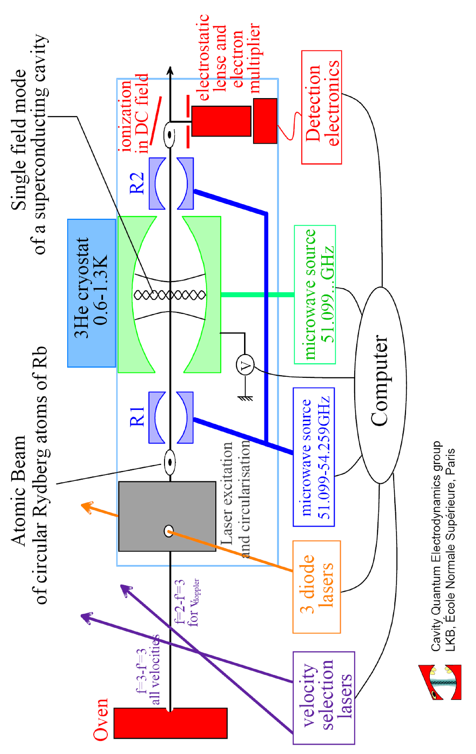
Cavity QED with Rydberg atoms

Slide 6
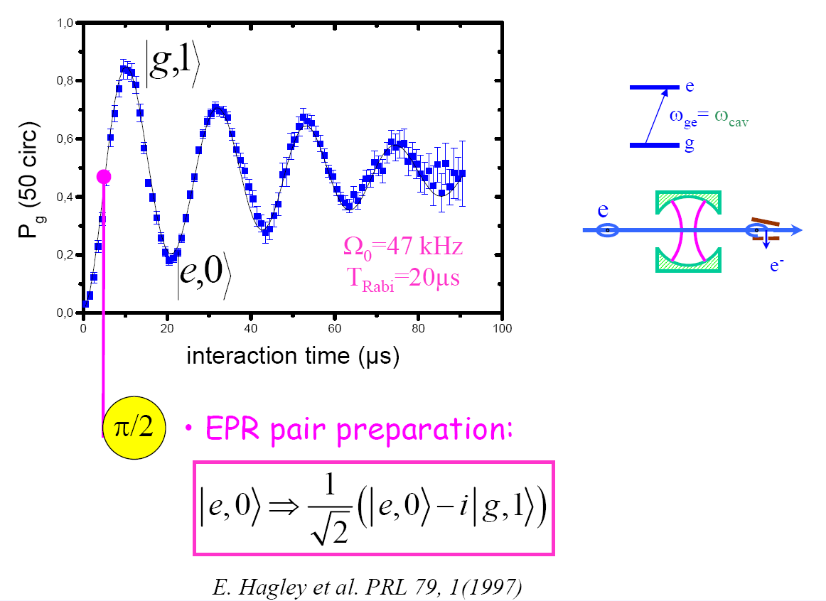
Cavity QED with Rydberg atoms

Slide 7
Cavity QED with Rydberg atoms

Slide 8
Cavity QED with Rydberg atoms

Slide 9
Cavity QED with Rydberg atoms

Slide 10
Cavity QED with Rydberg atoms

Slide 11
Cavity QED with Rydberg atoms

Slide 12
Cavity QED with Rydberg atoms

Slide 13
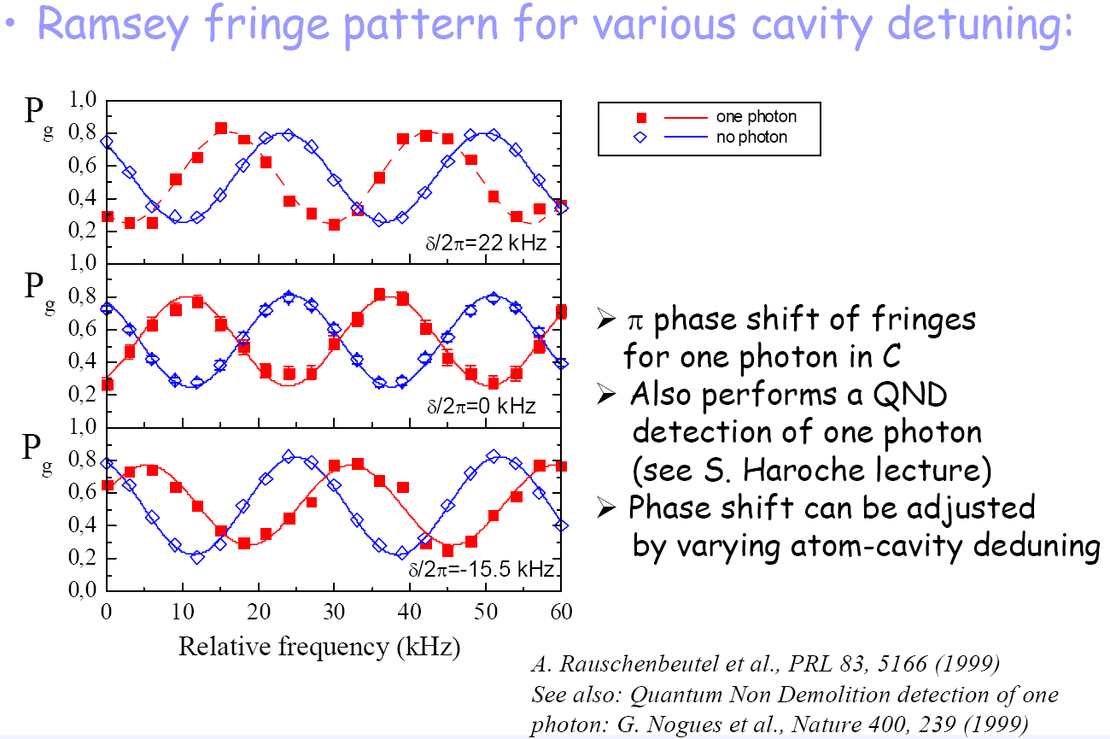
sqrt(2)Ω
|2,g>
|1,e>
Ω
|1,g>
|0,e>
δ
|0,g>
ΔE(n)/h = nΩ²/δ

Slide 14
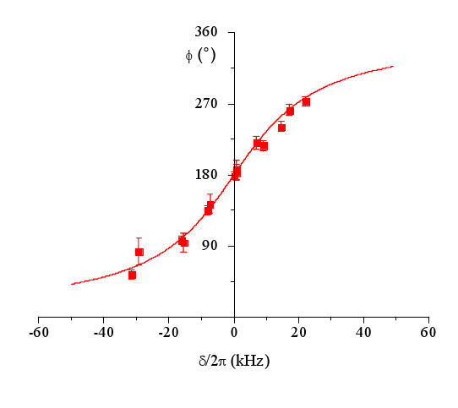
Phase shift as a function of δ

