Slide 1
List of topics
Hong (early Feb): Atom – photon entanglement
Dylan (mid Feb): Ion traps (high fidelity quantum gates / state read-out)
Thierry (late Feb): Cavity QED
(quantum non-demolition measurement of a single photon)
Ed (early Mar): Josephson junctions
Ryan / Dan (mid Mar): Circuit QED (Bell states / coupling of Josephson junctions)
Nikhil (late Mar April): Quantum dot qubits
(read-out / decoherence-free subspaces)
Michael (early April): Shor algorithm with NMR / with linear optics
Damon (mid April): Quantum error correction (ion trap / NMR)
Paul (late April): Quantum communication

Slide 2
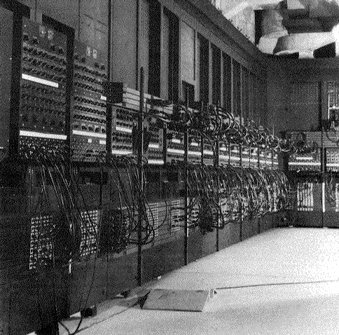
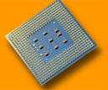
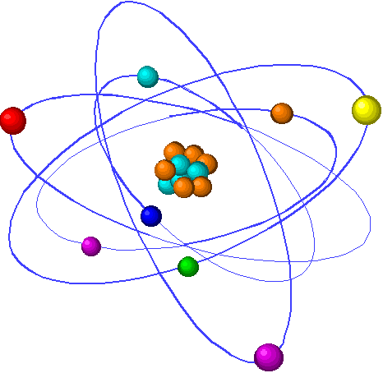
Advances in technology
Moore’s law for memory: progress is exponential
10¹⁹
ENIAC (1947)
10¹⁵
~ 2017
10¹¹
Atoms per bit
10⁷
Pentium 4 (2002)
10³
1 atom per bit
10⁰
1960
1970
1980
1990
2000
2010
2020
Year
Quantum
technology
1 atom

Slide 3
Motivation
Long term goal: A universal quantum computer
Quantum
Processor
000
001
010
011
100
011
110
011
In the mean time:
- “understand” quantum mechanics
- apply quantum mechanics
- where does quantum mechanics fail?

Slide 4
Requirements for quantum computing
Classical
computer
Quantum computer
Initialization
1-bit operations
(NOT)‏
2-bit gates
(e.g. NAND)
Computational
space:
Read out
   result
Initialization
1-qubit rotations
superpositions
2-qubit gates
(CNOT gate)
   entanglement
Computational space: Hilbert space
2^{n} dimensional
Read out of qubits
gain of classical information
00
01
10
11

Slide 5
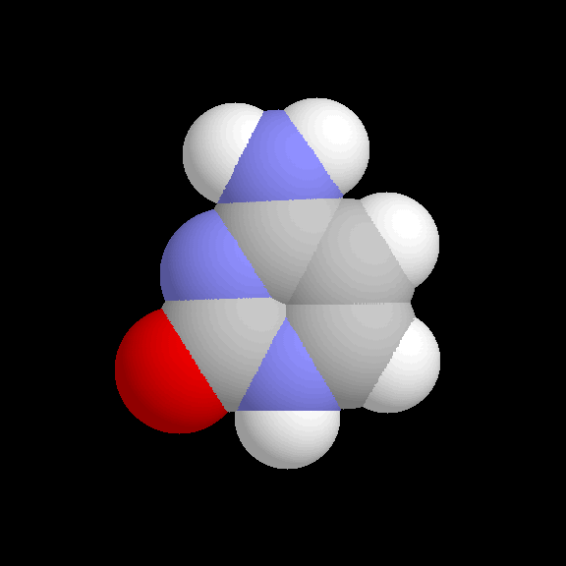
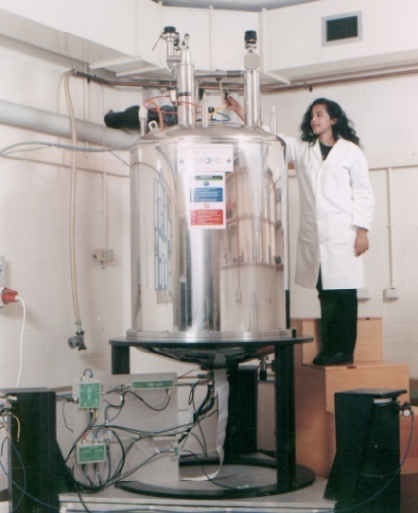
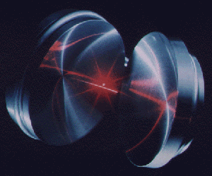
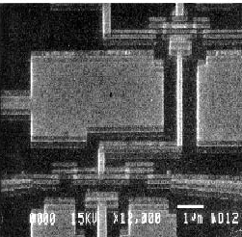
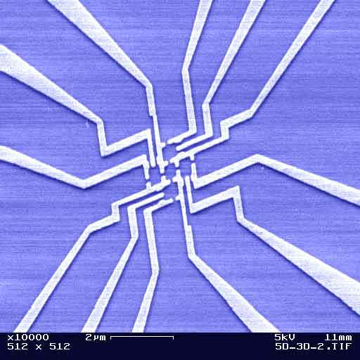
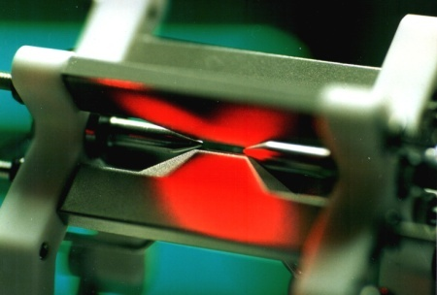
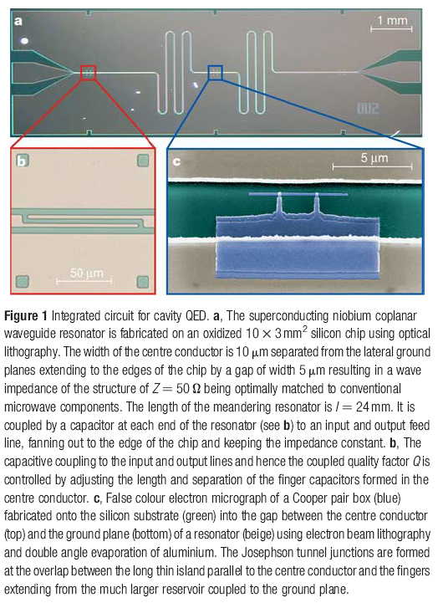
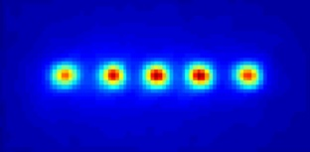
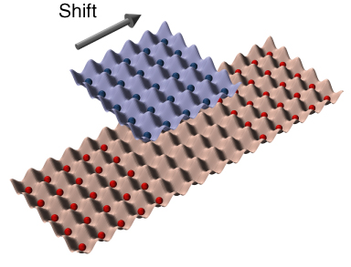
Which technology ?
Quantum
processor
000
001
010
011
100
011
110
011
Cavity QED
NMR
Superconducting qubits
Quantum dots
Trapped ions
Circuit QED
Neutral atoms
© A. Ekert

