Slide 1
List of topics
Hong (early Feb): Atom – photon entanglement
Dylan (mid Feb): Ion traps (high fidelity quantum gates / state read-out)
Thierry (late Feb): Cavity QED
(quantum non-demolition measurement of a single photon)
Ed (early Mar): Josephson junctions
Ryan / Dan (mid Mar): Circuit QED (Bell states / coupling of Josephson junctions)
Nikhil (late Mar April): Quantum dot qubits
(read-out / decoherence-free subspaces)
Michael (early April): Shor algorithm with NMR / with linear optics
Damon (mid April): Quantum error correction (ion trap / NMR)
Paul (late April): Quantum communication

Slide 2
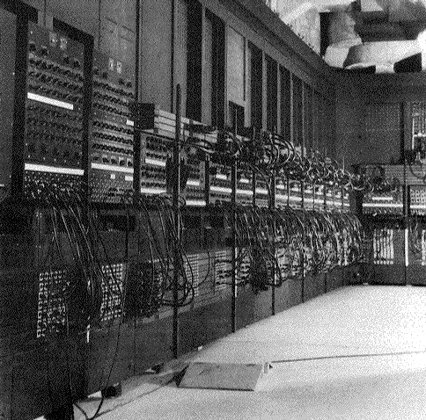
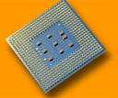
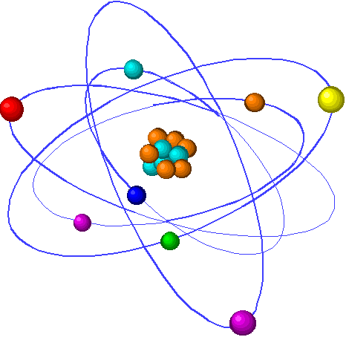
Advances in technology
Moore’s law for memory: progress is exponential
10¹⁹
ENIAC (1947)
10¹⁵
~ 2017
10¹¹
Atoms per bit
10⁷
Pentium 4 (2002)
10³
1 atom per bit
10⁰
1960
1970
1980
1990
2000
2010
2020
Year
Quantum
technology
1 atom

Slide 3
Motivation
Long term goal: A universal quantum computer
Quantum
Processor
000
001
010
011
100
011
110
011
In the mean time:
- “understand” quantum mechanics
- apply quantum mechanics
- where does quantum mechanics fail?

Slide 4
Requirements for quantum computing
Classical
computer
Quantum computer
Initialization
1-bit operations
(NOT)‏
2-bit gates
(e.g. NAND)
Computational
space:
Read out
   result
Initialization
1-qubit rotations
superpositions
2-qubit gates
(CNOT gate)
   entanglement
Computational space: Hilbert space
2^{n} dimensional
Read out of qubits
gain of classical information
00
01
10
11

Slide 5
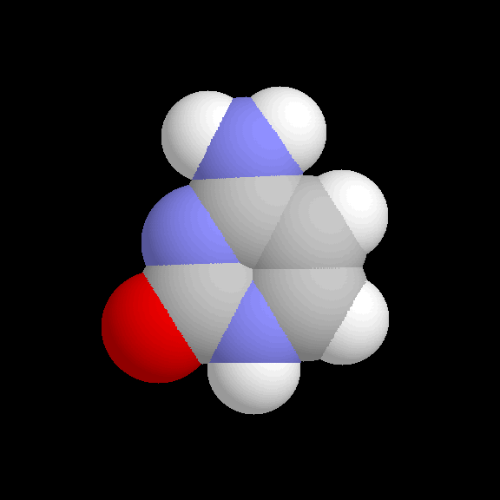
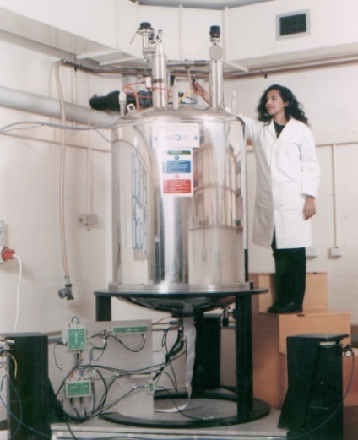
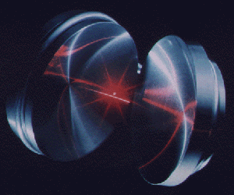
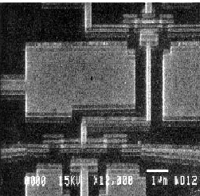
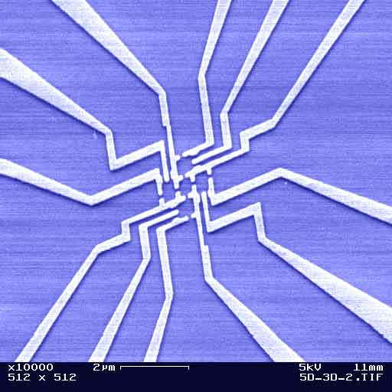
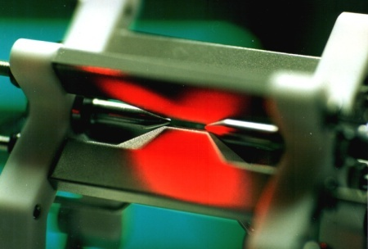
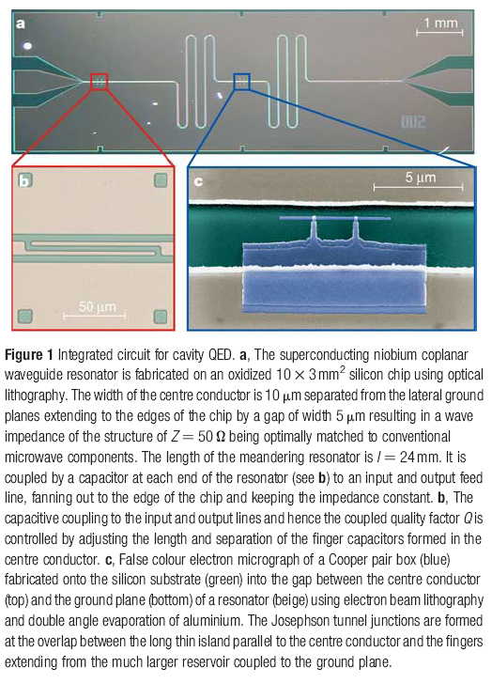
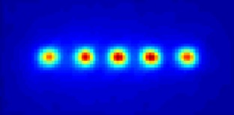
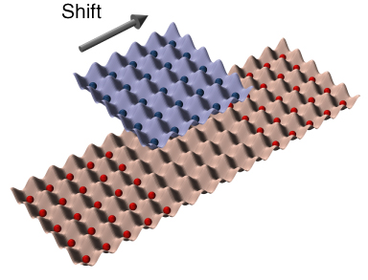
Which technology ?
Quantum
processor
000
001
010
011
100
011
110
011
Cavity QED
NMR
Superconducting qubits
Quantum dots
Trapped ions
Circuit QED
Neutral atoms
© A. Ekert

Slide 7
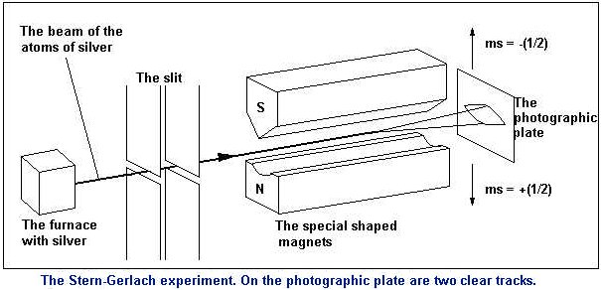
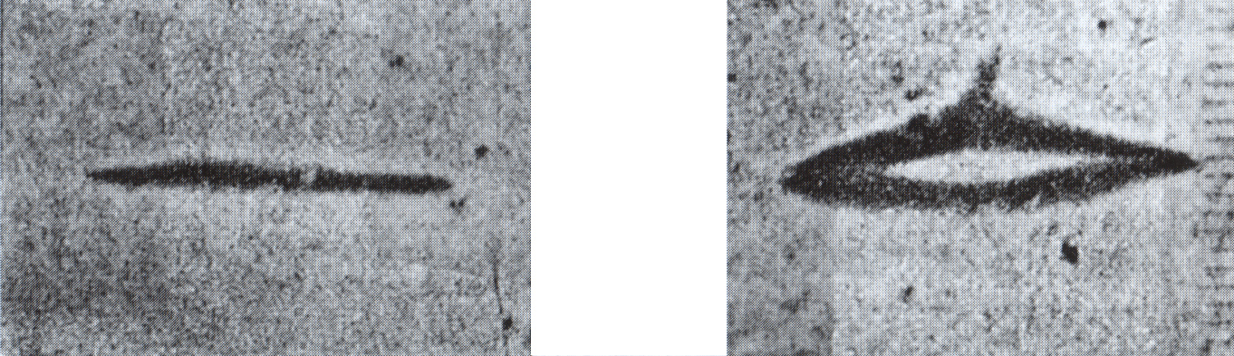
Stern-Gerlach experiment

Slide 8
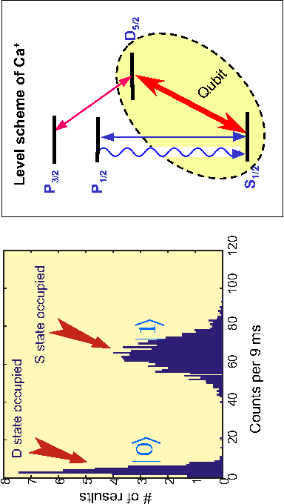
Qubit read-out

Slide 9
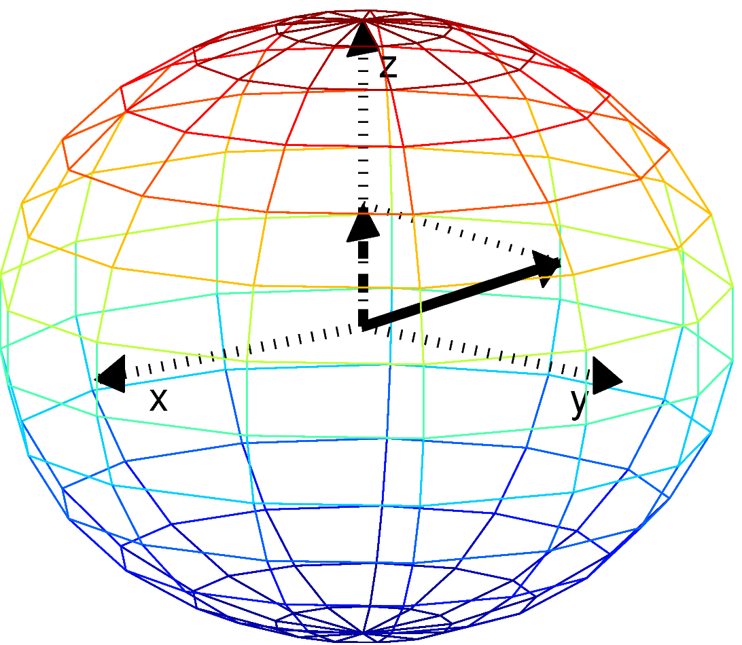
Measurement

Slide 11
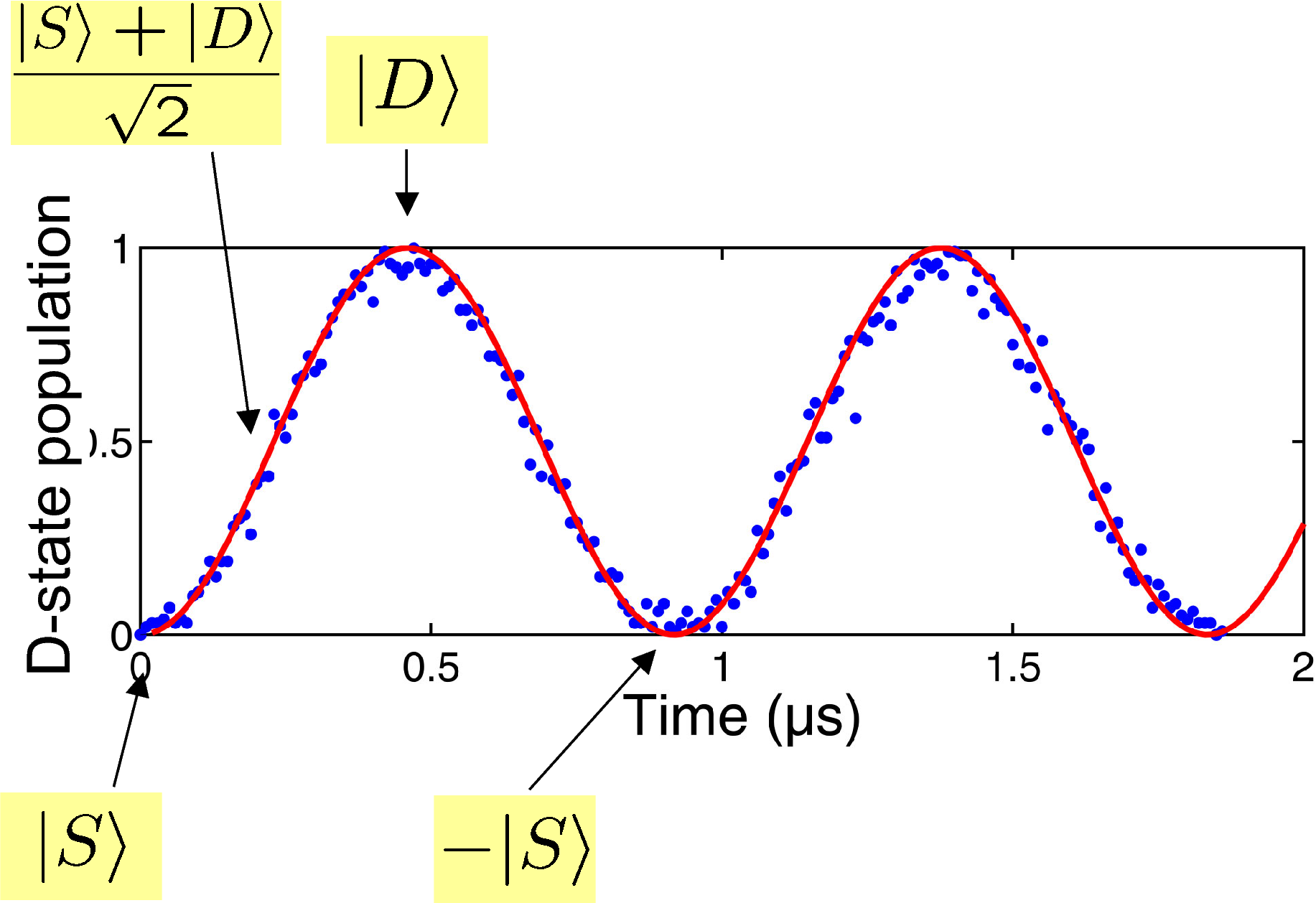
Rabi oscillations

Slide 12
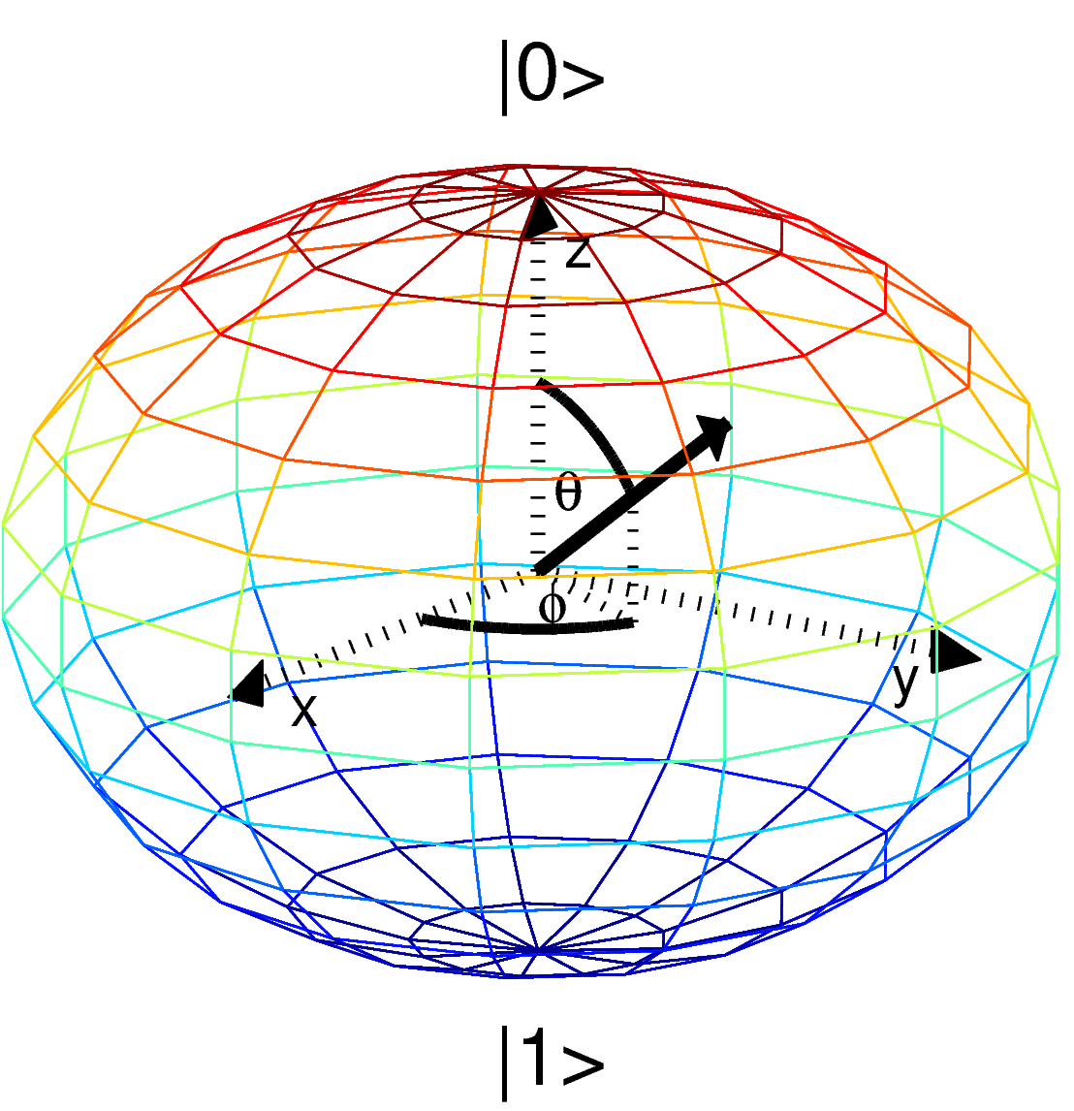
The Bloch sphere

Slide 13
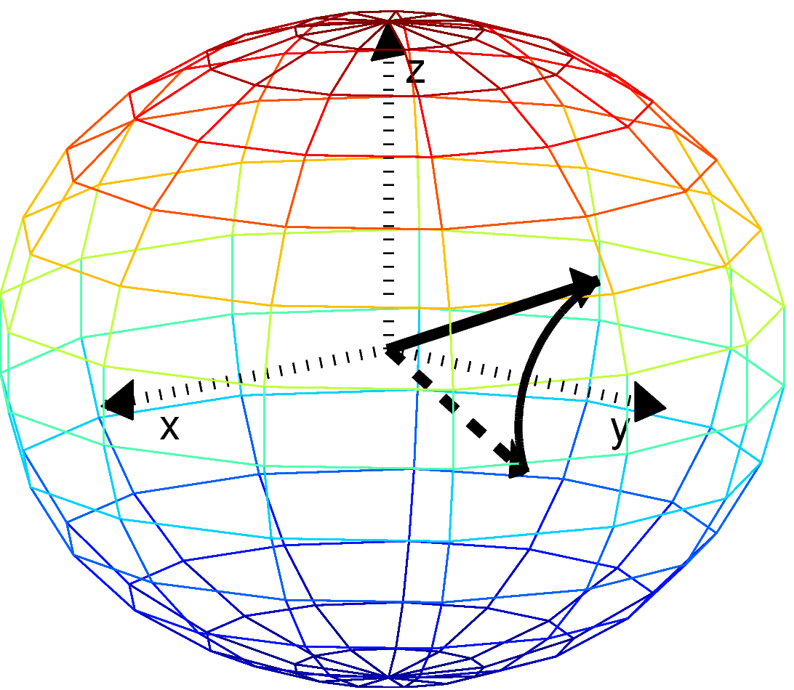
Single qubit rotations

Slide 14
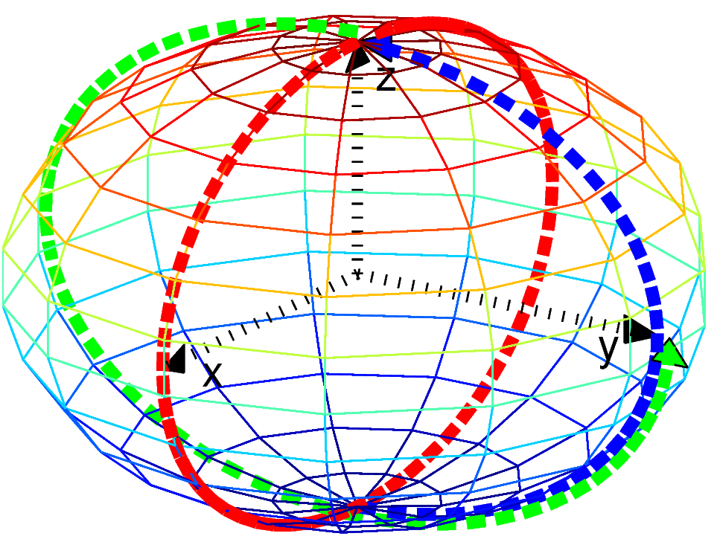
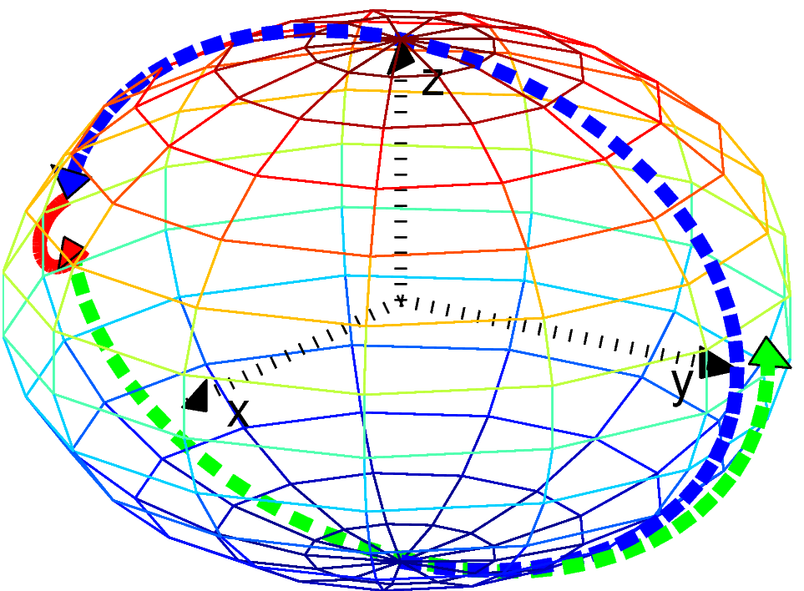
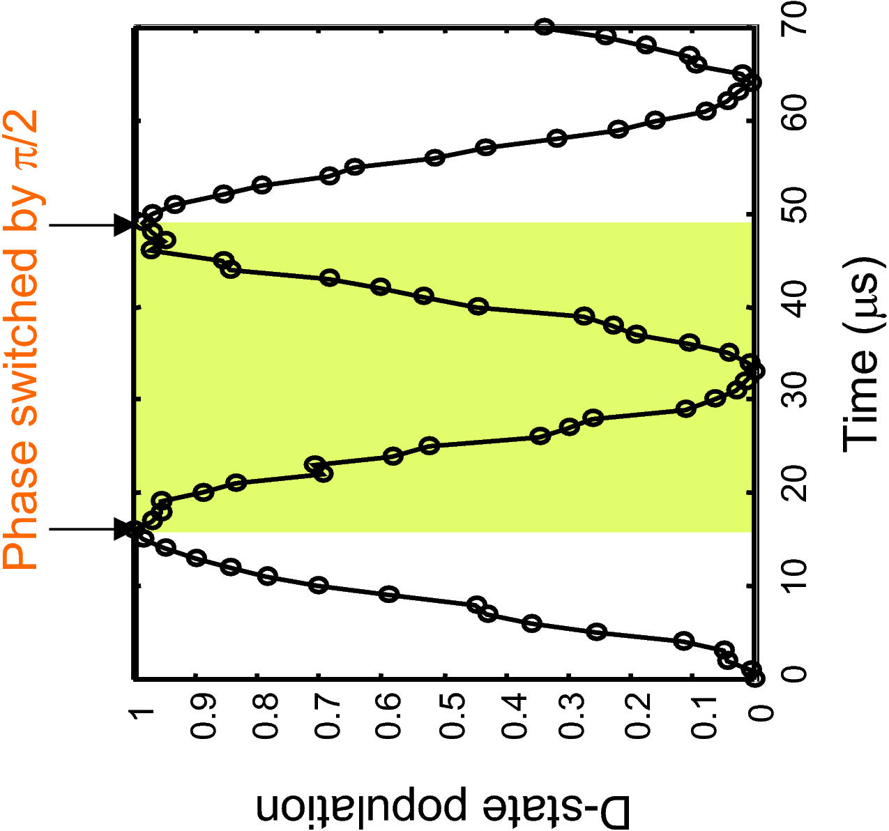
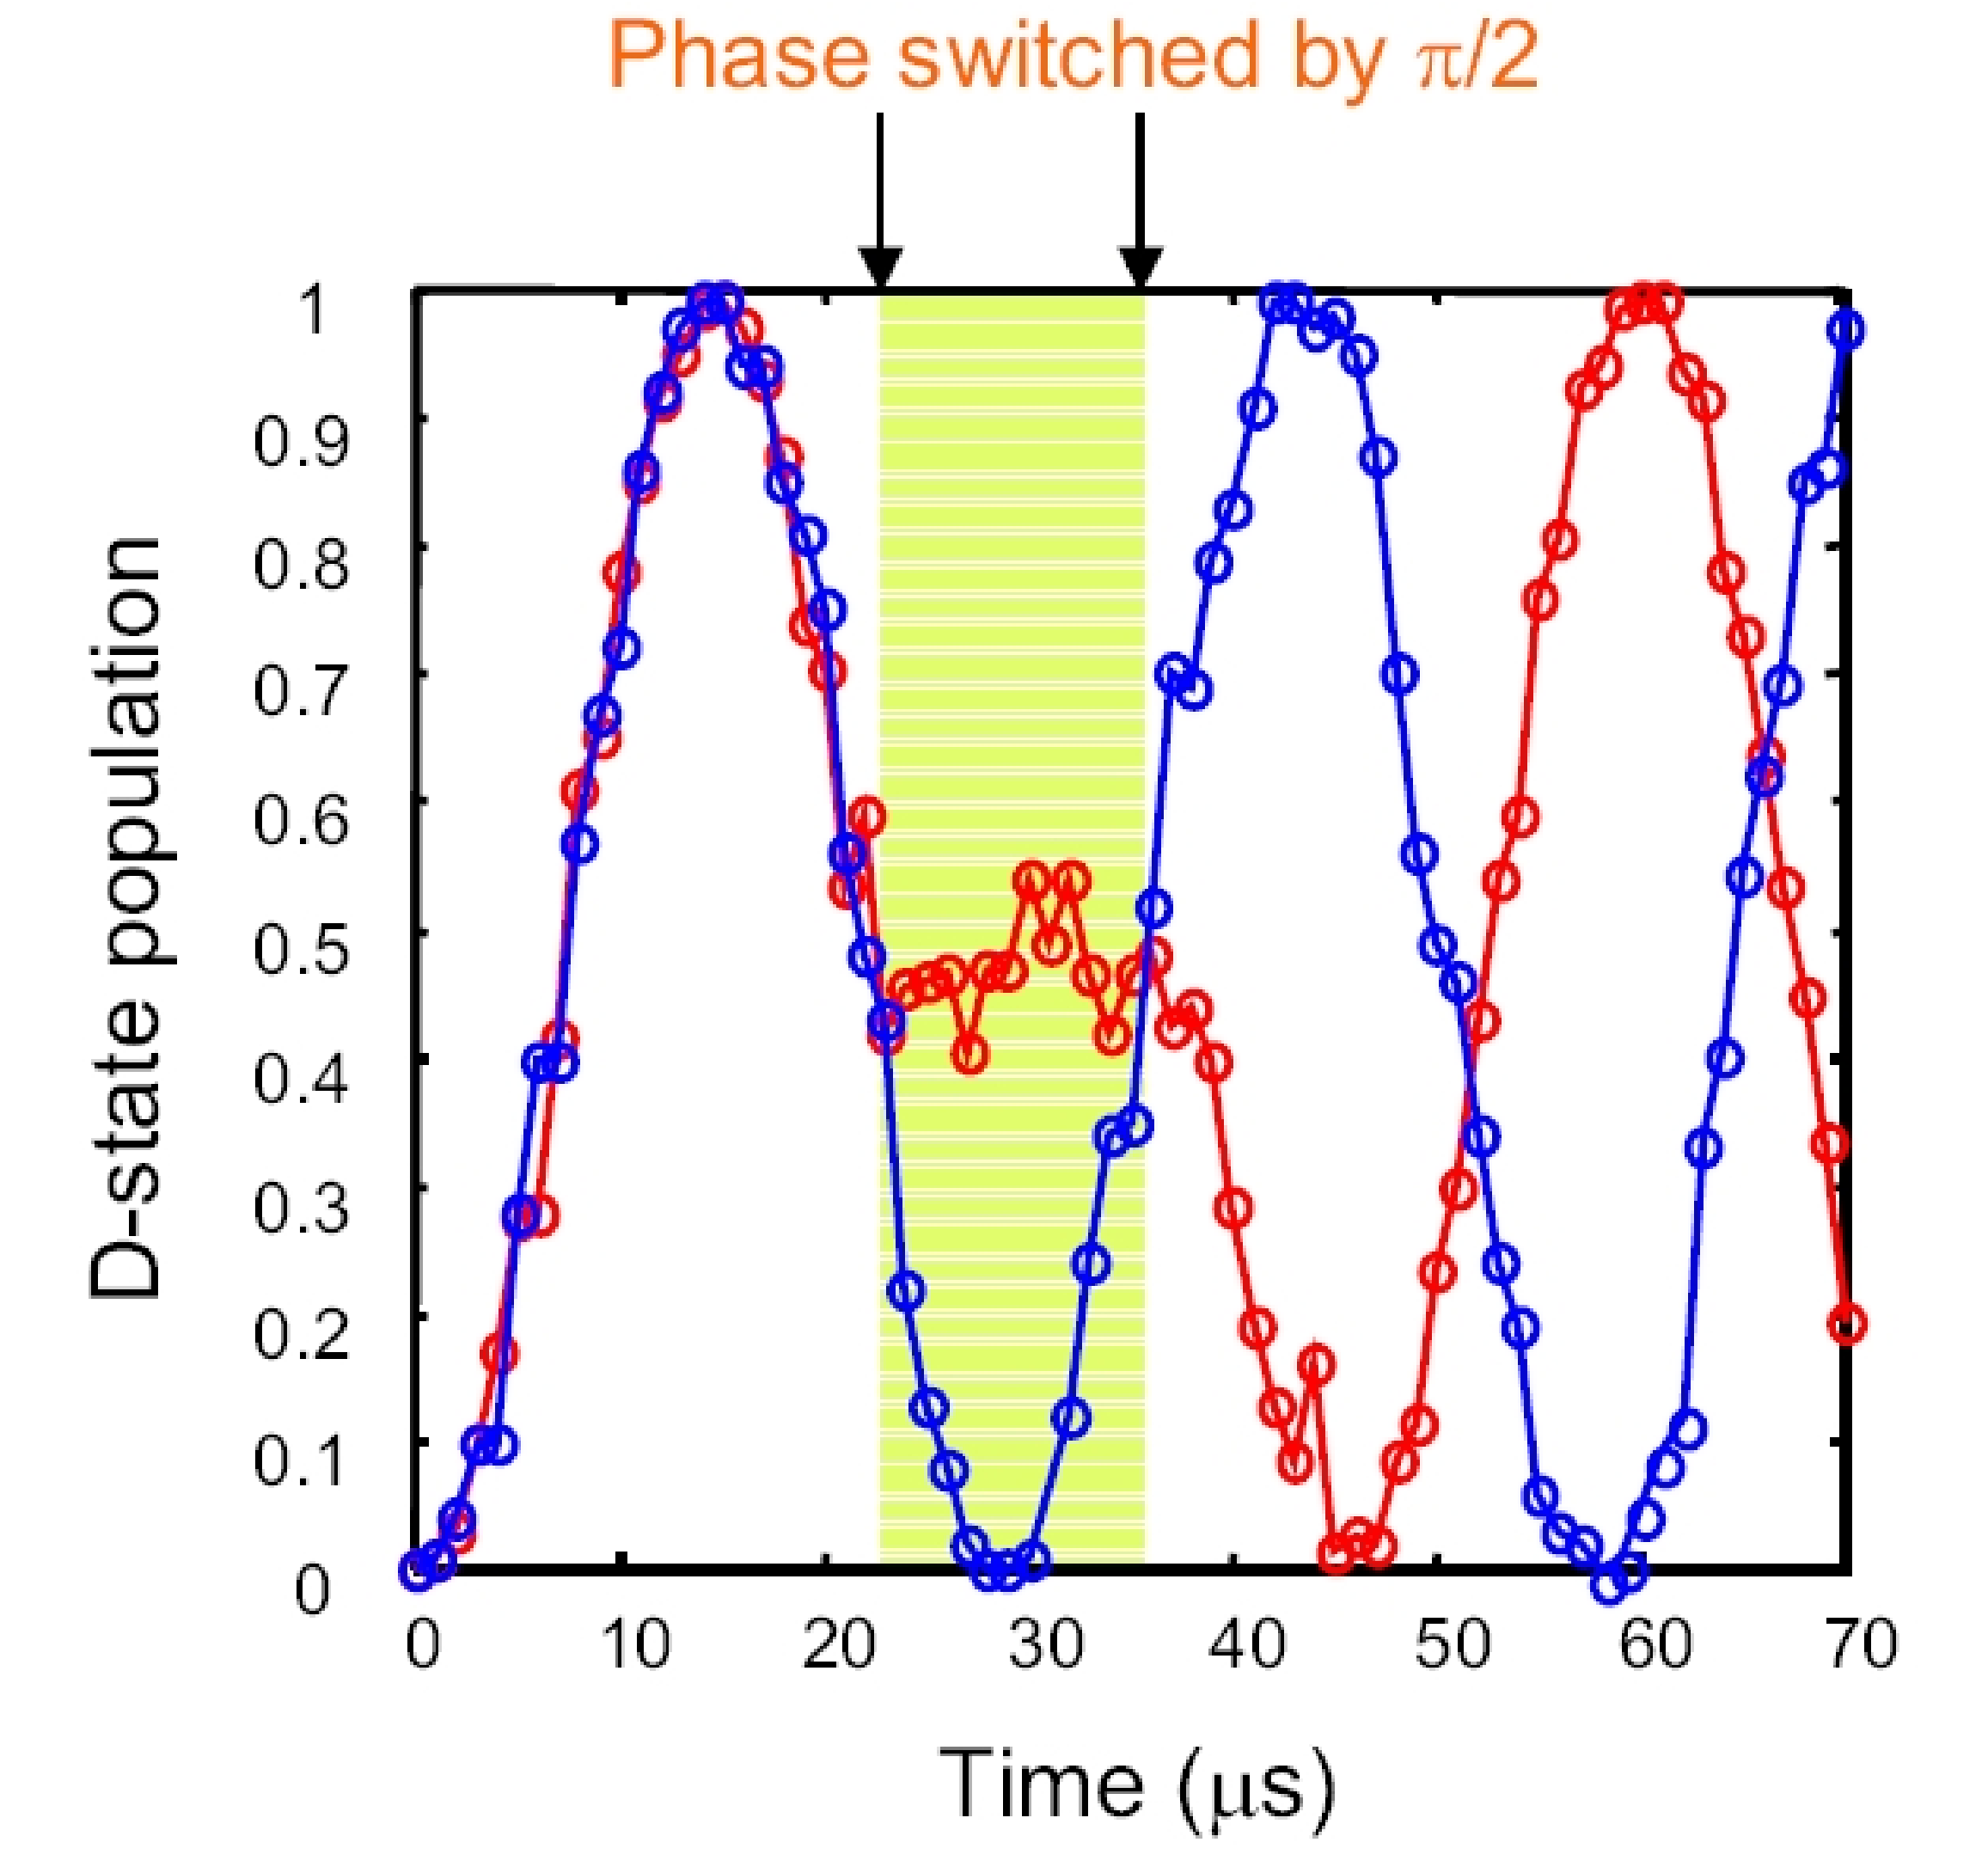
Single qubit gymnastics

Slide 15
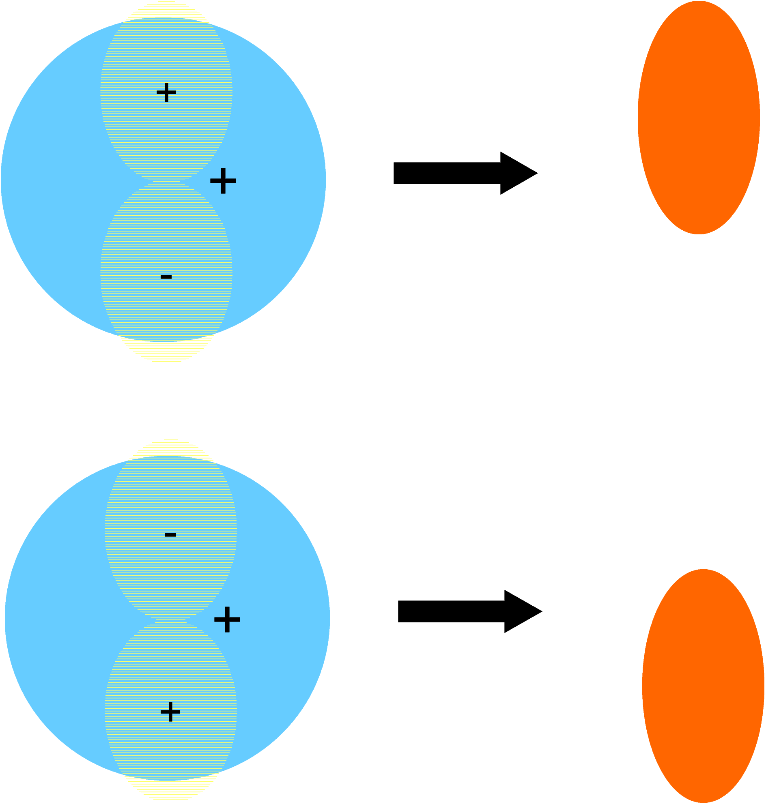
The phase of an atomic qubit

Slide 16
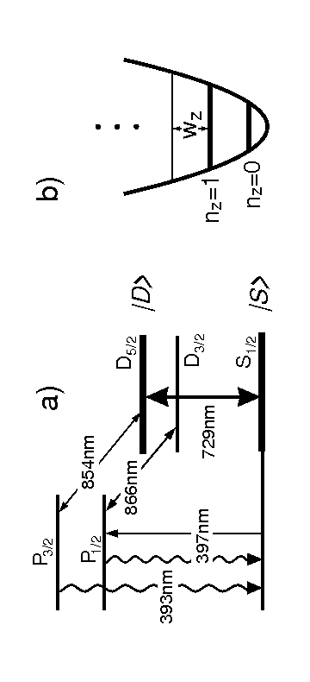
Level scheme of Ca⁺

Slide 17
heading

Slide 18
heading

Slide 19
heading

Slide 20
heading

