Slide 2
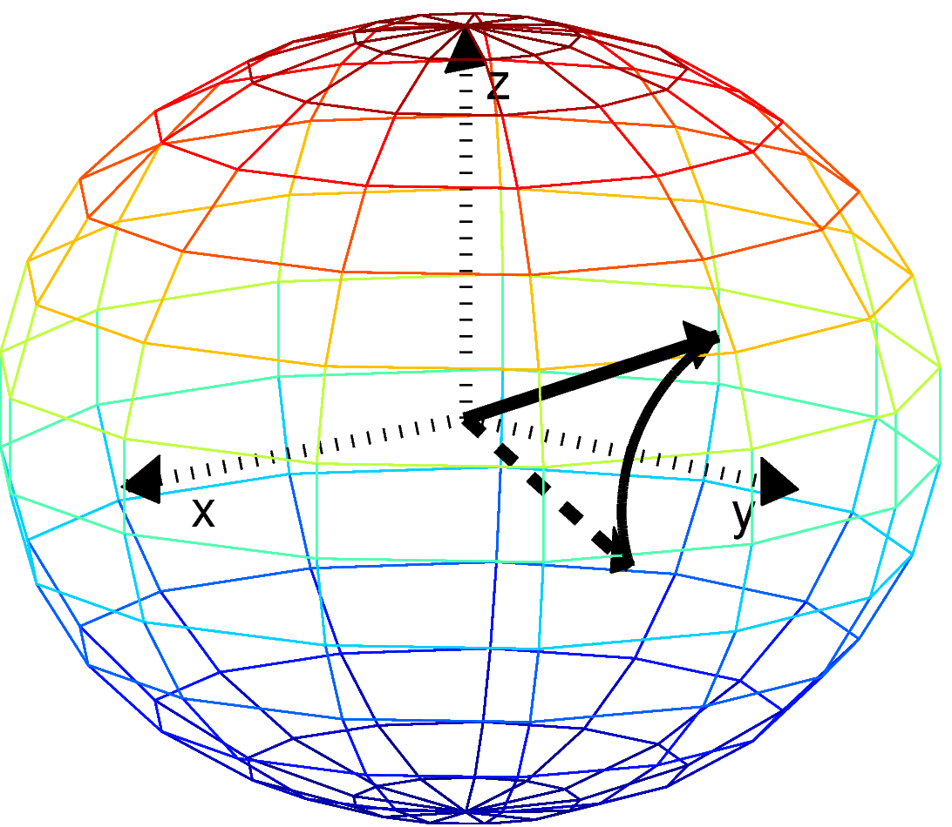
Single qubit rotations

Slide 3
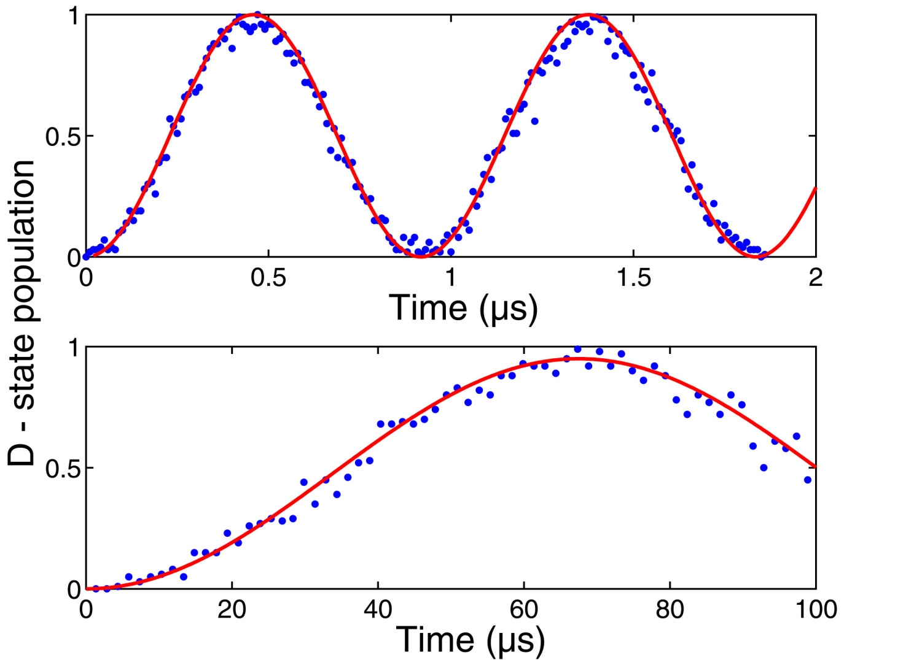

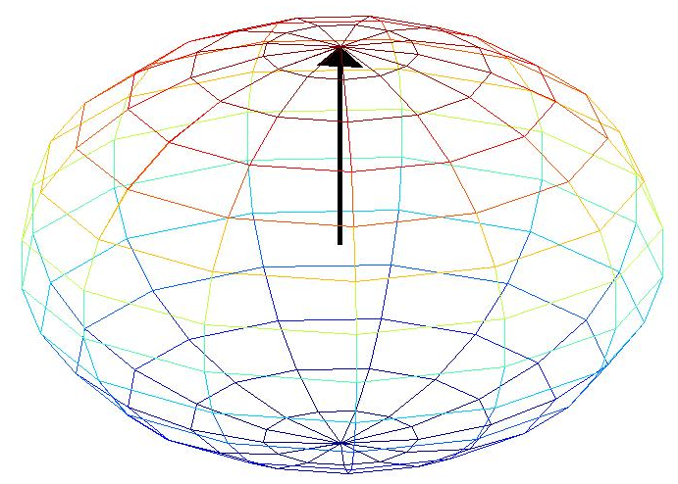

Rabi oscillations
P_{1/2}
D_{5/2}
D_{5/2}
S_{1/2}
D-state population

Slide 4
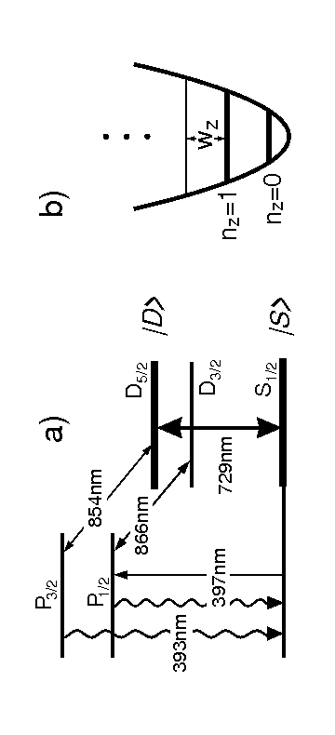
Level scheme of Ca⁺

Slide 5
Experimental procedure
Initialization in a pure quantum state
P_{1/2}
P_{1/2}
P_{1/2}
D_{5/2}
D_{5/2}
D_{5/2}
D_{5/2}
τ =1s
⁴⁰Ca⁺
S_{1/2}
S_{1/2}
S_{1/2}
S_{1/2}
Notes:
3 experimentelle Schritte

Slide 6
Experimental procedure
Initialization in a pure quantum state
P_{1/2}
D_{5/2}
D_{5/2}
Quantum state
manipulation
2. Quantum state manipulation on
S_{1/2} – D_{5/2} transition
S_{1/2}
S_{1/2}
Notes:
3 experimentelle Schritte

Slide 7

Experimental procedure
Initialization in a pure quantum state:
P_{1/2}
P_{1/2}
P_{1/2}
P_{1/2}
D_{5/2}
D_{5/2}
D_{5/2}
D_{5/2}
Quantum state
manipulation
τ =1s
2. Quantum state manipulation on
S_{1/2} – D_{5/2} transition
Doppler
cooling
Fluorescence
detection
Sideband
cooling
⁴⁰Ca⁺
S_{1/2}
3. Quantum state measurement
by fluorescence detection
S_{1/2}
S_{1/2}
S_{1/2}
Notes:
3 experimentelle Schritte

Slide 8

Experimental procedure
Initialization in a pure quantum state:
P_{1/2}
P_{1/2}
P_{1/2}
P_{1/2}
D_{5/2}
D_{5/2}
D_{5/2}
D_{5/2}
Quantum state
manipulation
τ =1s
2. Quantum state manipulation on
S_{1/2} – D_{5/2} transition
Doppler
cooling
Fluorescence
detection
Sideband
cooling
⁴⁰Ca⁺
S_{1/2}
3. Quantum state measurement
by fluorescence detection
S_{1/2}
S_{1/2}
S_{1/2}
Notes:
3 experimentelle Schritte

Slide 9
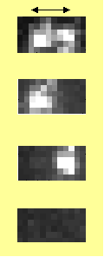
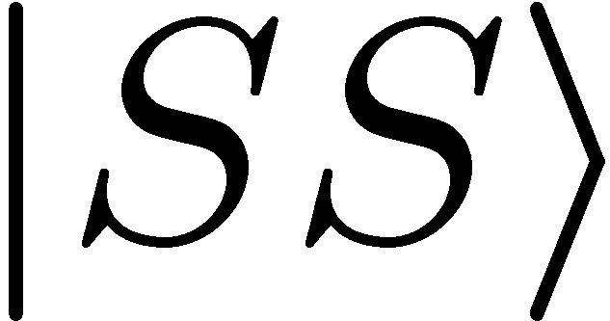
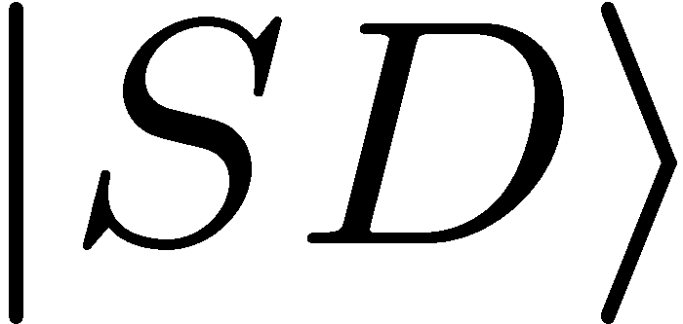
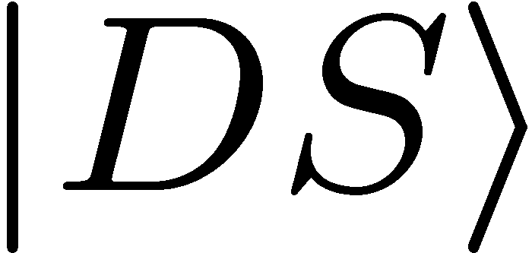
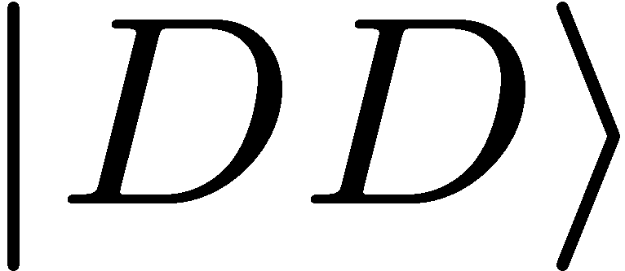
Initialization in a pure quantum state:
P_{1/2}
P_{1/2}
P_{1/2}
P_{1/2}
D_{5/2}
D_{5/2}
D_{5/2}
D_{5/2}
Quantum state
manipulation
τ =1s
2. Quantum state manipulation on
S_{1/2} – D_{5/2} transition
Doppler
cooling
Fluorescence
detection
Sideband
cooling
⁴⁰Ca⁺
S_{1/2}
3. Quantum state measurement
by fluorescence detection
S_{1/2}
S_{1/2}
S_{1/2}
Two ions:
5µm
Spatially resolved
detection with
CCD camera
50 experiments / s
Repeat experiments
100-200 times
Notes:
3 experimentelle Schritte

Slide 10
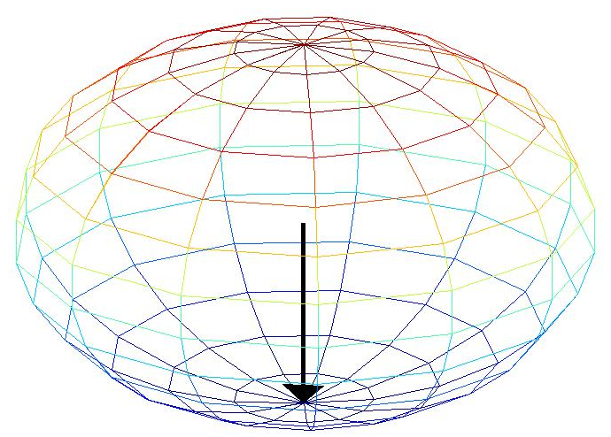
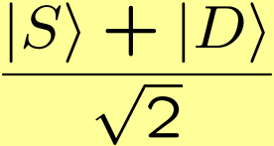
Rabi oscillations
P_{1/2}
D_{5/2}
D_{5/2}
S_{1/2}
D-state population

Slide 11
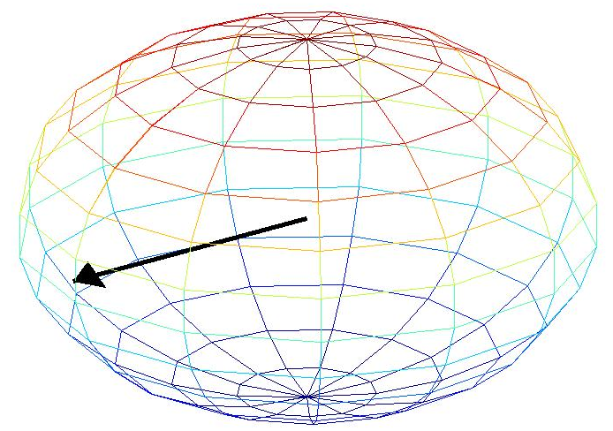
Rabi oscillations
P_{1/2}
D_{5/2}
D_{5/2}
S_{1/2}
D-state population

Slide 12
Rabi oscillations
P_{1/2}
D_{5/2}
D_{5/2}
S_{1/2}
D-state population

Slide 13
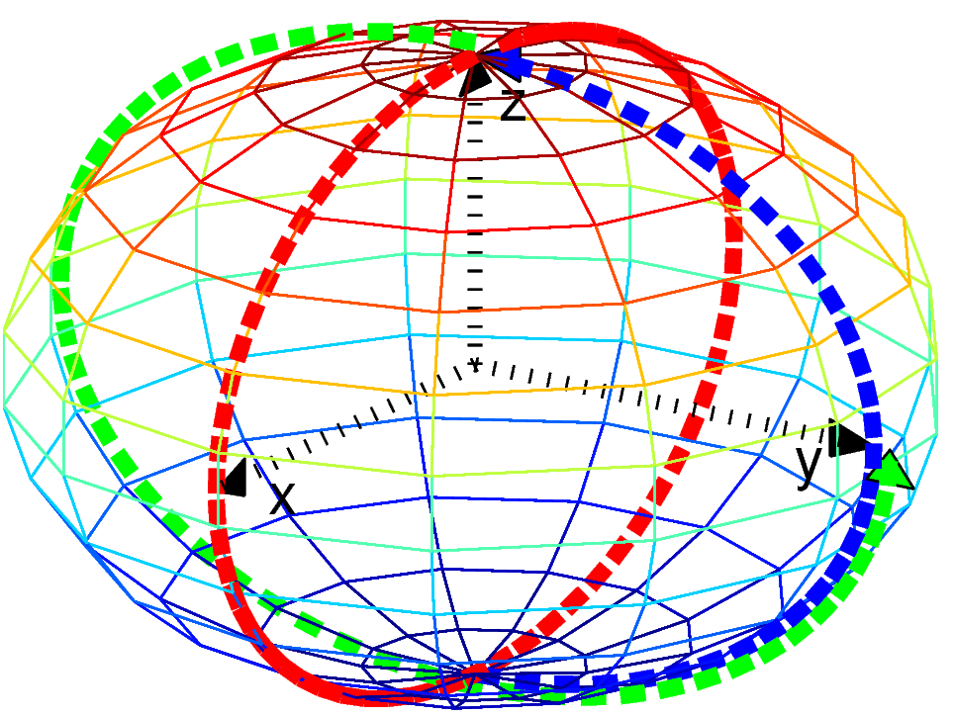
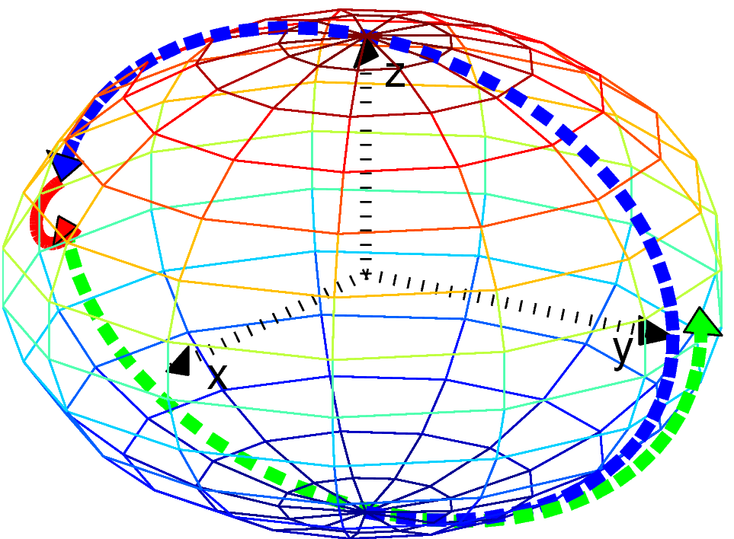
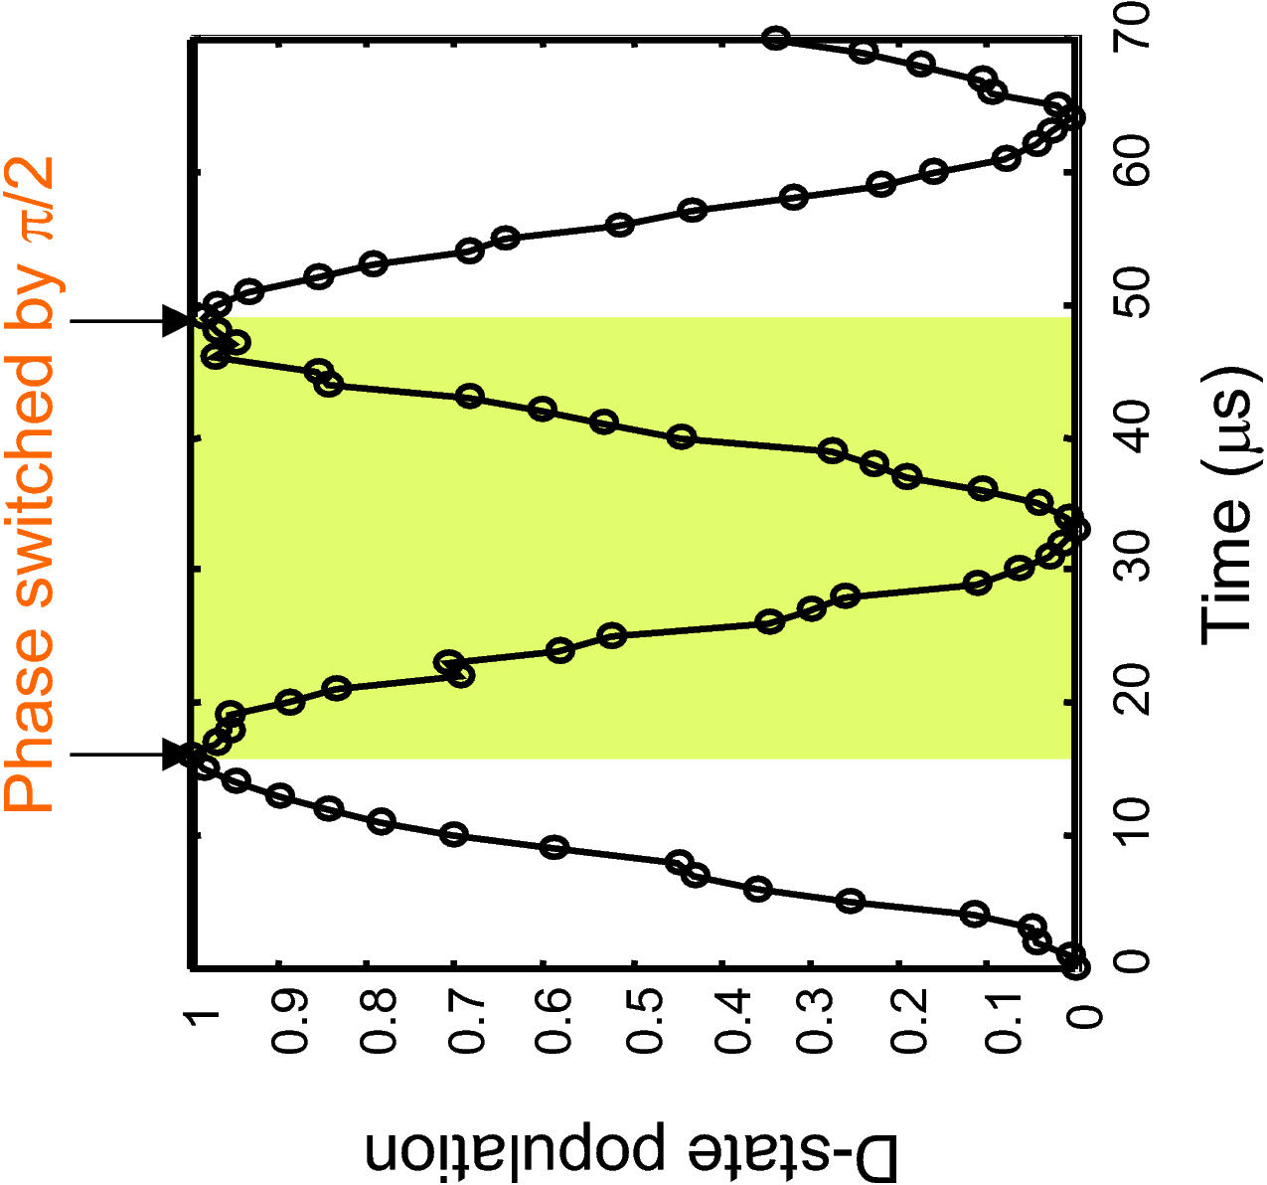
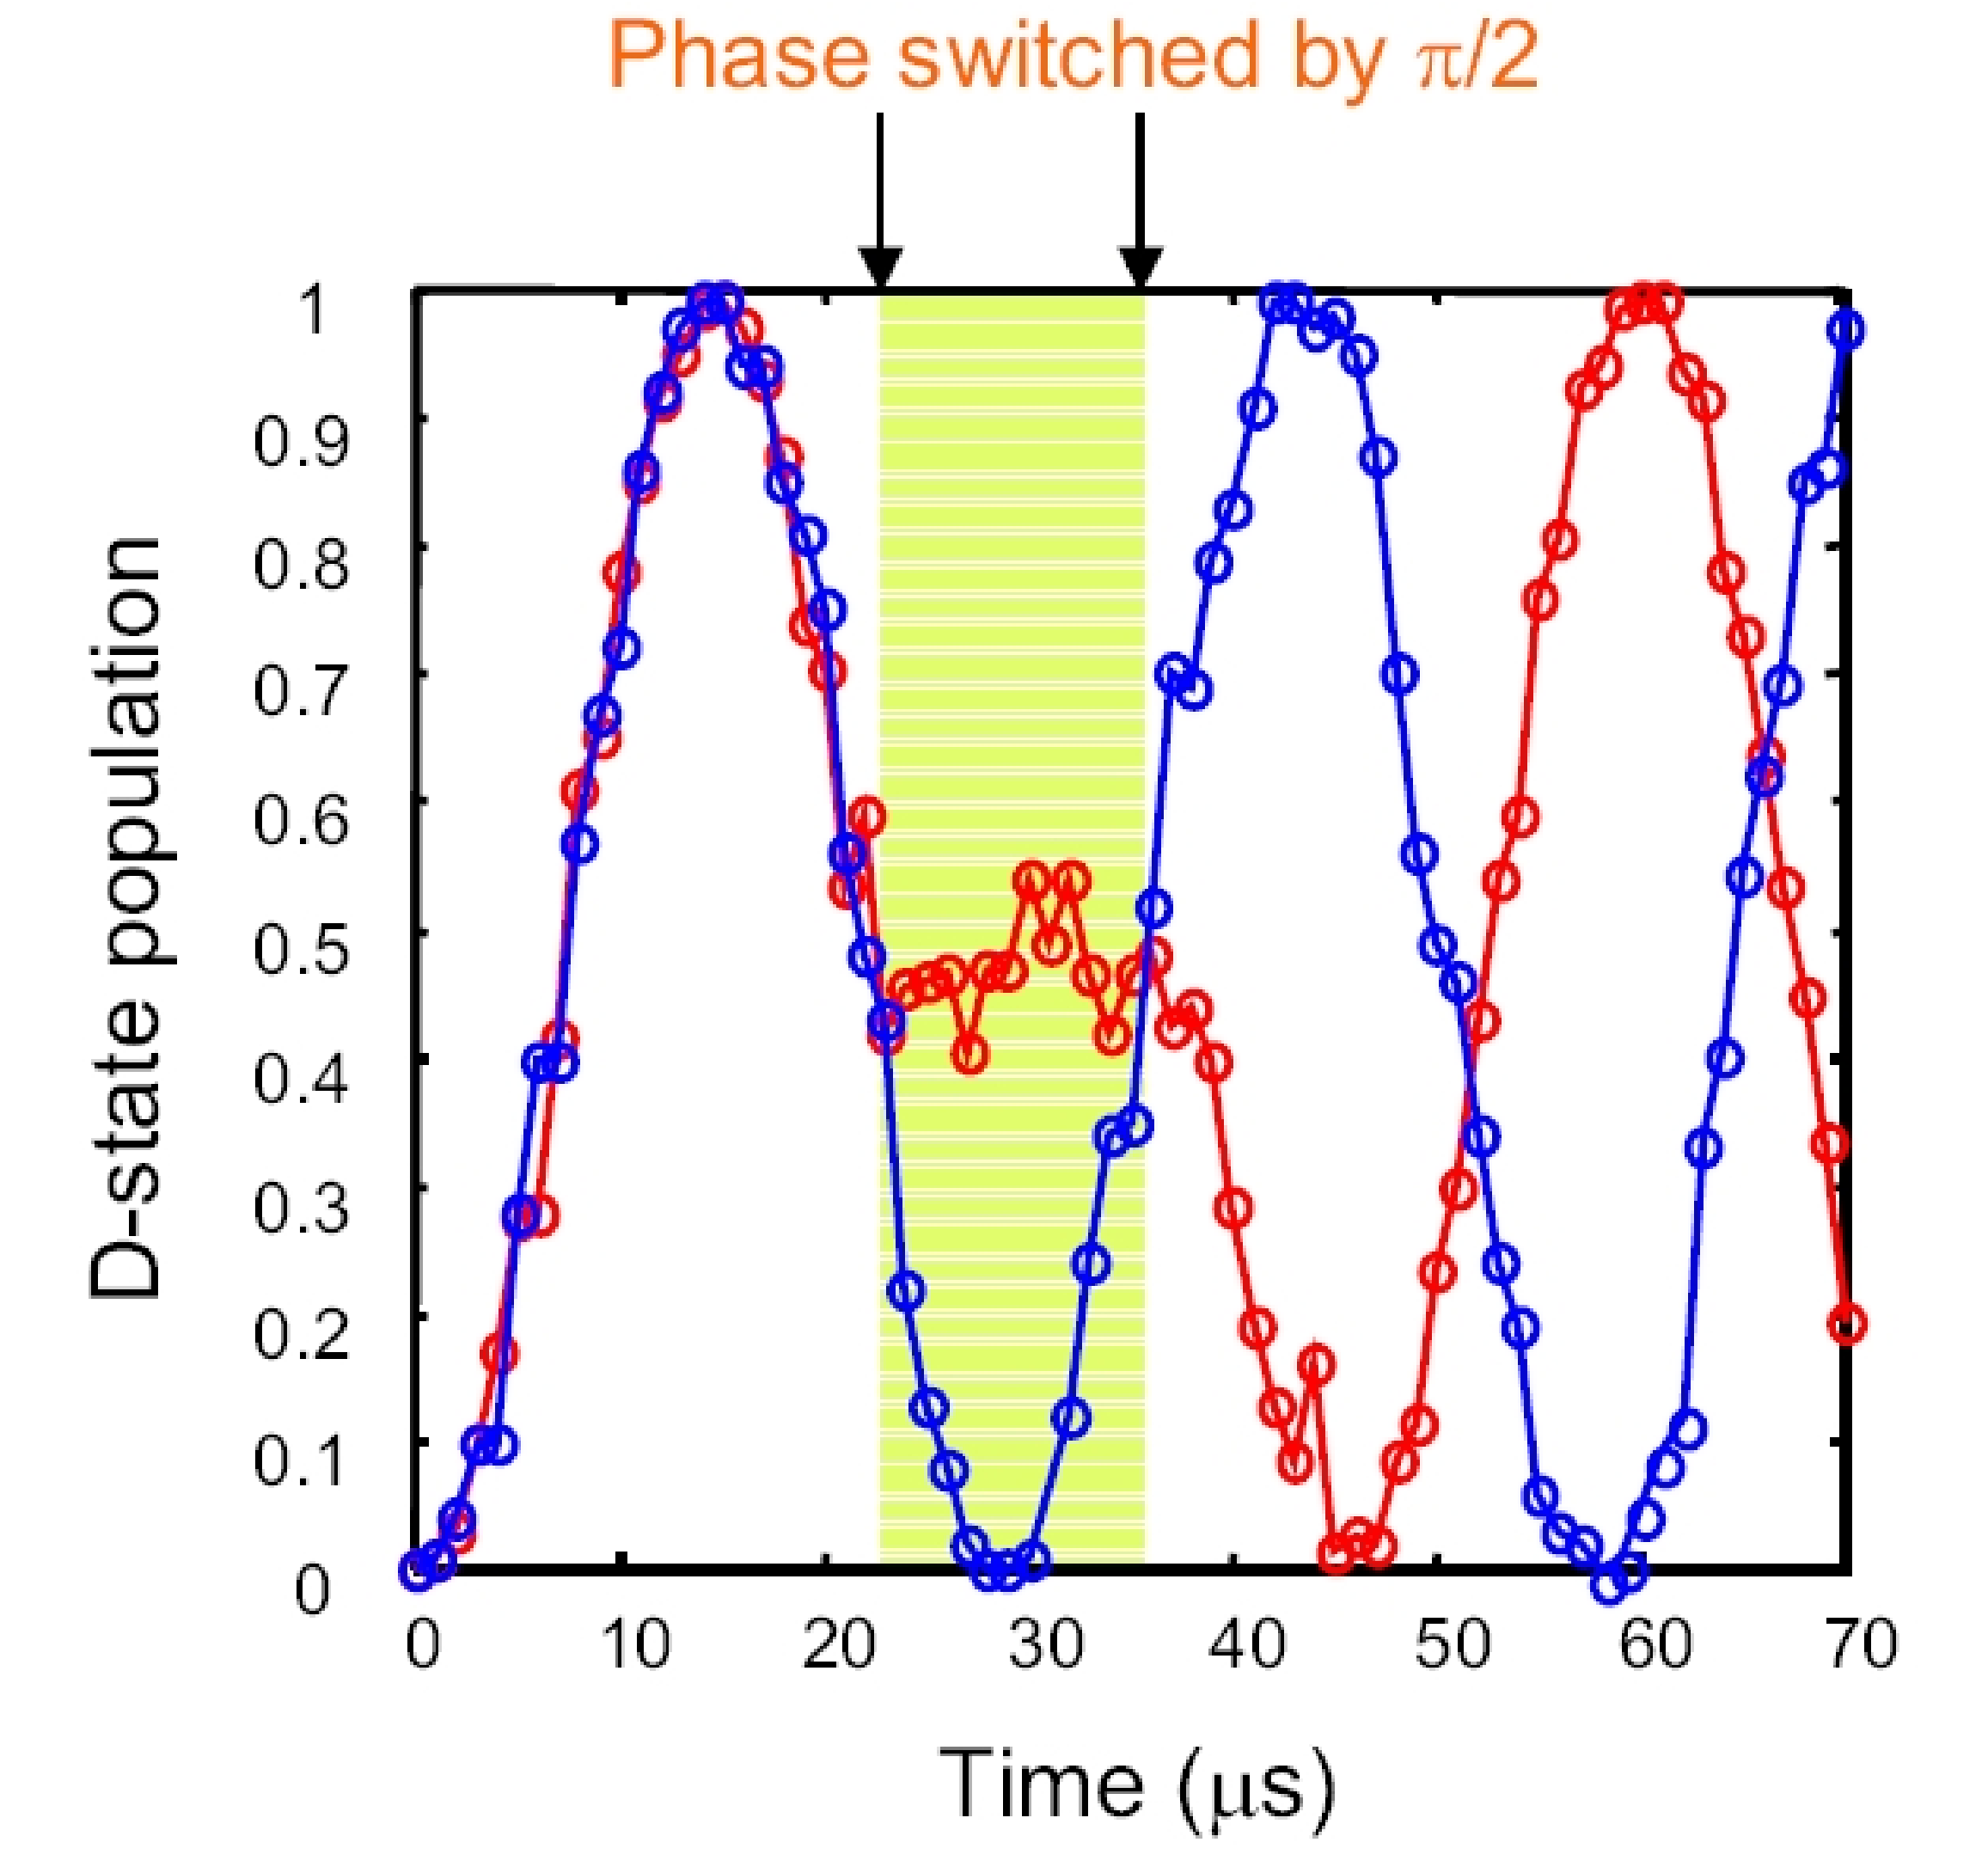
Single qubit gymnastics

Slide 14
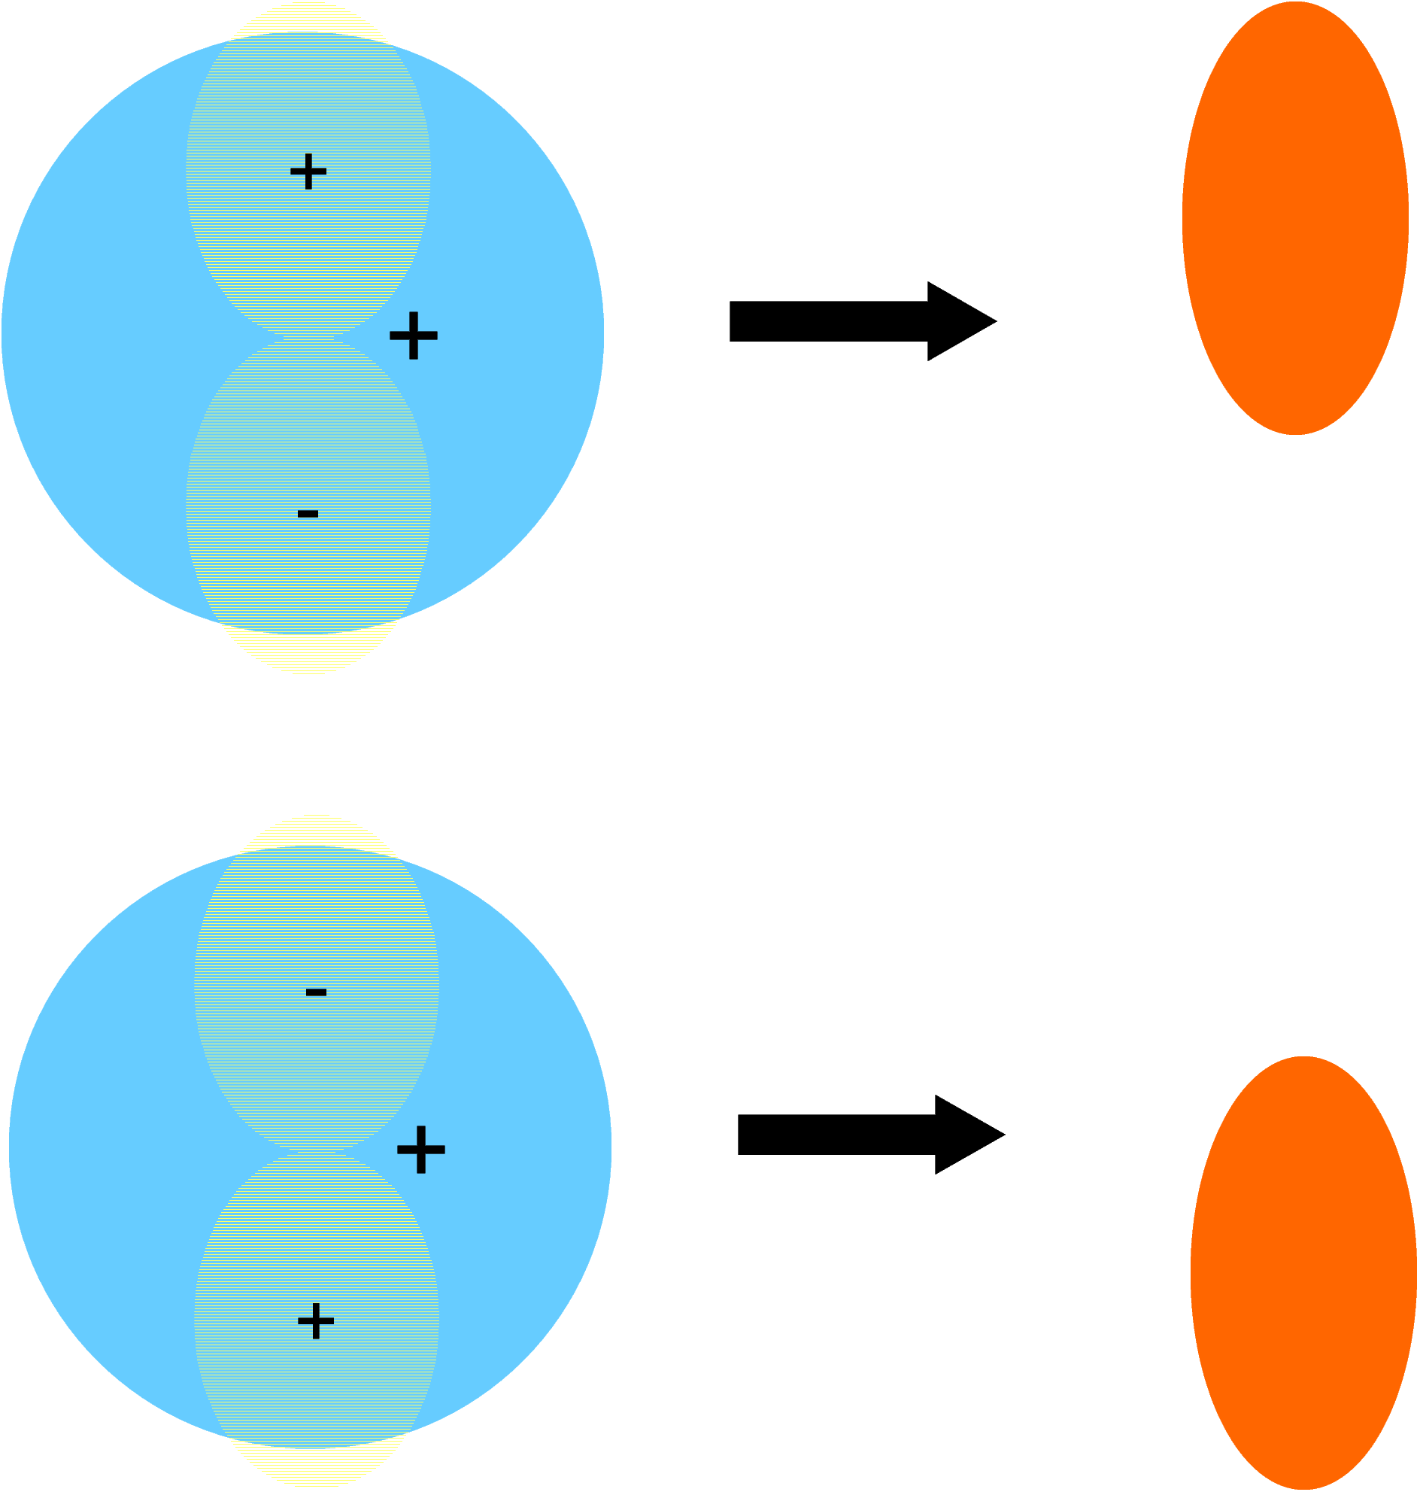
The phase of an atomic qubit

