Slide 2
Entangled photons

Slide 3
Parity oscillations with trapped ions

Slide 4
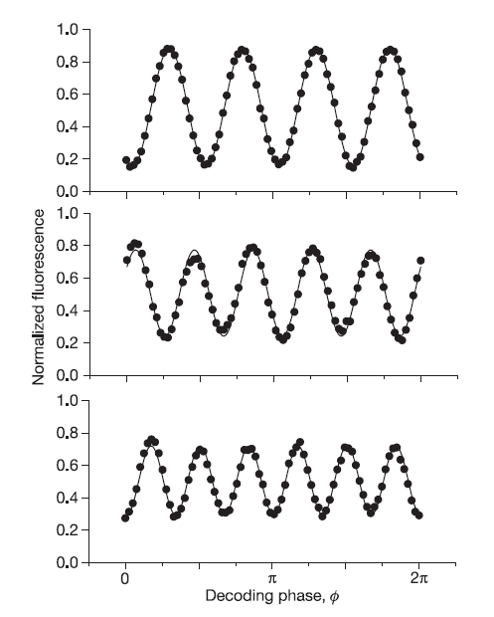
More oscillations with more ions
From the Wineland-group/Boulder

Slide 6
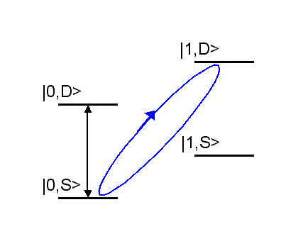
The -1 of the SU(2)
π/2
π/2
Blue
sideband

Slide 7
The -1 of the SU(2)

Slide 9
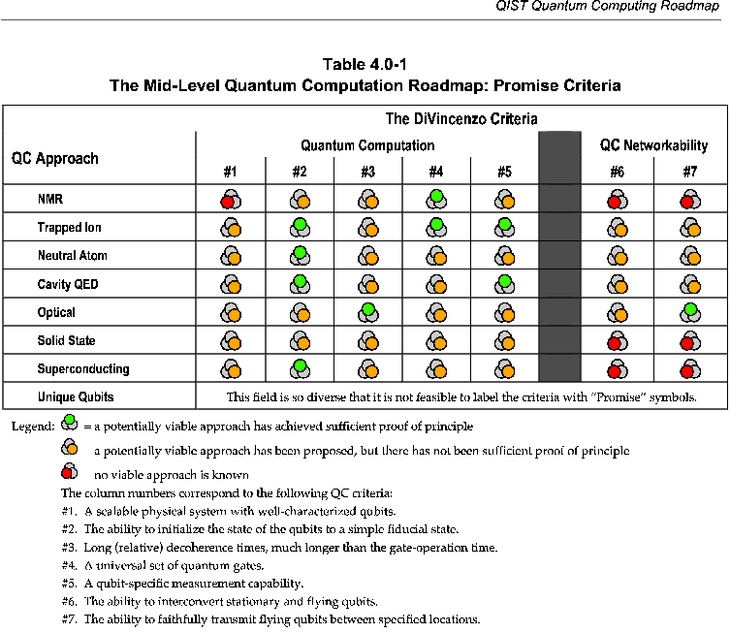
Dephasing

Slide 11
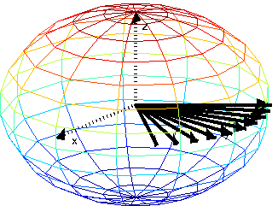
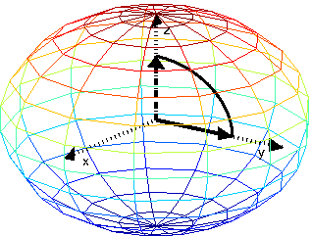
Dephasing

Slide 12
Dephasing

