Slide 1


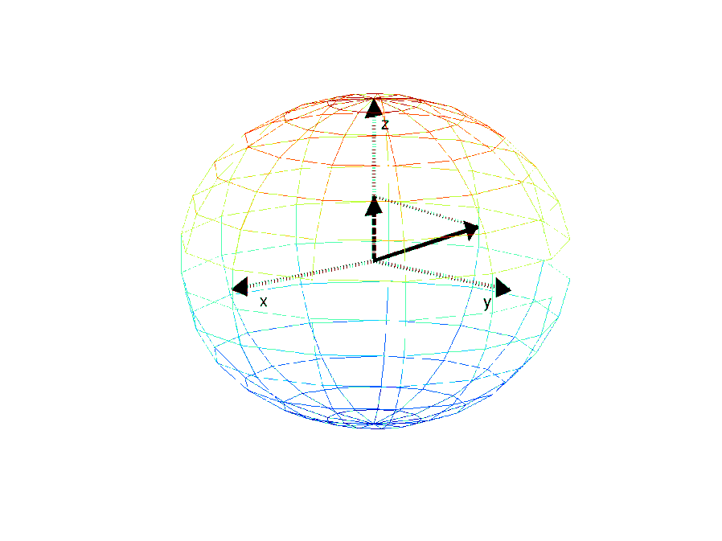

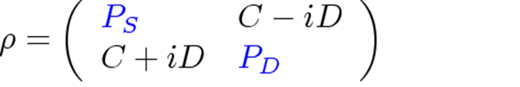

Measuring a density matrix
A measurement yields the z-component of the
Bloch vector
=> Diagonal of the density matrix

Slide 2
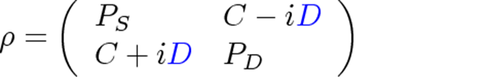
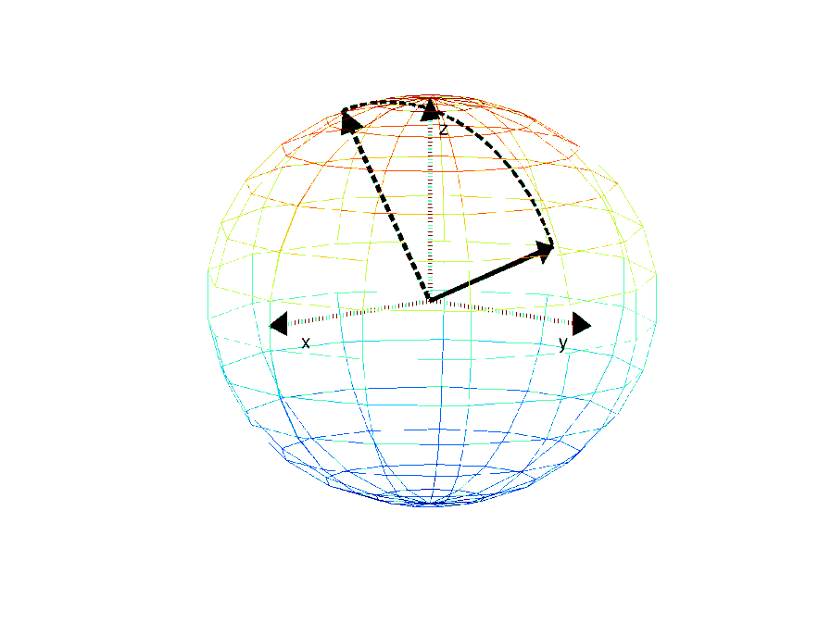
Measuring a density matrix
A measurement yields the z-component of the
Bloch vector
=> Diagonal of the density matrix
Rotation around the x- or the y-axis prior to
the measurement yields the phase information
of the qubit.

Slide 3
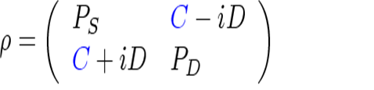
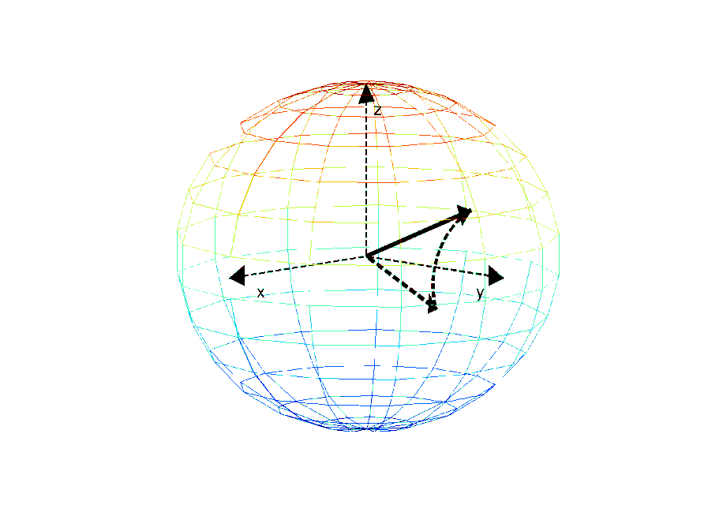
Measuring a density matrix
A measurement yields the z-component of the
Bloch vector
=> Diagonal of the density matrix
Rotation around the x- or the y-axis prior to
the measurement yields the phase information
of the qubit.
=> coherences of the density matrix

Slide 4
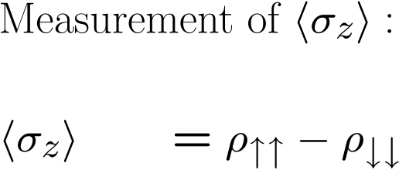
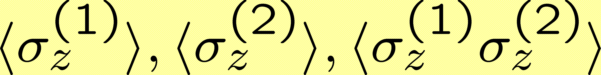
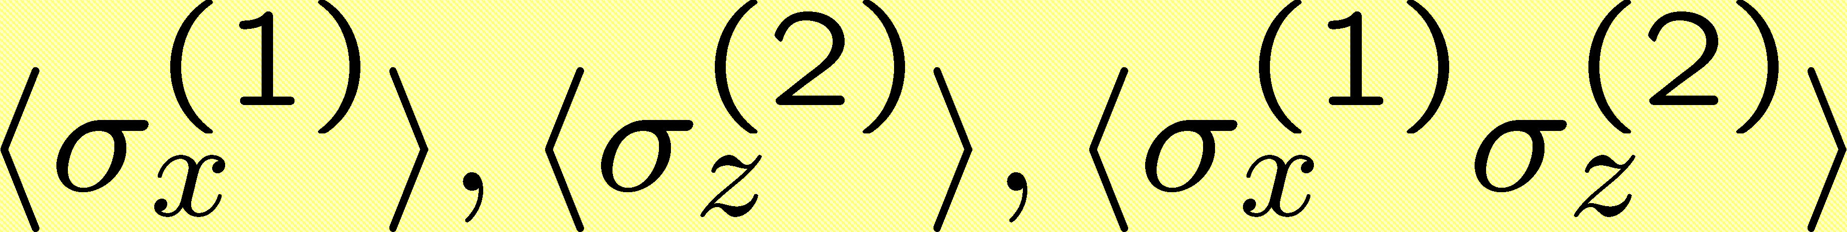
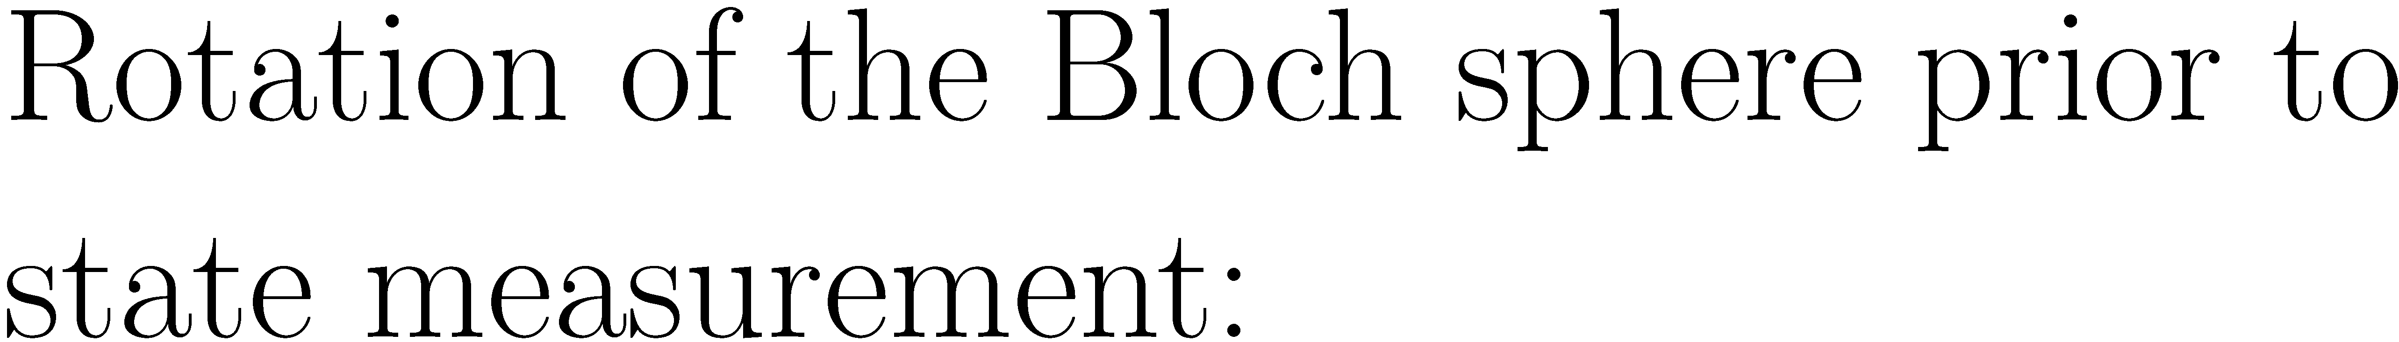
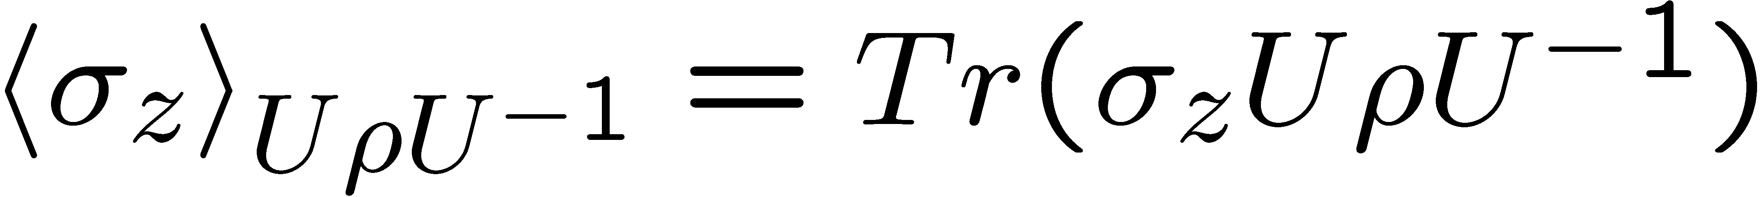
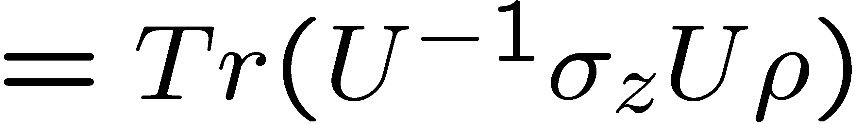
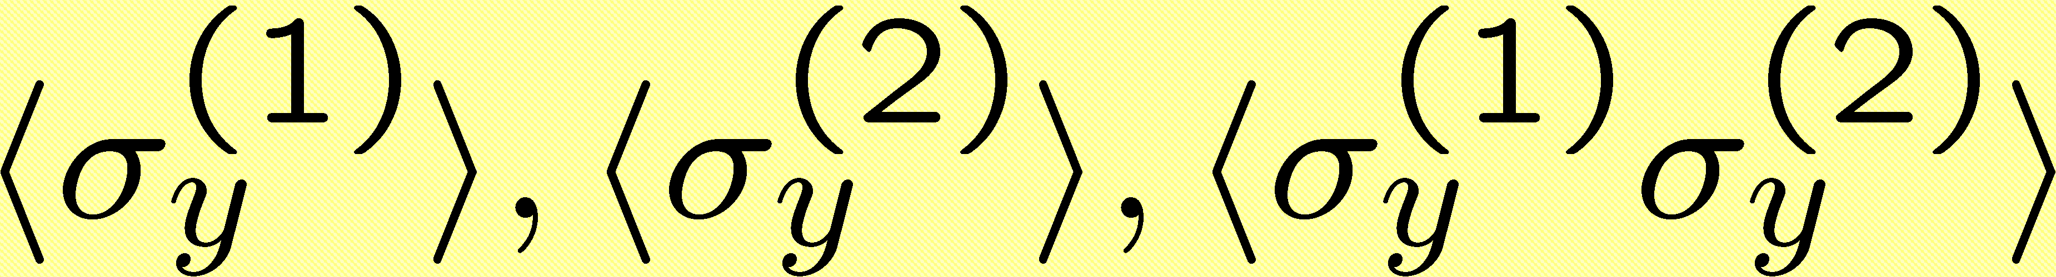
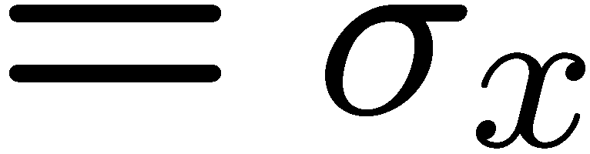
Bell state analysis
prepare Bell state
no rotation
measure
200 repetitions
prepare Bell state
ion #1, y - rotation
ion #2, identity
measure
200 repetitions
9 different
settings
prepare Bell state
ion #1, x - rotation
ion #2, x - rotation
measure
200 repetitions
!
Measurement time:
40 s

Slide 5
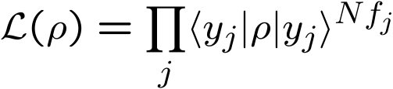
Maximum likelihood estimation
… not necessarily:
with a finite number of measurements, we can only
estimate expectation values
Maximum likelihood estimation:
(Hradil ’97, Banaszek ’99)‏

