Slide 1


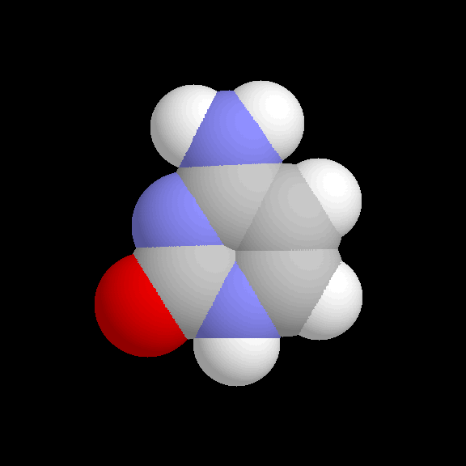
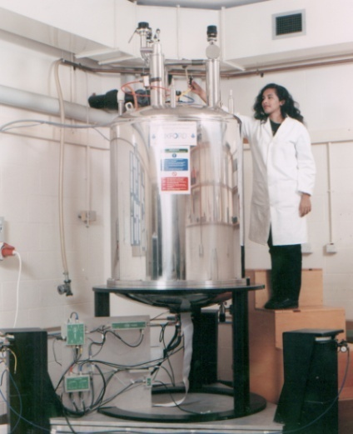
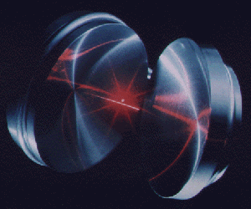
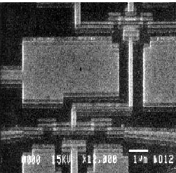
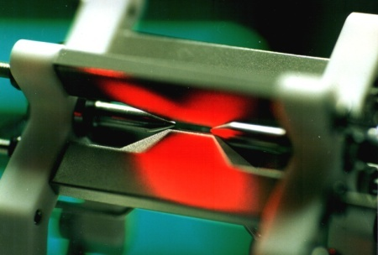
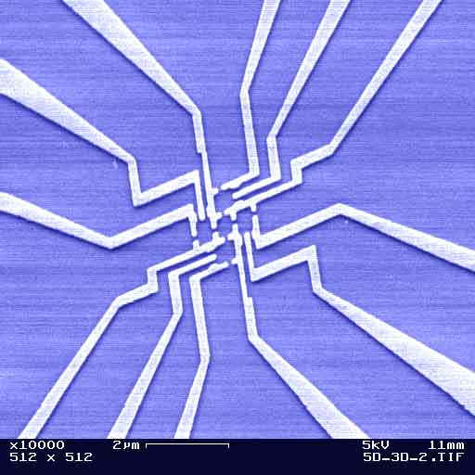
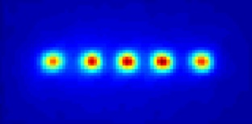
Which technology ?
Quantum
processor
000
001
010
011
100
011
110
011
Cavity QED
NMR
Superconducting qubits
Quantum dots
Trapped ions
© A. Ekert

Slide 2
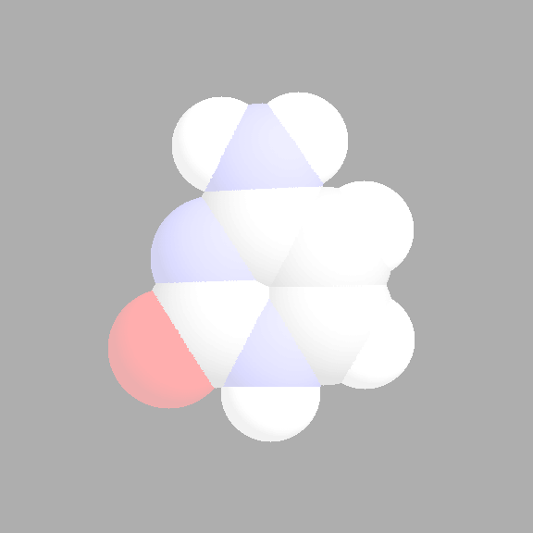
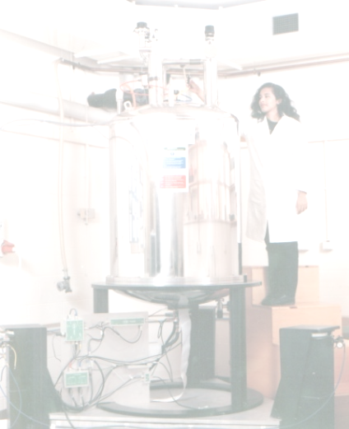
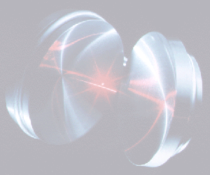
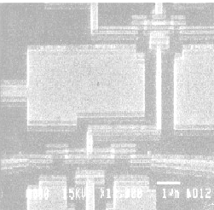
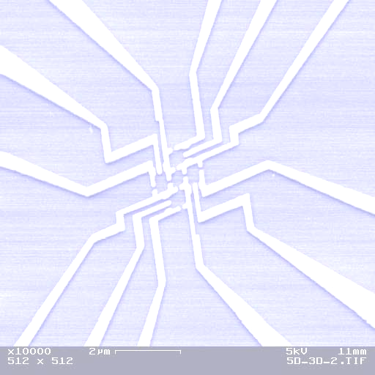
Which technology ?
Quantum
processor
000
001
010
011
100
011
110
011
Cavity QED
NMR
Superconducting qubits
Quantum dots
Trapped ions
© A. Ekert

Slide 3
Why trapped ions ?
Good things about ion traps:
Ions are excellent quantum memories; single qubit
coherence times > 10 minutes have been demonstrated
Ions can be controlled very well
Many ideas to scale ion traps
Bad things about ion traps:
Slow (~1 MHz)
Technically demanding

Slide 4
Why trapped ions ?
"Quantum computing with trapped ions",
H. Häffner, C. F. Roos, R. Blatt,
Physics Reports 469, 155 (2008).
"Quantum dynamics of single trapped ions",
D. Leibfried, R. Blatt, C. Monroe, D. Wineland,
Rev. Mod. Phys. 75, 281 (2003).
"Experimental issues in coherent quantum-state manipulation of trapped atomic ions," ,
D.J. Wineland, C. Monroe, W.M. Itano, D. Leibfried, B. King, and D.M. Meekhof,
Research of the National Institute of Standards and Technology 103, 259 (1998).
Literature can be found on:
http://tf.nist.gov/ion/qucomp/papers.htm
http://www.physics.berkeley.edu/research/haeffner/

Slide 5
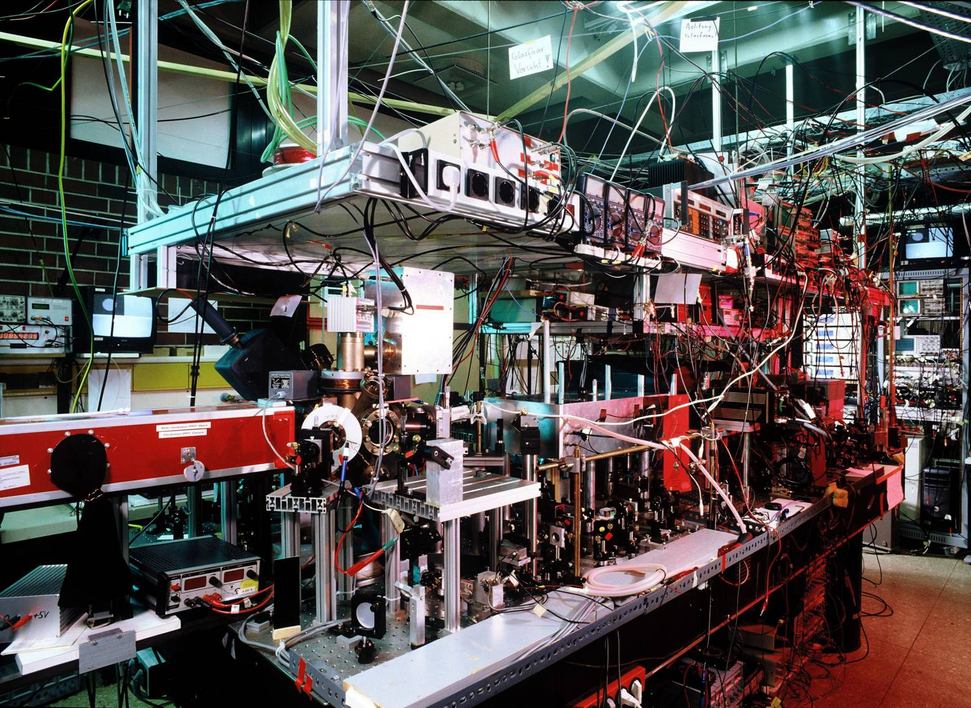

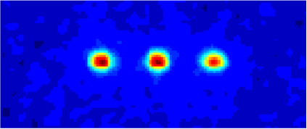
The hardware
P_{1/2}
D_{5/2}
Qubit
S_{1/2}

Slide 6
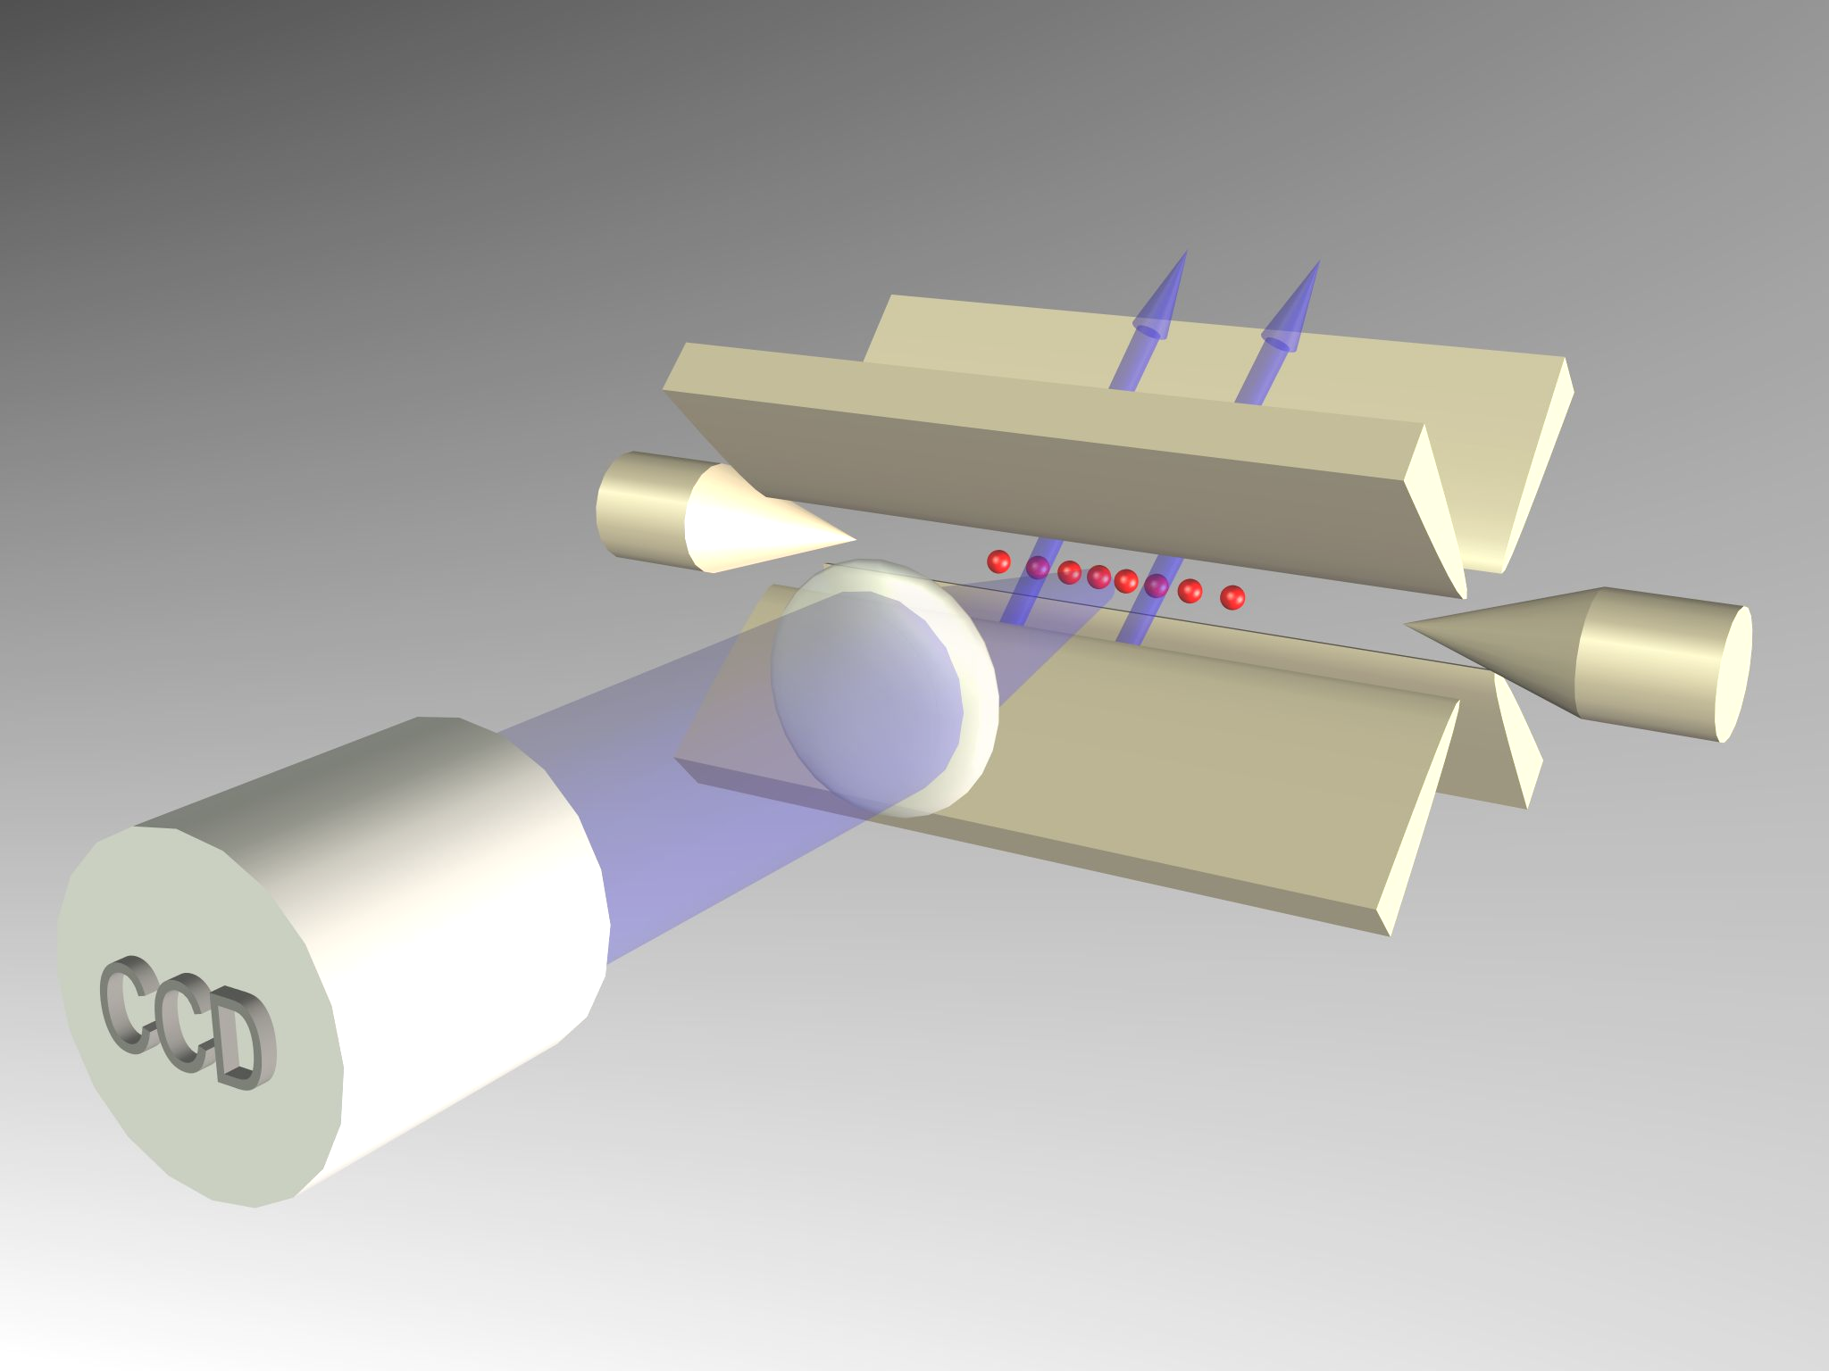
Innsbruck quantum processor
Trapped ions form the quantum register
Trap electrodes
Notes:
This ion crystal then develops normal modes of collective motion with center-of-mass frequencies on the order of 1 MHz. Here we see a parametrically excited mode

Slide 7
DiVincenzo criteria
Scalable physical system, well characterized qubits
Ability to initialize the state of the qubits
Long relevant coherence times, much longer than gate operation time
“Universal” set of quantum gates
Qubit-specific measurement capability

Slide 8
Experimental procedure
Initialization in a pure quantum state
P_{1/2}
P_{1/2}
P_{1/2}
D_{5/2}
D_{5/2}
D_{5/2}
D_{5/2}
τ =1s
⁴⁰Ca⁺
S_{1/2}
S_{1/2}
S_{1/2}
S_{1/2}
Notes:
3 experimentelle Schritte

Slide 9
Experimental procedure
Initialization in a pure quantum state
P_{1/2}
P_{1/2}
P_{1/2}
D_{5/2}
D_{5/2}
D_{5/2}
D_{5/2}
Doppler
cooling
τ =1s
Sideband
cooling
⁴⁰Ca⁺
S_{1/2}
S_{1/2}
S_{1/2}
S_{1/2}
Notes:
3 experimentelle Schritte

Slide 10
Experimental procedure
Initialization in a pure quantum state
P_{1/2}
D_{5/2}
D_{5/2}
Quantum state
manipulation
2. Quantum state manipulation on
S_{1/2} – D_{5/2} transition
S_{1/2}
S_{1/2}
Notes:
3 experimentelle Schritte

Slide 11

Experimental procedure
Initialization in a pure quantum state:
P_{1/2}
P_{1/2}
P_{1/2}
P_{1/2}
D_{5/2}
D_{5/2}
D_{5/2}
D_{5/2}
Quantum state
manipulation
τ =1s
2. Quantum state manipulation on
S_{1/2} – D_{5/2} transition
Doppler
cooling
Fluorescence
detection
Sideband
cooling
⁴⁰Ca⁺
S_{1/2}
3. Quantum state measurement
by fluorescence detection
S_{1/2}
S_{1/2}
S_{1/2}
Notes:
3 experimentelle Schritte

Slide 12

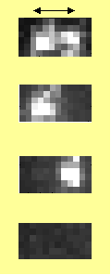

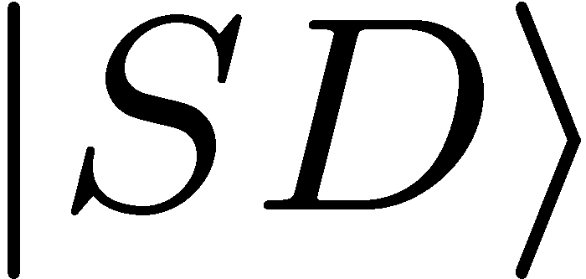


Experimental procedure
Initialization in a pure quantum state:
P_{1/2}
P_{1/2}
P_{1/2}
P_{1/2}
D_{5/2}
D_{5/2}
D_{5/2}
D_{5/2}
Quantum state
manipulation
τ =1s
2. Quantum state manipulation on
S_{1/2} – D_{5/2} transition
Doppler
cooling
Fluorescence
detection
Sideband
cooling
⁴⁰Ca⁺
S_{1/2}
3. Quantum state measurement
by fluorescence detection
S_{1/2}
S_{1/2}
S_{1/2}
Two ions:
5µm
Spatially resolved
detection with
CCD camera
50 experiments / s
Repeat experiments
100-200 times
Notes:
3 experimentelle Schritte

Slide 13
Notes:
3 experimentelle Schritte

Slide 14

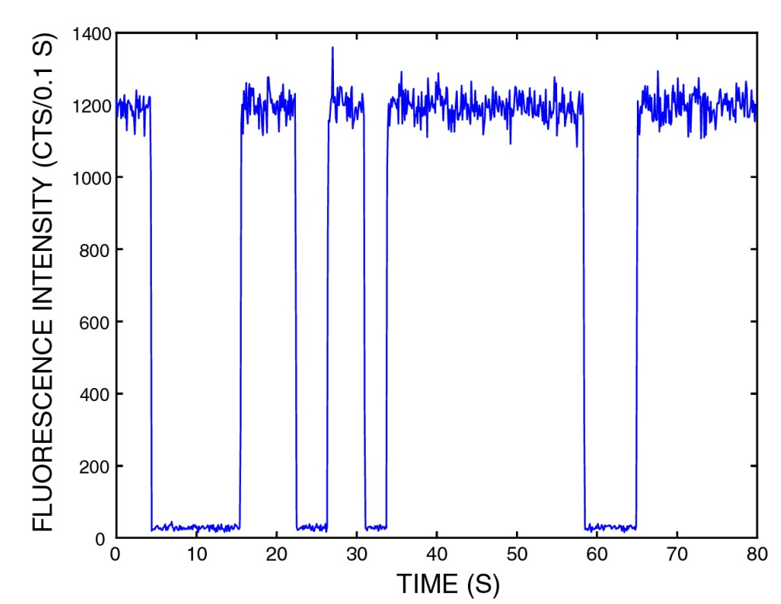
Quantum jumps: spectroscopy with quantized fluorescence
P
D
metastable
level
absorption and emission
cause fluorescence steps
(digital quantum jump signal)‏
monitor
weak transition
S
S
„ Quantum jump technique“
„ Electron shelving technique“
Observation of quantum jumps:
D
Nagourney et al., PRL 56,2797 (1986),
Sauter et al., PRL 57,1696 (1986),
Bergquist et al., PRL 57,1699 (1986)

Slide 15
⁴⁰Ca⁺ : Important energy levels
D_{5/2} : metastable state
P_{3/2}
S_{1/2} – D_{5/2} : quadrupole transition
τ = 7 ns
P_{1/2}
854 nm
866 nm
τ = 1 s
D_{5/2}
D_{3/2}
397 nm
729 nm
S_{1/2}

Slide 16


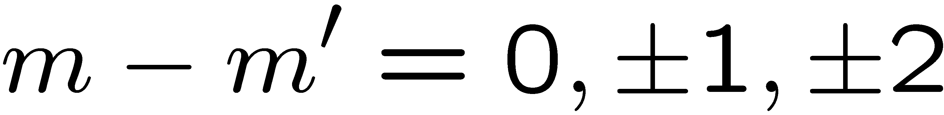
Spectroscopy on S_{1/2}-D_{5/2} quadrupole transition
Zeeman structure in non-zero magnetic field:
3/2
5/2
spectrum
D_{5/2}
1
/2
- /2
1
-3/2
-5/2
S_{1/2}
1
/2
Laser detuning Δ at 729 nm
- /2
1
Selection rule for electric quadrupole transition:
Notes:
3 experimentelle Schritte

Slide 17
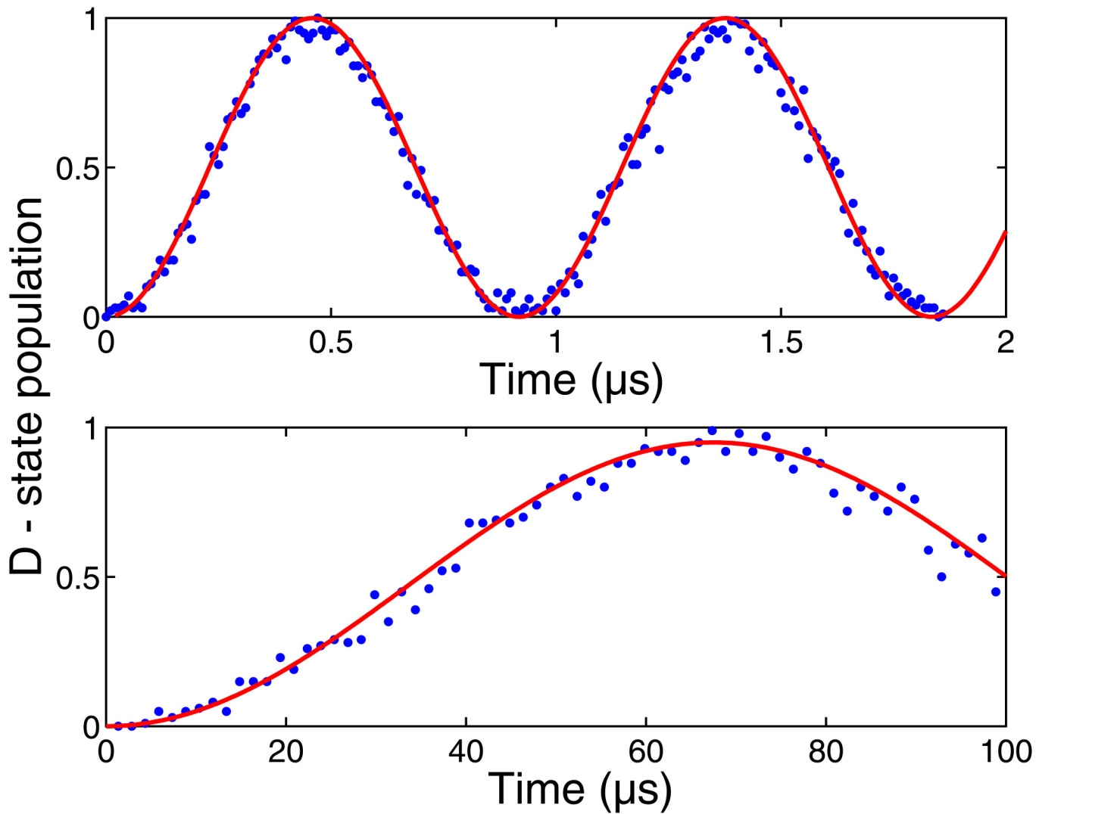


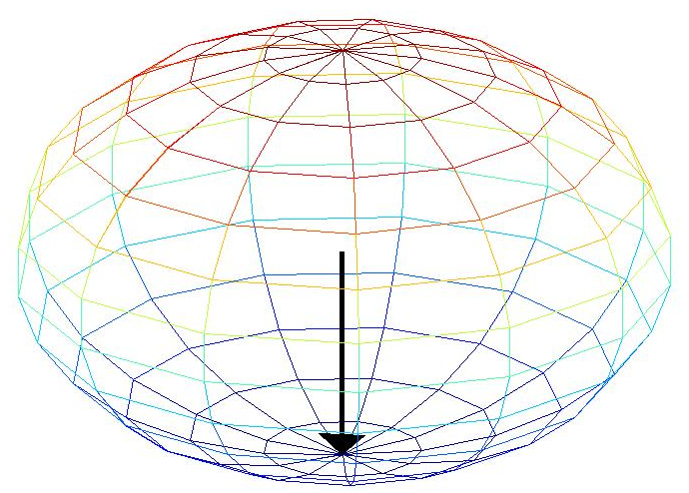
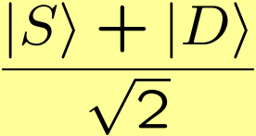
Rabi oscillations
P_{1/2}
D_{5/2}
D_{5/2}
S_{1/2}
D-state population

Slide 18
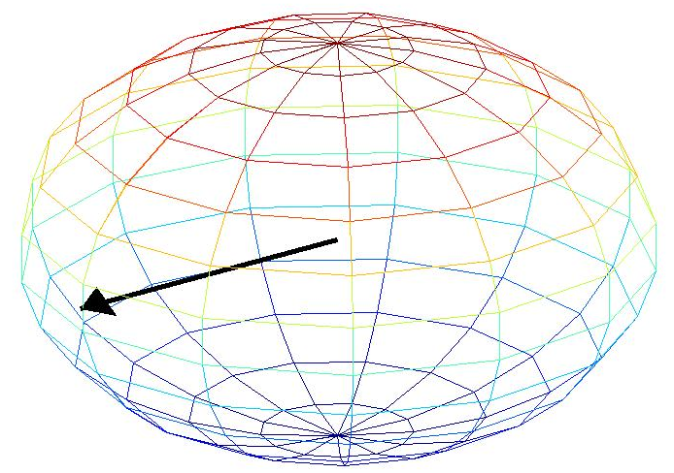
Rabi oscillations
P_{1/2}
D_{5/2}
D_{5/2}
S_{1/2}
D-state population

Slide 19
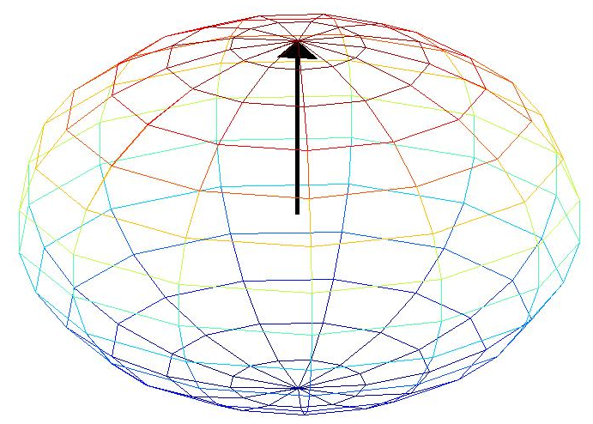
Rabi oscillations
P_{1/2}
D_{5/2}
D_{5/2}
S_{1/2}
D-state population

Slide 20
The phase ...
+
+
+
=
-
+
+
-
=
-

Slide 21
The phase ...
+
+
+
=
-
+
+
+e
-iωt
=
-

Slide 22
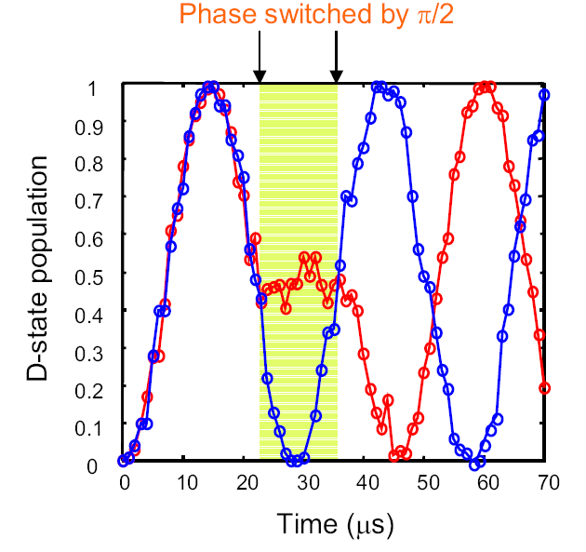
The phase ...

Slide 23
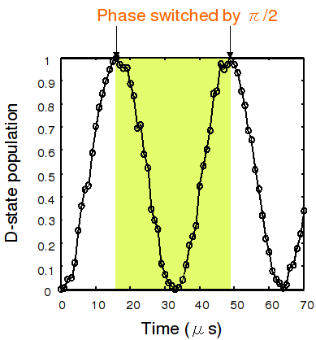
The phase ...

Slide 24
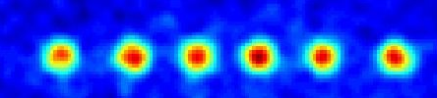

Addressing single qubits
coherent
manipulation
of qubits
Paul trap
0.8
0.7
electrooptic
deflector
0.6
0.5
Excitation
0.4
0.3
0.2
0.1
0
-10
-8
-6
-4
-2
0
2
4
6
8
10
dichroic
Deflector Voltage (V)‏
- inter ion distance: ~ 4 µm
- addressing waist: ~ 2 µm
< 0.1% intensity on neighbouring ions
beamsplitter
Fluorescence
detection
CCD
Notes:
The ions can be addressed individually on the qubit transition with an EO deflector which can quickly move the focus of the 729 light from one ion to another, using the same optical path as the fluorescence detection via the CCD camera.
How well the addressing works is shown here: The graph shows the excitation of the indiviual ions as the deflector is scanned across the crystal.

Slide 25
Decoherence mechanisms
Memory errors:
- Bit-flips (spontaneous decay, electromagnetic noise)‏
- Dephasing (magnetic field, laser frequency nois)‏
Operationial errors
- technical imperfections …

Slide 26
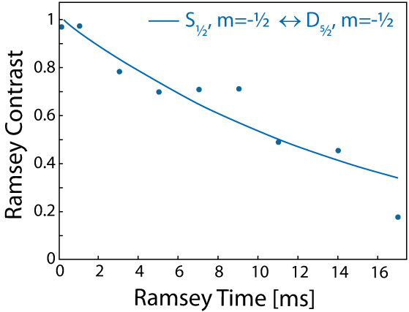
Dephasing of qubits
Ramsey Experiment
π / 2
Ramsey Time
π / 2
= 15.9 ms

Slide 27
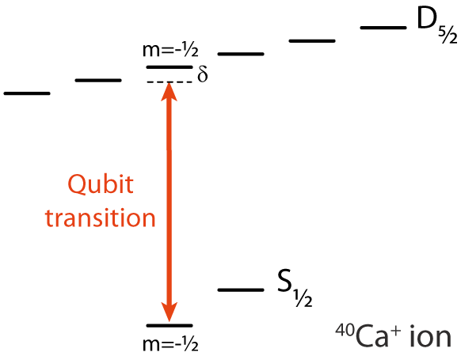
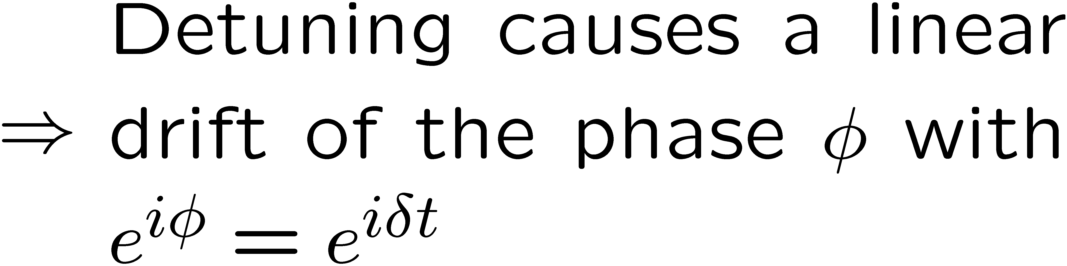
Zeeman shift

Slide 28
Realized time scales
Single qubit gates
10⁻⁶ s
Two qubit gates (Geometric phase gates) ‏
10⁻⁵ s
10⁻⁴ s
Two qubit gates (Cirac-Zoller approach)‏
10⁻³ s
10⁻² s
Single qubit coherence (magnetic field sensitive)‏
10⁻¹ s
Coherence of the motion
10⁰ s
10¹ s
10² s
10³ s

Slide 29
Long lived qubits
Raman transitions:
Excited state
qubit
Ground state

Slide 30
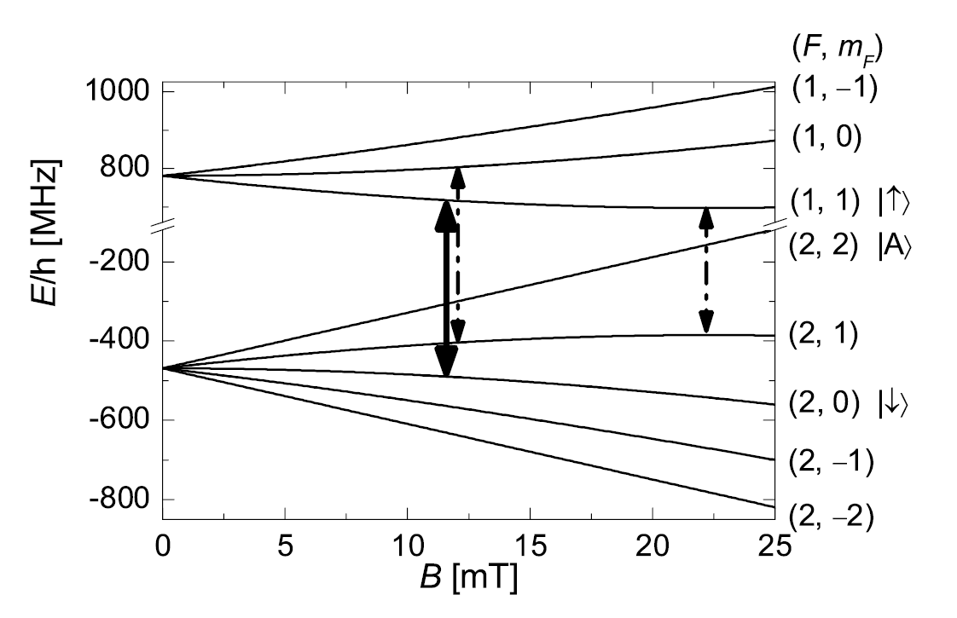
Long lived qubits
Raman transitions:
Excited state
Ground state

Slide 31
Long lived qubits
Level scheme of ⁹Be⁺:
From: C. Langer et al., PRL 95, 060502 (2005), NIST

Slide 32
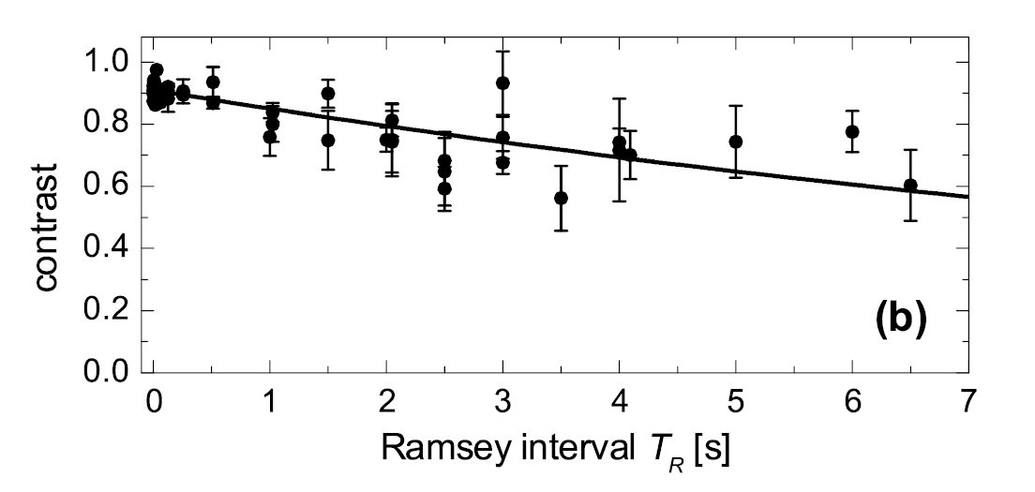
Long lived qubits
From: C. Langer et al., PRL 95, 060502 (2005), NIST

Slide 33
Realized time scales
Single qubit gates
10⁻⁶ s
Two qubit gates (Geometric phase gates) ‏
10⁻⁵ s
10⁻⁴ s
Two qubit gates (Cirac-Zoller approach)‏
10⁻³ s
10⁻² s
Single qubit coherence (magnetic field sensitive)‏
10⁻¹ s
Coherence of the motion
10⁰ s
10¹ s
Single qubit coherence (magnetic field insensitive)‏
10² s
10³ s
Single qubit coherence (magnetic field insensitive + RF drive)‏

Slide 34
DiVincenzo criteria
Scalable physical system, well characterized qubits
Ability to initialize the state of the qubits
Long relevant coherence times, much longer than gate operation time
“Universal” set of quantum gates
Qubit-specific measurement capability

Slide 35
Notes:
3 experimentelle Schritte

Slide 36
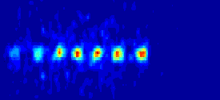
Having the qubits interact
The common motion
acts as the quantum
bus.
50 µm
Notes:
This ion crystal then develops normal modes of collective motion with center-of-mass frequencies on the order of 1 MHz. Here we see a parametrically excited mode

Slide 37




Ion motion
harmonic trap
…
…
Notes:
Now let's have a look at the qubit transition in the presence of the motional degrees of freedom. If we focus on just one motional mode ..., we just get a ladder of harm osc levels.

Slide 38










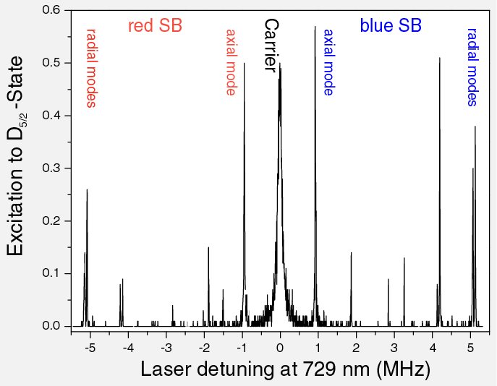
Ion motion
2-level-atom
harmonic trap
joint energy levels
…
…
Notes:
The joint system shows a double ladder structure. With our narrow laser we can selectively excite the carrier transition, where the motional state remains unchanged...
or the blue sideband ...
and red sideband transitions, where we can change the motional state

Slide 39
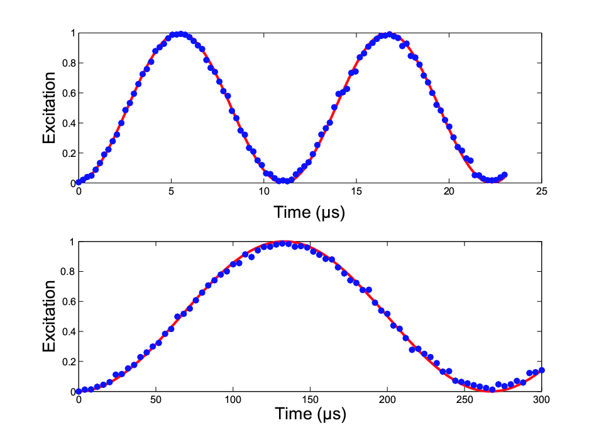




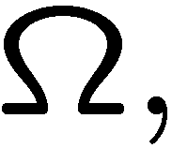


Coherent manipulation
carrier
carrier and sideband
Rabi oscillations
with Rabi frequencies
Lamb-Dicke parameter

Slide 40

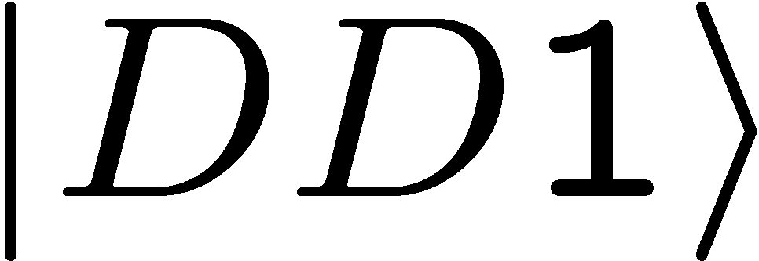






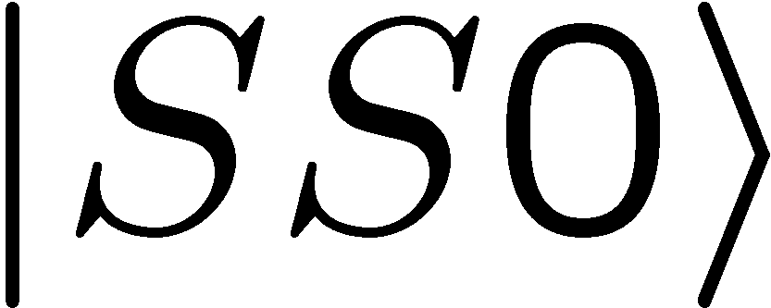
Generation of Bell states
…
…
…
…

Slide 41
Generation of Bell states
…
…
…
π
…

Slide 42
Generation of Bell states
…
π/2
…
…
…

Slide 43
Generation of Bell states
…
π
…
…
…

Slide 44
Generation of Bell states
…
π
…
…
Bell states with atoms
⁹Be⁺: NIST (fidelity: 97 %)‏
⁴⁰Ca⁺: Oxford (83%)‏
¹¹¹Cd⁺: Ann Arbor (79%)‏
²⁵Mg⁺: Munich
⁴⁰Ca⁺: Innsbruck (99%)‏
…

Slide 45

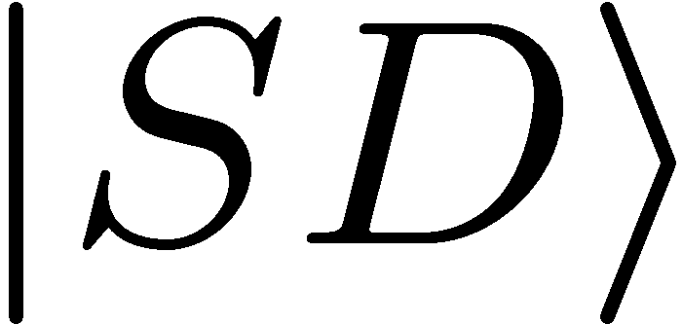
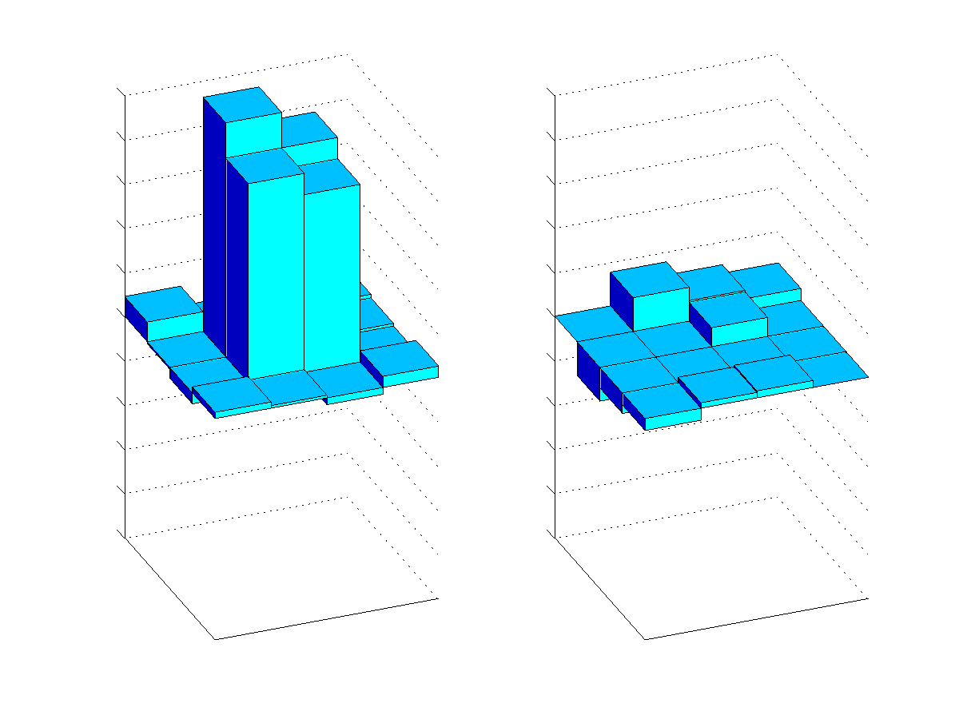
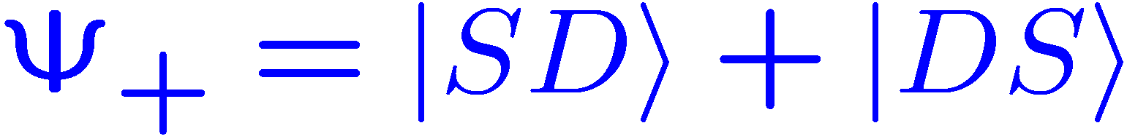


Analysis of Bell states
Fluorescence
detection with
CCD camera:
Coherent superposition or incoherent mixture ?
What is the relative phase of the superposition ?
SS
Measurement of the density matrix:
SD
DS
SS
DD
SD
DS
DD

