Slide 1
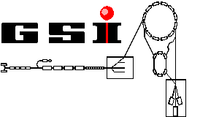

The g-factor of Hydrogenlike Ions
H. Häffner², N. Hermanspahn¹, M. Immel¹, H.-J. Kluge², R. Ley¹, R. Mann²,
W. Quint², S. Stahl¹, José Verdú¹ and G. Werth¹
¹ Institut für Physik, Universität Mainz, Germany
² GSI Darmstadt, Germany

Slide 2
Outline
- experimental subject and motivation
- the Penning trap
- detection of ions
- measurements and result
- observation of a single ion in
thermal equilibrium
- outlook

Slide 3
Experimental Subject

Slide 4
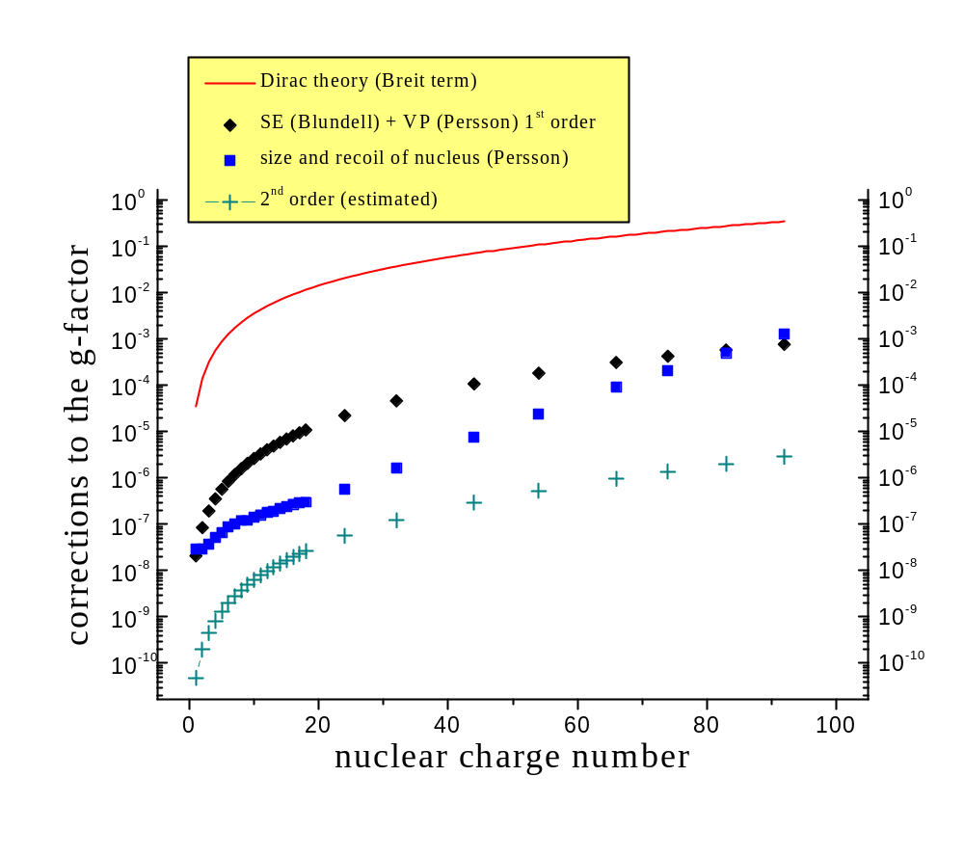
Corrections to the free electrons g-factor

Slide 5
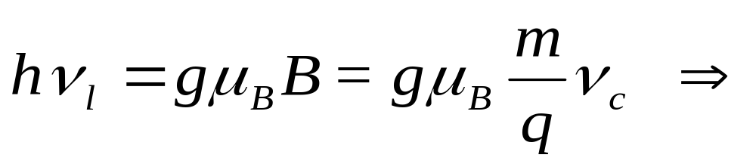
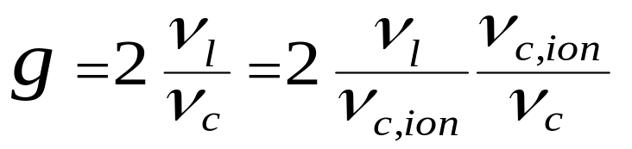
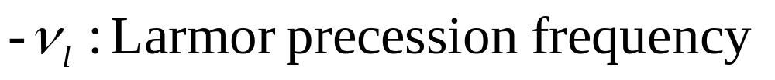
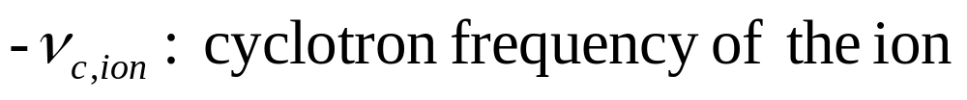
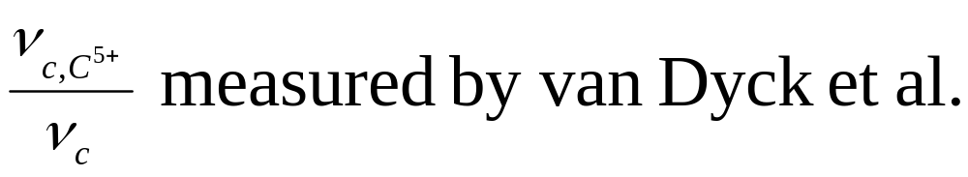
How to measure the g-factor?
to measure:

Slide 6
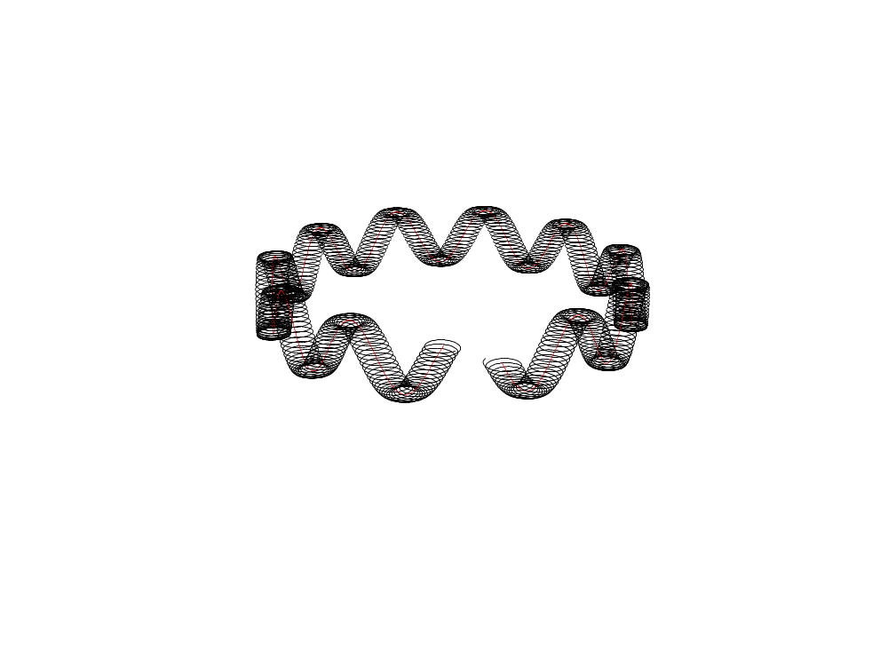


Motion of an Ion in a Penning Trap (schematic)
B
three oscillations
- E-field axial oscillation
- B-field modified cyclotron motion
- E B magnetron motion

Slide 7
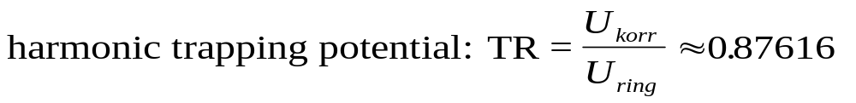

The Cylindrical Trap
1
c
r
m
endcap
correction electrode
U
k
o
r
r
ring electrode
U
r
i
n
g
U
k
o
r
r
B
z
-
axis

Slide 8
Picture of the Trap

Slide 9
triple-trap

Slide 10
Experimental Setup

Slide 11
experimental procedure
1. creation of ions
2. preparation of a single ion
3. cooling of the ion
- measurement of the cyclotron frequency
- analysis of the spin direction
- applying microwaves
- change microwave frequency
- measurement of the cyclotron frequency
determination of the Larmor-
precession frequency

Slide 12
Interaction of an Ion with the Electronics
signal voltage
tank circuit at 4 K
two detection scemes:
- hot ions: detection of the image current
- cool ions: detection of the shortened noise of the tank circuit

Slide 13
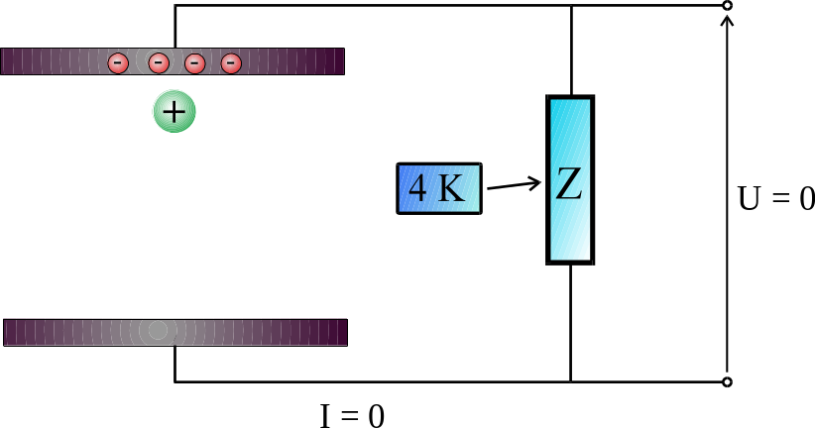
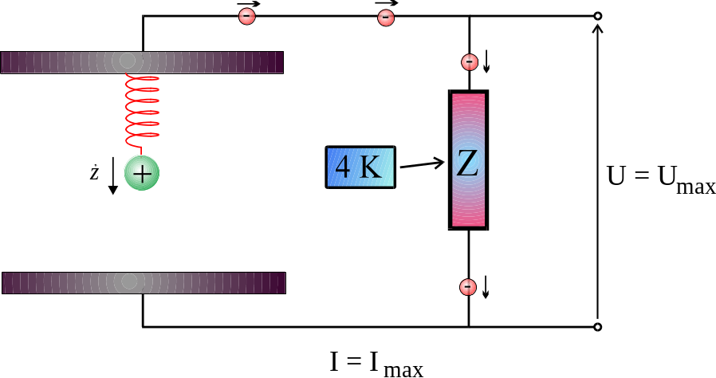
Electronic Detection
- Fourier-transformation of the voltage U yields the frequency of the ions motion
- cooling of the ions motion due to power dissipation in the resistor (resistive cooling)
- the cold ion conducts the AC-current at its resonance frequency very well => short-cut of the voltage
for good cooling and high signals: - small traps
- big resistors

Slide 14
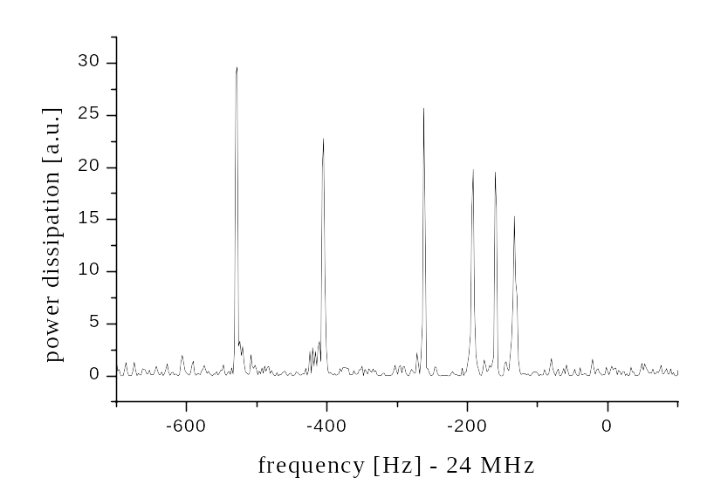
Cyclotron Signal of 6 C⁵⁺-Ions
Z

Slide 15
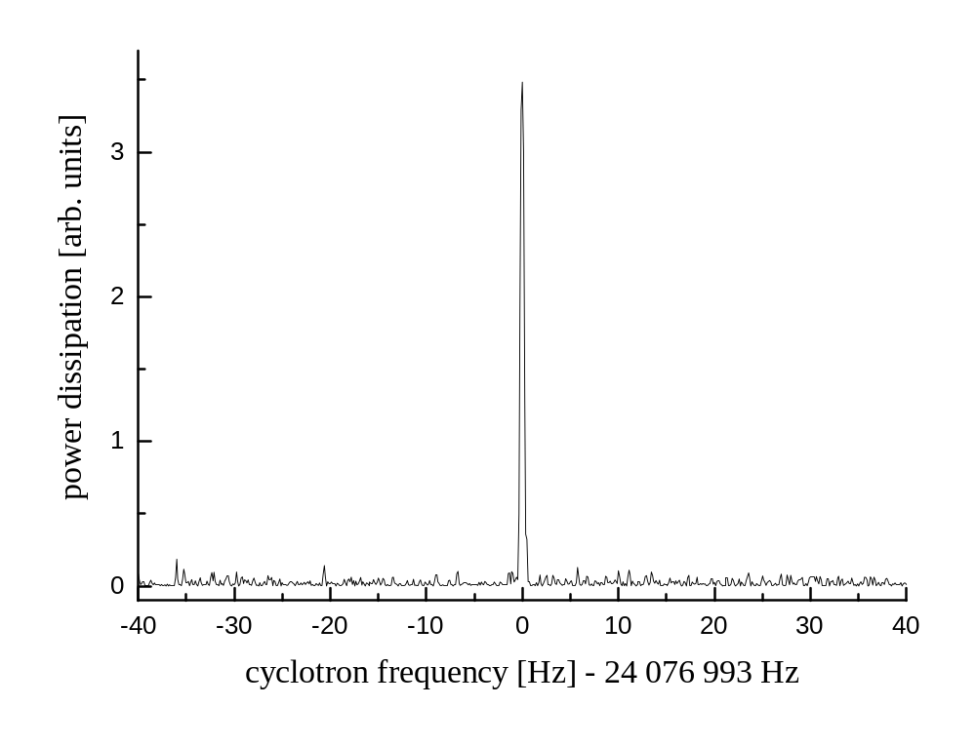
Cyclotron Signal of a Single ¹²C⁵⁺-Ion
Z

Slide 16
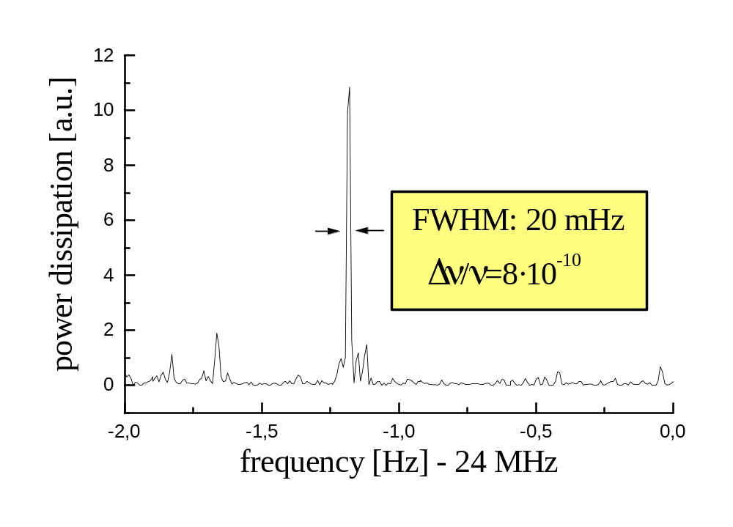
Cyclotron Resonance of a C⁵⁺-Ion
mass measurements at a level of 10⁻¹⁰ possible

Slide 17
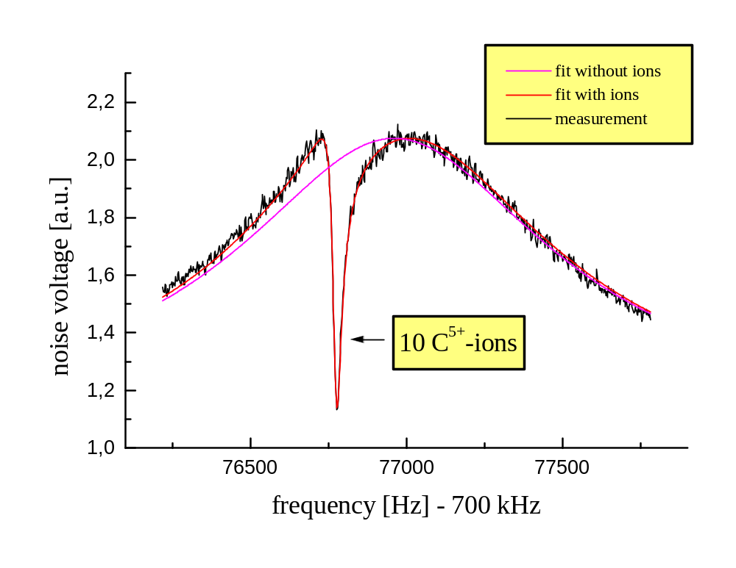
Observing the Axial Motion of Ions at T = 4K

Slide 18
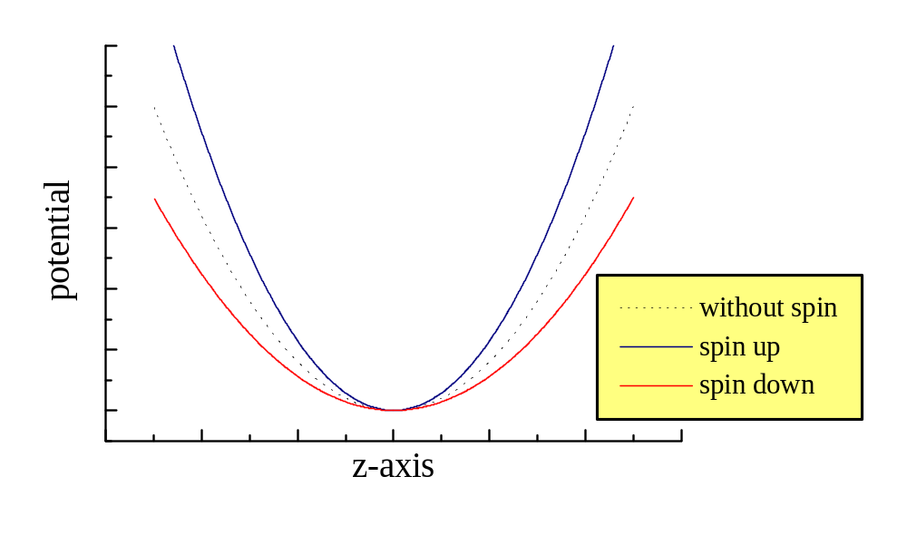
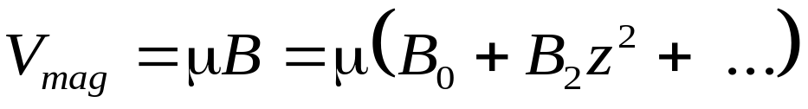
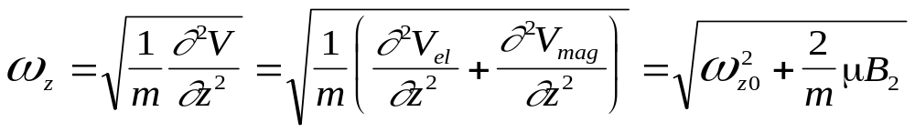
The Magnetic Bottle
magnetic field-lines
V = V_{el}+V_{mag}
ferromagnetic ring

Slide 19
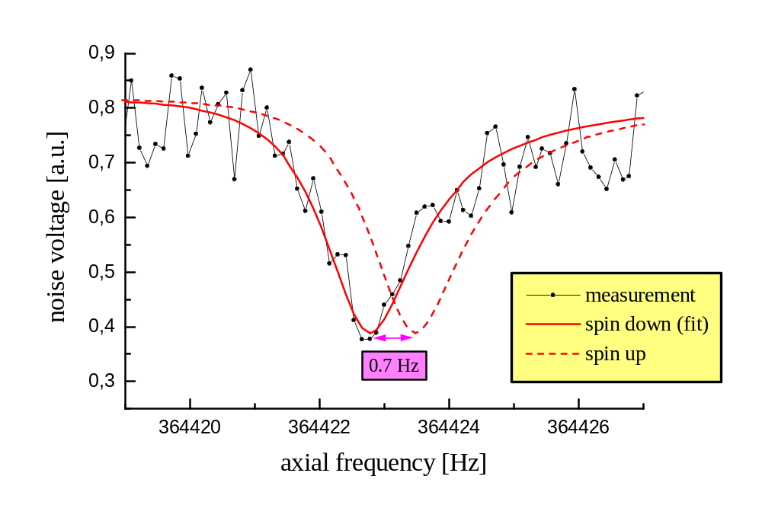
Axial Signal of a Single C⁵⁺-Ion

Slide 20
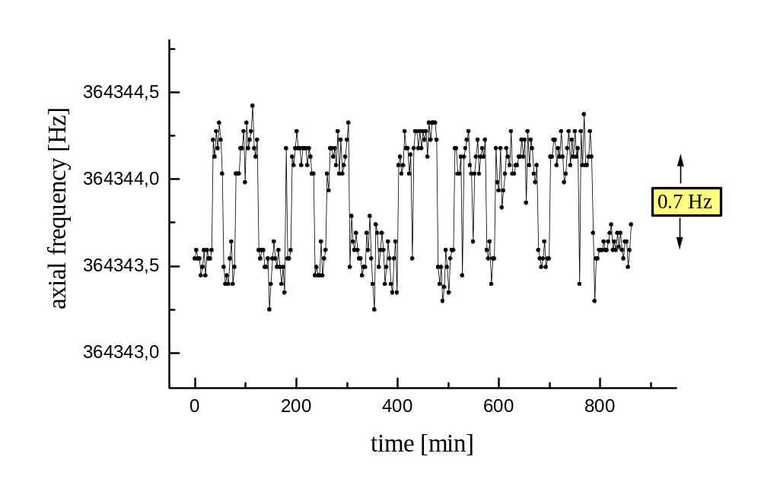
Spin Flips at Resonant Microwave Excitation
Spin up
Spin down

Slide 21
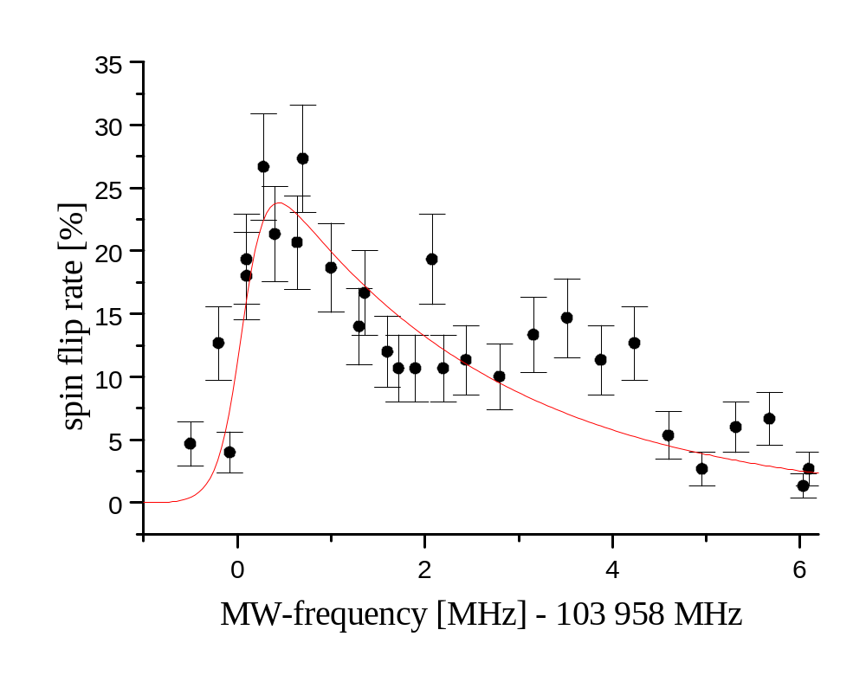
Larmor Resonance in a very inhomogeneous magnetic field
ν_{l} = 103958.1 (2) MHz

Slide 22
Cyclotron Resonance with a Magnetic Inhomogeneity
theoretical line shape
364430
(Integral over a Boltzmann distribution)
364425
364420
2 meV
axial frequency [Hz]
364415
ν
= 23.75250 (5) MHz
+
364410
sweep direction
-400
-200
0
200
400
600
800
excitation frequency [Hz] -23 752 500 Hz

Slide 23
Result for ¹²C⁵⁺
systematic error
statistic error
mass of the electron
Experiment: g_{ex} = 2,001 041 596 6 (09) (10) (44)
Theory: g_{th} = 2,001 041 590 9 (21) (50)
( Thomas Beier et al.
in preparation)
Computation accuracy
estimation of α²-terms
+ polarisation of nucleus
corrections to the g-factor of the bound electron:
free Dirac-Theory: 2,000 000 000 0
relativistic L-S coupling: - 0,001 278 645 8
QED-radiation corrections: + 0,002 319 304 4
Bound-State QED 1st order in α: + 0,000 000 844 4 (9)
recoil of nucleus: + 0,000 000 087 5 (12)
size of nucleus: + 0,000 000 000 4
total: 2,001 041 590 9 (21)

Slide 24
Outlook
measurement of the Larmor and cyclotron frequencies
of C⁵⁺ in the homogeneous part of the magnetic field
(expected accuracy better than 10⁻⁸)
measurement of the g-factors of other hydrogenlike ions
(O⁷⁺ to Mg¹¹⁺ in Mainz / up to U⁹¹⁺ at GSI in Darmstadt)
measurement of nuclear g-factors for different electronic shells
(with double resonance experiments)
mass measurements at a level 10⁻¹⁰
(this method allows the shortest possible measurement time)

Slide 25
Interaction of an Ion with the Electronics
for fast cooling small traps and big resistors

Slide 26
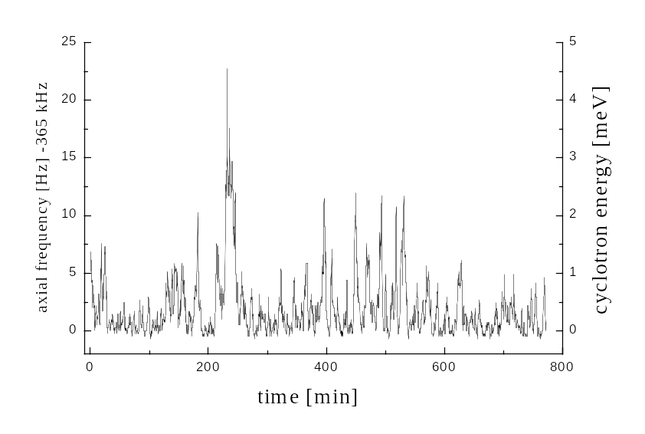
Thermal Energy Fluctuations of a Single Ion

Slide 27
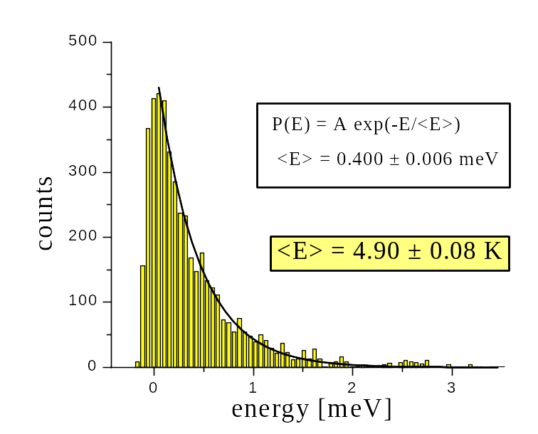
Boltzman-Distribution of the Energy

Slide 28
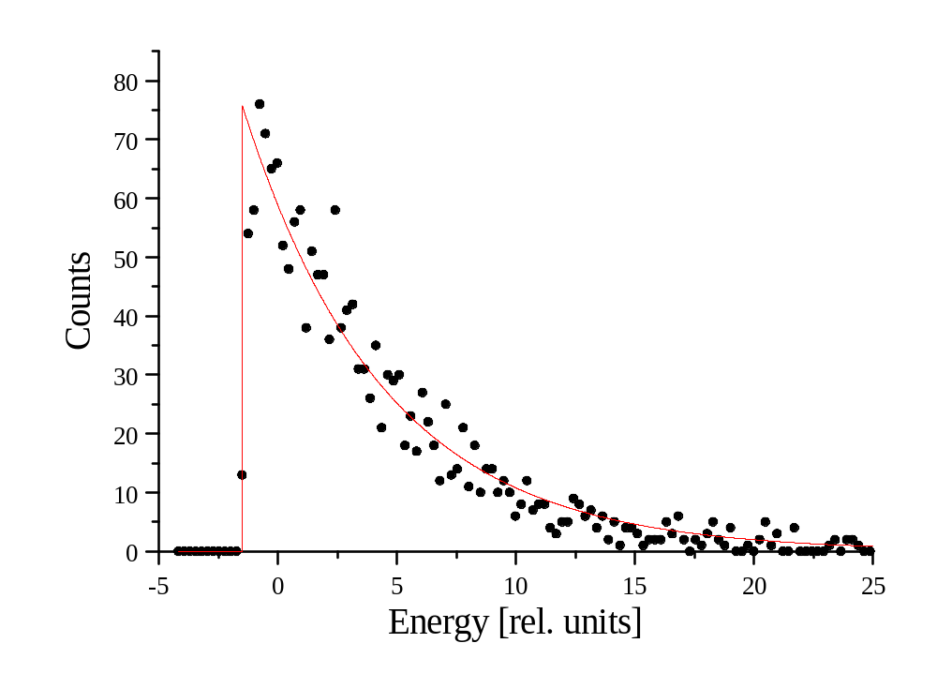
Boltzman-Distribution of the Energy

Slide 29
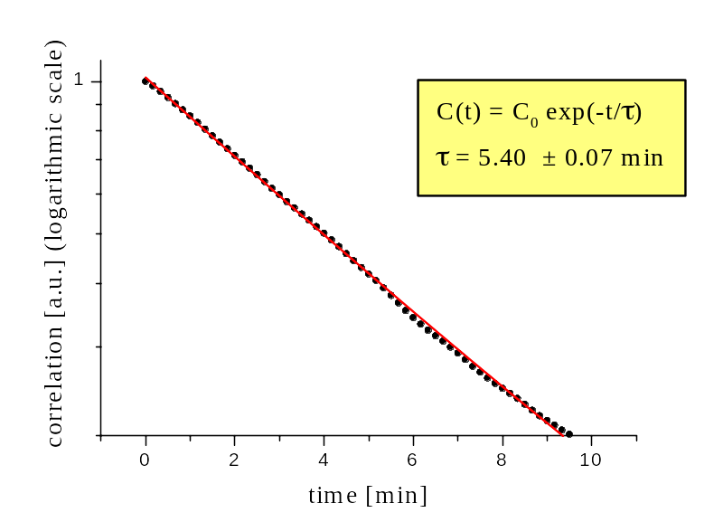
time-correlation of the energy

Slide 30
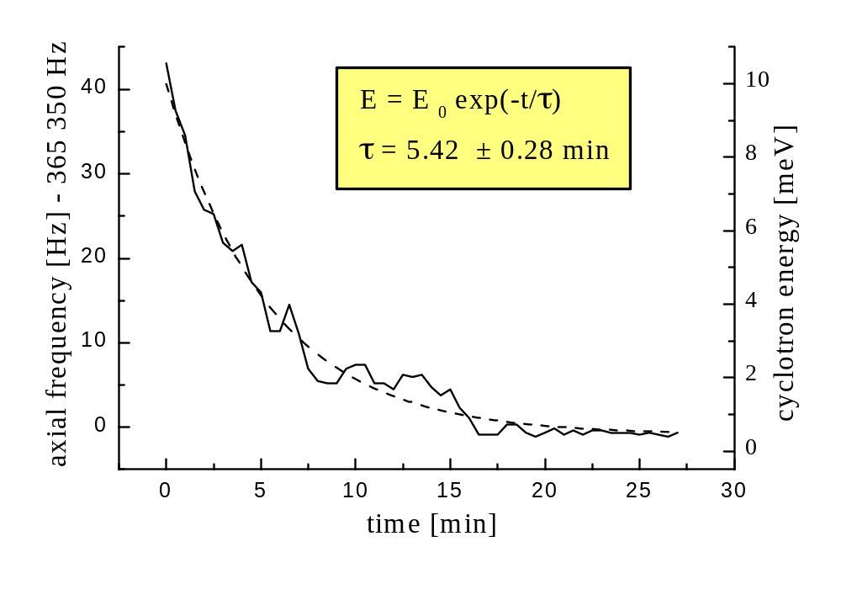
cooling-rate

Slide 31
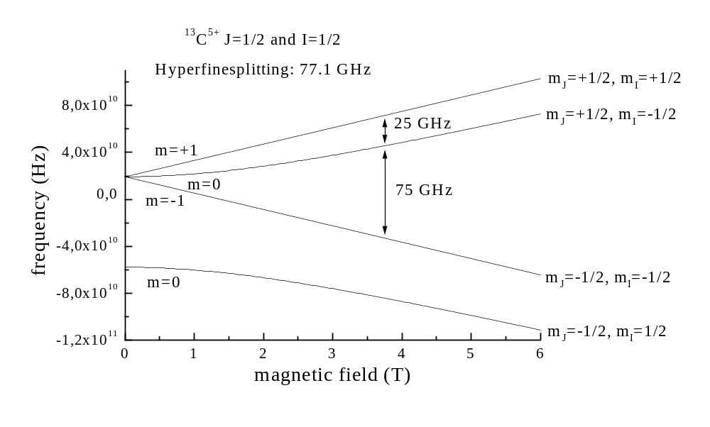
Zeeman-splitting of ¹³C⁵⁺

