Slide 1
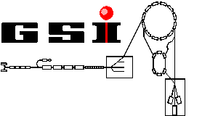

The g-factor of the bound electron:
A Test of QED
H. Häffner², N. Hermanspahn¹, H.-J. Kluge², G. Marx²,
W. Quint², S. Stahl¹, J. Verdú¹ and G. Werth¹
¹ Institut für Physik, Universität Mainz, Germany
² GSI Darmstadt, Germany

Slide 2
Contents
Motivation
Storage and detection of ions
Measurement of the magnetic moment
Results and outlook

Slide 3
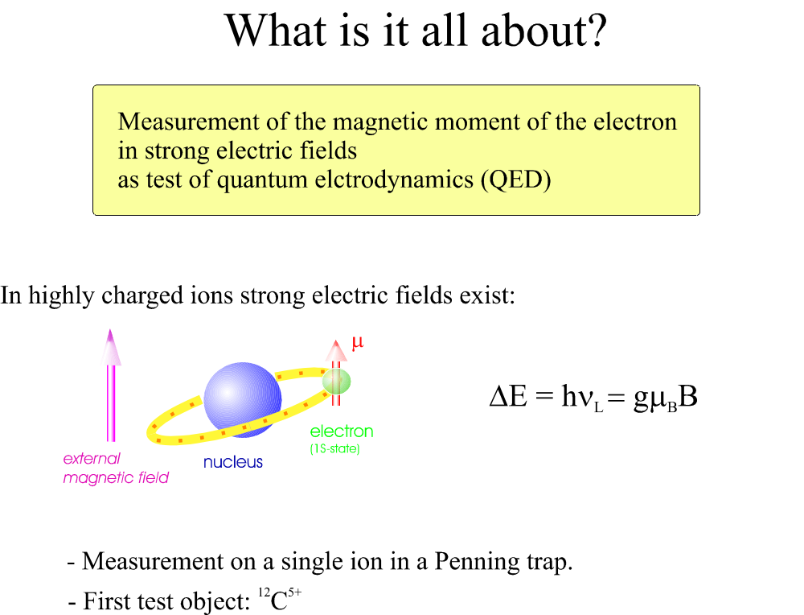

Slide 4
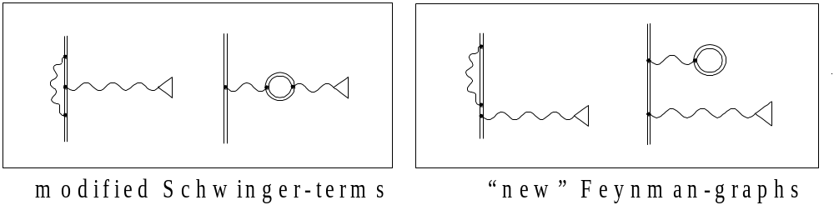
Motivation:
Is QED in strong electric field still valid?
=> highly charged ions:
Bound-State-QED:
QED for bound systems
Up to now tests of BS-QED-corrections only in Lambshift-measurements.
For the g-Faktor calculations the nuclear structure is not so important.

Slide 5
Quantities of interest in highly charged ions
Hyperfine structure Lamb shift g-Factor
Relevant electric
field strength (for C ⁵⁺ )
210¹⁴ V/m
10¹⁴ V/m
510¹³ V/m
Influence of
nulcear structure
Very large
large
small
Experimental data
available
few
plenty
few
Because of the small influence of the nulcear strucure a measurement of the g-Factor is a good test of QED in strong electric fields.

Slide 6
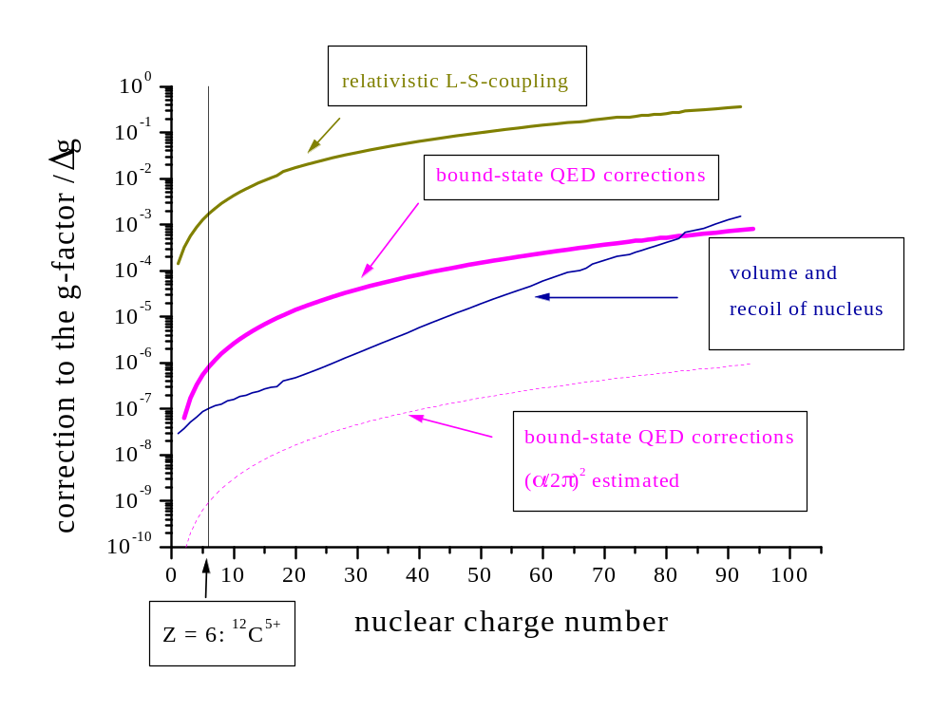
Corrections to the g-factor of the bound electron
g = 2 + Δg_{L-S} + Δg_{QED} + Δg_{BS-QED} + Δg_{nucl}
calculation: Göteborg-theory group

Slide 7
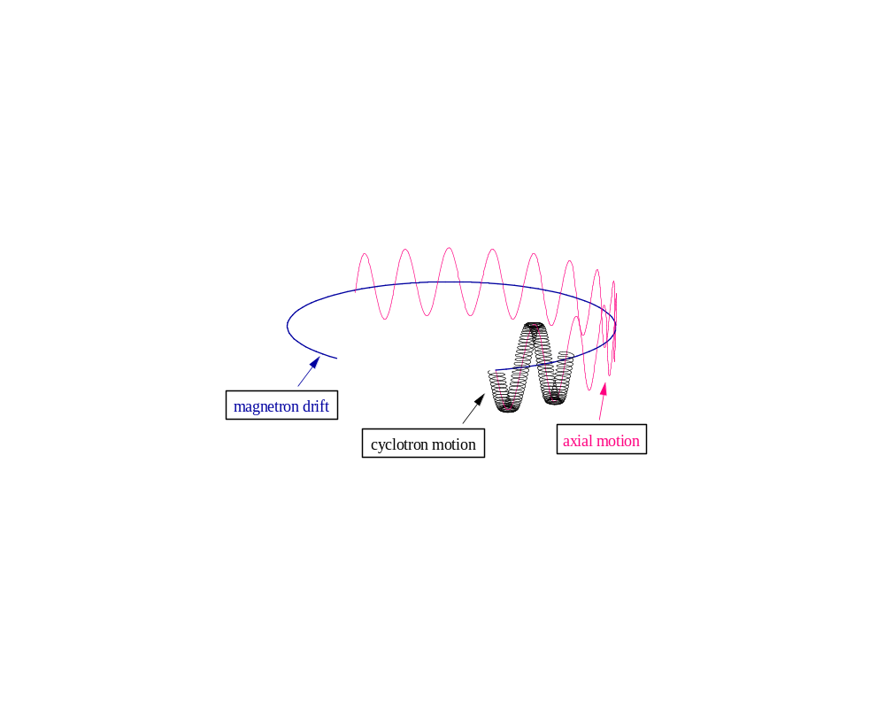


Storage of an Ion
B

Slide 8
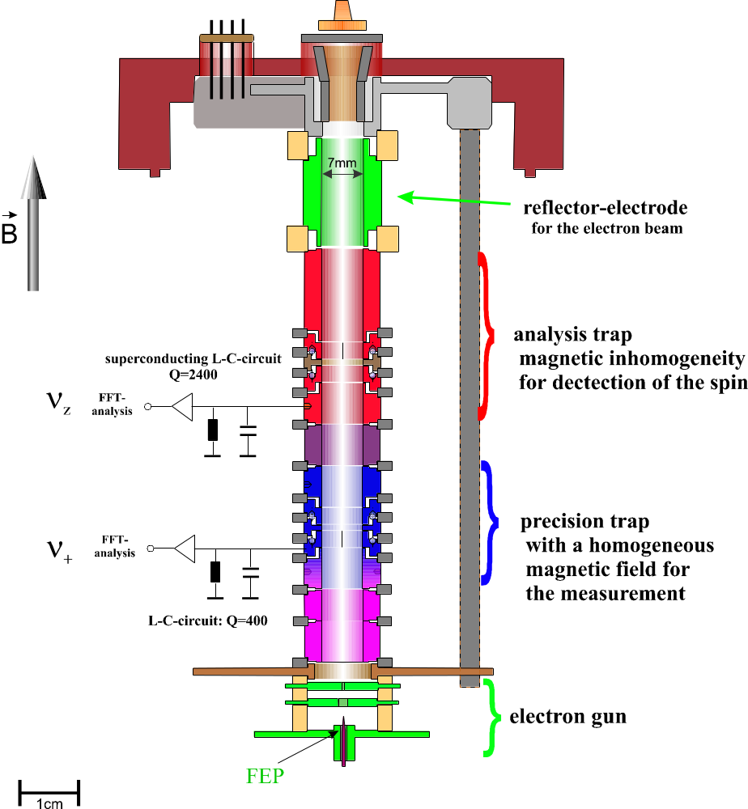

Slide 9
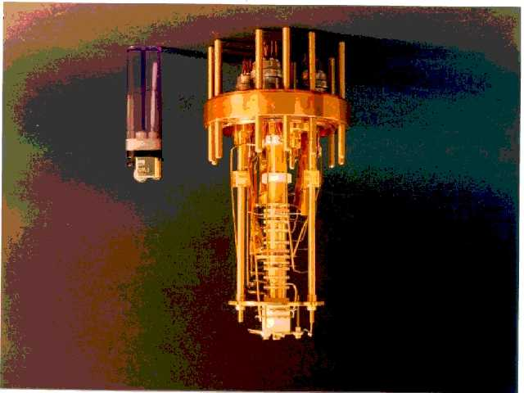
Picture of the traps

Slide 10
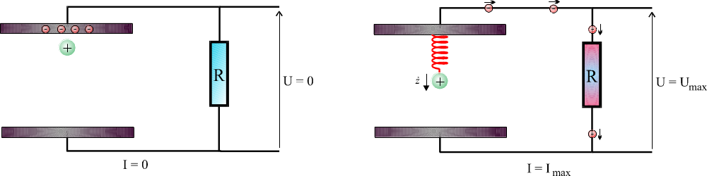
Electronic Detection of Single Ions
- Fourier-transform of the voltage U yields the frequency of the ion
- Dissipation in the resistor => resistive cooling of the ion

Slide 11
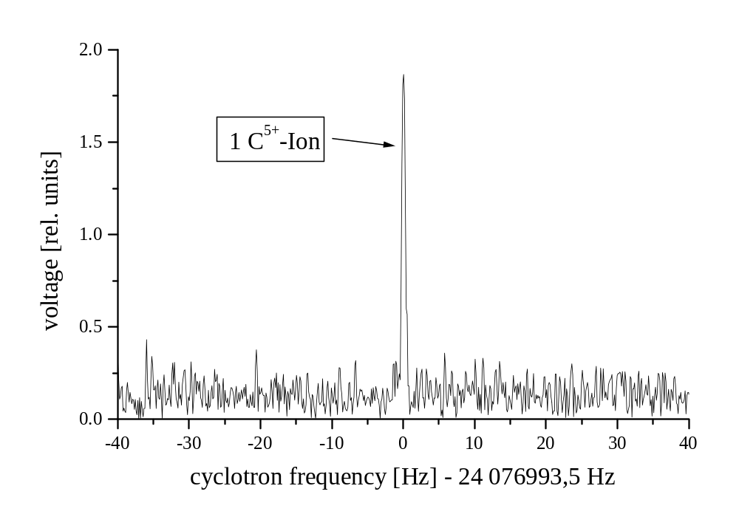
Cyclotron-Signal of a Single ¹²C⁵⁺-Ion
R
U

Slide 12
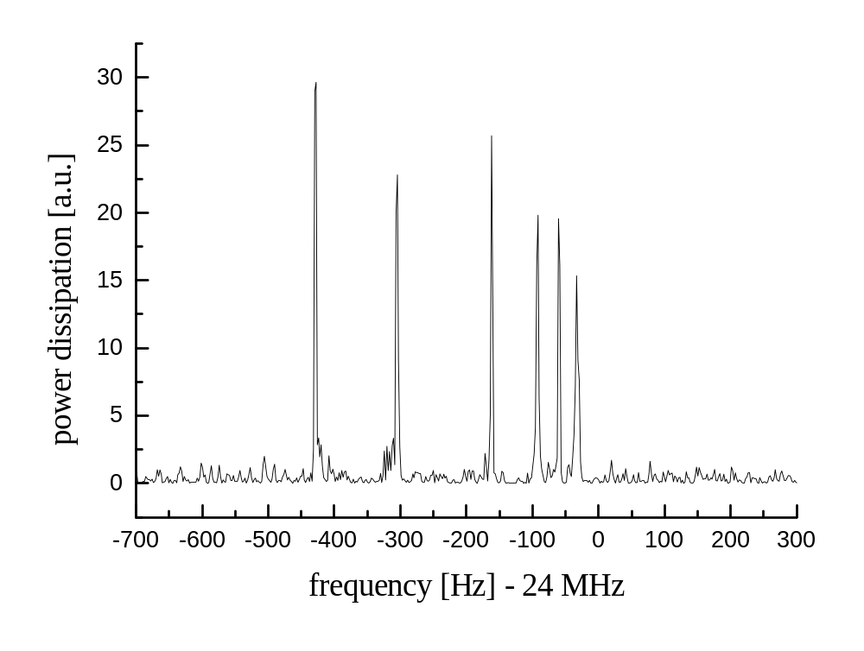
Cyclotron-Signal of 6 ¹²C⁵⁺-Ions

Slide 13
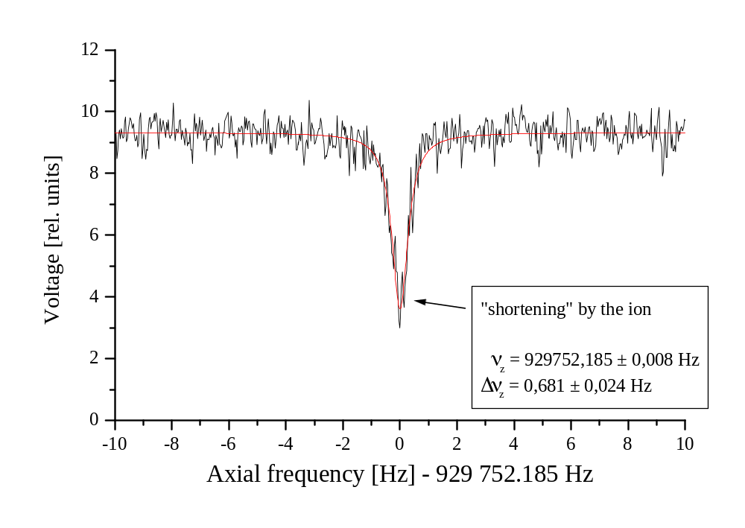
Axial signal

Slide 14
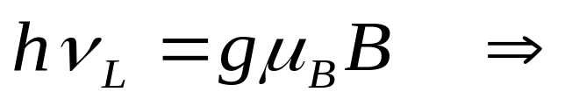
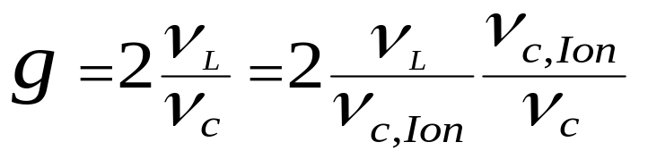
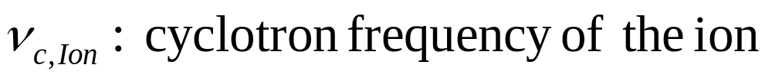
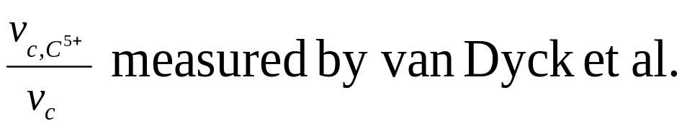
What is to Measure?
to measure is:

Slide 15
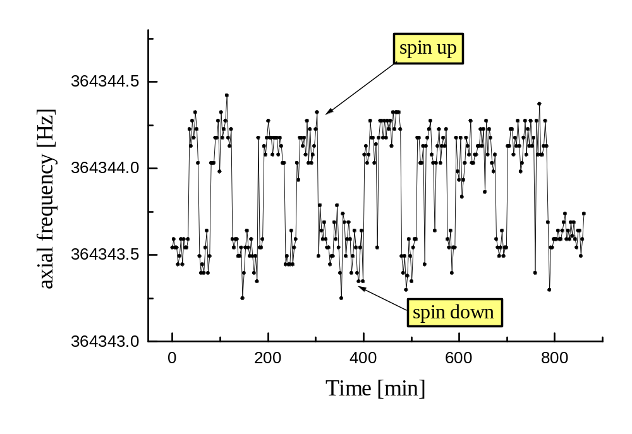
Observation of quantum jumps

Slide 16
Kontinuierlicher Stern-Gerlach-Effekt
Hochkant

Slide 17
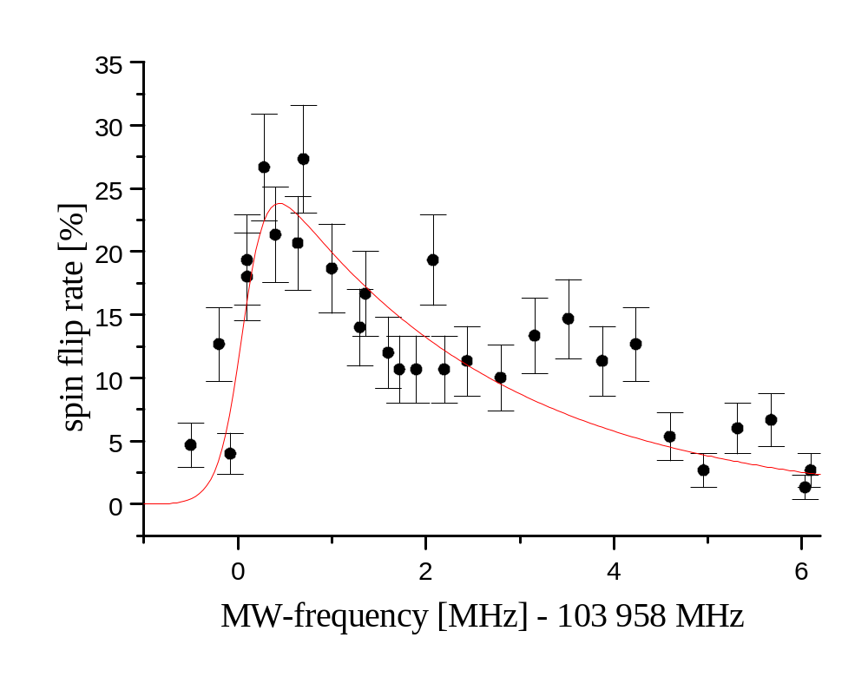
Larmor Resonance
(in a very inhomogeneous magnetic field)
ν_{l} = 103958.1 (2) MHz

Slide 18
Broadening of the Larmor-resonance
For the observation of spin-flips an inhomogeneous magnetic field
is necessary.
=> For the ion the magnetic field is fluctuating (ΔB/B = 10⁻⁵ ).
=> Limitation of the measurement to 10⁻⁶.
(Hermanspahn et al., Phys. Rev. Lett. 84 (2000) )
Overcome the limitation by spatially separating the functions
of induction and detection of the spin-flips
The measurement takes in the homogeneous magnetic field
place (double-trap technique).

Slide 20
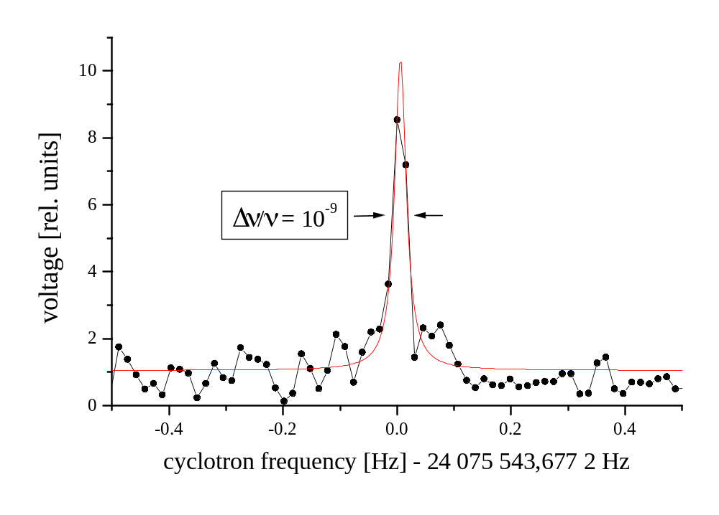
Determination of the Cyclotron-Frequency
(in the precision trap)

Slide 21
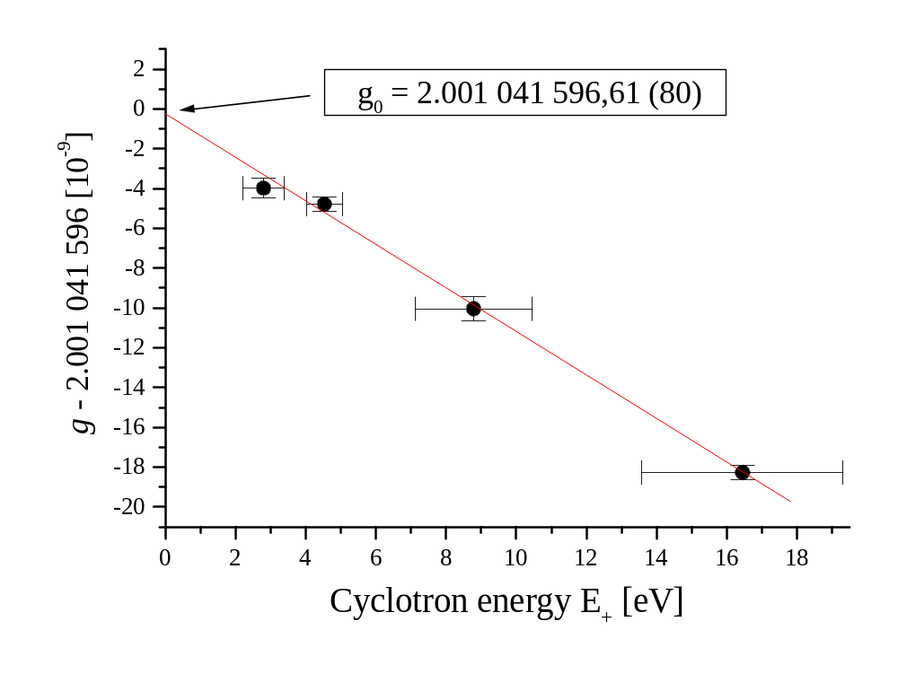
Extrapolating to vanishing cyclotron energy

Slide 22
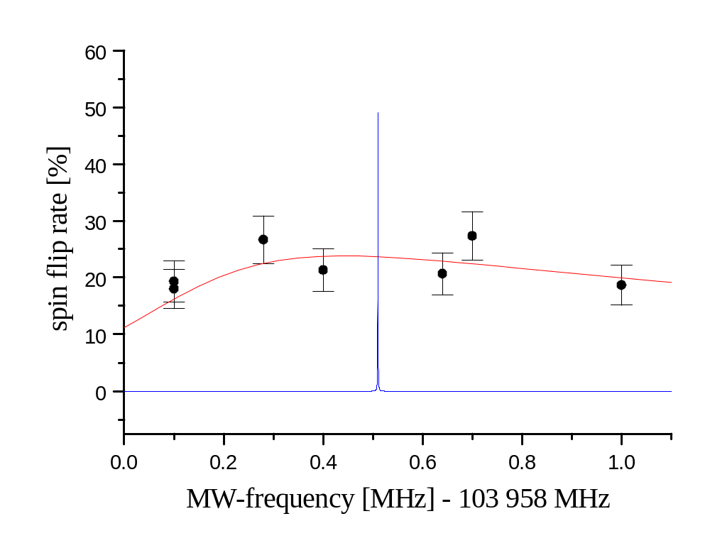
Comparision betwee the Larmor resonance in the two traps
old precision

Slide 23
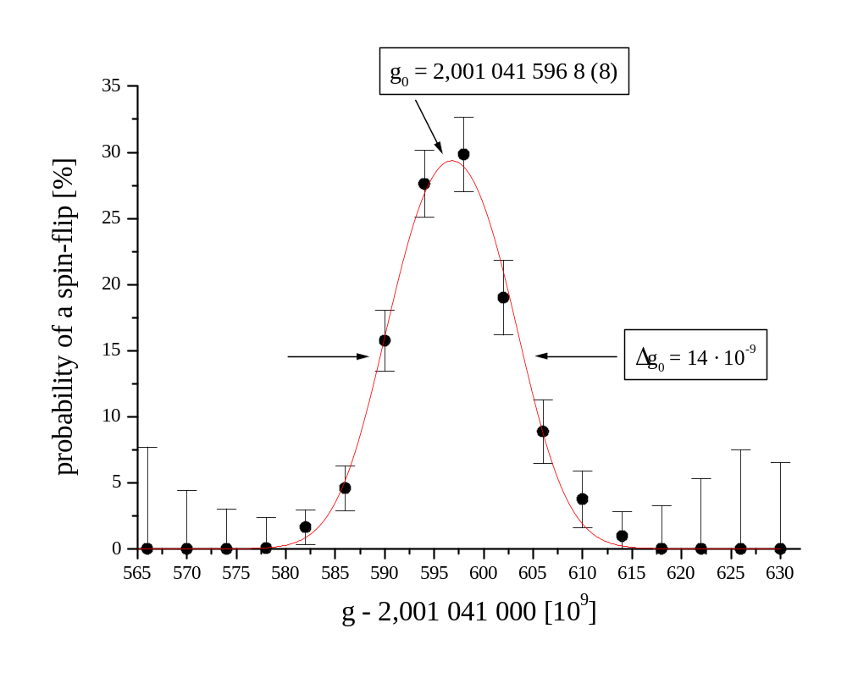
g-Factor-Resonance

Slide 24
Comparision of theory and experiment for ¹²C⁵⁺
Systematic uncertainty
Statistic uncertainty
Mass of the electron
Experiment: g_{ex} = 2,001 041 596 4 (8) (6) (44)
Theorie: g_{th} = 2,001 041 590 9 (21) (50) ( Beier et al. / Göteborg)
Computation accuracy
Estimation of α²−terms
(will be improved in near future)

Slide 25
Korrekturen zum g-Faktor des gebundenen Elektrons:
Free Dirac theory: 2,000 000 000 0
Relativistic L-S coupling / Dirac-theory - 0,001 278 645 8
QED free electron: + 0,002 319 304 4
Bound-state QED 1. order in α: + 0,000 000 844 4 (9)
Bound-state QED α² / estimated:  + 0,000 000 000 0 (50)
Nuclear recoil: + 0,000 000 087 5 (12)
Nuclear size: + 0,000 000 000 4
Sum: 2,001 041 590 9 (21) (50)

Slide 26
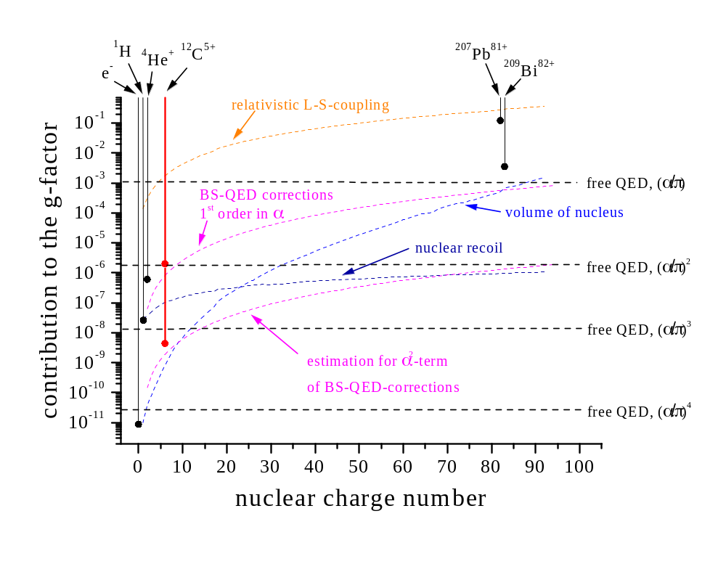
g-factor determinations of the bound electron
calculation: Göteborg-theory group

Slide 27
High precision due to
homogeneous magnetic field (B₂= 8 μT/mm²).
storage of a single “cold” ion in a
small volume of 5050100 μm³.
simultaneous measurement of the Larmor- und cyclotron-frequency.
good understanding of ion movement.

Slide 28
Conclusion
Improvement of the g-factor measurement on C⁵⁺
by a factor of 1000.
Up to now most precise determination of an atomic g-factor.
Test of bound-state-QED corrections to 1%.
- limitation of the test by the not calculated 2nd order BS-QED
and the knowledge of the electron mass.
Determination of the electron mass:

Slide 29
E-masse
hochkant

Slide 30
Outlook
- Optimization of apparatus (e.g.: more homogeneous magnetic field)
- Higher nuclear charge numbers (e.g. ⁴⁰Ca¹⁹⁺)
=> better test of BS-QED (e.g. 2nd order in α and higher electric field stregths)
=> measurement of the fine-structure constant α und the atomic mass of
the electron.
- Measurement of nulcear magnetic moments
=> Does the electronic shell affect the magnetic moment of the nucleus.
=> no chemical shifts
- Mass-Measurements of heavy highly charged ions at a level of 10⁻¹⁰
=> Binding-energies of the electronic shell to 10 eV / only for stable isotopes.
- Investigation of decay rates of nucleii
=> dependency on the hyperfine-state / direction of the electron spin.

Slide 31
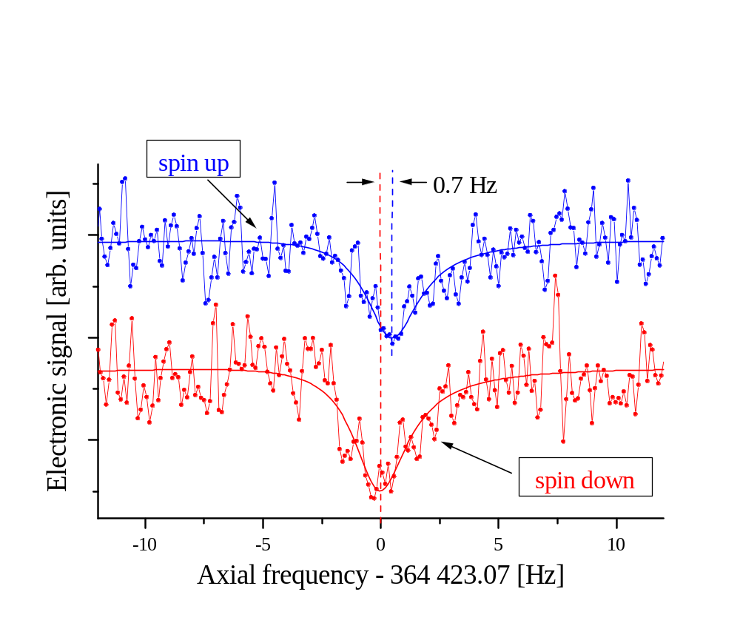
Detecting a spin-flip

Slide 32
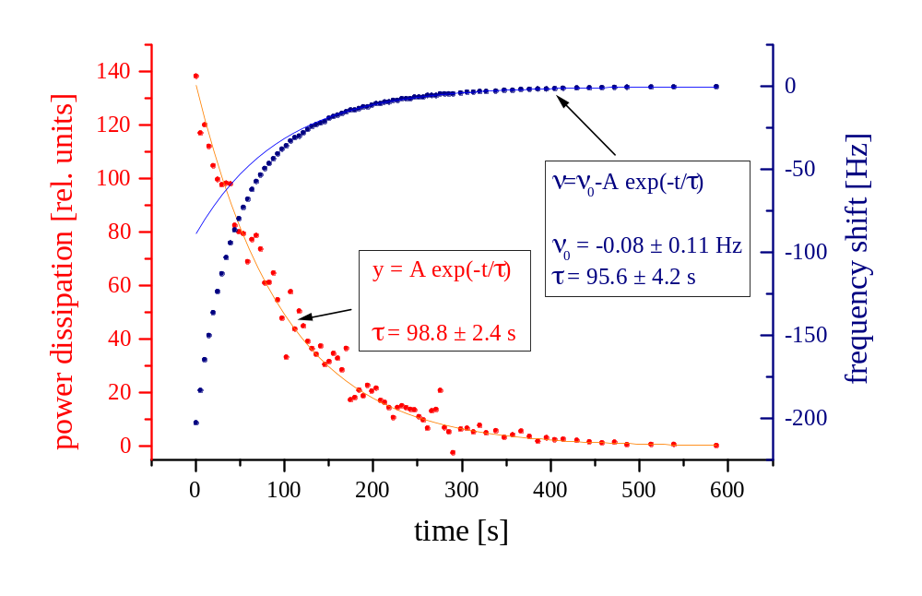
Resistive cooling of the cyclotron motion

