Slide 1
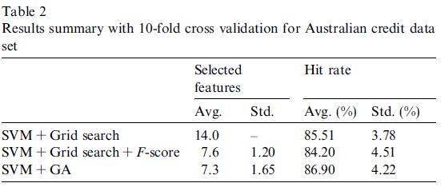
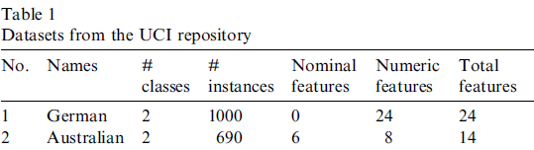
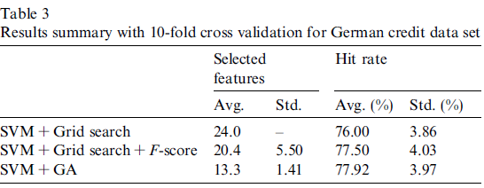
Credit scoring with a data mining approach based on support vector machines by Cheng-Lung Huang, Mu-Chen Chen, Chieh-Jen Wang
Motivation: small accuracy improvement can gain a lot
Things to do with SVM: choose kernel, set kernel parameters, determine a soft margin constant C, and select features. Etc?
Suggestions:
- Setting model parameters using grid search
- Plus above, selecting input features using F-score
- Optimizing model parameter and feature subset using GA-based approach
How they did: 10 folds cross-validation.
- parameter and feature selection, took 5 folds before comparison
- Friedman test is used to compare classification accuracy of the test set

Slide 2
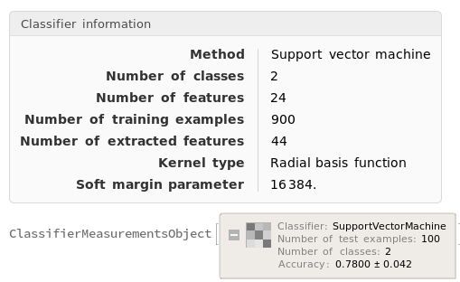
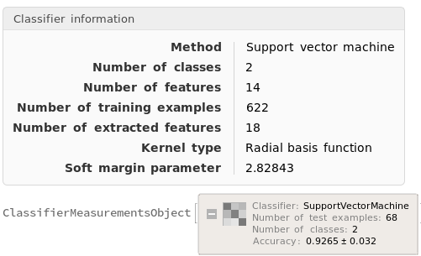
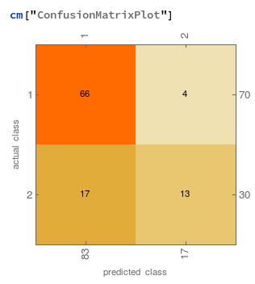
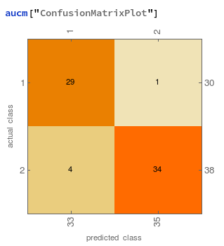
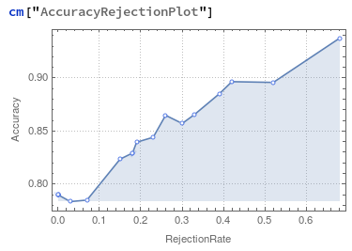
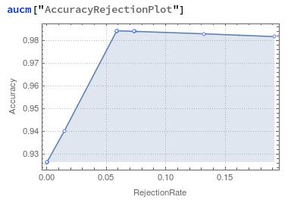
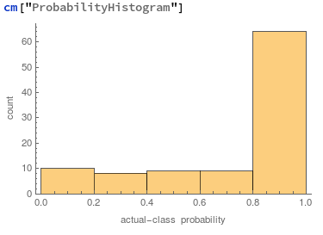
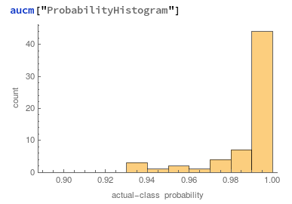

Slide 3
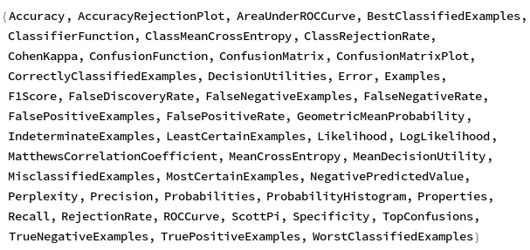
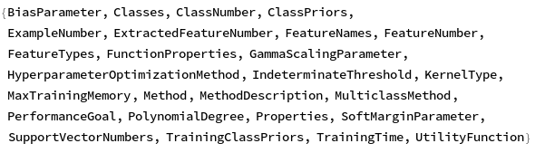
From paper…
- NN for credit scoring has difficulty in selecting the discriminative features and explaining the rationale for the credit decision
- SVM needs mechanism to search the optimal model parameters and feature subset
- Working on KDD (Knowledge Discovery Database) requires efficient processing of large DB, which means, time consuming task
 | Australian | German
Linear | 0.9118 +- 0.035 | 0.750 +- 0.044
Polynomial | 0.9706 +- 0.021 | 0.7700 +- 0.042
Radial Basis function | 0.9265 +- 0.032 | 0.7900 +- 0.041
Sigmoid | 0.9265 +- 0.032 | 0.760 +- 0.043

Slide 4
