Slide 1
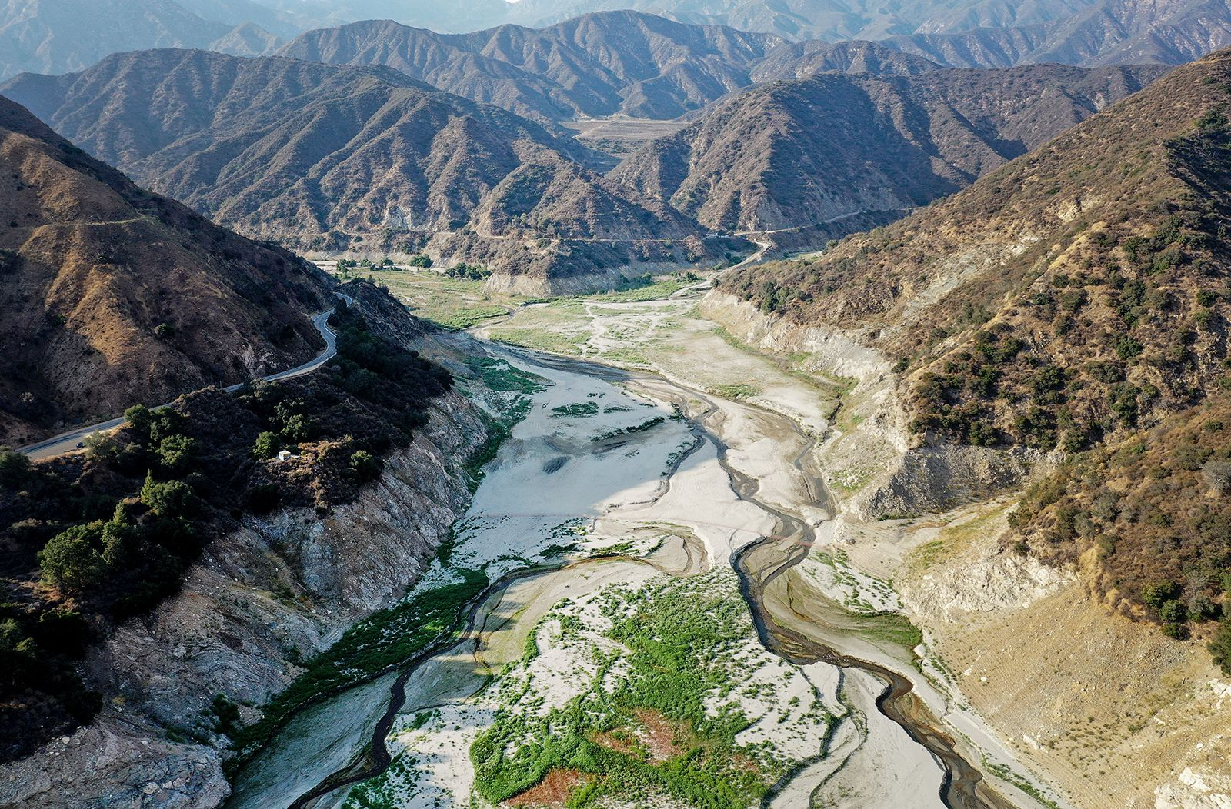
BMI525- Data Visualization Final project
Emily Lee

Slide 2
Purpose of the project
Present Visualizations about the drought severity in the U.S. over time​
Drought statistics for last 24 years available from the U.S. Drought Monitor.
Published a U.S. map and State-specific line graphs with a summary table using Shiny app.

Slide 3

Motivation
From the CNN news article, ‘The West’s historic drought’ (Aug.19^{th.}2022), said much of the Western US has been experience a historic and unrelenting drought. A study published in Nature Climate Change found the period from 2000 to 2021 was the driest in 1,200 years. The drought severity during this period was exceptional, and the extreme conditions would continue through 2022.
Reference: https://www.cnn.com/2022/08/19/weather/gallery/western-united-states-drought/index.html#:~:text=In%20pictures%3A%20The%20West's%20historic%20drought&text=Much%20of%20the%20western%20United,the%20driest%20in%201%2C200%20years.

Slide 4
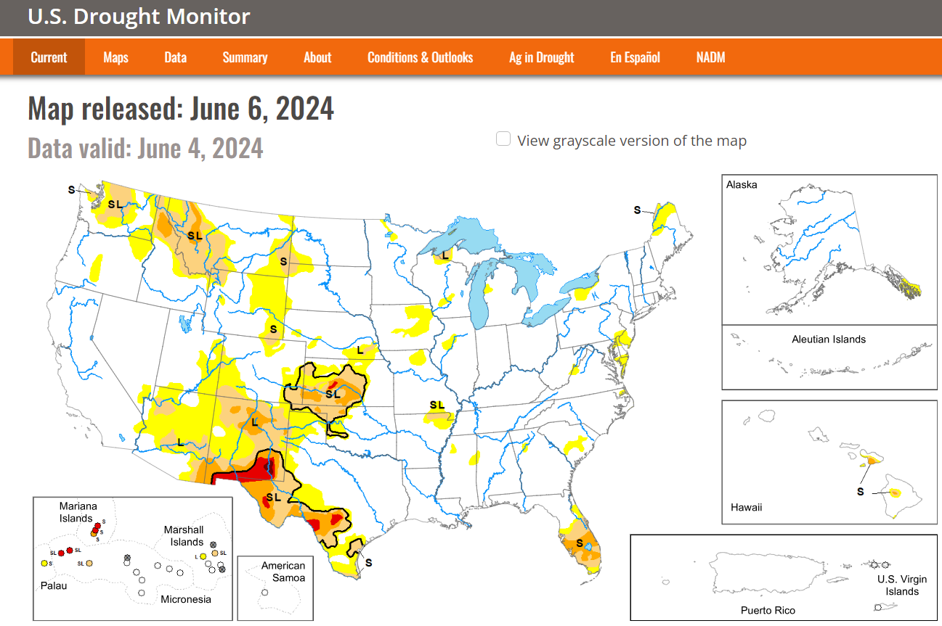
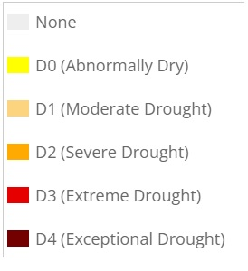
ABOUT Data
Q. How the dryness can be measured in the U.S.?
The data is about what proportion of an area is in what level of dryness or drought. The U.S. Drought Monitor (USDM) is open to public to download data with statistics for six categories (None, D0, D1, D2, D3, D4) about drought severity, which is measured and calculated every week.
From definition by USDM, a summary statistics, drought severity and coverage index (DSCI) can be calculated as weighted sum of D0 ~ D4. I used this statistics to show and compare the drought by State over time.
Refrence: https://droughtmonitor.unl.edu/DmData/DataDownload.aspx

Slide 5
Shiny app
https://7qd1v9-lee-emily.shinyapps.io/Drought_index/

Slide 6
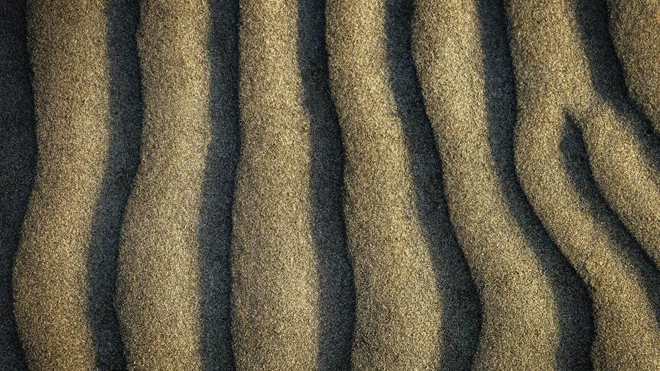
Thank you!
Emily Lee

